Slide 1
Angular
Notes:
https://www.smashingmagazine.com/2019/02/angular-application-bootstrap/
https://thinkster.io/tutorials/learn-angular-2
https://www.typescriptlang.org/docs/handbook/classes.html
https://codecraft.tv/courses/angular/built-in-directives/ngstyle-and-ngclass/
https://mytechnetknowhows.wordpress.com/2017/03/05/angular-2-nested-routing/

Slide 2
Angular Topics
What is Angular?
Setup: How to get started?
Component Architecture & Data Binding
Component Life Cycle Hooks
Nested Components
Component Intercommunication
Inbuilt Directives
Dependency Injection & Services
Handling Http Communication
Routing
Forms
Notes:
Applications
Some of the popular website using Angular Framework are listed below −
Weather.com − It is one of the leading forecasting weather report website.
Youtube − It is a video and sharing website hosted by Google.
Netflix − It is a technology and media services provider.
PayPal − It is an online payment system.

Slide 3
Angular
Introduction

Slide 4
What Is Angular?
Angular is a JavaScript Framework which allows you to create reactive Single-Page-Applications (SPAs)

Slide 5
What is Angular?
Angular is a JavaScript (actually a TypeScript based open-source full-stack web application) framework which makes you able to create reactive Single Page Applications (SPAs).
This is a leading front-end development framework which is regularly updated by Angular team of Google.
Angular is completely based on components. It consists of several components forming a tree structure with parent and child components.
Angular's versions beyond 2+ are generally known as Angular only. The very first version Angular 1.0 is known as AngularJS.
Angular is a complete rewrite of AngularJS by the same team that built AngularJS.

Slide 6
What Is SPA?
A single-page application is an app that works inside a browser and does not require page reloading during use.
A single page application is a web application or a website which provides users a very fluid, reactive and fast experience similar to a desktop application.
It contains menu, buttons and blocks on a single page and when a user clicks on any of them; it dynamically rewrites/updates the parts of the current page rather than loading entire new pages from a server.
Above then is the reason behind its reactive fast speed.
You are using this type of applications every day. These are, for instance: Gmail, Google Maps, Facebook or GitHub.
It is just one web page that you visit which then loads all other content using JavaScript
Notes:
Single-Page-Applications vs Multi-Page-Applications:- below link gives proper pros-cons of using SPA/MPA design-pattern for creating web-applications:-https://medium.com/@NeotericEU/single-page-application-vs-multiple-page-application-2591588efe58

Slide 7
What Is Typescript?
Typescript is super-set of JavaScript (JS + ES2015+ES2016/ES2017)
It offers static type checking that helps to catch errors early on in the development lifecycle especially with larger applications.
They make it much easier to see when something is passed or used incorrectly.
Angular Framework is built using TypeScript
https://blog.codewithdan.com/5-key-benefits-of-angular-and-typescript/
TypeScript
More features than vanilla JS (Types, Modules, Classes, Interfaces, decorators)
Compiled (by CLI)
JavaScript

Slide 8
Angular
Setup & Creating First App
Notes:
https://angular.io/tutorial

Slide 9
Setup: Tools
Brackets / Visual Studio Code [Editor]
Chrome [Browser]
NodeJS [Build Tool]
NPM [Node Package Manager – Comes with NodeJS]
----------------------------------------------------------------------------------
VS Code is light and easy to setup, it has a great range of built-in code editing, formatting, and refactoring features. It is free to use. It also provides a huge number of extensions that will significantly increase your productivity.
You can download VS Code from here: https://code.visualstudio.com
Notes:
Chrome Extensions
Augury [Angular2's Debug Tool]

Slide 10
Setup: Install Node.js
You should install node.js to run your Angular app.
It manages npm dependencies, support some browsers when loading particular pages.
It provides required libraries to run Angular project.
Node.js serves your run-time environment as your localhost.
See how to install node.js: install-nodejs
Or
Just go to node.js official website https://nodejs.org/en/
Download and install latest version of node.js. In my case, it is 11.8.0

Slide 11
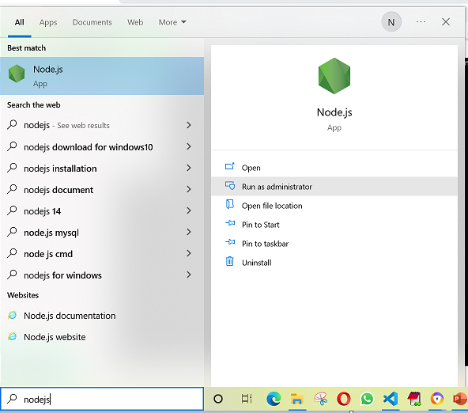
Setup: Start Nodejs
Start node-js command prompt from start menu with run as administrator option as below

Slide 12
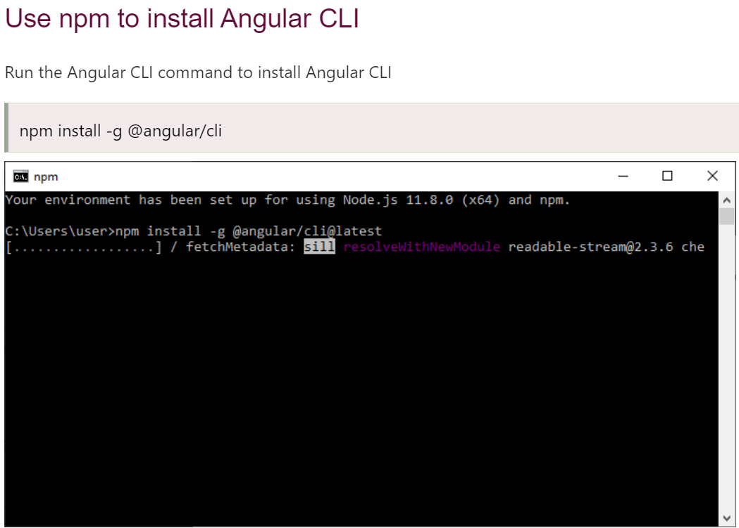
Setup: Install Angular CLI

Slide 13
Setup: QuickStart Using Angular CLI
Good tools make application development quicker and easier to maintain than if you did everything by hand.
The Angular CLI is a command line interface tool
It creates a new Angular Sample project and adds all required files related to project type. This helps to quick-start the application.
It’s also a Project Management Tool that performs variety of ongoing development tasks such as bundling, deploying, testing and maintaining angular applications from command shell
Notes:
https://angular.io/guide/quickstart#quickstart

Slide 14
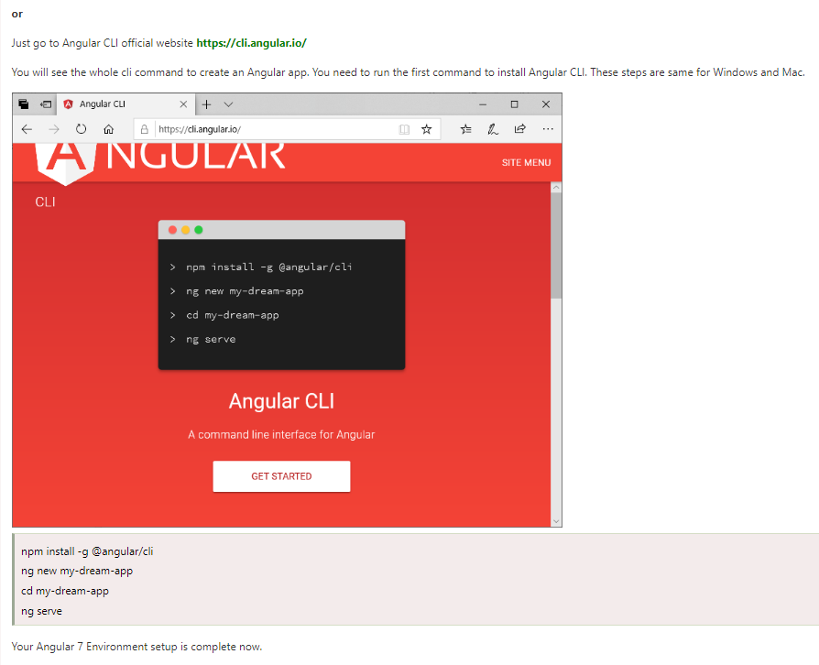
Setup & Create First App: Install Angular CLI

Slide 15
Setup & Create First App: Using Angular CLI To Create First App!
Step 1: set up the development environment
npm install -g @angular/cli@version
-g installs angular cli globally
npm –v
npm –v is used to check if node package manager (npm) is installed and its version
Step 2: create a new project
ng new my-app
It installs all required npm packages so this step takes time.
The CLI will then ask you:
Would you like to add Angular routing?
Press Y if you need Routing else press N. Next, it will ask you:
Which stylesheet format would you like to use?
Choose “CSS”.
Step 3: serve the application
cd my-app
ng serve –open
The ng serve command launches the server, watches your files, and rebuilds the app as you make changes to those files.
Using the --open (or just -o) option will automatically open your browser on
http://localhost:4200/.
Notes:
https://angular.io/guide/quickstart
https://github.com/Tynarus/angular-seed

Slide 16
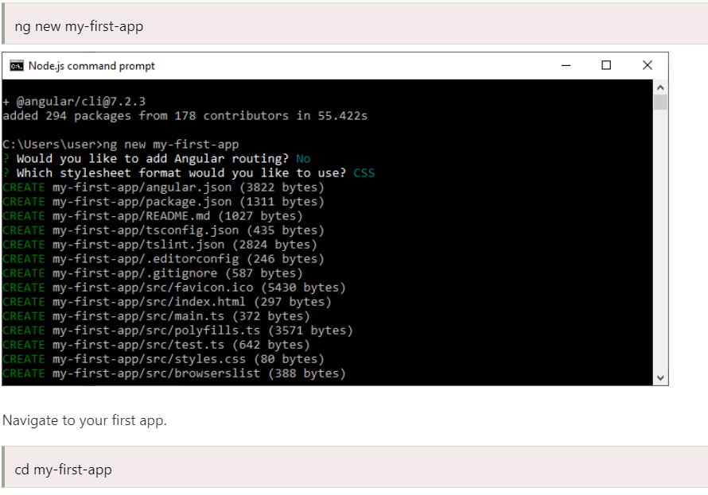
Create First App

Slide 17
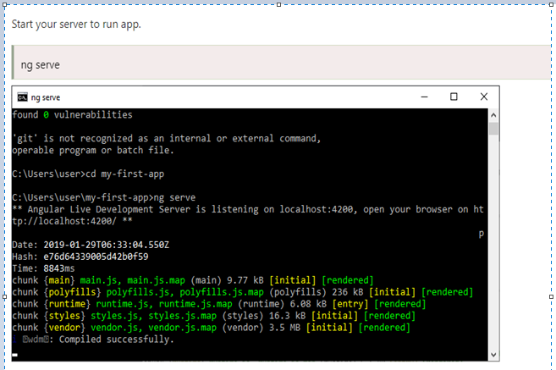
Create First App

Slide 18
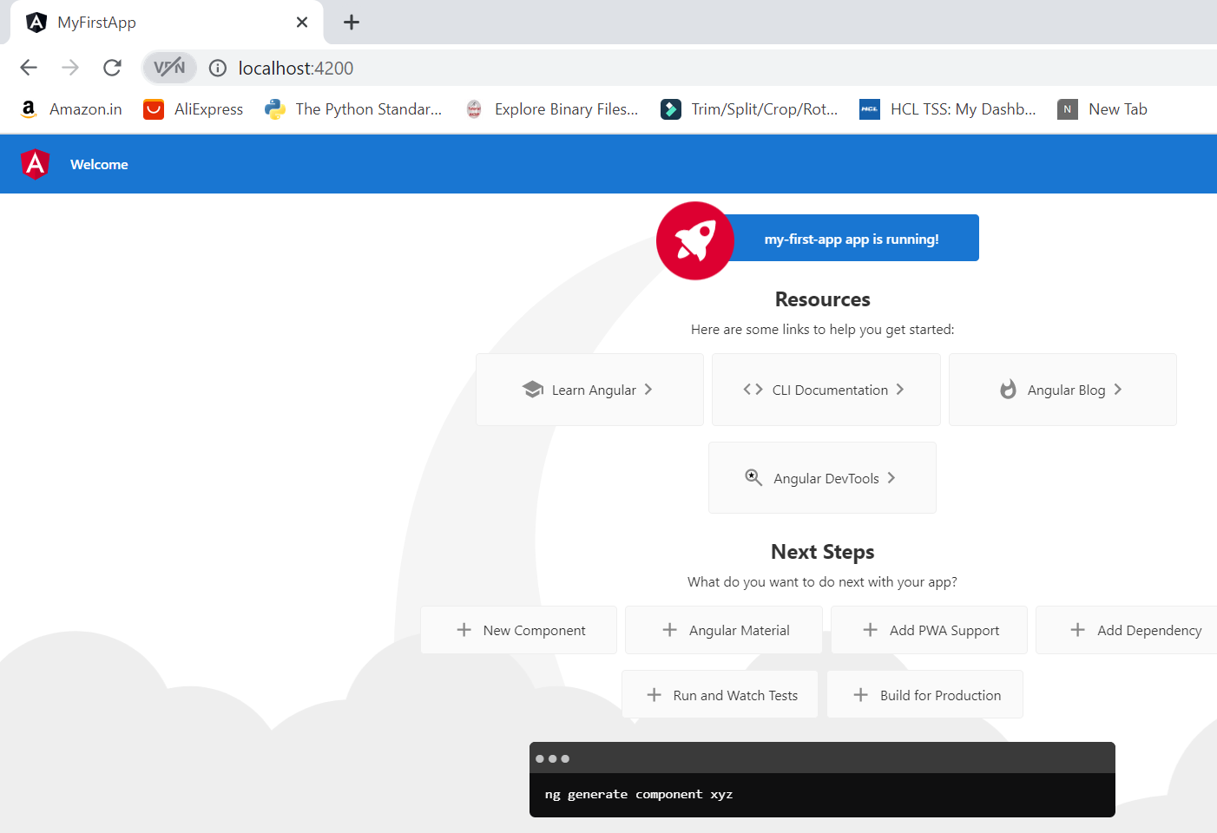
Create First App
Your server is running on localhost:4200. Now, go to the browser and open it.

Slide 19
Create First App
The page you see is the application shell/root. The shell is controlled by an Angular component named AppComponent.
Components are the fundamental building blocks of Angular applications.
They display data on the screen, listen for user input, and take action based on that input.

Slide 20
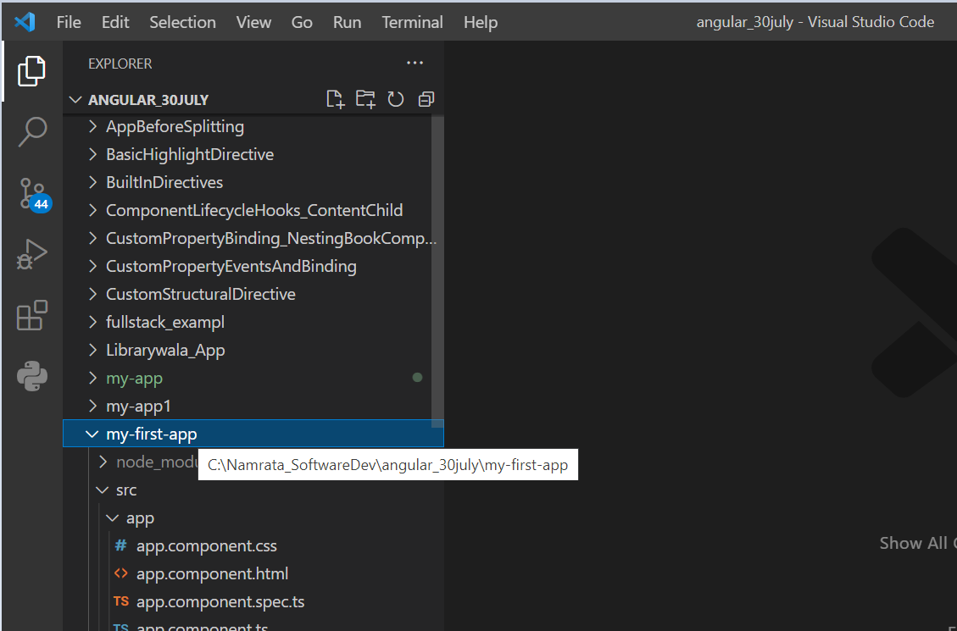
Create First App
Now, you need an IDE to edit and run your app's code. Here, we are using Visual Studio Code.
Open Visual Studio Code and open your app "my-first-app" in the IDE. It will look like this:

Slide 21
Create First App
Here, go to src folder, you will see app folder there. Expand the app folder.
You will see 5 components there:
app.component.css
app.component.html
app.component.spec.ts
app.component.ts
app.module.ts
You can see the code within the different components to understand what is going on and which part is responsible for the outlook of the app.

Slide 22
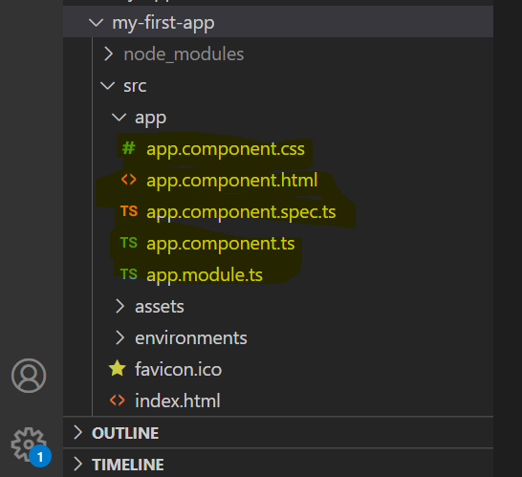
Create First App

Slide 23
Setup & Create First App: Files used in Angular App folder
Angular App files which are mainly used in your project are given below:
src folder: This is the folder which contains the main code files related to your angular application.
app folder: The app folder contains the files, you have created for app components.
app.component.css: This file contains the cascading style sheets code for your app component.
app.component.html: This file contains the html file related to app component. This is the template file which is used by angular to do the data binding.
app.component.spec.ts: This file is a unit testing file related to app component. This file is used along with other unit tests. It is run from Angular CLI by the command ng test.
app.component.ts: This is the most important typescript file which includes the view logic behind the component.
app.module.ts: This is also a typescript file which includes all the dependencies for the website. This file is used to define the needed modules to be imported, the components to be declared and the main component to be bootstrapped.
Notes:
The src folder –
Your app lives in the src folder. All Angular components, templates, styles, images, and anything else your app needs go here.
Any files outside of this folder are meant to support building your app.
app/app.component {ts,html,css,spec.ts} –
Defines the AppComponent along with an HTML template, CSS stylesheet, and a unit test.
It is the root component of what will become a tree of nested components as the application evolves.
app/app.module.ts –
Defines AppModule, the root module that tells Angular how to assemble the application.
Right now it declares only the AppComponent. Soon there will be more components to declare
angular.json –
Configuration for Angular CLI.
In this file you can set several defaults and also configure what files are included when your project is built.
Check out the official documentation if you want to know more.
karma.conf.js –
Unit test configuration for the Karma test runner, used when running ng test
E2e/ -
Inside e2e/ live the end-to-end tests.
They shouldn't be inside src/ because e2e tests are really a separate app that test your main app. They have their own tsconfig.e2e.json
The root folder-
The src/ folder is just one of the items inside the project's root folder.
Other files help you build, test, maintain, document, and deploy the app. These files go in the root folder next to src/.

Slide 24
Setup & Create First App: Files used in Angular App folder
Other Important files
package.json: This is npm configuration file. It includes details about your website's package dependencies along with details about your own website being a package itself.
angular.json: It is very important configuration file related to your angular application. It defines the structure of your app and includes any settings associated with your application. Here, you can specify environments on this file (development, production). This is the file where we add Bootstrap file to work with Angular.
index.html: This is the entry file which holds the high level container for the angular application.
main.ts: As defined in angular.json file, this is the main ts file that will first run. This file bootstraps (starts) the AppModule from app.module.ts , and it can be used to define global configurations.
Notes:
index.html –
The main HTML page that is served when someone visits your site. Most of the time you'll never need to edit it.
The CLI automatically adds all js and css files when building your app so you never need to add any <script> or <link> tags here manually.
main.ts –
The main entry point for your app.
Compiles the application with the JIT compiler and bootstraps the application's root module (AppModule) to run in the browser.
You can also use the AOT (Ahead Of Time) compiler without changing any code by passing in --aot to ng build or ng serve.
package.json – npm configuration listing the third-party packages your project uses.
You can also add your own custom scripts here.
node_modules – Node.js creates this folder and puts all third-party modules listed in package.json inside of it.

Slide 25
Setup & Create First App: Files used in Angular App folder
favicon.ico: This file specifies a small icon that appears next to the browser tab of a website.
karma.config.js: This file specifies the config file for the Karma Test Runner, Karma has been developed by the AngularJS team which can run tests for both AngularJS and Angular 2+
polyfills.ts: This file is a set of code that can be used to provide compatibility support for older browsers. Angular code is written mainly in ES6+ language specifications which is getting more adopted in front-end development, so since not all browsers support the full ES6+ specifications, pollyfills can be used to cover whatever feature missing from a given browser.
styles.css:/ This is a global css file which is used by the angular application.
tests.ts: This is the main test file that the Angular CLI command ng test will use to traverse all the unit tests within the application and run them.
tsconfig.json: This is a typescript compiler configuration file.
tsconfig.app.json: This is used to override the tsconfig.json file with app specific configurations.
tsconfig.spec.json: This overrides the tsconfig.json file with app specific unit test configurations.
assets folder: This folder is a placeholder for resource files which are used in the application such as images, locales, translations etc.
environments folder: The environments folder is used to hold the environment configuration constants that help when building the angular application. The constants are defined in 2 separate .ts files (environment.ts and environment.prod.ts), where these constants are used within the angular.json file by the Angular CLI. For example, if you run the ng build command, it will build the application using the development environment settings, whereas the command ng build ?prod will build the project using the production environment settings.
browserlist: This file is used by autoprefixer that adjusts the CSS to support a list of defined browsers.
Notes:
tsconfig.{app|spec}.json –
TypeScript compiler configuration for the Angular app (tsconfig.app.json) and for the unit tests (tsconfig.spec.json).
tslint.json –
Linting helps keep your code style consistent. Linting configuration for TSLint together with Codelyzer, used when running ng lint.
styles.css –
Your global styles go here.
Mostly you'll want to have local styles in your component for easier maintenance, but styles that affect all the app need to be in a central place in styles.css.
test.ts –
This is the main entry point for your unit tests. It has some custom configuration that might be unfamiliar, but it's not something you'll need to edit.

Slide 26
Setup & Create First App: Edit your first Angular component
Edit your first Angular component
The CLI created the first Angular component for you. This is the root component and it is named app-root (check selector tag in app.component.ts file)
You'll find the implementation of the root AppComponent distributed over four files:
app.component.ts— the component class code, written in Type Script.
app.component.html— the component template, written in HTML.
app.component.css— the component's private CSS styles.
app.component.spec.ts – the angular unit testing code, written in Type Script
Open component class file (app.component.ts) and add the title property inside AppComponent class as below:-
title = “my first angular app”;

Slide 27
Setup & Create First App: Edit your first Angular component
Open the component template file (app.component.html) and delete the default template generated by the Angular CLI. Replace it with the following line of HTML.
<h1>{{title}}</h1>
The double curly braces are Angular' s interpolation binding syntax.
This interpolation binding is used to display the component's title property value on the UI.
The browser refreshes and displays the new application title.

Slide 28
Setup & First App – Summary
You have learned –
Tools and software required for Angular
How to quick-start by creating angular application using angular CLI
How does angular application kick-start
Project file structure and file-review

Slide 29
Angular
Adding Component Template

Slide 30
Component Architecture
Component selector: Every component requires a CSS Selector.
A selector instructs Angular to instantiate this component wherever it finds the corresponding tag in template HTML or index.html
Component Template: A template is a block of HTML that tells Angular how to render the component in your application.
You can define a template for your component in one of two ways: by referencing an external file, or directly within the component.
Component Styles: You can declare component styles uses for its template in one of two ways: by referencing an external file, or directly within the component.

Slide 31
Component Template : inline and external template
import { Component } from '@angular/core';
@Component({
selector: 'app-root’,
// (external template file)
//templateUrl: './app.component.html’, (external file)
// or (inline – single-line)
//template: '<p> The app title is {{title}} </p>',
// or (inline – multi-line)
template: `
<p> The app title is {{title}} </p>
<p> The book title is {{bookname}} </p>
`,
styleUrls: ['./app.component.css']
})
export class AppComponent {
title = 'my-app';
bookname:string = 'angular’;
}
(Note :can’t have templateUrl and template both)
Notes:
The template is a multi-line string within ECMAScript 2015 backticks (`). The backtick (`)—which is not the same character as a single quote (')—allows you to compose a string over several lines, which makes the HTML more readable.
Beneath the hood, the component decorator is simply a class where the metadata is provided to the constructor method of some class.

Slide 32
Component Styles : inline and external styles
app.component.ts
import { Component } from '@angular/core';
@Component({
selector: 'app-root',
//templateUrl: './app.component.html',
template: `
<p> The app title is {{title}} </p>
<p> The book title is {{bookname}} </p>
`,
//styleUrls: ['./app.component.css’]
styles: [ (Note :cant have styleUrls and styles both)
`p { color:blue}`
],
})
export class AppComponent {
title = 'my-app';
bookname:string = 'angular’;
}
app.component.css
p { color:rgb(0, 255, 42)}
Notes:
The template is a multi-line string within ECMAScript 2015 backticks (`). The backtick (`)—which is not the same character as a single quote (')—allows you to compose a string over several lines, which makes the HTML more readable.
Beneath the hood, the component decorator is simply a class where the metadata is provided to the constructor method of some class.

Slide 33
Angular
Adding Styles

Slide 34
Adding Styles
Using Styles:-
Angular Templates can use CSS styles similar to HTML.
Template gets its style information from two sources:-
a) from application configuration.
b) from its component configuration.
Style given using application configuration is global i.e. it is applicable to all the components
Style given using component configuration applies only to that component
Each component will have its own css/scss specified inline or using external file, which will override global styles for that component

Slide 35
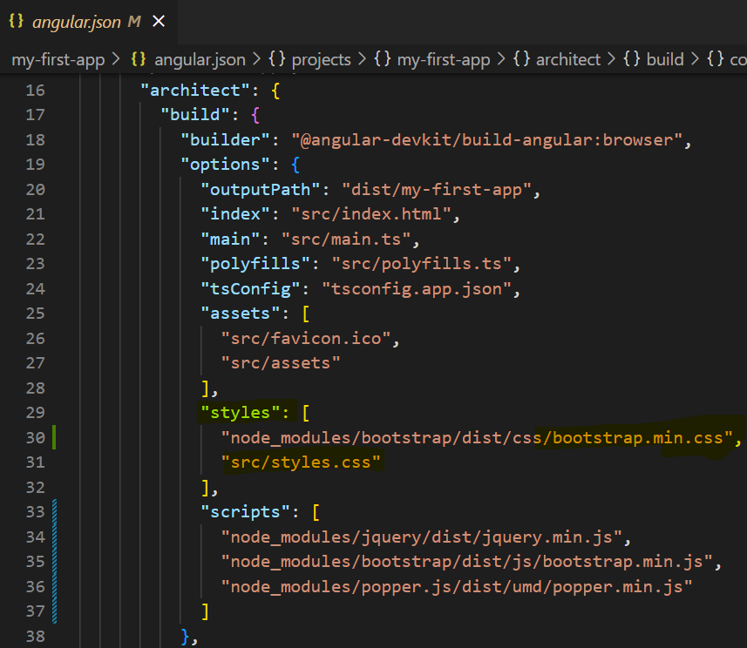
Application-Wide Global Style
Application-wide global styles using Application/project configuration:-
Most apps strive for a consistent look across the application. The CLI generated an empty styles.css for this purpose.
Put your application-wide styles there - src/styles.css
Angular provides an option in project configuration (angular.json) to specify this application wide CSS stylesheets.
The styles specified in angular.json will be applicable for all templates.

Slide 36
Component Specific Style
Component Specific style:
Each component will have its own css/scss file which will override global styles for that component
Component decorator @Component provides two option, styles or styleUrls
to provide CSS style information to its template.
styles − styles option is used to place the CSS inside the component itself.
styles: ['h1 { color: '#ff0000'; }']
styleUrls − styleUrls is used to refer external CSS stylesheet. We can use multiple stylesheet as well.
styleUrls: ['./app.component.css', './custom_style.css’]
Open src/app/app.component.css contain component specific style.
h1 {
color: #369;
font-family: Arial, Helvetica, sans-serif;
font-size: 250%;
}

Slide 37
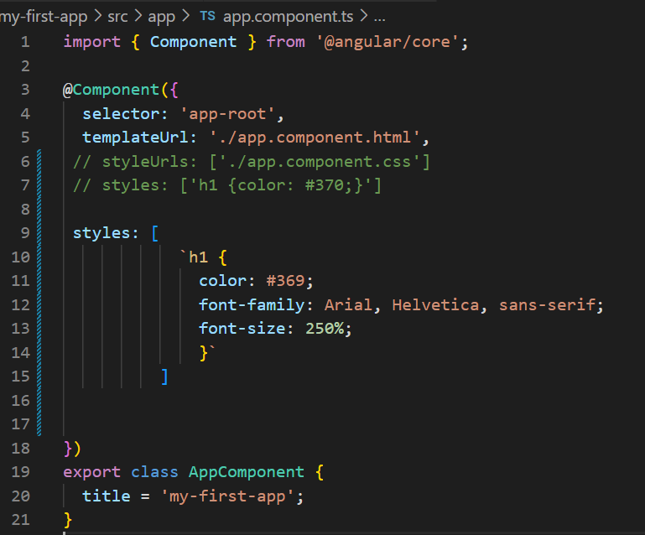
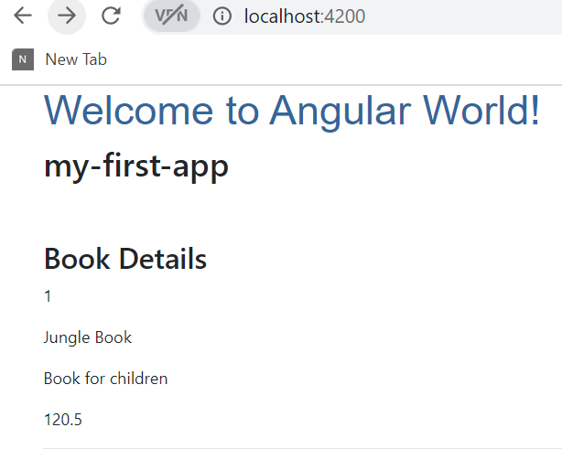
Component Specific Style
Note: add backticks ` to give inline style spanning multiple lines or single quote ‘ if inline style spans only single line.
You can also mention style using external stylesheet and link it using styleUrls array.

Slide 38
Adding Styles: Angular With Bootstrap
When you use a project created with Angular CLI 6+ (check via ng v ), you'll have an angular.json file instead of an .angular-cli.json file. In that file, you still need to add Bootstrap to the styles[] array, but the path should be node_modules/bootstrap/dist/css/bootstrap.min.css , NOT ../node_modules/bootstrap/dist/css/bootstrap.min.css . The leading ../ must not be included.
Here, we are using the Angular version above 6.
How to add bootstrap.css file in the project?
-- Expand Node Module (library root folder)
-- Go to bootstrap folder and expand it.
-- Go to dist folder and expand dist.
-- Expand css and you will find "bootstrap.css".
-- Expand bootstrap.css and you will see bootstrap.min.css

Slide 39
Adding Styles: Angular With Bootstrap
My-first-app> npm install --save bootstrap jquery popper.js
Angular.json file:-
"architect": {
"build": {
[...],
"styles": [
"src/styles.css",
"node_modules/bootstrap/dist/css/bootstrap.min.css"
],
"scripts": [
"node_modules/jquery/dist/jquery.min.js",
"node_modules/bootstrap/dist/js/bootstrap.min.js“,
"node_modules/popper.js/dist/umd/popper.min.js"
]
},
Note: If you are adding the bootstrap path into the angular.json file, make sure it is the styles within the project\architect\build. Not the one in the project\architect\test.

Slide 40
Adding Styles: Add bootstrap classes to html tags
app.component.html
<div class="container">
<h1>Hello World</h1>
<h2>Welcome to Angular World!</h2>
<h2>{{title}}</h2>
<button type="button" class="btn btn-primary">Primary</button>
</div>

Slide 41
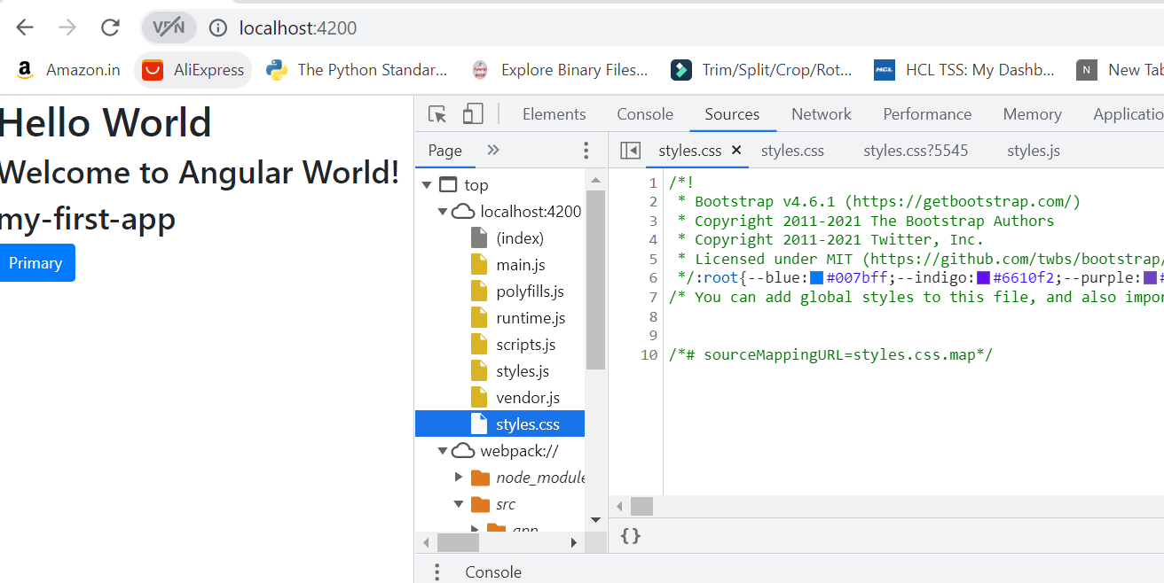
Adding Styles: Adding Bootstrap To Angular
Check if bootstrap is installed properly and it’s working.
Start the application
Inspect Webpage/F12 – sources/styles.css file should show bootstrap details as below if bootstrap got installed correctly.

Slide 42
Angular
Angular Architecture : building blocks of angular framework

Slide 43
Architecture Of Angular Framework
Angular framework is based on four core concepts and they are as follows −
Components.
Templates with Data binding and Directives.
Modules.
Services and dependency injection.

Slide 44
Angular Building Blocks: Component
Component is simply a class with decorator that mark it’s type and provide metadata which guide Angular to do things.
Every Angular application always has at least one component known as root component that connects a page hierarchy with page DOM.
Each component defines a class that contains application data and logic, and is associated with an HTML template that defines a view to be displayed in a target environment.
The HTML template can access the data from its corresponding JavaScript / Typescript class.
Component’s HTML template may include other component using its selector’s value (name).
The Angular Component may have an optional CSS Styles associated it and the HTML template may access the CSS Styles as well.
Metadata of Component class:-
The metadata for a component class associates it with a template that defines a view. A template combines ordinary HTML with Angular directives and binding markup that allow Angular to modify the HTML before rendering it for display.

Slide 45
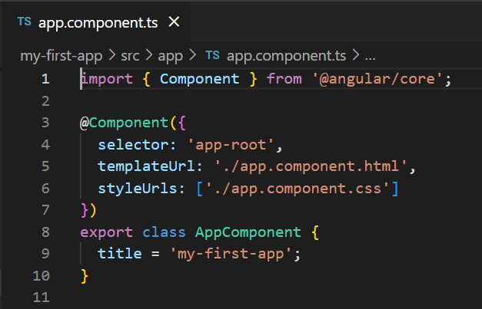
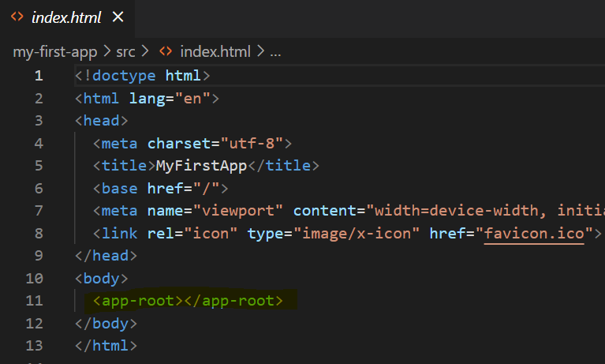
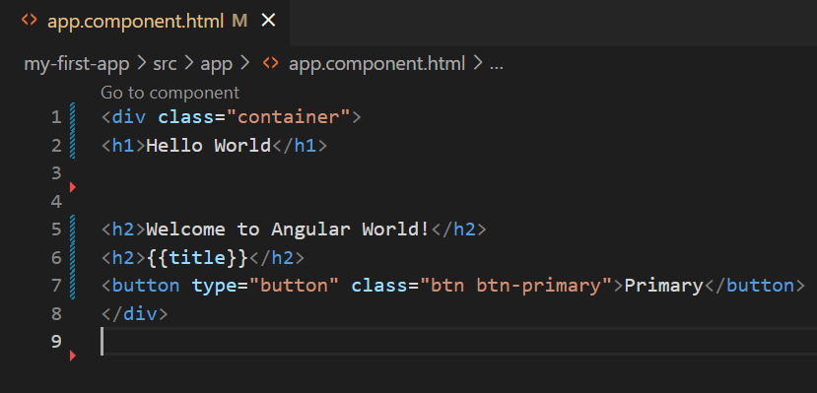





Angular Building Blocks: Component
@Component is a decorator and it is used to convert a normal Typescript class to Angular Component.
app-root is the selector / name of the component and it is specified using selector meta data of the component’s decorator. app-root can be used by application root document, src/index.html as specified above.

Slide 46
Angular Building Blocks: Component & @Component metadata tag
@Component is a decorator and it is used to convert a normal Typescript class to Angular Component.
Component selector: Every component requires a CSS Selector.
A selector instructs Angular to instantiate this component wherever it finds the corresponding tag in template HTML or index.html
app-root is the selector / name of the component and it is specified using selector meta data of the component’s decorator. app-root can be used by application root document, src/index.html as specified above.
app.component.html is the HTML template document associated with the component. The component template is specified using templateUrl meta data of the @Component decorator.
app.component.css is the CSS style document associated with the component. The component style is specified using styleUrls meta data of the @Component decorator.
AppComponent property (title) can then be displayed in the associated HTML template as mentioned below:
{{ title }}

Slide 47
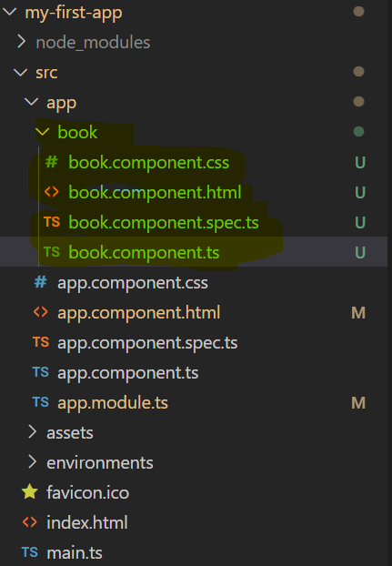
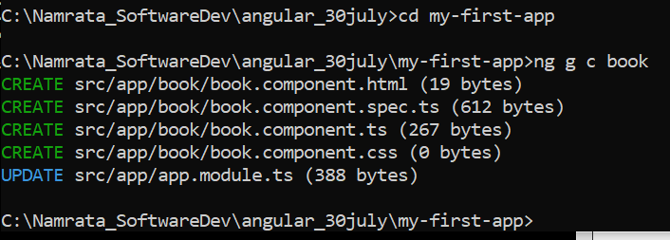
Angular Building Blocks: Creating component with CLI
Syntax
ng generate component component_name
Or
ng g c component_name
Visual Studio Explorer
Command prompt- Using Angular CLI command

Slide 48
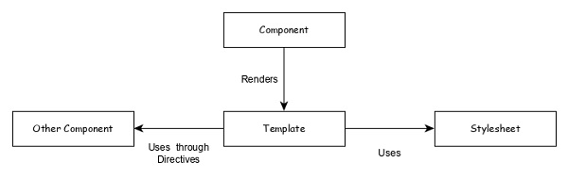
Angular Building Blocks: Component

Slide 49
Angular Building Blocks: Component Template
Template is basically a super set of HTML. Template includes all the features of HTML and provides additional functionality to bind the component data into the HTML and to dynamically generate HTML DOM elements.
The core concept of the template can be categorized into two items and they are as follows −
Data binding
Used to bind the data from the component to the template.
{{ title }}
Here, title is a property in AppComponent and it is bind to template using Interpolation.
Directives
Used to include logic as well as enable creation of complex HTML DOM elements.
<p *ngIf="canShow">
This sectiom will be shown only when the *canShow* propery's value in the corresponding component is *true* </p>
<p [showToolTip]='tips' />
Here, ngIf and showToolTip (just an example) are directives. ngIf create the paragraph DOM element only when canShow is true. Similarly, showToolTip is Attribute Directives, which adds the tooltip functionality to the paragraph element.
When user mouse over the paragraph, a tooltip with be shown. The content of the tooltip comes from tips property of its corresponding component.

Slide 50
Angular Building Blocks: Modules
Angular Module is basically a collection of related features / functionality.
Angular Module groups multiple inter-related components, services, directives under a single context.
For example, animations related functionality can be grouped into single module and Angular already provides a module for the animation related functionality, BrowserAnimationModule module.
For example: FormsModule for two-way-data-binding
An Angular application can have any number of modules but only one module can be set as root module, which will bootstrap the application and then call other modules as and when necessary.
A module can be configured to access functionality from other module as well. In short, components from any modules can access component and services from any other modules.

Slide 51
Angular Building Blocks: Module
The module declaration needs to be exported only if it needs to be imported into any other module.
The AppModule inside app.module.ts is the root/main/starting module of Angular application.
Notes:
http://blog.angular-university.io/angular2-ngmodule/
what is a module? Similar to the modules you attached controllers to in Angular 1,
Angular 4 has a module system that allows you to easily import and export functionality called NgModule

Slide 52
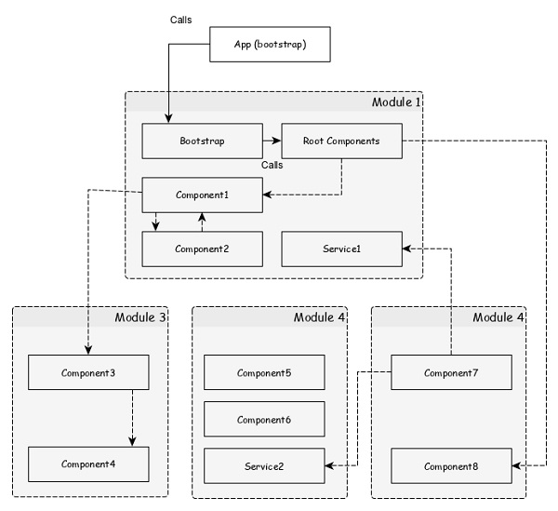
Angular Building Blocks: Modules

Slide 53
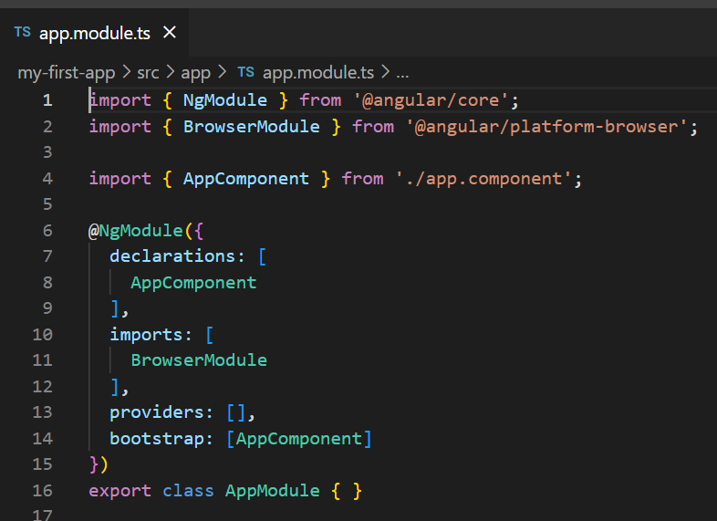
Angular Building Blocks: Modules
Let us check the root module of our my-first-app Angular application.
NgModule decorator is used to
convert a plain Typescript / JavaScript
class into Angular module.
declarations option is used to include components into AppModule module.
bootstrap option is used to set the root component of the AppModule module.
providers option is used to include the
services for the AppModule module.
imports option is used to import other modules into the AppModule module.

Slide 54
Angular Building Blocks: Module
imports is used to declare other modules being used inside current module.
declarations declare all components that are grouped into current module
providers declare all dependent services that can be injected and accessed throughout the module
Can omit ‘providers’ if no service to declare at application level
bootstrap denotes the set of components that are bootstrapped when this module is bootstrapped.
Notes:
http://blog.angular-university.io/angular2-ngmodule/
what is a module? Similar to the modules you attached controllers to in Angular 1,
Angular 4 has a module system that allows you to easily import and export functionality called NgModule

Slide 55
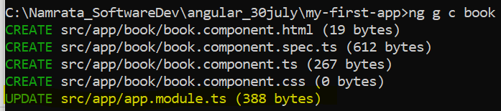
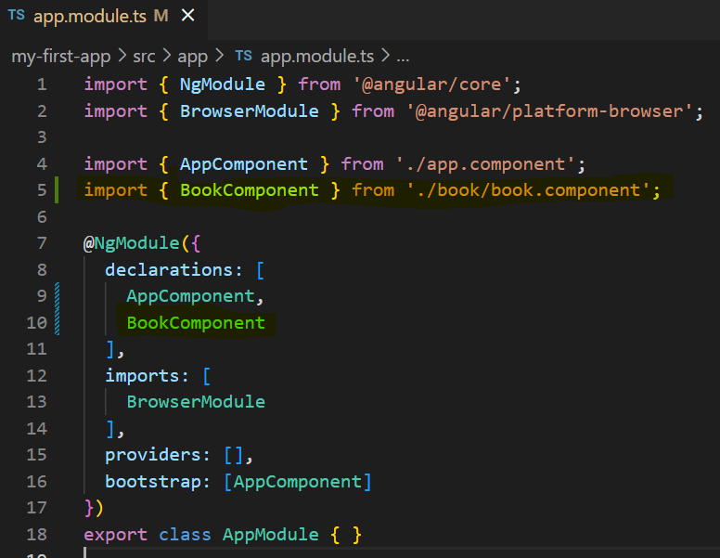
Angular Building Blocks: Modules
Afterwards you add more components to your current module – app-module
After adding book component to app-module using CLI command ‘ng g c book’

Slide 56
Angular Building Blocks: Services
In Angular, developers create a service class for data or logic that isn't associated with a specific view, and they want to share across components.
Dependency Injection (DI) is used to make service available into the Component class
Services are plain Typescript / JavaScript class providing a very specific functionality.
Services will do a single task and do it best. For example: ‘BooksDao’ service class providing data-access CRUD functionality for Book component.
The main purpose of the service is reusability. Instead of writing a functionality inside a component, separating it into a service will make it useable in other component as well.
Services enables the developer to organize the business logic of the application.
Basically, component uses services to do its own job.
Dependency Injection is used to properly initialize the service in the component so that the component can access the services as and when necessary without any setup.

Slide 57

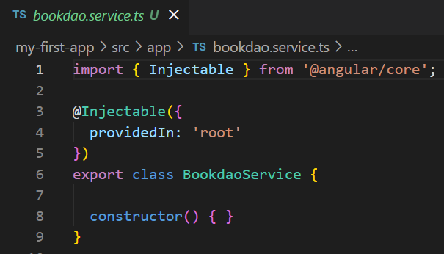
Angular Building Blocks: Services
By default, the Angular CLI command ng generate service registers a provider with the root injector for your service by including provider metadata, that is
providedIn: 'root’
in the @Injectable() decorator.
When you provide the service at the root level, Angular creates a single, shared instance of that Service and injects into any class that asks for it.
Registering the provider in the @Injectable metadata also allows Angular to optimize an application by removing the service if it turns out not to be used after all.

Slide 58
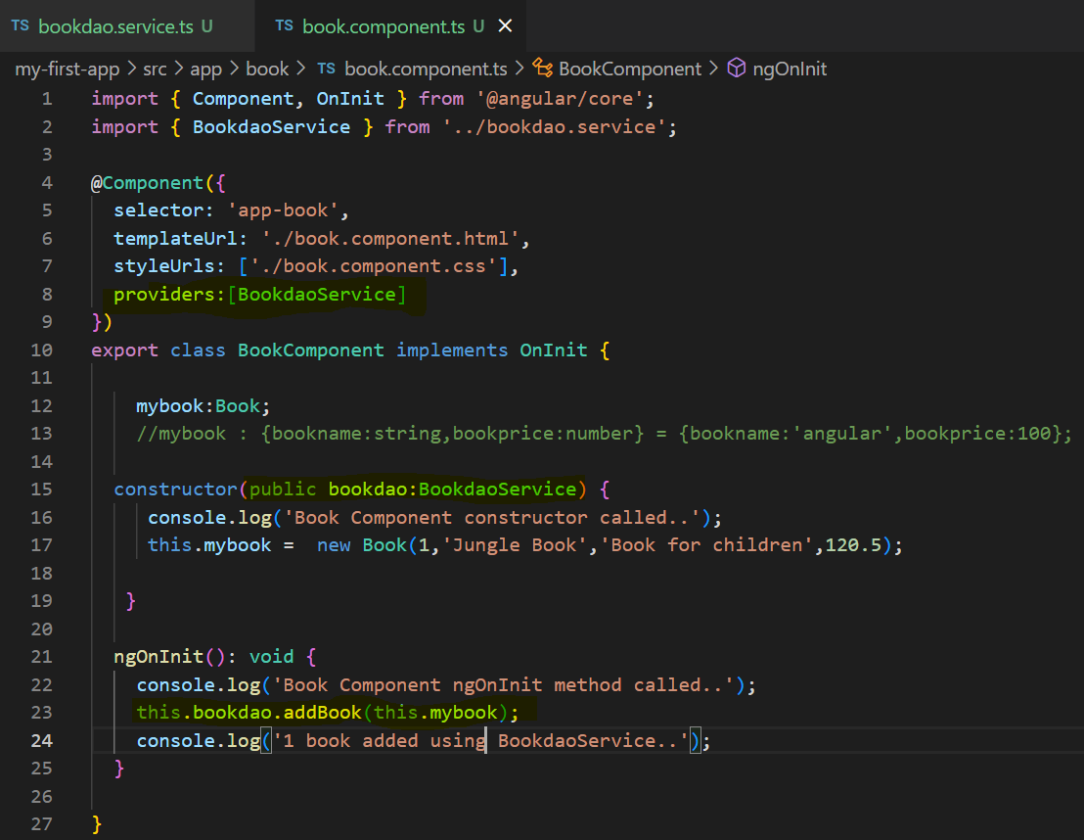
Angular Building Blocks: Services
Dependency Injection is used to properly initialize the service in the component so that the component can access the services as and when necessary without any setup.

Slide 59
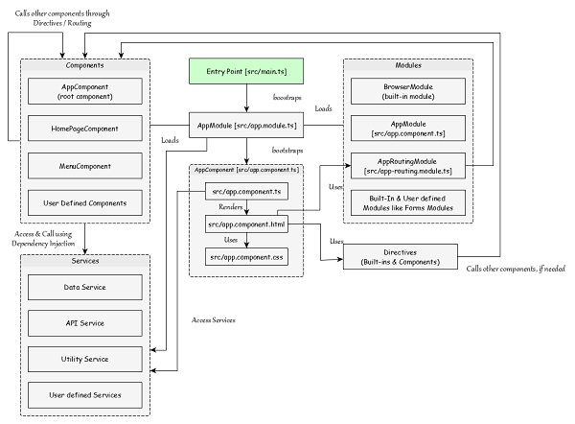
Angular Building Blocks: Workflow of Angular application
We have learned the core concepts of Angular application. Let us see the complete flow of a typical Angular application.

Slide 60
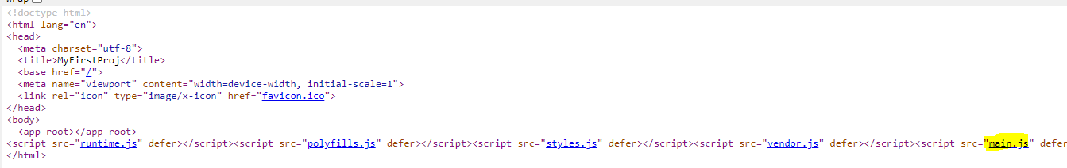
Angular Building Blocks: How does Angular App Kick Starts?
http://localhost:4200 loads index.html page in browser
index.html has <app-root> tag
Ng serve will Compile and Bundle all JS code (all TS code is converted into JS code) and automatically add imports using script tags in index.html file
One of the imports is main.js (as highlighted below)
main.ts → main.js is starting point of application
Main.js bootstraps App module and App module in turn bootstraps App Component

Slide 61
Angular Building Blocks: Workflow of Angular application
index.html imports and runs main.ts using script tag
src/main.ts is the entry point of Angular application.
src/main.ts bootstraps the AppModule (src/app.module.ts), which is the root module for every Angular application.
platformBrowserDynamic().bootstrapModule(AppModule)
.catch(err => console.error(err));
AppModule bootstraps the AppComponent (src/app.component.ts), which is the root component of every Angular application.
@NgModule({
…
bootstrap: [AppComponent]
})
export class AppModule { }

Slide 62
Angular Building Blocks: Workflow of Angular application
AppModule bootstraps AppComponent which is root component of every Angular application
It also loads modules through imports option.
AppModule also loads all the registered service using Dependency Injection (DI) framework.
AppComponent renders its template (src/app.component.html) and uses the corresponding styles (src/app.component.css).
AppComponent selector, <app-root></app-root> is used to place/render it inside the src/index.html.
@NgModule({
declarations: [
AppComponent,
BookComponent
],
imports: [
BrowserModule,
FormsModule
],
providers: [], //register service here in providers
bootstrap: [AppComponent]
})
export class AppModule { }

Slide 63
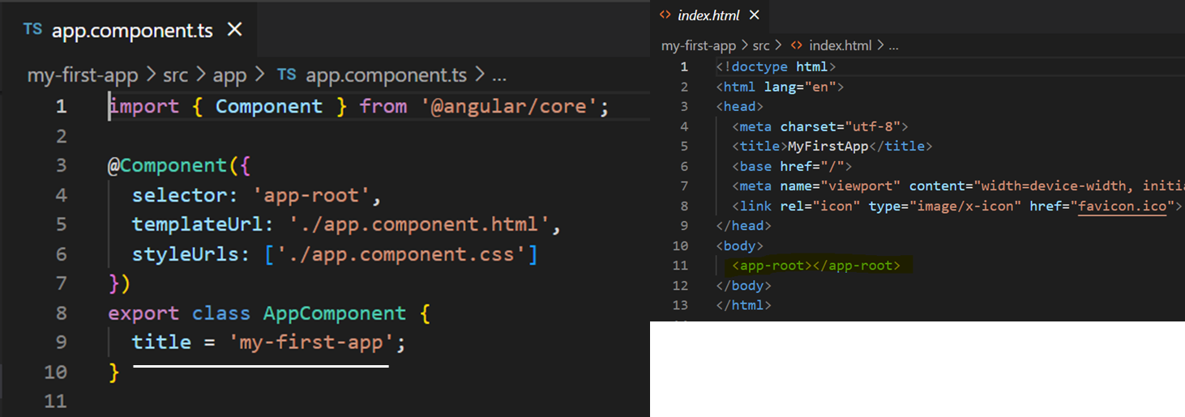
Angular Building Blocks: Workflow of Angular application

Slide 64
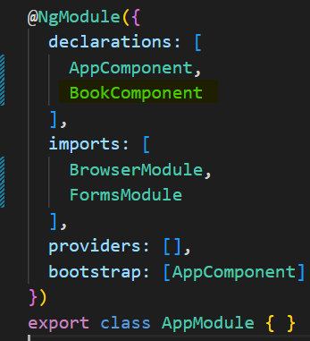
Angular Building Blocks: Workflow of Angular application
AppComponent can use any other components registered in the application.
Component use other component through directive in its template using target component’s selector name.
<component-selector-name>
</component-selector-name>
for e.g.:-
<app-book></app-book>
Also, all registered services are accessible to all Angular components through Dependency Injection (DI) framework.

Slide 65
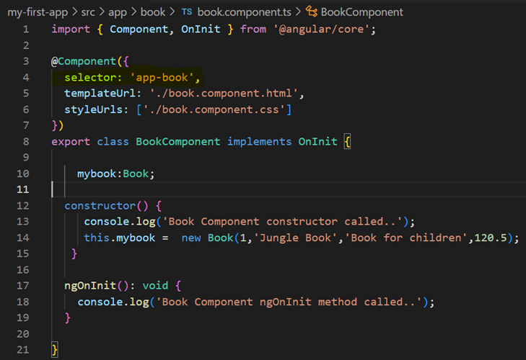
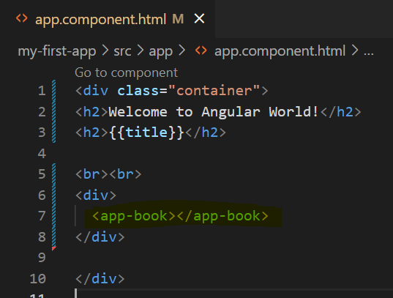
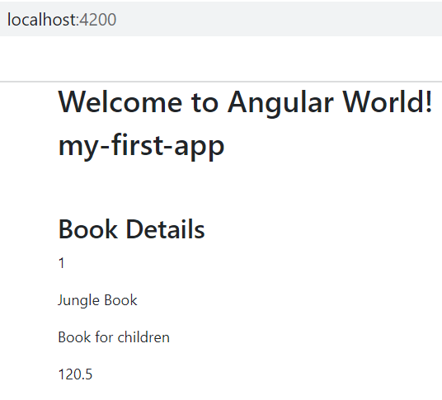
Angular Building Blocks: Workflow of Angular application: Component Nesting
Note:
Book Component is nested inside App Component by placing Selector of Book Component in App Component’s html Template

Slide 66
Using @ViewChild
@ViewChild :-
@ViewChild and @ViewChildren are the types of decorators used to access the child component class/child directive and its different properties into the parent component.
We can also access any specific template element by using @ViewChild instead of referencing the whole component
It's similar to the inheritance., and if a new child matches the selector, the property is updated.
We have to use ngAfterViewInit() hook in parent component to access the ViewChild ref properties. ( When the application loads, the child element may not be loaded completely, and if we try to access the component, it returns undefined. To resolve this, we use that lifecycle hook which allows us to access any element after the view is initialized.)
https://angular.io/api/core/ViewChild
Why do we use @ViewChild in Angular?
The ViewChild can get be used to get reference of template elements, so you can see all the associated attributes.
A common example would be if there were to be a custom component in a template a ViewChild could be used to pull values out of that component when needed.
https://www.pluralsight.com/guides/querying-the-dom-with-@viewchild-and-@viewchildren

Slide 67
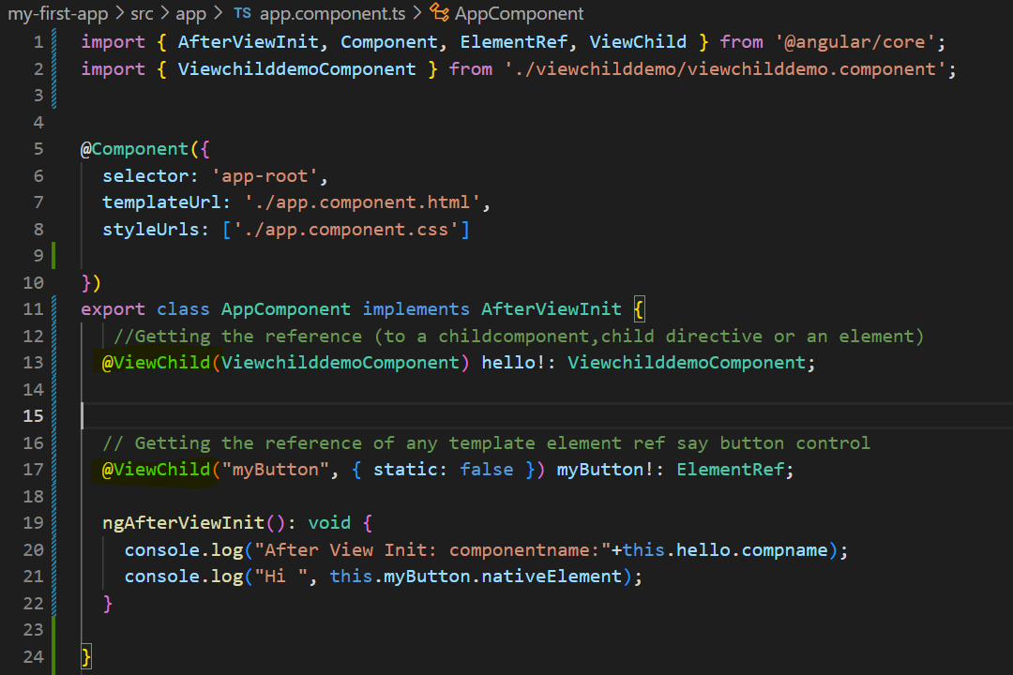
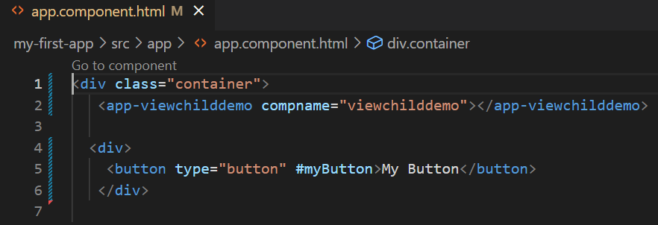
Using @ViewChild

Slide 68
Angular Building Blocks: Summary
Summary:
We created the initial application structure using the Angular CLI.
We created and started editing Angular application created using CLI
We learned that html rendered by Angular component can be styled at global and component level.
We learned how to add bootstrap css library to Angular
We saw different architecture level building blocks of Angular like:- Component, Template, Module, Service.
We also used these different building blocks in Angular application

Slide 69
Module, Component Architecture - Summary
You have learned -
Angular Module and its details
Angular Component and its details
Various ways of Component Templating and Styling
Brief introduction to Services

Slide 70
Building an App
You'll build the Books Library App, step by step.
Along the way, you'll become familiar with many of the core fundamentals of Angular.

