Slide 1
Java 8 – new features

Slide 2
forEach method
Java 8 introduced forEach method to iterate over the collections and Streams in Java.
It is defined in Iterable and Stream interface.
It is a default method defined in the java.lang.Iterable interface.
Collection classes which extends Iterable interface can use forEach loop to iterate elements.

Slide 3
forEach method
ArrayList<Integer> arrLst = new ArrayList<Integer>();
arrLst.add(5);
arrLst.add(9);
arrLst.add(8);
arrLst.add(1);
arrLst.forEach( (n) -> System.out.println(n));

Slide 4
Lambda Expression
Lambda Expressions were added in Java 8.
A lambda expression is a short block of code which takes in parameters and returns a value.
Lambda expressions are similar to methods, but they do not need a name
Instead of writing full method with name and body you can replace it with lambda expression which is compact and precise.

Slide 5
Lambda Expression - syntax
The simplest lambda expression contains a single parameter and an expression:
parameter → expression
To use more than one parameter wrap them in parentheses
(parameter1,parameter2) → expression

Slide 6
Lambda Expression – with body
Expressions are limited. They have to immediately return a value, and they cannot contain variables, assignments or statements such as if or for.
In order to do more complex operations, a code block can be used with curly braces.
(parameter1, parameter2) -> { code block }
If the lambda expression needs to return a value, then the code block should have a return statement.

Slide 7
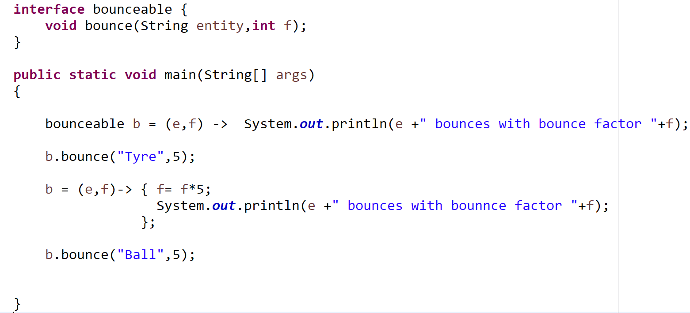
Lambda Expression

Slide 8
Lambda Expression
ArrayList<Integer> arrLst = new ArrayList<Integer>();
arrLst.add(5);
arrLst.add(9);
arrLst.add(8);
arrLst.add(1);
arrLst.forEach( (n) -> System.out.println(n) ); //lambda expression
arrLst.forEach( (n) -> { System.out.println(n); } ); //lambda exprsn with body

Slide 9
Lambda Expression – storing it in variable
Lambda expressions can be stored in variables if the variable's type is an interface and it has only one method.
The lambda expression should have the same number of parameters and the same return type as that method.
Java has many of these kinds of interfaces built in.
One such interface is Consumer interface found in the java.util package used by lists.

Slide 10
Lambda Expression – storing it in variable
Use Java's Consumer interface to store a lambda expression in a variable:
ArrayList<Integer> numLst = new ArrayList<Integer>();
numLst.add(5);
numLst.add(9);
numLst.add(8);
numLst.add(1);
Consumer<Integer> method = (n) -> { System.out.println(n); };
numLst.forEach( method );

Slide 11
Lambda Expression
interface StrIntf {
String run(String str);
}
public static void main(String[] args)
{
StrIntf var = (s) -> s + "!";
String r = var.run("Hi");
System.out.println(r);
}
public static void main(String[] args) {
StrIntf var = (s) -> s + "!";
func("Hello", var);
}
public static void func(String str, StrIntf f)
{
String result = f.run(str);
System.out.println(result);
}

Slide 12
Default Methods in Interfaces
public interface MyInterface {
// regular interface methods
default void defaultMethod()
{ // default method implementation
}
}

Slide 13
Default Methods in Interfaces
They allow us to add new (non-abstract) methods to an interface that are automatically available in the implementations. Hence, we don't need to modify the implementing classes.
In this way, backward compatibility is preserved without having to refactor the implementing classes.
Reason why Java 8 included default methods in an interface
It’s a Java rule that class implementing the interface should implement all of it’s abstract methods else compiler gives an error
If tomorrow new abstract method is added to an interface then all implementation classes will have to implement that abstract method so that there is no compiler error.
This is really cumbersome and default interface methods are an efficient way to deal with above issue.

Slide 14
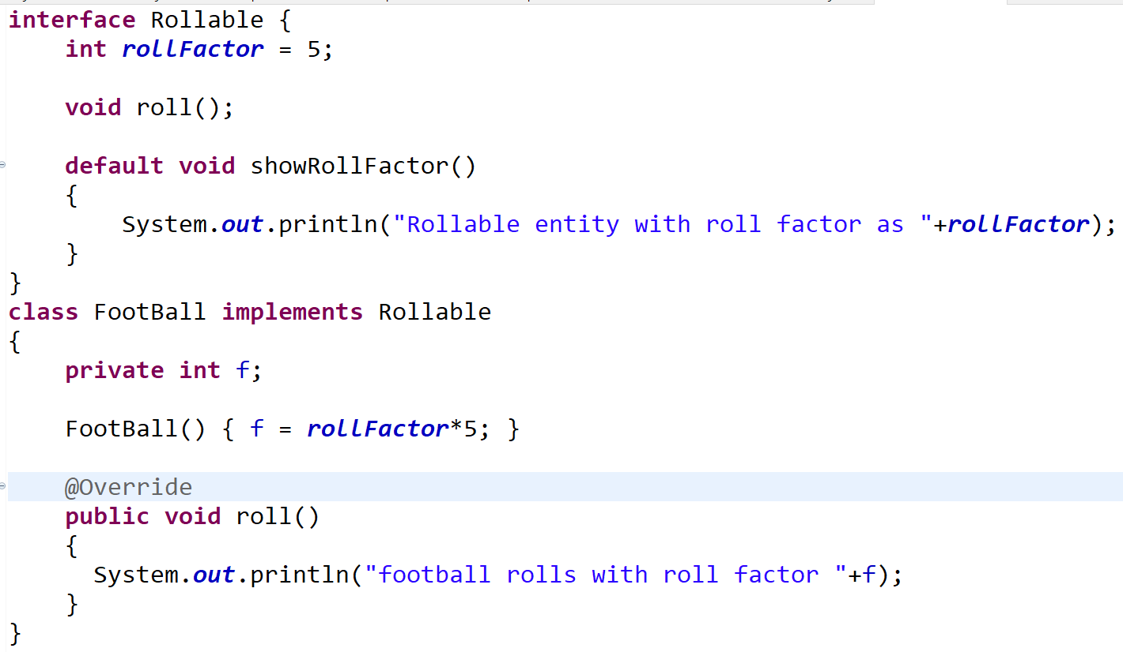
Default Methods in Interfaces

Slide 15
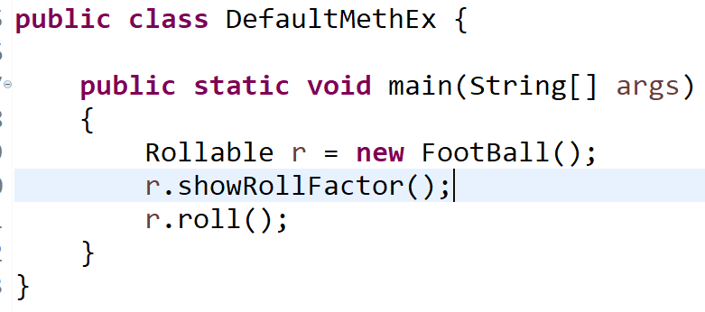
Default Methods in Interfaces
Please notice how default method showRollFactor() from Rollable interface is automatically available to implementation class FootBall.

Slide 16
Default Methods in Interfaces
The most common use of interface default methods is to incrementally provide additional functionality to a given interface type without breaking down the implementing classes.
It can also be used to provide additional functionality around an existing abstract method:
public interface Drivable {
// additional interface methods
double getSpeed();
default double getSpeedInKMH(double speed) {
// conversion
}
}

Slide 17
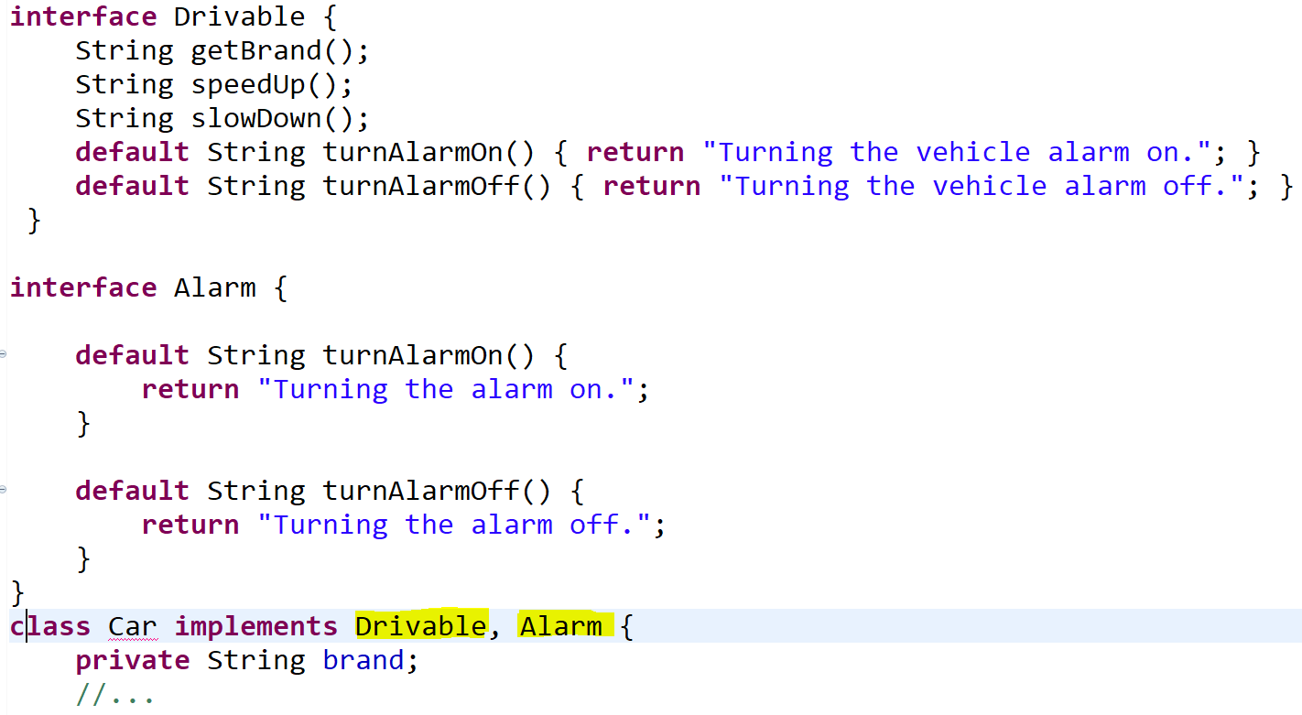
Default Methods in Interfaces
Diamond problem – Multiple interface inheritance rule :- what happens when a class implements several interfaces that define the same default methods?
In this case, the code simply won't compile, as there's a conflict caused by multiple interface inheritance (a.k.a the Diamond Problem).

Slide 18
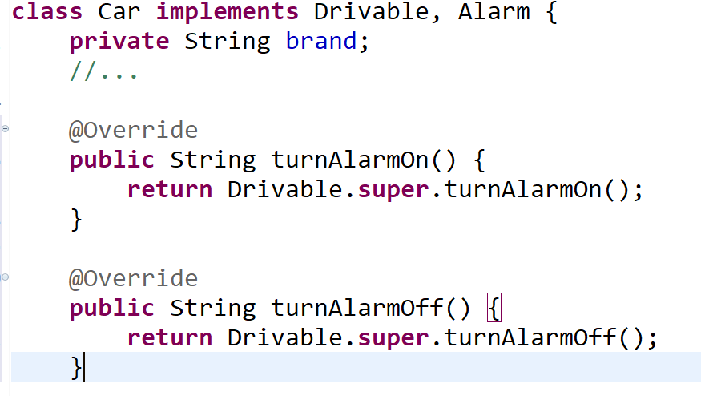
Default Methods in Interfaces
Diamond problem – Multiple interface inheritance rule :- what happens when a class implements several interfaces that define the same default methods?
When there's a conflict caused by multiple interface inheritance (a.k.a the Diamond Problem) and code won’t compile, solve this ambiguity by explicitly providing an implementation for the methods

Slide 19
Static Method in Interface
Java 8 also allows us to define and implement static methods in interfaces (in addition to default methods).
Static methods don't belong to a particular object, so they don’t belong to the classes implementing the interface.
They have to be called by using the interface name preceding the method name.
To understand how static methods work in interfaces, let's refactor the Drivable interface and add a static utility method to it:
public interface Drivable {
// regular / default interface methods
static int getHorsePower(int rpm, int torque) {
return (rpm * torque) / 5252;
}
}
Syntax to invoke static method is:-
interfaceName.staticMethName()
Drivable.getHorsePower(2500, 480));

Slide 20
Static Method in Interface
Java 8 included static interface methods so as to allow putting all related methods together in one single place without having to create extra class as placeholders for these static methods.
This improves the cohesion of the design.
Thus, static methods in interfaces make it possible to group related utility methods, without having to create artificial utility classes as placeholders for these static methods.
Defining a static method within an interface is identical to defining one in a class.
A static method can be invoked within other static and default methods.
Note: cohesion refers to the degree to which the elements inside a module/class/interface belong together
Notes:
The same can pretty much be done with abstract classes. The main difference is that abstract classes can have constructors, state, and behavior.

Slide 21
Default & Static methods in Java 8
Summary:-
We have covered use of static and default interface methods in Java 8
From Object Oriented perspective, interfaces shouldn't encapsulate behavior and should only be used for defining the public API of a certain type.
but..
When it comes to maintaining backward compatibility with existing code, static and default methods are a good trade-off.

Slide 22
Functional Interface
Functional Interface is an interface with only single abstract method.
Along with the one abstract method, it can have any number of default and static methods. It can also have methods of Object class.
As it can have only one abstract method it is also known as Single Abstract Method Interfaces or SAM Interfaces.
We can either create our own functional interface or can use predefined functional interfaces provided by java.

Slide 23
Functional Interface
A functional interface can extends another interface only when it does not have any abstract method.
On creating your own functional interface mark it using @FunctionalInterface annotation.
It is not mandatory to use @FunctionalInterface annotation, but it gives compile time error if more than one abstract method is added in a functional interface.

Slide 24
Functional Interface
@FunctionalInterface
interface AddInterface{
void add(int a, int b);
}
public class FunctionalInterfaceExample implements AddInterface {
public void add(int a, int b){
System.out.println(a+b);
}
public static void main(String args[]){
FunctionalInterfaceExample fie = new FunctionalInterfaceExample();
fie.add(10, 20);
}
}

Slide 25
Functional Interface
A functional interface can have methods of object class.
@FunctionalInterface
interface AddInterface{
void add(int a, int b);
//It can contain any number of Object class methods.
int hashCode();
String toString();
boolean equals(Object obj);
}

Slide 26
Functional Interface
In Java 8 there are 4 main functional interfaces which could be used in different scenarios. These are given below.
Consumer
Predicate
Function
Supplier
Among the above four interfaces, the first three interfaces also have extensions also which are given below.
Consumer - BiConsumer
Predicate – BiPredicate
Function – BiFunction, UnaryOperator, BinaryOperator

Slide 27
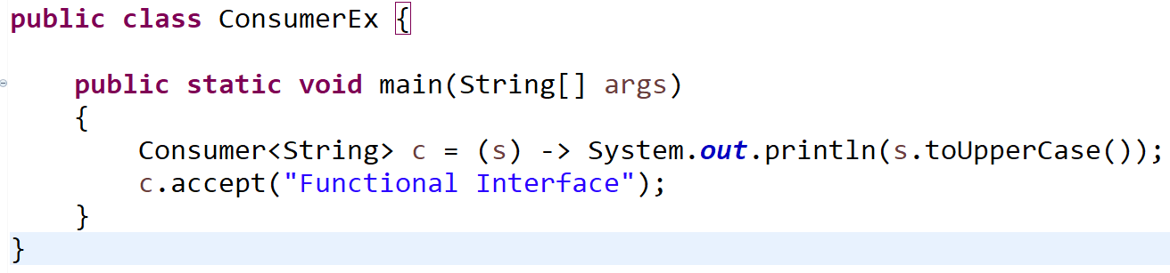
Functional Interface
CONSUMER :- Let’s discuss about Consumer:-
The consumer interface accepts one argument but there is no return value.
The name of function inside this interface is accept.
Output: FUNCTIONAL INTERFACE

Slide 28
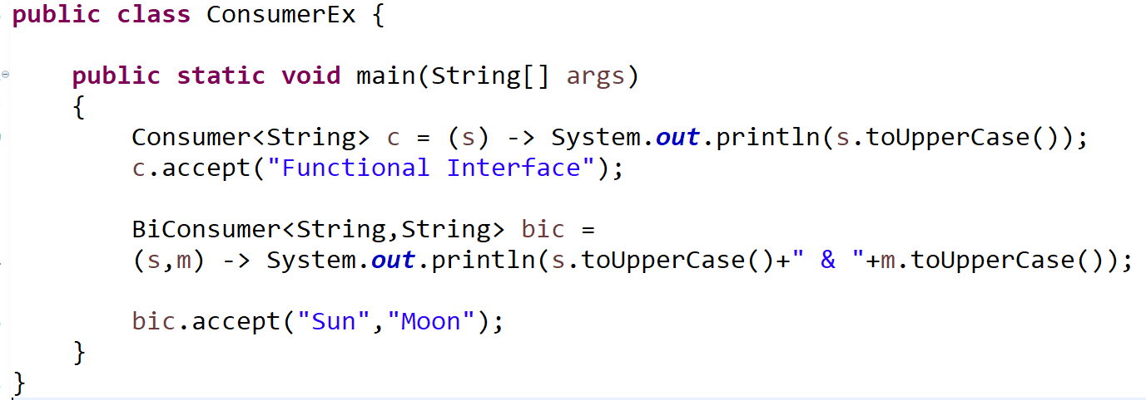
Functional Interface
The extension of the Consumer which is BiConsumer accepts two arguments and return nothing.
The name of method inside interface is ‘accept()’.
Output: SUN & MOON

Slide 29
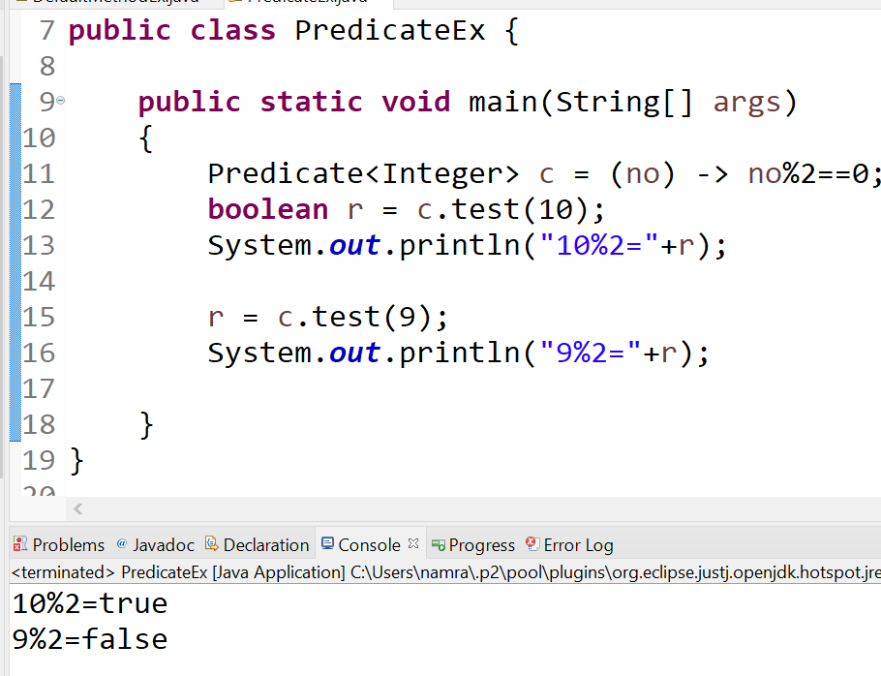
Functional Interface
PREDICATE:- Let’s discuss about Predicate:-
Predicate interface has single abstract method called as test() which accepts one argument, do some processing and then return boolean

Slide 30
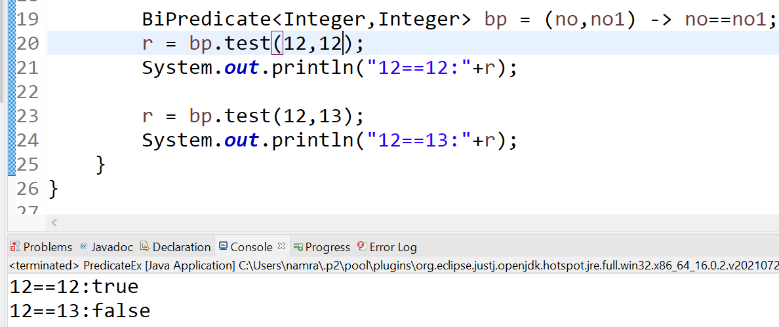
Functional Interface
BIPREDICATE:- Let’s discuss about Predicate:-
Instead of one argument BiPredicate will accept two arguments and return nothing. The abstract method name is ‘test’.

Slide 31
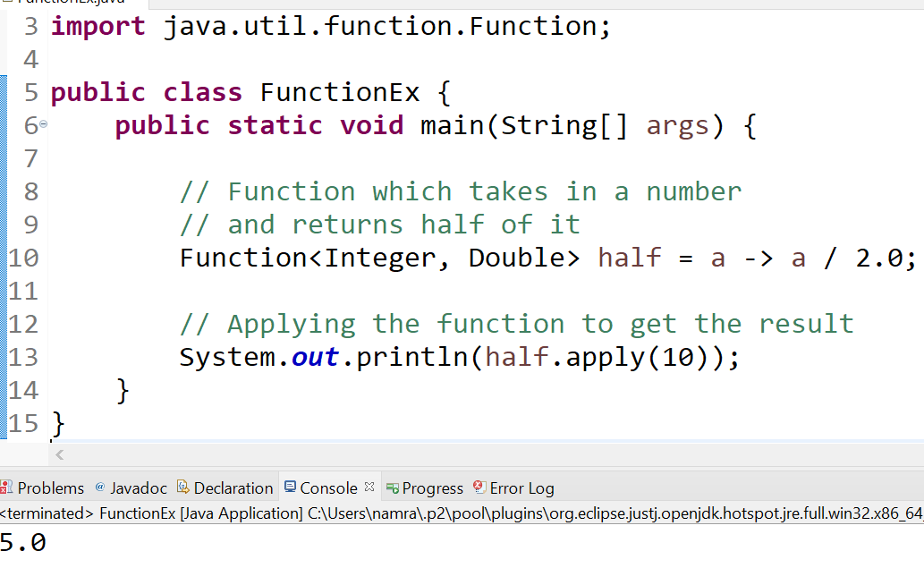
Functional Interface
FUNCTION:- Let’s discuss about FUNCTION interface type -
This interface accepts one argument and return a value after the required processing.
It is defined as below.
The required processing logic will be executed on invocation of the ‘apply’ method.

Slide 32
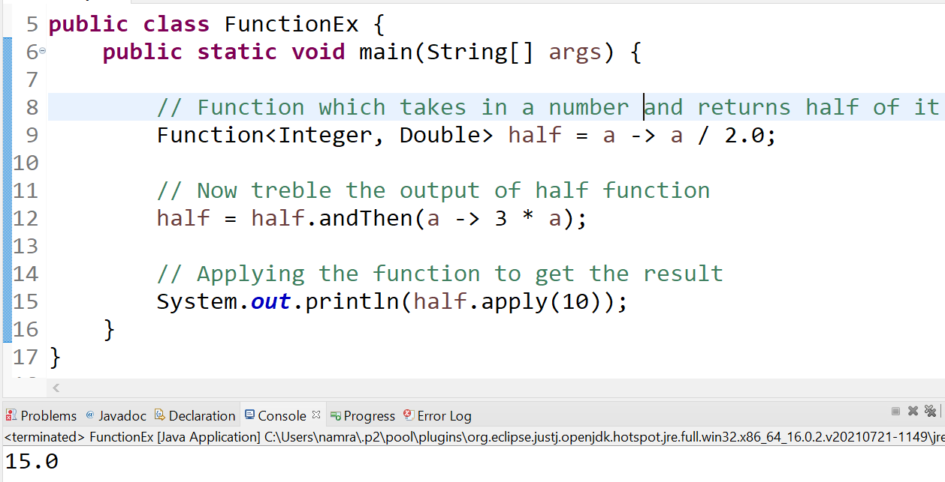
Functional Interface
FUNCTION:- Let’s discuss about FUNCTION interface type -
Method 2: andThen() - It returns a composed function wherein the parameterized function will be executed after the first one. If evaluation of either function throws an error, it is relayed to the caller of the composed function.

Slide 33
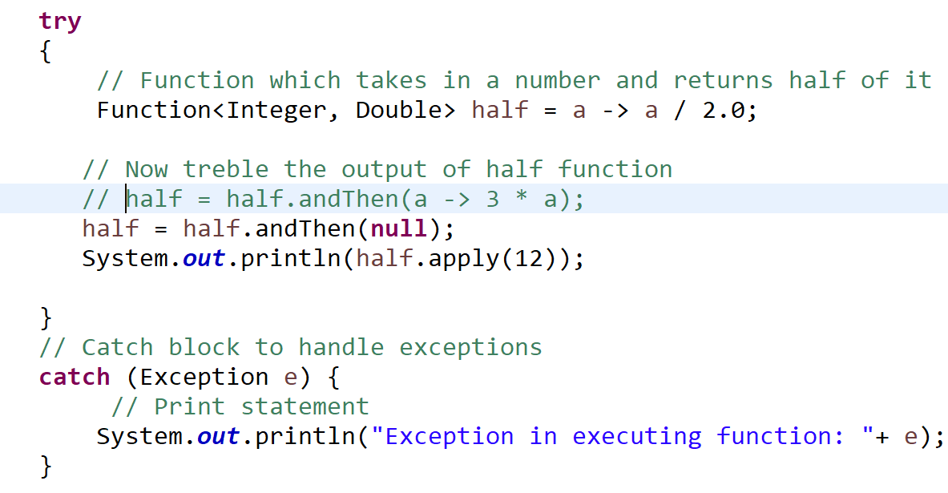
Functional Interface
FUNCTION:- Let’s discuss about FUNCTION interface type -
Method 2: andThen() - It returns a composed function wherein the parameterized function will be executed after the first one. If evaluation of either function throws an error, it is relayed to the caller of the composed function.

Slide 34
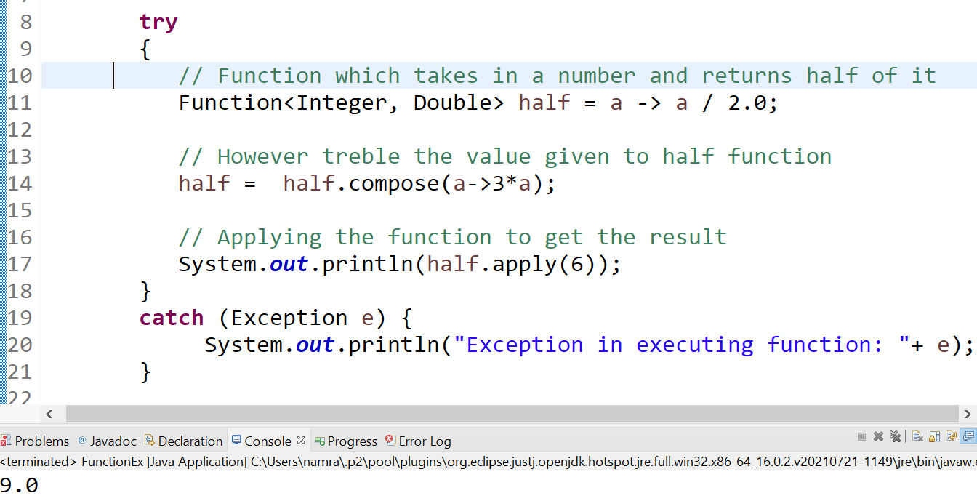
Functional Interface
FUNCTION:- Let’s discuss about FUNCTION interface type -
Method 3: compose() :- It returns a composed function wherein the parameterized function will be executed first and then the first one i.e. Function. If evaluation of either function throws an error, it is relayed to the caller of the composed function.

Slide 35
Functional Interface
BIFUNCTION, UnaryOperator, BinaryOperator:-
The BiFunction is similar to Function except it accepts two inputs whereas Function accepts one argument
UnaryOperator extends from Function interface accepts a single argument and return a single argument similar to Function but both the input and output argument should be of similar type.
BinaryOperator extends from BiFunction and accepts two arguments and return one argument similar to BiFunction but all the input and output argument should be of similar type.

Slide 36
Functional Interface
BIFUNCTION, UnaryOperator, BinaryOperator:-
@FunctionalInterface
public interface BiFunction<T, U, R> {
R apply(T t, U u);
}

Slide 37
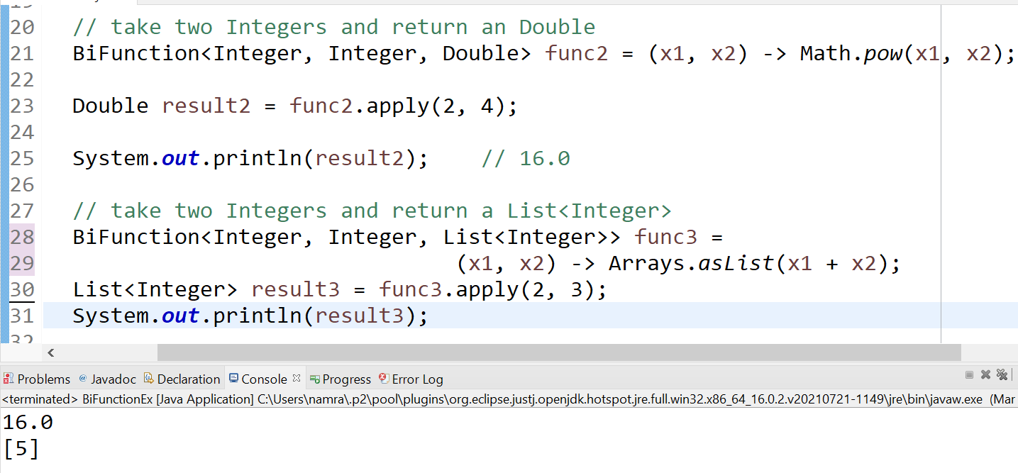
Functional Interface
BIFUNCTION, UnaryOperator, BinaryOperator:-

Slide 38
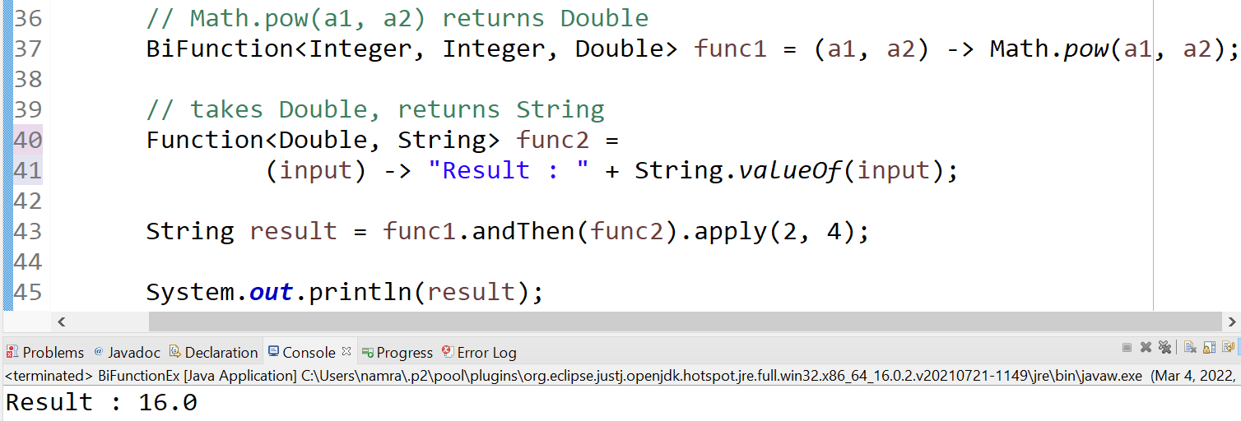
Functional Interface
BIFUNCTION:-

Slide 39
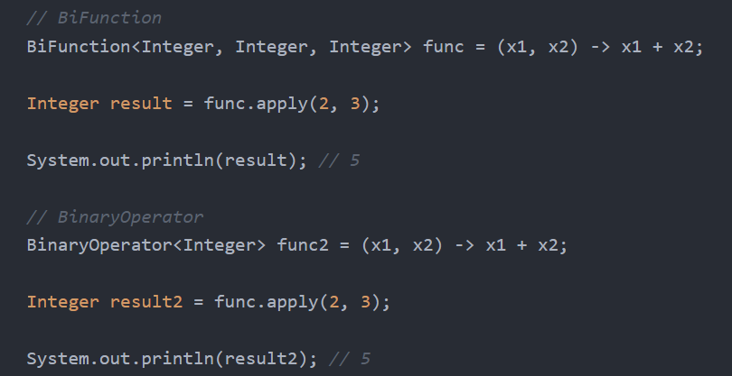
Functional Interface
BinaryOperator:-
@FunctionalInterface
public interface BinaryOperator<T> extends BiFunction<T,T,T> {}

Slide 40
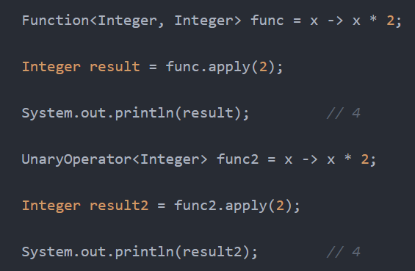
Functional Interface
UnaryOperator:-
@FunctionalInterface
public interface UnaryOperator<T> extends Function<T,T,> {}

Slide 41
Functional Interface
Supplier:- It is a functional interface; it takes no arguments and returns a result.
@FunctionalInterface
public interface Supplier<T> {
T get();
}

Slide 42
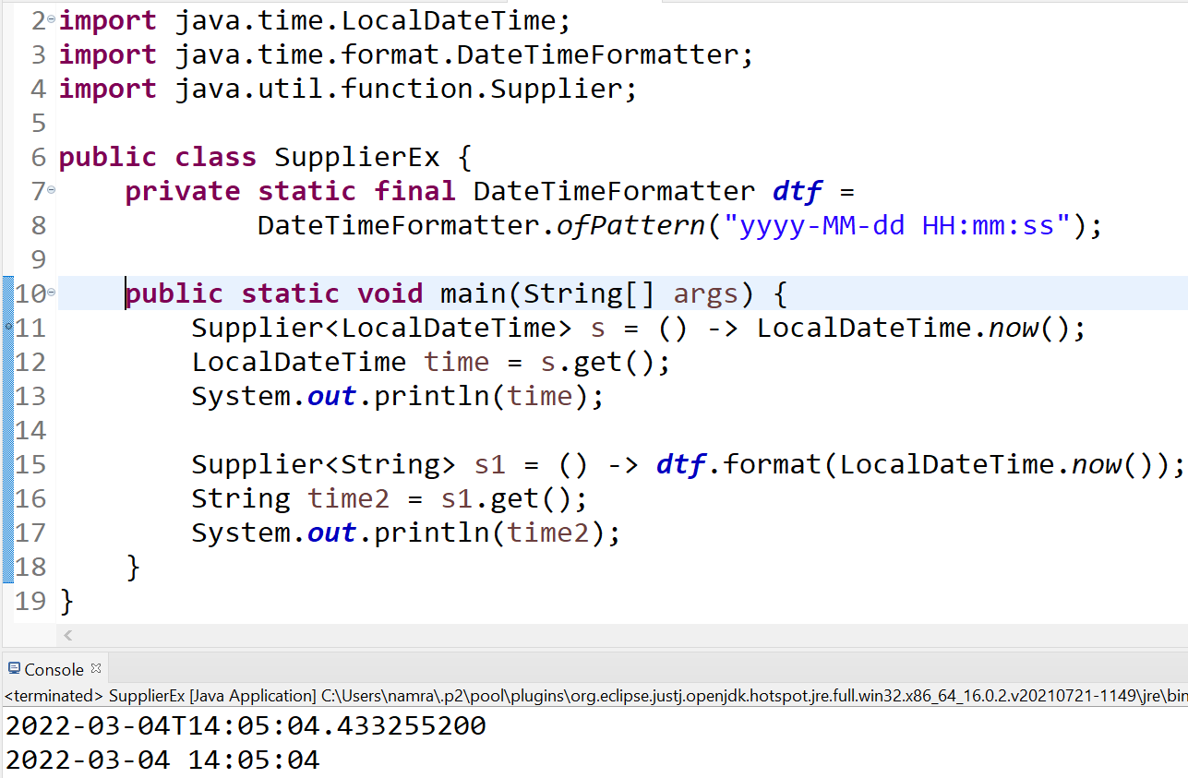
Functional Interface
Supplier:- It is a functional interface; it takes no arguments and returns a result.

Slide 43
Stream
A java.util.Stream represents a sequence of objects from a source, which supports aggregate operations which can be pipelined to produce the desired result.
Stream API is introduces in Java8 to process collection of objects
It supports declarative style of programming.
Stream support aggregate operations map-reduce-filter transformations on collections.
It should not be confused with Java I/O streams.
A stream is not a data structure. It takes input from the collections, Arrays or I/O channels.

Slide 44
Intermediate Operations on Streams
Map: Returns a stream that resulted after applying the given map function to the elements of the stream.
List<Integer> nums = Arrays.asList(2,3,4,5,6);
List<Integer> sqnums = nums.stream().map(x->x*x).collect(Collectors.toList());
Map can be used to extract particular field of Collection object - from employees collection extract only all employees name in uppercase
Set<String> names = employees.stream()
.map(Employee::getName)
.map(String::toUpperCase)
.collect(Collectors.toSet());
Filter: The filter method is used to filter the results based on predicate passed to the filter
List<String> names = Arrays.asList("Radha","Sita","Rajesh","Anuj","Suyash");
List<String> rnames= names.stream().filter(x->x.startsWith("R")).collect(Collectors.toList());

Slide 45
Intermediate Operations on Streams
Sorted: The sorted method is used to sort the stream based on comparator.
List<Employee> sortemp1 = employees.stream()
.sorted((e1,e2)->(int)(e2.getSalary()-e1.getSalary()))
.collect(Collectors.toList());
List<String> sortnames= names.stream()
.sorted()
.collect(Collectors.toList());
List<String> sortnamesdesc= names.stream()
.sorted((o1,o2)->o2.compareTo(o1))
.collect(Collectors.toList());
List<String> sortnamesdesc1= names.stream()
.sorted(Comparator.reverseOrder())
.collect(Collectors.toList());

Slide 46
Terminal Operations on Streams
Terminal operations on streams produces a non-stream results such as a primitive value, a collection or a no value at all.
collect – the collect method is used to return the result of the terminal operations performed on the stream.
List<String> names = Arrays.asList("Radha","Sita","Rajesh","Anuj","Suyash");
List<String> sortnames= names.stream().sorted().collect(Collectors.toList());
forEach – it is used to iterate over the stream.
List<String> names = Arrays.asList("Radha","Sita","Rajesh","Anuj","Suyash");
names.stream().sorted().forEach(n->System.out.println(n));
reduce – it performs a reduction on the element of the stream.
List<Integer> lints = Arrays.asList(1,2,3,4,5);
Integer sum = lints.stream().reduce(0, (a,b)->a+b);

Slide 47
Assignment
Create List of Employees
Sort them in ascending and descending order of salary
Find total salary of all employees
Filter employees that are managers and have their age > 29
Filter employees with names starting from letter “P”

Slide 48
Assignment Solution
List < Employee > employees = new ArrayList < Employee > ();
employees.add(new Employee(10, "Ramesh", 30, 400000,true));
employees.add(new Employee(20, "John", 29, 350000,false));
employees.add(new Employee(30, "Tom", 30, 450000,true));
employees.add(new Employee(40, "Pramod", 29, 500000,false));
employees.add(new Employee(42, "Pritam", 39, 500000,false));
Predicate<Employee> p1 = (e)->e.isManager();
Predicate<Employee> p2 = (e)->e.getAge()>29;
Map<String,Employee> mapemp = employees.stream().filter(p1).filter(p2) .collect(Collectors.toMap(Employee::getName,(e)->e));
System.out.println(mapemp);
Map<String,Integer> mapemp1 = employees.stream().filter(p1).filter(p2) .collect(Collectors.toMap(Employee::getName,Employee::getAge));
System.out.println(mapemp1);
Long totSal = employees.stream().map(e->e.getSalary())
.reduce(0L,(a,b)->a+b);
System.out.println(totSal);
List<Employee> sortemp = employees.stream()
.sorted(Comparator.comparingLong(Employee::getSalary))
.collect(Collectors.toList());
List<Employee> sortempd = employees.stream()
.sorted(Comparator.comparingLong(Employee::getSalary).reversed())
.collect(Collectors.toList());
System.out.println(sortemp);
System.out.println(sortempd);
List<Employee> lemp = employees.stream()
.filter(e->e.getName().startsWith("P"))
.collect(Collectors.toList());
System.out.println(lemp);

Slide 49
Method Reference Operator ::
The double colon (::) operator, also known as method reference operator in Java, is used to call a method by referring to it with the help of its class directly.
They behave exactly as the lambda expressions.
The only difference it has from lambda expressions is that this uses direct reference to the method by name instead of providing a delegate to the method.

Slide 50
Collections vs Streams
Collections | Streams
Are used to store and group the data | It is not a data-structure. It takes input from the collections, Arrays or I/O channels and performs operations on them.
You can add or remove elements from collections | You can’t add or remove elements from Streams. They are wrapper on top of collections which help us to perform different operations on collections.
Collections have to be iterated externally. for(String name:names) System.out.println(name); | Streams are internally iterated. Stream<String> nameStream = names.stream(); nameStream.forEach(System.out::println);
Collections are eagerly constructed | Streams are lazily constructed. Inermediate operations are not evaluated until terminal operation is invoked.
Collections can be traversed multiple times | Streams are traversable only once
Examples: List, Set, Map and implemented classes as ArrayList, Vector, HashMap | Examples: filter, map, reduce..

Slide 51
Stream Operations
flatmap()
count()
distinct()
anyMatch()
allMatch()
sorted()
noneMatch()
max()
min()

Slide 52
Stream Operations
limit(long n) – limits the stream up to n numbers.
skip(long n) – skips 1st n elements of the stream and returns restof the elements.
Factory methods to generate streams:-
of()
Iterate()
generate()

Slide 53
Numeric Streams
IntStream
LongStream
DoubleStream
Stream aggregate functions:-
sum()
min()
max()
average()

Slide 54
Streams – boxing,unboxing
List<Integer> numbers;
//Note: IntStream can't be collected directly using Collector.toList, it needs to be
//boxed from primitive int to Integer first
IntStream numstream = IntStream.rangeClosed(0,5000);
numbers = numstream.boxed().collect(Collectors.toList());
numbers.forEach(System.out::println);
//unboxing from Integer to int
Optional<Integer> sum = numbers.stream().reduce((a,b)->a+b);
if(sum.isPresent())
System.out.println(sum.get());
int sum1 = numbers.stream().mapToInt(Integer::intValue).sum();
System.out.println(sum1);

Slide 55
Stream – mapToObj, mapToLong, mapToDouble
mapToObj – The mapToObj() method in Numeric Stream returns an object-valued Stream
intStream.mapToObj(a→Integer.toBinaryString(a));
mapToLong – It returns a LongStream consisting of the results of the given function.
intStream.mapToLong(num→(long)num);
mapToDouble- It returns a DoubleStream consisting of the results of the given function
LongStream.mapToDouble(num→(double)num);

Slide 56
Collectors groupingBy
Map<String,List<Employee>> memp = employees1
.stream()
.collect(Collectors.groupingBy(e->e.isManager()?"Manager":"TeamMember"));
memp.forEach((k,v)-> { System.out.println("key-"+k+",value="+v); });
--------------------------------------------------------------------------------------------------------------------------------------
Map<Boolean,Double> eavgsal = employees1.stream()
.collect(
Collectors.groupingBy(
Employee::isManager,
Collectors.averagingLong(Employee::getSalary)
)//end of grouping
);//end of collect
System.out.println("group emp based on manager/non manager and find avg salary of all emps in each group:");
eavgsal.forEach((k,v)->{
System.out.println("key:"+k+":value:"+v);
});

Slide 57
Collectors groupingBy, maxBy, averagingBy
Map<Boolean,Optional<Employee>> emaxmap = employees1.stream()
.collect(
Collectors.groupingBy(
Employee::isManager,
Collectors.maxBy(Comparator.comparing(Employee::getSalary))
)//end of grouping
);//end of collect
System.out.println("group emp based on manager/non manager and find emp with highest salary in each group:");
emaxmap.forEach((k,v)->{
System.out.println("key:"+k+":value:"+v);
});

Slide 58
Collectors groupingBy
Map<Boolean,Employee> emaxmap1 = employees1.stream()
.collect(
Collectors.groupingBy(
Employee::isManager,
Collectors.collectingAndThen(
Collectors.maxBy(Comparator.comparing(Employee::getSalary)),
Optional::get)
)//end of grouping
); //end of collect
System.out.println("group emp based on manager/non manager and find emp with highest salary in each group:");
emaxmap1.forEach((k,v)->{
System.out.println("key:"+k+":value:"+v);
});

Slide 59
Collectors Statistical Summary GroupBy
Map<Boolean,IntSummaryStatistics> empsumstats = employees1.stream()
.collect(
Collectors.groupingBy(
Employee::isManager,
Collectors.summarizingInt(Employee::getAge)
)//end of grouping
);//end of collect
System.out.println("group emp based on manager/non manager and find summary statistics of all emps based on their age in each group:");
empsumstats.forEach((k,v)->{
System.out.println("key:"+k+":value:"+v);
});

Slide 60
Collectors PartitioningBy
Notes:
Collectors partitioningBy in Java - Java Developer Central (javadevcentral.com)

Slide 61
Parallel Streams
Suppose let’s take a scenario of you having a list of employee objects and you have to count employees whose salary is above 15000. Generally, to solve this problem you will iterate over list going through each and every employee and checking if employees salary is above 15000. This takes O(N) time since you go sequentially.
Streams provide us with the flexibility to iterate over the list in a parallel pattern and can give the aggregate in quick fashion.
Stream implementation in Java is by default sequential unless until it is explicitly mentioned for parallel. When a stream executes in parallel, the Java runtime partitions the stream into multiple substreams. Aggregate operations iterate over and process these sub-streams in parallel and then combine the results.
Notes:
Performance Implications:
Parallel Stream has equal performance impacts as like its advantages. Since each substream is a single thread running and acting on the data, it has overhead compared to sequential stream. Inter-thread communication is dangerous and takes time for coordination
When to use Parallel Streams:
They should be used when the output of the operation is not needed to be dependent on the order of elements present in source collection (on which stream is created).
Parallel Streams can be used in case of aggregate functions.
Iterate over large sized collections.
If you have performance implications with sequential streams.
If your environment is not multi threaded, because parallel stream creates thread and can effect new requests coming in.

Slide 62
Parallel Stream
Ways to do Parallel Stream in Java
parallelStream() method
List<Object> list=new ArrayList<Object>(); list.parallelStream();
parallel() method
IntStream inStream=IntStream.rangeClosed(initialValue, finalValue); inStream.parallel();
Notes:
Java Parallel Stream | How does Parallel Stream work in Java & Examples (educba.com)

Slide 63
Optional
Optional can be used to avoid ‘NullPointerException’ and abnormal program termination.
We code lots of null checks so as to avoid getting ‘NullPointerException’ in our code. Our code gets cluttered due to it.
If we don’t want to code so many null checks we can use Optional instead.
Java Program without using Optional

Slide 64
Optional
In the following example, we are not using Optional class. This program terminates abnormally and throws a NullPointerException.
public class OptionalExample {
public static void main(String[] args) {
String[] str = new String[10];
String lowercaseString = str[5].toLowerCase();
System.out.print(lowercaseString);
}
}

Slide 65
Optional
To avoid the abnormal termination, we use Optional class. In the following example, we are using Optional. So, our program can execute without crashing.
Java Optional Example: If Value is not Present
String[] str = new String[10];
Optional<String> checkNull = Optional.ofNullable(str[5]);
System.out.println(checkNull); //see that program won’t halt here by throwing null pointer exception
if(checkNull.isPresent()){ // check for value is present or not
String lowercaseString = str[5].toLowerCase();
System.out.print(lowercaseString);
} else
System.out.println("string value is not present");
Notes:
Optional of() method in Java with examples - GeeksforGeeks

Slide 66
Interface changes – default method & static method
Prior to java 8, interface in java can only have abstract methods. All the methods of interfaces are public & abstract by default.
Java 8 allows the interfaces to have default and static methods.
The reason we have default methods in interfaces is to allow the developers to add new methods to the interfaces without affecting the classes that implements these interfaces.
Static methods in interfaces are similar to the default methods except that we cannot override these methods in the classes that implements these interfaces.
Notes:
This is why in java 8, we have a new concept “default methods”. These methods can be added to any existing interface and we do not need to implement these methods in the implementation classes mandatorily, thus we can add these default methods to existing interfaces without breaking the code.
We can say that concept of default method is introduced in java 8 to add the new methods in the existing interfaces in such a way so that they are backward compatible. Backward compatibility is adding new features without breaking the old code.

Slide 67
Interface changes – default method & static method
interface MyInterface{
/* This is a default method so we need not
* to implement this method in the implementation
* classes
*/
default void newMethod(){
System.out.println("Newly added default method");
}
/* Already existing public and abstract method
* We must need to implement this method in
* implementation classes.
*/
void existingMethod(String str);
}
public class Example implements MyInterface{
// implementing abstract method
public void existingMethod(String str){
System.out.println("String is: "+str);
}
public static void main(String[] args) {
Example obj = new Example();
//calling the default method of interface
obj.newMethod();
//calling the abstract method of interface
obj.existingMethod("Java 8 is easy to learn");
}
}
Notes:
This is why in java 8, we have a new concept “default methods”. These methods can be added to any existing interface and we do not need to implement these methods in the implementation classes mandatorily, thus we can add these default methods to existing interfaces without breaking the code.
We can say that concept of default method is introduced in java 8 to add the new methods in the existing interfaces in such a way so that they are backward compatible. Backward compatibility is adding new features without breaking the old code.

Slide 68
Java introduced the java.util.concurrent.ThreadLocalRandom class in JDK 7 – for generating random numbers in a multi-threaded environment.

