Slide 1
JavaScript
Precursor to React

Slide 2
var vs let vs const
var is function scoped and it can be re-declared and updated
var greeter = "hey hi";
var times = 4;
if (times > 3) {
var greeter = "say Hello instead";
}
console.log(greeter) // "say Hello instead"
Notes:
https://www.freecodecamp.org/news/var-let-and-const-whats-the-difference/

Slide 3
var vs let vs const
var is replaced by let which is block scoped
let greeting = "say Hi";
let times = 4;
if (times > 3) {
let hello = "say Hello instead";
console.log(hello);// "say Hello instead"
}
console.log(hello) // hello is not defined
Notes:
https://www.freecodecamp.org/news/var-let-and-const-whats-the-difference/

Slide 4
var vs let vs const
let can be updated but not re-declared.
Just like var, a variable declared with let can be updated within its scope. Unlike var, a let variable cannot be re-declared within its scope. So while this will work:
let greeting = "say Hi";
greeting = "say Hello instead";
this will return an error:
let greeting = "say Hi";
let greeting = "say Hello instead"; // error: Identifier 'greeting' has already been declared
Notes:
https://www.freecodecamp.org/news/var-let-and-const-whats-the-difference/

Slide 5
var vs let vs const
let - if the same variable is defined in different scopes using let, there will be no error:
let greeting = "say Hi";
if (true) {
let greeting = "say Hello instead";
console.log(greeting); // "say Hello instead"
}
console.log(greeting); // "say Hi"
Why is there no error? This is because both instances are treated as different variables since they have different scopes.
This fact makes let a better choice than var. When using let, you don't have to bother if you have used a name for a variable before as a variable exists only within its scope.
Also, since a variable cannot be declared more than once within a scope, then the problem discussed earlier that occurs with var does not happen.

Slide 6
var vs let vs const
Hoisting of let : - Just like var, let declarations are hoisted to the top.
Unlike var which is initialized as undefined, the let keyword is not initialized.
So if you try to use a let variable before declaration, you'll get a Reference Error.

Slide 7
var vs let vs const
Const :- Variables declared with the const maintain constant values. const declarations share some similarities with let declarations.
const declarations are block scoped
const cannot be updated or re-declared
Every const declaration, therefore, must be initialized at the time of declaration.
While a const object cannot be updated, the properties of this object can be updated
Just like let, const declarations are hoisted to the top but are not initialized. So if you try to use a const variable before declaration, you'll get a Reference Error.

Slide 8
var vs let vs const
const greeting = {
message: "say Hi",
times: 4
}
we can’t do this:
greeting = {
words: "Hello",
number: "five"
} // error: Assignment to constant variable.
we can do this:
greeting.message = "say Hello instead";
//This will update the value of greeting.message without returning errors.

Slide 9
React
Notes:
https://github.com/academind/react-complete-guide-code/tree/03-react-basics-working-with-components/code

Slide 10
What is React?
React is a JavaScript library for building user interfaces.

Slide 11
Why React?
React makes building complex, interactive and reactive user interfaces simpler

Slide 12
Create React App
Create React App is a comfortable environment for learning React, and is the best way to start building a new single-page application in React.

Slide 13
Create-React-App
https://create-react-app.dev/docs/getting-started
npm/npx create-react-app app1
cd app1
npm start

Slide 14
Rendering an Element into the DOM
Let’s say there is a <div> somewhere in your HTML file:
<div id="root"></div>
We call this a “root” DOM node because everything inside it will be managed by React DOM.
Applications built with just React usually have a single root DOM node. If you are integrating React into an existing app, you may have as many isolated root DOM nodes as you like.
To render a React element,
1) first pass the DOM element to ReactDOM.createRoot()
2) then pass the React element to root.render():
const root = ReactDOM.createRoot(
document.getElementById('root')
);
const element = <h1>Hello, world</h1>;
root.render(element);

Slide 15
React Render HTML
React's goal is in many ways to render HTML in a web page.
React renders HTML to the web page by using a function called createRoot() and its method render().
The createRoot Function : - The createRoot() function takes one argument, an HTML element.
The purpose of the function is to define the HTML element where a React component should be displayed.
The render Method - The render() method is then called to define the React component that should be rendered.
But render where? - There is another folder in the root directory of your React project, named "public". In this folder, there is an index.html file.
You'll notice a single <div> in the body of this file with id values as root. This is where our React application will be rendered.

Slide 16
Root Node
The root node is the HTML element where you want to display the result.
It is like a container for content managed by React.
It does NOT have to be a <div> element and it does NOT have to have the id='root'
Notes:
Example
The root node can be called whatever you like:
<body>
<header id="sandy"> </header>
</body>
Display the result in the <header id="sandy"> element:
const container = document.getElementById('sandy’);
const root = ReactDOM.createRoot(container);
root.render(<p>Hallo</p>);

Slide 17
What is JSX?
Consider this variable declaration:
const element = <h1>Hello, world!</h1>;
This funny tag syntax is neither a string nor HTML.
It is called JSX, and it is a syntax extension to JavaScript.
We recommend using it with React to describe what the UI should look like.
JSX may remind you of a template language, but it comes with the full power of JavaScript.
JSX produces React “elements”.

Slide 18
Why JSX?
React embraces the fact that rendering logic is inherently coupled with other UI logic: how events are handled, how the state changes over time, and how the data is prepared for display.
Instead of artificially separating technologies by putting markup and logic in separate files, React separates concerns with loosely coupled units called “components” that contain both.

Slide 19
JSX as an Expression
After compilation, JSX expressions become regular JavaScript function calls and evaluate to JavaScript objects.
This means that you can use JSX inside of if statements and for loops, assign it to variables, accept it as arguments, and return it from functions:
function getGreeting(user) {
if (user) {
return <h1>Hello, {formatName(user)}!</h1>;
}
return <h1>Hello, Stranger.</h1>;
}
Notes:
https://legacy.reactjs.org/docs/introducing-jsx.html

Slide 20
Using JSX as an attribute
You may use quotes to specify string literals as attributes:
const element = <a href="https://www.reactjs.org"> link </a>;
You may also use curly braces to embed a JavaScript expression in an attribute:
const element = <img src={user.avatarUrl}></img>;
Don’t put quotes around curly braces when embedding a JavaScript expression in an attribute. You should either use quotes (for string values) or curly braces (for expressions), but not both in the same attribute.

Slide 21
Rendering an Element into the DOM
Updating the Rendered Element :- React elements are immutable.
Once you create an element, you can’t change its children or attributes.
An element is like a single frame in a movie: it represents the UI at a certain point in time.
The only way to update the UI is to create a new element, and pass it to root.render().

Slide 22
React is all about Components?

Slide 23
What is a Component?

Slide 24
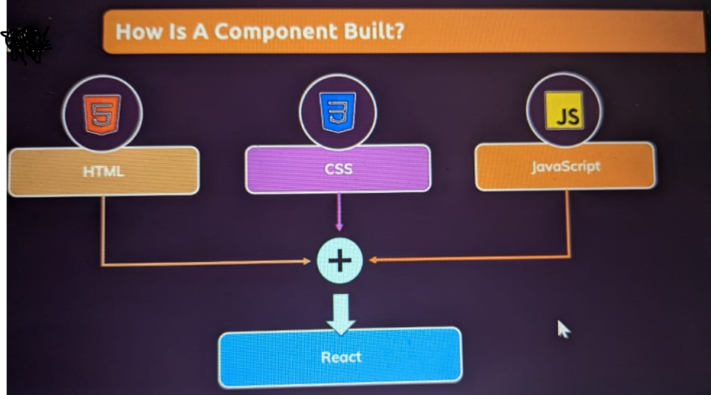

Slide 25
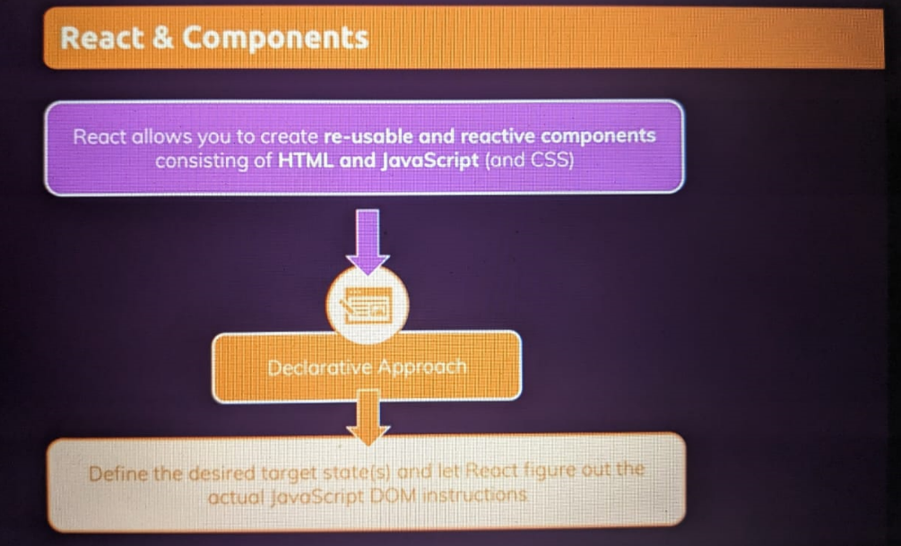

Slide 26
What is a Component?
Build your own, custom HTML elements.

Slide 27
What is a Component?
Components let you split the UI into independent, reusable pieces, and think about each piece in isolation.
Conceptually, components are like JavaScript functions.
They accept arbitrary inputs (called “props”) and return React elements describing what should appear on the screen.

Slide 28
Function and Class Components
The simplest way to define a component is to write a JavaScript function:
function Welcome(props) {
return (<h1>Hello, {props.name}</h1>);
}
Note: can omit round-bracket of return if it has only one statement
This function is a valid React component because it accepts a single “props” (which stands for properties) object argument with data and returns a React element.
We call such components “function components” because they are literally JavaScript functions.

Slide 29
Function and Class Components
You can also use an ES6 class to define a component:
import React from 'react’;
class Welcome extends React.Component {
render() {
return (<h1>Hello, {this.props.name}</h1>);
}
}
The (earlier and above) two components are equivalent from React’s point of view.

Slide 30
Component state
Any component can have it’s own internal state.
state is often called local or encapsulated.
It is not accessible to any component other than the one that owns and sets it.
props is immutable/readonly but state is mutable.
A component may choose to pass its state down as props to its child components

Slide 31
Stateful and Stateless Components
State generally refers to data or properties that need to be tracking in an application.
In React, a stateful component is a component that holds some state. Stateless components, by contrast, have no state.
Note that both types of components can use props.
In the example, there are two React components. The Store component is stateful and the Week component is stateless.
class Week extends React.Component {
render() {
return <h1>Today is {this.props.day}!</h1>;
}
}
class Store extends React.Component {
constructor(props) {
super(props);
this.state = { sell: 'anything' };
}
render() {
return <h1>I'm selling {this.state.sell}.</h1>;
}
}

Slide 32
Stateful and Stateless Components
The React useState Hook allows us to track state in a function component.
To use the useState Hook, we first need to import it into our component.
Initialize useState - We initialize our state by calling useState in our function component.
useState accepts an initial state and returns two values:
The current state.
A function that updates the state.
Update State - To update our state, we use our state updater function.
We should never directly update state. Ex: color = "red" is not allowed.
import { useState } from "react";
import ReactDOM from "react-dom/client";
function FavoriteColor() {
const [color, setColor] = useState("red");
return (
<>
<h1>My favorite color is {color}!</h1>
<button type="button"
onClick={ () => setColor("blue") }
>Blue</button>
</>
)
}
export default FavoriteColor;
Note: color, setColor - These names are variables that can be named anything you would like.

Slide 33
Stateful Components
The useState Hook can be used to keep track of strings, numbers, booleans, arrays, objects, and any combination of these!
We could create multiple state Hooks to track individual values Or, we can just use one state and include an object instead!

Slide 34
Stateful Component – UseState hook
const [brand, setBrand] = useState("Ford");
const [model, setModel] = useState("Mustang");
const [year, setYear] = useState("1964");
const [color, setColor] = useState("red");
return (
<>
<h1>My {brand}</h1>
<p>
It is a {color} {model} from {year}.
</p>
<button type="button"
onClick={()=> {
setColor("blue");
setYear("2000");
}
}
> change color and year</button>
</>
)
}
Notes:
https://www.w3schools.com/react/react_usestate.asp

Slide 35
Stateful Component – UseState hook
function Car(props) {
// const c = props.car;
const c = {
brand: "Ford",
model: "Mustang",
year: "1964",
color: "red"
}
const [car, setCar] = useState(c);
const updateColor = () => {
setCar(previousState => {
return { ...previousState, color: "blue" }
});
}
return (
<>
<h1>My {car.brand}</h1>
<p>
It is a {car.color} {car.model} from {car.year}.
</p>
<button
type="button"
onClick={updateColor}
>Blue</button>
</>
)
}
Notes:
https://www.w3schools.com/react/react_usestate.asp

Slide 36
What are stateless components in React?
React component with internal state is called Stateful component and React component without any internal state management is called Stateless component.
React recommends to create and use as many stateless component as possible and create stateful component only when it is absolutely necessary.

Slide 37
React Events
Just like HTML DOM events, React can perform actions based on user events.
React has the same events as HTML: click, change, mouseover etc.
Adding Events
React events are written in camelCase syntax:
onClick instead of onclick.
React event handlers are written inside curly braces:
onClick={shoot} instead of onClick="shoot()".
React:
<button onClick={shoot}>Take the Shot!</button>
HTML:
<button onclick="shoot()">Take the Shot!</button>

Slide 38
React Events
function Football() {
const shoot = () => {
alert("Great Shot!");
}
return (
<button onClick={shoot}>
Take the shot!
</button>
);
}
Passing Arguments
To pass an argument to an event handler, use an arrow function:-
function Football() {
const shoot = (a) => {
alert(a);
}
return (
<button onClick={ () => shoot("Goal!") }>
Take the shot!
</button>
);
}

Slide 39
React Events
React Event Object
Event handlers have access to the React event that triggered the function.
In our example the event is the "click" event.
function Football() {
const shoot = () => {
alert("Great Shot!");
}
return (
<button onClick={shoot}>
Take the shot!
</button>
);
}
Passing Arguments
To pass an argument to an event handler, use an arrow function:-
function Football() {
const shoot = (a) => {
alert(a);
}
return (
<button onClick={ () => shoot("Goal!") }>
Take the shot!
</button>
);
}

Slide 40
Conditional Rendering
Using if condition
Using && operator
function Garage(props)
{
const car = props.car;
return(
<>
<h3>Garage</h3>
{car.length>0 && <p>There are {car.length} cars in my garage!</p>}
</>
);
}
function Goal(props)
{
const isGoal = props.isGoal;
if( isGoal )
{ return <MadeGoal/>; }
return <MissedGoal/>;
}
Using Ternary (?:) operators
function Goal(props)
{
return(
<>
{ props.isGoal ? : <MadeGoal/> : <MissedGoal/> }
</>
) ;
}

Slide 41
React List
In React, you will render lists with some type of loop.
The JavaScript map() array method is generally the preferred method.
Keys
Keys allow React to keep track of elements. This way, if an item is updated or removed, only that item will be re-rendered instead of the entire list.
Keys need to be unique to each sibling. But they can be duplicated globally.
Generally, the key should be a unique ID assigned to each item. As a last resort, you can use the array index as a key.

Slide 42
Iterating through Lists
function Car1(props)
{
return(
<li> { props.brandname } </li>
);
}
function CarList1(props)
{
const carlist = [
{id:1,name:'Santro'},
{id:2,name:'Hondacity'},
{id:3,name:'Jazz'},
{id:4,name:'Ecosport'}
];
return(
<ul>
{
carlist.map( c =>
<Car1 key={c.id}
brandname={c.name}
/>)
}
</ul>
);
}
Note: CarList1 return has <ul> whereas Car1 has <li>
CarList1 component creates repeated Car1 components

Slide 43
Handling Forms
Handling forms is about how you handle the data when it changes value or gets submitted.
In HTML, form data is usually handled by the DOM.
In React, form data is usually handled by the components.
When the data is handled by the components, all the data is stored in the component state.
You can control changes by adding event handlers in the onChange attribute.
We can use the useState Hook to keep track of each inputs value and provide a "single source of truth" for the entire application.

Slide 44
Handling Forms
function MyForm(props)
{
const [name,setName] = useState("Namrata");
const handleSubmit = (event) => {
event.preventDefault();
alert(`The name entered is ${name}`);
}
return(
<form onSubmit={handleSubmit}>
<label>
Name :
<input type='text'
value={name}
onChange={e=>{ setName(e.target.value); }}
/>
</label>
<input type='submit' />
</form>
);
} //end of MyForm component

Slide 45
Multiple Input Fields
You can control the values of more than one input field by adding a name attribute to each element.
We will initialize our state with an empty object.
To access the fields in the event handler use the event.target.name and event.target.value syntax.
To update the state, use square brackets [bracket notation] around the property name.

Slide 46
Handling Forms
function MyForm1(props)
{
const [inputs,setInputs] = useState({});
const handleSubmit = (event) => {
event.preventDefault();
alert(inputs.username +','+inputs.age);
}
const handleChange = (event) =>
{
const namee = event.target.name;
const value = event.target.value;
setInputs((pv)=>{
return {
...pv,
[namee]:value };
});
}
return(
<form onSubmit={handleSubmit}>
<label> UserName :
<input type='text'
name='username’
value={inputs.username || ‘’}
onChange={handleChange}
/> </label>
<label> Age :
<input type='text'
name='age’
value={inputs.age || ''}
onChange={handleChange}
/> </label>
<input type='submit' />
</form>
);
Note: initially inputs object is empty. To update the state in setXXX(), use square brackets around the property name to add the property .

Slide 47
Handling Forms
useRef() hook can be used to access a DOM element directly.
useRef() only returns one item. It returns an Object called current.
When we initialize useRef we set the initial value: useRef(0).
function UseRefInForm(props) {
const inputEle = useRef();
const handleChange = (event) => {
//inputEle.current is reference to HtmlInputElement
console.log(inputEle.current.value);
alert(`entered text value is ${inputEle.current.value}`);
}
const handleSubmit = (event) => {
event.preventDefault();
alert(`The final input value you entered is: ${inputEle.current.value}`);
inputEle.current.focus();
}
return (
<form onSubmit={handleSubmit}>
<input type="Text" value={'Namrata'} ref={inputEle} onChange={handleChange}/>
<input type="submit" />
</form>
);
}

Slide 48
useRef hook
The useRef Hook allows you to persist values between renders.
It can be used to store a mutable value that does not cause a re-render when updated.

Slide 49
useRef vs useState
The 2 main differences between reference and state:
Updating a reference doesn't trigger re-rendering, while updating the state makes the component re-render;
The reference update is synchronous (the updated reference value is available right away), while the state update is asynchronous (the state variable is updated after re-rendering).
From a higher point of view, references store infrastructure data of side-effects, while the state stores information that is directly rendered on the screen.

Slide 50
useRef vs useState
import {useState} from "react";
function UseRef1(props) {
const [count, setCount] = useState(0);
const handle = () => {
const updatedCount = count + 1;
console.log(`Clicked ${updatedCount} times`);
setCount(updatedCount);
};
console.log('I rendered!');
return <button onClick={handle}>Click me</button>;
}
export default UseRef1;

Slide 51
Side-effects: useEffect() hook
. Side-effects :-
A functional React component uses props and/or state to calculate the output. If the component makes calculations that don't target the output value, then these calculations are named side-effects.
Examples of side-effects are fetch requests, manipulating DOM directly, using timer functions like setTimeout(), and more.
Component rendering and the side-effect logic are independent.
Performing side-effects directly in the body of the component is a mistake, because the body contains code to compute/change the component's output.
How often the component renders isn't something you can control — if React wants to render the component, you cannot stop it. But you don’t want side-effect code to run every-time component output changes or component gets rerendered.
How to decouple rendering from the side-effect? Welcome useEffect() — the hook that runs side-effects independently of rendering.

Slide 52
Side-effects: useEffect() hook
. Side-effects :-
The useEffect Hook allows you to perform side effects in your components.
Some examples of side effects are: fetching data, directly updating the DOM, and timers.
useEffect accepts two arguments. The second argument is optional.
useEffect(<function>, <dependency>)

Slide 53
Side-effects: useEffect() hook
useEffect() hook -
There are several ways to control when side effects run.
We should always include the second parameter which accepts an array. We can optionally pass dependencies to useEffect in this array.
Example
1. No dependency passed:
useEffect(() => {
//Runs on every render
});
Example
2. An empty array:
useEffect(() => {
//Runs only on the first render
}, []);
Example
3. Props or state values:
useEffect(() => {
//Runs on the first render
//And any time any dependency value changes
}, [prop.prop1, state.dep1]);

Slide 54
Side-effects: useEffect() hook
Effect Cleanup - Some effects require cleanup to reduce memory leaks.
Timeouts, subscriptions, event listeners, and other effects that are no longer needed should be disposed.
We do this by including a return function at the end of the useEffect Hook.
import { useState, useEffect } from "react";
import ReactDOM from "react-dom/client";
function Timer() {
const [count, setCount] = useState(0);
useEffect(() => {
let timer = setTimeout(() => {
setCount((count) => count + 1);
}, 1000);
return () => clearTimeout(timer) //cleanup
}, []);
return <h1>I've rendered {count} times!</h1>;
}

Slide 55
React Context
React Context is a way to manage state globally.
It can be used together with the useState Hook to share state between deeply nested components more easily than with useState alone.
The Problem:-
State should be held by the highest parent component in the stack that requires access to the state.
To illustrate, we have many nested components. The component at the top and bottom of the stack need access to the state.
To do this without Context, we will need to pass the state as "props" through each nested component. This is called "prop drilling".

Slide 56
Calling Rest API in React
There are multiple options available to choose from when it comes to making an API request in a React app:
Fetch/Axios – The easiest option is to use the Fetch API or use a library like Axios to make API requests. These are pretty bare-bones options without any advanced functionality like caching, deduping requests, etc.
SWR/React Query – For complex applications that require a more robust solution, it’s probably a better idea to go with a full-fledged data fetching library which offers a lot more functionalities out of the box.
Notes:
https://pusher.com/tutorials/consume-restful-api-react/#consuming-a-rest-api-in-react

Slide 57
Using Fetch and Axios
Fetch API is a web standard that is implemented in all major browsers to allow for making network requests in a standardized way.
Axios is a third-party library that is functionally very similar to Fetch. It offers a few improvements over Fetch such as better backward compatibility, data transforms, or the ability to intercept a request before or after it is made.
For the reasons listed above, I’ll be using Axios in this tutorial but save for some minor differences (e.g., Axios serializes the response into JSON automatically) in usage, you should be able to use Fetch in almost ~~exactly~~ the same way.
Install the Axios library. Fetch doesn’t need to be installed as it ships with every major browser save for Internet Explorer.
npm install axios

Slide 58
Async Await
What is the difference between async await and promises and callbacks?
Promise Vs Callback Vs Async/Await | by Mohit garg | Dev Genius
In summary, promises, callbacks, and async/await are all ways to handle asynchronous operations in JavaScript, with promises providing a more elegant way of handling async operations, callbacks being a more traditional way, and async/await providing a more convenient and readable way of handling async operations.
https://www.geeksforgeeks.org/difference-between-promise-and-async-await-in-node-js/

Slide 59
Async Await
Async/Await is used to work with promises in asynchronous functions. It is basically syntactic sugar for promises.
It is just a wrapper to restyle code and make promises easier to read and use.
It makes asynchronous code look more like synchronous/procedural code, which is easier to understand.
await can only be used in async functions. It is used for calling an async function and waits for it to resolve or reject.
await blocks the execution of the code within the async function in which it is located.
Error Handling in Async/Await: For a successfully resolved promise, we use try and for rejected promise, we use catch.
To run a code after the promise has been handled using try or catch, we can .finally() method. The code inside .finally() method runs once regardless of the state of the promise.

