Slide 1
What Is TDD?
Notes:
https://www.browserstack.com/guide/what-is-test-driven-development
https://www.guru99.com/test-driven-development.html
https://semaphoreci.com/blog/test-driven-development#:~:text=The%20invention%20of%20TDD%20is,actual%20code%20that%20needs%20testing.

Slide 2
What is Test Driven Development (TDD)?
Test Driven Development (TDD) is a software development practice that focuses on creating unit test cases before developing the actual code. It is an iterative approach that combines programming, the creation of unit tests, and refactoring.
The TDD approach derives its roots from the Agile manifesto principles and Extreme programming.
As the name suggests, the test process drives software development.
Moreover, it’s a structuring practice that enables developers and testers to obtain optimized code that proves to be resilient in the long term.
In TDD, developers start creating small test cases for every feature based on their initial understanding.
The primary intention of this technique is to modify or write new code only if the tests fail. This prevents duplication of test scripts.

Slide 3
What is Test Driven Development(TDD)?
Test-Driven Development (TDD) refers to the practice of writing a piece of code only if the automated test has failed.
The approach states that one should write “implementation code” only if there is a “failing test case”. It is an iterative approach for developing software products where –
A failing test case is written
Enough business code is created which makes the failing test case pass
Then, if needed, the entire code is refactored.
Finally, the entire process is repeated, creating more tests over a period of time.
Notes:
https://agilemania.com/benefits-of-tdd-test-driven-development/

Slide 4
History of TDD
TDD is one of the technical practices of eXtreme Programming. The invention of TDD is usually attributed to Kent Beck; one of the first “extreme programmers”.
This practice shook the common sentiment of programmers at the time.
The practice of testing was already widespread, but no one before had ever suggested writing tests before writing the actual code that needs testing.
This act is itself counterintuitive if one thinks of TDD as a testing practice.
As the author has repeatedly pointed out (and with him many other distinguished programmers), TDD was not born as a testing practice but as a software design practice.

Slide 5
History of TDD
TDD is one of the technical practices of eXtreme Programming. The invention of TDD is usually attributed to Kent Beck; one of the first “extreme programmers”.
This practice shook the common sentiment of programmers at the time.
The practice of testing was already widespread, but no one before had ever suggested writing tests before writing the actual code that needs testing.
This act is itself counterintuitive if one thinks of TDD as a testing practice.
As the author has repeatedly pointed out (and with him many other distinguished programmers), TDD was not born as a testing practice but as a software design practice.

Slide 6
History of TDD
The mantra of the early extreme programmers was to take things that worked well and “exert them to the extreme”.
In the same way, TDD was born: “If I test the code I write, I get better quality code: what would happen if I took the process to the extreme: writing tests before the code itself?”
Kent Beck answered this by developing TDD, and starting a small revolution within the eXtreme Programming revolution.

Slide 7
Three phases of Test Driven Development
Create precise tests: Developers need to create precise unit tests to verify the functionality of specific features. They must ensure that the test compiles so that it can execute. In most cases, the test is bound to fail. This is a meaningful failure as developers are creating compact tests based on their assumptions of how the feature will behave.
Correcting the Code: Once a test fails, developers need to make the minimal changes required to correct the code so that it can run successfully when re-executed.
Refactor the Code: Once the test runs successfully, check for redundancy or any possible code optimizations to enhance overall performance. Ensure that refactoring does not affect the external behavior of the program.

Slide 8
TDD as a design practice
TDD thus began as a practice related to testing, but it soon turned out that the resulting tests were just a nice side-effect. The point of writing tests before code had much more to do with the design of the code itself than its testing.
Writing the test before the code helps the programmer put himself in the shoes of the user, making it easier to create clear software APIs.
Using TDD helps make you more comfortable with circumscribing the scope of your code, writing shorter but more focused code, and producing easily-composable modules.

Slide 9
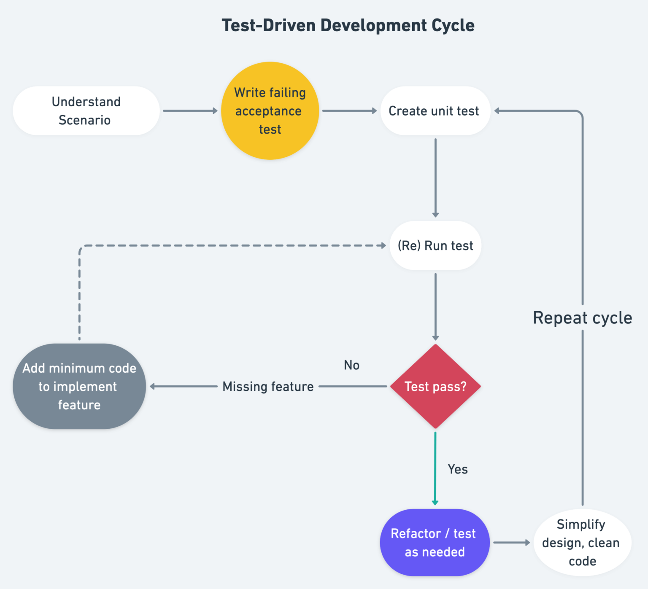
TDD Cycle
Test-Driven development is a process of developing and running automated test before actual development of the application. Hence, TDD sometimes also called as Test First Development.

Slide 10
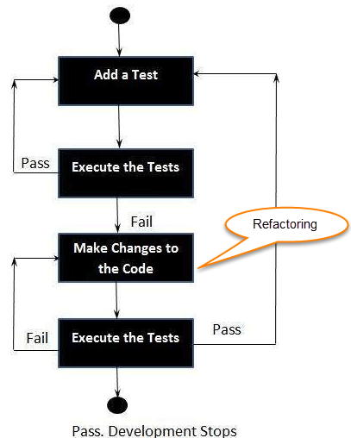
How to perform TDD Test
Following steps define how to perform TDD test,
Add a test.
Run all tests and see if any new test fails.
Write some code.
Run tests and Refactor code.
Repeat.

Slide 11
TDD Lifecycle
Test-driven development (TDD) is a software development process that interweaves coding, testing, and design.
It is a test-first approach that aims to improve the quality of your applications.
Test-driven development is defined by the following lifecycle:
TDD cycle defines
Write a test
Make it run.
Change the code to make it right i.e. Refactor.
Repeat process.

Slide 12
Why practice TDD ? Benefits of Test Driven Development (TDD)
Fosters the creation of optimized code.
Helps developers better analyze and understand client requirements and request clarity when they are not adequately defined.
The addition and testing of new functionalities become much easier in the latter stages of development.
Test coverage under TDD is much higher compared to the conventional development models. This is because the TDD focuses on creating tests for each functionality right from the beginning.
Enhances the productivity of the developer and leads to the development of a codebase that is flexible and easy to maintain.

Slide 13
TDD Characteristics
TDD stands for Test-driven development.
Test-driven development is a process of modifying the code in order to pass a test designed previously.
It more emphasis on production code rather than test case design.
In Software Engineering, It is sometimes known as “Test First Development.”
TDD testing includes refactoring a code i.e. changing/adding some amount of code to the existing code without affecting the behavior of the code.
TDD programming when used, the code becomes clearer and simple to understand.
TDD gives 100% code coverage

Slide 14
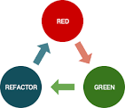
Red-Green Refactor Cycle
Red-green-refactor is a cycle of steps in Test-Driven Development (TDD) that helps developers write better code. The cycle involves writing a failing test, implementing code to pass the test, and then improving the code.

Slide 15
Mocking and testing doubles
Test doubles are objects that replace real objects during testing. They are used to isolate components and test them separately from their dependencies.
Here are some types of test doubles:
Stubs
Provide predetermined answers to method calls. Stubs are useful for preparing a system's state for testing or interacting with external APIs.
Mocks
Verify if a specific method was called. Mocks are useful for testing the behavior of code.
https://medium.com/@matiasglessi/mock-stub-spy-and-other-test-doubles-a1869265ac47

Slide 16
JUnit

Slide 17

JUnit
It is another open-source unit testing framework, which was written in Java programing language.
It is mainly used in the development of the TDD - test-driven environment.
Junit offers the annotation, which helps us to find the test method.
This tool helps us to enhance the efficiency of the developer, which provides the consistency of the development code and reduces the time of the debugging.

Slide 18
Feature of JUnit
It offers the assertions for testing expected results.
In this tool, we can quickly develop a code that enhances the quality of the code.
This tool can be structured in the test suites, which have the test cases.
To run the test, it gives the test runners.
It will take less time to run the test cases.
For more details about the Junit, refers to the below link:

Slide 19

Mockito
It is a mocking framework that is used in the unit testing, and it was written in the Java programing language. Mockito is also an open-source tool introduced by the MIT (Massachusetts Institute of Technology) License.
With the help of Mockito, we can develop the testable application.
The primary objective of using this tool is to simplify the development of a test by mocking external dependencies and use them in the test code.
It can be used with other testing frameworks such as TestNG and Junit.

Slide 20
Mockito Features
Feature of Mockito
It will be used to support exceptions.
With the help of the annotation feature, we can produce the mocks.
We do not need to write the mocks object on our own.
It will support return values.
It provides multiple methods like verify(), mock(), when(), etc., which are helpful to test Java applications.

Slide 21
Overview
JUnit is one of the most popular unit-testing frameworks in the Java ecosystem.
The JUnit 5 version contains a number of exciting innovations, with the goal of supporting new features in Java 8 and above, as well as enabling many different styles of testing.

Slide 22
Maven Dependencies
Setting up JUnit 5.x.0 is pretty straightforward; we just need to add the following dependency to our pom.xml:
<dependency>
<groupId>org.junit.jupiter</groupId>
<artifactId>junit-jupiter-engine</artifactId>
<version>5.8.1</version>
<scope>test</scope>
</dependency>
Furthermore, there's now direct support to run Unit tests on the JUnit Platform in Eclipse, as well as IntelliJ. We can, of course, also run tests using the Maven Test goal.
On the other hand, IntelliJ supports JUnit 5 by default. Therefore, running JUnit 5 on IntelliJ is pretty easy. We simply Right click –> Run, or Ctrl-Shift-F10.
It's important to note that this version requires Java 8 to work.

Slide 23
Architecture
With JUnit 4 a lot of stuff that was originally added as an internal construct only got used by external extension writers and tool builders. That made changing JUnit 4 especially difficult and sometimes impossible.
The JUnit Lambda (now called JUnit 5) team decided to redesign JUnit into two clear and separate areas of concern:
An API for writing tests.
An API for discovering and running those tests.
These areas of concern are now baked into the architecture of JUnit 5, and they're clearly separated from each other.
Notes:
https://developer.ibm.com/tutorials/j-introducing-junit5-part1-jupiter-api/

Slide 24
Architecture
JUnit 5 = JUnit Platform + JUnit Jupiter + JUnit Vintage
Notes:
https://junit.org/junit5/docs/current/user-guide/

Slide 25
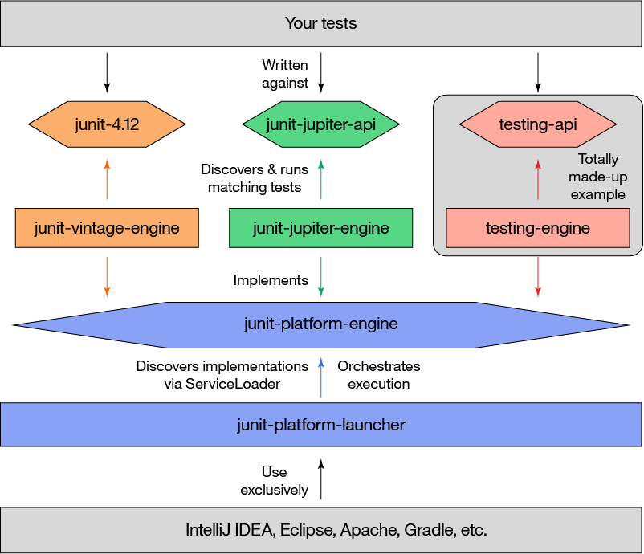
Architecture Of JUnit5
If you look closely, it starts to sink in just how supremely cool JUnit 5's architecture is. Go ahead, really stare at it. What the boxes in the top-right corner show is that the JUnit Jupiter API is just another API as far as JUnit 5 is concerned! Because JUnit Jupiter's components follow the new architecture, they work with JUnit 5, but you could just as easily define a different testing framework. As long as a framework implements the TestEngine interface, you can plug it into any tool supporting the junit-platform-engine and junit-platform-launcher APIs!

Slide 26
Writing tests with JUnit Jupiter
For our purpose as test writers, any JUnit-compliant testing framework (including JUnit Jupiter) consists of two components:
The API against which we write tests.
The JUnit TestEngine implementation that understands that particular API.
For this tutorial, the former is the JUnit Jupiter API, while the latter is the JUnit Jupiter Test Engine. I'll introduce them both.
https://developer.ibm.com/tutorials/j-introducing-junit5-part1-jupiter-api/

Slide 27
The JUnit Jupiter API
As a developer, you'll use the JUnit Jupiter API to create unit tests that exercise your application code.
Using the API's basic features—annotations, assertions, and so forth—is the main focus of this part of the tutorial.
The JUnit Jupiter API is designed so that you can extend its functionality by plugging into various lifecycle callbacks.
You'll learn how to use these callbacks to do cool things like run parameterized tests, pass arguments to test methods, and lots more.

Slide 28
The JUnit Jupiter Test Engine
You'll use the JUnit Jupiter Test Engine to discover and execute your JUnit Jupiter unit tests.
The test engine implements the TestEngine interface, which is part of the JUnit Platform.
You can think of the TestEngine as the bridge between your unit tests and the tools you use to launch them (like your IDE).

Slide 29
Running tests with JUnit Platform
In JUnit terminology the process of running unit tests is divided into two parts:
Discovery of tests and the creation of a test plan.
Launching the test plan in order to (1) execute tests and (2) report results to the user.
Notes:
API for discovering tests
The API for discovering tests and creating the test plan is part of the JUnit Platform, and is implemented by a TestEngine. The testing framework encapsulates the discovery of tests into its implementation of a TestEngine. The JUnit Platform is responsible for initiating the test discovery process, using IDEs and build tools like Gradle and Maven.
API for executing tests
The API for executing tests is part of the JUnit Platform, and is implemented by one or more TestEngines. Testing frameworks encapsulate the execution of tests into their implementation of TestEngine, but the JUnit Platform is responsible for initiating the test execution process. Test execution is initiated through IDEs and build tools like Gradle and Maven.
A JUnit Platform component called the Launcher is responsible for executing the test plan created during test discovery. Some process—let's say your IDE—initiates test execution through the JUnit Platform (specifically, the junit-platform-launcher API). At that time, the JUnit Platform hands the Launcher the test plan, along with a TestExecutionListener. The TestExecutionListener will report test execution results for display in your IDE.
The goal of the test execution process is to report to the user exactly what happened when the tests ran. This includes reporting test successes and failures, and messages accompanying the failures to help the user understand what happened.

Slide 30
Backward compatibility: JUnit Vintage
Many organizations have a significant investment in JUnit 3 and 4, and thus cannot afford to convert wholesale to JUnit 5. Knowing this, the JUnit 5 team have provided the junit-vintage-engine and junit-jupiter-migration-support components to assist with migration.
As far as JUnit Platform is concerned, JUnit Vintage is just another test framework, complete with its own TestEngine and API (specifically, the JUnit 4 API).

Slide 31
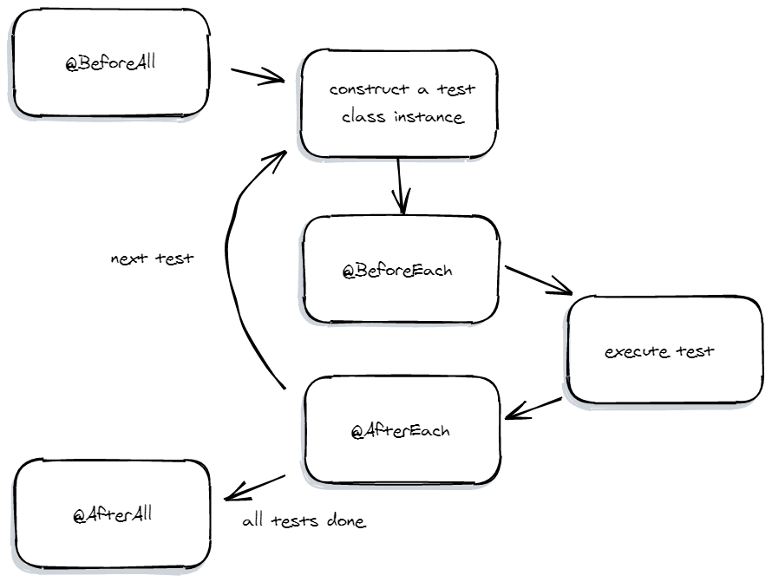
Lifecycle Methods

Slide 32
Assertions
An assertion is one of a number of static methods on the org.junit.jupiter.api.Assertions class. Assertions are used to test a condition that must evaluate to true in order for the test to continue executing.
If an assertion fails, the test is halted at the line of code where the assertion is located, and the assertion failure is reported. If the assertion succeeds, the test continues to the next line of code.
All of the JUnit Jupiter assertion methods listed in Table 2 take an optional message parameter (as the last parameter) that displays if the assertion fails, rather than the standard default message.

Slide 33
Assertions
The org.junit.jupiter.api.Assertions class provides a set of static methods for comparing actual and expected results.
The Assertions class has the following methods, which cover most of the primitive data types:
assertArrayEquals compares the contents of an actual array to an expected array.
assertEquals compares an actual value to an expected value.
assertNotEquals compares two values to validate that they are not equal.
assertTrue validates that the provided value is true.
assertFalse validates that the provided value is false.
assertLinesMatch compares two lists of Strings.
assertNull validates that the provided value is null.
assertNotNull validates that the provided value is not null.
assertSame validates that two values reference the same object.
assertNotSame validates that two values do not reference the same object.
assertThrows validates that the execution of a method throws an expected exception (you can see this in the testConvertToDecimalInvalidDenominator example above).
assertTimeout validates that a supplied function completes within a specified timeout.
assertTimeoutPreemptively validates that a supplied function completes within a specified timeout, but once the timeout is reached it kills the function's execution.
If any of these assertion methods fail, the unit test is marked as failed. That failure notice will be written to the screen when you run the test, then saved in a report file.

Slide 34
Method @assertThrows()
Under certain conditions, the class under test is expected to throw an exception.
JUnit 4 provided this capability through the expected = method parameter, or through a @Rule.
In contrast, JUnit Jupiter provides this capability through the Assertions class, making it more consistent with other assertions.
An expected exception is considered to be just another condition that can be asserted, and thus Assertions contains methods to handle this.

Slide 35
Method @assertThrows()

Slide 36
Nested Hierarchy
Feature called Nested class that is supported only by JUnit 5. This is not available in JUnit 4.
Notes:
https://www.softwaretestinghelp.com/junit-5-nested-class/
https://howtoprogram.xyz/2016/10/28/junit-5-parameter-resolution-example/

Slide 37
Assumptions
Assumptions are similar to assertions, except that assumptions must hold true or the test will be aborted.
In contrast, when an assertion fails, the test is considered to have failed.
Assumptions are useful when a test method should only be executed under certain conditions—the assumption.
An assumption is a static method of the org.junit.jupiter.api.Assumptions class. To appreciate the value of assumptions, all you need is a simple example.
Suppose you want to run a particular unit test only on Friday (I assume you have your reasons):

Slide 38
Assumptions
Suppose you want to run a particular unit test only on Friday (I assume you have your reasons):
@Test
@DisplayName("This test is only run on Fridays")
public void testAdd_OnlyOnFriday() {
LocalDateTime ldt = LocalDateTime.now();
assumeTrue(ldt.getDayOfWeek().getValue() == 5);
// Remainder of test (only executed if assumption holds)...
}

Slide 39
Assumptions
Suppose you want to run a particular unit test only on Friday (I assume you have your reasons):
@Test
@DisplayName("This test is only run on Fridays")
public void testAdd_OnlyOnFriday() {
LocalDateTime ldt = LocalDateTime.now();
assumeTrue(ldt.getDayOfWeek().getValue() == 5);
// Remainder of test (only executed if assumption holds)...
}

Slide 40
Assumptions
Note Line 5: If the condition doesn't hold, then the test is skipped.
In this case, the day of the week when the test runs is not Friday (5).
This doesn't affect the "green" of the project, and won't cause the build to fail; all of the code in test method after assumeTrue() is simply skipped.
In cases where only a portion of the test method should execute if an assumption holds, you could write the above condition with the assumingThat() method, which uses lambda syntax:

Slide 41
Using assertions vs assumptions
The difference can be subtle, so use this rule of thumb: Use assertions to check the results of a test method.
Use assumptions to determine whether to run the test method at all.
An aborted test is not reported as a failure, meaning that failure won't break the build.

Slide 42
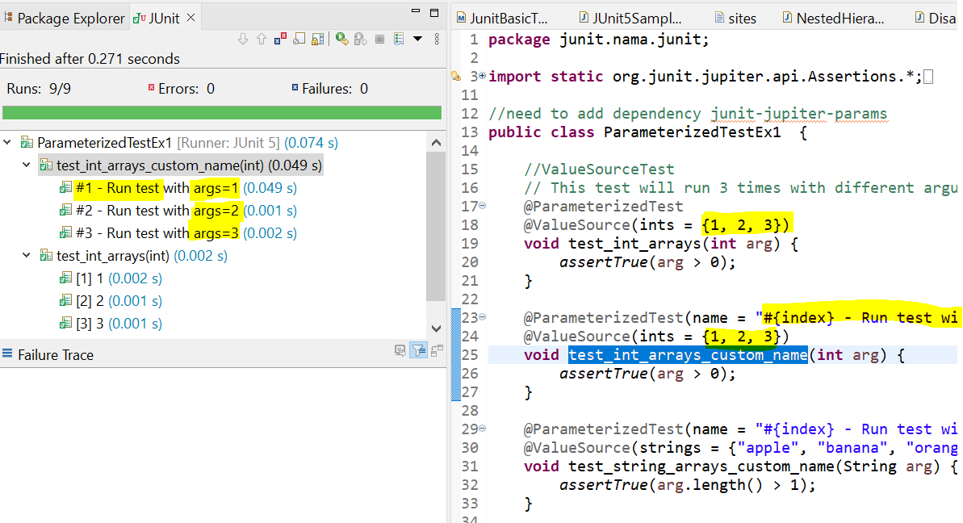
Parameterized Test
Parameterized Test allows to run a test multiple times with different arguments:-
@ValueSource - For a single argument test.
@ParameterizedTest
@ValueSource(ints = {1, 2, 3})
void test_int_arrays(int arg) {
assertTrue(arg > 0);
}
we can't pass null through a @ValueSource, even for String and Class.

Slide 43
Parameterized Test
We can pass empty or null values into the test via @EmptySource, @NullSource or @NullAndEmptySource (since JUnit 5.4)
@ParameterizedTest(name = "#{index} - isEmpty()? {0}")
@EmptySource
@NullSource
//@NullAndEmptySource
@ValueSource(strings = {""})
void test_is_empty_true(String arg) {
assertTrue(isEmpty(arg));
}

Slide 44
Parameterized Test
@MethodSource - Run tests that take a static method to generate arguments.
Custom Argument Provider
@ParameterizedTest(name = "#{index} - Test with Int : {0}")
@MethodSource("rangeProvider")
void test_method_int(int arg) {
assertTrue(arg < 10);
}
// this need static
static IntStream rangeProvider() {
return IntStream.range(0, 10);
}
Notes:
https://mkyong.com/junit5/junit-5-parameterized-tests/
https://www.petrikainulainen.net/programming/testing/junit-5-tutorial-writing-parameterized-tests/

Slide 45
Nested Test Class
Why Do We Use The Nested Class?
The Nested class is used by the developers for the following benefits:
To make a large and complex test class more readable.
The result looks even better than the one with the usual single class.
Check out here
Notes:
https://www.softwaretestinghelp.com/junit-5-nested-class/

Slide 46
Repeated Test
@RepeatedTest annotation introduced in JUnit 5 provides us a powerful way to write any test that we want to repeat several times.
Check out here
The term ‘repeated test’ means to repeat the execution of specific tests or tests for a certain number of times. The same purpose can be achieved in parameterization too.
However, the only difference between the parameterized test and the repeated test is that the parameterized tests work with data variations while the repeated tests work with the same data.
Compared to the feature of parameterization, the repeated test is a feature that is rarely used.
Notes:
https://www.softwaretestinghelp.com/junit-5-repeat-tests/

Slide 47
Dynamic Tests
It allows users to generate tests dynamically, at runtime.
Useful for implementing some interesting data-driven test scenarios.
A dynamic test method should be annotated with @TestFactory instead of @Test
A dynamic test is not a test but a test generator.
As test generator it needs to return Stream, Collection, Iterable, or Iterator of a DynamicNode implementation.

Slide 48
Dynamic Test
// This method produces Dynamic test cases
@TestFactory
Collection<DynamicTest> dynamicTestsFromCollection() {
return Arrays.asList(
dynamicTest("1st dynamic test", () -> assertTrue(MathUtil.isPrime(13))),
dynamicTest("2nd dynamic test", () -> assertEquals(5, MathUtil.devide(25, 5)))
);
}

Slide 49
Dynamic Test
The standard tests annotated with @Test annotation are static tests which are fully specified at the compile time.
A DynamicTest is a test generated during runtime. These tests are generated by a factory method annotated with the @TestFactory annotation.
A @TestFactory method must return a Stream, Collection, Iterable, or Iterator of DynamicTest instances.Returning anything else will result in a JUnitException since the invalid return types cannot be detected at compile time.
Each of the DynamicTest consists of two parts, the name of the test or the display name, and an Executable.
A @TestFactory method cannot be static or private.
The DynamicTests are executed differently than the standard @Tests and do not support lifecycle callbacks. Meaning, the @BeforeEach and the @AfterEach methods will not be called for the DynamicTests.

Slide 50
Dynamic Test
@TestFactory
Stream<DynamicTest> dynamicTestsForEmployeeWorkflows() {
List<Employee> inputList = Arrays.asList(
new Employee(1, "Fred"), new Employee(2), new Employee(3, "John"));
EmployeeDao dao = new EmployeeDao();
Stream<DynamicTest> saveEmployeeStream = inputList.stream()
.map(emp -> DynamicTest.dynamicTest(
"saveEmployee: " + emp.toString(),
() -> {
Employee returned = dao.save(emp.getId());
assertEquals(returned.getId(), emp.getId());
}
));
Stream<DynamicTest> saveEmployeeWithFirstNameStream
= inputList.stream()
.filter(emp -> !emp.getFirstName().isEmpty())
.map(emp -> DynamicTest.dynamicTest(
"saveEmployeeWithName" + emp.toString(),
() -> {
Employee returned = dao.save(emp.getId(), emp.getFirstName());
assertEquals(returned.getId(), emp.getId());
assertEquals(returned.getFirstName(), emp.getFirstName());
}));
return Stream.concat(saveEmployeeStream,
saveEmployeeWithFirstNameStream);
}

Slide 51
Test Interface & Default methods
JUnit Jupiter allows @Test, @RepeatedTest, @ParameterizedTest, @TestFactory, @TestTemplate, @BeforeEach, and @AfterEach to be declared on interface default methods.
@BeforeAll and @AfterAll can either be declared on static methods in a test interface or on interface default methods if the test interface or test class is annotated with @TestInstance(Lifecycle.PER_CLASS)
@ExtendWith and @Tag can be declared on a test interface so that classes that implement the interface automatically inherit its tags and extensions.
Finally, In your test class, you can implement these test interfaces to have them applied.

Slide 52
Mockito
It is a mocking framework that is used in the unit testing, and it was written in the Java programing language. Mockito is also an open-source tool introduced by the MIT (Massachusetts Institute of Technology) License.
With the help of Mockito, we can develop the testable application.
The primary objective of using this tool is to simplify the development of a test by mocking external dependencies and use them in the test code.
It can be used with other testing frameworks such as TestNG and Junit.
Notes:
https://www.lambdatest.com/blog/junit5-mockito-tutorial/
https://www.baeldung.com/mockito-junit-5-extension
https://www.baeldung.com/tag/mockito/

Slide 53
Mockito Features
Feature of Mockito
It will be used to support exceptions.
With the help of the annotation feature, we can produce the mocks.
We do not need to write the mocks object on our own.
It will support return values.
It provides multiple methods like verify(), mock(), when(), etc., which are helpful to test Java applications.

Slide 54
Mockito We will now learn - how to integrate Mockito with the JUnit 5 extension model.
Notes:
https://www.lambdatest.com/blog/junit5-mockito-tutorial/

Slide 55
Mockito – JUnit5 extensions
Mockito provides an implementation for JUnit5 extensions in the library – mockito-junit-jupiter.
We'll include this dependency in our pom.xml:
<dependency>
<groupId>org.mockito</groupId>
<artifactId>mockito-junit-jupiter</artifactId>
<version>4.6.1</version>
<scope>test</scope>
</dependency>

Slide 56
Mockito
what are the difference between spy and mock in Mockito API?
Both can be used to mock methods or fields.
The difference is that in mock, you are creating a complete mock or fake object
In spy, there is the real object and you just spying or stubbing specific methods of it.
When using mock objects, the default behavior of the method when not stub is do nothing. Simple means, if its a void method, then it will do nothing when you call the method or if its a method with a return then it may return null, empty or the default value.
While in spy objects, of course, since it is a real method, when you are not stubbing the method, then it will call the real method behavior.
If you want to change and mock the method, then you need to stub it.

Slide 57
@Mock mock objects for any class attribute or method parameter annotated with @Mock.

Slide 58
@Spy Spy objects for any class attribute or method parameter annotated with @Spy.

Slide 59
When should you use mock or spy?
If you want to be safe and avoid calling external services and just want to test the logic inside of the unit, then use mock.
If you want to call external service and perform calling of real dependency, or simply say, you want to run the program as it is and just stub specific methods, then use spy.
So that’s the difference between spy and mock in mockito.

Slide 60
@Captor Using @Captor annotation to capture Method arguments.

Slide 61
Mockito - @Captor annotation
Captor annotation is used to create an ArgumentCaptor instance to capture method argument values for further assertions.
Next slide shows a simple implementation of @Captor annotation that captures MyMap’s key and values:

Slide 62
Mockito - @Captor annotation
@Mock
HashMap<String, Integer> MyMap;
@Captor
ArgumentCaptor<String> keyCaptor;
@Captor
ArgumentCaptor<Integer> valueCaptor;
@Test
public void ArgumentCaptorTest()
{
hashMap.put("A", 10);
Mockito.verify(MyMap).put(keyCaptor.capture(), valueCaptor.capture());
assertEquals("A", keyCaptor.getValue());
assertEquals(new Integer(10), valueCaptor.getValue());
}

Slide 63
@InjectMock Injecting mock inside

Slide 64
Learn How to inject mock into a Spy.

Slide 65
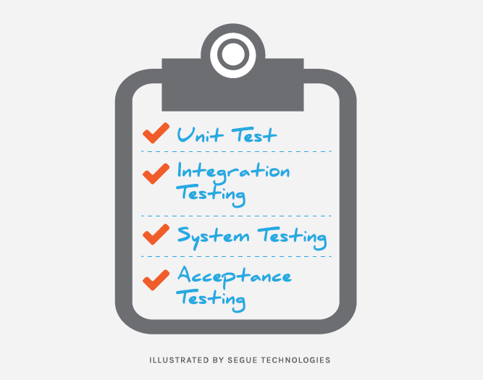
Types Of Testing
Notes:
https://www.seguetech.com/the-four-levels-of-software-testing/

Slide 66
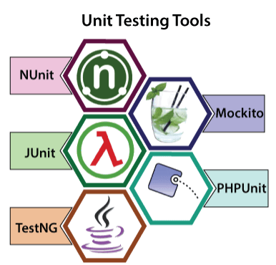
Testing Frameworks & Tools

Slide 67
Testing Frameworks & Tools
Selenium is an open-source automation testing framework.
Selenium is widely used for web application testing.
It is mainly built on Java and extensively used for automation of web application.
Basically, selenium is used for functional and regression testing.

