Slide 1



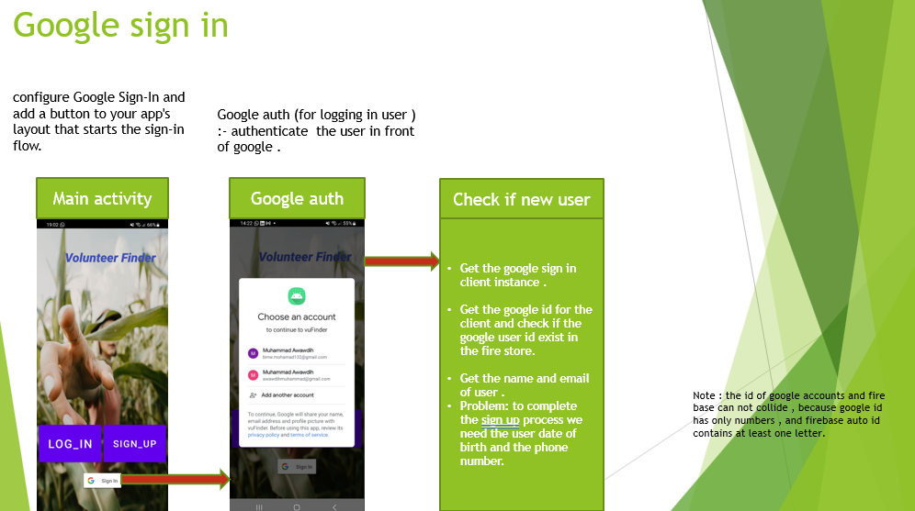
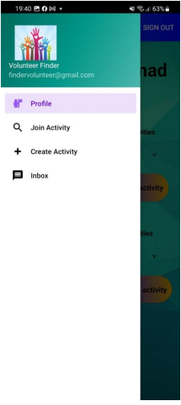
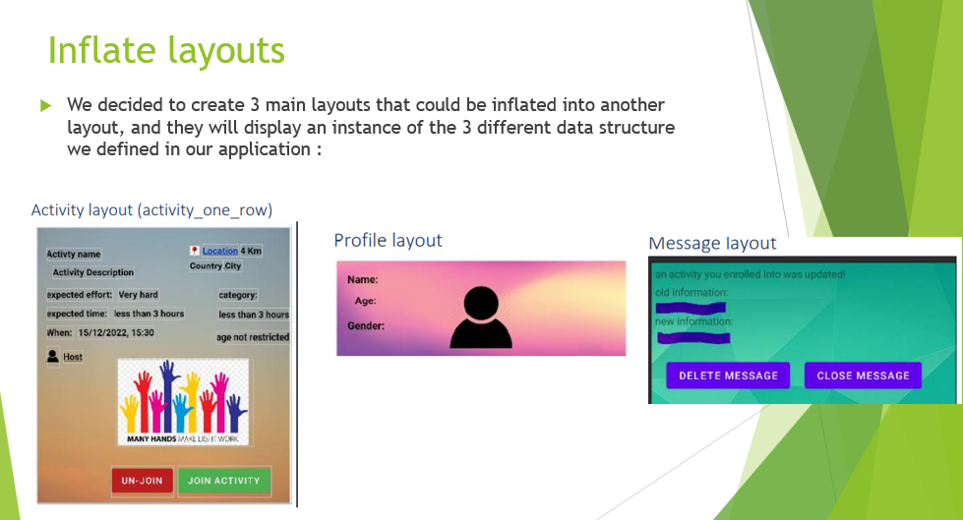
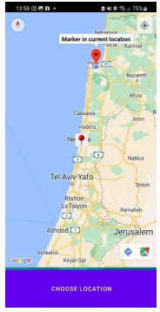
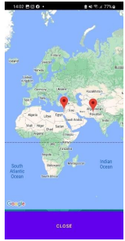
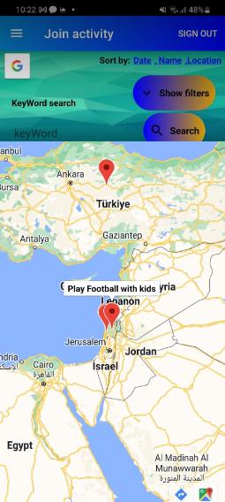
Volunteer finder
Muhammad Awawdih, Feras Kanaan Supervised by: Viktor Kulikov
Motivation
App diagram
Timeserving (use your free time with something).
Help people and do good to the community .
Make it easy to find a specific volunteering activity .
Make it easier to find volunteers for your activity .
Encourage people to volunteer in their time.
User menu activity
User menu is the primary activity in our application(after the user is signed in) it manages all the fragments(sub activities) .
The menu contains an app bar and navigation menu
The app bar menu has the sign out button .
The navigation menu is the host for 4 fragments shown in the left picture and is responsible for managing them.
Why use fragments?
When Using fragments in the project, the project structure will be good, and we can handle it easily.
Lifecycle methods in fragments are hosted by hosting activity not OS .
Google maps
Google map displays your current location, navigate location direction, search location etc. We can also customize Google map according to our requirement.
In our app we customized 3 different google maps instances :
Insert location
Show location in map
Map view

