Slide 1
Protection against SQL injection attacks
2.progress report
Filip Brutovský

Slide 2
Progress
1. App development
2. Manual testing
3. Automated testing
4. Results of the testing
5. Securing the application
6. Repeated testing
7. Conclusion and results
We are here
1
2
3
4
5
6
7

Slide 3
Testing Tools
Burp suite
Request Analysis: Examine exact HTTP parameters sent to server
Response Analysis: Observe error messages and data leakage
Sqlmap
Run sqlmap with specific parameters
<python sqlmap.py -r login.req --level=5 --risk=3 –batch>
<python sqlmap.py -r login.req --dump –batch>
<python sqlmap.py -r login.req --level=5 --risk=3
--schema –batch>

Slide 4
Vulnerable application
Vulnerable Components
Login Form: Direct string interpolation
Search Function: Unparameterized queries
Dashboard: Wide joined queries
Key vulnerability:
SQL queries constructed using string concatenation with user input

Slide 5
Vulnerable application
Time-Based
(valid_username)' AND pg_sleep(10) IS NULL --
Result: System delayed 10 seconds - confirmed valid username
Error-Based
(valid_username)' AND 0/1 = 1--
Result: Database error exposed - confirmed valid username
Manual attack results
Login Bypass
' OR 1=1; --
Result: Successfully bypassed authentication
Union-Based Extraction
' UNION ALL SELECT id, password_hash, email FROM users;--
Result: Extracted password hashes and emails

Slide 6
Vulnerable application
Database Dump
python sqlmap.py -r login.req --dump --batch
Result: Complete database extraction successful
Automated
attack results
Schema Enumeration
python sqlmap.py -r login.req --schema --batch
Result: Full schema structure revealed
Vulnerability Detection
python sqlmap.py -r login.req --level=5 --risk=3 --batch
Detected vulnerabilities:
✓ Boolean-based blind SQLi
✓ Stacked queries
✓ Time-based blind SQLi
✓ UNION-based SQLi

Slide 7
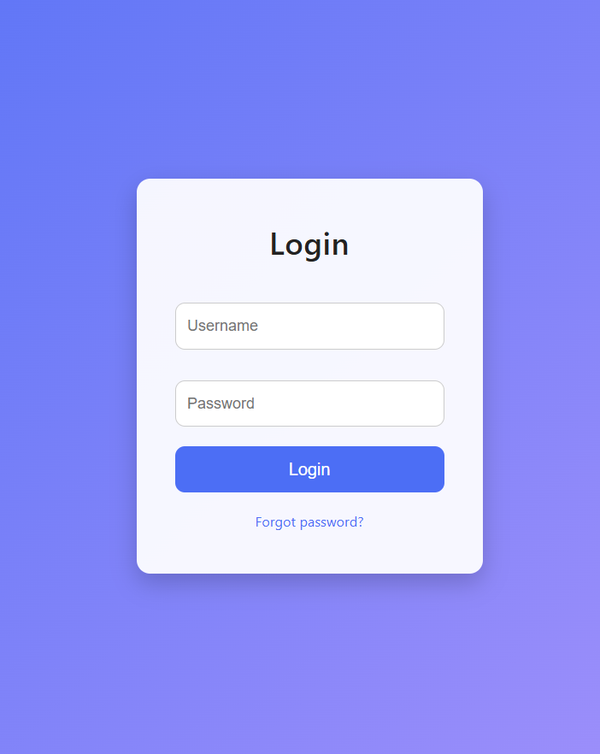
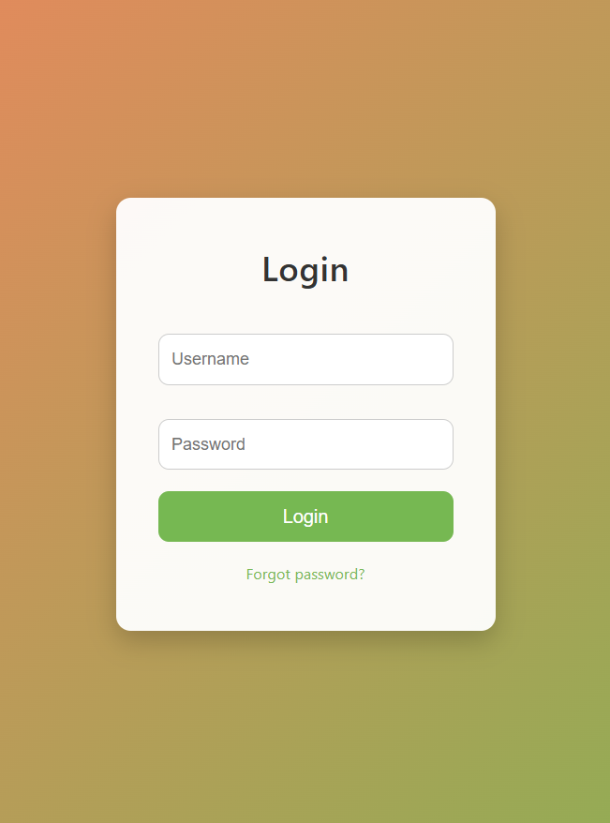

Slide 8
Secure application
Parameterized queries
Input validation
Least privilege
Correct error handling
Mitigation strategies used

Slide 9
Secure application
' OR 1=1; -- → "Invalid username or password"
' UNION ALL SELECT... → "Invalid query"
' AND pg_sleep(10) IS NULL→ "Invalid username or password"
' AND 0/1=1-- → "Invalid username or password"
Manul attack results
Test Duration: ~30 minutes
[CRITICAL] all tested parameters do not appear to be injectable
Vulnerability detection: Failed
Database dump: Failed
Schema enumeration: Failed
Automated attack results

Slide 10
Finishing project
Nginx + ModSecurity (reverse proxy)
More experiments

Slide 11

The End
Thx for your attention!
Link for GH: AweFilko/PIB_SQL_injection: Project about prevention from SQL injection with experiment

