Slide 1
Protection against SQL injection attacks
1.progress report
Filip Brutovský

Slide 2

Introduction
SQL injection (SQLi)
  In-band
  Inferential
  Out-of-band
Security vulnerability in web applications
Allows attackers to manipulate database queries
Can lead to data theft, authentication bypass, and system compromise

Slide 3
Types of SQLi
In-band
  Error-based
  Union-based
Inferential
  Boolean-based
  Time-based

Slide 4
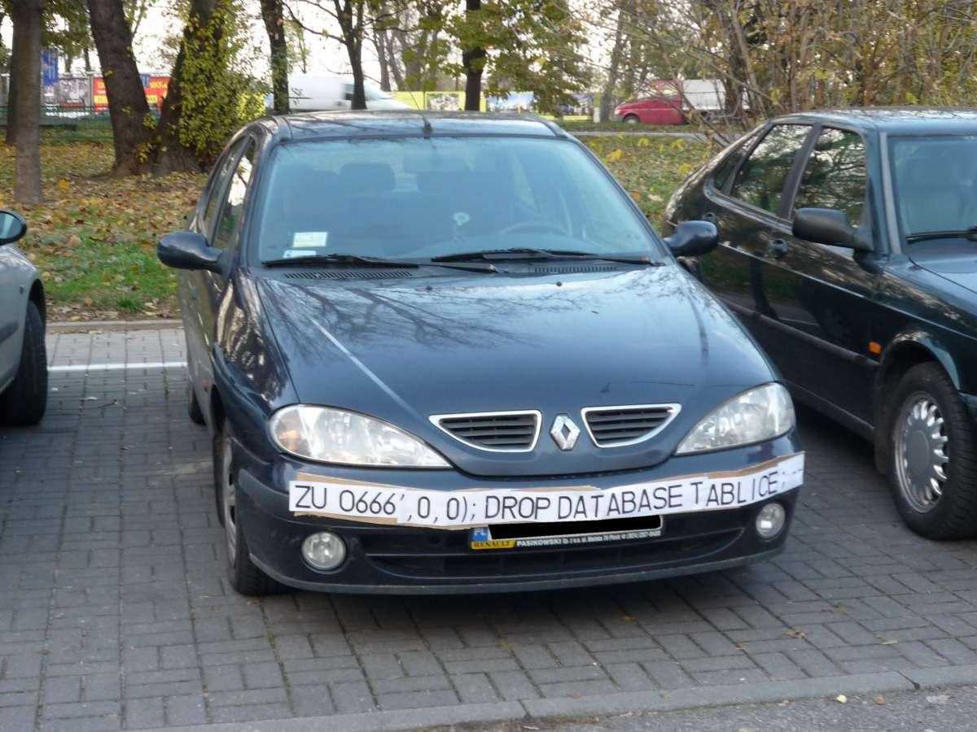

Slide 5
Project overview
Build vulnerable web application
Perform manual and automated attacks
Implement security measures
Verify effectiveness of mitigations

Slide 6
Progress
1. App development
2. Manual testing
3. Automated testing
4. Results of the testing
5. Securing the application
6. Repeated testing
7. Conclusion and results
We are here
1
2
3
4
5
6
7

Slide 7
Experimental environment
Flask: Lightweight, easy to work with and adapt for vulnerable and secure app
PostgreSQL: Enterprise-grade DBMS, representative of production environments

Slide 8
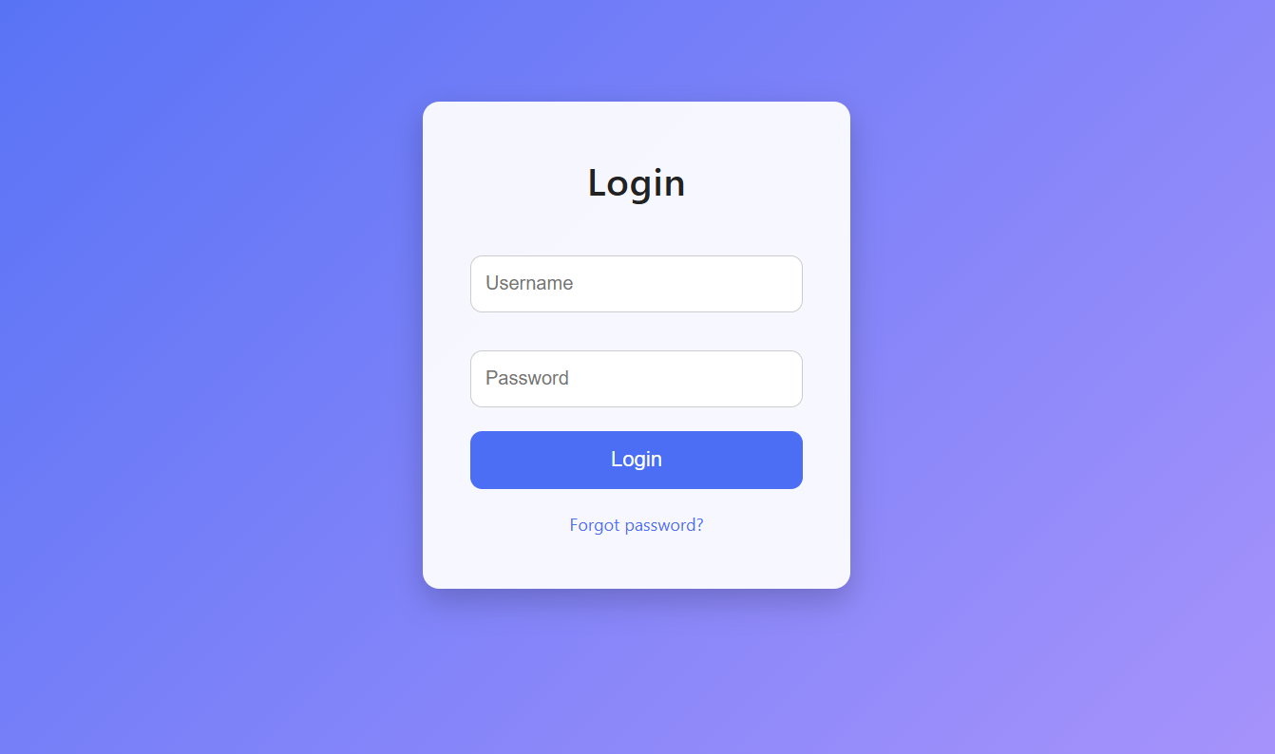
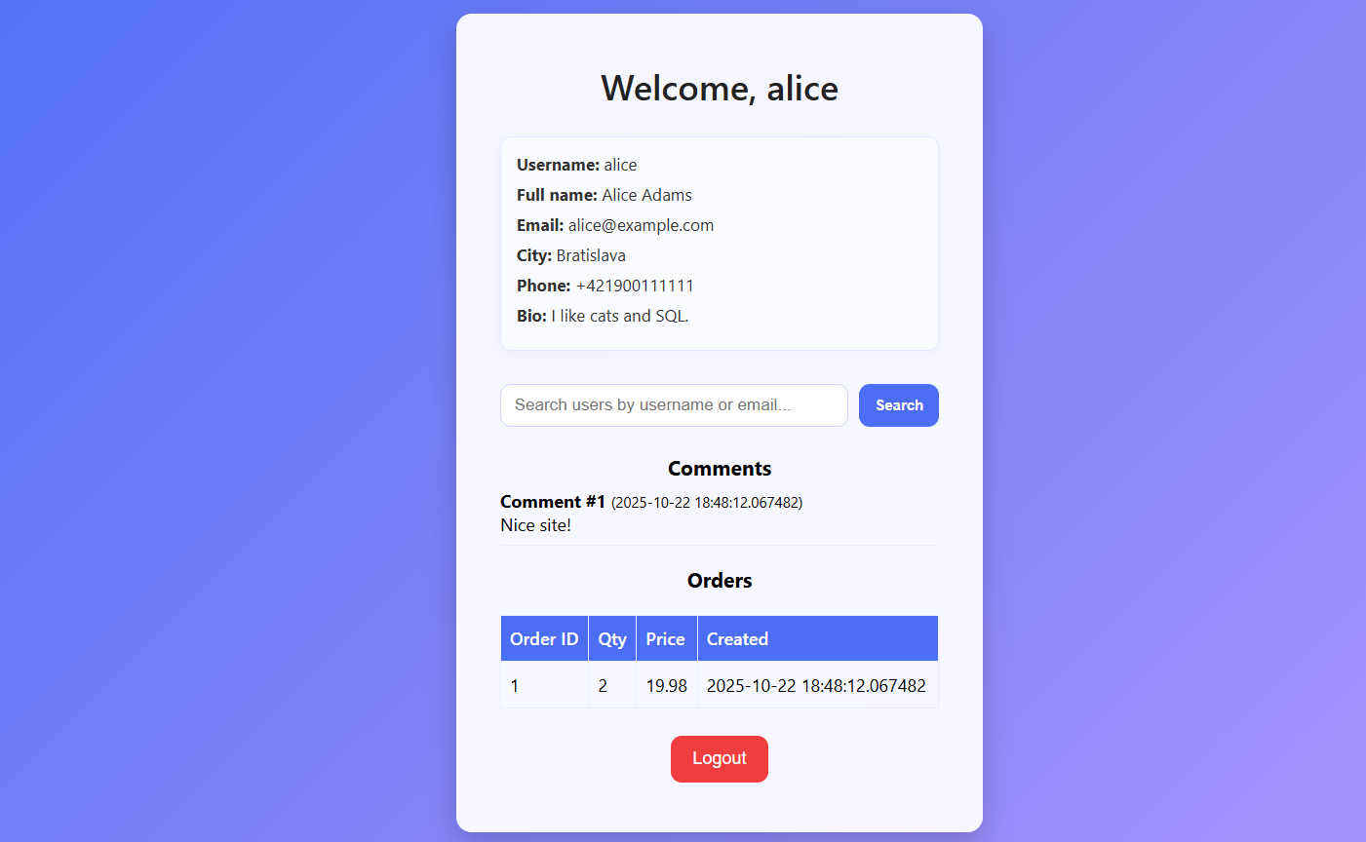

Slide 9
Tools
Burp suite
Intercepting proxy for web security testing
Sits between browser and server
Captures and modifies HTTP/HTTPS traffic in real-time
Manual Testing: Craft precise SQL injection payloads
Request Analysis: Examine exact HTTP parameters sent to server
Response Analysis: Observe error messages and data leakage
Sqlmap
Open-source penetration testing tool
Automates SQL injection detection and exploitation
Supports all major database systems
Can enumerate entire database structure
Capture vulnerable request with Burp Suite
Export request to request.txt
Run sqlmap with specific parameters

Slide 10
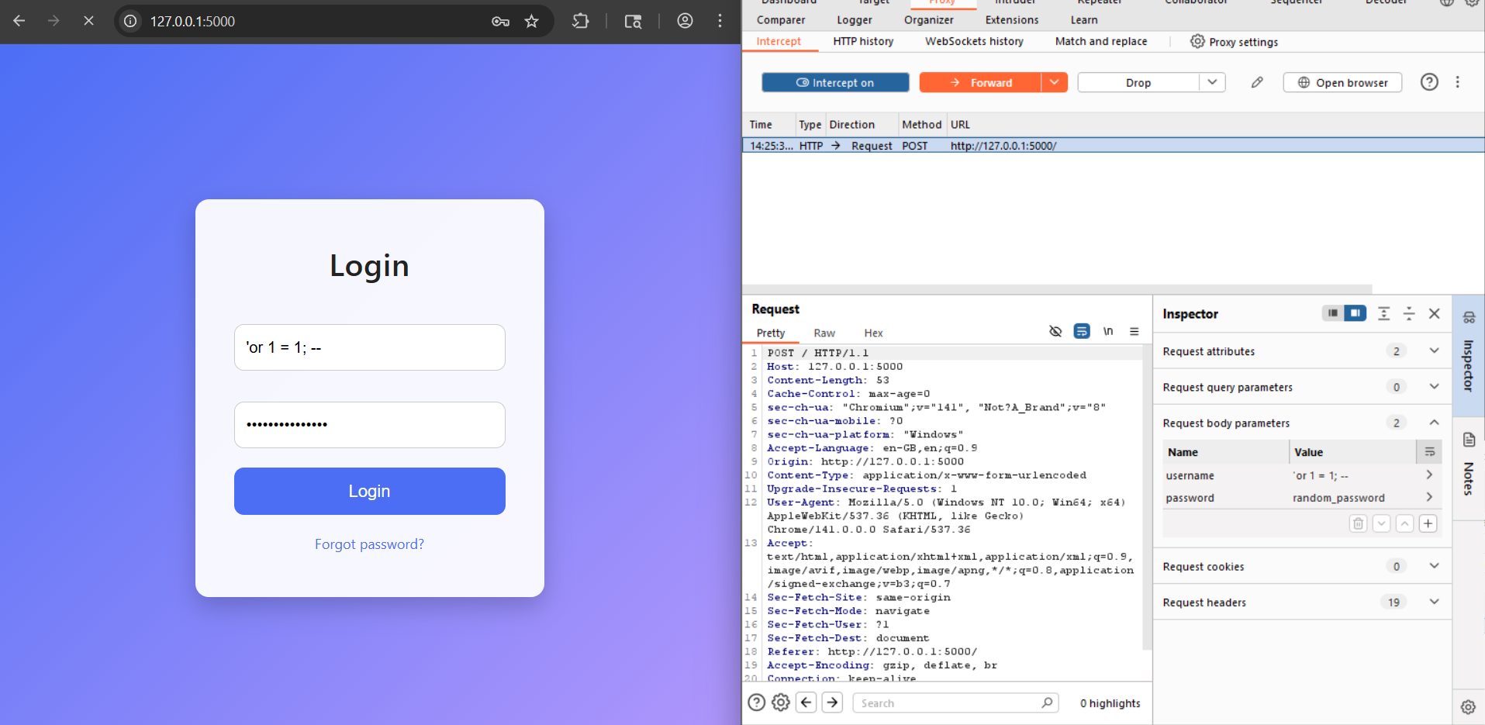
Early experiment report
Login bypass

Slide 11
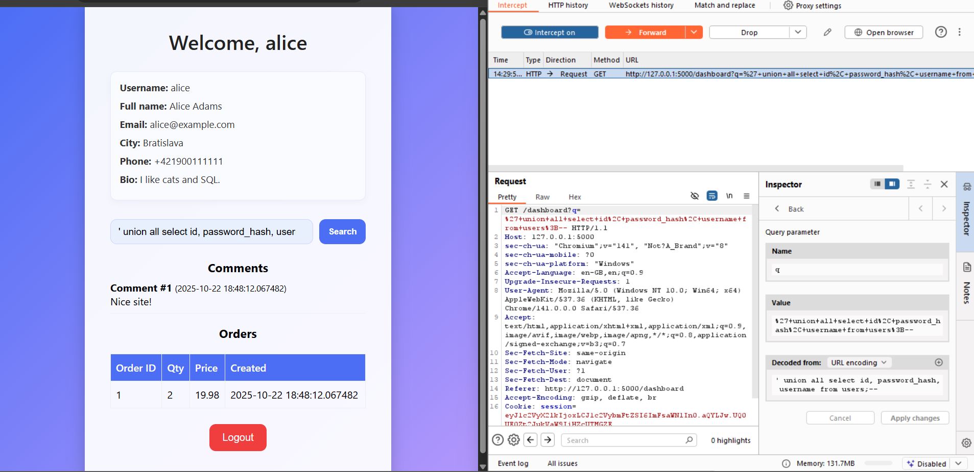
Early experiment report
Union-based
pull

Slide 12
Prevention
Parameterized Queries
Separate SQL code from user data using placeholders
ORM
Object-relational mapping with automatic parameterization
Input Validation
Whitelist validation, type checking, length restrictions
Least Privilege
Restrict database user permissions
Error Handling
Hide detailed error messages from users
WAF Rules
Web Application Firewall to detect attack patterns

Slide 13
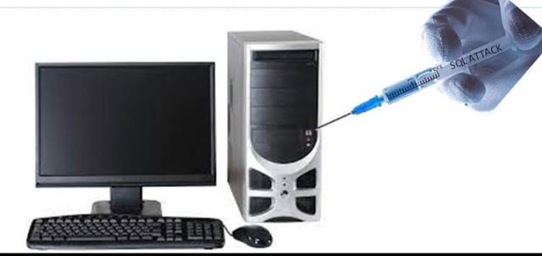
The End
Thx for your attention!

