Slide 1
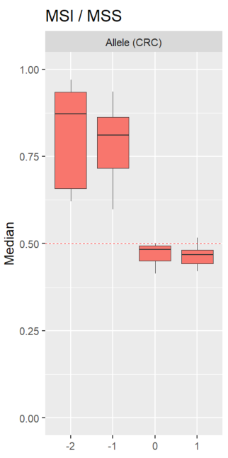
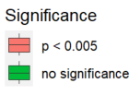
Background :
Mismatch Repair (MMR)
What it does
Antimutagenic
promutagenic
Why assessment of MMR in tumors is important
Lynch syndrome
MMRd detection
IHC
MSI
Gene sequencing
Microsatellite instability (MSI)
Increased frequency of length mutations in microsatellite regions
Usually caused by lack of mismatch repair (MMR)
Found in certain types of cancer (colorectal, endometrial, etc..)
PCR errors
In previous work
In previous work, I investigated whether the patterns of microsatellite instability in tumors from Lybch syndrome patients and sporad MMR deficient tumors are different
My results suggest that the different mutant alleles behave differently
Deletions and insertions
+1 allele detected in both MMRp and MMRd samples
Higher frequency in MMRp than MMRd
This can also be seen when comparing MMRd and MMRp tumors
Why do insertions behave differently from deletions?
Where do the +1 alleles originate from in MMRp tumors?
- PCR aretefacts
Mutagenic effect of MMR
Figure 1. Standardized ratios (y-axis) comparing allele frequencies (x-axis) in different markers between MMRp and MMRd samples. A ratio > 0.5 indicates a greater allele frequency in MMRd compared to MMRp and vice-versa.

Slide 2
Question : How does the +1 allele arise?
Caused by MMRd?
Unlikely due based on previous results
PCR artefacts?
Possible due to its low frequency (~1%)
A normal function of MMR?
Aligns with previous results
MMR is also known to be involved in trinucleotide expansion diseases
Significance :
Assuming hypothesis 2, then +1 allele frequency can be used to estimate PCR error rate and can be used to (further) normalize the dataset
Assuming hypothesis 3, then +1 allele frequency can be used as a marker to evaluate MMR function in constitutional samples

Slide 3
To investigate :
Deletion rate at each marker depends on its length
↑ length ~ ↑ deletions
What about insertions? Theoretically Yes
Spearman’s test on 0 and +1 allele frequency (per marker)
Expect each marker to have different sensitivities to mutational effects
whether by MMR or PCR
We assume that the +1 allele originates from insertions in the 0 allele
(↘ 0 allele) ⟶ (↗ +1 allele)
Stronger negative correlation ~ marker is more prone to insertions (and vice versa)
Are markers that are more prone to insertions (in MMRp) also more prone to deletions (in MMRd)?
Notes:
Stronger negative correlation ~ marker is more prone to insertions (and vice versa)
- Maybe not true??

Slide 4
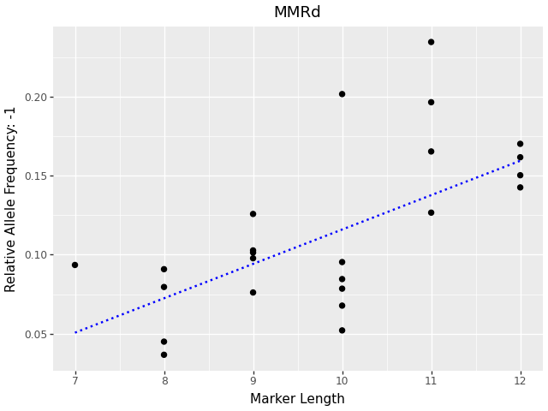
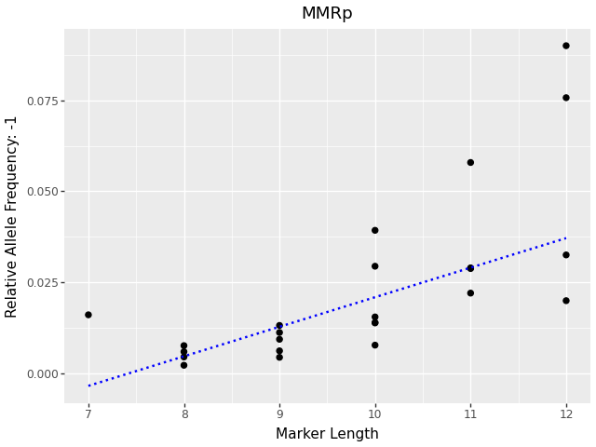
Marker length ∝ Deletion rate
Assumption
-1 allele frequency ∝ deletion rate
Positive correlation in MMRd and MMRp
Longer markers are more prone to deletions
More sites where slippage is possible
Figure 2. Average frequencies of the main deletion allele (-1) for each marker, plotted against its length in MMRd samples (spearman correlation : 0.66) and in MMRp samples (spearman correlation: 0.80)

Slide 5
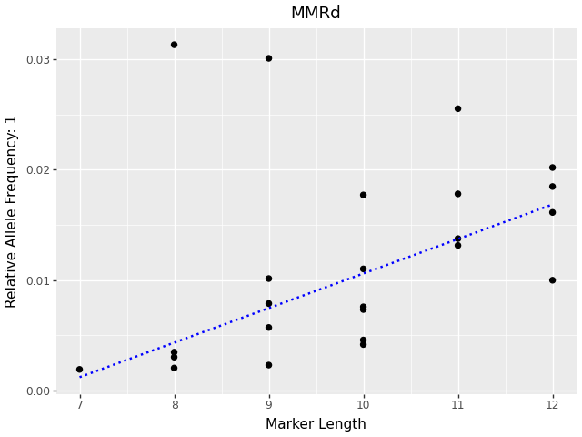
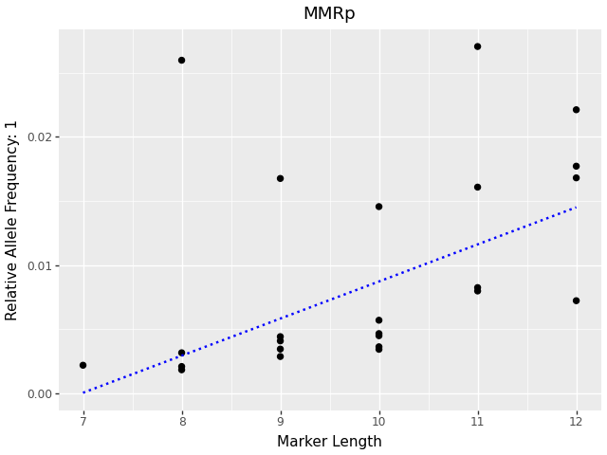
Marker length ∝ Insertion rate
Assumption
+1 allele frequency ∝ insertion rate
Positive correlation in MMRd and MMRp
Longer markers are more prone to insertions
Same mechanism to deletions
Figure 3. Average frequencies of the main insertion allele (+1) for each marker, plotted against its length in MMRd samples (spearman correlation : 0.54) and in MMRp samples (spearman correlation: 0.67)

Slide 6
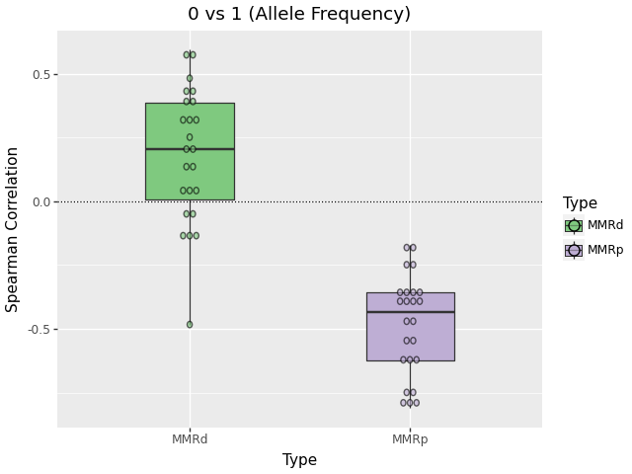
Result (0 vs -1)
Different behavior in MMRp and MMRd
Negative correlation in MMRp
Supports hypothesis 3
Positive, but weaker correlation in MMRd
Evidence against hypothesis 1
Could be explained by double deletion ?
0 allele deletion rate ∝ +1 allele double deletion rate ?
Figure 4. Spearman coefficient (per marker) between 0 and +1 allele frequencies in MMRd and MMRp samples.

Slide 7
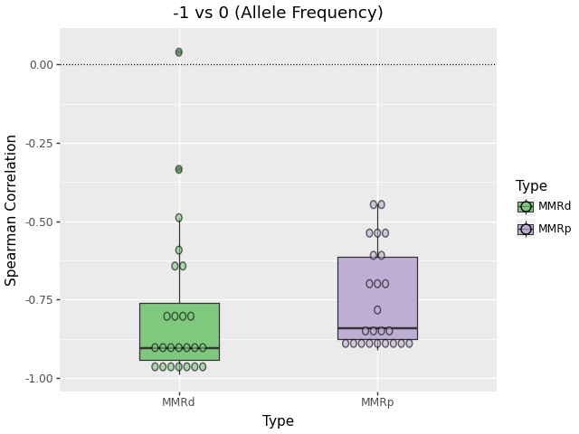
Result (0 vs -1)
Same behavior in MMRp and MMRd
Strong negative correlation
When mutations happen in the reference allele, they are mainly deletions
Figure 4. Spearman coefficient (per marker) between 0 and -1 allele frequencies in MMRd and MMRp samples.

Slide 8
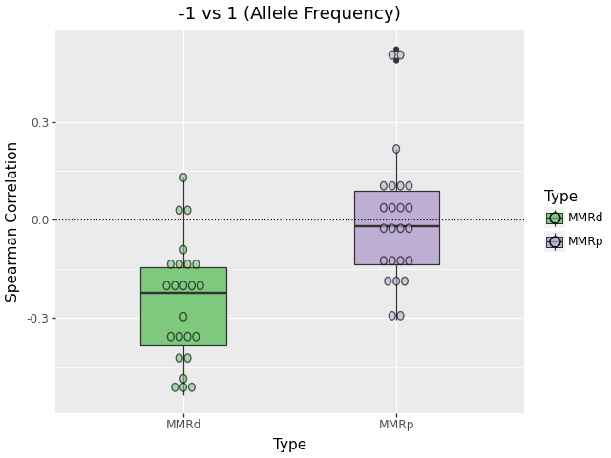
Result (-1 vs +1)
Negative correlation in MMRd
Evidence against hypothesis 1
If loss of MMR function contributes to both +1 and -1 allele generation then expected is +1 allele ∝ -1 allele
No correlation in MMRp
Mechanism for insertion in MMRp is not related to mechanism for deletion in MMRp
Figure 5. Spearman coefficient (per marker) between -1 and +1 allele frequencies in MMRd and MMRp samples.

Slide 9
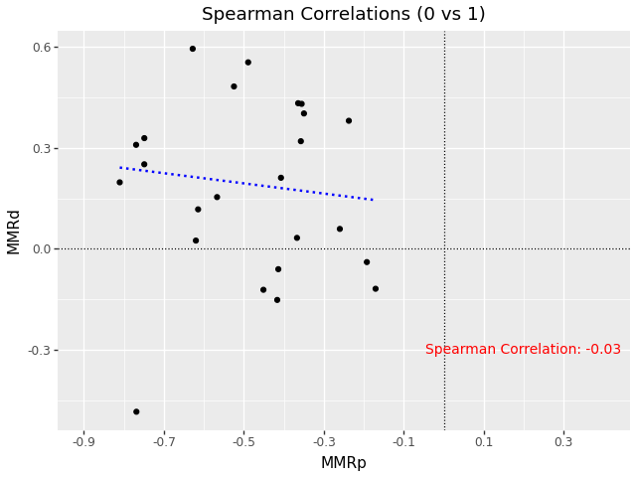
To Mauro :
Since spearman correlation does not measure the sensitivity of a marker (rather it just measures how well a monotonic model fits), would it make more sense to have our data be the gradient of the regression line instead of the spearman correlation coefficient??

Slide 10
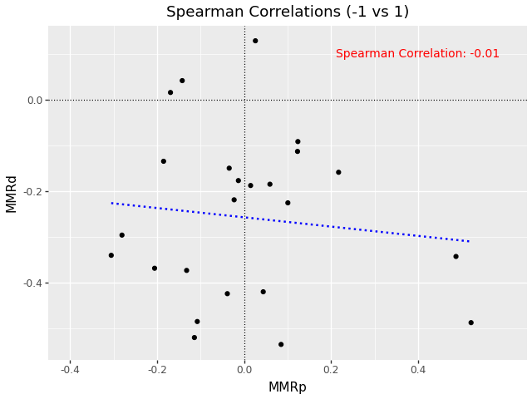
Result (-1 vs +1)

Slide 11
Conclusion
+1 allele negative or no correlation with other mutant alleles
negative correlation with -1 allele in MMRd
no correlation with -1 allele in MMRp
+1 allele does not correlate with loss of MMR
+1 allele’s correlation with reference allele
Negative correlation (i.e. “normal” mutant behaviour) in MMRp
Opposite behaviour in MMRd ? Still unclear why

