Slide 1
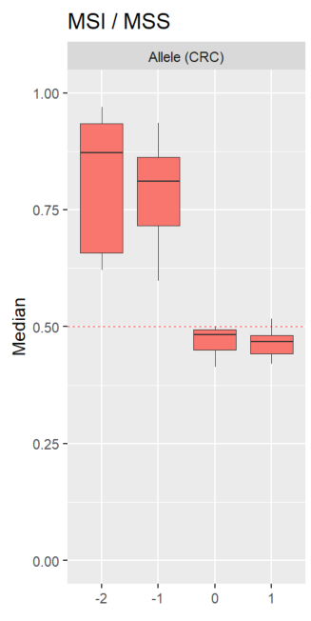
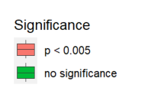
Background :
In a previous study, the presence of +1 alleles in microsatellites was identified through PCR sequencing of tumor samples from patients with CRC and EC.
Curiously, the relative frequency of these +1 alleles were significantly higher in MSS tumors compared to MSI tumors.
Figure 1. Standardized ratios (MSI/MSS) of relative allele frequencies, grouped by allele length

Slide 2
Problem :
The +1 alleles were detected at a very low frequency, making it unclear whether they represent actual insertion mutations in the microsatellites or are simply a result of PCR artefacts.
If it is the case that the majority of the +1 alleles observed are due to PCR artefacts, then it would be beneficial to exclude the +1 allele frequency from the training dataset (for classification)

Slide 3
Solution
Spearman’s test was used to determine the correlation between the reference and +1 allele frequencies for each microsatellite marker in both MSS and MSI tumors
???

Slide 4
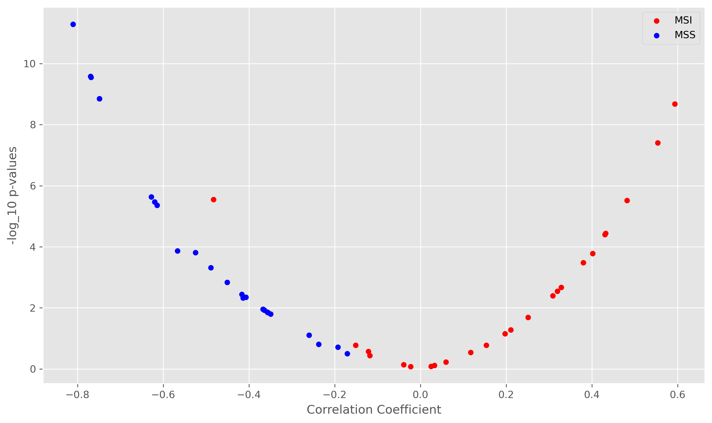
Result
The reference and +1 allele frequencies of microsatellite markers are negatively correlated in MSS tumors
The opposite trend is observed in MSI tumors.
Figure 2. Spearman correlation coefficient for the reference and +1 allele frequencies of each microsatellite marker in MSI and MSS tumors

Slide 5
Conclusion
The negative correlation observed in MSS tumors are a strong indication that insertion mutations (in the reference allele) and/or deletion mutations (in the +1 allele) have taken place.
These two events contribute to the negative correlation between the frequencies of the reference and +1 allele
But it is still unclear whether these mutations are the result of inherent microsatellite instability or PCR artefacts
The positive correlation observed in MSI tumors are a strong indication that there is a considerable “double deletion” effect which would mask the relationship between the reference and +1 allele

Slide 6
Approach :
If these +1 alleles are the result of PCR artefacts, then we would expect to see a negative correlation between the reference and +1 allele frequencies.
This is because the +1 allele species is generated from the depletion of the reference allele species as PCR mutations are introduced
Since there is a greater abundance of the reference allele species in MSS tumors (compared to MSI tumors), we would also expect to see a greater abundance of the +1 allele species in MSS tumors as well; which indeed was observed
Spearman’s test was used to determine the correlation between the reference and +1 allele frequencies for each microsatellite marker in both MSS and MSI tumors

