Slide 1
Background :
Microsatellite instability (MSI)
Increased frequency of length mutations in microsatellite regions
Usually caused by lack of mismatch repair (MMR)
Aim : Can we predict MMR status via MSI ?
MSI measured by ↑ frequency of mutant alleles
High MSI → MMRd
Problem :
Are some mutant alleles (+1, -1, etc..) more predictive than others?

Slide 2
To Investigate :
Low frequency of +1 alleles (~1%)
Higher in MMRp than MMRd
Genuine insertion mutations?
PCR artefacts? → not predictive of MMRd
Is there a correlation between the allele frequencies?
0 vs +1, -1 vs +1 ?
Different behaviour between MMRp and MMRd ?

Slide 3
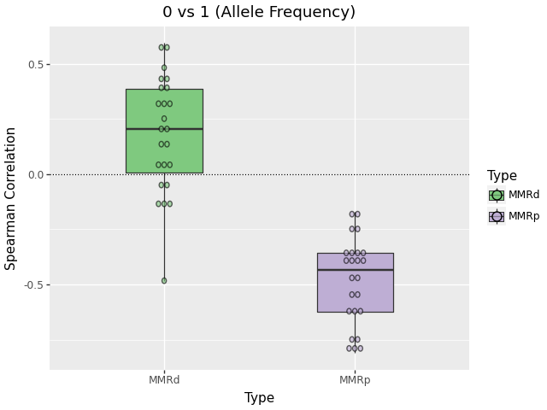
Result (0 vs +1)
Different behavior in MMRp and MMRd
Negative correlation in MMRp
Deletion in +1 allele ?
Insertion in 0 allele ?
Due to PCR artefact or MMRd ?
Positive correlation in MMRd
double deletion ?
0 allele deletion rate ∝ +1 allele double deletion rate ?

Slide 4
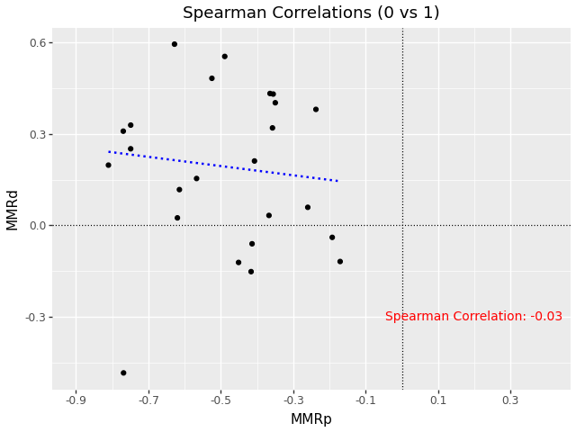
Result (0 vs +1)
Slight negative correlation in marker behaviour between MMRp and MMRd
not significant
Spearman correlation : -0.03

Slide 5
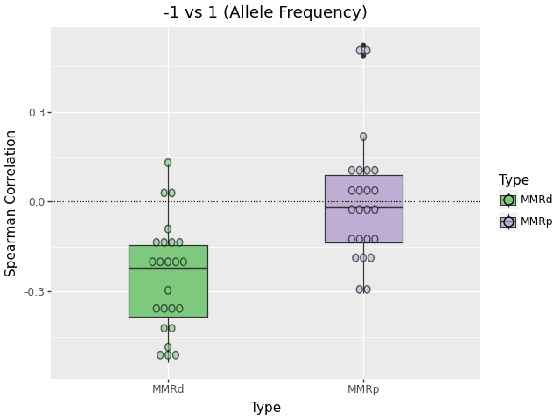
Result (-1 vs +1)
Different behavior in MMRp and MMRd
No significant correlation in MMRp
Negative correlation in MMRd
More evidence for double deletion at +1 allele

Slide 6
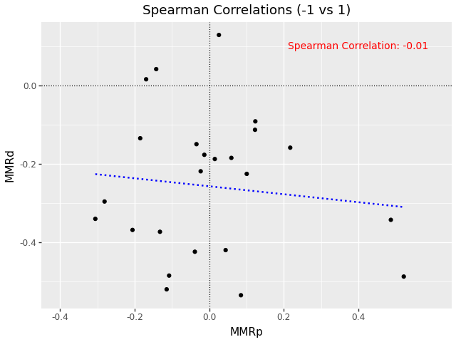
Result (-1 vs +1)
Slight negative correlation also observed
Not significant
Spearman correlation : -0.01

Slide 7
Conclusion
+1 allele negative or no correlation with other mutant alleles
negative correlation with -1 allele in MMRd
no correlation with -1 allele in MMRp
Evidence for +1 allele not being a genuine mutant ?
+1 allele’s correlation with reference allele
Negative correlation (i.e. “normal” mutant behaviour) in MMRp
Opposite behaviour in MMRd ? Still unclear why

