Slide 1

Visionary Idea Browsing Environment (V.I.B.E)
NEVER Stop dreaming!

Slide 2

Project description
A Web app designed for all budding entrepreneurs across the globe. Its specifically designed for people who want to invent something of their own, the one who believe in developing something from scratch.
Working
On successful registration a user can start posting new ideas on their page.
A search engine where in user inputs some keywords and the search engine returns the existing ideas and the problems related to those keywords. Based on this information the user has two options, either create a new idea keeping in mind the problems or improve an existing idea.
Based on the content that is being posted by the user, recommendation of people with similar ideas will be generated.
A user can choose to add the recommended people to its “Contacts” and likewise other users can add people based on the recommendations.
The ideas put up by your “Contacts” will be displayed on your feed.
Furthermore, users can use the search engine for more ideas.

Slide 3
Techniques implemented
Server Side
REST API for Users, Posts, Contacts and Recommendations.
Using Promises while dealing with Database Models. (Asynchronous programming)
Using Mongoose for keeping a definite schema of Database Models.
Using bcrypt for password encryption and JSON Web Token for Authentications.
Client Side
Using react props for maintaining state across different components.
Using FETCH API for opening a connection to the server side and making asynchronous requests. (Similar to XHR)
Using reactstrap and React DOM for better responsiveness and animations.

Slide 4
Intelligent functionality
A Content Based Recommender for recommending users with similar ideas.
Description
A Machine Learning algorithm which computes the tf-idf scores of each of the users posts (taking into account both the title and the description of the post) with all the other user’s post(s) and generates the users with the closest match based on cosine similarity.
Search Engine: Scrapes google search results to find existing ideas and problems related to the query entred.

Slide 5


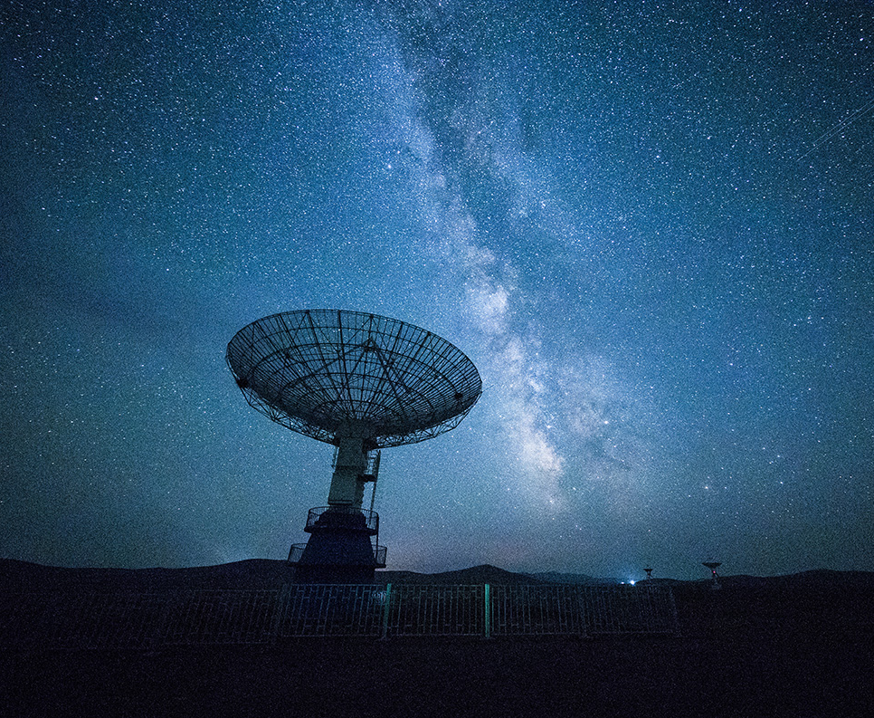
Technologies used
Front-End
Framework Used: ReactJS
Modules Used: Reactstrap, React Router, Font-Awesome Icons, React DOM
Back-End
Framework Used: Node.js with an Express server.
Database Technology Used: MongoDB
Modules Used: Mongoose, JSON Web Token, Body parser, Cookie Parser
Stack Used: MERN STACK

Slide 6
Thank You!

