Slide 1
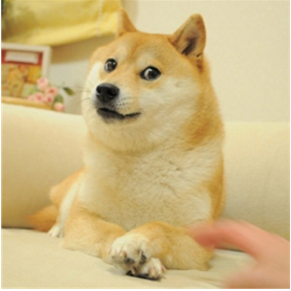
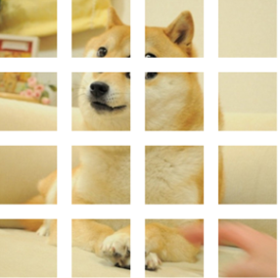
BEiT is All You Need
Bao H, Dong L, Wei F. Beit: Bert pre-training of image transformers[J]. arXiv preprint arXiv:2106.08254, 2021.
EECE 7370 Tutorial
Yihao Huang 002190017
Jiayun Xin 001563582
Lingyu Yang 002953563

Slide 2
Problem Statement
Directly apply BERT- style pre-training for image data?

Slide 3
Motivation
Transformer has achieved promising performance in computer vision.
Vision Transformers require more training data than convolutional neural networks.
To solve the data-hungry issue
self-supervised pre-training is a promising solution to leverage large-scale image data.

Slide 4
Contributions
First paper that makes self-supervised pre-training of Vision Transformers (ViTs) outperform supervised pre-training.
Proposed a masked image modeling task to pretrain vision Transformers in a self-supervised manner.
Present the self-attention mechanism of self-supervised BEiT learning to distinguish semantic regions and object boundaries.

Slide 5
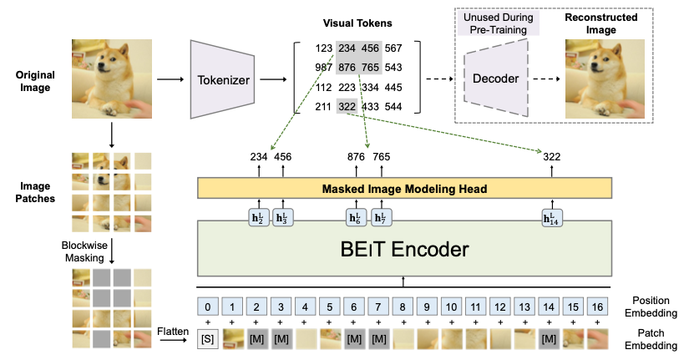
Method
dVAE
BEIT Encoder
[1] BEIT: BERT Pre-Training of Image Transformers , 2021
Notes:
In this section, I will talk about the method of BEIT model implementation.
The overall implementation of the BEIT model can be seen in this picture. We can divide BEIT into two parts: dVAE and BEIT encoder.
dVAE is used to tokenize the image,
and The BEIT encoder is a vision transformer based masking image modeling that encodes the image and predicts the role of the image token.
在这个部分，我来讲一下BEIT模型实现的方法。
BEIT的流程图如图所示。我们可以将整个模型分为两个部分：dVAE和BEIT encoder。
dVAE用于标记图像，BEIT encoder是一个基于视觉变换器的遮蔽图像建模，对图像进行编码并预测图像token的作用。

Slide 6
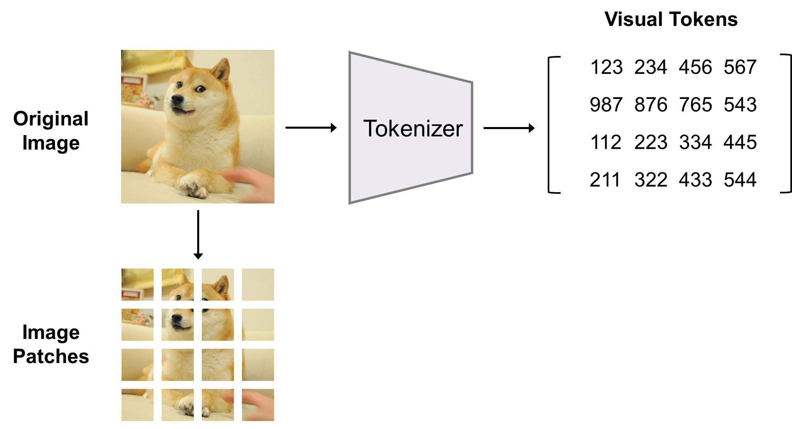
Image Representation
Image Patches
Visual Tokens
[1] BEIT: BERT Pre-Training of Image Transformers , 2021
[7] An image is worth 16x16 words: Transformers for image recognition at scale, 2020
Notes:
BEIT模型在预处理的时有两个图片视角。分别是image patch 和 visual token。
The BEIT model has two image views during pre-processing. They are image patch and visual token.
首先讲一下image patch的操作。Image Patch的思想是最先在ViT中被提出的，它是将一个图像拆分成若干个不同的图像Patches，然后它们会被送到Transformer中进行模型的训练。image patch只是原始图片通过 Linear Transformation的结果，所以只能保留图片的原始信息。
The idea of image patch was first proposed in ViT, which is to split an image into several different image patches, and then they are sent to Transformer for model training. The image patch is only the result of the original image through Linear Transformation, so only the original information of the image is retained.

Slide 7
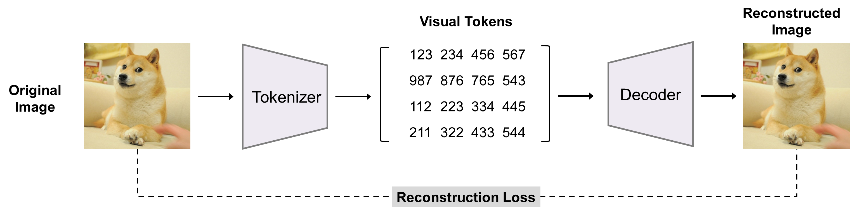
BEiT : Visual Tokens
[1] BEIT: BERT Pre-Training of Image Transformers , 2021
Notes:
我们知道要想将masked language model应用于图像领域，第一个问题就是如何将图像数据转化为natural language processing中离散化的token。作者提出的方法是采用dVAE实现将图像离散化称为图像token。BEIT采用zero-shot text to image gereration(2021)这篇文章介绍的思路，利用dVAE将图像转化为token。
We know that to apply the masked language model to the image domain, the first problem is how to transform the image data into a discrete token like in natural language processing. The approach proposed by the authors is to use dVAE to implement the image discrete called image token. This method comes from the article zero-shot text to image generation (2021).

Slide 8
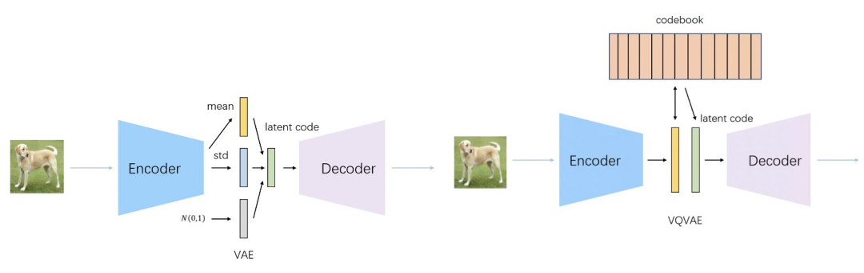
VAE & VQVAE
visual codebook (i.e., vocabulary)
[4] Zero-shot text-to-image generation, 2021
[5] Video generation using vq-vae and transformers, 2021
Notes:
VAE的原理，VAE主要用于生成任务，采用类似于Autoencoder的框架，利用encoder将输入数据映射到均值为0，方差为1的高斯分布中，再从高斯分布中进行采样，最后将结果向量通过Decoder还原出输入样本。
The principle of VAE, VAE is mainly used for generation tasks, using a framework like Autoencoder, using encoder to map the input data into a Gaussian distribution with mean 0 and variance 1, then sampling from the Gaussian distribution, and finally reducing the result vector to the input samples by Decoder.
由于我们的目的是将输入的图片映射成离散化的向量，所以我们把VAE中的高斯分布换成了一个从字典中的均匀分布，来建立dVAE模型，使得输入图片tokenize。
Since our purpose is to map the input image into a discrete vector, we replace the Gaussian distribution in VAE with a uniform distribution from a dictionary to build the dVAE model that makes the input image tokenize.

Slide 9
BEiT : Visual Tokens
[1] BEIT: BERT Pre-Training of Image Transformers, 2021

Slide 10
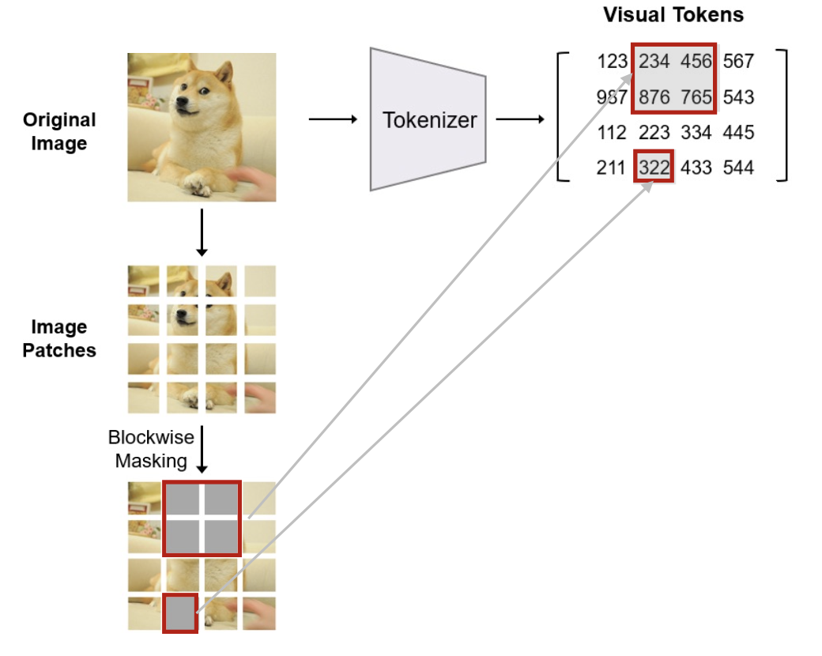
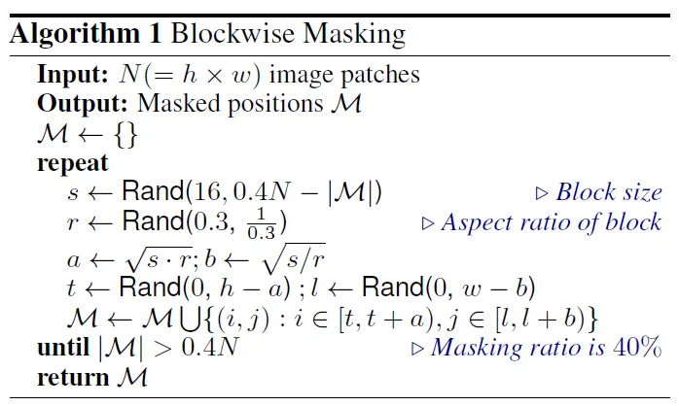
BEiT : Blockwise Masking
[1] BEIT: BERT Pre-Training of Image Transformers, 2021
Notes:
BEIT采用ViT的结构，输入和ViT相同，也是分割好的patch的，但是会随机mask掉部分patch，类似于MLM中的mask部分单词。不同于BERT的完全随机的遮盖，MIM的策略是blockwise masking。遮盖操作直到有40%的patch被遮盖时结束。
BEIT adopts the structure of ViT, and the input is the same as ViT, which also splits the patches, but randomly masks some of the patches, similar to the masking of some words in MLM. Unlike BERT's completely random masking, MIM's strategy is blockwise masking, and the masking operation ends when 40% of the patches are masked.

Slide 11
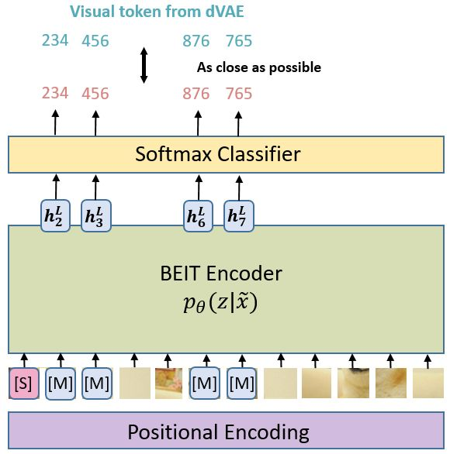


$$H^{L}= \left[h_{\left\{\left[s\right]\right\}}^{\left\{L\right\}},h_{\left\{1\right\}}^{\left\{L\right\}},…h_{\left\{N\right\}}^{\left\{L\right\}}\right]$$
$$H_{0}=\left[e_{\left[s\right]},Ex_{i}^{p},…,Ex_{N}^{p}\right]+E_{pos}$$
[1] BEIT: BERT Pre-Training of Image Transformers, 2021
Notes:
最终整体BEIT预训练简单来说就是通过随机盖住一些 image patches，让 BEIT模型预测盖住的patches是什么，不断计算预测的 patches 与真实的 patches 之间的差异，利用它作为 loss 进行反向传播更新参数，来达到 Self-Supervised Learning 的效果。
The final overall BEIT pre-training simply means that by randomly covering some image patches, the BEIT model predicts what the covered patches are, continuously calculates the difference between the predicted patches and the real patches, and uses it as loss for back-propagation to update the parameters to achieve the effect of Self-Supervised Learning.

Slide 12
BEiT : Bert pre-training of image transformers
[1] BEIT: BERT Pre-Training of Image Transformers, 2021
Notes:
最终整体BEIT预训练简单来说就是通过随机盖住一些 image patches，让 BEIT模型预测盖住的patches是什么，不断计算预测的 patches 与真实的 patches 之间的差异，利用它作为 loss 进行反向传播更新参数，来达到 Self-Supervised Learning 的效果。
The final overall BEIT pre-training simply means that by randomly covering some image patches, the BEIT model predicts what the covered patches are, continuously calculates the difference between the predicted patches and the real patches, and uses it as loss for back-propagation to update the parameters to achieve the effect of Self-Supervised Learning.

Slide 13
Pre-training Setup
BEiT: Pre-training on ImageNet-1K
Parameters | Value
Batch Size | 2000
Epochs | 800
Optimizer and parameters | Adam, β1 = 0.9, β2 = 0.999
Learning rate | 1.5e-3
Warmup epochs | 10
Cosine learning rate decay | Weight decay = 0.05
Data augmentation | Random resized cropping, horizontal flipping, color jittering
[1] BEIT: BERT Pre-Training of Image Transformers, 2021

Slide 14
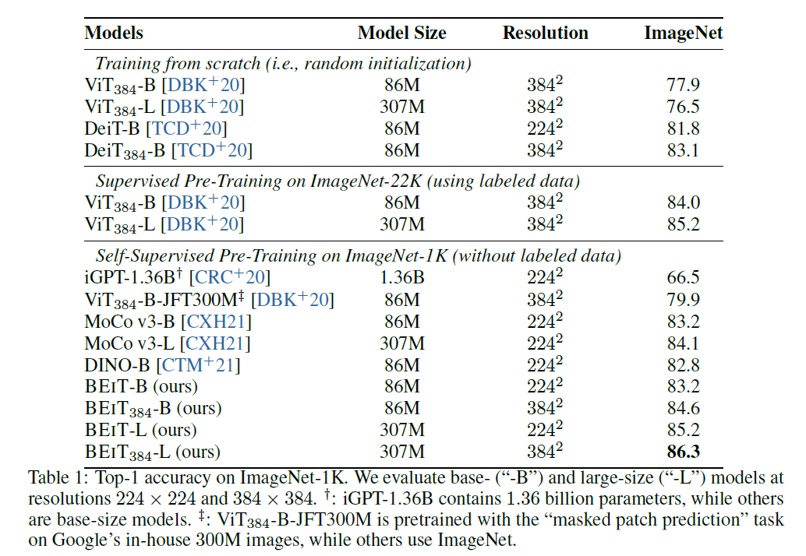
Image Classification
All the compared models are base-size.
Fine-tuning to 384*384 resolution.
Scaling up to larger size.
[1] BEIT: BERT Pre-Training of Image Transformers, 2021

Slide 15
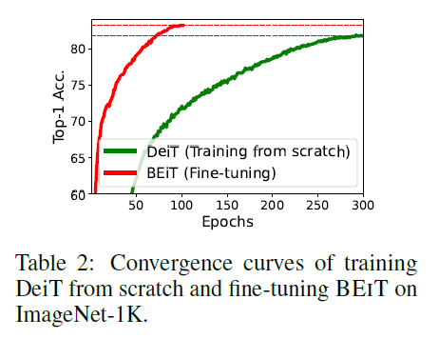
Convergence Curves
BEIT can reach reasonable numbers within very few epochs.
[1] BEIT: BERT Pre-Training of Image Transformers, 2021

Slide 16
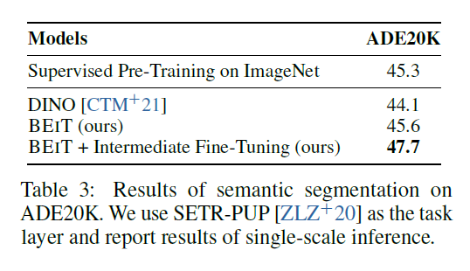
Semantic Segmentation
On ADE20K, we use Adam as the optimizer. The learning rate is set to 1e-3 with layer-wise decay similar to image classification. We conduct fine-tuning for 160K steps. The batch size is 16.
[1] BEIT: BERT Pre-Training of Image Transformers, 2021

Slide 17
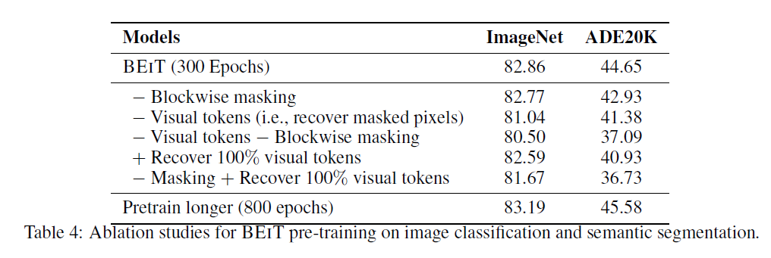
Ablation Studies
[1] BEIT: BERT Pre-Training of Image Transformers, 2021

Slide 18
Strength and Weakness
Strength:
Solve the problem of pre-training visual transformers.
Excessive learning of small-scale detail information
Insufficient learning of the overall structure
Weakness:
BEiT v1 did not conduct in-depth exploration and optimization of the semantic space learned by dVAE.
Notes:
In the article Generative Pretraining from Pixels, IGPT was proposed, and the model also used MLM or autoregressive to achieve image pre-training. However, the IGPT period lost a lot of image information because the modeling method of ViT was not yet available, and Transformer was implemented in CV by reducing the image resolution.
The MLM self-supervised learning method was also tried in ViT, but regression modeling was used without discretization of image patches, and this pixel-level regression-based method suffers from the problem of over-learning small-scale detail information and under-learning on the overall structure.
BEIT solves the problem of image discretization by dVAE, while based on ViT's mature Vision Transformer structure, it finally realizes the application of MLM in unsupervised learning in CV field.

Slide 19
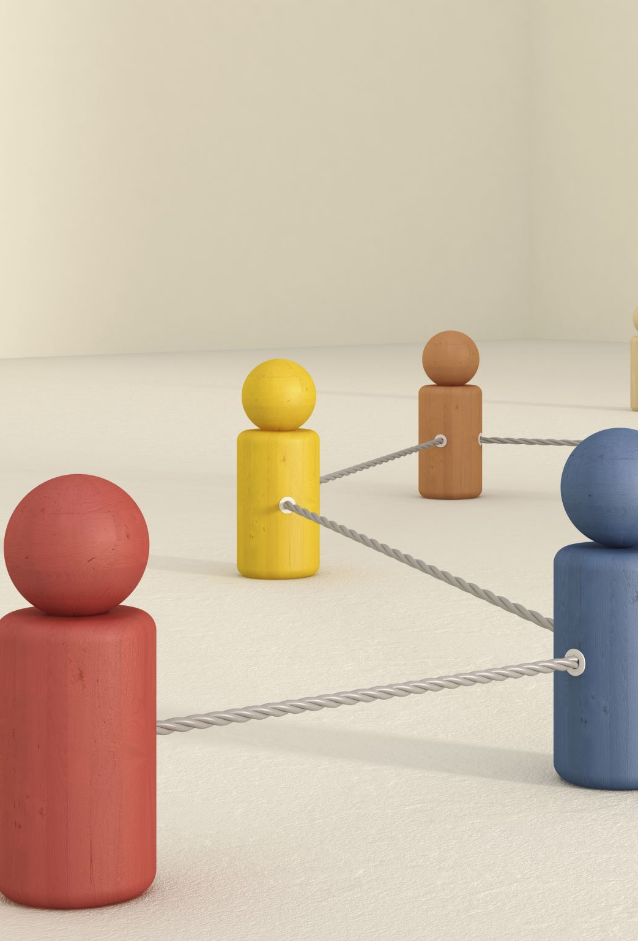
Extension
With BEiT, the visual model can be scaled up to a larger scale while making better use of unlabeled big data.
Under the framework of masked image modeling, other pre-training methods can be proposed.
Extended BEiT to multimodal learning and better unify with semantic pre-training.

Slide 20
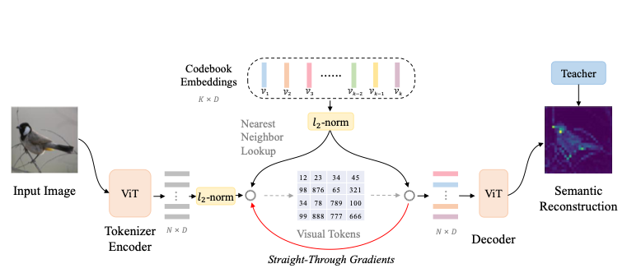
Beit v2 : Visual Token
[2] Beit v2: Masked image modeling with vector-quantized visual tokenizers, 2022

Slide 21
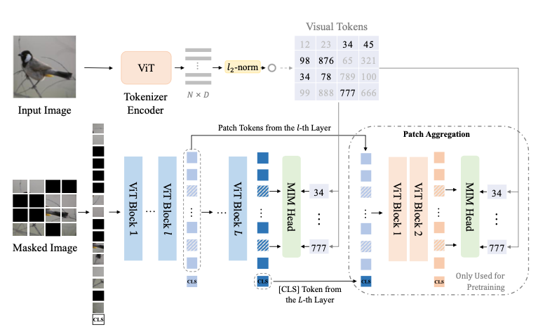
Overall Framework for BEIT V2
[2] Beit v2: Masked image modeling with vector-quantized visual tokenizers, 2022

Slide 22
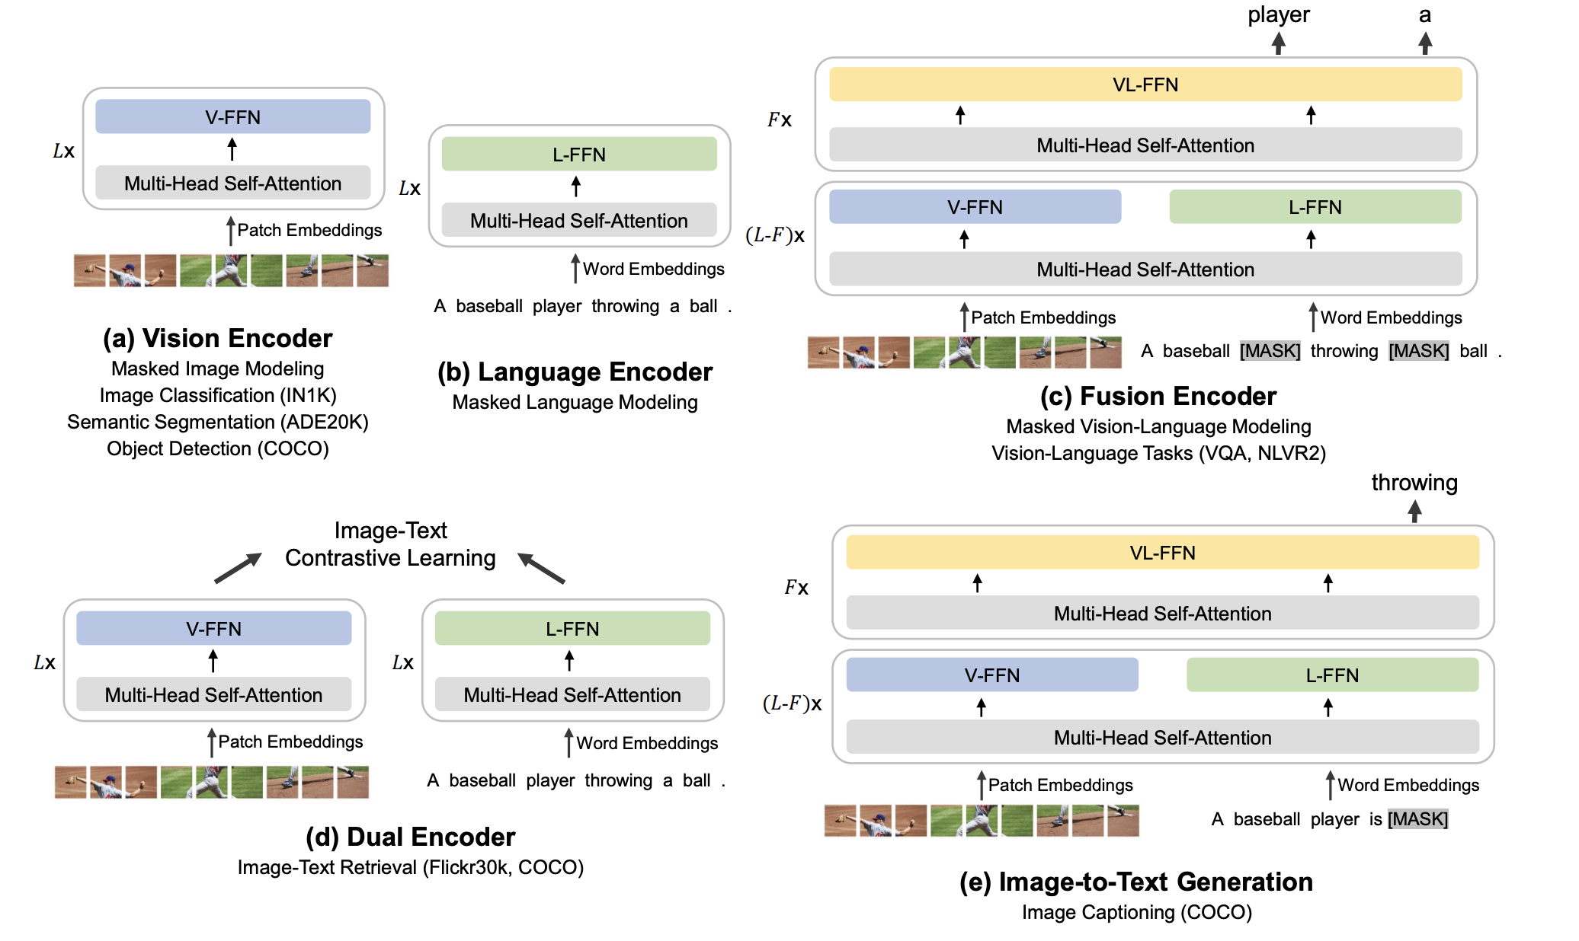
BEiT v3
[3] Image as a foreign language: Beit pretraining for all vision and vision-language tasks, 2022

Slide 23
References
[1]Bao H, Dong L, Wei F. Beit: Bert pre-training of image transformers[J]. arXiv preprint arXiv:2106.08254, 2021.
[2]Peng Z, Dong L, Bao H, et al. Beit v2: Masked image modeling with vector-quantized visual tokenizers[J]. arXiv preprint arXiv:2208.06366, 2022.
[3]Wang, W., Bao, H., Dong, L., Bjorck, J., Peng, Z., Liu, Q., ... & Wei, F. (2022). Image as a foreign language: Beit pretraining for all vision and vision-language tasks. arXiv preprint arXiv:2208.10442.
[4] Ramesh A, Pavlov M, Goh G, et al. Zero-shot text-to-image generation[C]//International Conference on Machine Learning. PMLR, 2021: 8821-8831.
[5] Yan W, Zhang Y, Abbeel P, et al. Videogpt: Video generation using vq-vae and transformers[J]. arXiv preprint arXiv:2104.10157, 2021.
[6] Devlin, Jacob, et al. "Bert: Pre-training of deep bidirectional transformers for language understanding." arXiv preprint arXiv:1810.04805, 2018.
[7] Alexey Dosovitskiy, et al. An image is worth 16x16 words: Transformers for image recognition at scale. preprint arXiv:2010.11929, 2020.

