Slide 1
Portfolio
By Esther Pisano

Slide 2
About
Date of birth: 12/07/2006.
Place of birth: London.
First name: Esther.
Last name: Pisano.
I am an Independent WEB 3.0 programmer.
Embracing diligence and hardwork.
Encouraging a sense of camaraderie and teamwork on collaboration for collective success.

Slide 3
Programming languages
Python.
R.
JavaScript.
CSS.
HTML.

Slide 4
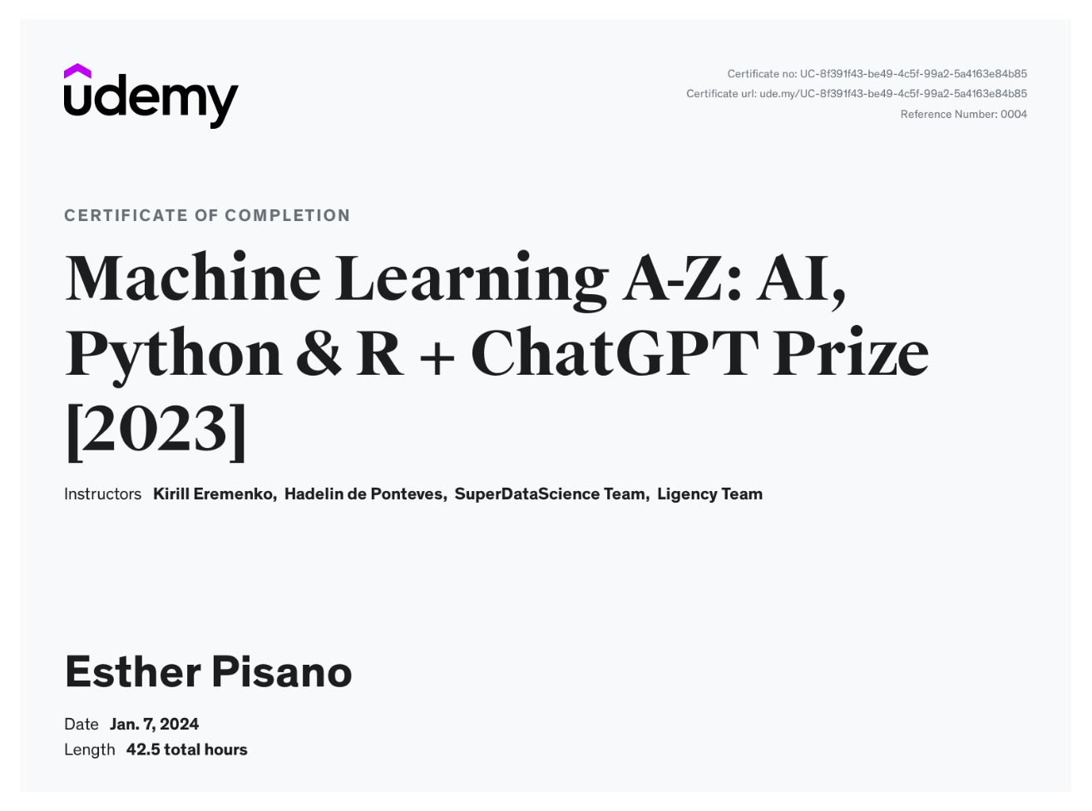
Master Machine Learning on Python & R
Have a great intuition of many Machine Learning models
Make accurate predictions
Make powerful analysis
Make robust Machine Learning models
Create strong added value to your business
Use Machine Learning for personal purpose
Handle specific topics like Reinforcement Learning, NLP and Deep Learning
Handle advanced techniques like Dimensionality Reduction
Know which Machine Learning model to choose for each type of problem
Build an army of powerful Machine Learning models and know how to combine them to solve any problem

Slide 5
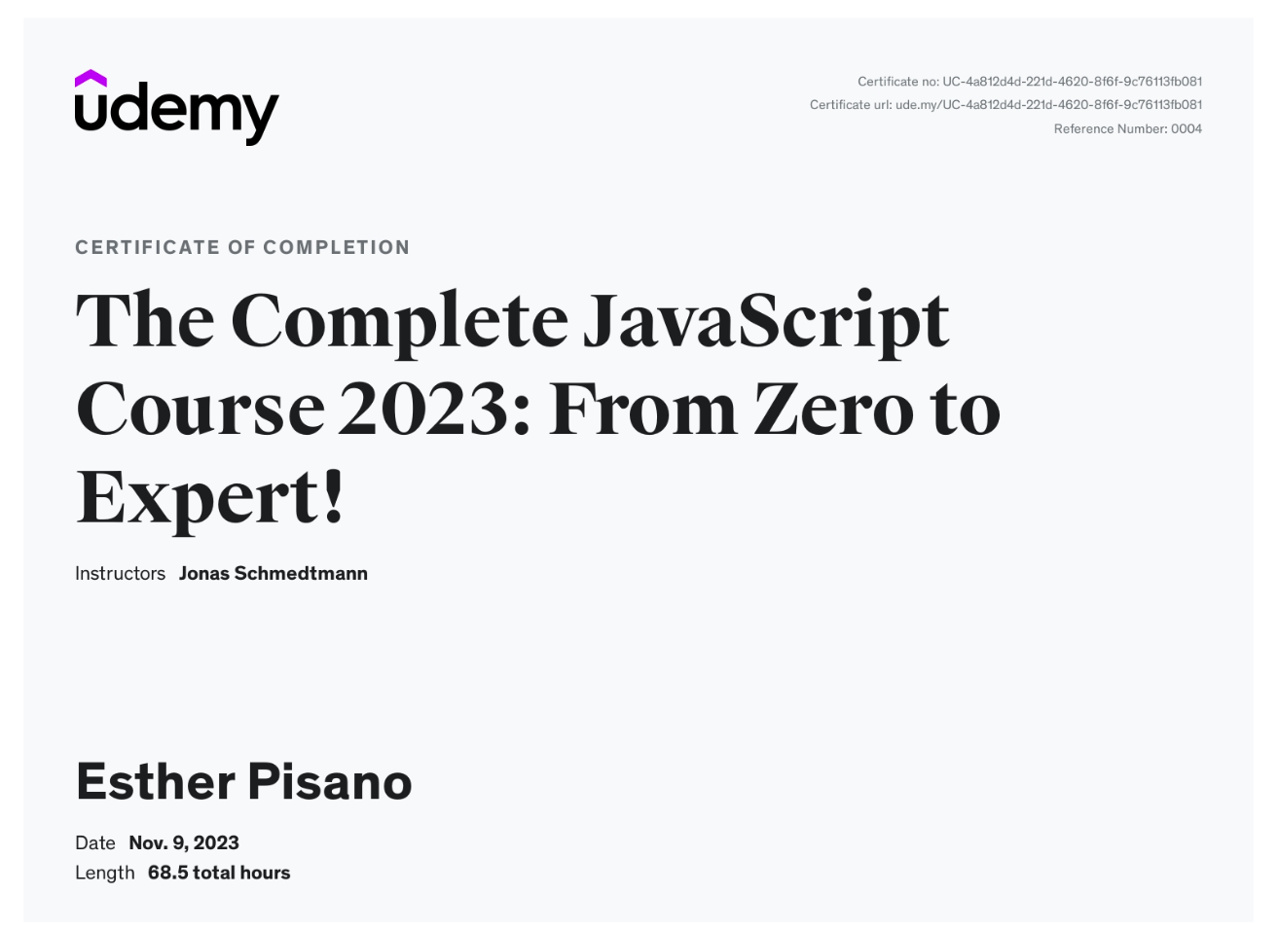
Skills & certificate
An advanced, confident, and modern JavaScript developer from scratch
Job-ready by understanding how JavaScript really works behind the scenes
How to think and work like a developer: problem-solving, researching, workflows
JavaScript fundamentals: variables, if/else, operators, boolean logic, functions, arrays, objects, loops, strings, etc.
Modern ES6+ from the beginning: arrow functions, destructuring, spread operator, optional chaining (ES2020), etc.
Modern OOP: Classes, constructors, prototypal inheritance, encapsulation, etc.
Complex concepts like the 'this' keyword, higher-order functions, closures, etc.
Asynchronous JavaScript: Event loop, promises, async/await, AJAX calls and APIs
How to architect the code using flowcharts and common patterns
Modern tools for 2022 and beyond: NPM, Parcel, Babel and ES6 modules

Slide 6
More
Learn how Blockchain works
Familiarize with Blockchain Definitions
Understand what makes Smart Contracts so “smart”
Learn how to build your Enterprise Blockchain career

Slide 7
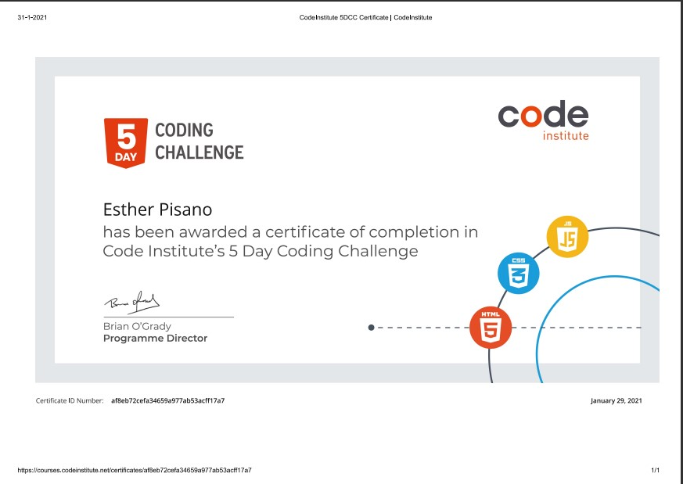

Slide 8
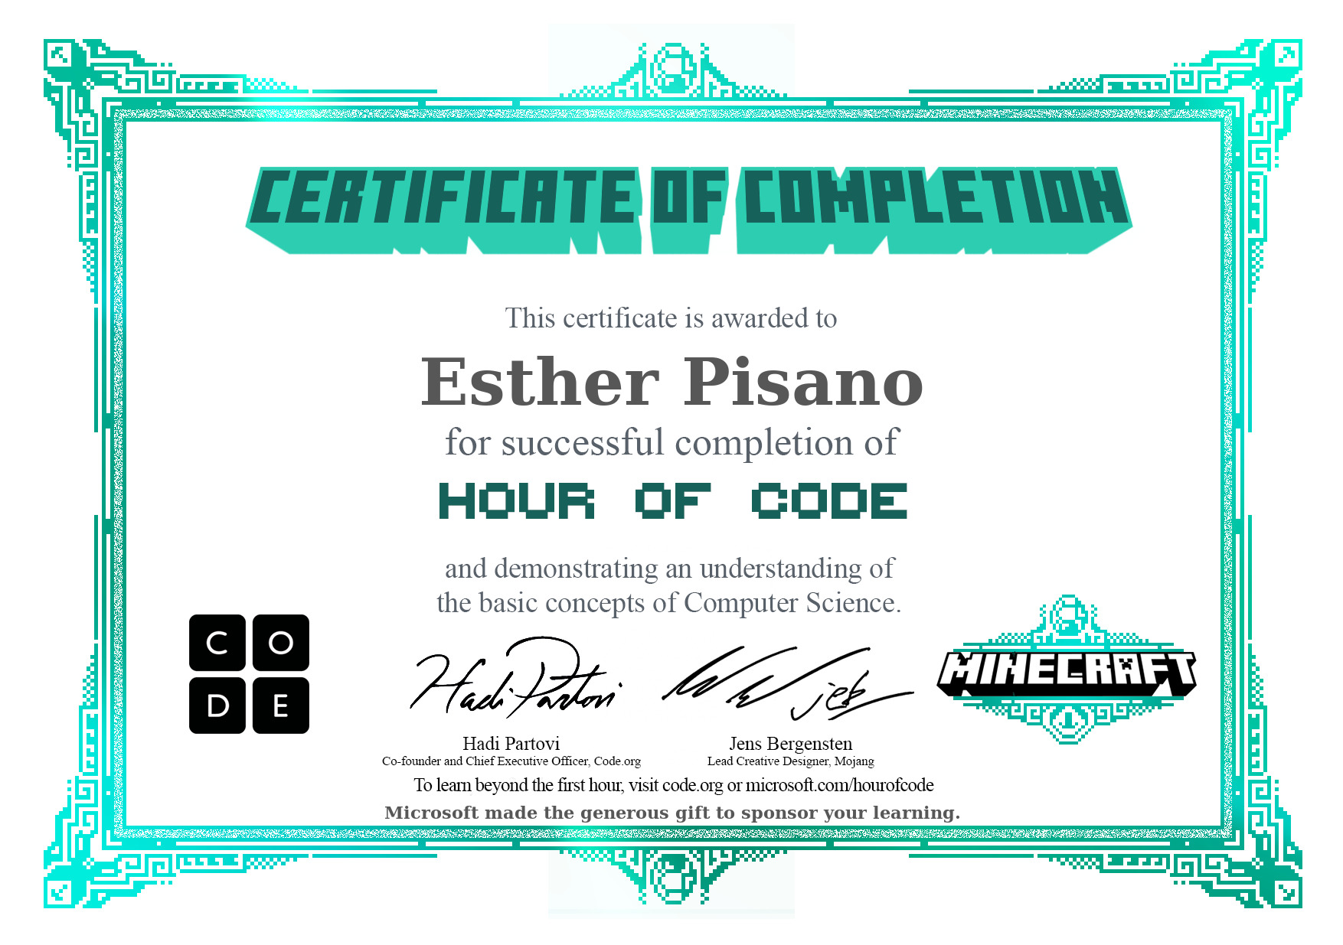

Slide 9
Social Media
GitHub: https://github.com/AwesomeGoesSavage-fr
Telegram: @awesomegoessavage

