Slide 1
GOOD MORNING!!!
Presentation on Bony Pelvis
Prepared by:Roll no(.11-15)
Gayatri Chaudhary Roll no.11
Hasina Devkota Roll no.12
Menuka Maharjan Roll no.13
Mili Maharjan Roll no.14
Meena katuwal , Roll no.15

Slide 2
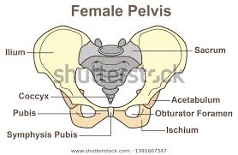
Bony Pelvis
It is the basin shaped complex of bones that connects the trunk and the leg.
It is also called bony pelvis or pelvic girdle.

Slide 3
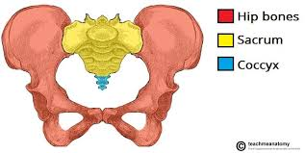
Parts of pelvis
Two innominate /Hip Bone(Nameless bone)
One Sacrum Bone
One Coccyx Bone.

Slide 4
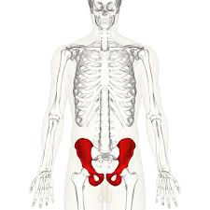
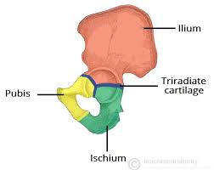
A. The Innominate Bone
Illium
Ischium
Pubis

Slide 5
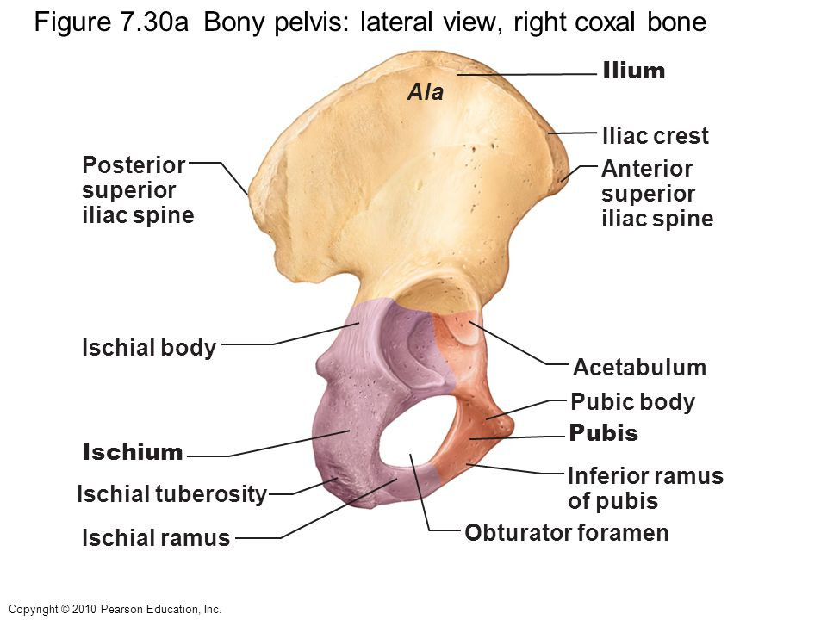
ILLIUM
Largest part of innominate bone which spread like a wings.
Two surface=inner concave surface is illiac fossa and outer convex is illiac creast.
Two projections=front is anterior superior illiac spine and back is posterior superior illiac spine.

Slide 6
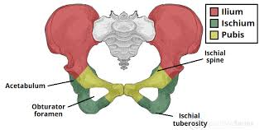
ISCHIUM
Thickest and lowest part of ischium,on the body rest while sitting= ischial tuberosity.
Sharp projection above ischial tuberosity ,directed backward and slightly inward =ischial spine,

Slide 7
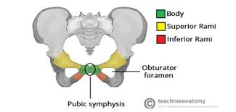
PUBIS
Consist of two pubis bone connected by cartilage called symphysis pubis.
Two projection=superior ramus and inferior ramus.
Superior ramus and ischial join forms =illiopectineal eminence.

Slide 8
B .SACRUM
Triangular shaped bone ,made up of 5 vertebrae fused together.
Anterior surface is concave and forms birth canal
Lateral surface extend into wings or ala.
Projection at center of upper part=promontary of sacrum.
4 pairs of holes allows
nerves from cauda
equida to pelvis organ.

Slide 9
C.COCCYX
Terminal part of spine.
Composed of 4 fused coccygeal vertebrae.
Moves backward /forward which increases diameter of pelvic outlet during normal birth.

Slide 10
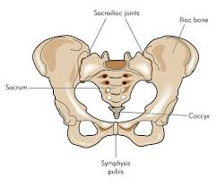
PELVIC JOINTS
4 pelvic joints.
Two sacroilliac joint=joint between sacrum and illium.
Symphysis pubis=forms between two pubic bone by pad of cartilage.
Sacro coccygeal joint=joint between sacrum and coccyx.

Slide 11
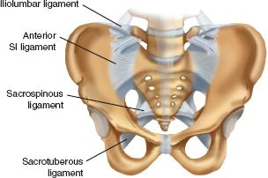
PELVIC LIGAMENTS
It is made up of fibrous tissue and helps to strengthen the joints.
2pelvic ligaments.
Sacrotuberous ligament=attached to posterior aspect of lower 3 sacral vertebrae and medial border of ischial tuberositis.
Sacrospinous ligament=triangular and thin extend from lateral border of sacrum and coccyx to ischial spine.

Slide 12
Functions of pelvis
Helps the body to maintain its balance and to support our weight.
Protects the reproductive organ ,bladder and other parts contained in pelvis.
Acetabulam receives head of femur ,thus helps in locomotion and movement of body.
Sacrum transmits cauda equina and distributes nerves to various parts of pelvis.
Women”s pelvis is adopted for childbearing process.

Slide 13
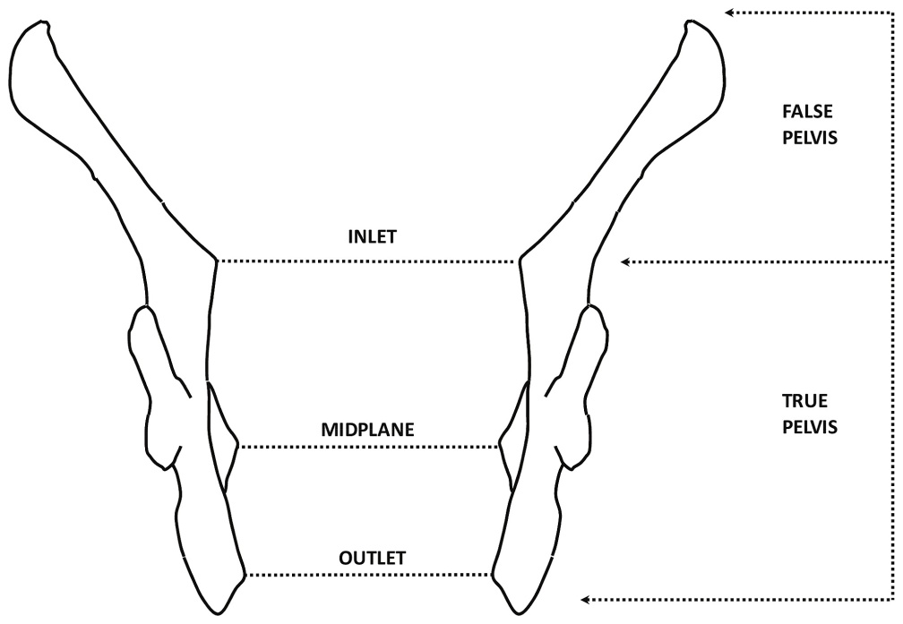
TRUE AND FALSE PELVIS.
False pelvis.
Parts of pelvis above pelvic brim.
Its boundaries are; posteriorly=lumber vertebrae.,,,laterally=illiac fossa.,,anteriorly=abdomen wall .
Functions=support the enlarged uterus during pregnacy.

Slide 14
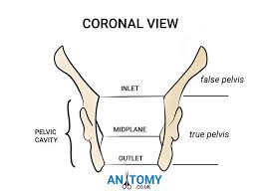
B.True pelvis.
Shallow bony passage which lies below the false pelvis.
It is divided into
The pelvis inlet(brim)
The pelvis cavity
The pelvis outlet.

Slide 15
The pelvis inlet.
It is round except where the sacral promontory projects into it.
Posteriorly=promontory and wings of sacrum.
Lateral =iliac bone
Anterior=pubic bone

Slide 16
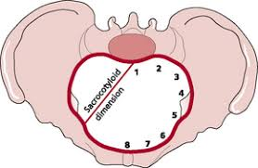
The landmark of pelvis brim are.
1=sacral promontory.
2=sacral ala or wings.
3=sacroiliac joints.
4=iliopectineal line(edge formed at the inward aspect of ilium)
5=iliopectineal eminence(roughened area formed where the superior ramus of pubic bone meets ilium).
6=Superior ramus of the pubic bone.
7=upper inner border of the body of the pubic bone.
8=upper inner border of the symphysis pubis.

Slide 17

Pelvis Cavity
Curved canal between brim and outlet; deeper at the back; almost circular.
The plane extend from the mid point of posterior surface of symphysis pubis to the junction of second and third sacral vertebrae.
It is the roomiest place of pelvis

Slide 18
Pelvis outlet.
Diamond shaped .
Anteriorly=sub pubis arch
Laterally=ischial tuberculosis and the sacro-tuberous ligament.
Posteriorly=tip of sacrum.

Slide 19
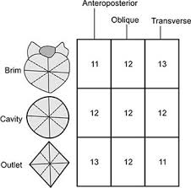
Measurement of pelvis canal diameters(in cm)

Slide 20
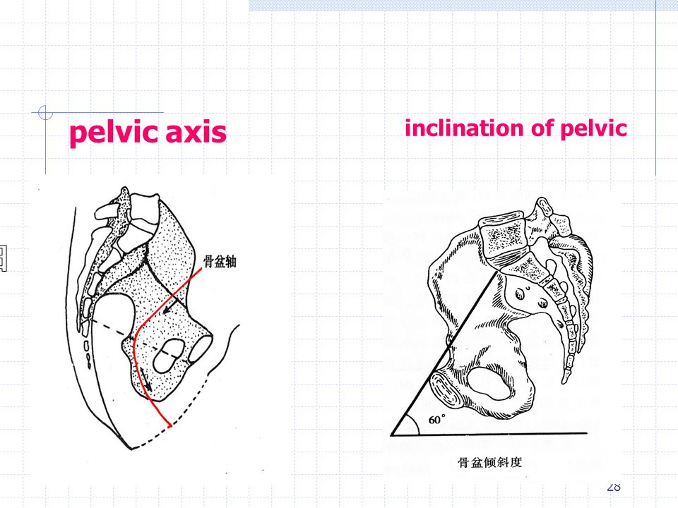
Pelvic inclination
When the woman stands up in an upright position,the pelvic brim is not horizontal but is tilted at an angle of 60 degree.This angle is called pelvic inclination.

Slide 21
Types of Pelvic.
Gynecoid pelvis.
Most common and present in50% of women/also known as true female pelvic.
Sacrum is well curved,sun pubic arch is at 90 degree or more and sacro –sciatic notch is wider and iliac crest is broad and well curved.
.

Slide 22
Round brim,shallow cavity;spacious and allows easy delivery
#Justo minor pelvis=It is a small gynocoid pelvic in minuature women of small statute with small hand and feet.

Slide 23
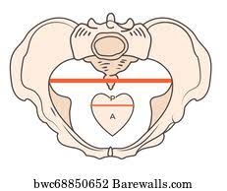
B .Android pelvis
Found in 20% of women.
triangular(heart) inlet ;which makes anterior posterior diameter of brim short.
Ischial spine are more prominent.(so difficult for head to decend through pelvic)

Slide 24
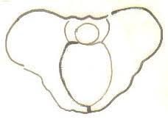
C.Anthropoid pelvic
Found in 25% of women.
Long oval inlet which makes anterioposterior diamet longer .
Ischial spine arenot prominent;sciatic notch is very wide.

Slide 25
D.Platypelloid pelvic
Rare and found in 5% of women.
Kidney shaped brim and not particularly conductive to vaginal delivery.(shoet anteroposterior diameter and a wide transverse diameter).
Ischial spine are somewhat blunt and pubic arch is wide.

Slide 26
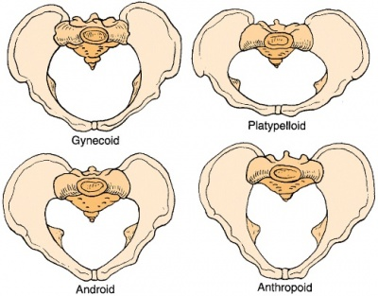
Differences of pelvis.

Slide 27
THANK YOU!!!!!!!!

