Slide 1
Sampling and Spectral Analysis
INTRODUCTION

Slide 2
INTRODUCTION
This workshop is about spectral analysis—determining the frequency components of a time-varying signal—and using the results to make decisions about selecting sensors, filters, and DAS sampling rates.
It is not clear at all from this signal, what might wrong.
Vertical component of engine acceleration as a function of time during the engine test:
time domain and frequency domain.

Slide 3
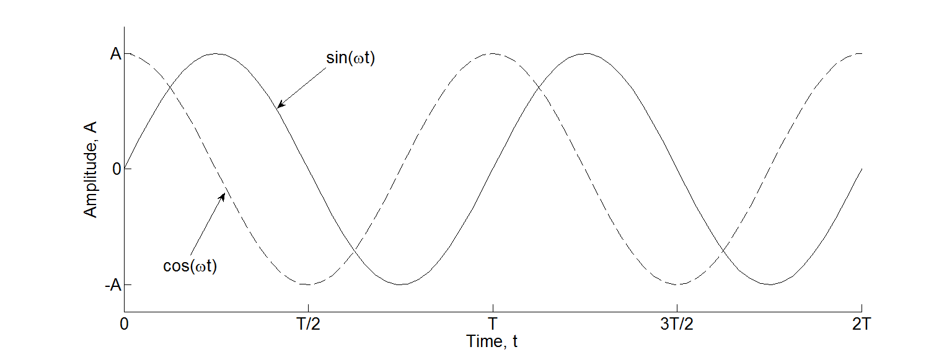
BASICS
Let us first recall the form of a sine wave.
where x_{DC} is the offset, A is amplitude (units of the measurand), ω is frequency (rad/s), and φ the phase shift (rad). Phase can be positive (lead) or negative (lag). Negative phase corresponds to a time delay

Slide 4
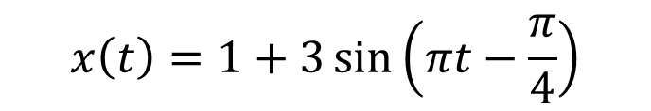
BASICS Nomenclature review
Identify each of the following terms on the graph and specify their numerical values using the graph and the equation:
$$x\left(t\right)=1+3\sin\left(πt−\frac{π}{4}\right)$$

Slide 5
Basics
Fourier Series
Any function x(t) can be expressed as an infinite series of sums of sine and cosine functions, called the Fourier series,
(1)
The coefficients a₀, a_{k}, b_{k} are found using the following integrals:
Part I exercise

Slide 6
Basics
Complex Fourier Series
The relationships between cosine, sine, and complex exponentials given by
Where . Substituting for x, these relationships are substituted in (1) to obtain the complex Fourier series:
(4)
The complex coefficients are found from
(5)

Slide 7


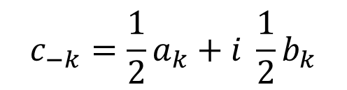
Basics
Complex Fourier Series
Relating the a’s, b’s, and c’s.
(6)
$$c_{0}=a_{0}$$
$$c_{+k}=\frac{1}{2}a_{k}−i \frac{1}{2}b_{k}$$
$$c_{−k}=\frac{1}{2}a_{k}+i \frac{1}{2}b_{k}$$

Slide 8
Basics
Discrete Fourier Transform (DFT)
The transform equations (4) and (5) are for functions that are periodic, continuous, and infinite.
But data are usually non-periodic, discrete, and finite. Without developing the derivation, we c_{k} in (5) using DFT given by
(7)

Slide 9
Basics
Discrete Fourier Transform (DFT)
Comparing the terms in (5) and (7):

Slide 10
Sampling rate
When we take data with a computer we are sampling analog (continuous) signals. In general, if we sample fast enough, there are no problems and the frequency spectrum is correctly represented. But how fast is fast enough?
Sampled Data
Aliased Signal
True Signal
Aliasing: misidentification of a signal frequency
Aliasing of a 10 Hz sine wave by sampling at 5 Hz.
Part II exercise

Slide 11
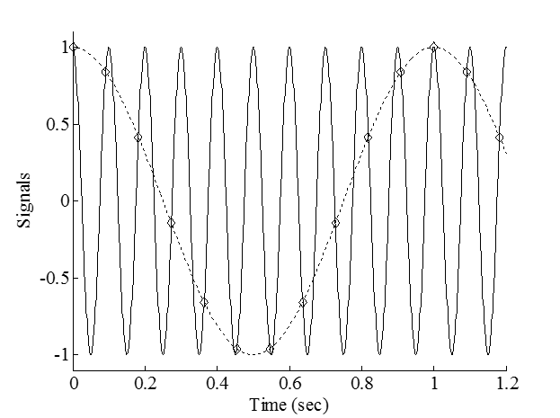
Sampling rate
Sampled Data
Aliased Signal
True Signal
The 10 Hz sine wave appears to be 1 Hz aliased signal.
Aliasing of a 10 Hz sine wave by sampling at 11 Hz.

Slide 12
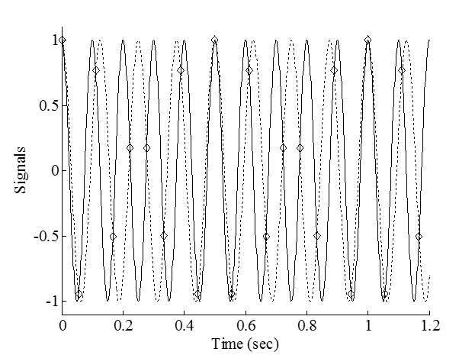
Sampling rate
Sampled Data
Aliased Signal
True Signal
The 10 Hz sine wave appears to be 8 Hz aliased signal.
Aliasing of a 10 Hz sine wave by sampling at 18 Hz.

Slide 13
Sampling rate
To correctly represent a sine wave from sampled data a minimum of 2 data points are required per period. This minimum is achieved when the sample frequency is twice the true frequency.
Another way of saying this is that the highest frequency that can be correctly represented in a sampled signal is one-half of the sample frequency, which is called the Nyquist frequency f_{N}
(8)
where f_{s} is the sampling frequency.

Slide 14

Sampling rate
Sampled Data
True Signal
The 10 Hz sine wave is accurately captured.
As a rule-of-thumb we want to keep the sampling frequency at 10x the highest frequency we expect in the signal we are measuring.
Sampling of a 10 Hz sine wave at 20 Hz.

