Slide 1
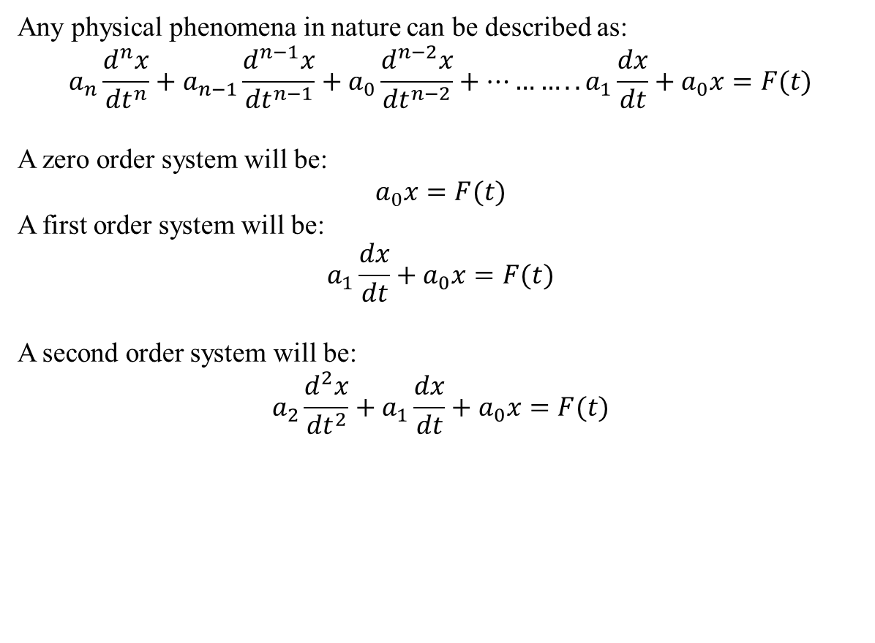
Different order systems
Vibration analysis and accelerometer
Till now we studied static measurement systems such that the output does not change with time
Vibration represents a dynamic system such that output changes with time
Any physical phenomena in nature can be described as:
$$a_{n}\frac{d^{n}x}{{dt}^{n}}+a_{n−1}\frac{d^{n−1}x}{{dt}^{n−1}}+a_{0}\frac{d^{n−2}x}{{dt}^{n−2}}+………..a_{1}\frac{dx}{dt}+a_{0}x=F(t)$$
A zero order system will be:
$$a_{0}x=F(t)$$
A first order system will be:
$$a_{1}\frac{dx}{dt}+a_{0}x=F(t)$$
A second order system will be:
$${a_{2}\frac{d^{2}x}{{dt}^{2}}+a}_{1}\frac{dx}{dt}+a_{0}x=F(t)$$

Slide 2
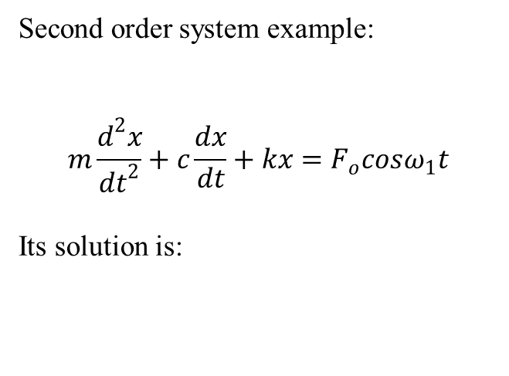
Second order system
Second order system example:
$$m\frac{d^{2}x}{{dt}^{2}}+c\frac{dx}{dt}+kx=F_{o}cosω_{1}t$$
Its solution is:
Frequency Amplitude response

Slide 3
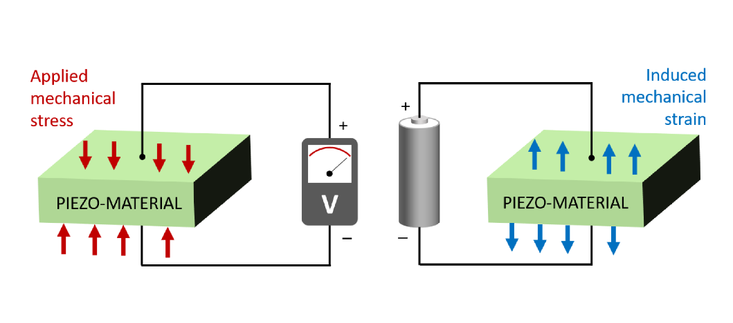
Principle of accelerometer
The mass present inside causes a force to the piezoelectric element which is proportional to the vibratory acceleration as long a frequency is less than the resonence frequency of complete spring mass system

Slide 4
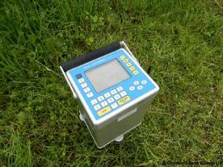
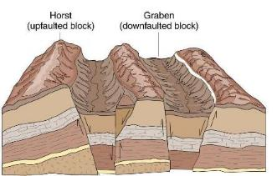
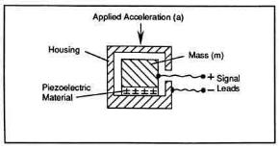
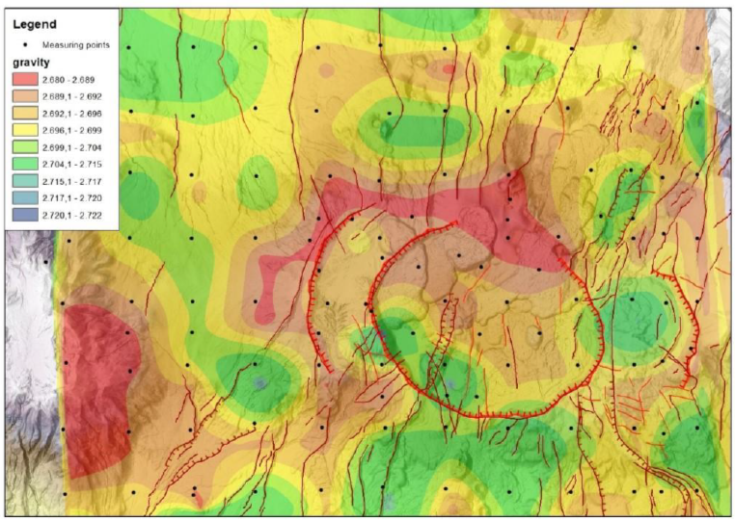
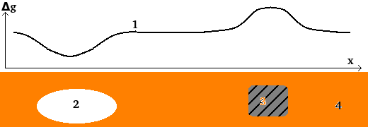
Applications of Accelerometers
Vibration of beams, cars and machines
Measuring seismic activity
Gravimetry
Gravimeter

Slide 5
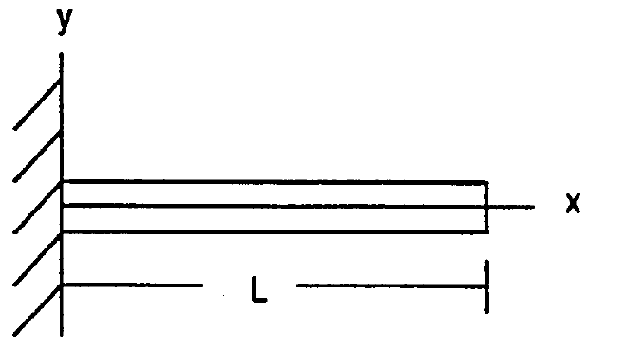
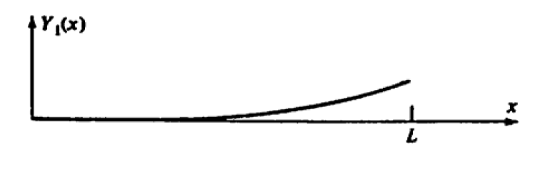

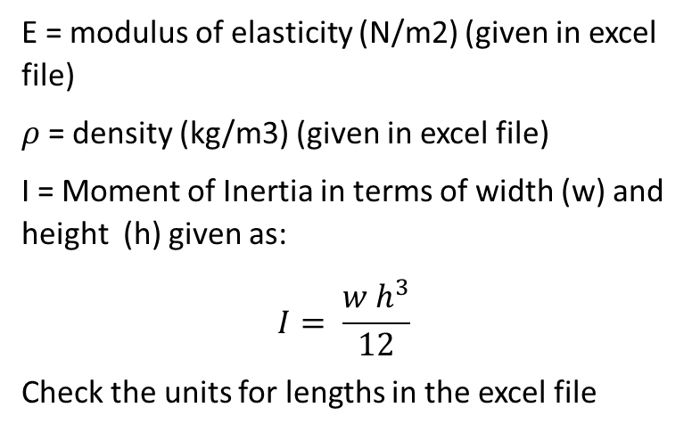
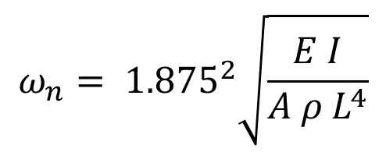
Experiment: frequency of a cantiliver beam
Theoretical Frequency
$$ω_{n}= {1.875}^{2}\sqrt{\frac{E I}{A ρ L^{4}}}$$
w
h
E = modulus of elasticity (N/m2) (given in excel file)
$ρ$= density (kg/m3) (given in excel file)
I = Moment of Inertia in terms of width (w) and height (h) given as:
$$I= \frac{w h^{3}}{12}$$
Check the units for lengths in the excel file

Slide 6
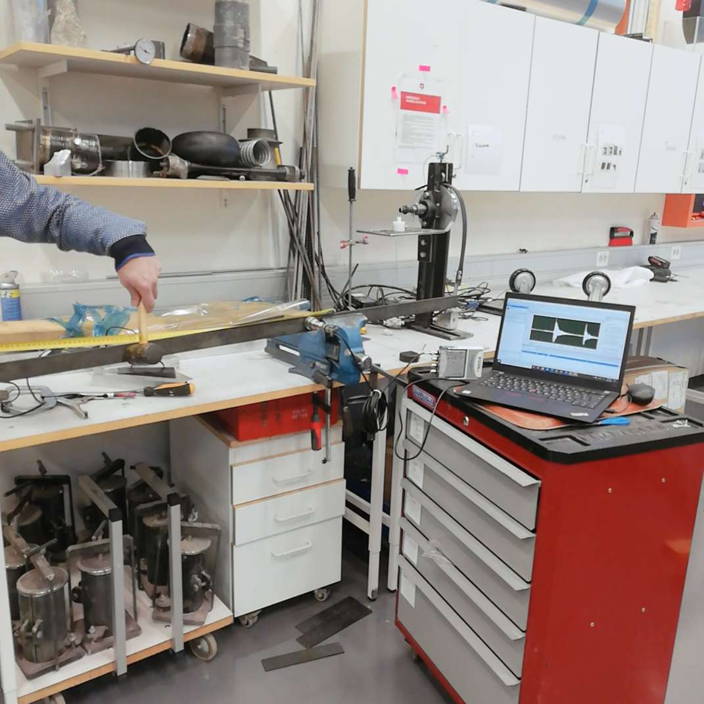
Experiment Steps
Experimental Frequency
Assemble the system as shown in figure
Measure the length of the beam
Measure the width and height of the beam
Insert these values in the excel file
Hit with the hammer at the end
Click the record button, once you see a proper sine wave on the screen
Extract the excel file for your data

