Slide 1
Microsoft .NET Cross-Platforms Dev & Migration Startup
Microsoft Enterprise Services
Apps Domain
Consultant
Xiyue Yu
yu.xiyue@microsoft.com
https://github.com/microshaoft

Slide 2

敏感话题 引子 Apple vs Google
苹果、谷歌 成功靠什么？
无疑都是 靠创新，但创新的特质不同，最近十年专利发明对比
鉴定完毕
左谷歌：
由8,888个团队已经产生了12,386项专利
右苹果：
由5,232个发明人的团队已经产生了10,975项专利
谷歌靠人
苹果靠神
数据可视化来源
http://www.periscopic.com/

Slide 3
敏感话题: 我大微软靠啥？
成功曾经靠什么？
由于创新不足，的确靠边儿了几年
Windows + Office
再次成功靠什么？
微软靠废
壮士断腕，背水一战，保三争一

Slide 4
.NET Glossary
https://docs.microsoft.com/en-us/dotnet/standard/glossary
https://docs.microsoft.com/en-us/dotnet/standard/frameworks
https://docs.microsoft.com/en-us/dotnet/core/versions/index
https://docs.microsoft.com/en-us/dotnet/core/rid-catalog
https://docs.microsoft.com/en-us/dotnet/core/tutorials/libraries

Slide 5
AOT
Ahead-of-time compiler.
Similar to JIT, this compiler also translates IL to machine code. In contrast to JIT compilation, AOT compilation happens before the application is executed and is usually performed on a different machine. Because AOT tool chains don't compile at runtime, they don't have to minimize time spent compiling. That means they can spend more time optimizing. Since the context of AOT is the entire application, the AOT compiler also performs cross-module linking and whole-program analysis, which means that all references are followed and a single executable is produced.
JIT
Just-in-time compiler.
Similar to AOT, this compiler translates IL to machine code that the processor understands. Unlike AOT, JIT compilation happens on demand and is performed on the same machine that the code needs to run on. Since JIT compilation occurs during execution of the application, compile time is part of the run time. Thus, JIT compilers have to balance time spent optimizing code against the savings that the resulting code can produce. But a JIT knows the actual hardware and can free developers from having to ship different implementations.

Slide 6
CoreRT
.NET Core runtime.
In contrast to the CLR/CoreCLR, CoreRT is not a virtual machine, which means it doesn't include the facilities to generate and run code on-the-fly because it doesn't include a JIT. It does, however, include the GC and the ability for runtime type identification (RTTI) and reflection. However, its type system is designed so that metadata for reflection isn't required. This enables having an AOT tool chain that can link away superfluous metadata and (more importantly) identify code that the app doesn't use. CoreRT is in development.
See Intro to .NET Native and CoreRT
.NET Native
A compiler tool chain that produces native code ahead-of-time (AOT), as opposed to just-in-time (JIT).
Compilation happens on the developer's machine similar to the way a C++ compiler and linker works. It removes unused code and spends more time optimizing it. It extracts code from libraries and merges them into the executable. The result is a single module that represents the entire app.
UWP was the first application framework supported by .NET Native. Now, we support building native console apps for Windows, macOS, and Linux.
See Intro to .NET Native and CoreRT
NGEN
Native (image) generation.
You can think of this technology as a persistent JIT compiler. It usually compiles code on the machine where the code is executed, but compilation typically occurs at install time.

Slide 7
A new world for .NET
WINDOWS APPLICATIONS
CROSS-PLATFORM SERVICES
MOBILE APPLICATIONS
.NET FRAMEWORK
.NET CORE
XAMARIN
Notes:
二、.NET core 与 .NET Framework的区别
.NET Core 就是.NET Framework的区别的开源且跨平台版本 .NET Core 虽然是.NET Framework的开源版本，但微软毕竟不能维护两个不同的分支 一个跑在Windows上，一个跑在Linux（Unix Like）系统上，所以微软抽象出来一个标准库 .NET Core 与 .NET Framework 都必须实现标准库的API ，就这样.NET Core、.NET Framework、XAMARIN成了三兄弟，分别为不同的平台服务。

Slide 8
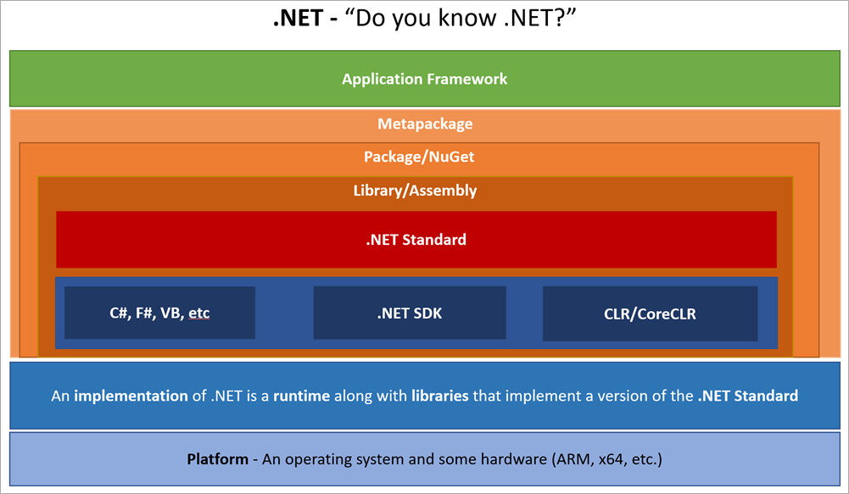

Slide 9
Here are these concepts used in an example sentence, for context:
Application Framework - “Are you using the ASP.NET Core web framework for that microservice?”
Metapackage - “I want to install the ASP.NET Core framework; it’s a package of packages”
Package/NuGet - “I know there’s a NuGet package for decoding JSON.”
Library/Assembly - “Now, you’ll compile your source into an assembly”
.NET Standard – “Which version of the .NET Standard specification does your assembly target?"
"My Apple Watch supports .NET Standard 1.6 but my Windows 10 laptop supports 2.0 with more APIs.”
C#, F#, VB, etc – “Which language did you use?”
.NET SDK - “Did you get the developer tools?”
CLR/CoreCLR – “Which runtime is your app using?”
An implementation of .NET is a runtime along with libraries that implement a version of the .NET Standard
“Are you using .NET Core, .NET Framework, or Mono for this project?”
Platform - An operating system and some hardware (ARM, x64, etc.)
“Is that an ASP.NET Core app running in Docker on a Raspberry Pi?”

Slide 10


Unified platform
WINDOWS APPLICATIONS
CROSS-PLATFORM SERVICES
.NET FRAMEWORK
MOBILE APPLICATIONS
.NET CORE
XAMARIN
TOOLS
Visual Studio
.NET STANDARD LIBRARY
Visual Studio Code
COMMON INFRASTRUCTURE
Xamarin Studio
Compilers
Languages
Runtime components

Slide 11
.NET Standard Library
WINDOWS APPLICATIONS
CROSS-PLATFORM SERVICES
.NET FRAMEWORK
MOBILE APPLICATIONS
.NET CORE
XAMARIN
TOOLS
Visual Studio
.NET STANDARD LIBRARY
Visual Studio Code
COMMON INFRASTRUCTURE
Xamarin Studio
Compilers
Languages
Runtime components

Slide 12
What is .NET Standard?
One library to rule them all
It is a specification, for any platform to implement by Microsoft
Reuse and Sharing your code or binaries across .NET platforms and solves the code sharing problem for .NET developers across all platforms by bringing all the APIs.
Easily consume third party / Open Source Software libraries
Evolution of Portable Class Libraries (PCLs) with a much simpler model
It’s a type of class library & provided as a NuGet package

Slide 13
.NET Standard 2.0
Much bigger API surface
It is a set of APIs that all .NET platforms have to implement. This unifies the .NET platforms and prevents future fragmentation.
Bigger API surface than old PCLs and .NET Standard 1.x
Extended to cover intersection between .NET Framework and Xamarin
.NET Core will bring the new API surface to comply with .NET Standard 2.0
.NET Framework interop （互操作）
Compatibility shim allows .NET Standard based libraries to reference existing .NET Framework binaries
No recompile required
Limited to .NET Framework libraries that only use APIs in .NET Standard (which are most of them)
Notes:
NET Standard
This repository contains the principles and definition of the .NET Standard.
.NET Standard solves the code sharing problem for .NET developers across all platforms by bringing all the APIs that you expect and love across the environments that you need: desktop applications, mobile apps & games, and cloud services:
.NET Standard is a set of APIs that all .NET platforms have to implement. This unifies the .NET platforms and prevents future fragmentation.
.NET Standard 2.0 will be implemented by .NET Framework, .NET Core, and Xamarin. For .NET Core, this will add many of the existing APIs that have been requested.
.NET Standard 2.0 includes a compatibility shim for .NET Framework binaries, significantly increasing the set of libraries that you can reference from your .NET Standard libraries.
.NET Standard will replace Portable Class Libraries (PCLs) as the tooling story for building multi-platform .NET libraries.

Slide 14
How does versioning work in .NET Standard?
2.0
Higher versions incorporate all APIs from previous versions.
Projects targeting version X.Y can reference libraries & projects targeting any version between 1.0 and X.Y
Concrete .NET platforms implement a specific version of .NET Standard
From that platform you can reference libraries up to that version
1.6
1.3
1.0

Slide 15
How is .NET Standard different from .NET Core?
.NET Standard is a specification that covers which APIs a .NET platform has to implement.
.NET Core is a concrete .NET platform and implements the .NET Standard.

Slide 16
How does .NET Standard work?
.NET Standard is represented by
The NuGet package NetStandard.Library which contains
The reference assembly netstandard.dll
At build time
.NET Standard bridges references to existing .NET Framework and PCL assemblies via type forwarding
At runtime
Each platform provides an implementation for netstandard.dll that type forwards to its implementation

Slide 17
APIs in .NET Standard 2.0
XML
XLinq • XML Document • XPath • Schema • XSL
SERIALIZATION
BinaryFormatter • Data Contract • XML
NETWORKING
Sockets • Http • Mail • WebSockets
IO
Files • Compression • MMF
THREADING
Threads • Thread Pool • Tasks
CORE
Primitives • Collections • Reflection • Interop • Linq

Slide 18
What’s new in .NET Standard 2.0?
Many more APIs!
Compat with .NET Framework libs!
.NET standard 2.0 more than doubles the number of available APIs!
Most libraries are still targeting .NET Framework
A compat shim makes them usable on other platforms, with caveats
Version | #APIs | Growth %
1.x | 13,501 | +1%
2.0 | 32,638 | +142%
Target | Usage on NuGet
.NET Framework | 46,894
.NET Standard | 1,886
PCL | 4,501

Slide 19
Platform | Version
.NET Standard | 1.0 | 1.1 | 1.2 | 1.3 | 1.4 | 1.5 | 1.6 | 2.0
.NET Core | 1.0 | 1.0 | 1.0 | 1.0 | 1.0 | 1.0 | 1.0 | 2.0
.NET Framework | 4.5 | 4.5 | 4.5.1 | 4.6 | 4.6.1 | 4.6.1 4.6.2 | 4.6.1 vNext | 4.6.1
Mono | 4.6 | 4.6 | 4.6 | 4.6 | 4.6 | 4.6 | 4.6 | vNext
Xamarin.iOS | 10.0 | 10.0 | 10.0 | 10.0 | 10.0 | 10.0 | 10.0 | vNext
Xamarin.Android | 7.0 | 7.0 | 7.0 | 7.0 | 7.0 | 7.0 | 7.0 | vNext
Universal Windows Platform | 10.0 | 10.0 | 10.0 | 10.0 | 10.0 | vNext | vNext | vNext
Windows | 8.0 | 8.0 | 8.1
Windows Phone | 8.1 | 8.1 | 8.1
Windows Phone Silverlight | 8.0
The higher the .NET Standard version, the more APIs are available to you.
The lower the .NET Standard version, the more platforms you can run on
如果是大量存量 .NET Framework 程序跨平台移植支持 .NET Standard 1.6 及以下请慎重

Slide 20
.NET Standard/Core 2.0 Roadmap
Milestone | Release Date
.NET Core 2.0 Preview 1 | Released on 2017/5/10, see announcement
.NET Standard 2.0 Preview 1 | Released on 2017/5/10, see announcement
.NET Core 2.0 Preview 2 | Released on 2017/6/28, see announcement
.NET Core 2.0 | Q3 2017, see also latest build 2017/09/18
.NET Standard 2.0 | Q3 2017 final https://github.com/dotnet/standard/issues/439
UWP 6.0 (implements .NET Standard 2.0) | Q4 2017 (Win10 Fall Creators Update)
.NET Core 2.1 | Q4 2017 (after UWP 6.0)

Slide 21
.NET Core 2.0 Preview 2.0 改进
首次给出了对所有平台上各种软件包和安装程序的统一命名模式。所有的运行时文件将以"dotnet-运行时名称”命名，而SDK将以“donet-SDK名称”命名。例如，Windows SDK文件将被命名为dotnet-sdk-2.0.4-win10-x64.exe。
如果开发人员的构建目标是.NET Standard 2.0，那么不再需要.NET Standard NuGet软件包给出所需的依赖，因为.NET Core SDK已经提供了该基础功能。
.NET Framework软件库可以从一个使用.NET Standard的项目中引用。类似地，.NET Core应用和软件库可以依赖于.NET Framework软件库。这一改进意在对从.NET Framework平滑迁移到.NET Standard项目提供帮助，适用于编译目标为.NET Framework 4.6.1及更早版本的代码

Slide 22
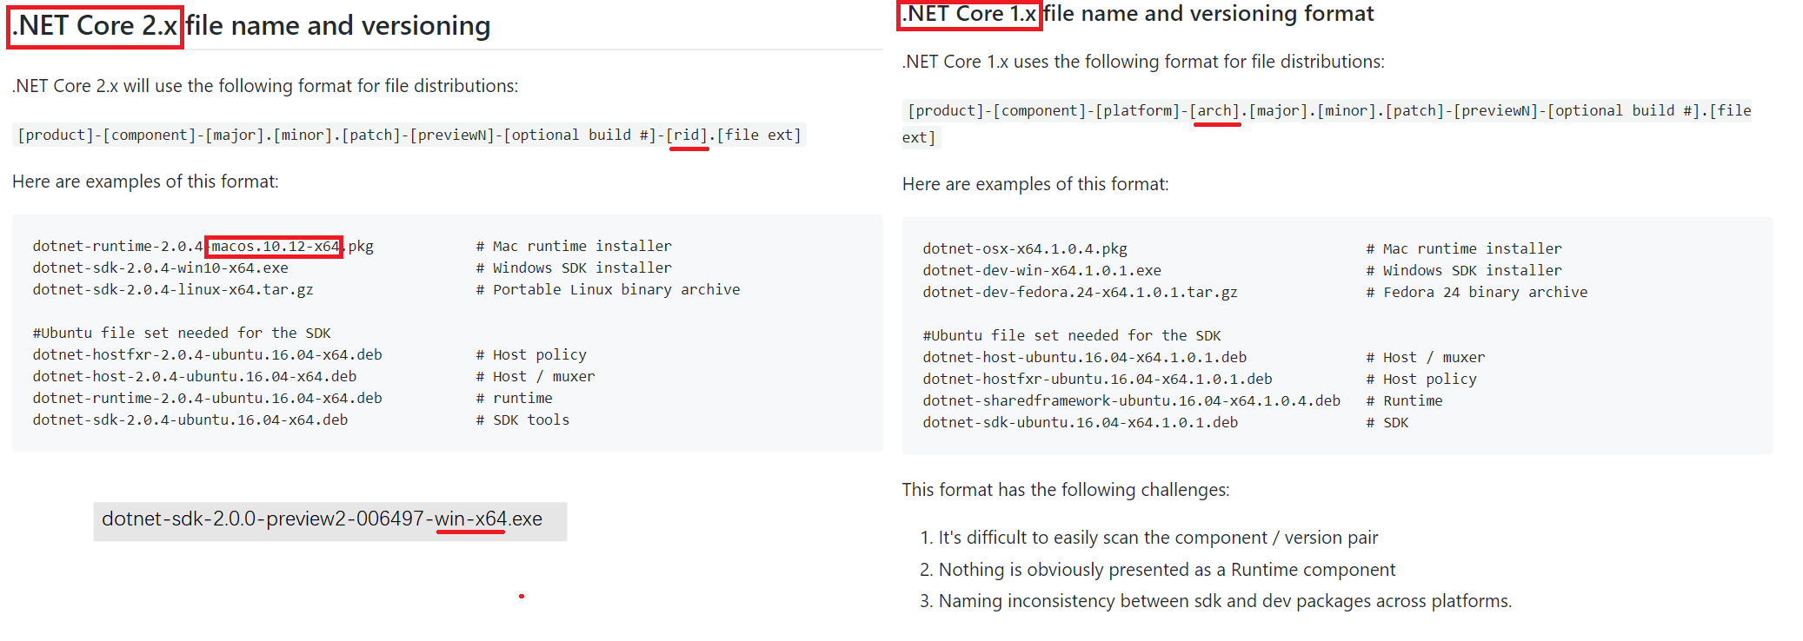
.NET Core 2+ Naming and Versioning
https://github.com/dotnet/designs

Slide 23
.NET 开源了, 微软不能再任性了
关于开源.NET版本的一个小插曲
围绕ASP.NET Core 2.0，他们在GitHub上吵什么？
NET 噩梦：ASP.NET Core 2.0 不再支持 .NET Framework
简单来说，微软之前开发 ASP.NET Core 2.0时，所有的代码都仅仅依赖于 .NET Standard 2.0，好处是可以在多个平台上运行，包括 .NET Framework 和 .NET Core。但是法国的微软 MVP Kévin Chalet 在​5月5号吃惊地发现微软工程师把所有的依赖项都从 .NET Standard 改为了 .NET Core，也就使 .NET Framework 这个平台不再受支持。于是他立即登录 GitHub 相关的仓库，开始和微软工程师沟通。而微软十四个小时之后才由 Scott Hanselman 做出了初步回应，而且不甚详细。
最终结论
以.NET码农的名义，参与监督的 .NET 开源项目的工作
​ASP.NET Core 2.0 Preview 2 将会重新支持 .NET Framework，微软不会在近期放弃这个用户众多的老平台。
微软吸取教训，信息公开最重要，这也是管理开源项目必须承担的东西了。
微软目前是 github 开源代码贡献第一
https://news.cnblogs.com/n/566180
http://www.infoworld.com/article/3149765/application-development/win-win-open-source-net-pays-off-for-devs.html
https://dotnetfoundation.org/projects

Slide 24
.NET 开源了, 微软不能再任性了
关于开源.NET版本的一个小插曲
围绕ASP.NET Core 2.0，他们在GitHub上吵什么？
NET 噩梦：ASP.NET Core 2.0 不再支持 .NET Framework
简单来说，微软之前开发 ASP.NET Core 2.0时，所有的代码都仅仅依赖于 .NET Standard 2.0，好处是可以在多个平台上运行，包括 .NET Framework 和 .NET Core。但是法国的微软 MVP Kévin Chalet 在​5月5号吃惊地发现微软工程师把所有的依赖项都从 .NET Standard 改为了 .NET Core，也就使 .NET Framework 这个平台不再受支持。于是他立即登录 GitHub 相关的仓库，开始和微软工程师沟通。而微软十四个小时之后才由 Scott Hanselman 做出了初步回应，而且不甚详细。
最终结论
以.NET码农的名义，参与监督的 .NET 开源项目的工作
​ASP.NET Core 2.0 Preview 2 将会重新支持 .NET Framework，微软不会在近期放弃这个用户众多的老平台。
微软吸取教训，信息公开最重要，这也是管理开源项目必须承担的东西了。
微软目前是 github 开源代码贡献第一
https://news.cnblogs.com/n/566180
http://www.infoworld.com/article/3149765/application-development/win-win-open-source-net-pays-off-for-devs.html
https://dotnetfoundation.org/projects

Slide 25
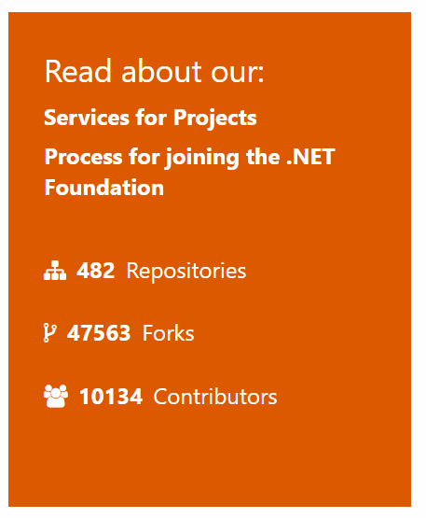

.NET Open Source momentum
ASP.NET Core
IdentityManager
MEF
.NET Core
Mono
Mailkit
Kudu
Cecil
Microsoft Azure SDK for .NET
Cake
Xamarin.Auth
xUnit.net
Open Live Writer
Mimekit
Nancy
WCF
Couchbase Lite for .NET
ASP.NET Web Pages
Umbraco
LLILC
Orchard CMS
System.Drawing
IdentityServer
ASP.NET MVC
Open XML SDK
NuGet
OWIN Authentication Middleware
Polly
Orleans
Microsoft Azure WebJobs SDK
Prism
Xamarin.Mobile
Salesforce Toolkits for .NET
ASP.NET SignalR
Xamarin SDK
ASP.NET Web API
.NET SDK for Hadoop
WorldWide Telescope
Entity Framework
Benchmark.NET
MVVM Light Toolkit
.NET Compiler Platform ("Roslyn")
MSBuild
ASP.NET AJAX Control Toolkit
ProtoBuild
http://www.infoworld.com/article/3149765/application-development/win-win-open-source-net-pays-off-for-devs.html

Slide 26
开源文化、精神
开源不等于免费、开源尊重版权
具有开源传染性的许可协议
充分体现了开源文化与精神
强制必须参与贡献开源代码
如： GPL/LGPL
不具开源传染性的许可协议
体现了作者奉献精神
可能满足了作者个人精神上的诉求
作者也可能不负责任，靠开源弥补
被开源吸血者利用，然后闭源
参与贡献才是开源真谛，而不是在闭源后简单的声明致谢，取之于民，用之于民
开源有其他问题吗？
病毒武器库
信息泄露
非死不可公司 开源负面新闻一则
《如何看待Apache基金会禁止使用React在内的Facebook license软件？》
https://www.zhihu.com/question/62577904/answer/200334320?from=timeline&utm_source=wechat_session&utm_medium=social

Slide 27
.NET Core command-line interface (CLI) tools Brief Introduce
https://docs.microsoft.com/en-us/dotnet/core/tools/
Basic commands
new
restore
build
publish
run
test
vstest
pack
migrate
clean
sln
Project modification commands
add package
add reference
remove package
remove reference
list reference
Advanced commands
nuget delete
nuget locals
nuget push
msbuild
dotnet install script

Slide 28
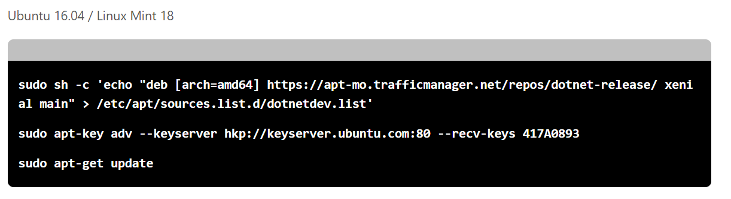
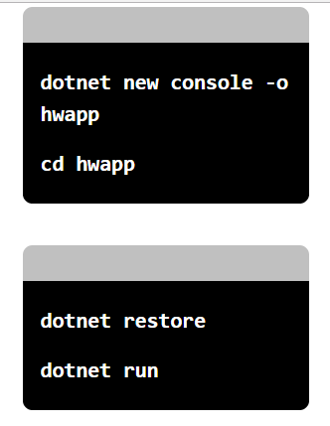
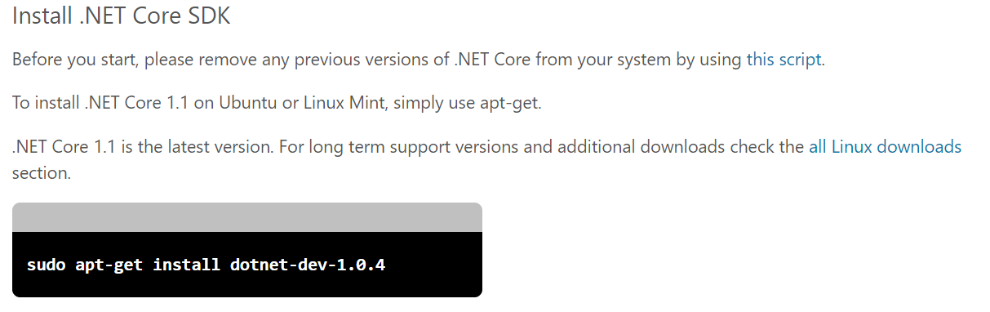
.NET Core command-line interface (CLI) tools Sample

Slide 29
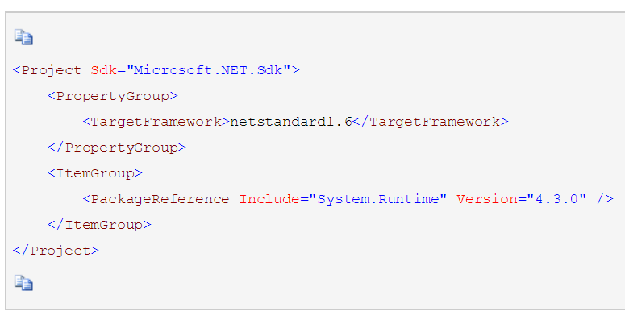
Packages, Metapackages and Frameworks
NET Core是一个由NuGet包组成的平台。一些产品受益于细粒度包的定义，也有一些受益于粗粒度包的定义。为了适应这种二重性，根据颗粒度如下定义：
Package (包)
粒度最小，最原子，如：
System.Runtime - 这是最基本的.NET Core包，包括Object, String, Array, Action 和IList<T>.
System.Collections - 表示一组常用泛型集合，包括List<T> 和Dictionary<K,V>.
System.Net.Http - 用于HTTP通讯的类型，包括HttpClient 和HttpResponseMessage.
System.IO.FileSystem -用于读写基于磁盘的本地或网络存储类型，包括File和Directory.
System.Linq - 用于查询对象，包括including Enumerable 和ILookup<TKey, TElement>.
System.Reflection - 用于加载、检查、创建类型，包括Assembly, TypeInfo 和MethodInfo.
说明：
细粒度的包在开发、测试过程中与其它包的关联有限
细粒度的包可以提供对不同操作系统和CPU的支持
细粒度的包可以只依赖某个特定的库
在发布应用时，未被引用的包不会成为应用的一部分，因此应用程序会有更小的体积

Slide 30
Packages, Metapackages and Frameworks
MetaPackage (元包)
元包是一个NuGet包约定，用于描述一组放在一起有意义的包。 这些包是通过依赖项来被描述的，如：
.NET 标准库元包(.NET Standard Library metapackage)：
NETStandard.Library - 表示.NET标准类库的一部分。所有的.NET 实现（如，.NET Framework、.NET Core 和 Mono）都支持.NET 标准类库。NETStandard.Library用于建立netstandard框架。
.NET Core核心元包有：
Microsoft.NETCore.App - .NET Core发行版本类库的一部分，用于建立 .NETCoreApp框架，它依赖NETStandard.Library。
Microsoft.NETCore.Portable.Compatibility - 一组基于mscorlib的运行于.NET Core上的可移植类库
说明：
避免同时在引用大量原子细粒度包，从而有更好的用户体验
定义了一组经过测试且运行良好的包（包括指定的各种版本）

Slide 31
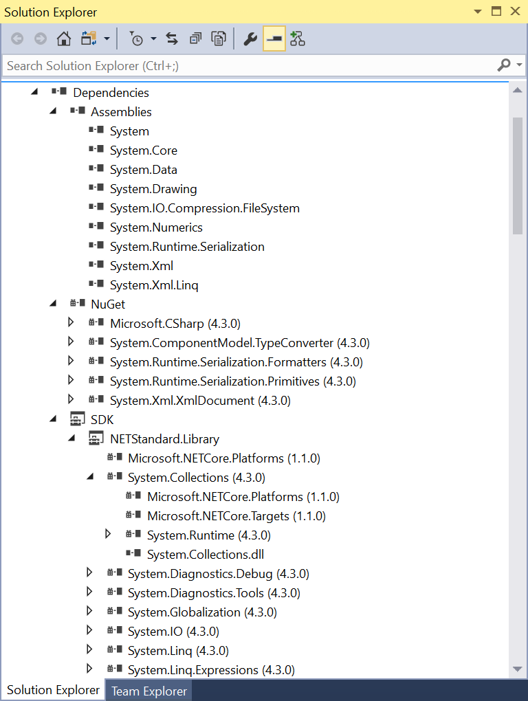
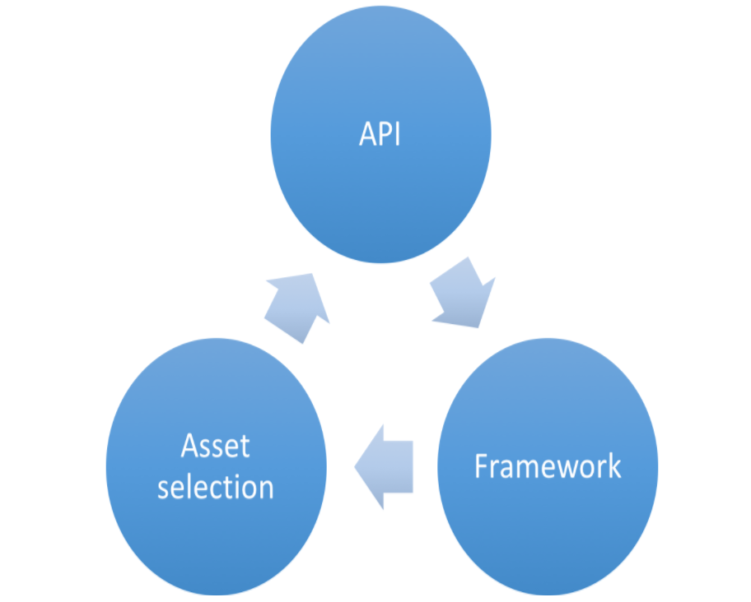
Packages, Metapackages and Frameworks
Framework (框架)
传统的框架：
是事先定义好的一个整体，而 基于包的框架，则可以对不同的包自由组合。
如：.NETFramework,Version=4.6
基于包的框架
每一个 .Net Core 包都支持一组框架，在框架文件夹中进行声明(就在前面所说的 lib 与 ref目录中)。框架描述了一组可用的API（以及潜在的其他特性），当指定一个目标框架时得到相应的功能。
如：.NETStandard,Version=1.3
这个框架是一个基于包的框架。那些以此框架为目标的包，定义并且实现的API，就组成了这个框架。
“基于包的框架”与“包”之间的关系是双向的。
Notes:
首先是为一个给定的框架定义了一组API，如 netstandard1.3。以 netstandard1.3 为目标的包（或者兼容框架，如netstandard1.0）定义了哪些API是可以使用的，听起来像是循环定义，然而并不是。从 “基于包的”这个词本身的角度来讲，框架的API定义是来自于包的，框架本身并不定义任何API。
其次，是这个双向关系中的资产选择。包内部可以含有不同框架的资产，对于一组包或者元包的引用，框架需要决定它应选择哪些资产，例如，是 net46 还是 netstandard1.3。对于交叉资产来说，这个非常重要，例如，一个 net46 的资产可能并不会与 .Net Framework 4.0 或者 .Net Core 1.0 兼容。

Slide 32
Some significant changes happened
We announced some significant changes in May
https://blogs.msdn.microsoft.com/dotnet/2016/05/23/changes-to-project-json/ for more context
The project.json project system is going away
We are back to csproj, vbproj and fsproj
The build system is standardizing on msbuild

Slide 33
跨平台代码移植、开发初探(1)
工具静态分析评估
VS + .NET Portability Analyzer
Visual Studio 扩展
Evaluates portability of assemblies across .NET platforms
https://github.com/Microsoft/dotnet-apiport
https://github.com/Microsoft/dotnet-apiport/releases
https://marketplace.visualstudio.com/items?itemName=ConnieYau.NETPortabilityAnalyzer
VS + .NET API Analyzer
NuGet package Microsoft.DotNet.Analyzers.Compatibility
第三方开源工具
https://icanhasdot.net/
https://github.com/hvanbakel/CsprojToVs2017

Slide 34
The Roslyn based Analyzers
API Analyzer: This analyzer examines your code for potential compatibility risks or uses of deprecated APIs.
Framework Analyzer: This analyzer examines your code to ensure it follows the guidelines for .NET Framework applications. These rules include several security-based recommendations.
.NET Portability Analyzer: This analyzer examines your code to see how much work is required to make your application compatible with other .NET implementations and profiles, including .NET Core, .NET Standard, UWP, and Xamarin for iOS, Android, and Mac.

Slide 35
将包移植到 PackageReference
.NET Core 使用 PackageReference 来指定包依赖项。 如果使用 packages.config 来指定包，将需要转换为 PackageReference。使用 PackageReference 的好处
在一个位置管理所有项目依赖项：与项目到项目的引用和程序集引用一样，NuGet 包引用（使用 PackageReference 节点）直接在项目文件中进行管理，而不是使用单独的 packages.config 文件进行管理。
顶级依赖项的有序视图：与 packages.config 不同，PackageReference 仅列出那些直接安装在项目中的 NuGet 包。 因此，NuGet 包管理器 UI 和项目文件不会与低级依赖项混在一起。
性能改进：使用 PackageReference 时，包保留在 global-packages 文件夹中（而不是解决方案中的 packages 文件夹中），如管理全局包和缓存文件夹中所述。 因此，PackageReference 的执行速度更快，但占用的磁盘空间更少。
更好地控制依赖项和内容流：使用 MSBuild 的现有功能可以有条件地引用 NuGet 包，并选择每个目标框架、配置、平台或其他透视的包引用。
PackageReference 正处于积极开发阶段：请参阅 GitHub 上的 PackageReference 问题。 packages.config 不再处于积极开发阶段。
限制
NuGet PackageReference 在 Visual Studio 2015 及更早版本中不可用。 只能在 Visual Studio 2017 及更高版本中打开已迁移的项目。
目前，C++ 和 ASP.NET 项目无法进行迁移。
某些包可能与 PackageReference 不完全兼容。 有关详细信息，请参阅包兼容性问题。

Slide 36
跨平台代码移植、开发初探(2)
人肉分析工具
Source Code
.NET Core (CoreFx) source index:
https://source.dot.net
ASP.NET Core 1.0 (unofficial) source index:
https://aspnetsource.azurewebsites.net/
"Full" .NET Framework source index:
https://referencesource.microsoft.com
API Reference
API Browser:
https://docs.microsoft.com/en-us/dotnet/core/api
API Catalog: (incl. APIs from daily builds and API usage info)
http://apisof.net/
API Reverse Package search:
http://packagesearch.azurewebsites.net/

Slide 37
Windows Compatibility Pack for .NET Core
https://docs.microsoft.com/en-us/dotnet/standard/choosing-core-framework-server
https://www.nuget.org/packages/Microsoft.Windows.Compatibility
https://docs.microsoft.com/en-us/dotnet/standard/choosing-core-framework-server

Slide 38
跨平台代码移植、开发初探(3)
简单样例演示
小目标（初级）：
简单移植
共享代码
独立工程
编译通过
条件编译
Socket.Close(）
编写兼容的代码
Array.ForEach()
Foreach()
寻求目标平台的类似功能替代物或Port
特定平台特有功能及其API，如：
PerformanceCounter => Metrics.NET
.注册表
放弃，改用conf
区分平台写代码，或条件编译
跨平台源代码调试
VS2017 Remote Debug + BASH/SSH on WSL

Slide 39
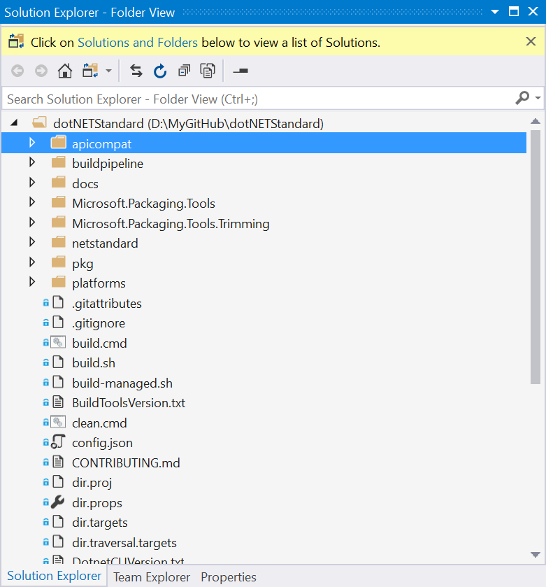
.NET Standard 到底长啥样?
https://github.com/dotnet/standard
https://github.com/dotnet/standard/blob/master/docs/versions.md
https://github.com/dotnet/standard/blob/master/docs/faq.md
Open In Visual Stuido 2017
支持 File->Open->Folder

Slide 40
最后插播 github 公益广告一条
农码一生 代码不腐
星不在多 有码就行
GitHub开放员工用公司资源开发个人项目，还保证不抢走知识产权
https://news.cnblogs.com/n/565587/

Slide 41
.NET 5

Slide 42
.NET 5
.NET
.NET FRAMEWORK
.NET CORE
.NET
XAMARIN / MONO
Runtime (JIT & Native)
Runtime
Runtime
Runtime
One Base Class Library
Base Class Library
Core Library
Mono Class Library
.NET STANDARD
Notes:
2019 – Introduce .NET 5 – Windows, Mac, Linux, Android, IOS all run .NET Core’s runtime
Same BCL used on all platforms, same runtime used on all platforms
Native code compilation on all platforms, by merging .NET Native and Mono AOT
JIT and AOT Runtime
.NET 5 is the next major version of the .NET Platform that brings technologies from .NET Framework, .NET Core and & Mono runtimes and frameworks together into one .NET platform.
.NET 5 will have one Base Class Library (BCL) that will contain APIs for building any type of application. All .NET workloads are supported with application frameworks including cross-platform web development with ASP.NET, iOS and Android mobile development with Xamarin, Windows Desktop, and cross-platform IoT.
.NET 5 will have both Just-in-Time (JIT) and Ahead-of-Time (AOT) compilation models for the multiple compute and device scenarios it must support. JIT has better performance for server and desktop workloads as well as development environments. AOT has better startup, a small footprint, and is required for mobile and IoT devices.
.NET 5 will also have one unified toolchain supported by new SDK project types, will have a flexible deployment model (Side-by-Side and self-contained EXEs) and continue .NET Core's superior performance for server & cloud workloads.

Slide 43
.NET Schedule
July 2019
.NET Core 3.0
RC
Sept 2019
.NET Core 3.0
Nov 2019
.NET Core 3.1
LTS
Nov 2020
.NET 5.0
Nov 2021
.NET 6.0
LTS
Nov 2022
.NET 7.0
Nov 2023
.NET 8.0
LTS
.NET Core 3.0 released today!
.NET Core 3.1 = Long Term Support (LTS)
.NET 5.0 release in November 2020
Major releases every year, LTS for even numbered releases
Predictable schedule, minor releases if needed

Slide 44











.NET – A unified platform
TOOLS
DESKTOP
WEB
CLOUD
MOBILE
GAMING
IoT
AI
WPF
Windows Forms
UWP
ASP.NET
Azure
Xamarin
Unity
ARM32
ARM64
ML.NET
.NET for Apache Spark
VISUAL STUDIO
.NET STANDARD
VISUAL STUDIO FOR MAC
.NET 5
VISUAL STUDIO CODE
INFRASTRUCTURE
RUNTIME COMPONENTS
COMPILERS
LANGUAGES
COMMAND LINE INTERFACE

