Slide 1
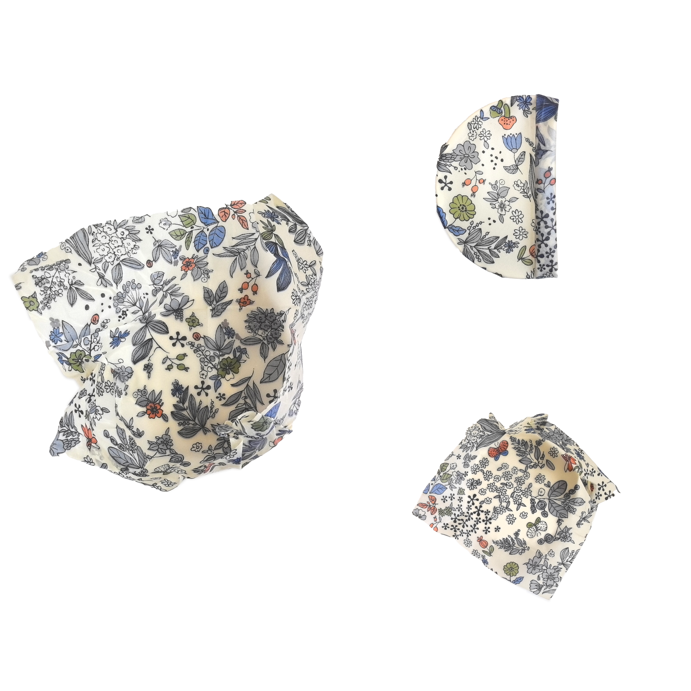
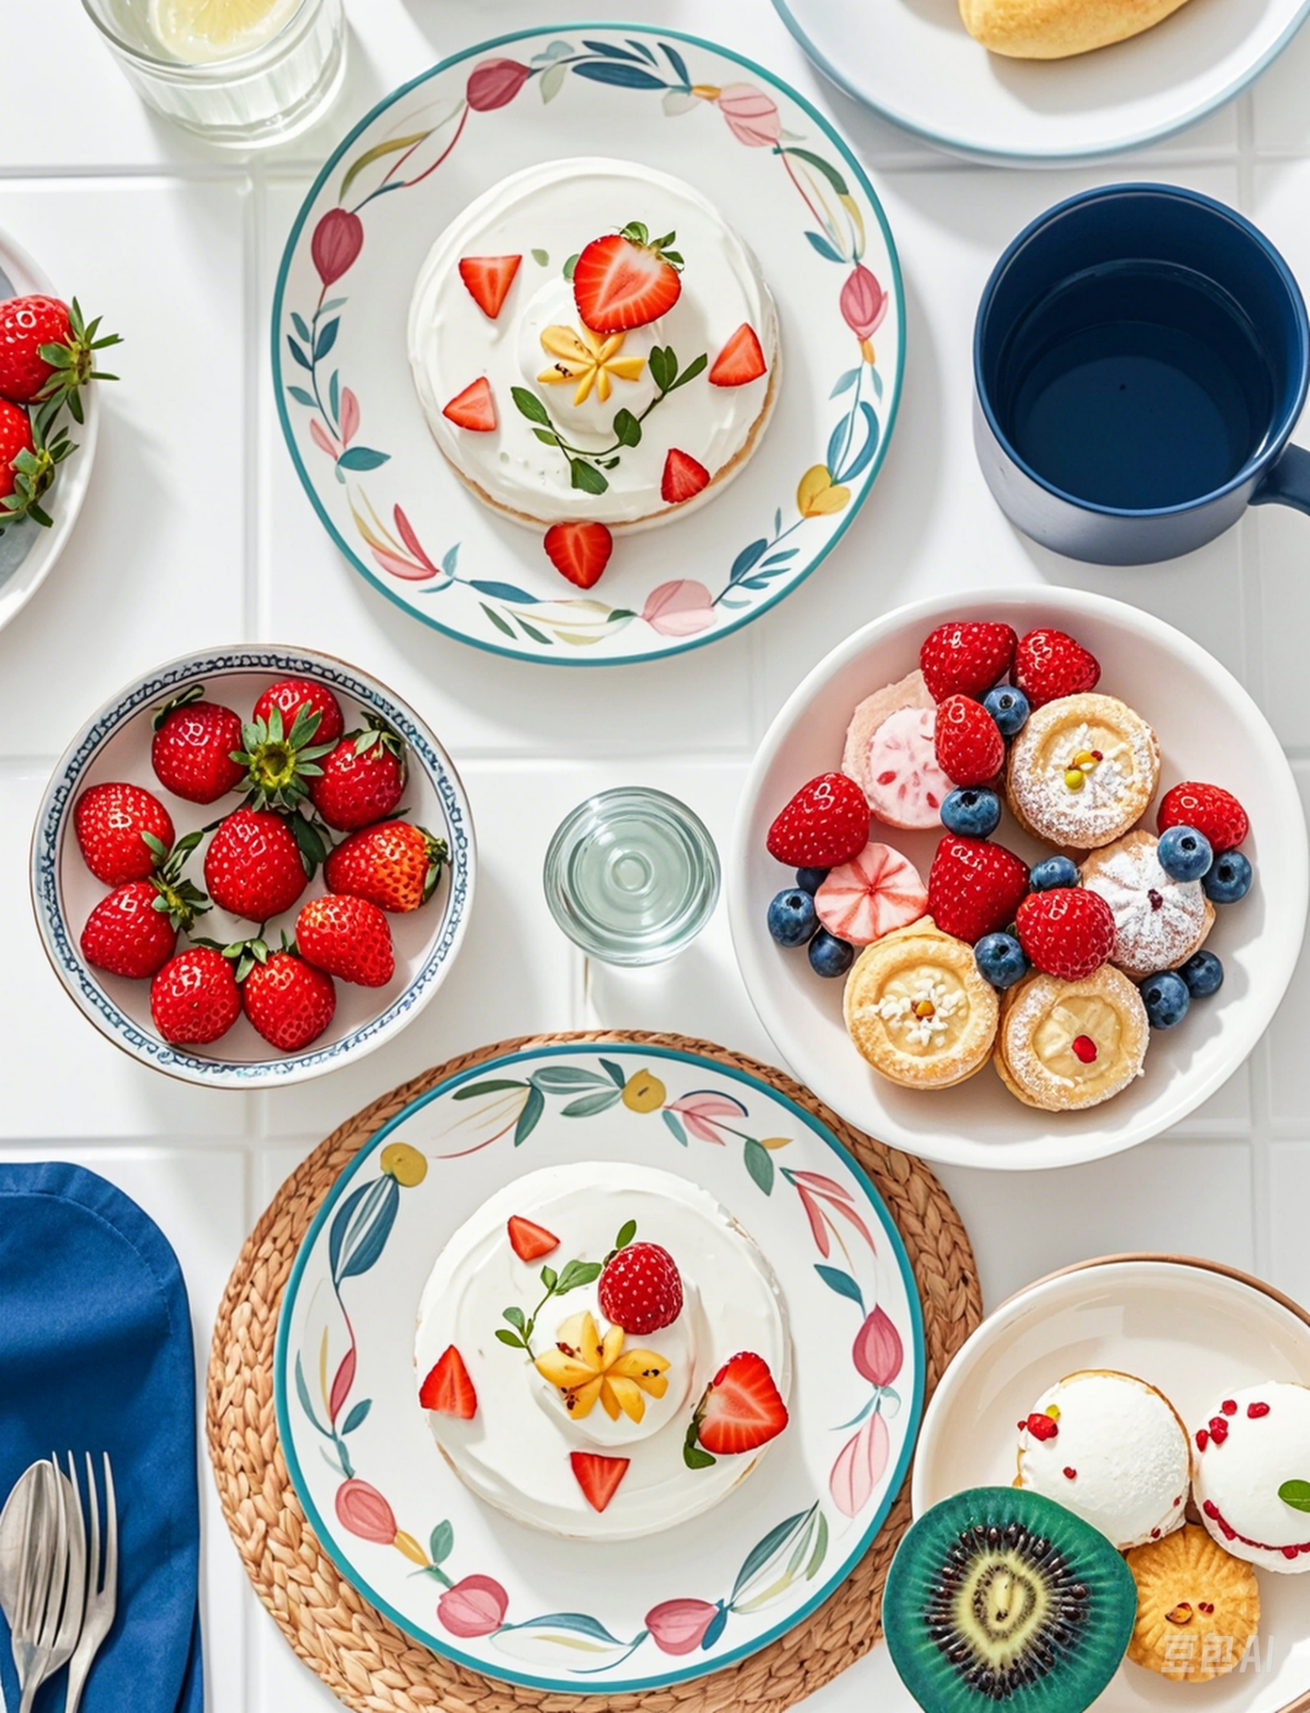
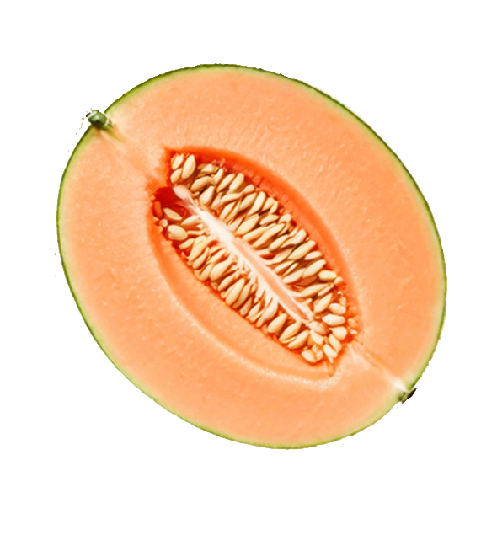

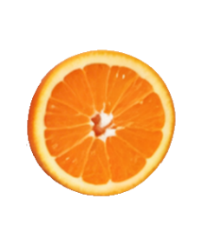
Beewax Wrap makes it easy to cut down on plastic and store food sustainably

Slide 2
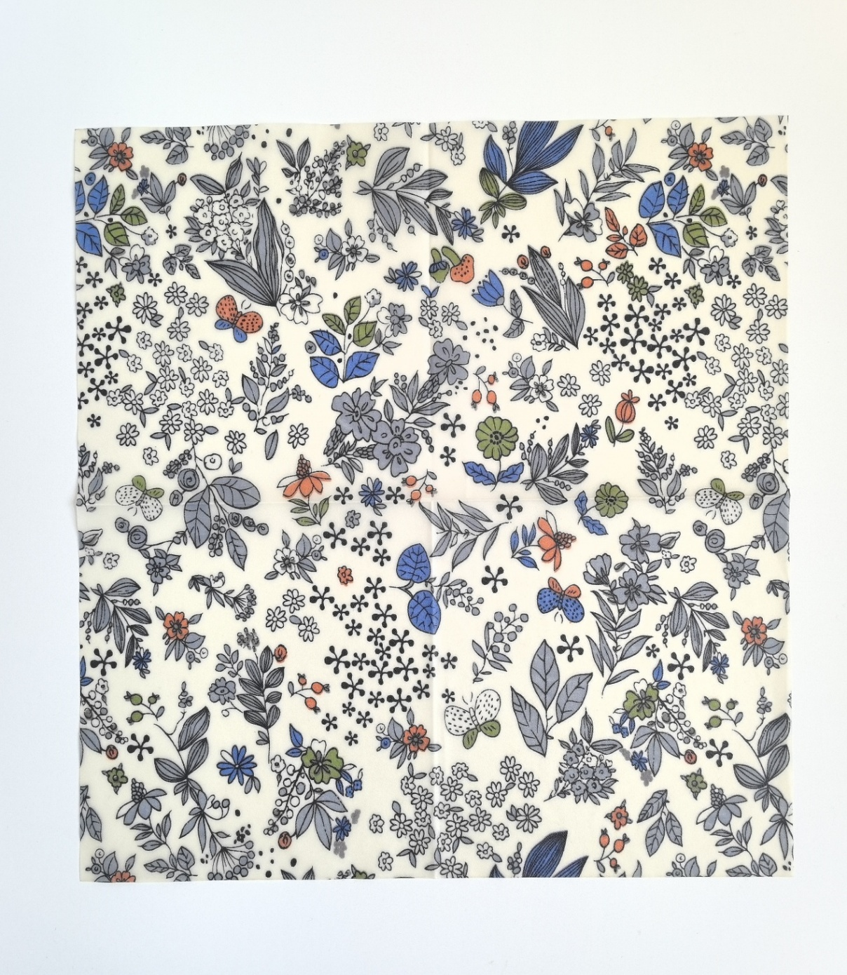
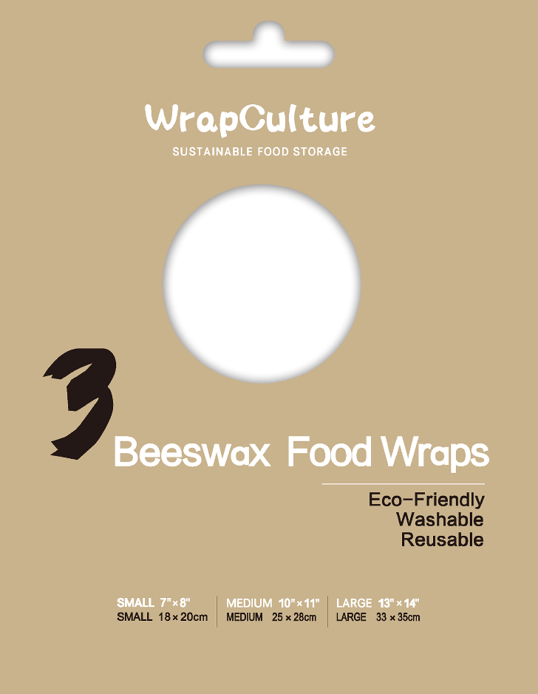

LARGE :
13” X 14” 33 X 35CM
MEDIUM :
10” X 11” 25 X 28CM
SMALL :
7” X 8” 18 X 20CM

Slide 3
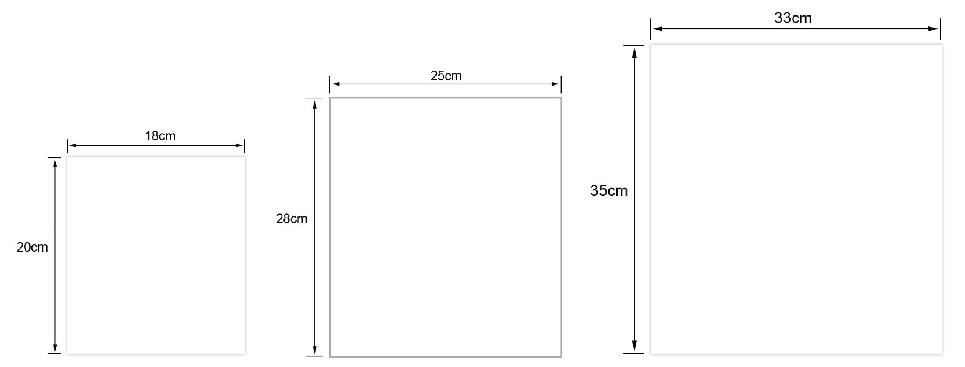

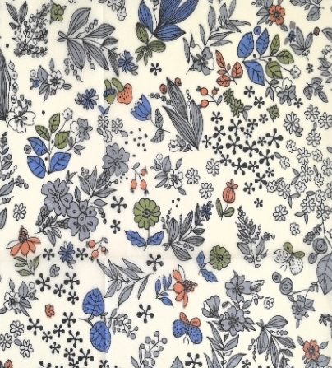

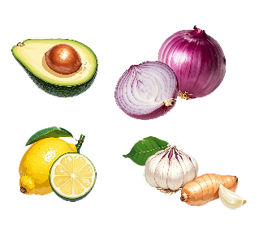
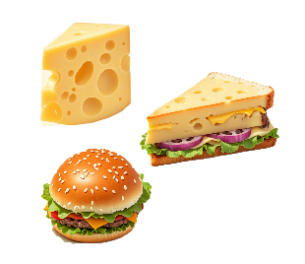
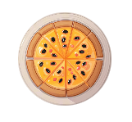

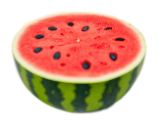
33cm（13”）
25cm（10”）
18cm（7”）
28cm
（11”）
35cm
（14”）
20cm
（8”）
SMALL :
7” X 8” 18 X 20CM
MEDIUM :
10” X 11” 25 X 28CM
LARGE :
13” X 14” 33 X 35CM
Perfect for wrapping half an onion, avocado, lemon, ginger, garlic, orsnacks to go.
Suitable for wrappingsandwiches,hamburgers, cheese, sliced fruit, and more.
Ideal for covering a salad bowl, pie dish, or wrapping half a loaf of bread or watermelon, and some large fruitsand vegetables.

Slide 4
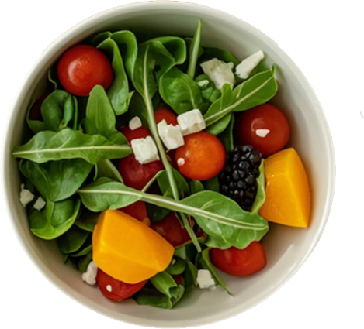

FRESHER CHEESE,
BREAD, AND PRODUCE
MEDIUM :
Store cheese and pack snacks
LARGE :
Cover most bowls and food containers
SMALL :
Save citrus, lemon, onions,and avocados

Slide 5
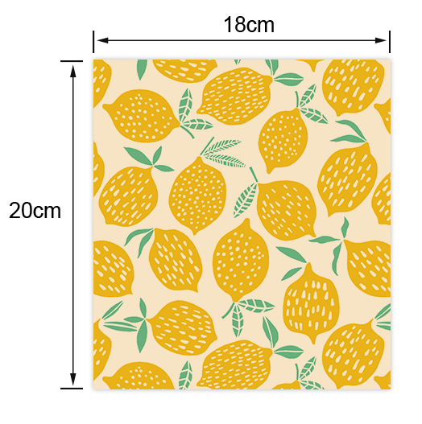

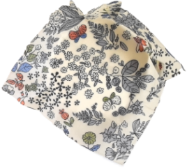
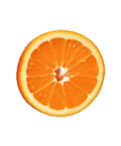
SMALL :
7” X 8” 18 X 20CM
Perfect for wrapping half an onion, avocado, lemon, ginger, garlic, orsnacks to go.

Slide 6

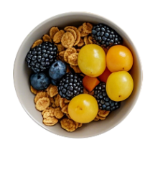
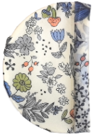
MEDIUM :
10” X 11” 25 X 28CM
Suitable for wrapping sandwiches,hamburgers, cheese, sliced fruit, and more.

Slide 7

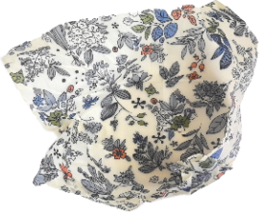
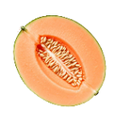
LARGE :
13” X 14” 33 X 35CM
Ideal for covering a salad bowl, pie dish, or wrapping half a loaf of bread or watermelon, and some large fruitsand vegetables.

Slide 8





PRODUCT MATERIALS & BENEFITS
From Nature, For Nature
Cotton Beeswax Jojoba Oil Tree Resin
USE & CARE
Use your hands to fold a wrap over your food or container and seal with gentle pressure.The warmth of yourhands will form a tight seal.
Rinse the wrap with cool or lukewarm water and dish soap, using a cloth or sponge to wipe it down like you would with dishes. Then rinse off.
After washing, air dry the beeswax wraps. Store them in a dry place with your other wraps,and they'll be ready for reuse.

