Slide 1
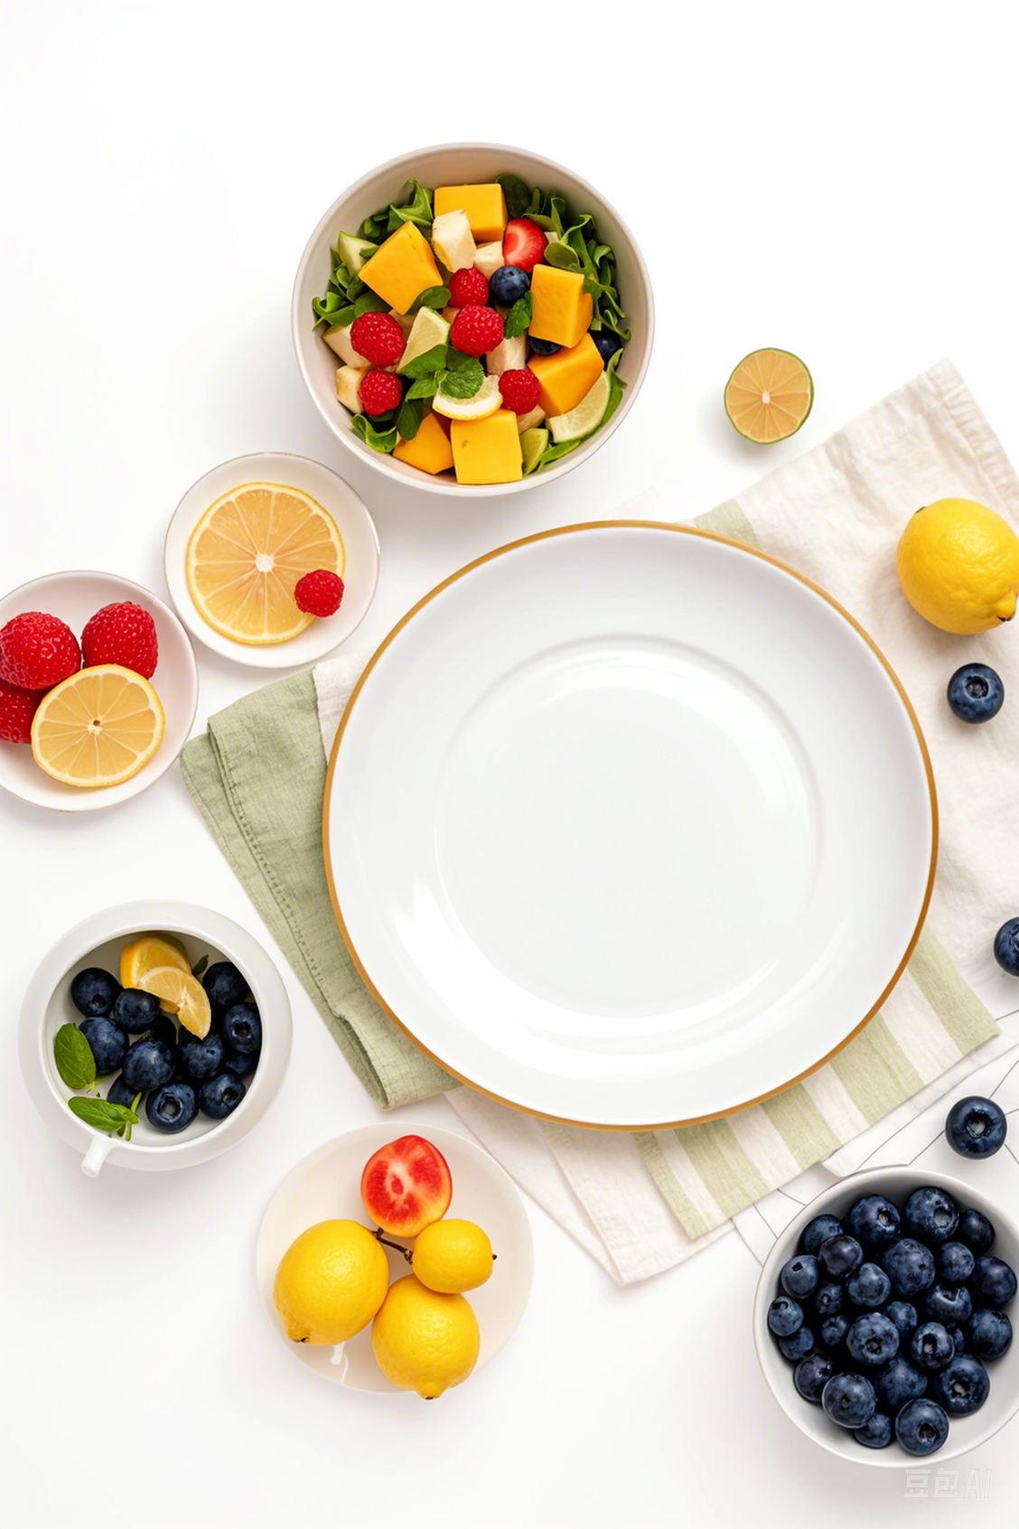

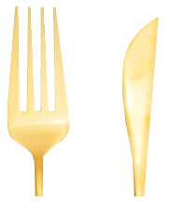
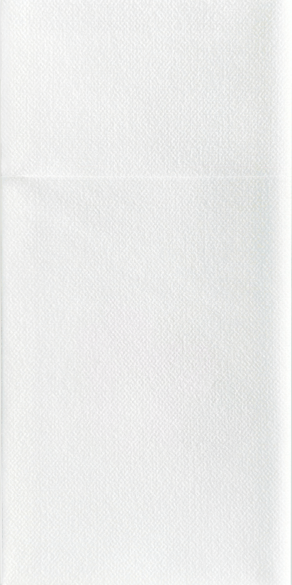
DISPOSABLE DINNER NAPKINS POCKET FOR FLATWARE
Cutlery Pocket Napkin

Slide 2
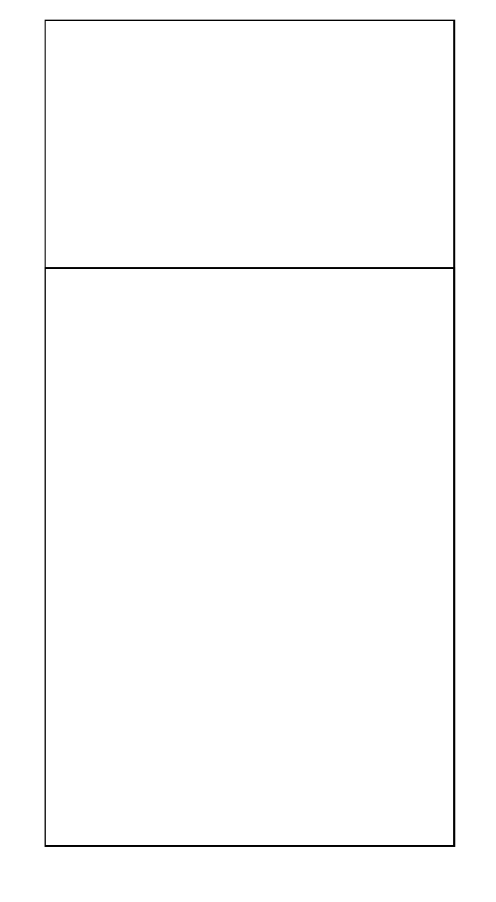
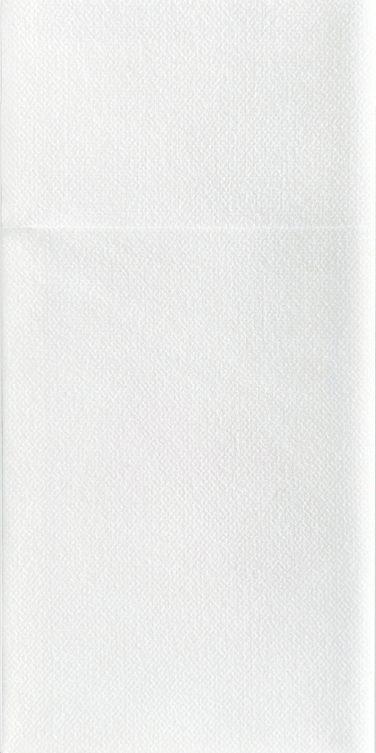
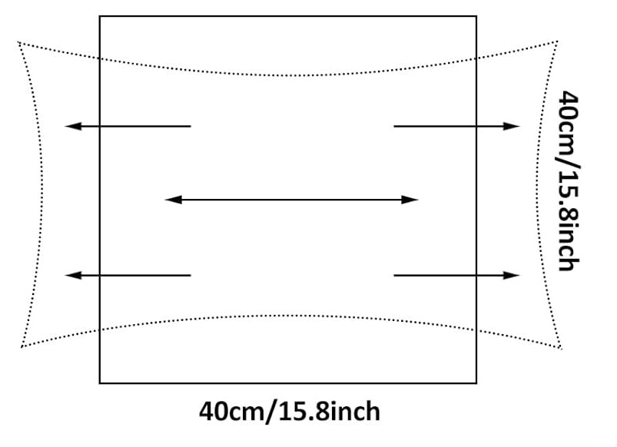
CUTLERY POCKET NAPKIN
DFHO Cutlery Pocket napkins are a modern alternative to linen serviettes. A thicker, softer embossed napkin
ERO-FRIENDLY RAW MATERIAL, REUSABLE, SUSTAINABLE
HIGHLY ABSORBENT AND EASY TO WIPE OFF
NON TOXIC AND NO UNPLEASANT SMELL, SAFE TO HOLD SILVERWARE
SMOOTH SURFACE, LESS PRONE TO BREAK AND FADE
VARIOUS CUSTOMIZED EXQUISITE DESIGNS ARE AVAILABLE
20 CM/ 7.87 INCH
FULL OPEN
10 CM/ 3.94 INCH
PKA-A2413
FOLDED :
10 X 20CM /3.94 X 7.87 INCH

Slide 3
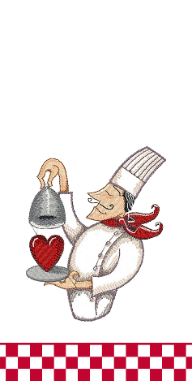
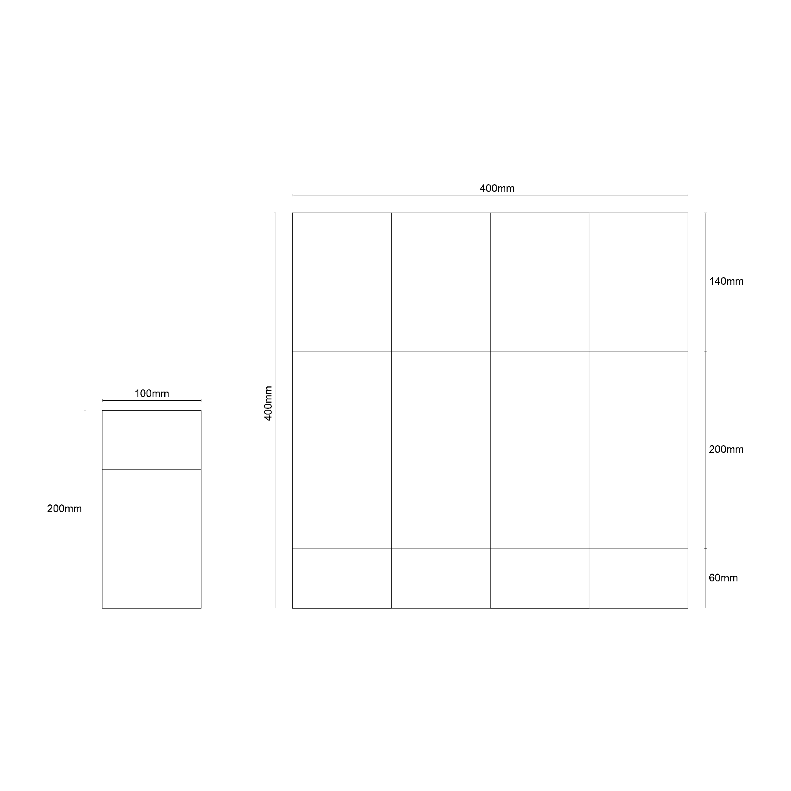
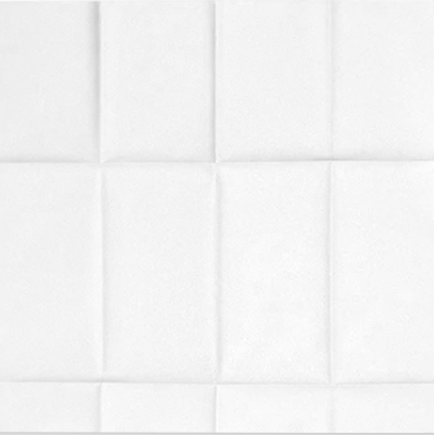
DISPOSABLE DINNER NAPKINS POCKET FOR FLATWARE
15 CM
5.51 INCH
40 CM/15.75 INCH
20 CM
7.87 INCH
5CM
2.36 INCH
40 CM/15.75 INCH
PKA-A2413
FULL OPEN :
40 X 40CM / 15.75 X 15.75 INCH
DINNER NAPKIN
Providing ample coverage for most spills, or messy meals

Slide 4
PRODUCT DETAIL
AIRLAID NAPKINS
FOLDED WITH CUTLERY POCKET ;SLEEVE,LINENALIKE
15 CM
5.51 INCH
40 CM/15.75 INCH
20 CM
7.87 INCH
20 CM/ 7.87 INCH
5CM
2.36 INCH
10 CM/3.94 INCH
40 CM/15.75 INCH
FOLDED :
10 X 20CM /3.94 X 7.87 INCH
Designed to fit most standard size dinnerware
FULL OPEN :
40 X 40CM / 15.75 X 15.75 INCH
Providing ample coverage for most spills,
or messy meals

Slide 5
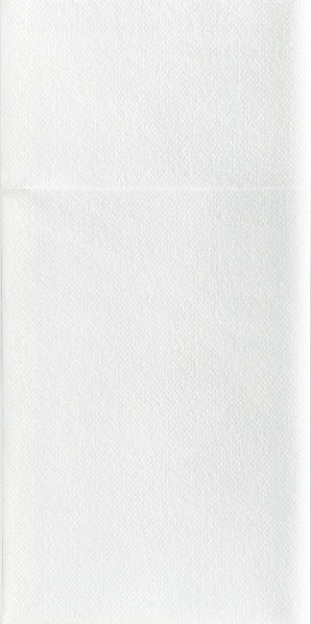
SET OF 3,
DISPOSABLE DINNER NAPKINS
POCKET FOR FLATWARE
PKA-A2413
20 CM/ 7.87 INCH
10 CM/ 3.94 INCH
PKA-A2413
Elegant,Modern look
Multi purpose
Perfect size
Disposable convenience
PKA-A2413

Slide 6
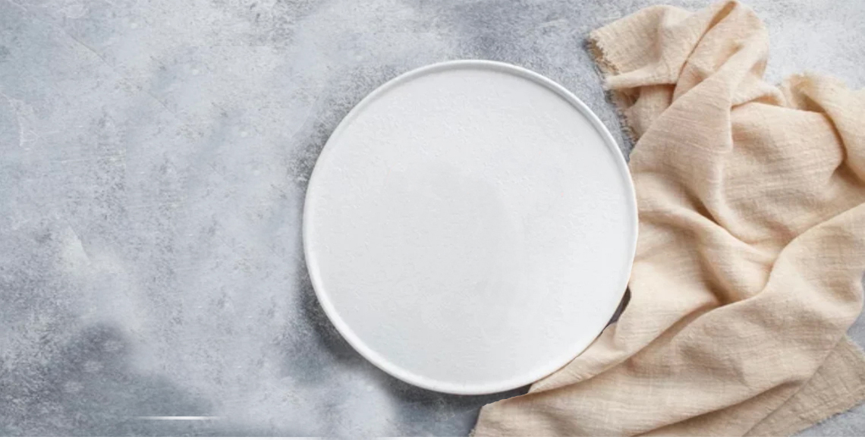
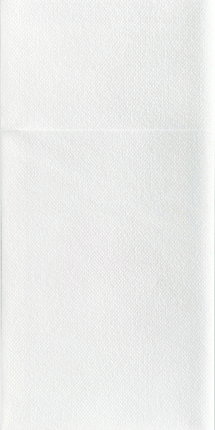
DISPOSABLE DINNER NAPKINS POCKET FOR FLATWARE
PKA-A2413
PKA-A2413
Cutlery Pocket Napkin

