Slide 1
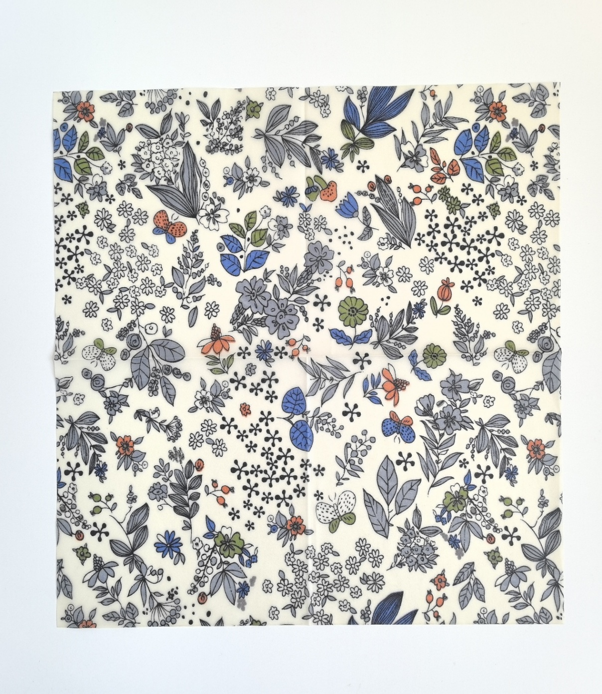


LARGE :
13” X 14” 33 X 35CM
MEDIUM :
10” X 11” 25 X 28CM
SMALL :
7” X 8” 18 X 20CM
PAPER BAG PACKING B1 :
SIZE: 17.9 X 20.9CM

Slide 2

LARGE :
13” X 14” 33 X 35CM
MEDIUM :
10” X 11” 25 X 28CM
SMALL :
7” X 8” 18 X 20CM
PAPER BAG PACKING S1 :
SIZE: 12.9 X 20.9CM

Slide 3

LARGE :
13” X 14” 33 X 35CM
MEDIUM :
10” X 11” 25 X 28CM
SMALL :
7” X 8” 18 X 20CM
PAPER BAG PACKING B2 :
SIZE: 17.9 X 20.9CM

Slide 4

LARGE :
13” X 14” 33 X 35CM
MEDIUM :
10” X 11” 25 X 28CM
SMALL :
7” X 8” 18 X 20CM
PAPER BAG PACKING S2 :
SIZE: 12.9 X 20.9CM

