Slide 1


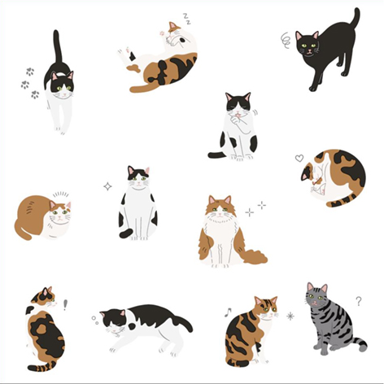

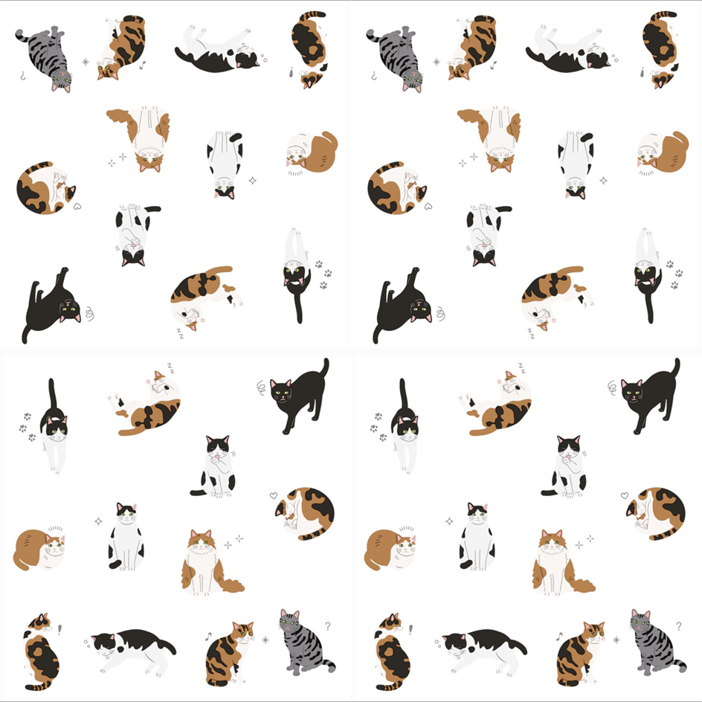

PAPER NAPKINS /SERVIETTEN
SERVIETTES
Front
16.5CM/ 6.5 INCH
16.5 CM
6.5 INCH
33 CM/13INCH
16.5CM/ 6.5 INCH
Back
16.5 CM
6.5 INCH
16.5CM/ 6.5 INCH
33 CM/13INCH
16.5CM/ 6.5 INCH
FULL OPEN :
33 X 33CM / 13 X 13 INCH
2461753756160_.pic

