Slide 1




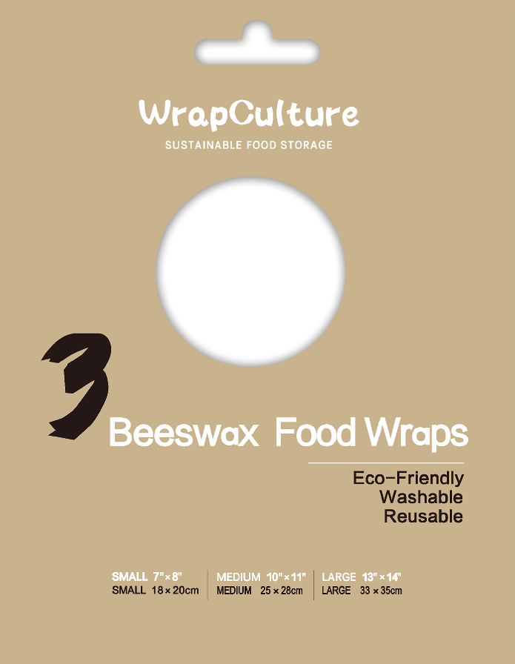

Beeswax Wrap Bags
LARGE :
10” X 13”
25 X 33CM
MEDIUM :
8” X 12”
21 X 30CM
SMALL :
7” X 8” 18 X 20CM
Name

Slide 2
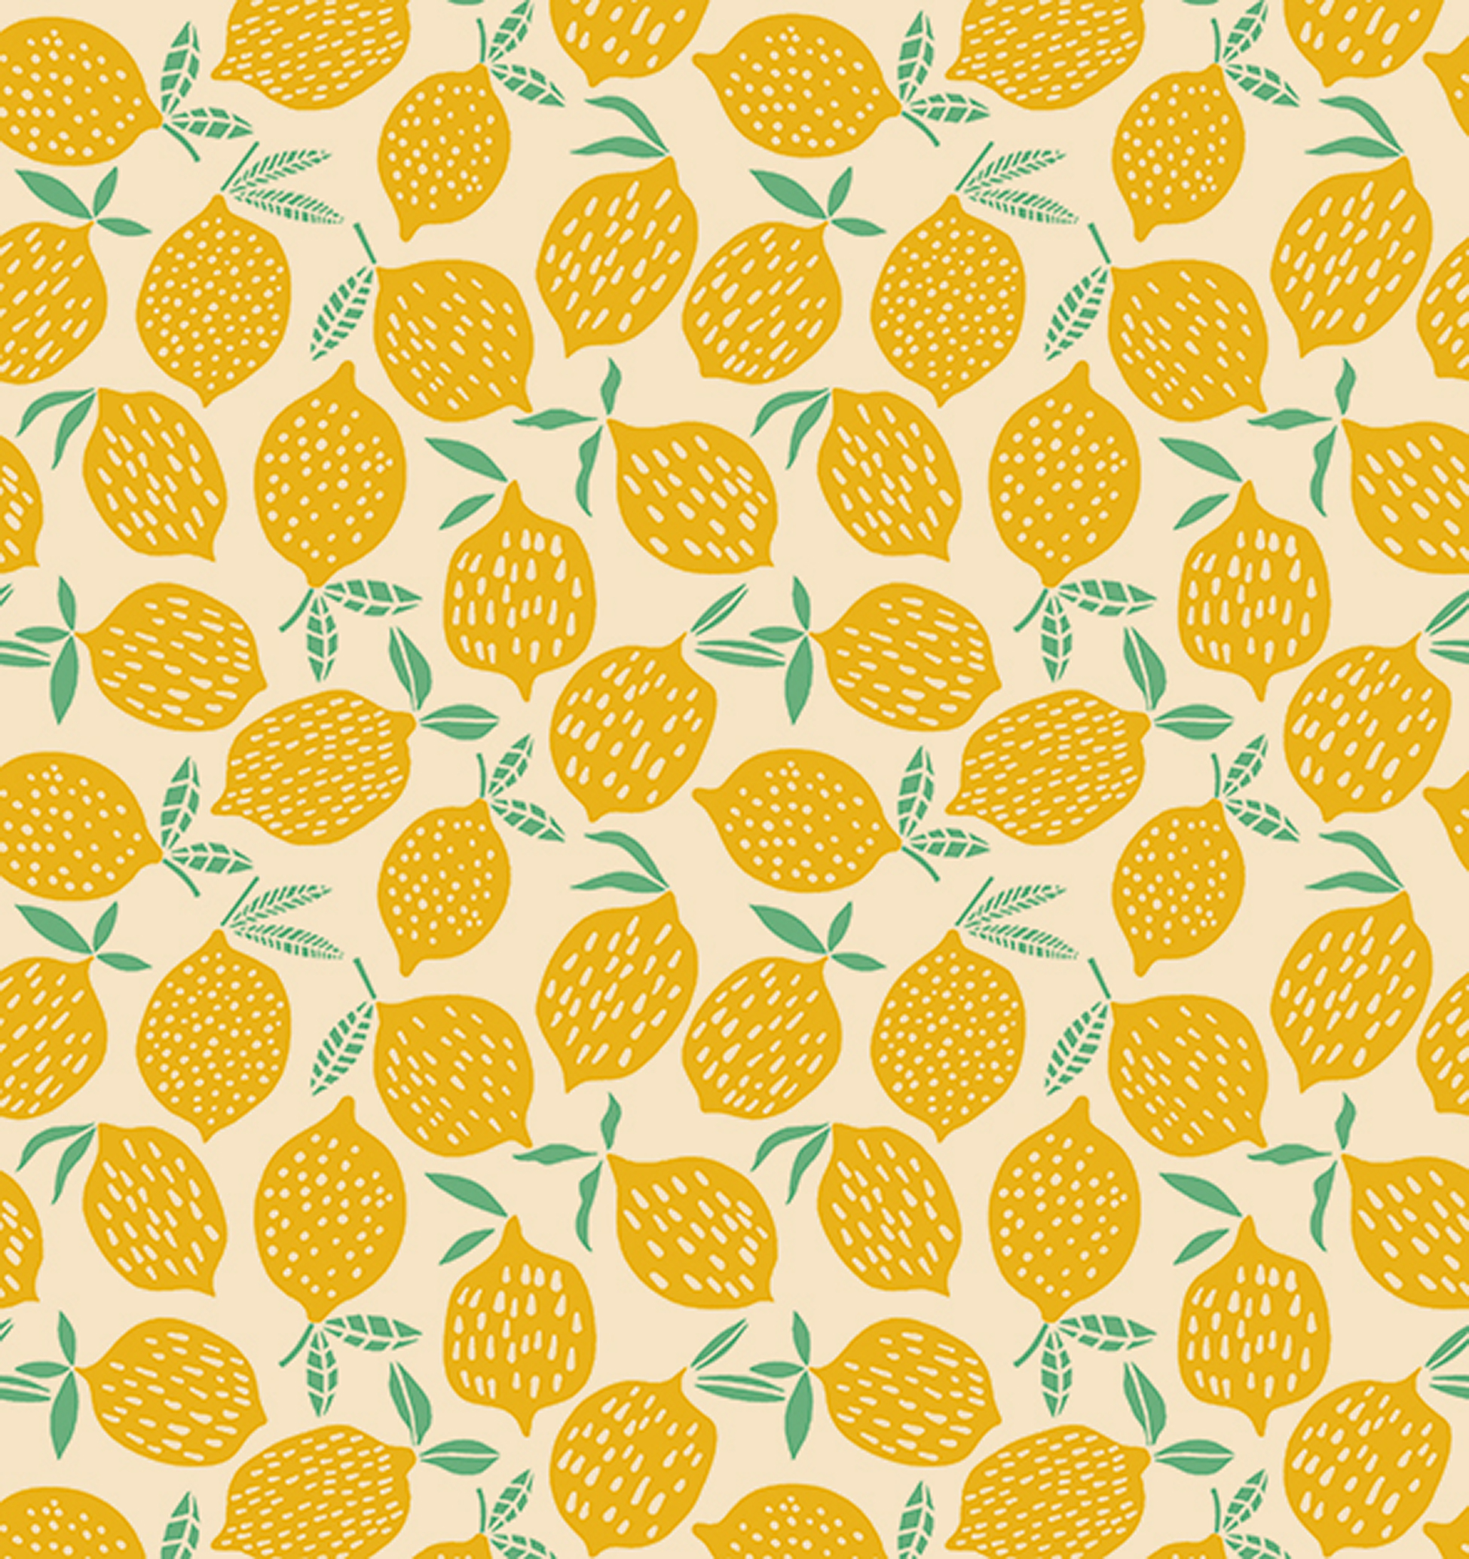
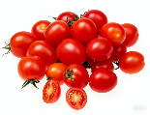
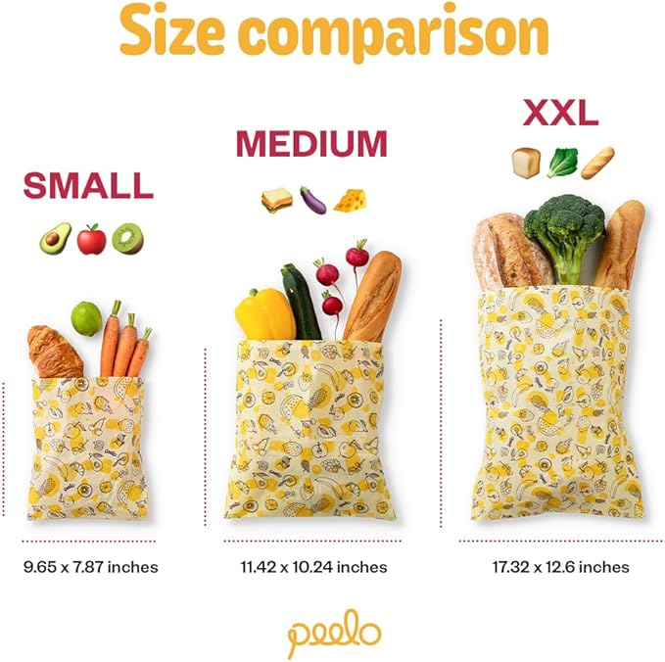
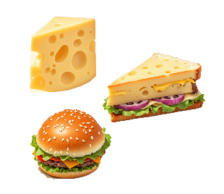
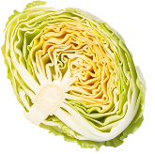
Beeswax Wrap Bags
25cm（10”）
21cm（8”）
18cm（7”）
33cm
（13”）
30cm
（12”）
20cm
（8”）
Name
Name
Name
SMALL :
7” X 8” 18 X 20CM
MEDIUM :
10” X 11” 25 X 28CM
LARGE :
13” X 14” 33 X 35CM
Perfect for Sandwich Bag & Snack Bag
Suitable for wrapping sandwiches, hamburgers, cheese, sliced fruit, and more.
Ideal for covering a salad bowl, pie dish, or wrapping half a loaf of bread or watermelon, and some large fruits and vegetables.

Slide 3
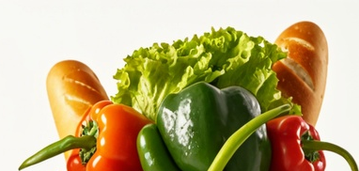
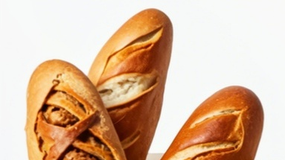
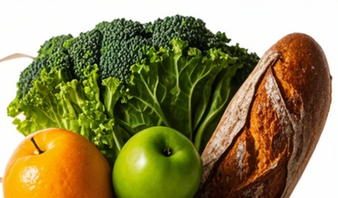
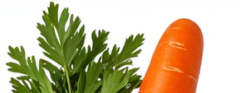




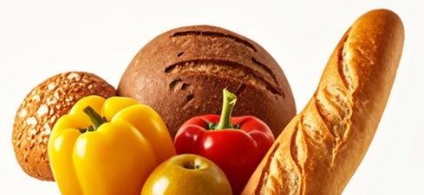
Beeswax Wrap Bags
MEDIUM :
10” X 11” 25 X 28CM
LARGE :
13” X 14” 33 X 35CM
Compostable
Reusable
Sustainable
SMALL :
7” X 8” 18 X 20CM

Slide 4
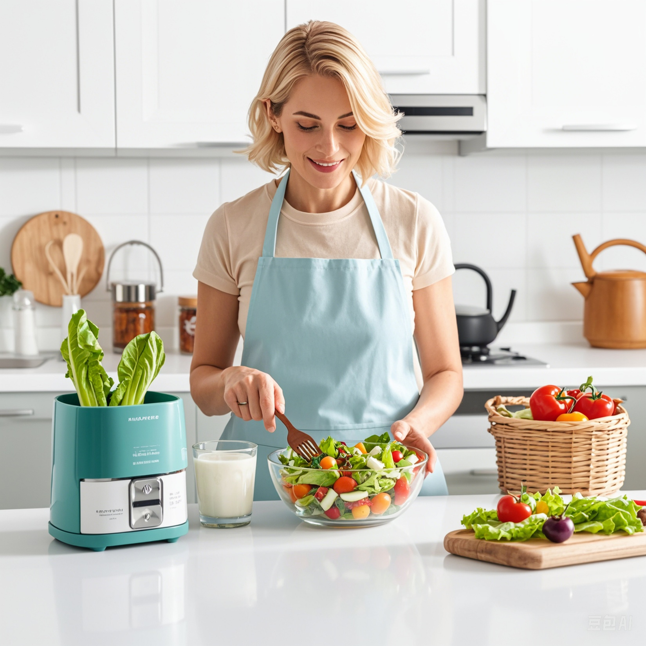


Slide 5




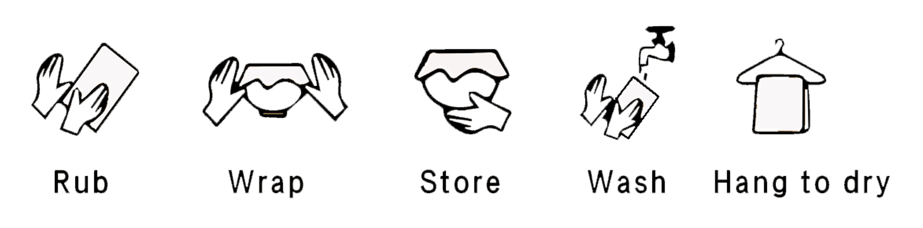
PRODUCT MATERIALS & BENEFITS
From Nature, For Nature
Cotton Beeswax Jojoba Oil Tree Resin
USE & CARE
Use your hands to fold a wrap over your food or container and seal with gentle pressure. The warmth of your hands will form a tight seal.
Rinse the wrap with cool or lukewarm water and dish soap, using a cloth or sponge to wipe it down like you would with dishes. Then rinse off.
After washing, air dry the beeswax wraps. Store them in a dry place with your other wraps, and they'll be ready for reuse.

