Slide 1
How AI Agents
Work For You
A visual walkthrough of how we automate your most
time-consuming workflows — in real time.
Conduit AI

Slide 2
THE PROBLEM
When a lead comes in, this is what happens today:
9:02 AM
New lead arrives from Zillow
9:02 AM
Lead sits in inbox, waiting...
11:45 AM
Agent finally sees it (2.5 hrs later)
11:50 AM
Agent reads message, decides how to respond
12:00 PM
Types personalized response manually
12:05 PM
Updates CRM, sets follow-up reminder
12:10 PM
Done. 15 minutes of work. Lead already went cold.
20 leads/week × 15 min = 5 hours/week wasted. Leads go cold. Money lost.

Slide 3
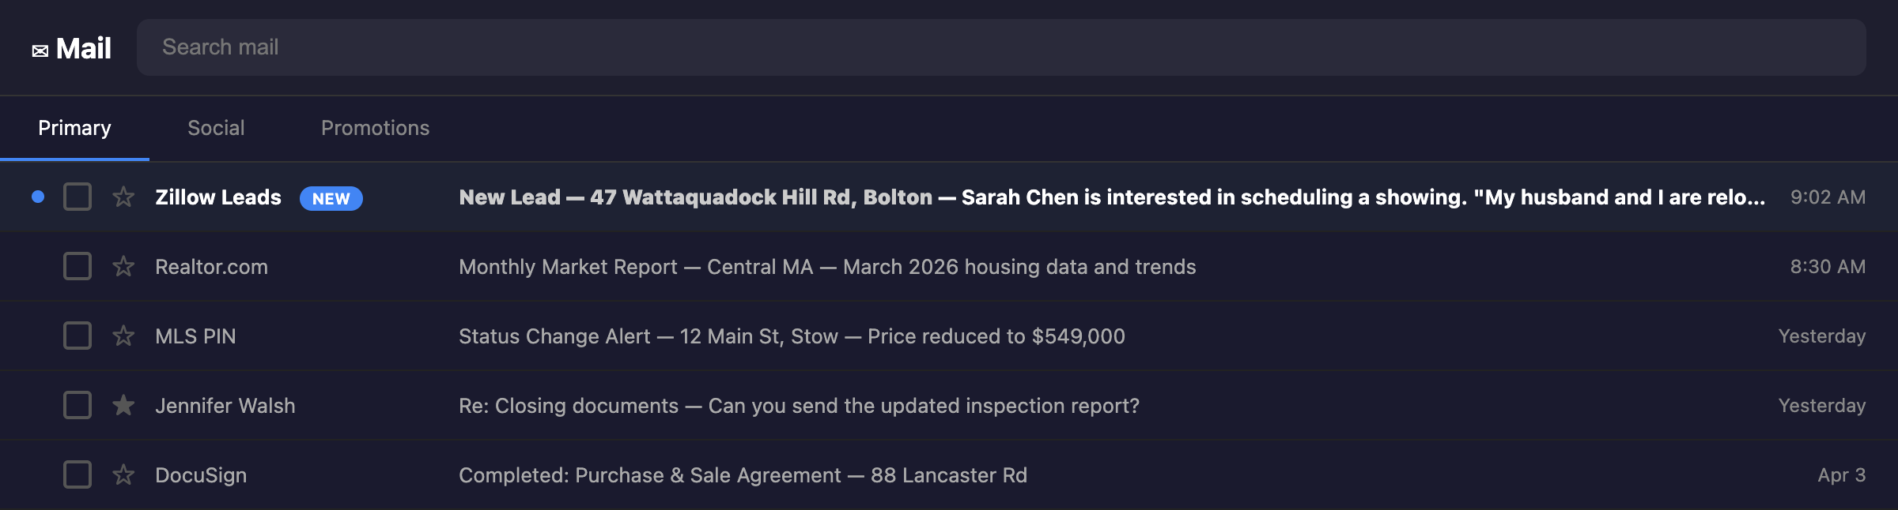
STEP 1
A New Lead Arrives
9:02 AM
Sarah Chen from Zillow wants to schedule a showing at 47 Wattaquadock Hill Rd.
She mentions relocating from Worcester for the school district.
Without AI: this sits for 2+ hours. With AI: processed in 10 seconds.

Slide 4
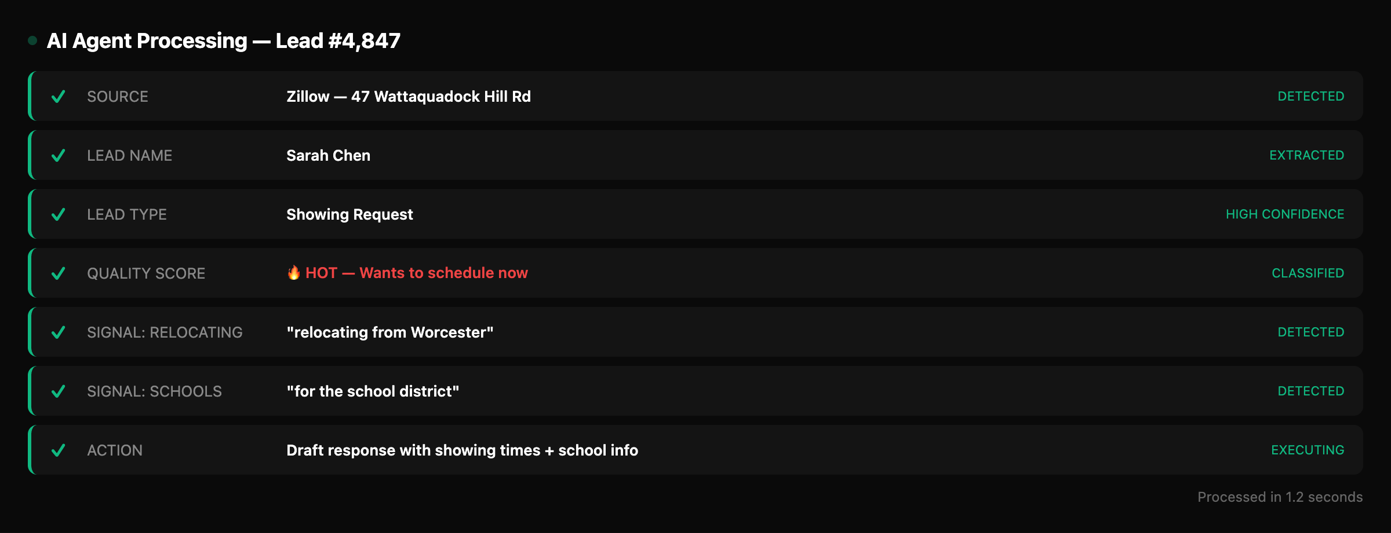
STEP 2
AI Agent Reads, Classifies & Decides
1.2 seconds
The agent detected this is a showing request from a hot lead who is relocating
and cares about schools. It decided to include school district info in the response.

Slide 5
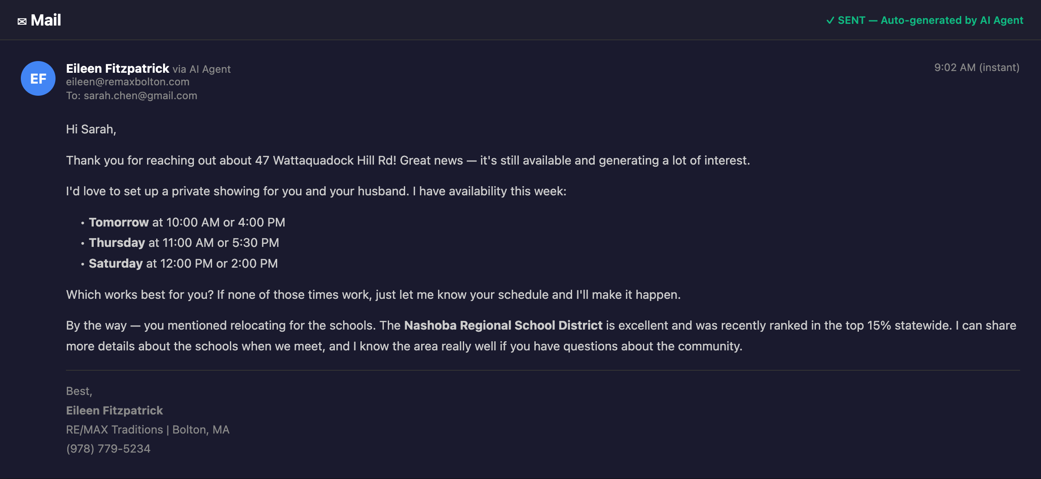
STEP 3
Personalized Email Sent Automatically
✓ SENT
Personalized response with showing times + school district info.
Sent at 9:02 AM — same minute the lead arrived.

Slide 6
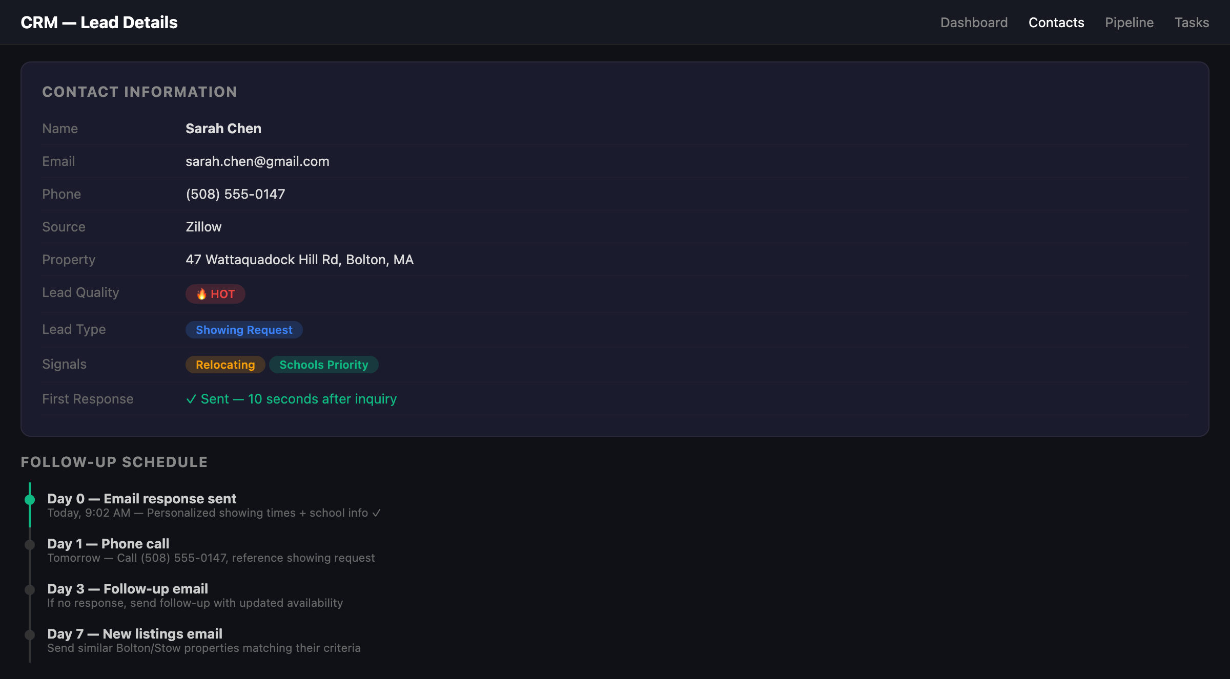
STEP 4
CRM Updated + Follow-Ups Scheduled
Automatic
Lead classified, signals extracted, follow-up plan set. No human touched it.

Slide 7
THE MATH
Here's exactly how the cost of doing it manually adds up.
WITHOUT AI — Manual Lead Response Cost
15 min per lead × 20 leads per week = 5 hrs / week
5 hrs × $25 / hour × 52 weeks = $6,500 / year
WITH AI AGENT — Automated Lead Response Cost
20 leads × ~0 min (AI handles it) + tool cost (~$50/mo)
Staff time saved = 5 hrs/week → $5,200 annual savings

Slide 8
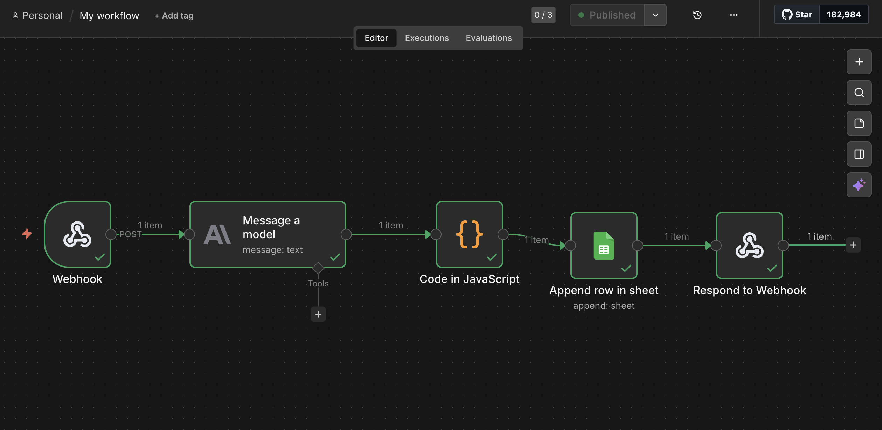
WORKFLOW BREAKDOWN
The pipeline that runs automatically, 24/7, behind the scenes.
Lead arrives → AI classifies → response drafted → CRM logged → response sent. No human touch.

Slide 9
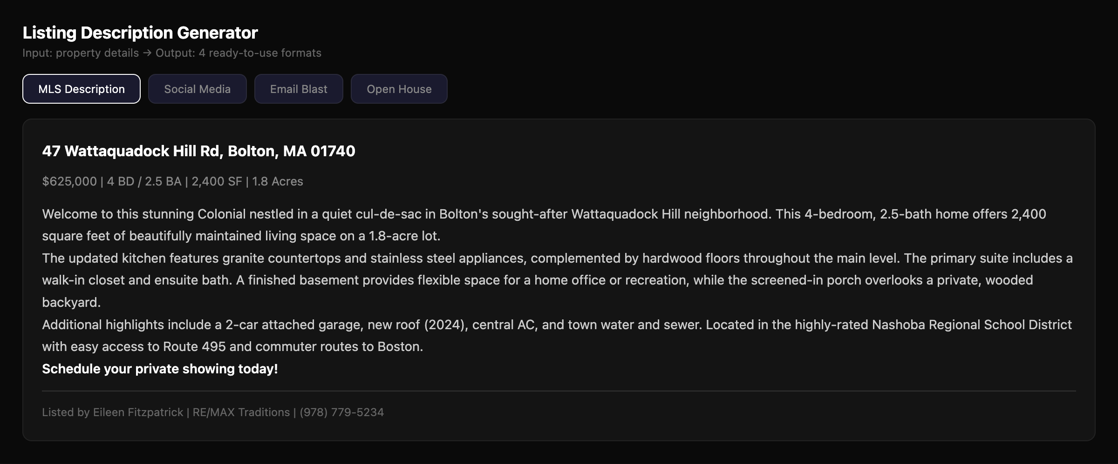
And One More Thing...
WE DO THIS FOR LISTINGS TOO
45 minutes of writing per listing → 10 seconds. Four formats at once.
Enter property details once → get MLS description, social media post, email blast, and open house announcement.

Slide 10
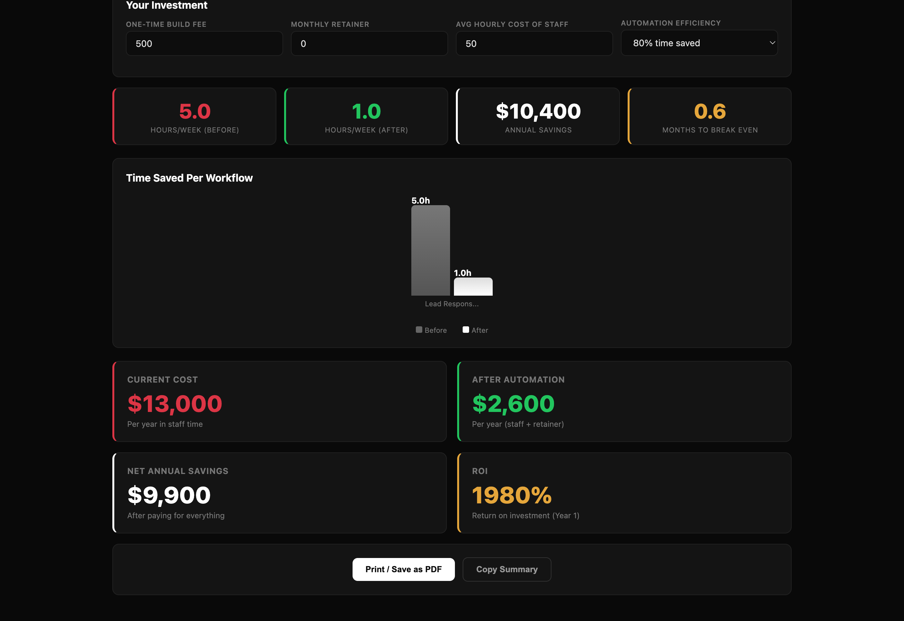
THE NUMBERS
Plugged into our ROI calculator with your actual numbers:
5 hours/week saved. $10,400 annual savings. 1,980% ROI.

Slide 11
Want to see this
with your leads?
We'll run a free audit on your actual workflows and show you
exactly how much time and money you'll save.
Conduit AI | Daniel Weadock | Bolton, MA

