Slide 1

Pressing Sequences and Binary Matrix Algebra
Joshua Cooper
University of South Carolina
Department of Mathematics
with
Jeffrey Davis, USC

Slide 2



Permutation Sorting as a Fundamental Problem in Phylogenetics
SPECIES 1
SPECIES 2
Q: How did 12345 arrive at 21534?
A: Some sequence of reversals of subsequences.

Slide 3
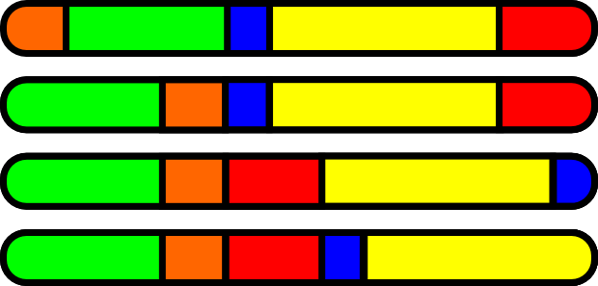
Permutation Sorting as a Fundamental Problem in Phylogenetics
In general, reconstructing the shortest (i.e., most
evolutionarily likely) sequence of swaps is NP-hard.
However: the genes have a direction.

Slide 4
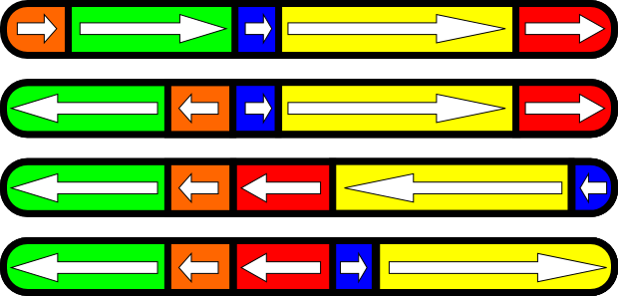
Permutation Sorting as a Fundamental Problem in Phylogenetics
The problem becomes sorting signed permutations.
“How did 12345 arrive at 21534?”

Slide 5
Signed Permutation Sorting
Theorem (Hannenhalli-Pevzner ‘99). It is possible to find a shortest sequence of reversals to turn any signed permutation into any other in polynomial time.
At its core, the proof reduces to showing that it is possible to quickly find a shortest “successful pressing sequence” for every “bicolored graph”*.
Bicolored Graph

Slide 6

Pressing
Press any black vertex: this flips the state of its closed neighborhood, complementing the induced subgraph and exchanging colors black and white.

Slide 7
Pressing

Slide 8
Pressing

Slide 9
Pressing

Slide 10
Pressing

Slide 11
Pressing

Slide 12
Pressing

Slide 13
Pressing

Slide 14
Pressing

Slide 15
Pressing

Slide 16
Pressing

Slide 17
Pressing

Slide 18
Pressing

Slide 19
Pressing

Slide 20
Pressing

Slide 21
Pressing
“Success”: All vertices white, all edges gone.
* Such a sequence exists iff the graph has a black vertex in each component.

Slide 22
You can get stuck…

Slide 23
You can get stuck…
Uh-oh!

Slide 24
Pressing Sequence
5
7
3
1
2
8
6
4

Slide 25
Augmented Adjacency Matrix
Given a (labeled) bicolored graph G on n vertices, there is an associated n×n “augmented adjacency matrix” A(G) over GF(2) whose (v,w) entry is 1 if v and w are adjacent, 0 if v and w are not adjacent, and whose (v,v) entry is 1 if v is black and 0 if v is white.
5
7
1 1 0 0 1 1 0 0
1 0 0 1 0 1 1 0
0 0 1 0 0 0 1 1
0 1 0 0 0 1 1 1
1 0 0 0 0 0 1 0
1 1 0 1 0 1 0 0
0 1 1 1 1 0 1 0
0 0 1 1 0 0 0 0
3
1
2
8
6
4
G

Slide 26
Augmented Adjacency Matrix
One can view A(G) as the adjacency matrix of a loopy graph:
5
7
1 1 0 0 1 1 0 0
1 0 0 1 0 1 1 0
0 0 1 0 0 0 1 1
0 1 0 0 0 1 1 1
1 0 0 0 0 0 1 0
1 1 0 1 0 1 0 0
0 1 1 1 1 0 1 0
0 0 1 1 0 0 0 0
3
1
2
8
6
4
loopy(G)

Slide 27

Pressing = Gauss Move
Note that pressing a vertex impacts the augmented adjacency matrix by a single “self-destructive” Gaussian-elimination step:
5
7
1 1 0 0 1 1 0 0
1 0 0 1 0 1 1 0
0 0 1 0 0 0 1 1
0 1 0 0 0 1 1 1
1 0 0 0 0 0 1 0
1 1 0 1 0 1 0 0
0 1 1 1 1 0 1 0
0 0 1 1 0 0 0 0
3
1
2
8
6
4
5
7
0 0 0 0 0 0 0 0
0 1 0 1 1 0 1 0
0 0 1 0 0 0 1 1
0 1 0 0 0 1 1 1
0 1 0 0 1 1 1 0
0 0 0 1 1 1 0 0
0 1 1 1 1 0 1 0
0 0 1 1 0 0 0 0
3
1
2
8
6
4

Slide 28
Pressing Sequences via Linear Algebra
Theorem (C-Davis ’16). Given a bicolored graph G, the number of vertices in any pressing sequence is the same, and equals the GF(2) rank of A.
Corollary. A bicolored graph G has a successful pressing sequence that is a permutation of the vertices iff A(G) is invertible.
By reordering the rows and columns of A(G) (i.e., permuting the vertices) to obtain a matrix P^{T}A(G)P, we obtain the following…

Slide 29
Pressing Sequences via Linear Algebra
Theorem (C-Davis ’16). Given a bicolored graph G, the following are equivalent.
The sequences of vertices 1, 2, …, k is a successful pressing sequence for G.
A(G) = LU for some lower-triangular matrix L and upper-triangular matrix U of rank k.
A(G) = U^{T}U for some upper-triangular matrix U of rank k (“Cholesky decomposition”).
The first k leading principal minors of L are nonzero, and the rest of the leading principal minors are 0.
The subgraph of loopy(G) induced on {1, …, j} has an odd number of perfect matchings iff j ≤ k.

Slide 30
Pressing Sequences via Linear Algebra
Theorem (C-Davis ’15+). Given a bicolored graph G, the following are equivalent.
The sequences of vertices 1, 2, …, k is a successful pressing sequence for G.
A(G) = LU for some lower-triangular matrix L and upper-triangular matrix U of rank k.
A(G) = U^{T}U for some upper-triangular matrix U of rank k (“Cholesky decomposition”).
The first k leading principal minors of L are nonzero, and the rest of the leading principal minors are 0.
The subgraph of loopy(G) induced on {1, …, j} has an odd number of perfect matchings iff j ≤ k.
1
k
n

Slide 31
Pressing Sequences of Full Length
Recall: G on n vertices has a successful pressing sequence of length n iff A(G) is invertible.
Theorem (C-Davis ’16). Given a bicolored graph G with A(G) invertible, the following are equivalent.
The sequence of vertices 1, 2, …, n is a successful pressing sequence for G.
A(G) = U^{T}U for some invertible upper-triangular matrix U (“Cholesky decomposition”).
All leading principal minors of L are nonzero.
The subgraph of loopy(G) induced on {1, …, j} has an odd number of perfect matchings for all j.

Slide 32
Perfect Matchings in Loopy Graphs
Here, a perfect matching is a set of pairwise nonincident edges incident to every vertex.
5
7
3
1
2
8
6
4

Slide 33
Perfect Matchings in Loopy Graphs
Here, a perfect matching is a set of pairwise nonincident edges incident to every vertex.
# PM
1
5
7
1
1
3
1
1
2
1
1
8
7
11
6
4

Slide 34
Perfect Matchings in Loopy Graphs
Here, a perfect matching is a set of pairwise nonincident edges incident to every vertex.
Theorem (C-Davis ’16). A loopy graph G has an odd number of perfect matchings iff A(G) is invertible.
Theorem (Grood-Hunter-Leong ’16+). A graph G has an odd number of perfect matchings iff A(G) is invertible.

Slide 35
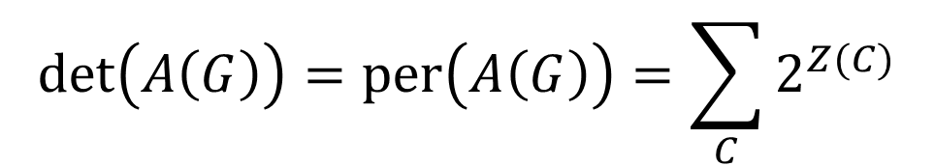
Perfect Matchings in Loopy Graphs
Here, a perfect matching is a set of pairwise nonincident edges incident to every vertex.
Theorem (C-Davis ’16). A loopy graph G has an odd number of perfect matchings iff A(G) is invertible.
Proof.
$$\det\left(A\left(G\right)\right)=\text{per}\left(A\left(G\right)\right)=\sum_{C}{2^{Z(C)}}$$
C = vertex circuit cover, a family of closed walks visiting each vertex once
Z(C) = number of circuits of length > 2

Slide 36
Relating Pressing Sequences
Theorem (C-Davis ’16). Suppose that the bicolored graph G has been labeled so that the identity permutation is a successful pressing sequence, and let A(G)= U^{T}U be a Cholesky decomposition. Then another permutation, given by the permutation matrix P, is a pressing sequence of G iff there exists an orthogonal matrix Q and another upper triangular U’ so that:
UP = QU’
Furthermore, P determines Q and U’.

Slide 37
Pressing Sequences & Automorphisms
Note that, if P is an automorphism of G, the equation
UP = QU’
is satisfied by Q = I and U’ = U.
UP = U
(UP)^{T}(UP) = U^{T}U
P^{T}A(G)P=
= A(G)
Permuting vertices does nothing.

Slide 38
Pressing Sequences & Automorphisms
Note that, if P is an automorphism of G, the equation
UP = QU’
is satisfied by Q = I and U’ = U.
Therefore, pressing sequences are a kind of mod 2 relaxation of graph automorphisms.
Biologists want to understand the set of all successful pressing sequences (possible evolutionary histories), so, how many are there, and how to generate them?

Slide 39
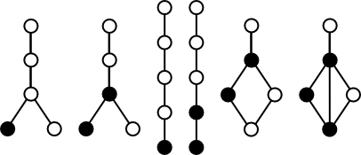

Counting Pressing Sequences
Theorem (C-Davis ’16). The average number of pressing sequences of a random bicolored graph on n vertices is exactly
$$\frac{n!}{2^{n}}$$
Question 1. What are the uniquely pressible graphs, i.e., graphs with exactly one pressing sequence?

Slide 40
More Questions
Question 2. Is it NP-complete (or perhaps GI-complete) to count the number of pressing sequences of a graph? Is there a better algorithm than depth-first search of all permutations?
Question 3. Can we at least sample asymptotically uniformly from the pressing sequences of a graph?
Question 4. (“Pressing Game Conjecture”, Bixby-Flint-Miklós ’15) Does the following MCMC work? Change a pressing sequence to any other obtained by at most 4 edits (insertions/deletions).

Slide 41
Bixby-Flint-Miklós Conjecture is Tight

Slide 42
Bixby-Flint-Miklós Conjecture is Tight
154623
6
4
5
3
1
2
234615
154623
Edit Distance 4
234615

Slide 43
Thank you!

