Slide 1
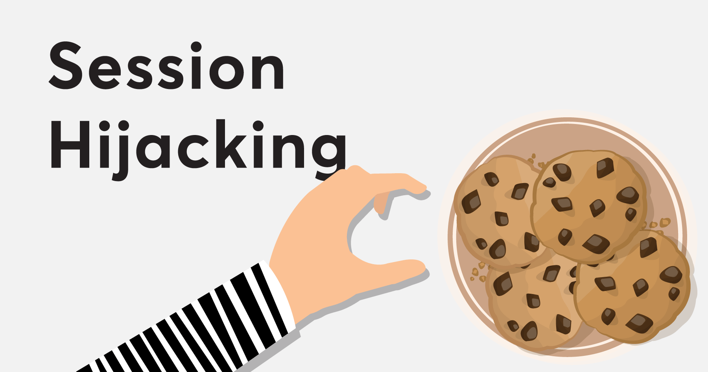

Slide 2
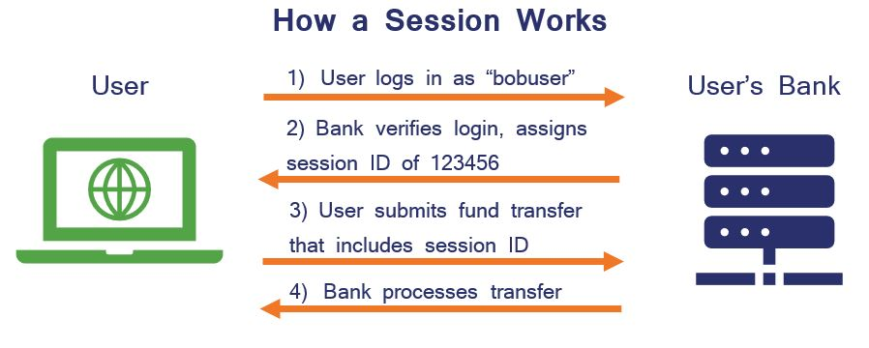
How A Session Works?

Slide 3
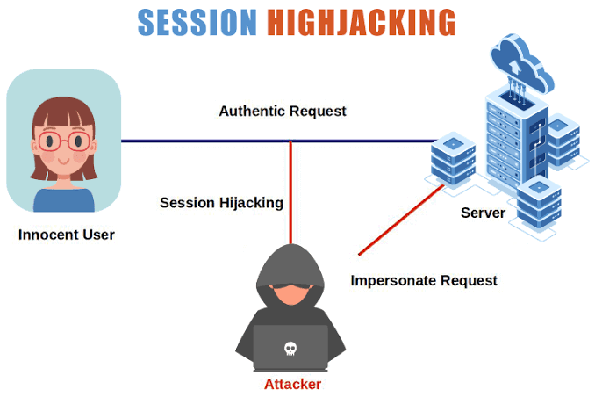
The exploitation of a valid computer session—sometimes also called a session key—to gain unauthorized access to information or services in a computer system. In particular, it is used to refer to the theft of a magic cookie used to authenticate a user to a remote server.

Slide 4
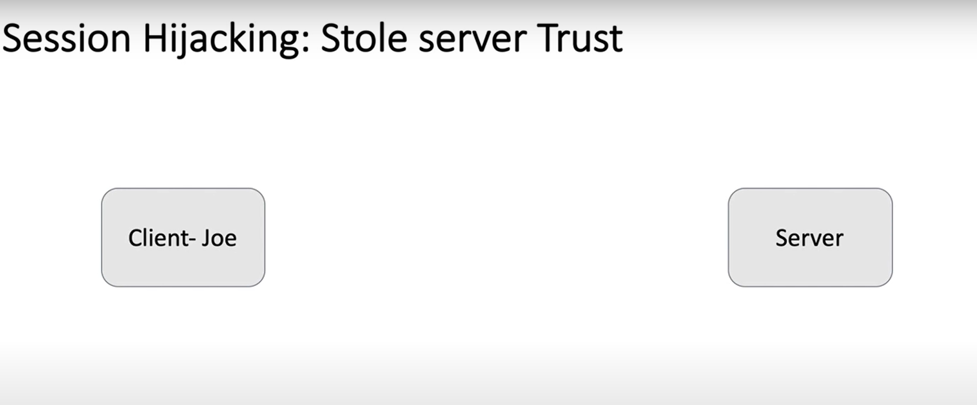

Slide 5
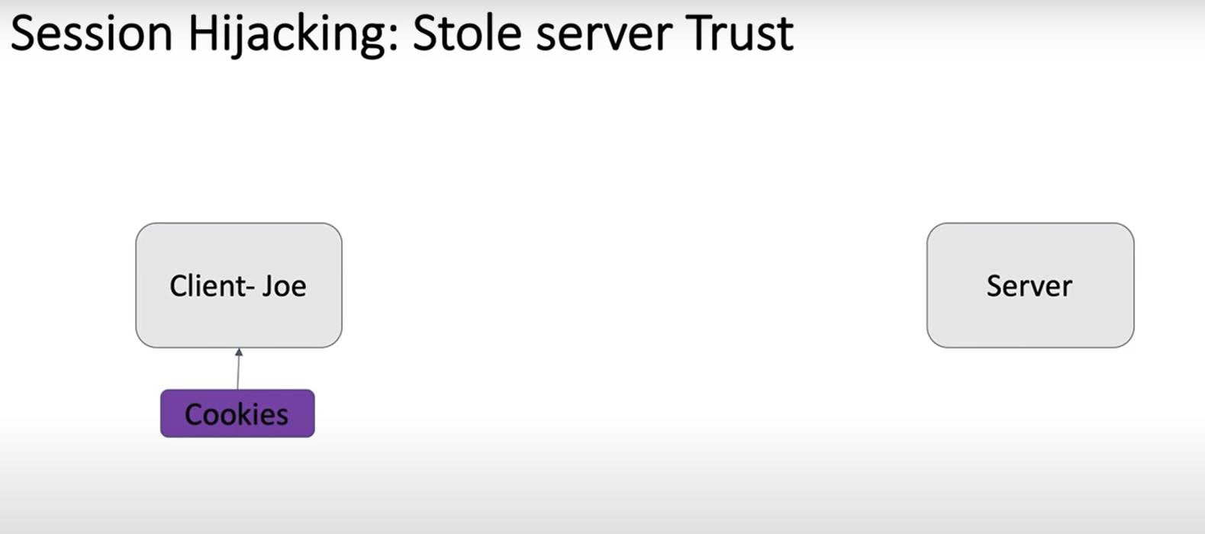

Slide 6
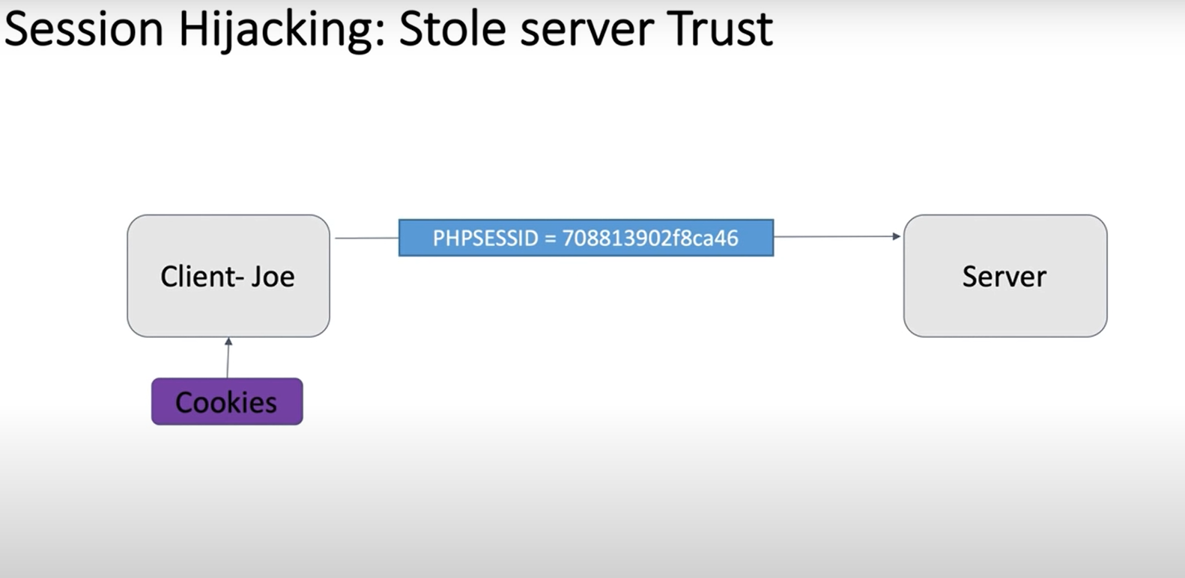

Slide 7
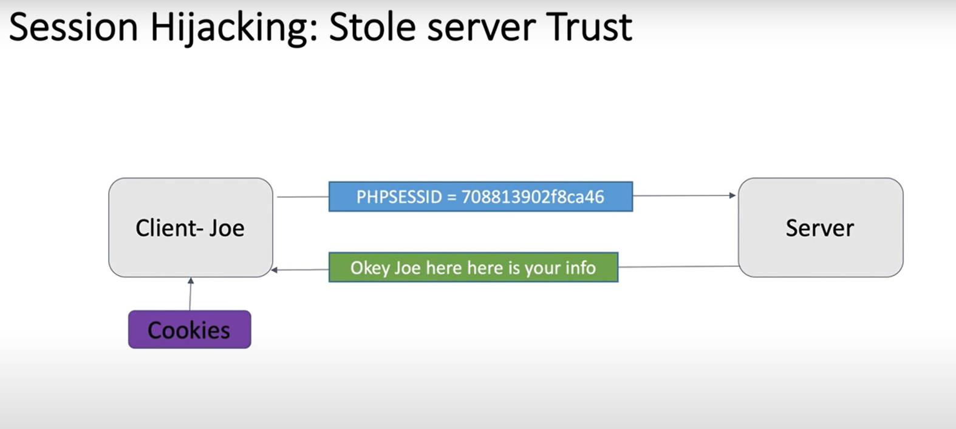

Slide 8
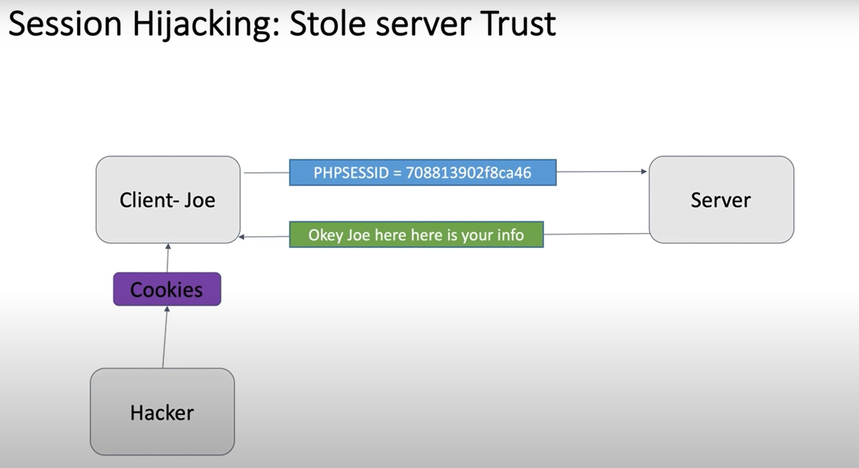

Slide 9
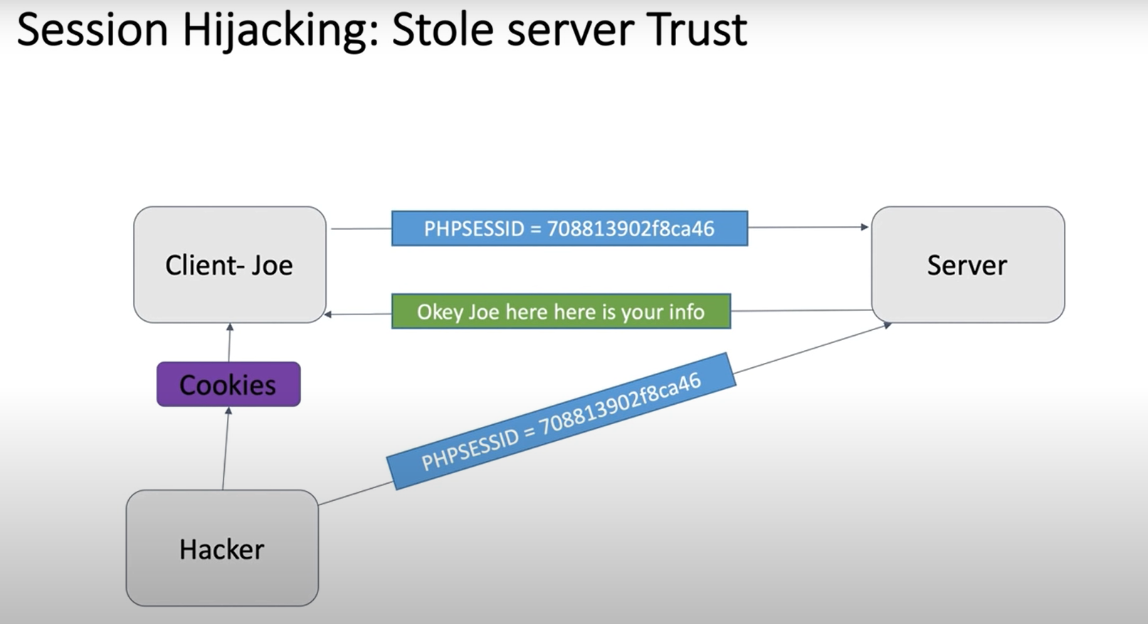

Slide 10
How???
1) Compromise the server or the user’s machine/browser and copy the cookie.
2) Server algorithm for generating cookies is known then the hacker can predict the user’s cookie.
3) sniff the network (session side jacking):Packet sniffers.
4)DNS cache poisoning :
Trick the user into thinking you are Facebook
The user will send you the cookie.

Slide 11
Prevention
To prevent sniffing we can use Encrypted connection. Sensitive interaction after a log in should secure HTTP which is called HTTPS. (by setting the secure attribute of the cookie)
To avoid guessing the algorithm cookies should be:
Randomly chosen
Long

Slide 12
Some services will change the value of the cookie with each and every request. This will reduce the window in which an attacker can operate.
Make a secondary check : The current IP Address of the user matches the previous one stored .However this could be frustrating for users whose IP address is liable to change during a browsing session.

Slide 13
Handshake protocol
Handshake Protocol is used to establish sessions. This protocol allows the client and server to authenticate each other by sending a series of messages to each other. Handshake protocol uses four phases to complete its cycle.

Slide 14
