Slide 1

FRUIT
START Hack St Gallen
Christelle Xu – Anis Hosni – Axel Uran – Robin Genolet

Slide 2
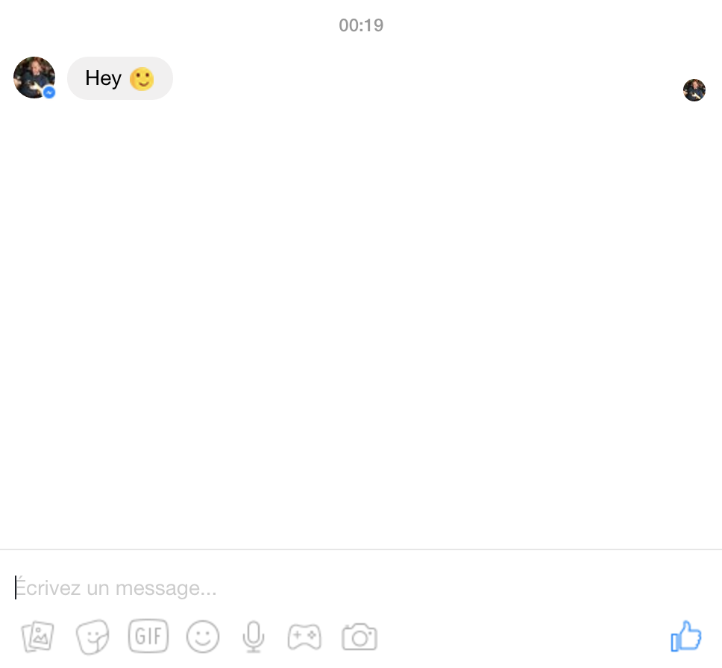

Slide 3
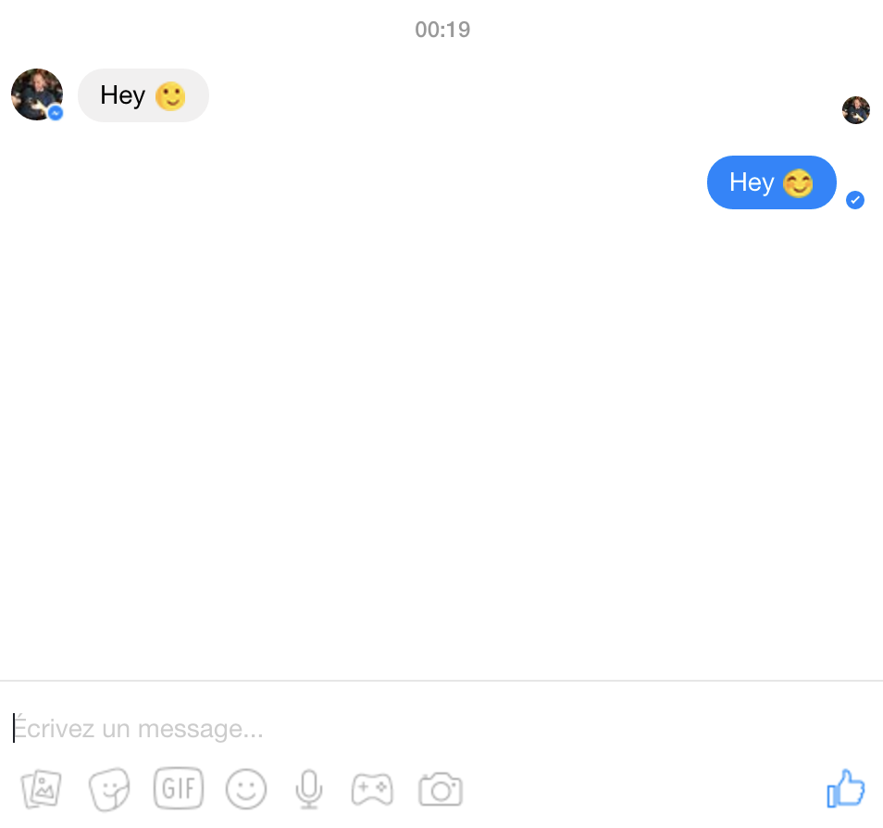

Slide 4
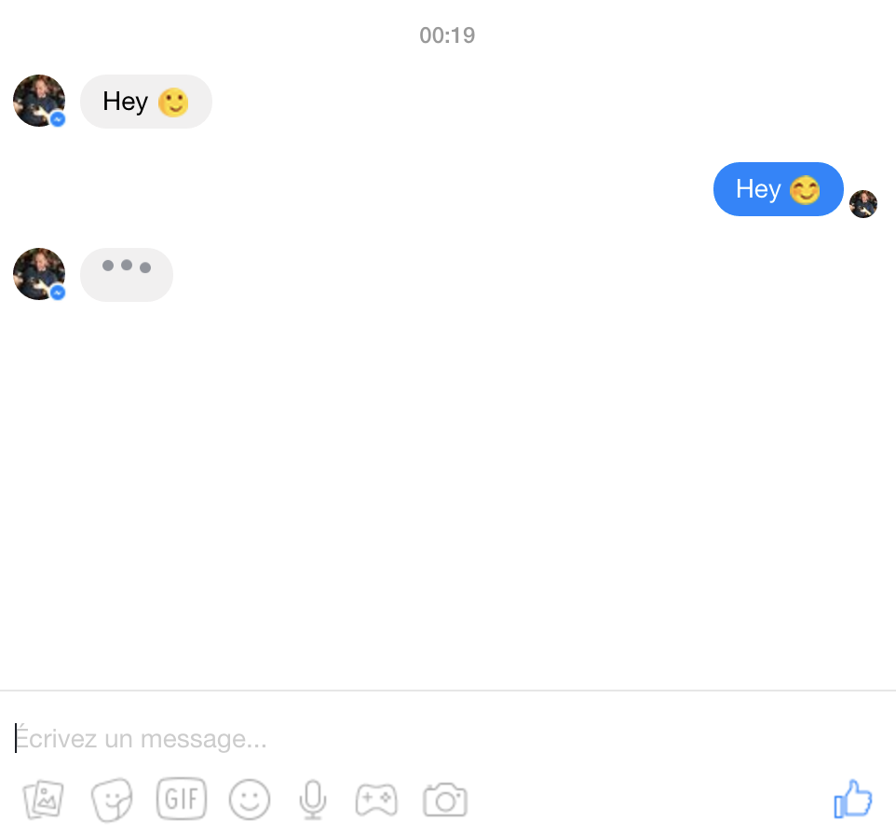

Slide 5
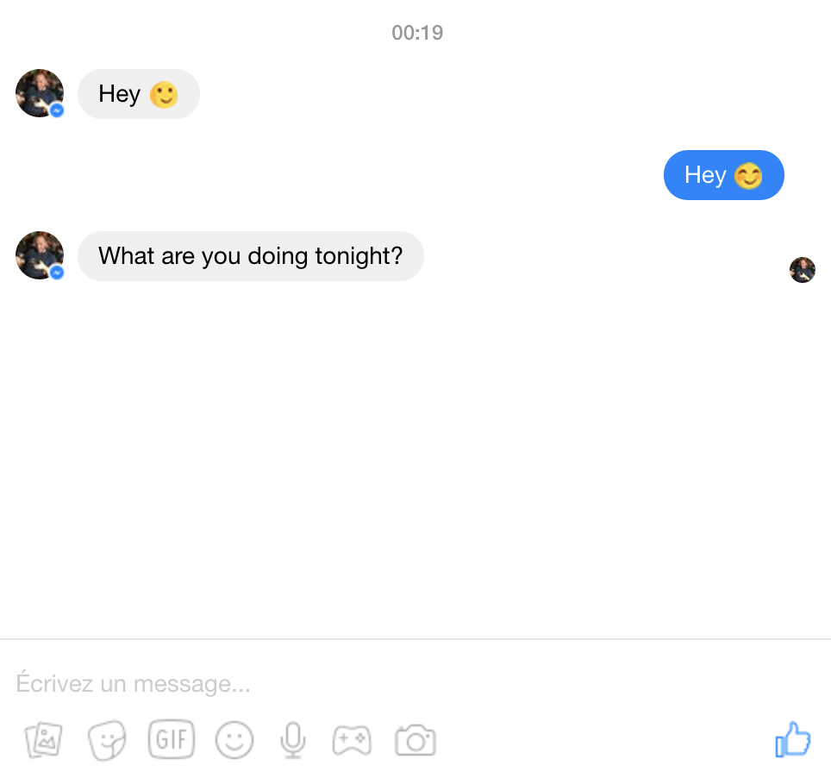

Slide 6
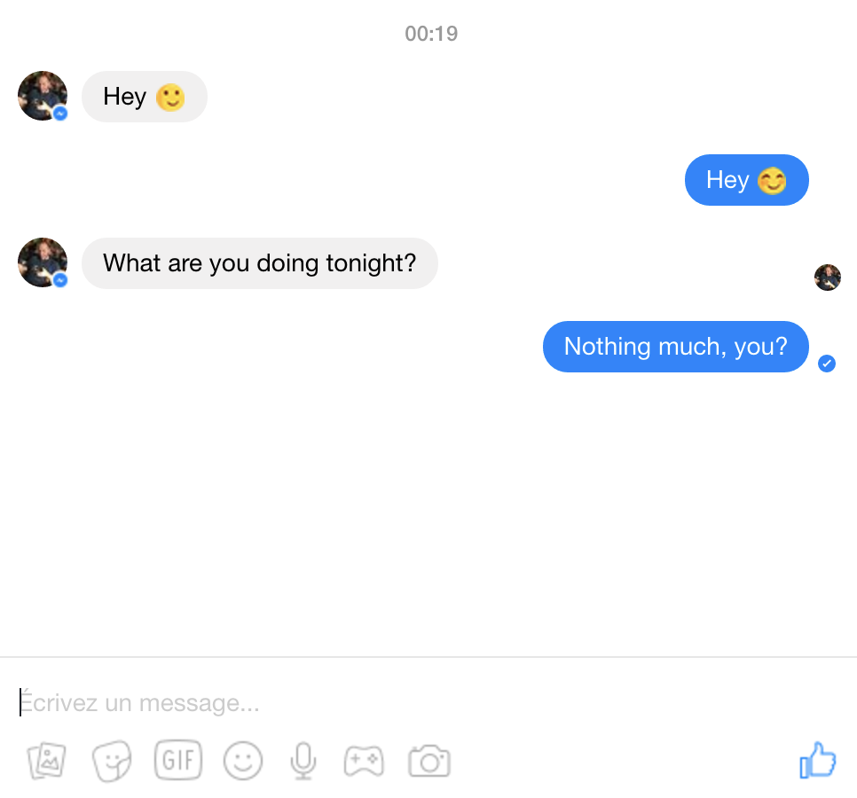

Slide 7
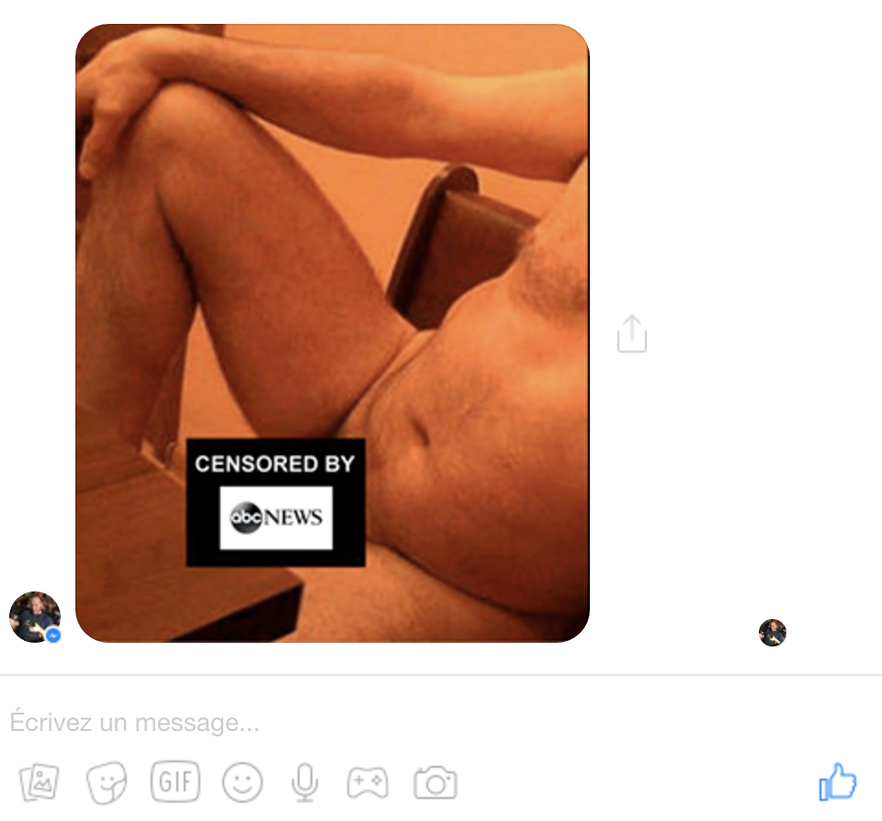

Please Standby

Slide 8




HOW?
Choose your target
Summary before date
1
Let us do our magic
Go on the date

