Slide 1
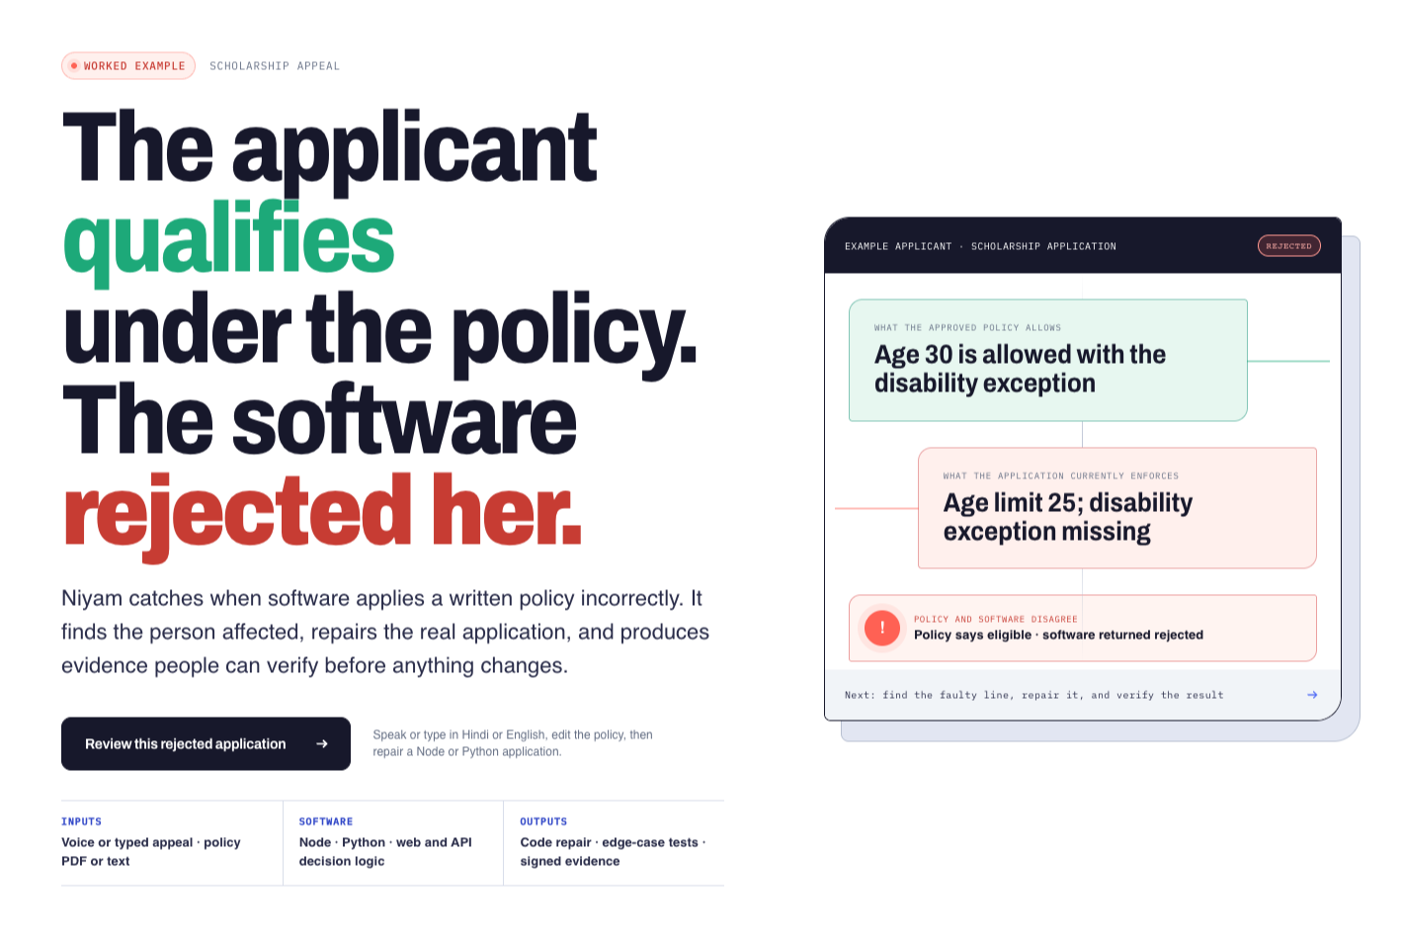
NIYAM
When policy and software disagree
Niyam repairs the decision code—and proves the fix before people approve it.
Appeal → cited policy → live repair → tests → two approvals → signed evidence
d3rre9ztdq52vx.cloudfront.net · github.com/Awowowow/niyam
NIYAM · HUMAN-APPROVED POLICY-TO-CODE VERIFICATION
01

Slide 2
A silent code error becomes a human decision
The written scholarship policy allows a disability age exception. The running application forgot it—so a qualified applicant is rejected with confidence.
WHAT THE POLICY REQUIRES
WHAT THE APPLICATION ENFORCES
ELIGIBLE
INELIGIBLE
Income ≤ INR 437,500 Standard age ≤ 27 Disability exception → age ≤ 31
Income ≤ INR 437,500 Age ≤ 25 Disability exception missing
Niyam traces that disagreement to the exact rule, person, and faulty line.
NIYAM · HUMAN-APPROVED POLICY-TO-CODE VERIFICATION
02

Slide 3
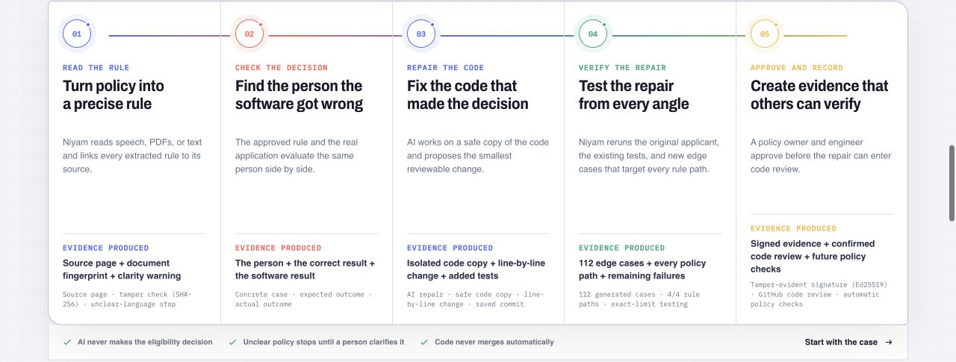
One visible chain turns rejection into verified evidence
Every stage produces something the next stage must verify. Nothing jumps directly from an AI answer to production.
NIYAM · HUMAN-APPROVED POLICY-TO-CODE VERIFICATION
03

Slide 4
Three systems share the work—and none can bypass the others
AI handles messy language and source inspection. Repeatable code decides whether behavior is correct. People retain authority.
01
02
03
AI reads and repairs
Checks decide
People authorize
OpenAI gpt-oss-120b links policy values to source sentences. Qwen3 Coder proposes the smallest patch on an isolated branch.
The rule engine reruns the applicant, existing tests, generated policy tests, and 112 boundary cases across every demonstrated rule path.
A policy owner approves meaning. An engineer approves code. Only then can Niyam sign evidence or open a GitHub code review.
Next.js + NestJS + Python verifier · Amazon Bedrock · AWS ECS/Fargate · Ed25519 evidence
NIYAM · HUMAN-APPROVED POLICY-TO-CODE VERIFICATION
04

Slide 5
AI is essential—and boxed in by hard gates
Niyam uses AI where fixed forms fail, then surrounds it with rules that are easy for judges, engineers, and policy owners to audit.
01
Every rule cites its source
02
Ambiguity stops the workflow
The AI cannot invent a threshold: each extracted value must point back to submitted policy text.
Missing, conflicting, exclusive, unsupported, or low-confidence language returns to a person.
03
The original code stays untouched
04
Nothing merges automatically
Repair happens in an isolated copy with a real diff, commit, build, and application tests.
Policy owner and engineer approvals are mandatory before signed evidence or code review.
NIYAM · HUMAN-APPROVED POLICY-TO-CODE VERIFICATION
05

Slide 6
The judge build has already survived repeat use
Production AWS build · live model calls · real Node repair · verified signature · zero browser warnings or errors across the five-flow rehearsal
12/12
10/10
5/5
live-AI reliability cases succeeded 10.04 s mean · 17 Jul 2026
AI/status checks resolved ≤ 1.2 s · 19 Jul 2026
complete reset-to-evidence flows 112/112 each · 19 Jul 2026
NIYAM · HUMAN-APPROVED POLICY-TO-CODE VERIFICATION
06

Slide 7
THE OUTCOME
Software should earn the right to say no.
Niyam turns a silent rejection into a cited rule, a reviewable code repair, repeatable tests, two human approvals, and evidence anyone can verify.
LIVE PRODUCT d3rre9ztdq52vx.cloudfront.net · PUBLIC SOURCE github.com/Awowowow/niyam
NIYAM · HUMAN-APPROVED POLICY-TO-CODE VERIFICATION
07

