Slide 1

Master’s Project: Uncovering Latent Semantics in BERT’s Activation Space Given Text Inputs Provided by GPT 3.5 Awritrojit Banerjee(Dushtu) MatNr: 23228169 MSc AI Neuroscience Lab University Hospital FAU Supervisors: Prof Patrick Krauss and Achim Schilling

Slide 2
Introduction
Motivation and Problem statement
It has been established in the neuroscience of vision that different parts of a stimulus or even different types of stimuli are processed in different parts of the visual pathway i.e., specific stimuli localise to specific receptive fields in the brain(Ref.1). Is it the same for sequential – auditory or textual – stimulus?
To find out, the current attempt studies the localisation of activations in state-of-the-art artificial neural networks - BERT(Bidirectional Encoder Representation of Transformer) and GPT(Generative Pretrained Transformer) - since these have structures which computationally model the biological receptive fields.
Problem formulation: Consider n narratives by m authors. Have GPT generate each of the n narratives in the style of each of the m authors – in total we have nxm narratives. Provide each of these nxm narratives as input to BERT. Study BERT’s activations.
Hypothesis: Localisation in terms of the narratives(the content of the text input), or authors(writing styles) or both is expected in BERT’s activation space.

Slide 3
Data Generation
The selected novels and their authors are as follows:
Novel/Story | Author | OriginalNarratives
Twelfth Night, or What You Will | William Shakespeare | Short text from the introductory part
A Tale of Two Cities | Charles Dickens | “
Jane Eyre | Charlotte Bronte | “
The Hound of the Baskervilles | Sir Arthur Conan Doyle | “
The Tell Tale Heart | Edgar Allan Poe | “
A Song of Ice and Fire: A Dance with Dragons | George R R Martin | “
The Wolves of Cernogratz | Hector Hugh Munro(Saki) | “
The Last Leaf | William Henry Porter(O’Henry) | “
Angels and Demons | Dan Brown | “
Three Men in a Boat | Jerome K. Jerome | “

Slide 4
Datasets
Dataset 1(gpt dataset):
Prompt: “write a brief summary of [novel name] such that after tokenization it will fit as BERT's input”
Prompt: “now rewrite this:
[generated text]
in the styles of the following authors one at a time: shakespeare, dickens, charlotte bronte, conan doyle, poe, george r r martin, saki, o’henry, dan brown, jerome k jerome.”
Repeat the 2 prompts until the 100 different narratives are generated

Slide 5
Datasets
Dataset 2(orig dataset):
Initialise a new chat.
Prompt: “You are the best content writer and comparative literature expert ever. You have utmost knowledge in ancient, pre-victorian, post-victorian, modern, postmodern and contemporary english literature. You are particularly an expert on the works of William Shakespeare, Charles Dickens, Charlotte Brontë, Sir Arthur Conan Doyle, Edgar Allan Poe, George R R Martin, Hector Hugh Munro also known as Saki, William Henry Porter also known as O'Henry, Dan Brown and Jerome K. Jerome. From now on you will be provide with small excerpts of works by the above authors in the order mentioned above. The works are, in order: 'The Twelfth Night or What You Will', 'A Tale of Two Cities', 'Jane Eyre', 'The Hound of the Baskervilles', 'The Tell Tale Heart', 'A Song of Ice and Fire: A Dance with Dragons', 'The Wolves of Cernogratz', 'The Last Leaf', 'Angels and Demons' and 'Three Men in a Boat' respectively. You can see there are 10 authors and 10 novels/stories. You will be provided with one excerpt at a time. Your job is to take that excerpt and generate similar text pieces in the style of all the other authors mentioned. For example, when provided with a piece from Angels and Demons, draft narratives in the style of all the authors except Dan Brown. One other very important thing is that the narratives after tokenization by BertTokenizer on HuggingFace's transformers API, should be concise enough to pass as input to the LLM called BERT, more specifically the model named bert-base-uncased.”
After this prompt, each excerpt of a story was provided and the other 9 narratives were generated.
At the end, 100 different narratives were organised in a CSV format.

Slide 6
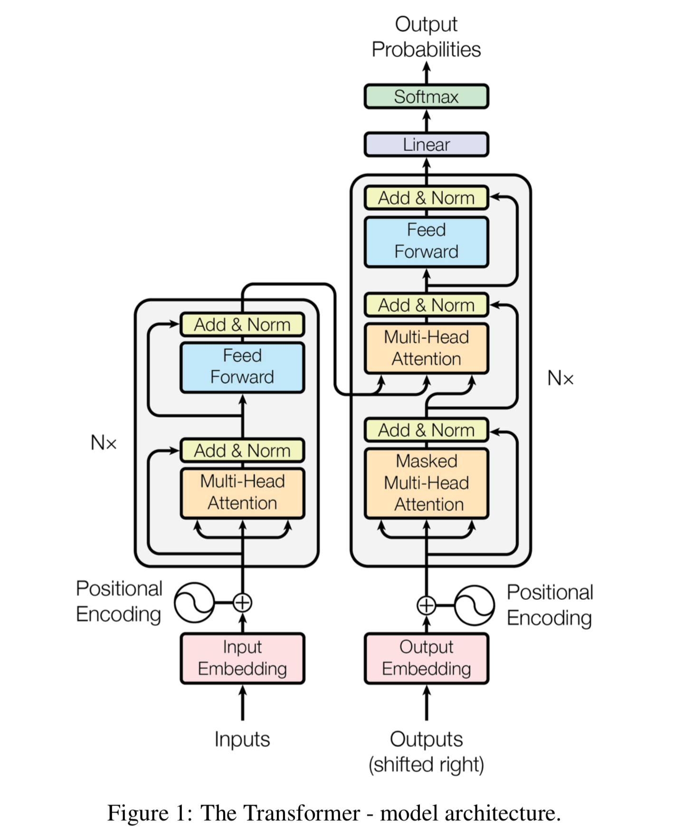
Technical Specifications
GPT used: GPT 3.5 by OpenAI
BERT used(Ref 3): “bert-base-uncased” model available on HuggingFace’s transformers API.
This is a smaller BERT with only 12 layers and 110M parameters.
Necessary additional libraries: PyTorch v2.1.1, Scikit learn v1.3.0
Ref 2

Slide 7
BERT’s Activations
The CLS Token
Each layer of BERT generates a tensor of size (batch_size, sequence_size, hidden_size).
In our case: (1, x, 768)
It means that we have x tokens in our input sequence(x depends on the actual input size), and the model has 768 hidden units( or neurons) in each layer.
The first token is always the CLS token.
The CLS token in BERT represents the aggregated understanding of the input sequence.
For every layer and for each of the 100 narratives there will be a CLS token. Each CLS token is of 768 dimensions.
The dimensionality of the activation space becomes: (12,100,768) [essentially 768]

Slide 8
Projection
What does it mean
If there are two vectors u and v, then the projection of u on v is simply the shadow of u on v. Or, what does u look like along v.
Most real world applications of ML/DL today deal with very high dimensional data and accordingly the models are also very complex i.e., have a lot of parameters - #parameters in LLMs ~ 10^6 at least. This makes understanding what these models are learning very difficult.
Possible solution: If we can project the parameter-space of such models to lower dimensional space(choose v such that it is easier looking at u from v’s perspective without losing information about u), then we can start to learn better what the models have encoded/learnt.
Two very popular projection methods are Principal Component Analysis(PCA) and Multi-dimensional Scaling(MDS).

Slide 9
Projection Methods
PCA vs MDS
PCA:
Idea - Maximize the variance of the data along the new orthogonal axes (principal components) that are created through linear combinations of the original features.
Used for feature reduction.
It works by finding the eigenvectors and eigenvalues of the covariance matrix of the data.
Eigenvectors represent the directions of maximum variance and eigenvalues represent the magnitude of that variance.
Select the n eigenvectors corresponding to the top n highest eigenvalues as principal components.
For visualization purposes n<=3.
MDS:
Idea - Minimization of the (linear) distances between dimensions/components/features.
Used for visualizing the pairwise dissimilarities or similarities between a set of objects.
Preserves how similarly different two points are in the high-dimensional space when embedding into a low-dimensional space.
MDS achieves this by computing a matrix of pairwise dissimilarities or similarities between the objects and then finding a configuration of points in the low-dimensional space that best approximates these pairwise relationships.
For visualization purposes set the dimensionality of the low-dimensional space to be <=3.

Slide 10
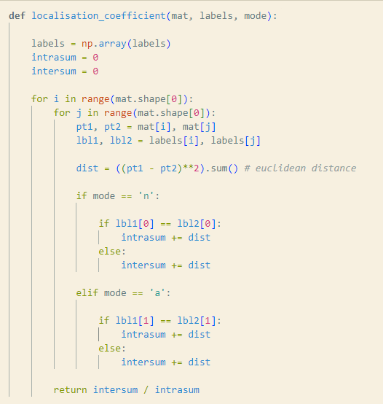
Measure of Localisation
Localisation Coefficient
Relies on the foundational principle for assessing the quality of clustering – ratio of the sum of norm magnitudes of intercluster points to that of intracluster points. Simply, ratio of how separated and how compact the clusters are.
Target: Maximise this ratio.
Custom-made for this project:
Operates in 2 modes: clustering in terms of novels and in terms of authors.
Labelling scheme: (n,a) => n=Novel-ID and a=Author-ID.

Slide 11
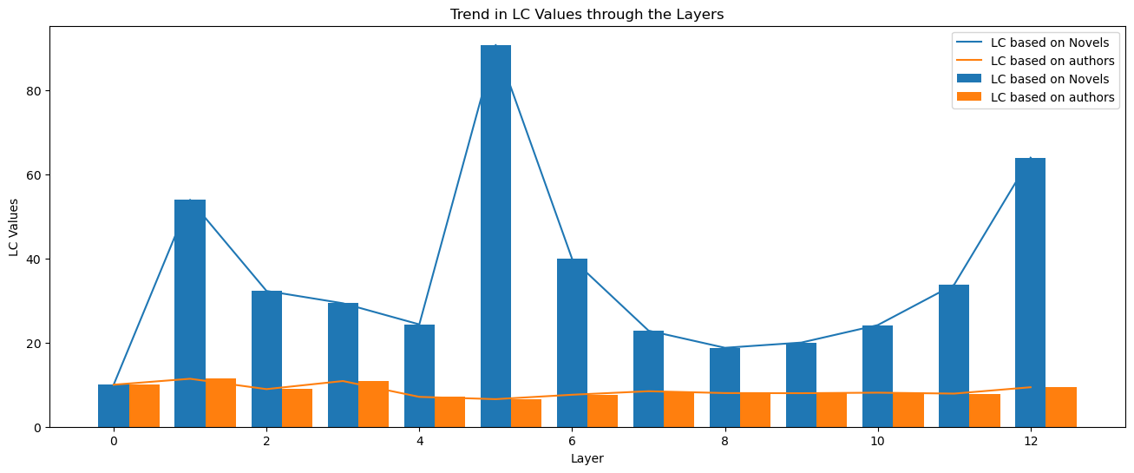
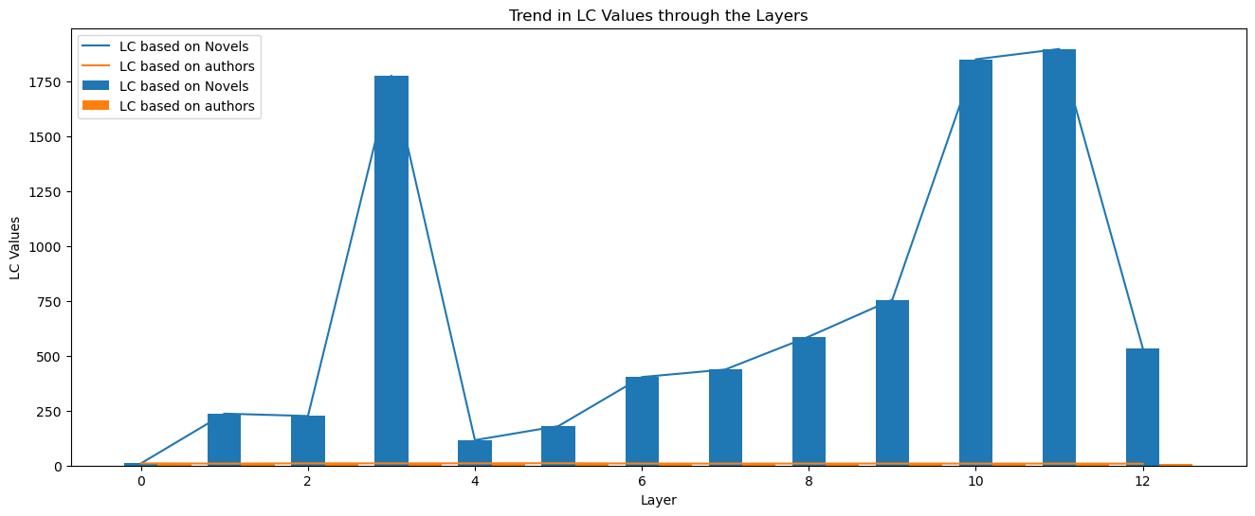
PCA Results
Trend(LC*100)
Localisation results for the GPT dataset.
Localisation results for the Orig dataset.

Slide 12
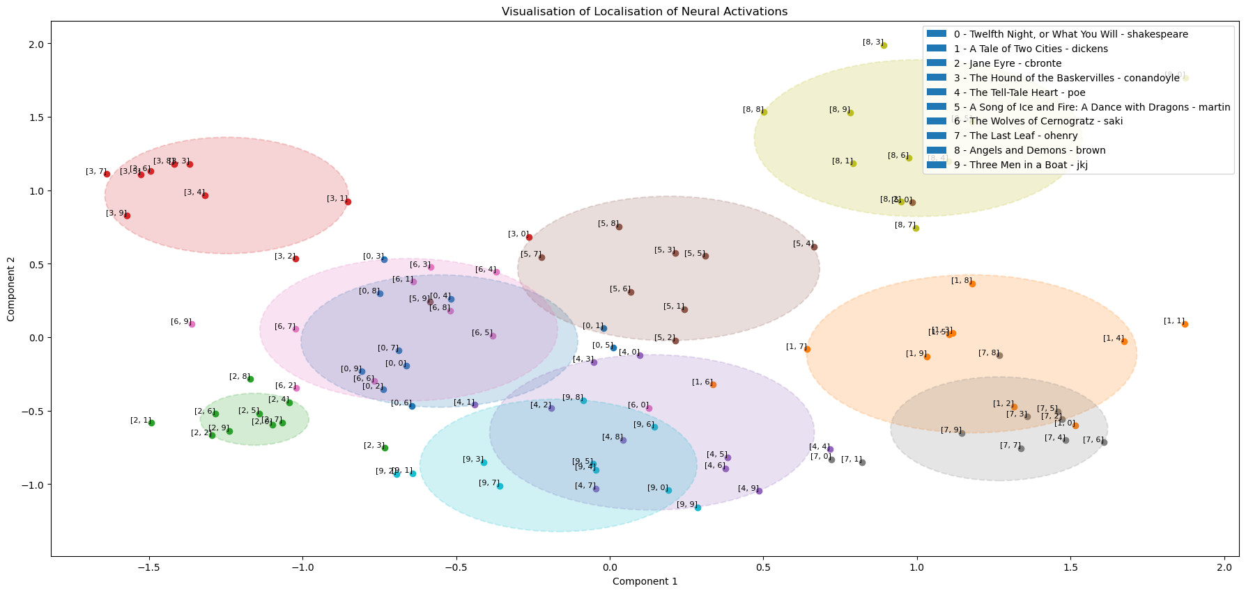
PCA Results
Layer with Max LC as per GPT dataset: Layer 5

Slide 13
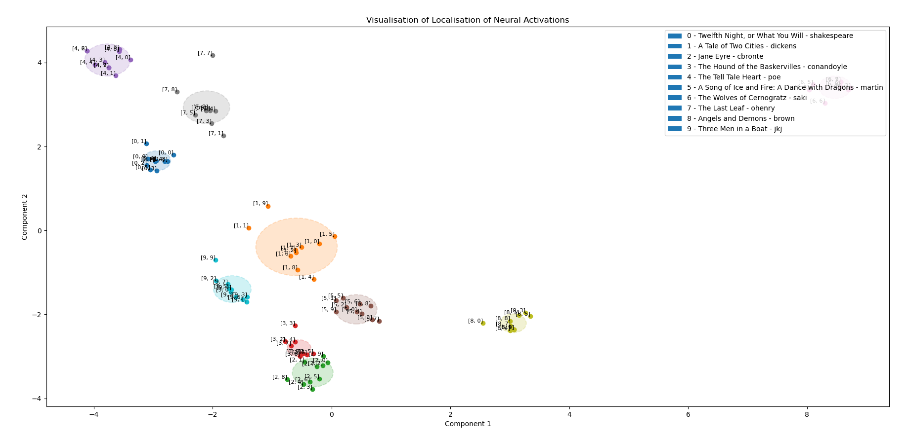
PCA Results
Layer with Max LC as per Orig dataset: Layer 11

Slide 14
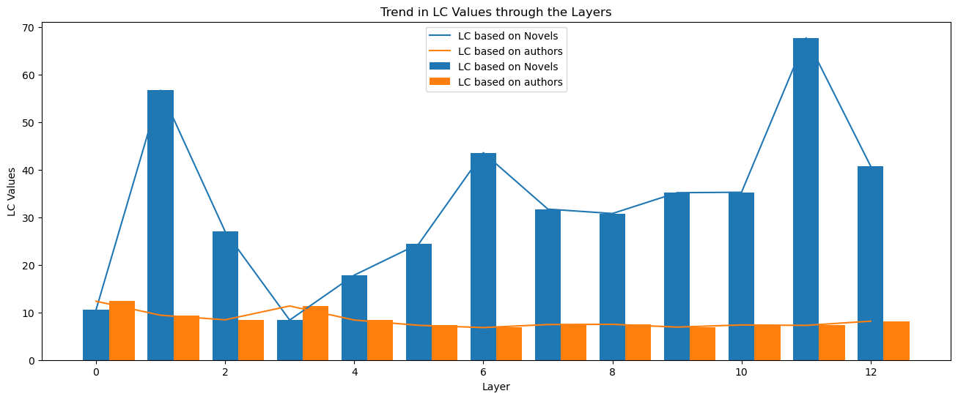
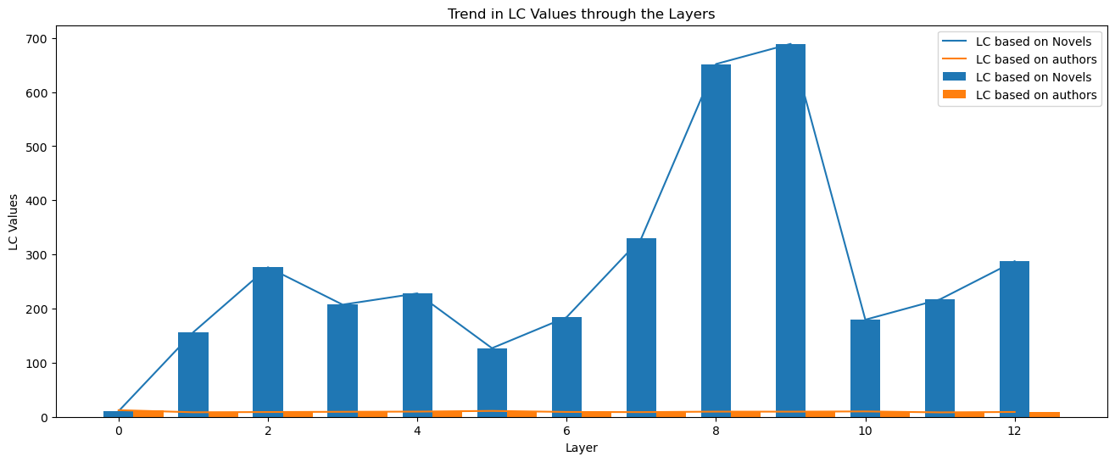
MDS Results
Trend(LC*100)
Localisation Results for the GPT dataset.
Localisation Results for the Orig dataset.

Slide 15
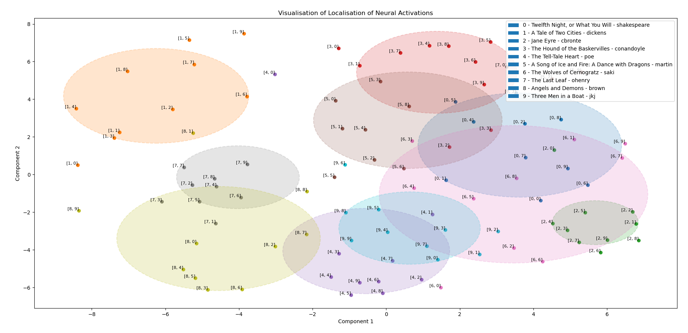
MDS Results
Layer with Max LC as per GPT dataset: Layer 11

Slide 16
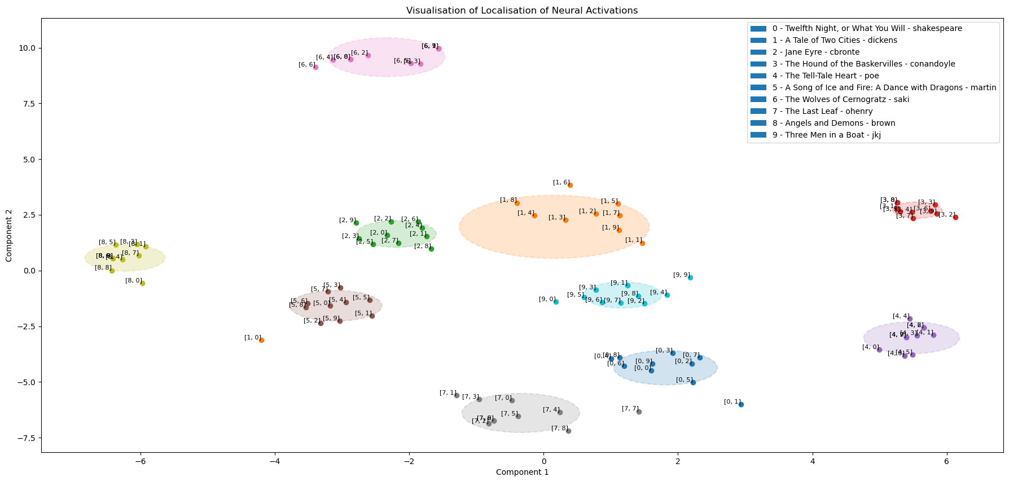
MDS Results
Layer with Max LC as per Orig dataset: Layer 9

Slide 17
PCA vs MDS Projection Capability
Comprehensive Tabular Comparison
Layer | pca_lc_n_gpt | pca_lc_a_gpt | pca_lc_n_orig | pca_lc_a_orig | mds_lc_n_gpt | mds_lc_a_gpt | mds_lc_n_orig | mds_lc_a_orig
1 | 53.98738754 | 11.41455412 | 236.662506 | 9.061676425 | 56.66702484 | 9.401521532 | 156.288924 | 8.455788008
2 | 32.31355197 | 8.951301194 | 225.8403212 | 10.08423953 | 26.9953139 | 8.446904936 | 276.2756786 | 8.870865977
3 | 29.37613457 | 10.87582276 | 1777.136819 | 10.06560948 | 8.385448059 | 11.34642352 | 207.2515659 | 9.317786073
4 | 24.34557791 | 7.110620407 | 115.8481432 | 10.1252411 | 17.82563035 | 8.397591942 | 228.0726068 | 9.684249373
5 | 90.82097567 | 6.567711258 | 179.9256218 | 10.7230756 | 24.40638586 | 7.286625712 | 126.8653122 | 10.95565002
6 | 39.91068494 | 7.615507626 | 403.3736798 | 9.314725279 | 43.56472586 | 6.81196534 | 184.0956519 | 9.025004893
7 | 22.86439622 | 8.452262779 | 437.8467922 | 8.958753687 | 31.7009552 | 7.452336175 | 329.8968422 | 8.736534034
8 | 18.78084635 | 8.017046935 | 587.5912841 | 9.311166629 | 30.77857376 | 7.496759045 | 651.7765033 | 9.631909397
9 | 20.02775969 | 7.983249173 | 755.838952 | 9.200606525 | 35.1495743 | 6.91423335 | 689.0565681 | 9.567744678
10 | 24.18501773 | 8.109405604 | 1851.586588 | 9.097102326 | 35.24571047 | 7.363079425 | 179.468465 | 10.01143817
11 | 33.8033163 | 7.887097516 | 1898.566784 | 9.05812254 | 67.68331166 | 7.275326411 | 217.0369401 | 8.264343398
12 | 64.00207913 | 9.39980835 | 535.4387288 | 8.550167908 | 40.73328071 | 8.157366587 | 287.4563791 | 9.013272332
Mean LC of Layers 5, 9 and 11 with PCA: 252.533606
Mean LC of Layers 5, 9 and 11 with MDS: 100.8718346

Slide 18
Conclusion
As per our hypothesis, localisation in neuronal activations is observed in a low-dimensional projection of BERT’s activation space.
Exploring the localisation uncovers semantics which suggest local processing of input data in terms of the content of the text piece itself rather than author specific writing-styles in BERT.
In this usecase PCA does a better job of projection than MDS.
*The previous two observations suggest the actual activation manifold follows an organization which is a function of the variability in the data, much more than normative magnitudes.
Localisations observed upon using the GPT dataset are much worse than those of the Orig dataset. This suggests existence of high correlation amongst the datapoints, which is to be expected since all the narratives are being generated by the same author – ChatGPT.

Slide 19
References
Mazade, R., Jin, J., Pons, C., & Alonso, J. (2019). Functional Specialization of ON and OFF Cortical Pathways for Global-Slow and Local-Fast Vision.. Cell reports, 27 10, 2881-2894.e5 . https://doi.org/10.1016/j.celrep.2019.05.007.
Attention is All You Need: https://arxiv.org/abs/1706.03762
BERT: Pre-training of Deep Bidirectional Transformers for Language Understanding: https://arxiv.org/pdf/1810.04805.pdf

Slide 20
Thank you!

