Slide 1

Scrum-Agile Option
Aws Albayati

Slide 2
Roles: Product Owner
Communicating the stakeholders' vision to the rest of the team
Defining and prioritizing the team backlog
In charge of ROI
Release management

Slide 3
Roles: Scrum Master
Fostering Communication
Meeting Facilitation
Agile Coaching
Team Support
Remove Blockers
Tool Maintenance

Slide 4
Roles: Scrum Team
Planning and architecting
Developing
Testing
Attending scum meetings
Contributing to the sprint's objectives

Slide 5
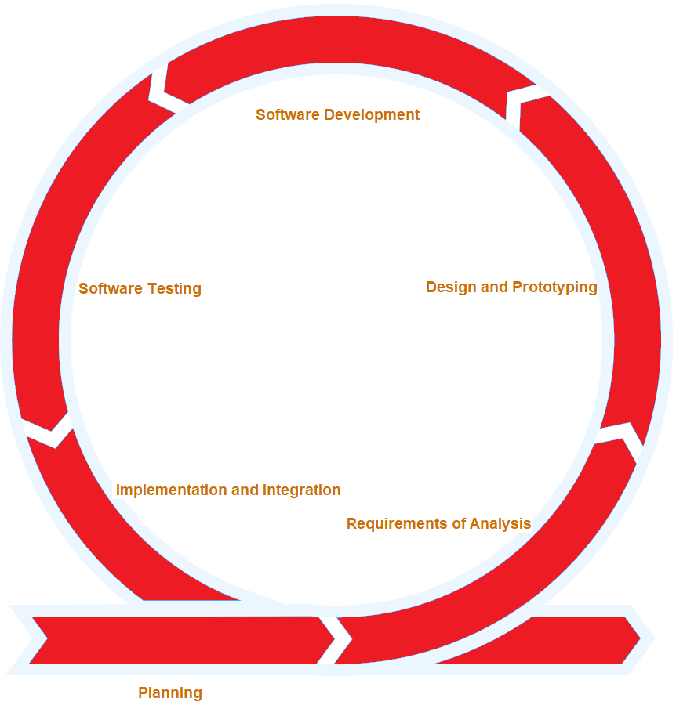















Stages of the SDLC of Agile model

Slide 6
Stages of the SDLC of Waterfall model
Planning
Requirements of Analysis
Design and Prototyping
Software Development
Software Testing
Implementation and Integration
Maintenance

Slide 7
7 Stages of the SDLC
Planning: developing an effective outline for the upcoming development cycle
Requirements of Analysis: define system requirements and perform research and analysis
Design and Prototyping: outline the details of application like system interfaces, database …etc.
Software Development: write code and build the application according to the design and specifications
Software Testing: preform unit testing, integration testing, system testing…etc.
Implementation and Integration: outline the process, system tests, methods, and logistics
Maintenance: perform routine maintenance on the system

Slide 8


Agile vs Waterfall
Scrum-agile is the best approaches to SNHU Travel project because SNHU Travel is seasonal service provider where the time and delivery are very crucial. Also, SNHU Travel has series competition in the market that requires quick market response to any changes which makes Scrum-agile a perfect approach due to it adaptive nature compared to Waterfall approach.

