Slide 1
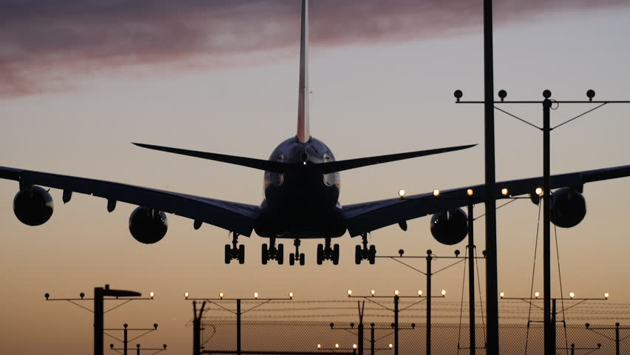
AIRLINE MANAGEMENT SYSTEM
Supervised BY:
Adiba Sanjana
Ahmed Nafis Fuad
(1505113)
Md Awsaf Alam
(1505114)

