Slide 1
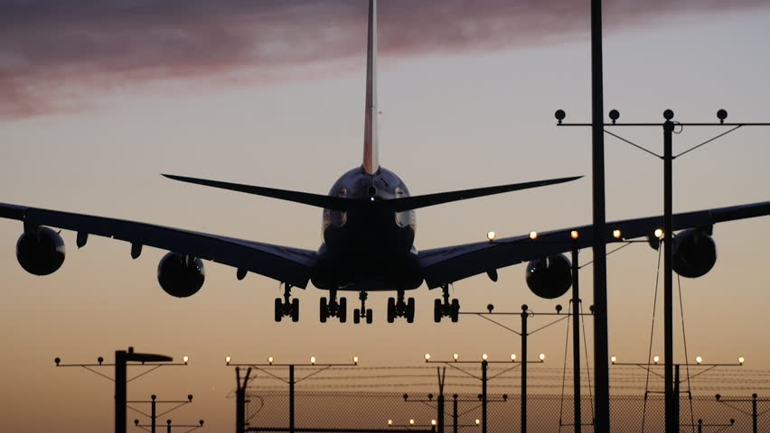
AIRLINE MANAGEMENT SYSTEM
Supervised BY:
Adiba Sanjana
Ahmed Nafis Fuad
(1505113)
Md Awsaf Alam
(1505114)

Slide 2
Three Modules
1. Ticket Booking System
-For Passengers
2. Schedule Management
-For Flight crew and other employees
3. Sales Report & Aircraft maintenance
-For Manager

Slide 3
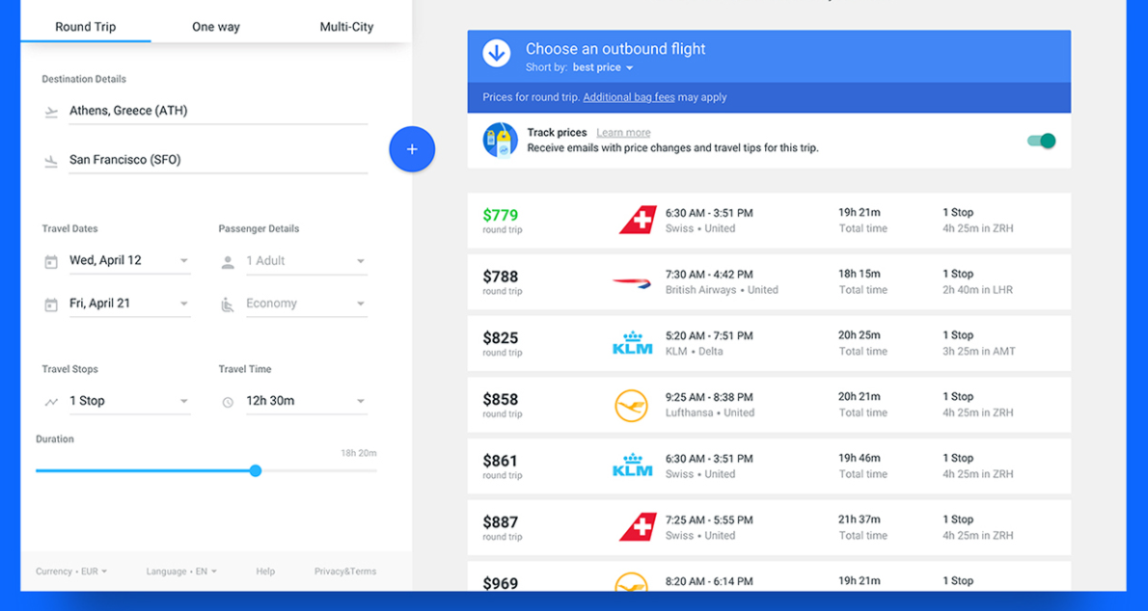
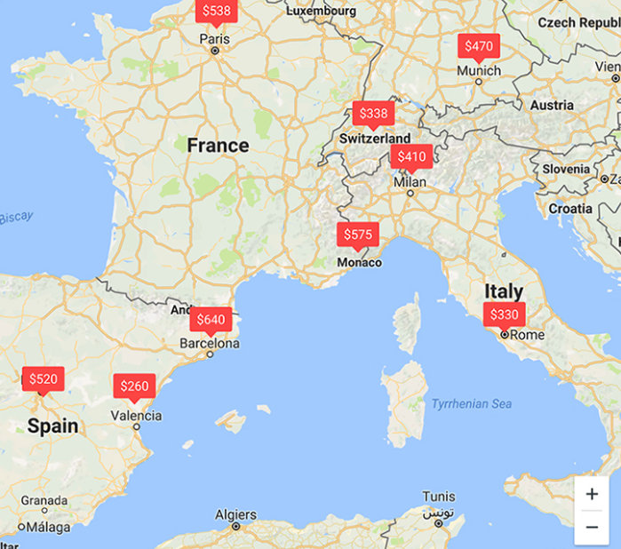
Ticket Booking

Slide 4
Entity And Attributes
Airport(Airport code , Name, City , Country )
Route(Route ID, Airport code_src , Airport code_dst)
Price(Price ID, Flight Id, First Class , Business Class , Economic Class)
Flight Schedule(Flight ID , Route ID , Plane ID , Arrival Time , Departure Time , Status,Type , Arrival Date , Departure Date )
Boarding(Boarding pass,Passenger ID, Flight ID,Booking ID, Baggage weight)
Booking(Booking ID, Flight ID, Passenger ID ,Class, seat no., Date of Booking, Payment Status, Amount Payable )
Passenger (Passenger ID , First Name , Last Name ,phone Number, Date of Birth,Gender, passport No.,Email ID, Address,Nationality)
Maintainance(Complain ID,plane ID, Employee ID,Parts to be replaced,Out of service date, Back to service date)
Plane info(Plane ID,price,length, height,wingspan,cabin width,cruising speed,start of service,End of service,Total Number of Flights)
Aircraft(Plane ID, Max take off weight, Max landing weight, first class capacity,Business class capacity,Economy class capacity)
Parts(parts id, price,Description)
Fuel(Refuel ID, Plane id,flight id,employee id,quantity)

Slide 5
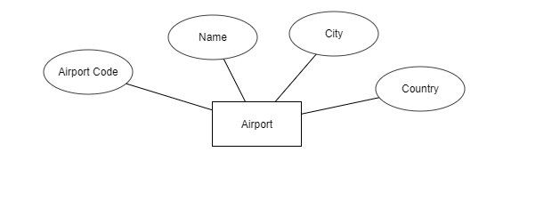

Slide 6


Slide 7
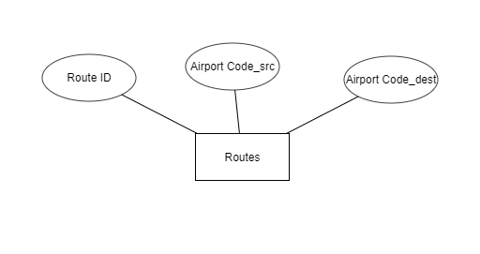

Slide 8
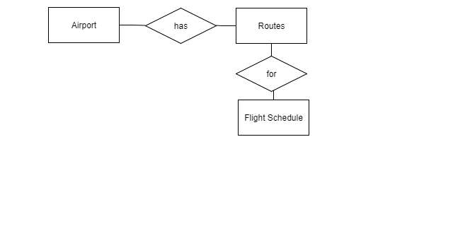

Slide 9
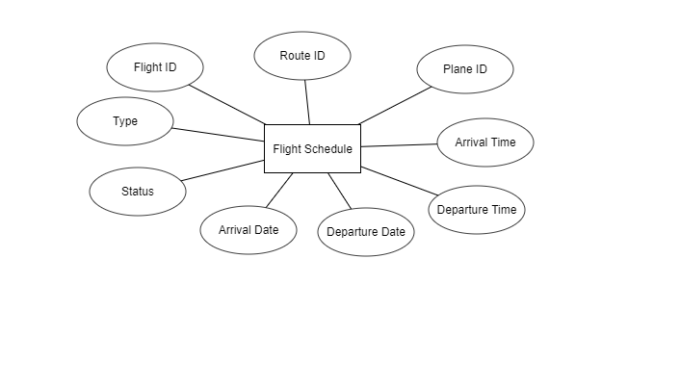

Slide 10
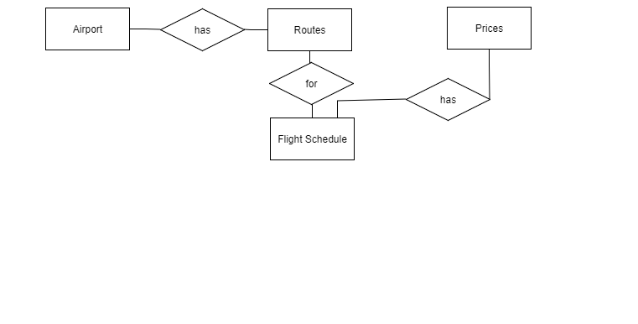

Slide 11
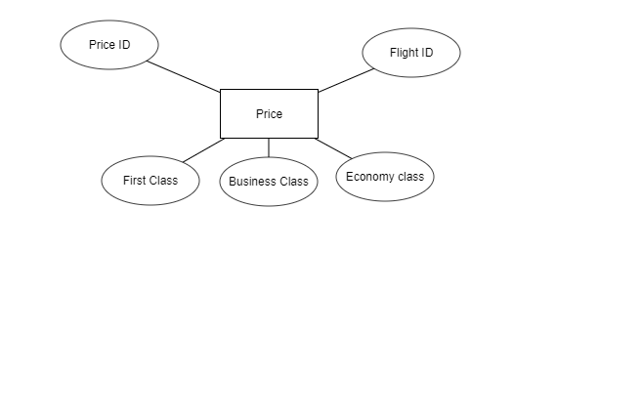

Slide 12
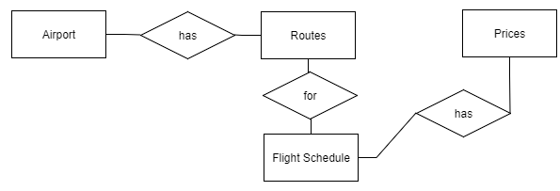

Slide 13
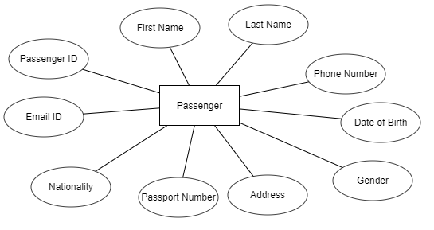

Slide 14
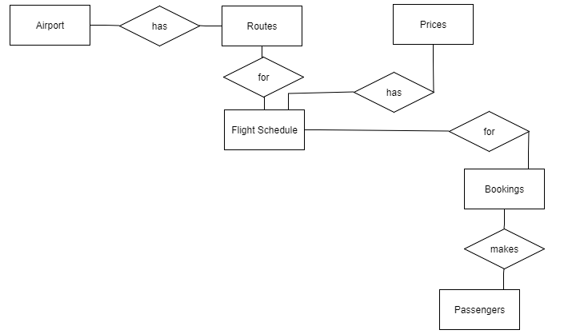
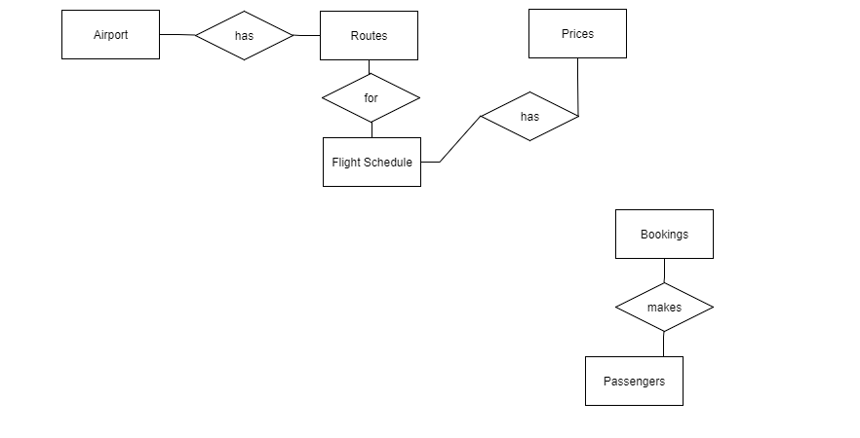

Slide 15
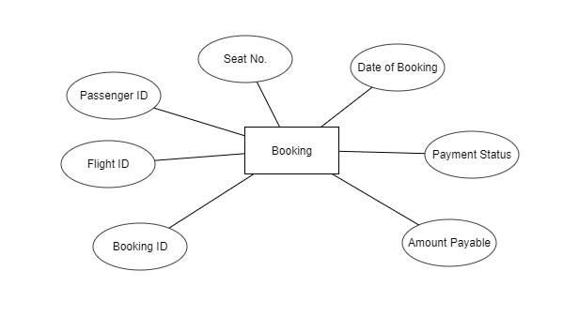

Slide 16
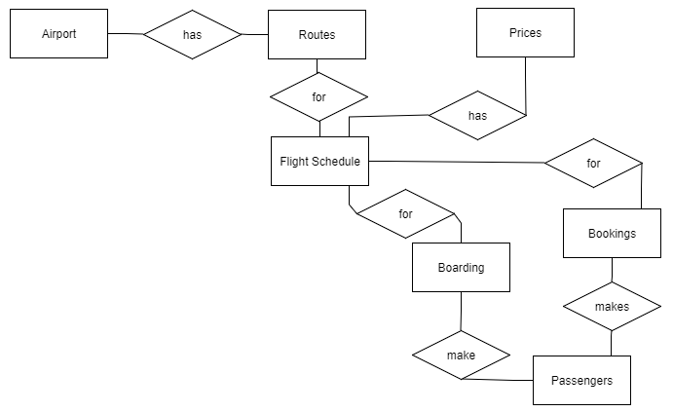

Slide 17
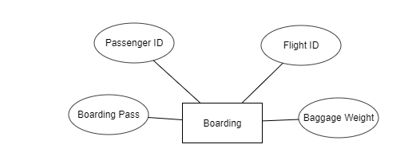

Slide 18
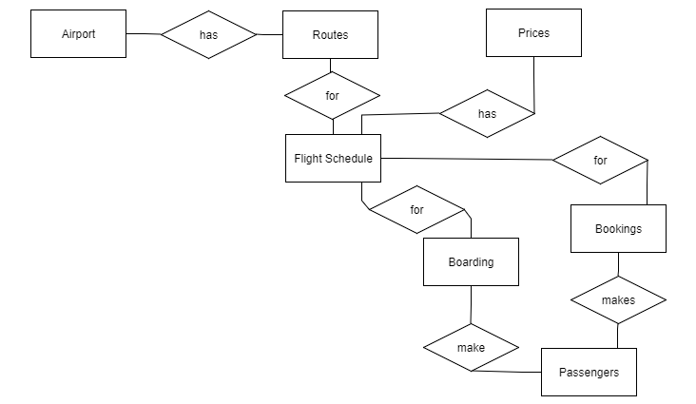

Slide 19
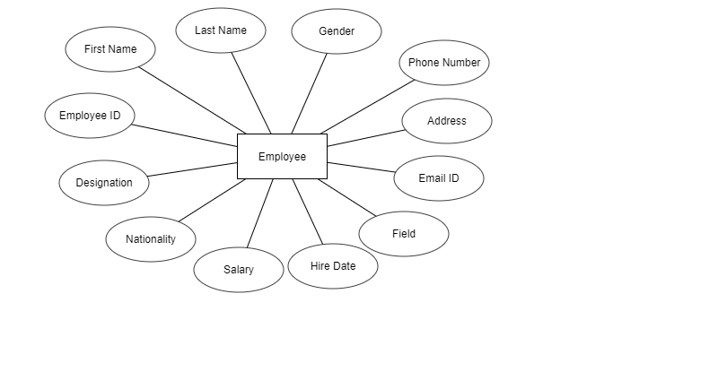

Slide 20
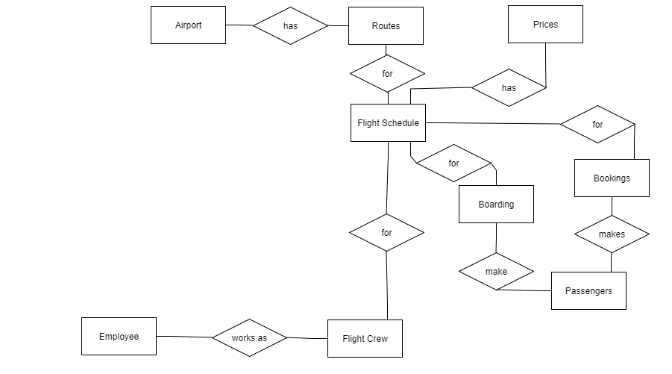

Slide 21
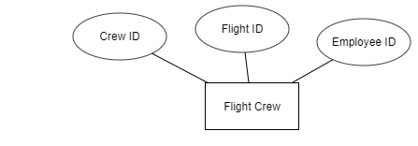

Slide 22
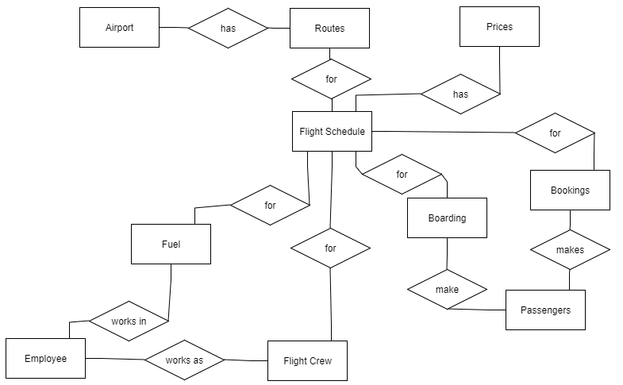

Slide 23
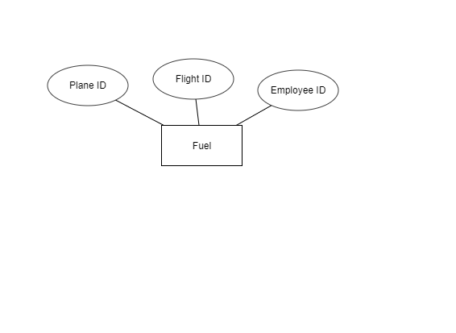

Slide 24
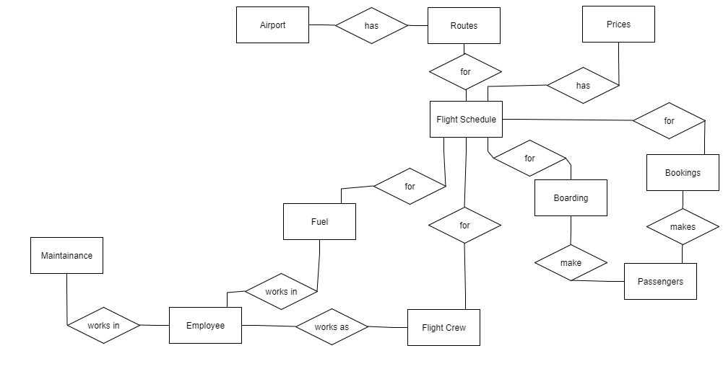

Slide 25
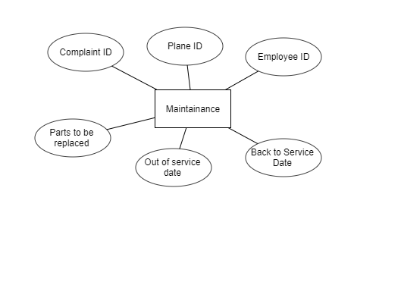

Slide 26
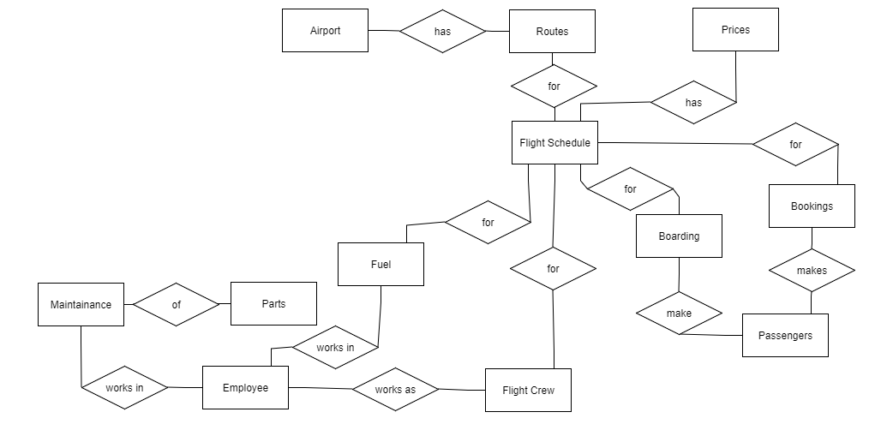

Slide 27
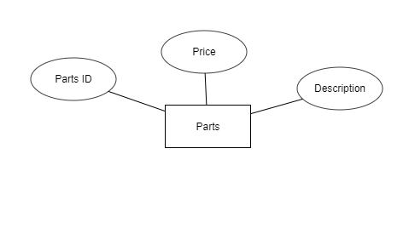

Slide 28
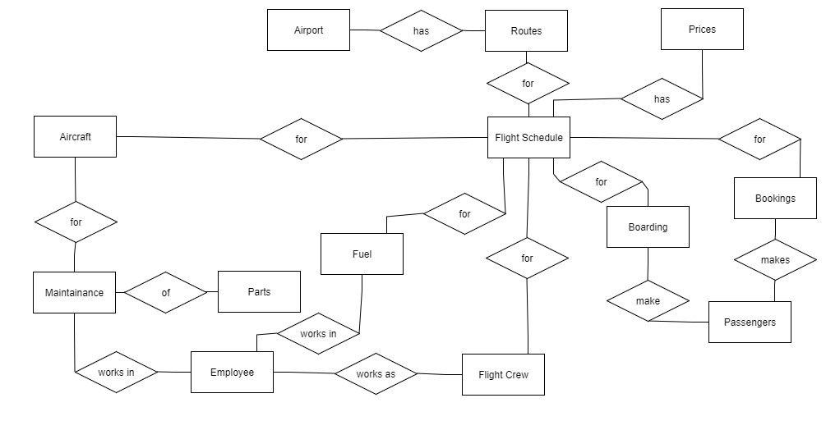

Slide 29
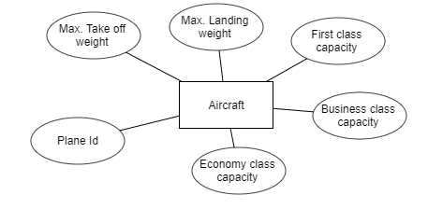

Slide 30
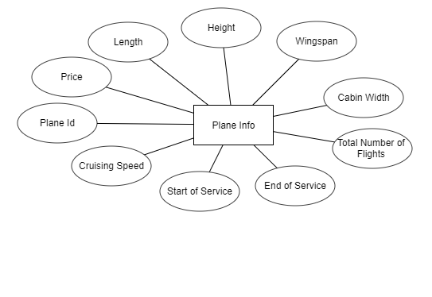

Slide 31
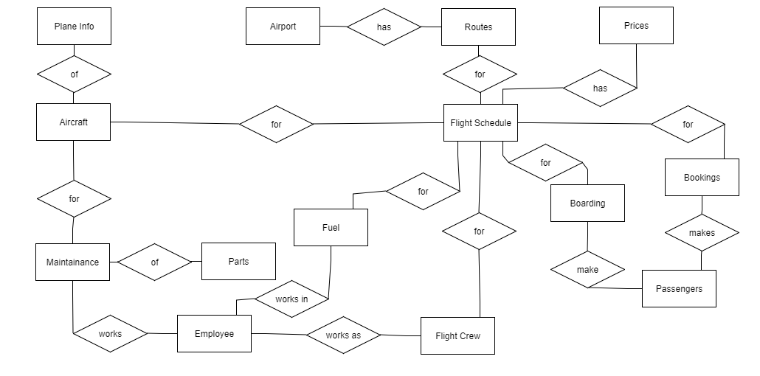

Slide 32
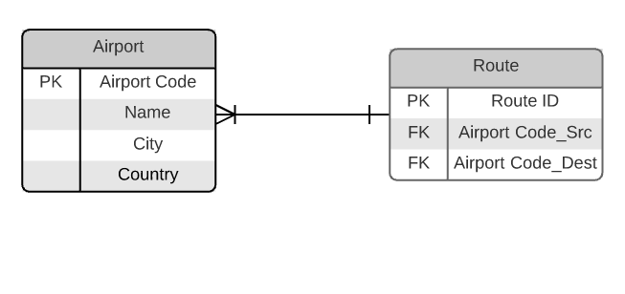

Slide 33
