Slide 1

Customized Deep Learning Models for
Artificial Intelligence Surveillance
YANGON TECHNOLOGICAL UNIVERSITY Department of Mechatronic Engineering
Defense Seminar
25-5-2020
Monday
Supervised by
Dr. Phyu Phyu Htun
Presented by
Aw Thura (VI-McE-11)

Slide 2
Outline
Introduction
Problem Statement
Literature Review
Objective and Goals
System Overview
Thesis Roadmap
Timeline and Milestones

Slide 3
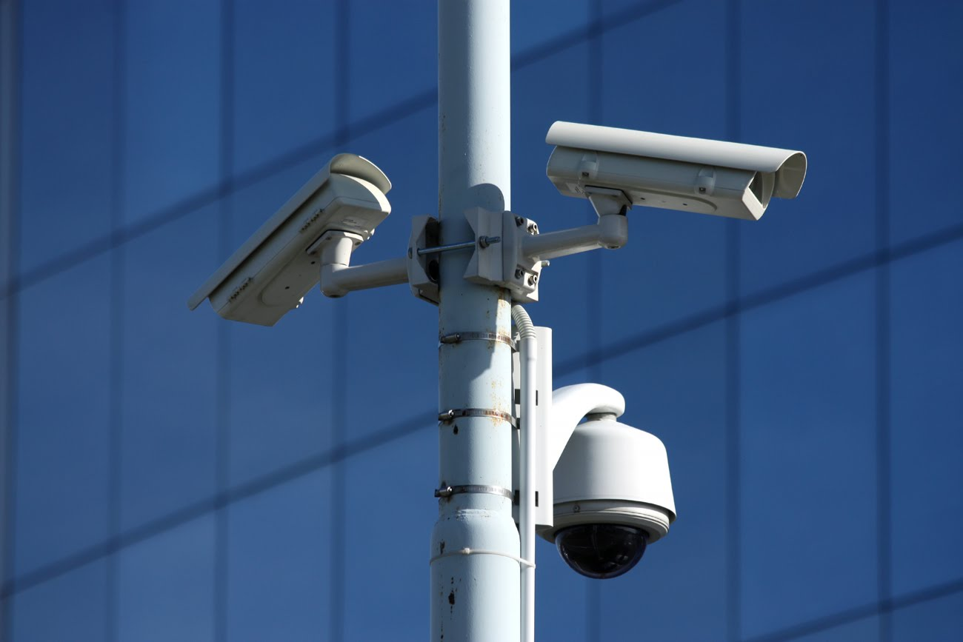
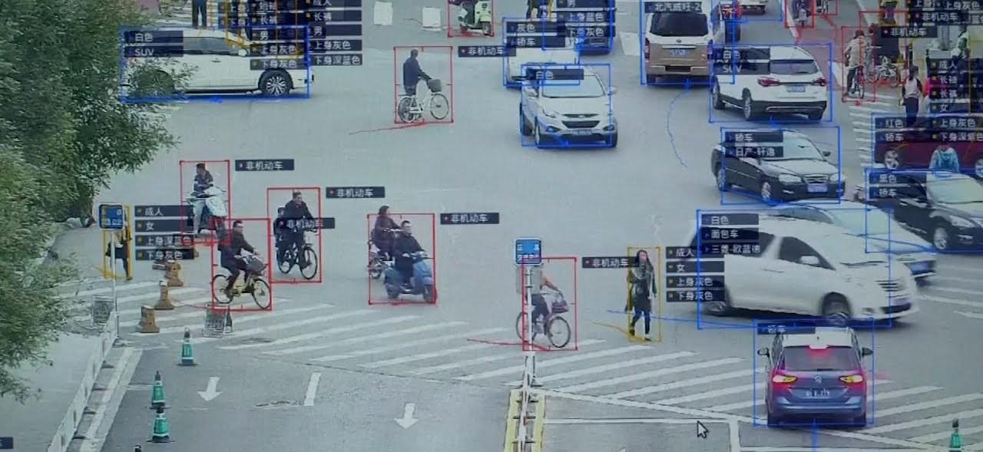
Introduction
A.I. Surveillance is increasingly being used to monitor public and private spaces throughout the world
Example applications include
Smart road surveillance
Facial recognition systems
Smart policing
Facial recognition system is integrated successfully in immigration check points and offices in Myanmar
The potential to implement smart road and security surveillance systems

Slide 4
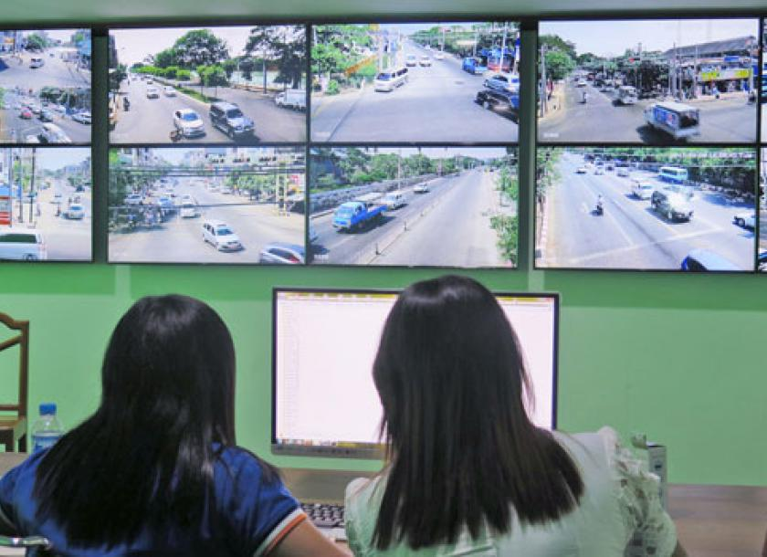
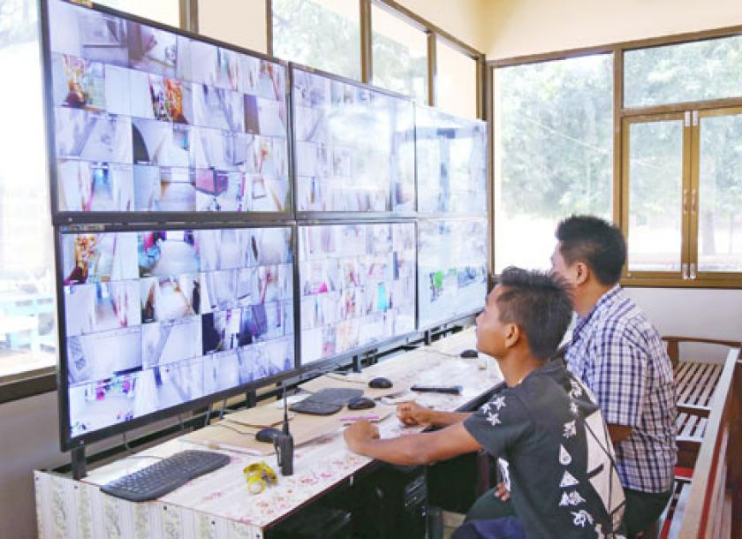
Problem Statement
Surveillance cameras are monitored manually and the officers usually have many cameras to cover.
Most CCTVs are left idle and it makes CCTV reviewing a time consuming process.
The recorded data is also vulnerable if stored locally.

Slide 5
Literature Review
J. Redmon, S. Divvala, R. Girshick, and A. Farhadi. You only look once : Unified, real-time object detection. (Redmond et al 2015)
J. Redmon and A. Farhadi. Yolo9000: Better, faster, stronger. (2016)
J. Redmon Ali Farhadi YOLOv3: An Incremental Improvement (2018)
A. Bochkovskiy C.Y. Wang H.Y.M. Liao YOLOv4: Optimal Speed and Accuracy of Object Detection (2020 April)

Slide 6
Literature Review
Model | Features & Capabilities | Limitations
Original YOLO (2015) | 24 convolutional layers, Divides the image into 7x7 grid cells. Can perform classification and localization on all 49 grid cells simultaneously. mAP score is 63.4% at with frame rate of 45 FPS. | Each grid cell can only have one object, Thus, YOLO can detect only 49 max objects. Bad for small objects that appear in groups Relatively high localization error.
YOLO v2 (2017) | 19 convolution layers, Detects over 9000 classes using Hierarchical classification Uses anchor boxes, Added batch normalization on all convolutional layers, 2% improvement in mAP | Computationally expensive Still struggles with small clusters

Slide 7
Literature Review
Model | Features & Capabilities | Limitations
YOLO v3 (2018) | 53 convolutional layers, enables multilabel prediction. Uses shortcut connecters to achieve better performance on small objects | Worse performance on medium and larger size objects compared to YOLO 9000 Sometimes struggles to get the boxes perfectly aligned with the object
YOLO v4 (2020 April) | 53 conv layers, state of the art results Data augmentation, which increases the generalization ability of the model Uses Spatial Pyramid Pooling to maintain aspect ratio of the image while pooling, results in better accuracy | None

Slide 8
Objectives & Goals
To develop and experiment customized YOLO v4 models that can detect various classes such as pedestrians, types of vehicles, and animals to track them.
To develop a tracking model with deepSORT that can track movement of the detected objects and to identify suspicious behavior.
To implement the developed models for real time surveillance.
To store the detected data on cloud and monitor the data via network.
Notes:
In real-time image processing.
Image processing

Slide 9
System Overview
START
Tracking model
START
Labelled Dataset
Output Tracking Data
Train Customized YOLO.v4
Behavior prediction with ROI
Cloud
No
Trained Weights
Monitoring Device
Yes
END
Satisfactory?
Tracking Model
IOT
Detection Model

Slide 10
Thesis Roadmap
Detection Model
Tracking Models
IoT integration
Developing appropriate model
(custom trained YOLO v4)
Gathering datasets for training
Training the model
Testing and evaluation
Developing appropriate model (most likely deepSORT)
Perform behavior prediction based on Region of Interest
Generate tracking output data
Making the data real time compatible with a device
Data storage in cloud
Live monitoring via the network

Slide 11
Timeline and Milestones
Duration | Tasks
May 1, 2020 - June 30, 2020 | Developing and Testing Detection models
July 1, 2020 - July 31, 2020 | Developing and Testing Tracking models
Aug 1, 2020 - Aug 31, 2020 | Behavior Prediction
Sep 1, 2020 - Sep 31, 2020 | IoT integration

Slide 12
End
Thank You For Your Attention.
Notes:
Work in indoor system

