Slide 1
AromaGen Data Analysis
Methodology, Findings, and Open Questions
Demo Corpus: June 3–17, 2026

Slide 2
Corpus Overview
7 dialogue log files, June 3–17 2026 demo sessions
99 compose events = 99 sessions (one compose per session, no re-composing)
85 total feedback rounds, 11 accepted compositions
All analysis is reproducible from the raw dialogue logs

Slide 3
Methodology / Pipeline
extract.py — filters raw logs to compose events, builds human_input.txt and scent_usage.csv
word_cloud.py — word cloud from session inputs, tuned stopword list
theme_taxonomy.py — classifies sessions into food/nature/place/memory/other, or noise
Automatic rules + 33 manual corrections from full line-by-line review
scent_usage.py — scent frequency, floral-bias %, per-day usage
session_funnel.py — daily compose → feedback → accept funnel
feedback_coding.py — qualitative coding of all 85 feedback utterances (in progress)

Slide 4
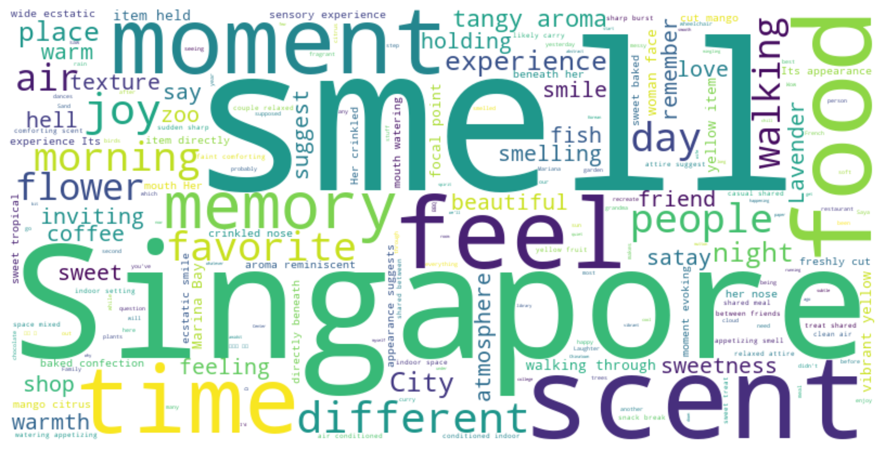
Word Cloud — What People Wanted to Smell
Dominant terms: scent, smell, Singapore, memory, food, coffee, flower, walking, joy, sweetness.
"Singapore" and place terms are prominent — sessions are location-specific to the deployment, not a general system finding.

Slide 5
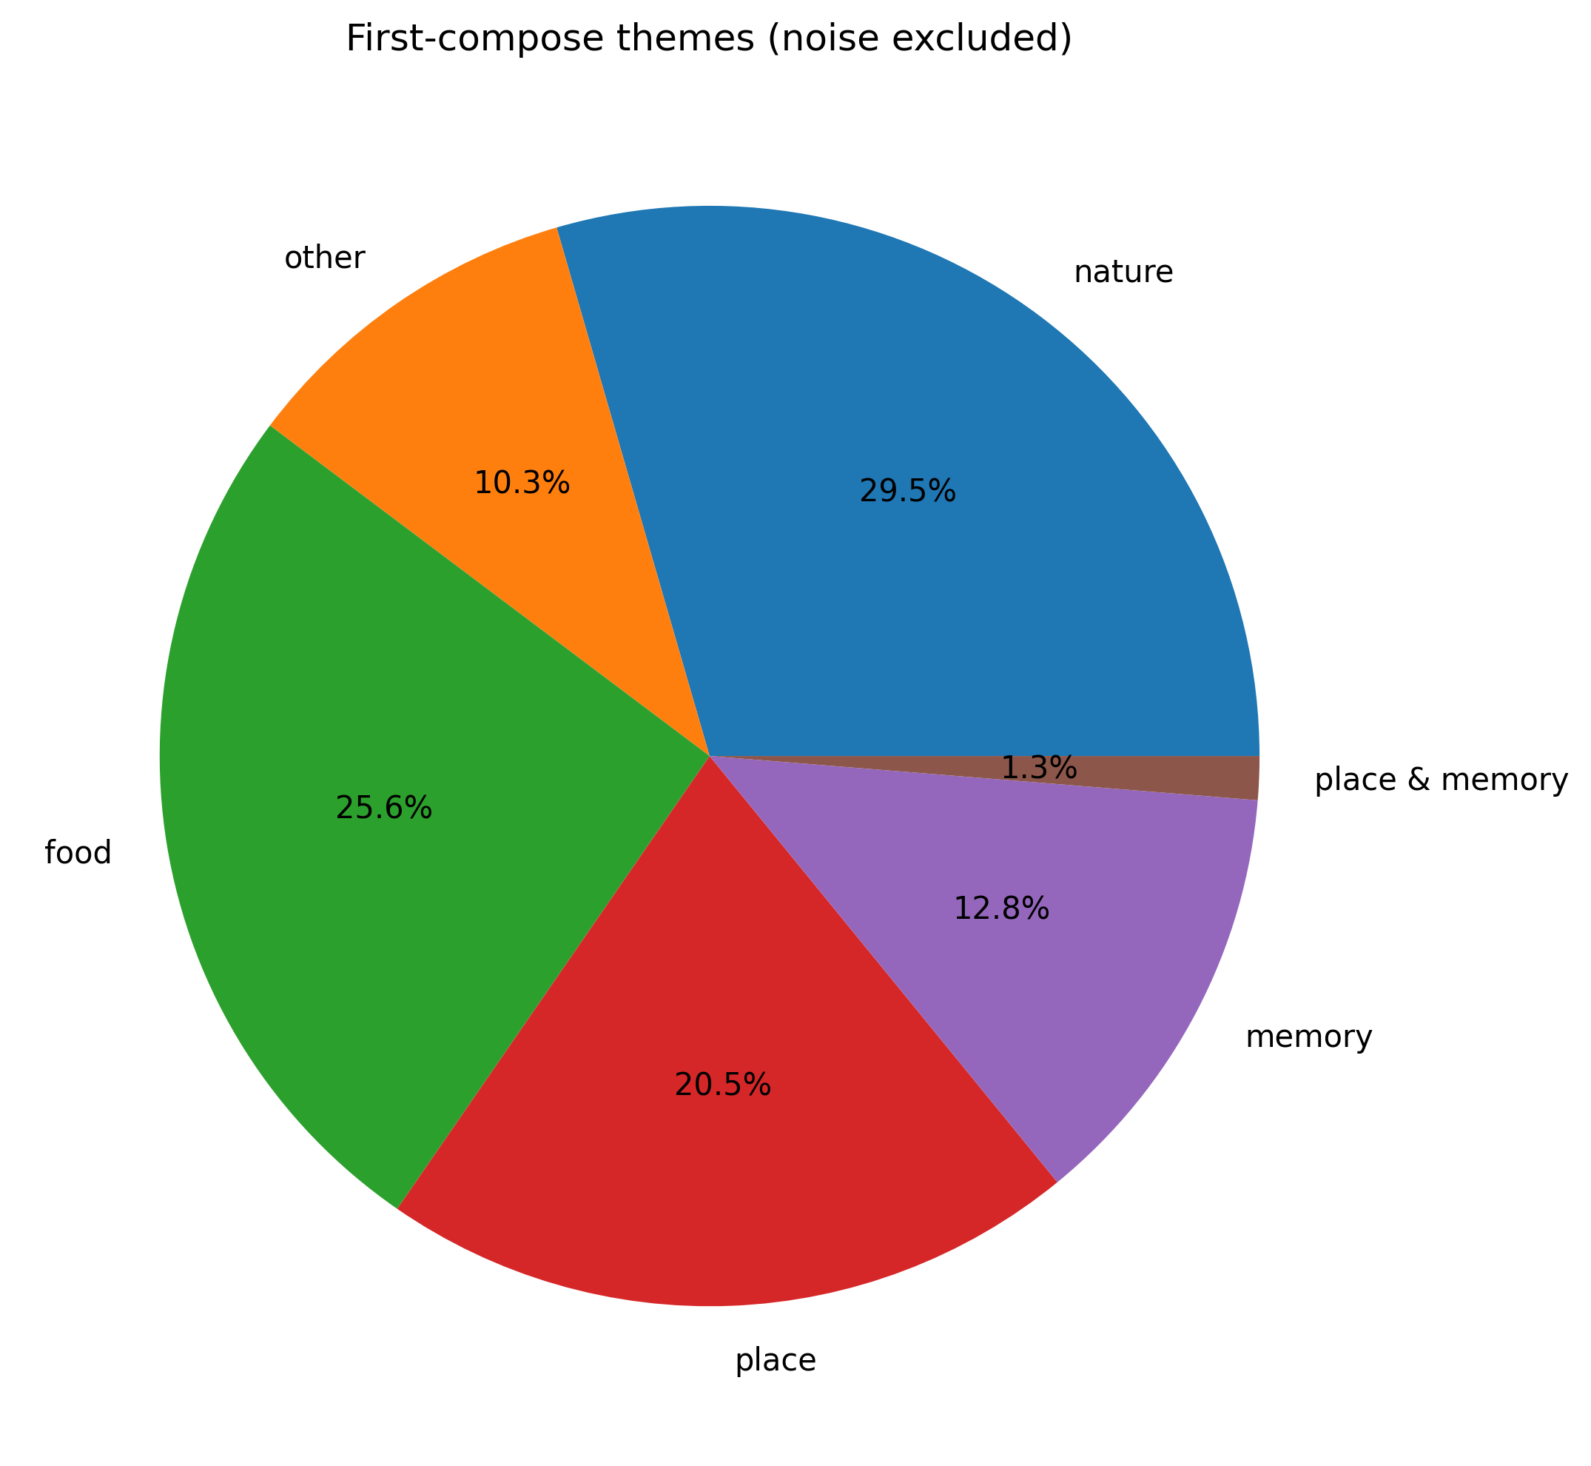
Theme Taxonomy
All 99 sessions (corrected from an earlier dedup bug — see notes). Nature 23, Food 20, Place 16, Memory 10, Other 8, Place & Memory 1, Noise 21 (excluded).
Previously-pending row resolved with supervisor as joint Place & Memory, not a single theme.

Slide 6
Noise Audit
21 of 99 sessions flagged as noise, by detection reason:
Facilitator question pattern — 6
Single word, no theme match — 5
Repeated-phrase (Whisper transcription glitch) — 4
Manual override (holistic judgment) — 3
High filler-word ratio — 2
Manual exclude list (off-topic conversation) — 1
A fixed <20-char rule was deliberately replaced with coherence-based rules after finding real counterexamples in both directions

Slide 7
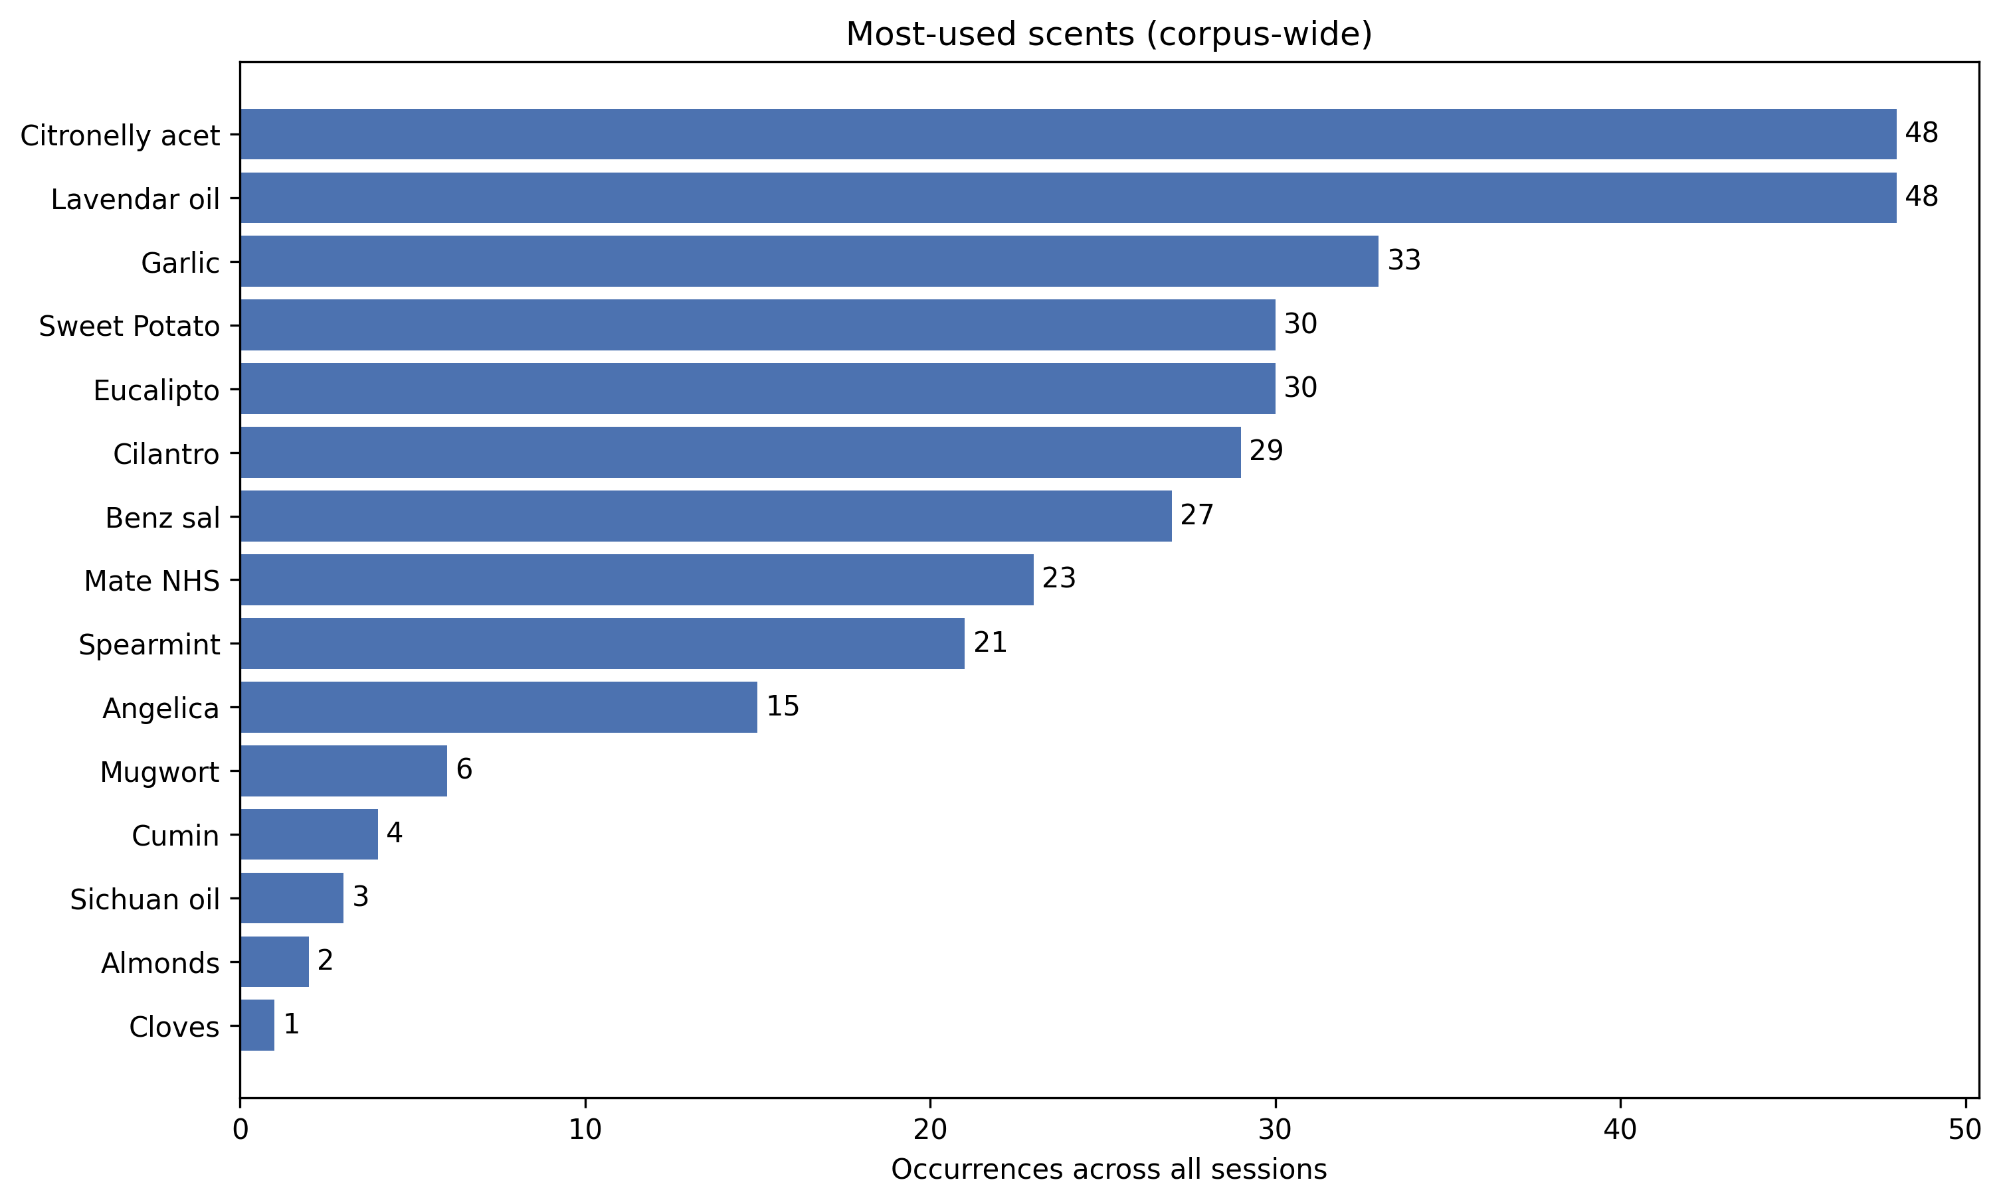
Scent Usage — Most-Used Scents
Floral-default bias: 62.6% of sessions (62/99) include Citronelly, Lavender, or Eucalipto —
the two most-used scents corpus-wide, suggesting a possible reliance on a "safe" floral fallback.

Slide 8
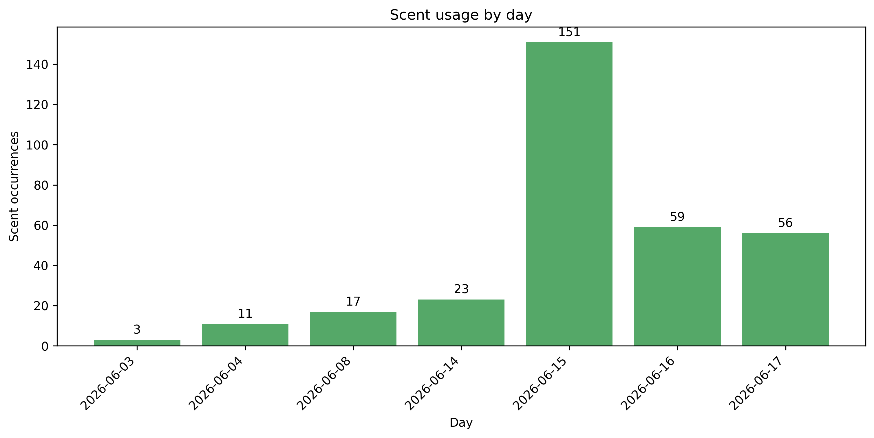
Scent Usage — By Day
June 15 is a major outlier (151 occurrences) — consistent with it being the busiest demo day overall.

Slide 9
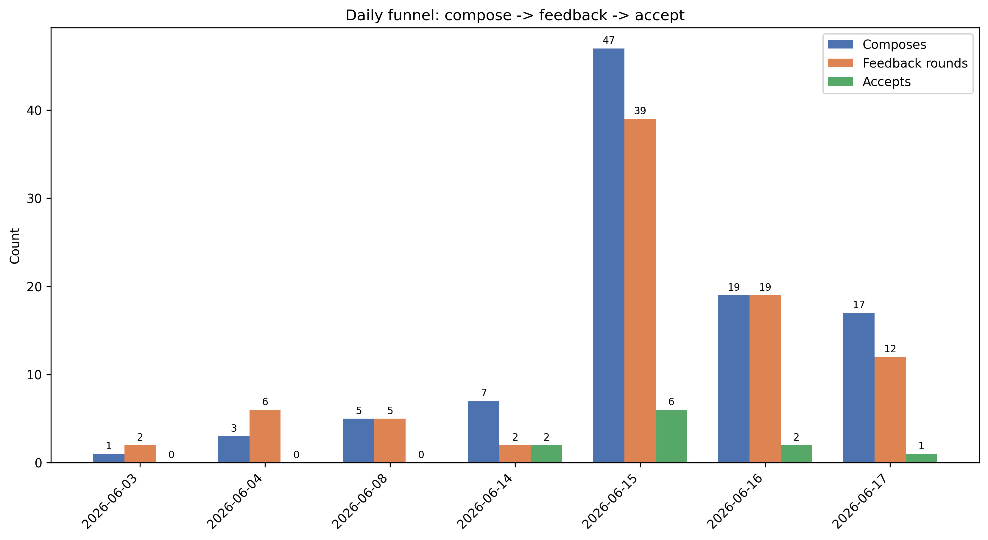
Session Funnel — Compose → Feedback → Accept
Totals validate against known corpus stats: 99 composes, 85 feedback rounds.
Acceptance rate declines across the busiest days: 12.8% (6/15) → 10.5% (6/16) → 5.9% (6/17).

Slide 10
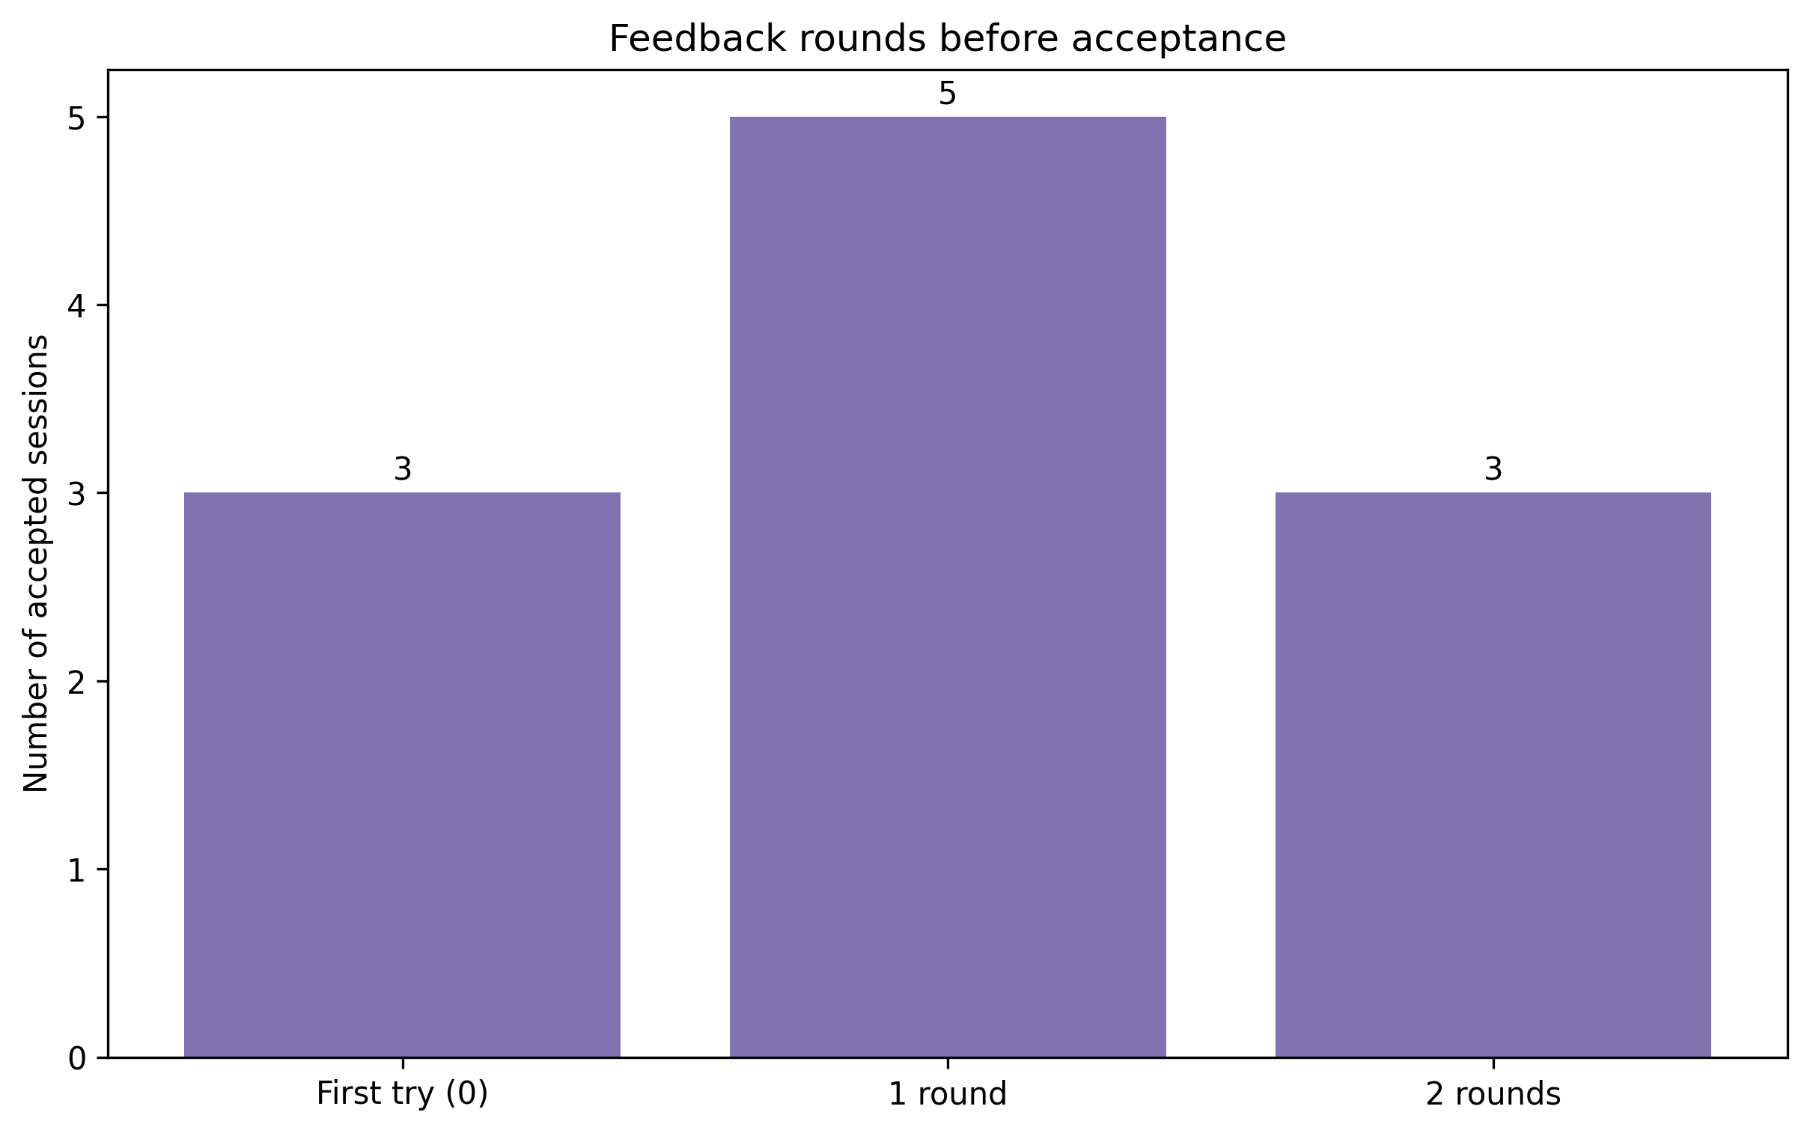
Iterations Before Acceptance
Of 11 accepted sessions: 3 first-try, 5 took one round, 3 took two rounds — feedback loop converges quickly when it works.

Slide 11
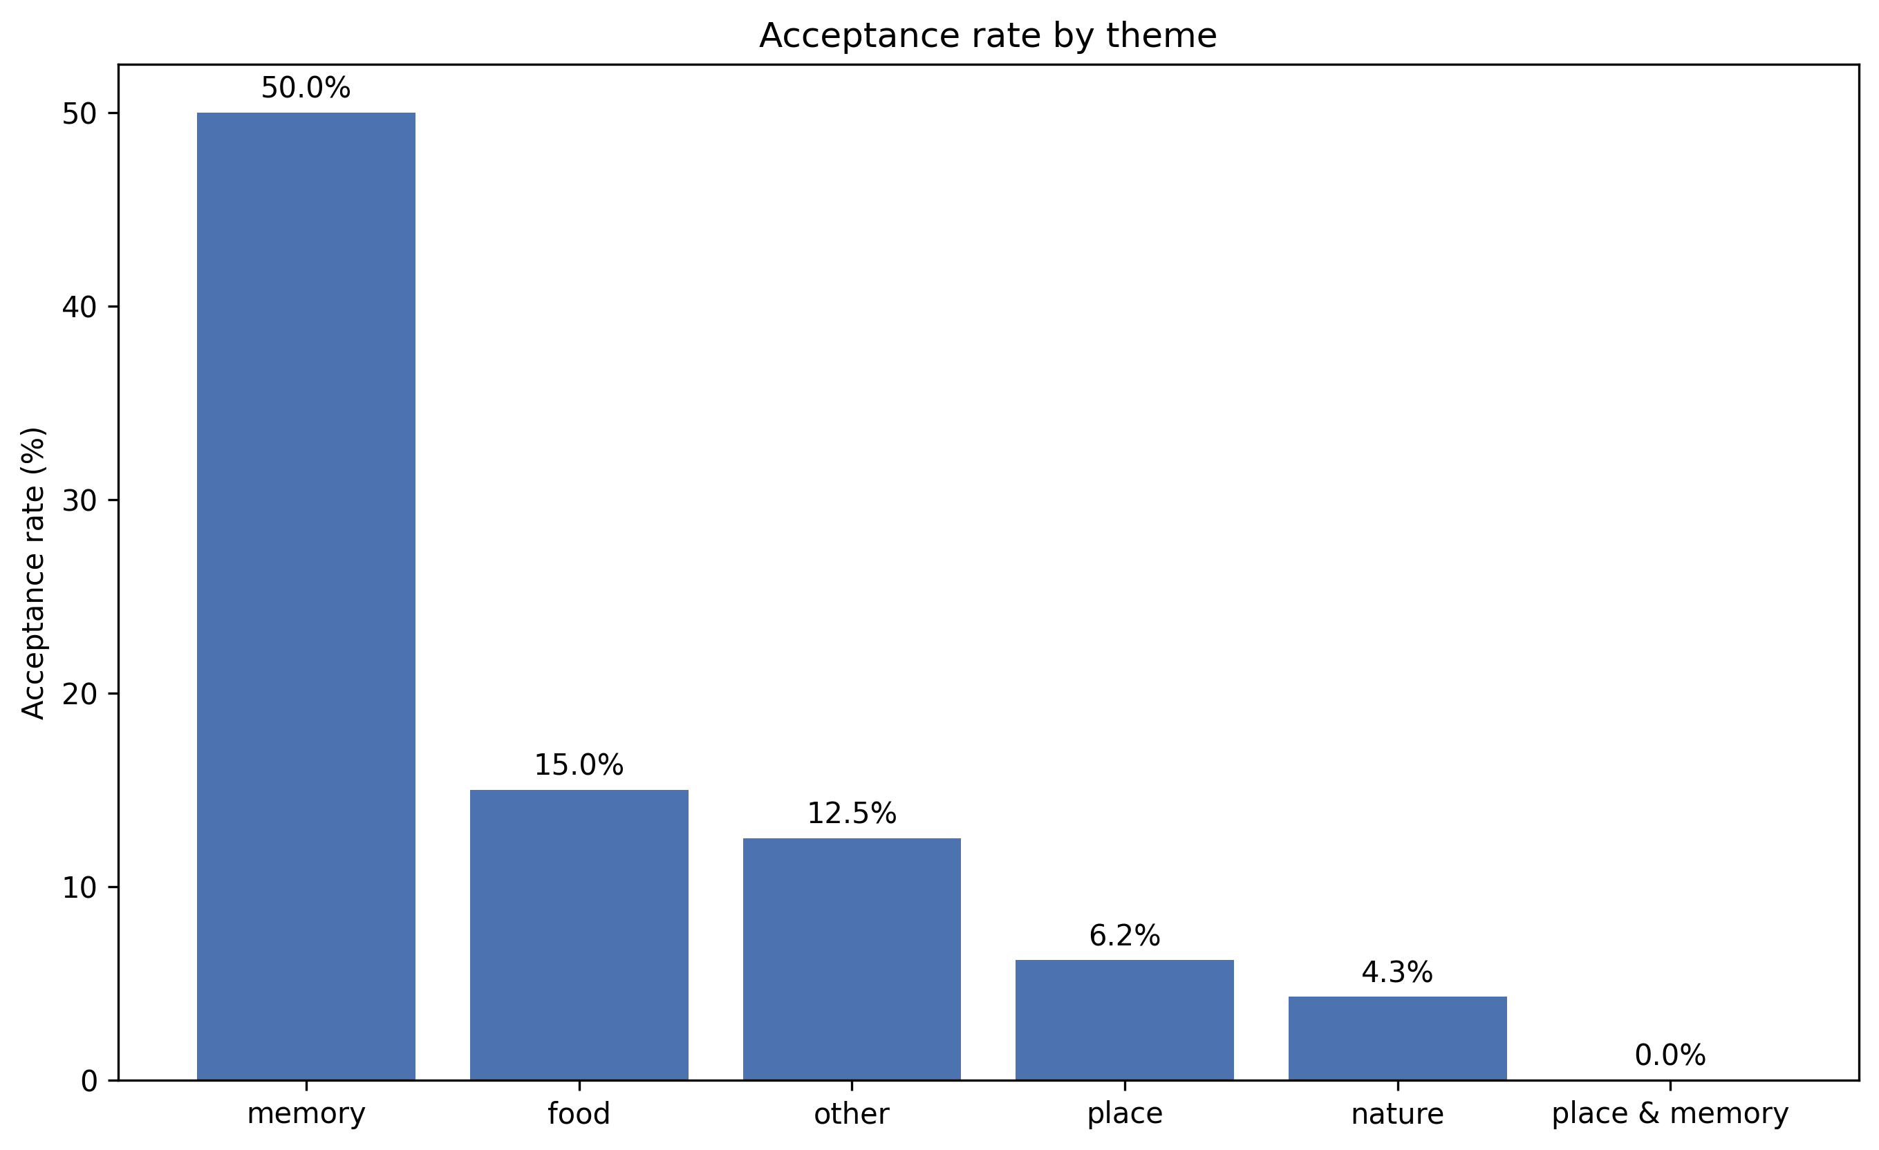
Theme vs. Acceptance Rate
Requested by supervisor: cross-reference theme classification against which sessions were accepted.
Memory-themed sessions accept far more often (50%) than any other theme — food 15%, other 12.5%, place 6.2%, nature 4.3%.
Caveat: small per-theme sample sizes (10 or fewer for most categories) — suggestive, not statistically robust.

Slide 12
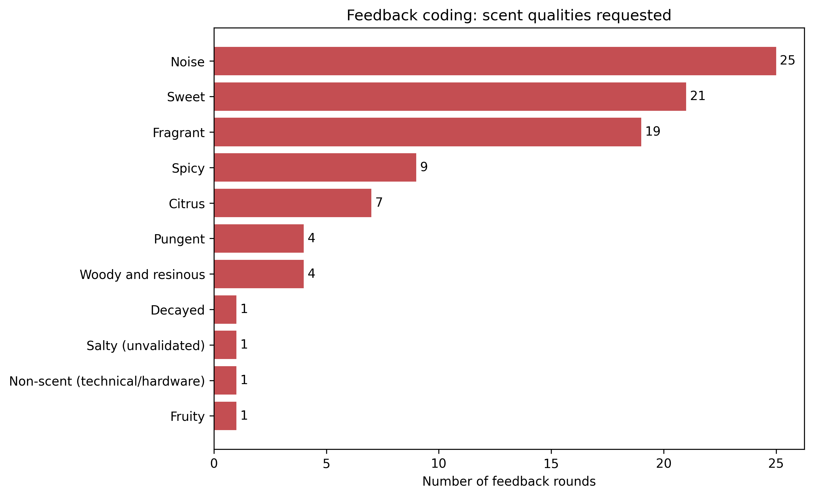
Feedback Coding — Scent Qualities Requested
All 85 feedback rounds accounted for (60 coded, 25 flagged noise). Noise, Sweet, and Fragrant dominate.
"Spicy" added as a local 11th category — a published odor-quality guide had no clean bucket for common food-spice feedback.
Next: second independent coder on a subset, for inter-rater reliability (per study protocol section 14).

Slide 13
Data Quality Notes
5 pairs of sessions share identical text/output but have different session_ids — genuinely distinct sessions, not logging duplicates; all 99 kept
Catalog scent names differ from protocol naming (e.g. "Lavendar oil", "Citronelly acet") — handled via stem matching
Some sessions have null session_id, later corrected in a follow-up event

Slide 14
Outstanding / Open Questions
Feedback coding: complete (85/85); needs a second coder for inter-rater reliability
prepare_finetune.py / eval_models.py: IRB/consent cleared
Still blocked on an OpenAI API key with fine-tuning access

Slide 15
Questions / Discussion

