Slide 1
Classification of Indian Lepidoptera Species
Fine-Grained Butterfly Recognition Under Domain Shift
Akshit Bansal • Jayendra Singh • Kriti Chaturvedi • Sirjan Singh • Priyal Maheswari
Deep Learning for Computer Vision (CSE3292) | April 2026

Slide 2
Why This Problem Is Hard
India hosts 1,500+ Lepidoptera species — one of the world's richest biodiversity hotspots.
Three structural challenges:
1. Spatial specificity — where a wing pattern is located matters taxonomically
(eyespot on forewing vs hindwing = different genus)
2. Multi-scale dependence — submarginal bands (low-level) + wing shape (high-level)
3. Extreme class imbalance — 966 classes, from >500 to <5 images
Head-Only accuracy = 53.20%
"ImageNet features are blind to wing morphology"

Slide 3
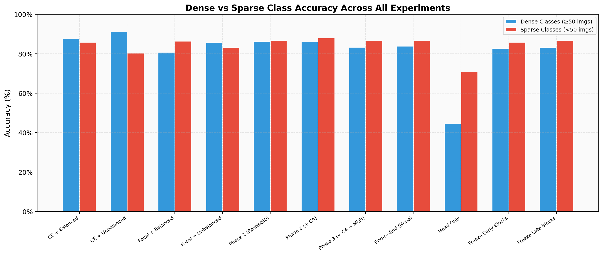
Dataset — IndoLepAtlas
Sources: indiabutterflies.com + iNaturalist India (GBIF)
Pipeline:
Web scraping → metadata extraction (GPS, date)
→ state-to-biogeographic zone mapping → data_audit.py
Final Statistics:
• 24,825 images across 966 species
• 34 Indian states, 9 biogeographic zones
• Dense (≥50 img/class) vs Sparse (<50 img/class)
• Metadata: 98.3% location, 76.1% date coverage

Slide 4
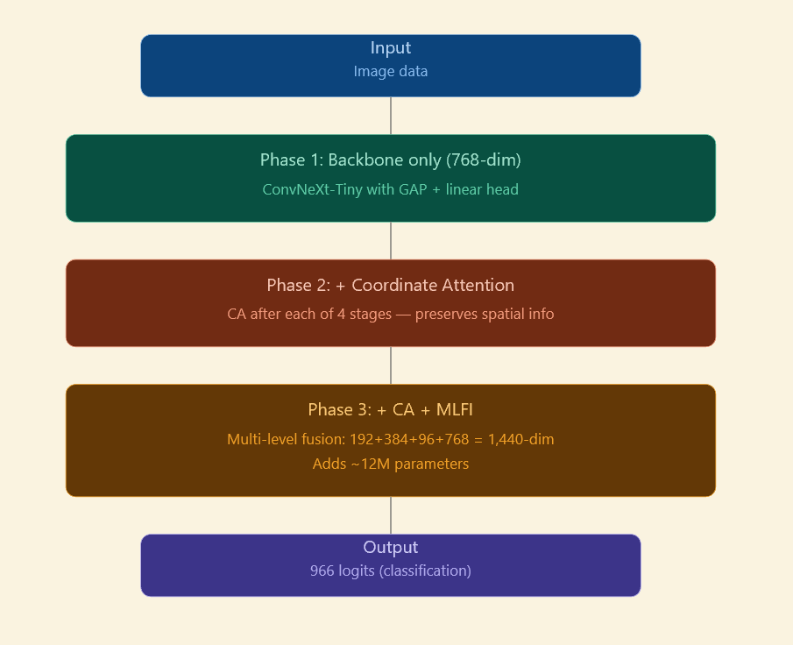
Architecture — Progressive Pipeline
Input → ConvNeXt-Tiny (4 stages) → [CA ×4] → [MLFI → 1440-dim] → LN+Dropout+Linear → 966 logits
Phase 1: Backbone only (768-dim)
Standard ConvNeXt-Tiny with GAP + linear head
Phase 2: + Coordinate Attention
CA after each of 4 stages — preserves spatial info
Phase 3: + CA + MLFI
Multi-level fusion: 192+384+96+768 = 1,440-dim
Adds ~12M parameters
Training:
AdamW, cosine annealing, 5-epoch warmup
Differential LR: backbone 0.1×, heads 1×

Slide 5
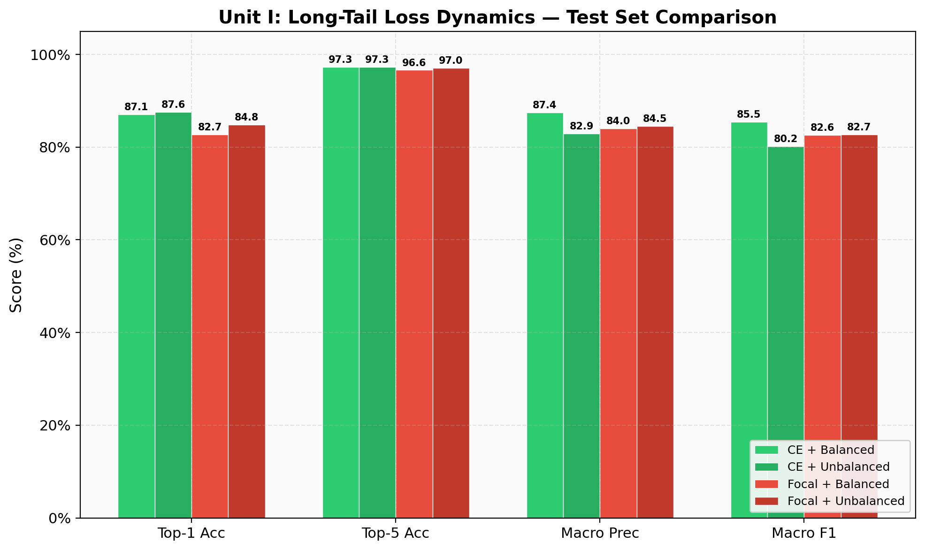
Unit I — Loss & Sampling Strategy (30 Epochs)
Configuration | Top-1 | Top-5 | Macro-F1 | Dense | Sparse
CE + Balanced | 87.06% | 97.31% | 85.48% | 87.67% | 85.84%
CE + Unbalanced | 87.60% | 97.25% | 80.23% | 91.22% | 80.35%
Focal + Balanced | 82.69% | 96.62% | 82.64% | 80.85% | 86.40%
Focal + Unbalanced | 84.83% | 97.03% | 82.70% | 85.70% | 83.07%
Key Insights:
• CE+Unbalanced: highest Top-1 but 5.25-pt Macro-F1 gap → "Unbalanced Illusion"
• Focal Loss boosts Sparse (86.40%) but destroys Dense (80.85%)
• Balanced sampling compresses Dense–Sparse gap to 1.83 points

Slide 6
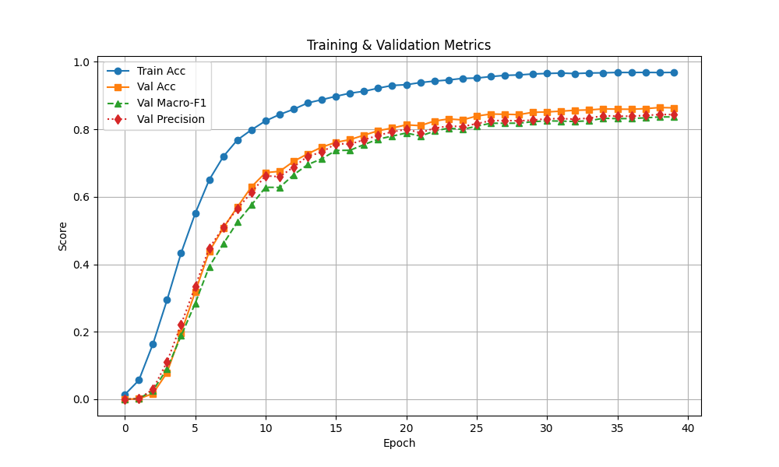
Why Coordinate Attention?
SE-Net Problem:
Global avg pool → collapses all spatial dims
→ loses WHERE the pattern is
Coordinate Attention Solution:
Axis-decomposed attention along H and W independently
• Pool along width → height attention map
(captures horizontal wing banding)
• Pool along height → width attention map
(captures vertical vein streaking)
Placement: After each of 4 backbone stages
Overhead: <0.5% added parameters
Result: Sparse accuracy 86.76% → 88.05% (+1.29 pts)

Slide 7
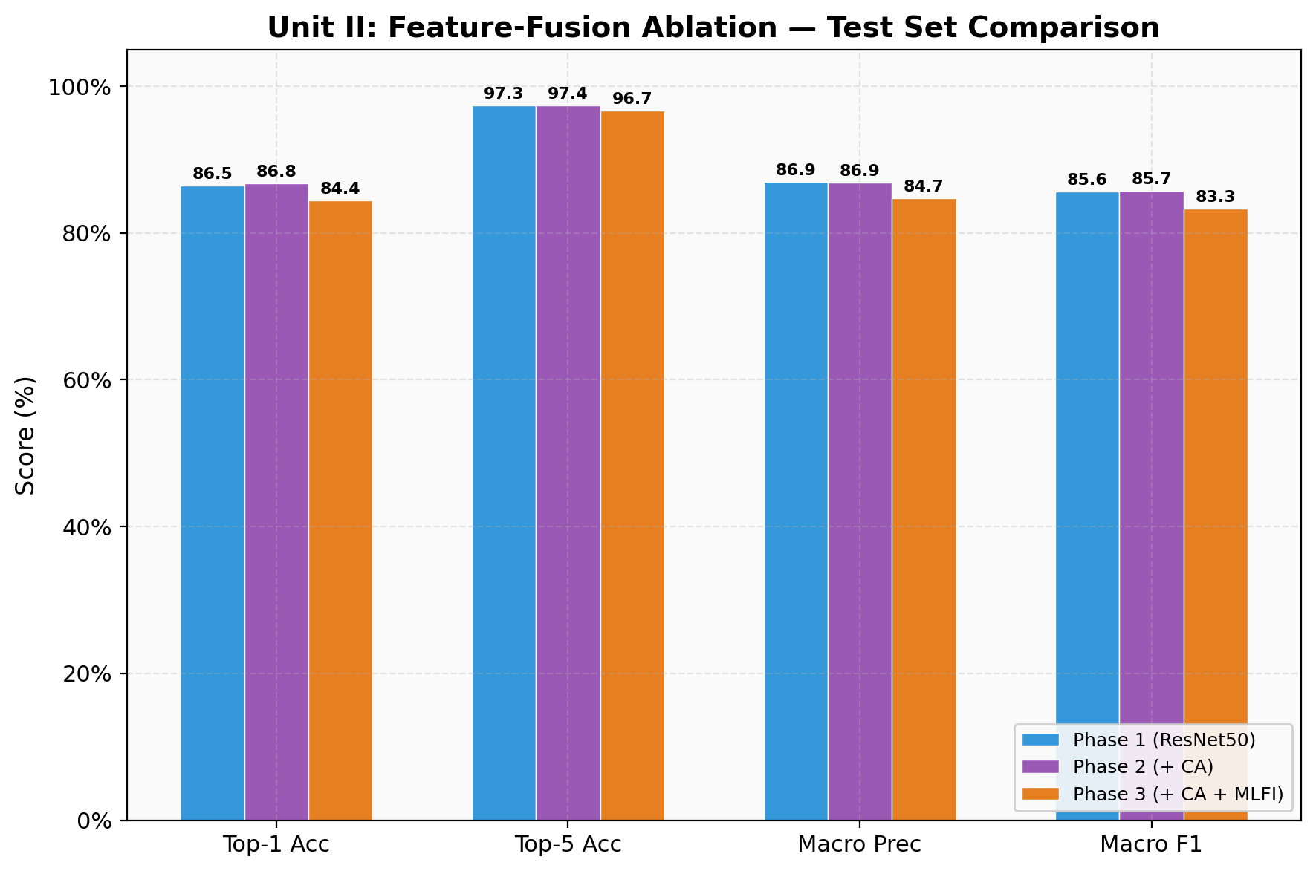
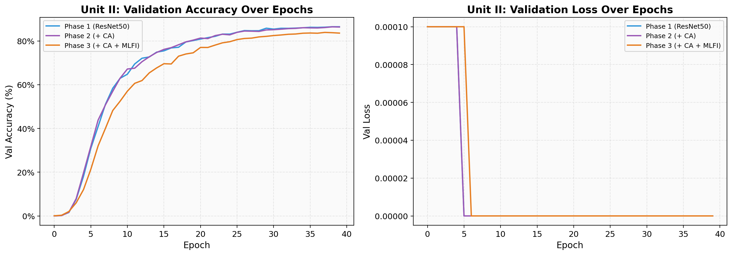
Unit II — Feature Fusion Ablation (40 Epochs)
Architecture | Top-1 | Top-5 | Macro-F1 | Dense | Sparse
Phase 1 (Baseline) | 86.50% | 97.34% | 85.65% | 86.36% | 86.76%
Phase 2 (+ CA) | 86.77% | 97.36% | 85.75% | 86.13% | 88.05%
Phase 3 (+ CA+MLFI) | 84.43% | 96.69% | 83.34% | 83.32% | 86.66%
Key Insights:
• CA: best overall — 86.77% Top-1, 88.05% Sparse
• MLFI adds ~12M params → optimisation imbalance
• MLFI Sparse (86.66%) still strong — benefits rare classes
• 2-point gap is convergence, not architecture problem

Slide 8
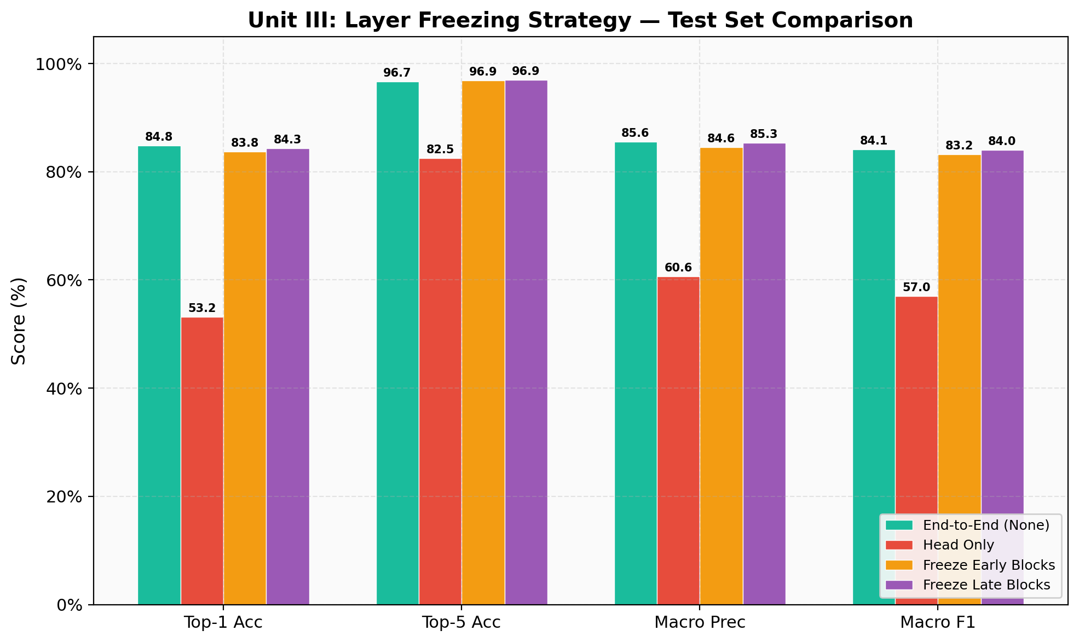
Unit III — Transfer Learning & Domain Shift (40 Epochs)
Strategy | Top-1 | Top-5 | Macro-F1 | Dense | Sparse
End-to-End | 84.79% | 96.68% | 84.11% | 83.89% | 86.61%
Freeze Late | 84.33% | 96.93% | 84.02% | 83.15% | 86.71%
Freeze Early | 83.77% | 96.91% | 83.20% | 82.74% | 85.84%
Head Only | 53.20% | 82.52% | 57.02% | 44.46% | 70.75%
Key Insights:
• Head-Only = catastrophic failure (53.20%)
• Dense (44.46%) < Sparse (70.75%) — striking inversion
• ImageNet features actively INTERFERE with classification
• End-to-End mandatory; partial freezing marginal (Δ<1%)

Slide 9
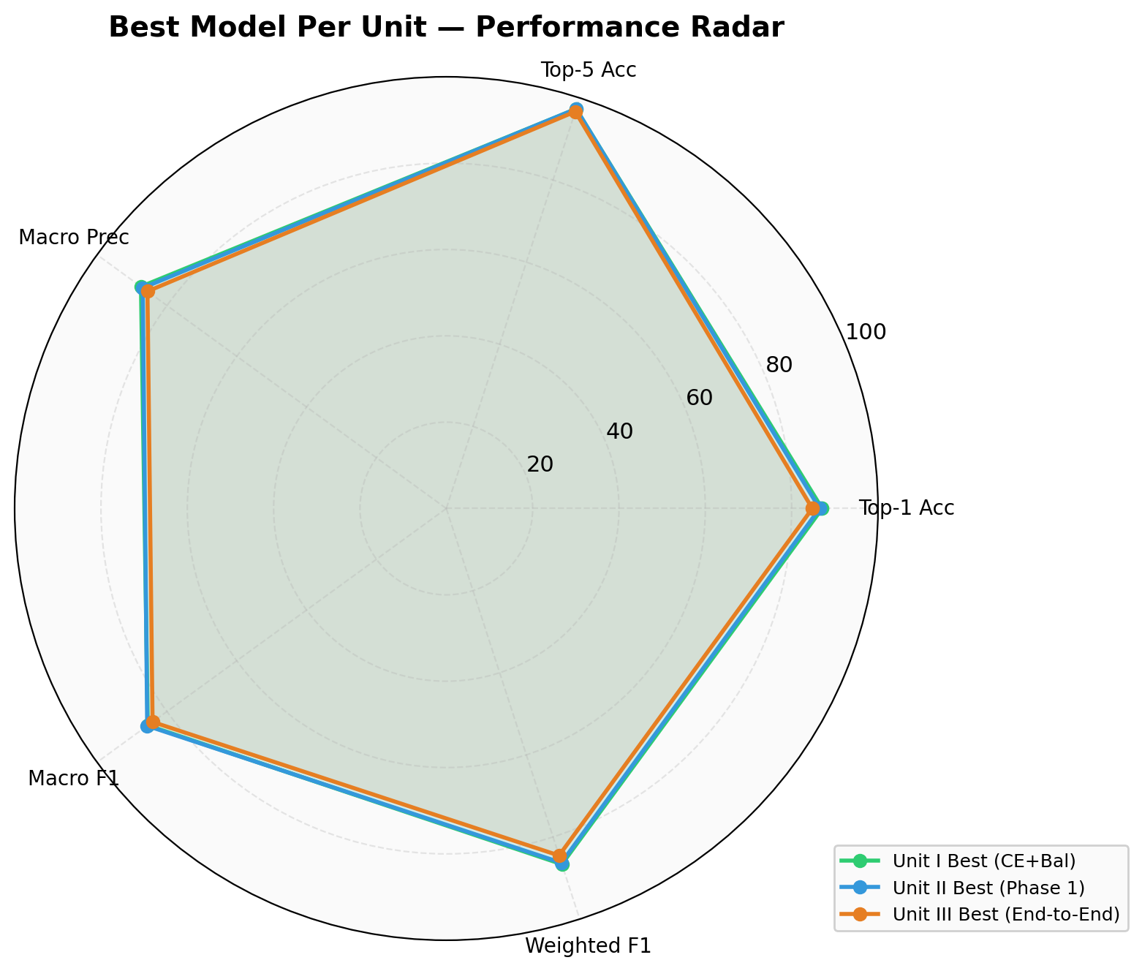
Cross-Unit Analysis & Master Results
Best Configurations:
Best Overall: CE + Balanced
87.06% Top-1 | 85.48% Macro-F1
Best Sparse: Phase 2 (+ CA)
88.05% Sparse accuracy
Top-5 Accuracy > 96.6%
for all configs except Head-Only
→ confusion is between morphologically similar species
Dense–Sparse Gap:
Balanced sampling compresses it most effectively

Slide 10
Conclusion & Future Work
Three Key Findings:
1. Balanced CE is the single most impactful intervention
85.48% Macro-F1, 1.83-pt Dense–Sparse gap
2. Coordinate Attention is high-value, low-cost
+1.29 pts Sparse accuracy, minimal parameters
3. ImageNet transfer fails for biological domains
53.20% Head-Only → end-to-end fine-tuning mandatory
Future Work:
• MLFI optimisation: warm-up scheduling,
progressive unfreezing
• Phase 5: Geotemporal fusion
(biogeographic zone + season encoding)
• Prototypical network heads
for ~400 Sparse classes (<50 images)
• Domain-specific self-supervised pretraining
(DINO on butterfly images)

