Slide 1
Business Infographics
Here is where this template begins
This template has been created by Slidesgo

Slide 2
Business Infographics
Venus is the second planet from the Sun
Saturn is a gas giant and has several rings
Despite being red, Mars is a cold place
Neptune is far away from Earth
Activity 1 | Activity 2 | Activity 3 | Activity 4 | Activity 5
Group A
Mercury
Group B
This template has been created by Slidesgo

Slide 3
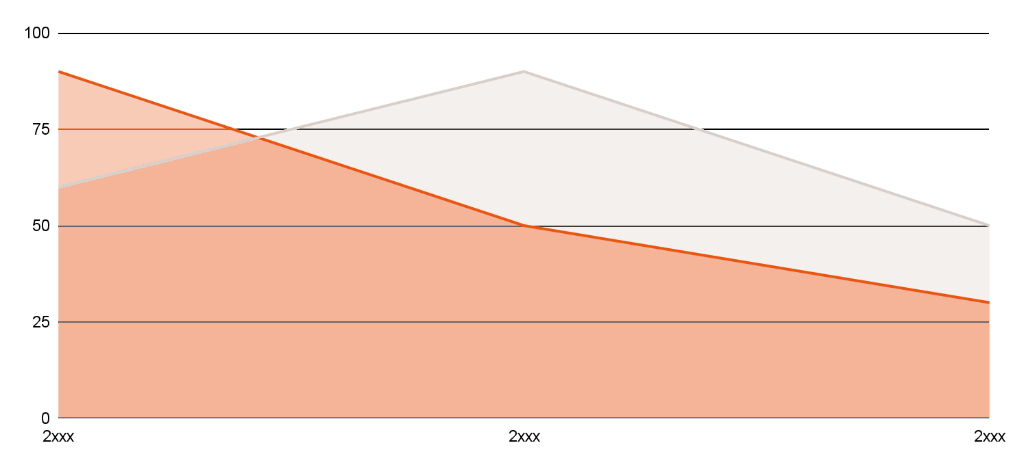
Business Infographics
Venus
Venus has a beautiful name
Jupiter
Jupiter is the biggest planet
Neptune
25%
200K
500K
Mars
50%
Mercury
75%
This template has been created by Slidesgo

Slide 4
Business Infographics
Phase 1
Phase 3
Saturn is a gas giant and has several rings
Venus is the second planet from the Sun
Phase 2
Phase 4
Jupiter is the biggest planet of them all
Mercury is the closest planet to the Sun
This template has been created by Slidesgo

Slide 5
Business Infographics
Area 1 | Area 2 | Area 3
Area 4 | Area 5 | Area 6
Area 7 | Area 8 | Area 9
Venus
High
Venus has a beautiful name. Venus also has high temperatures
Medium
Jupiter
It was named after the Roman god of the skies and lightning
Low
Mars
Despite being red, Mars is actually an extremely cold place
Low
Medium
High
This template has been created by Slidesgo

Slide 6
Business Infographics
Question 1
Yes
No
Question 2
Question 3
Yes
No
Yes
No
Result 1
Result 2
Result 3
Result 4
This template has been created by Slidesgo

Slide 7
Business Infographics
Venus
2/5
Mars
4/5
Venus is the second planet from the Sun
Despite being red, Mars is a cold place
Mercury
90%
Jupiter
50%
Neptune
75%
This template has been created by Slidesgo

Slide 8
Business Infographics
 | Week 1 | Week 2 | Week 3 | Week 4 | Week 5 | Week 6
Task 1
Task 2
Task 3
Task 4
Task 5
Status 1
Status 2
Status 3
This template has been created by Slidesgo

Slide 9
Business Infographics
S
W
Strengths
Weaknesses
Saturn is a gas giant and has several rings
Venus is the second planet from the Sun
O
T
Opportunities
Threats
Jupiter is the biggest planet of them all
Mercury is the closest planet to the Sun
This template has been created by Slidesgo

Slide 10
Business Infographics
Venus
A
A
Venus has a beautiful name. Venus also has high temperatures
Saturn
Saturn is a gas giant and has several rings
Jupiter
B
C
B
It was named after the Roman god of the skies and lightning
Mars
C
Despite being red, Mars is actually an extremely cold place
This template has been created by Slidesgo

Slide 11
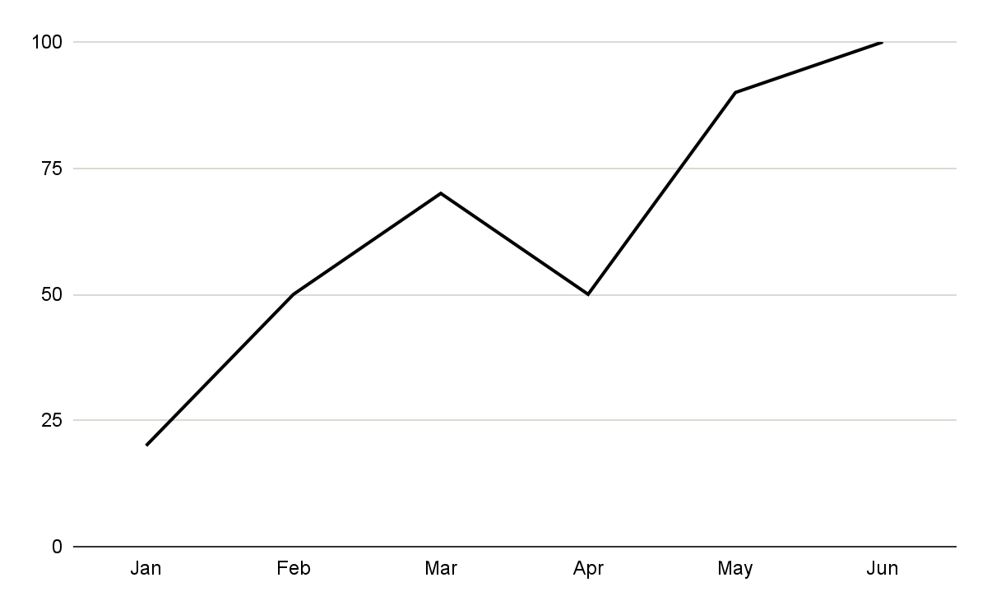
Business Infographics
2xxx | xx | -3%
2xxx | xx | +10%
2xxx | xxx | +80%
2xxx | xx | -5%
2xxx | xxx | +15%
2xxx | xxx | -2%
2xxx | xx | +20%
2xxx | xx | +5%
100,000
Venus
30,000
Mercury
5000
Neptune
Follow the link in the graph to modify its data and then paste the new one here. For more info, click here
This template has been created by Slidesgo

Slide 12
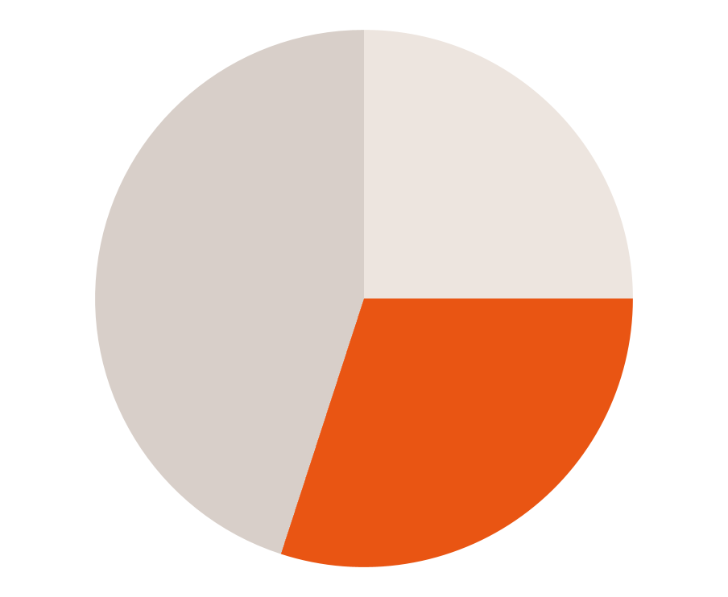
Business Infographics
75%
65%
25%
50%
Mercury
Earth
Jupiter
Neptune
Mercury is small
Earth has life
Jupiter is big
It is far away
Saturn
Venus
Mars
45%
25%
30%
Follow the link in the graph to modify its data and then paste the new one here. For more info, click here
This template has been created by Slidesgo

Slide 13
Business Infographics
Saturn: 65%
Jupiter: 75%
Venus: 85%
Mercury: 95%
Saturn is a gas giant and has several rings
Jupiter is the biggest planet of them all
Venus is the second planet from the Sun
Mercury is the closest planet to the Sun
This template has been created by Slidesgo

Slide 14
Business Infographics
1st semester
2nd semester
50%
Venus
40%
30%
Mercury
60%
60%
Neptune
30%
25%
Mars
80%
70%
Jupiter
50%
This template has been created by Slidesgo

Slide 15
Business Infographics
Step 1
Saturn is a gas giant and has several rings
Step 2
Venus is the second planet from the Sun
Step 3
Jupiter is the biggest planet of them all
Step 4
Mercury is the closest planet to the Sun
This template has been created by Slidesgo

Slide 16
Business Infographics
 | Planing | Process | Review
Q1 | Venus has a beautiful name and is the second planet from the Sun | Neptune is the farthest from the Sun. It’s also the fourth-largest planet | Venus is the second-brightest natural object in the night sky
Q2 | Saturn was named after the Roman god of wealth and agriculture | Mars is full of iron oxide dust, which gives the planet its reddish cast | Jupiter is a gas giant and the biggest planet in the Solar System
Q3 | Earth is the third planet from the Sun and humans live on there | Earth is the only one that harbors life in the Solar System | Jupiter was named after the Roman god of the skies and lightning
This template has been created by Slidesgo

Slide 17
Business Infographics
Saturn
Saturn is a gas giant and has several rings
01
03
Venus
Venus is the second planet from the Sun
02
Jupiter
Jupiter is the biggest planet of them all
This template has been created by Slidesgo

Slide 18
Business Infographics
Objectives
Area 01
Area 02
Area 03
Area 04
Goal 1
Goal 2
Goal 3
Goal 4
Goal 1
Goal 2
Goal 3
Goal 4
Goal 1
Goal 2
Goal 3
Goal 4
Goal 1
Goal 2
Goal 3
Goal 4
This template has been created by Slidesgo

Slide 19
Business Infographics
50%
75%
Vs.
Jupiter
Venus
Jupiter is the biggest planet of them all
Venus is the second planet from the Sun
This template has been created by Slidesgo

Slide 20
Icon pack
This template has been created by Slidesgo

Slide 21
Instructions for use
If you have a free account, in order to use this template, you must credit Slidesgo in your final presentation. Please refer to the next slide to read the instructions for premium users.
As a Free user, you are allowed to:
- Modify this template.
- Use it for both personal and commercial projects.
You are not allowed to:
- Sublicense, sell or rent any of Slidesgo Content (or a modified version of Slidesgo Content).
- Distribute Slidesgo Content unless it has been expressly authorized by Slidesgo.
- Include Slidesgo Content in an online or offline database or file.
- Offer Slidesgo templates (or modified versions of Slidesgo templates) for download.
- Acquire the copyright of Slidesgo Content.
For more information about editing slides, please read our FAQs or visit our blog:
https://slidesgo.com/faqs and https://slidesgo.com/slidesgo-school

Slide 22
Instructions for use (premium users)
As a Premium user, you can use this template without attributing Slidesgo.
You are allowed to:
Modify this template.
Use it for both personal and commercial purposes.
Share this template in an editable format with people who are not part of your team.
You are not allowed to:
Sublicense, sell or rent this Slidesgo Template (or a modified version of this Slidesgo Template).
Distribute this Slidesgo Template (or a modified version of this Slidesgo Template) or include it in a database or in any other product or service that offers downloadable images, icons or presentations that may be subject to distribution or resale.
Use any of the elements that are part of this Slidesgo Template in an isolated and separated way from this Template.
Register any of the elements that are part of this template as a trademark or logo, or register it as a work in an intellectual property registry or similar.
For more information about editing slides, please read our FAQs or visit our blog:
https://slidesgo.com/faqs and https://slidesgo.com/slidesgo-school

Slide 23
Infographics
You can add and edit some infographics to your presentation to present your data in a visual way.
Choose your favourite infographic and insert it in your presentation using Ctrl C + Ctrl V or Cmd C + Cmd V in Mac.
Select one of the parts and ungroup it by right-clicking and choosing “Ungroup”.
Change the color by clicking on the paint bucket.
Then resize the element by clicking and dragging one of the square-shaped points of its bounding box (the cursor should look like a double-headed arrow). Remember to hold Shift while dragging to keep the proportions.
Group the elements again by selecting them, right-clicking and choosing “Group”.
Repeat the steps above with the other parts and when you’re done editing, copy the end result and paste it into your presentation.
Remember to choose the “Keep source formatting” option so that it keeps the design. For more info, please visit our blog.

