Slide 1
Oil Price Over Time

Slide 2
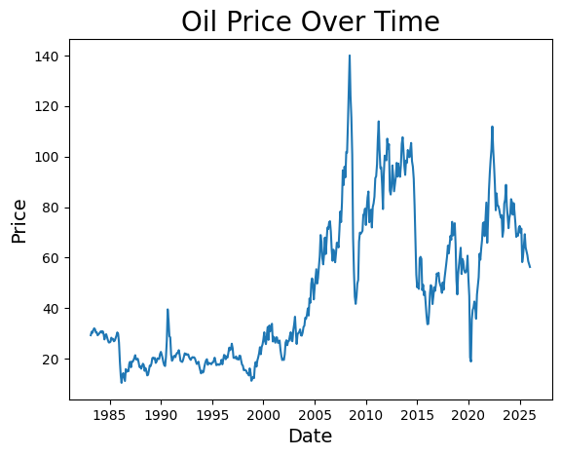
Highest and Lowest Oil Price

Slide 3
Oil Price Statistics
Highest price: $140.0 on 2008-06-01
Lowest price: $10.42 on 1986-03-01

Slide 4
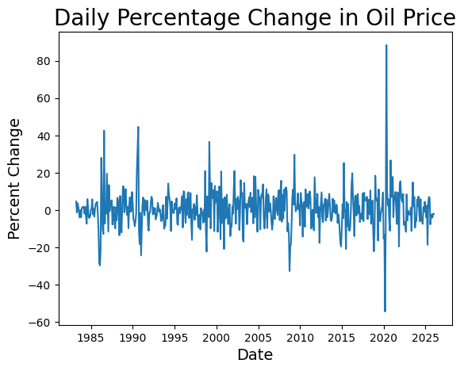
Oil Price Percentage Change

Slide 5
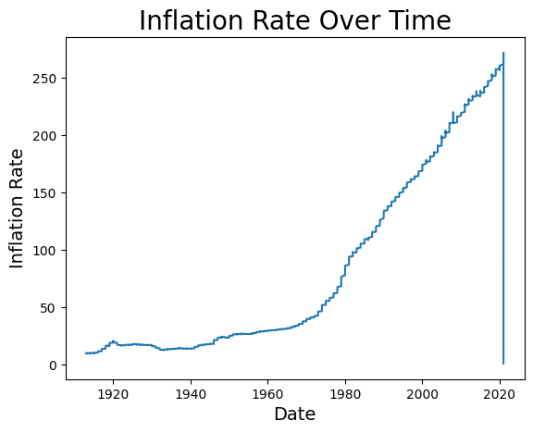
US CPI Over Time

Slide 6
Highest and Lowest Inflation CPI
Highest CPI: 271.696 on 2021-01-06
Lowest CPI: 1.003 on 2021-01-07

Slide 7
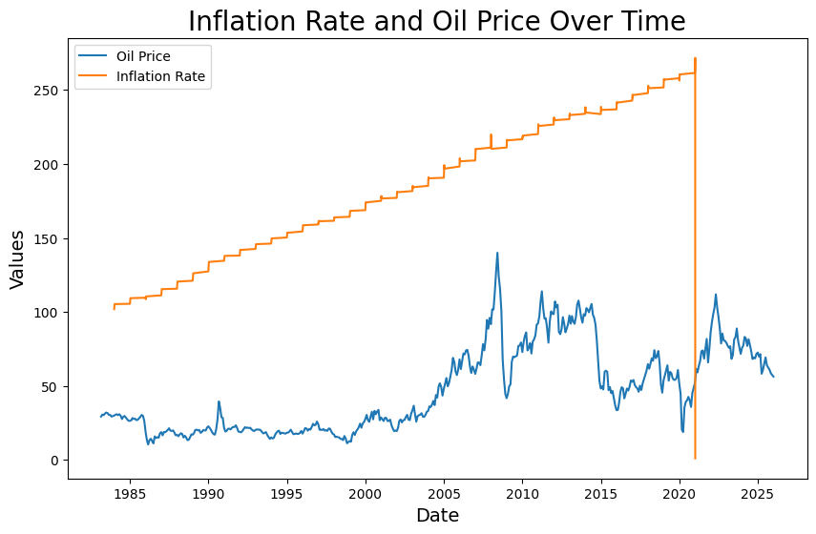
Inflation Rate vs Oil Price

