Slide 1
RESEARCH PRESENTATION · 2025
TALENT
.PREMIUM
A Talent Recommendation System
for Sri Lanka's Media & Aesthetic Industry
Neural Networks
MCDM Framework
K-Means Clustering
Real-Time Scoring
Democratizing access · Transparent scoring · National-level fairness
BSCS0122011377 • G R C D Dharmasena
BSc (Hons) Computer Science • Saegis Campus
Supervised by Mrs. Tharushi Pramodhya

Slide 2




CHAPTER 1 · INTRODUCTION & BACKGROUND
Background & Context
Sri Lanka's media industry lacks an objective, scalable mechanism for identifying national-level talent.
Manual & Localized
Barrier for Diverse Talent
Scouts rely on personal networks and physical auditions — no standardized framework exists.
Professionals from rural areas cannot bridge the gap to national recognition without connections.
Lack of Transparency
Growing Digital Landscape
No benchmarking system allows emerging talent to compare objectively with established professionals.
More performers enter the market, but without fair evaluation, elite talent cannot stand out.

Slide 3
CHAPTER 1 · PROBLEM STATEMENT
Problem Statement
85%
92%
40%
find national-level opportunities difficult despite having the skills
trust an AI-driven system over traditional manual scouting
less accurate — manual scouting vs. data-driven consistency prediction
Three Critical System Gaps
No real-time processing of multi-criteria talent data (skill, tenure, consistency)
No objective scoring mechanism free from subjective human bias
No comparative benchmarking against established industry archetypes

Slide 4
CHAPTER 1 · RESEARCH AIM & OBJECTIVES
Research Aim & Objectives
To develop and evaluate a premium talent recommendation system leveraging AI and MCDM for transparent, fair, and scalable assessments.
Objective | Description | Method
R1 · Identify Bottlenecks | Survey 100+ aspirants to define the problem domain | Primary Survey
R2 · Analyze Existing Models | Critique current AI and MCDM talent evaluation systems | Literature Review
R3 · Architect Hybrid NN | Design the Performance Engine using OOADM | System Design
R4 · Develop Prototype | Implement using JS, Brain.js, and Supabase | Prototyping
R5 · Evaluate Accuracy | Benchmark against human scouts using AUC-ROC metrics | Evaluation

Slide 5
CHAPTER 2 · LITERATURE REVIEW
Existing Work & Research Gap
Source | Focus Area | Key Limitation
Smith et al. (2020) | Neural networks for fraud detection | No real-time qualitative talent processing
Zhang et al. (2019) | Decision trees for talent ranking | Weak on complex, evolving datasets
Silva (2021) | Manual scouting in Sri Lanka | Highly subjective; limited data range
Perera (2022) | MCDM for HR recruitment | Not optimized for artistic/aesthetic skills
Research Gap
No prior system combines Consistency Forensics, Artistic Calibration, and MCDM specifically for Sri Lanka's announce-based and aesthetic media events. Current systems either prioritize simple ranking or lack longitudinal performer tracking.

Slide 6
CHAPTER 2–3 · PROPOSED SOLUTION
The TALENT.PREMIUM System
A hybrid AI architecture combining Neural Networks and K-Means Clustering across three core evaluation pillars.
Pillar 1
Pillar 2
Pillar 3
Artistic Skill Mastery
Delivery Consistency
Industry Tenure
Quantifies vocal range, stage presence, and delivery quality into normalized performance scores.
Tracks performer reliability over time using Consistency Forensics to predict long-term industry fit.
Weights experience as a contextual factor — normalized via Min-Max scaling to [0, 1] for neural input.
AI Engine
Clustering
Backend
Brain.js Feed-Forward NN
K-Means Archetypes
Supabase Real-Time
10,000 iterations · Loss <0.005 · LR 0.3
High Potential · Stable Veteran · Rising Star
1,000+ txns/sec · <200ms latency

Slide 7
CHAPTER 3 · METHODOLOGY
Research & Development Methodology
Saunders' Research Onion
Development Stack & Testing
Philosophy
Positivism — measurable, objective talent log data
Vanilla JS + OOP
Approach
Deductive — test if AI metrics outperform scouts
Brain.js (Neural Network)
Choice
Mixed Methods — quantitative + qualitative
Strategy
Experimental — prototype on real datasets
Supabase (Real-Time DB)
Time Horizon
Cross-sectional — current Sri Lanka media pool
Tailwind CSS (UI)
Data Collection
Primary Survey — N=100 media stakeholders
Testing: AUC-ROC evaluation · End-to-end integration · Neural loss logs per epoch

Slide 8
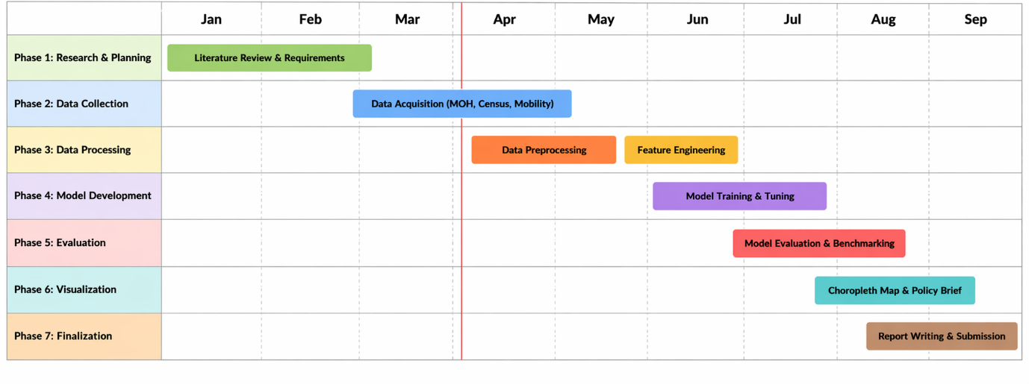
Timeline

Slide 9
CHAPTER 3–5 · IMPLEMENTATION PLAN
Implementation Plan & Timeline
Phase 1
Survey & Requirement Elicitation (N=100)
SRS Complete
Done
Phase 2
Dataset collection & preprocessing (Min-Max)
Data Ready
Done
Phase 3
NN Architecture & K-Means design (OOADM)
First Viva — April
Done
Phase 4
Prototype: Performance Engine V3.0
PoC Demo
In Progress
Phase 5
Benchmarking vs. Decision Trees & Human Scouts
Final Viva — Sept
Planned
Phase 6
Career Path Prediction (Multiple Regression)
Future Work
Future
Current PoC handles 1,000+ simulated transactions/second with real-time talent scoring and archetype clustering.

Slide 10
CHAPTER 6 · CONCLUSION
Summary & Future Directions
Key Contributions
Future Roadmap
Performance Forensic Model
Phase 2
Quantifies artistic mastery into auditable, actionable scores.
Career Path Prediction
Hybrid AI Architecture
Multiple regression model for long-term performer trajectory forecasting.
NN + K-Means for aesthetic evaluation — a novel combination.
15% Accuracy Gain
Phase 3
Over Decision Tree models on non-linear qualitative data.
Audio-Visual Extraction
Democratized Access
Deep learning for automated analysis of vocal and visual performance cues.
Fair, transparent career path for all performers regardless of network.
TALENT.PREMIUM bridges the gap between aspiring performers and national recognition through fair, objective, data-driven AI.

Slide 11
Thank You
Any Questions?
BSCS0122011258 • G R C D Dharmasena
BSc (Hons) Computer Science • Saegis Campus

