Slide 1
Obesity Risk Factors in the United States DATA 602: FINAL PROJECT
By: Alex Ptacek

Slide 2
Abstract
This project analyzes CDC-published data on obesity in the United States. We explore correlations between obesity rates and demographic or behavioral factors like income, age, race, and physical activity. Using exploratory analysis and statistical modeling, we identify key patterns in obesity risk across states and years. The analysis draws on over 100,000 records of health behavior data collected nationally.
This study demonstrates that obesity rates are statistically different across certain demographics and has been overall trending upwards over time.

Slide 3
Introduction
Obesity is a leading risk factor for many chronic health conditions. This project investigates obesity prevalence in the United States using CDC surveillance data and explores the relationship between obesity and various demographic and lifestyle indicators. Key questions include: How do obesity rates differ by income, race, and physical activity level? Which behavioral factors appear to correlate with changes in obesity over time? The analysis focuses on U.S. states from 2011 to 2023.

Slide 4
Metric Definitions
Obesity Rate: Percent of adults classified as obese based on BMI threshold. Physical Activity: Percent of adults who meet CDC-recommended levels of physical activity. Income Group: Reported income category for survey respondent. Stratification Variables: Demographics including age, sex, race/ethnicity, education, and income.

Slide 5
Data Collection
The data was sourced from the U.S. Centers for Disease Control and Prevention (CDC), via their Behavioral Risk Factor Surveillance System, and can be found on the DATA.gov website:
https://catalog.data.gov/dataset/nutrition-physical-activity-and-obesity-behavioral-risk-factor-surveillance-system
It includes: - Predicted yearly obesity rates by state (2011–2023) - Demographic info (race, gender, income, age) - Behavioral data (physical activity, diet) The dataset contains over 100,000 records and was cleaned to focus on adult obesity trends.

Slide 6
Data Cleaning
Data Cleaning Process: - Filtered to obesity-related questions only - Dropped missing values from key columns - Renamed columns for clarity (e.g., 'Data_Value' → 'Obesity Rate') - Merged with physical activity responses on year and state - Selected top stratification variables: income, race, activity The final dataset retained ~50,000 records after filtering.

Slide 7
Exploratory Data Analysis

Slide 8
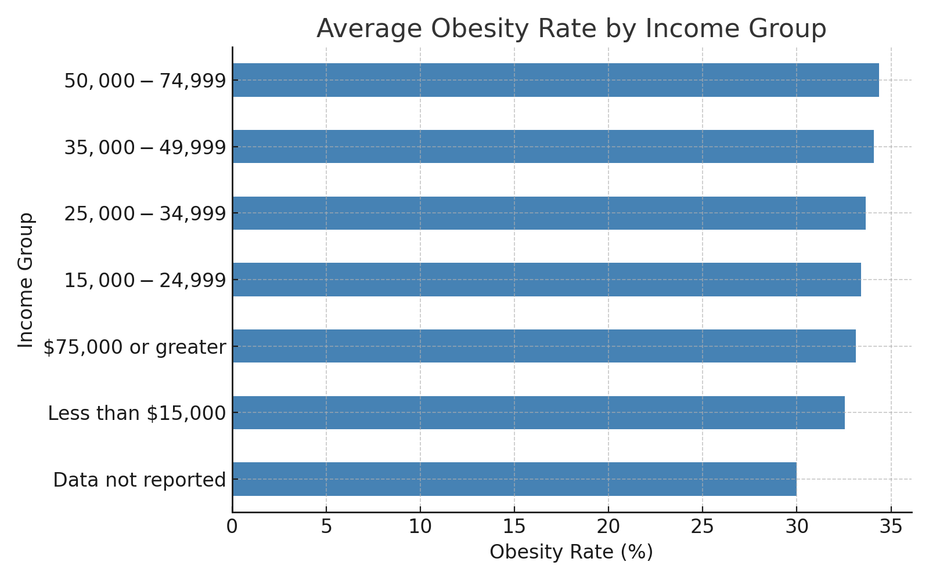
Does Wealth Mean Health?
I originally expected to see a trend where higher income brackets had lower obesity, given they have access to higher quality, healthier foods.
Instead, this chart tells a different story:
Obesity rates do not decrease until the >$75k bracket is reached. Perhaps it is not until that amount is reached that people tend to think more about the food they are eating, and are willing to invest in it.
The <$15k bracket has the lowest obesity rates. This may prove that as money becomes more scarce, people become willing to sacrifice meals for other necessities.
Overall, the differences are not great enough to prompt further investigation.

Slide 9
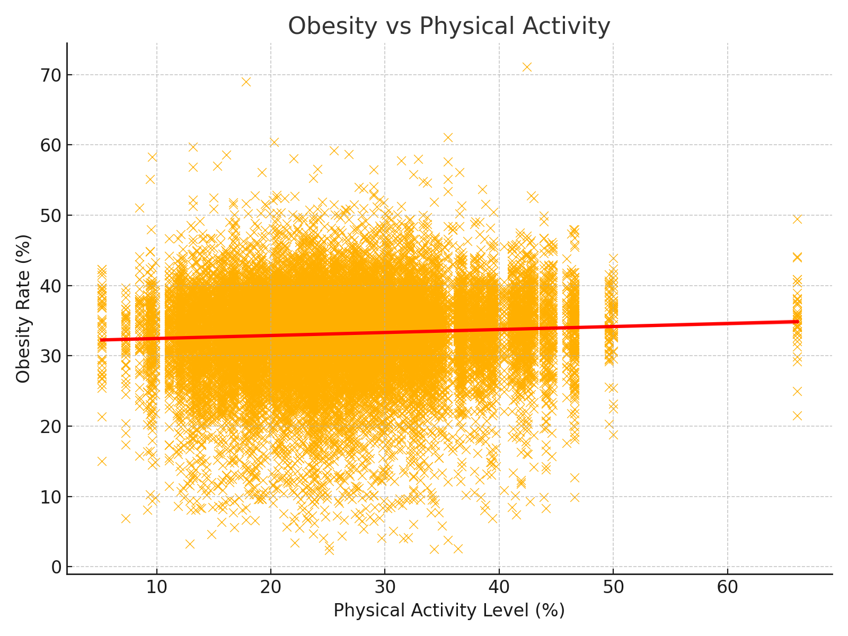
Run Don't Walk
Here, I plotted physical activity against obesity. Again, I came in with a preconceived notion – that higher levels of physical activity would obviously correlate with less obesity. However, although we see a slight upward trend, it is not the strong relationship I expected.
Due to plethora of scientific evidence proving that exercise can aide in weight loss, I will presume that there is something else, perhaps more granular, that is affecting this relationship in the data and masking the effects of exercise. Or perhaps the questioning is too vague and people are over-reporting their physical activity. However, that is outside the scope of this data, and therefore this project.

Slide 10
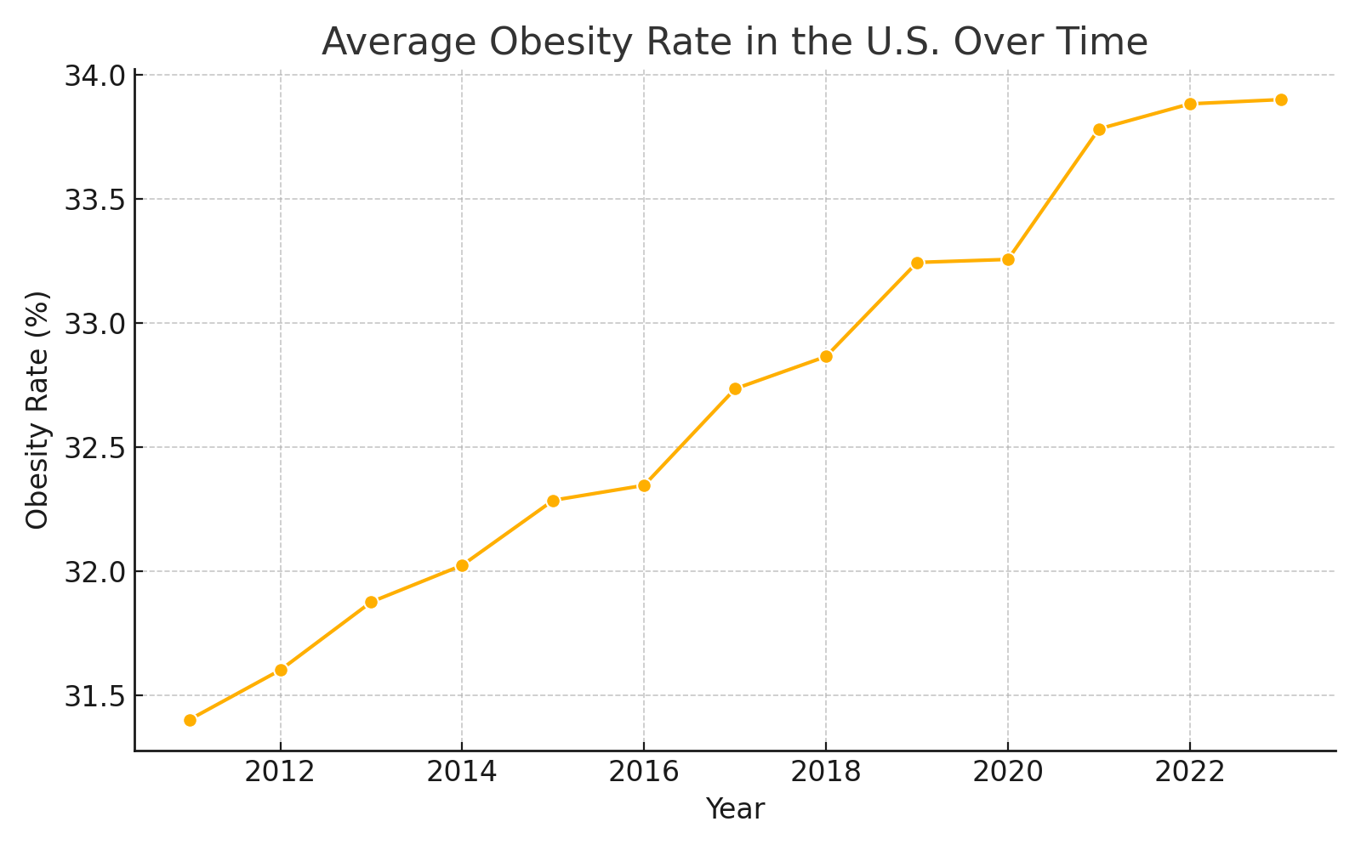
A Growing America
This line chart shows the average U.S. obesity rate by year. The trend has gradually increased from 2011 to 2023 and seems to be on an upward trend. However, it also seems to start plateauing in recent years. Therefore, I believe a nonlinear regression model would help us predict obesity rates in future years.
This will be analyzed further in later sections.

Slide 11
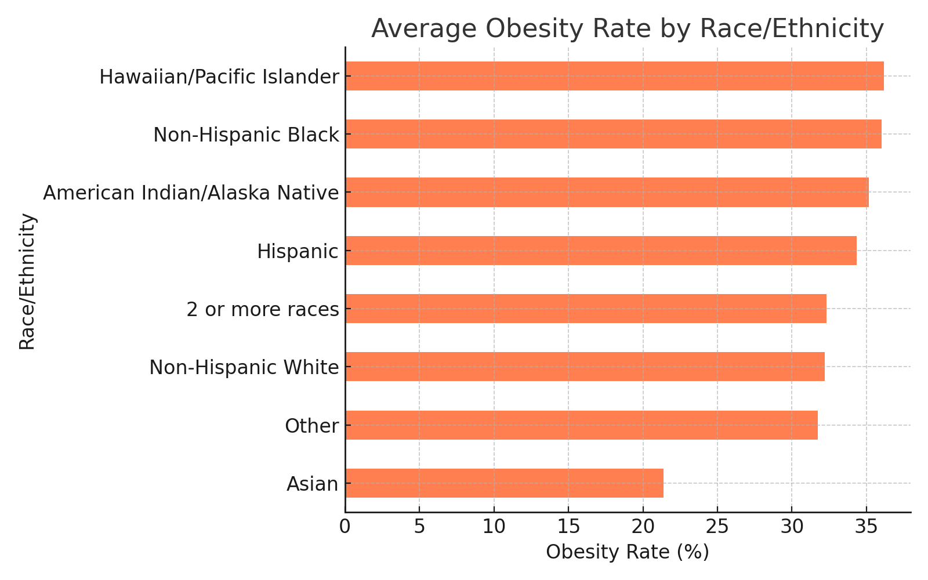
Obesity by Race/Ethnicity
This chart displays obesity rates by racial/ethnic group. Certain populations show elevated obesity risk.
Most notably:
Those who identify as Asian seem to be at much lower risk of obesity than all other groups.
Those who identify as Hawaiin/Pacific Islander or Non-Hispanic Black seem to be at highest risk of obesity.

Slide 12
Data Analysis & Model Selection
The two most notable takeaways for me based on EDA were:
There have been clear increases in obesity rates over time.
Obesity risk seems to vary significantly based on race/ethnicity.
I will continue my analysis by addressing both of these discoveries. If we can both predict future obesity rates and infer obesity rates based on race/ethnicity, then this will be interesting information for anyone, as well as applicable in the real world.
For obesity rates over time, I see a clear linear trend, and will therefore be fitting a linear regression model.
For inference on obesity vs. race/ethnicity I will use an ANOVA model to test the significance of differences, because we are comparing the rates of a variable with many fields.

Slide 13
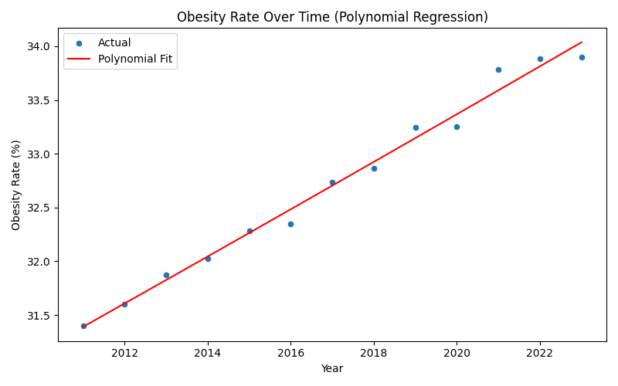

Have we hit peak obesity?
Based on the R-squared and RMSE of our linear regression, we have proven that there has been (and likely will be) a clear upward trend in obesity rates in the U.S. over time.
A major caveat here is that we can also clearly see the residuals increasing in later years, meaning there is information that our model isn't capturing.
As mentioned before, the obesity rates seem to be plateauing in recent years and may eventually level, or even decline. I originally wanted to run a nonlinear regression to capture this, but I could not work it out in time, so we will have to caveat for now.

Slide 14
Race/Ethnicity is a factor
Based on the p-value of our ANOVA test, we have proven that obesity rates are statistically different across various race/ethnic groups.
This does not tell us definitively which individual groups are statistically different. However, we can infer that the groups with lower obesity (e.g. Asian) are at statistically lower risk of obesity that those groups at the higher end (e.g. Hawaiian, Black).
One-Way ANOVA Result:
F-statistic: 383.26
p-value: 0.00000

Slide 15
Conclusion
Obesity rates are increasing over time. Race/ethnicity is a key predictor. This analysis highlights the need for targeted health interventions, particularly for those populations with higher obesity risk.
Overall, I believe this study resulted in useful information for two groups: certain companies and all individuals. At the individual level, it is not only interesting, but also important for everyone to better understand risk factors for obesity, which itself is known as a significant risk factor for many health conditions.
This study may also be valuable to certain companies, particularly in health-related industries. For example, fitness companies (e.g. gyms, workout gear, health blogs, etc.) may want to target people who are struggling with obesity, and the results of this study may help them piece together and understand those audiences.

