Slide 1
COMP-472 A2
Xavier Morin - 40077865
Axel Bogos - 40077502
Luan Meiyi - 40047658

Slide 2
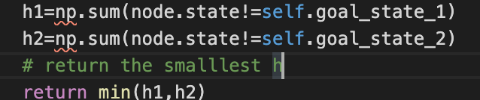
Heuristic 1 Hamming distance
Heuristic function will count how many numbers in the list is not at the correct spot
Example:
0 | 3 | 4 | 6
1 | 2 | 5 | 7
h1=6 h2=2 return h2

Slide 3
Heuristic 2 Manhattan distance
Heuristica 2 function will count how far is a number from its correct spot
Examples:
0 | 1 | 2 | 7
4 | 5 | 6 | 3
for goal state 1: 7’s distance is 1, 3’s distance is 1. h1 is 2
0 | 2 | 4 | 6
1 | 7 | 5 | 3
for goal state 2: 7’s distance is 2, 3’s distance is 2. h2 is 4

Slide 4
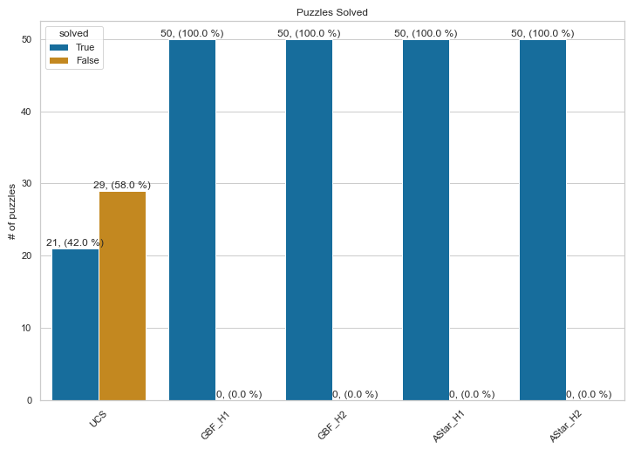
Analysis – Success Rates
All puzzles are solved with every method/heuristic pairs except for Uniform Cost with 60s of computation time.

Slide 5
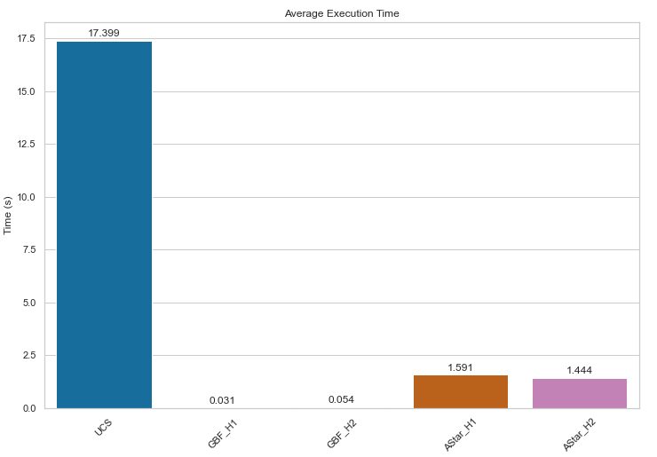
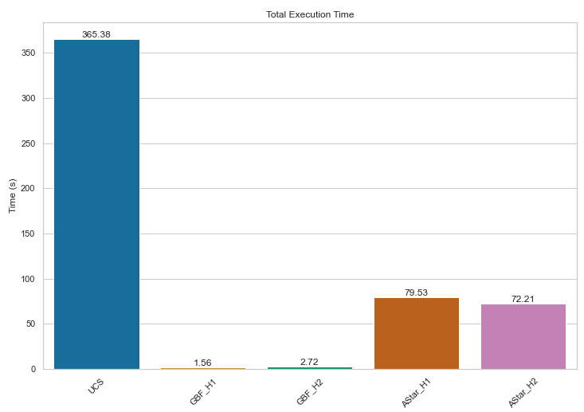
Analysis – Execution Time
As expected, UCS has a significantly higher execution time, both in terms of average per solution and total time.
About 561x slower than GBF_H1!
A* method is marginally slower than GBF (about 51x); however it guarantees lowest cost.
It seems the choice of method has a much greater impact on perfomances than heuristic itself.

Slide 6
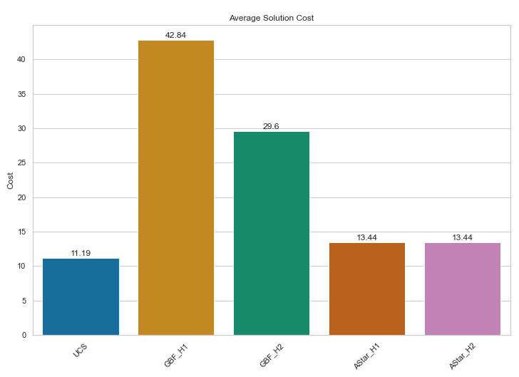
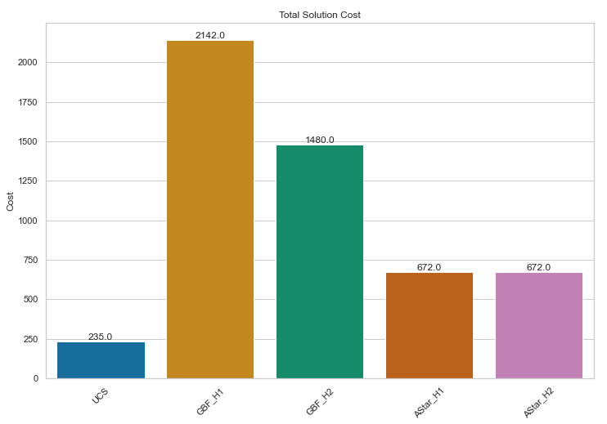
Analysis – Cost
As expected, average and total cost is much higher for greedy algorithms.
As expected, both heuristic have the same cost on A* since it guarantees optimal cost.
UCS has the lowest average and total cost, however this is skewed by the fact that UCS does not find a solution for many puzzles. As
we expect the cost of UCS and A* to be the same.

Slide 7
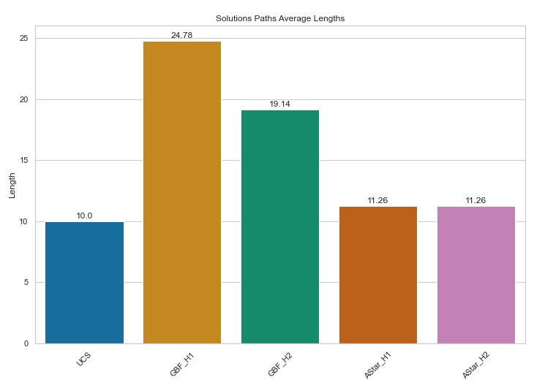
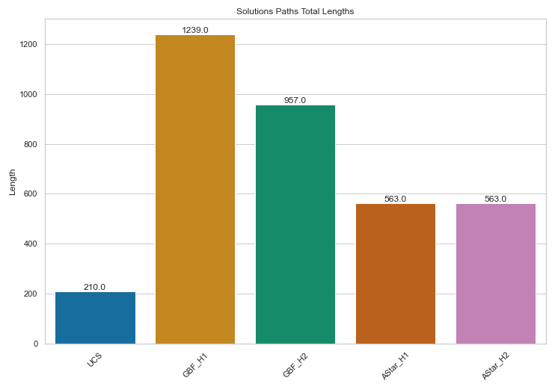
Analysis – Solution Path
Similarly to cost, average and total solution paths are much longer for greedy algorithms.
As expected, both heuristic have the same path lengths on A* since it guarantees optimal path.
UCS has the lowest path lengths, however this is skewed by the fact that it does not find a solution for many puzzles (esp. for longer sol paths). Given infinite time, we expect the cost of UCS and A* to be the same.

Slide 8
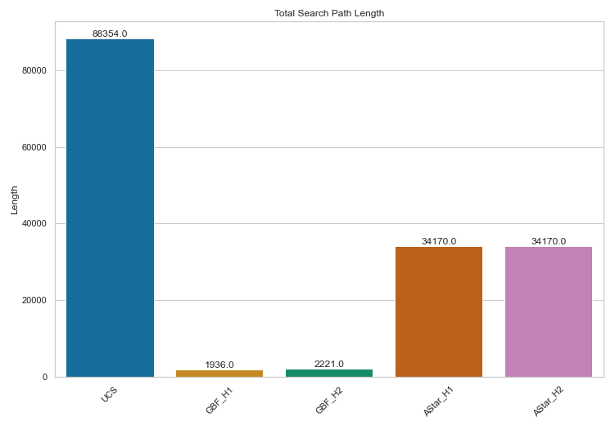
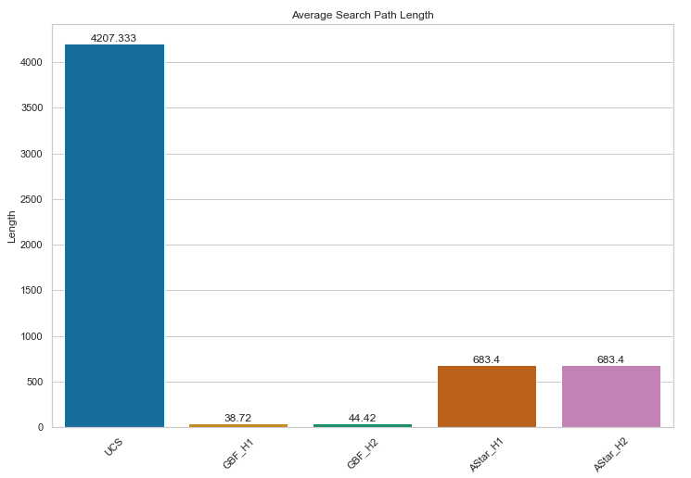
Analysis – Search Path
As UCS is the least informed heuristic, it has by far the largest search path.
Greedy Algorithms have the lowest search path, pointing to the fact that the greedy choice often converges to the solution state quickly
A* is balanced between the 2, but still searches far less states than UCS for an equally optimal solution.

Slide 9
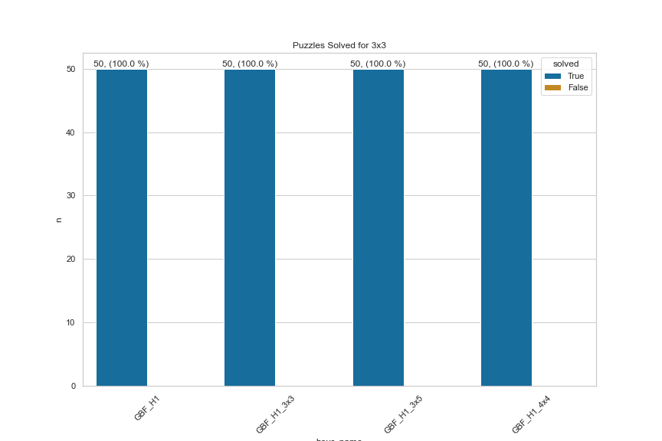
Scaled-up experiment - Sucess Rates
For GBF_H1, increasing the size of the puzzle did not diminish the success rate.
The sub-problem greedy choice property seems true in enough cases for greedy algorithms to perform well under more complex problem space.

Slide 10
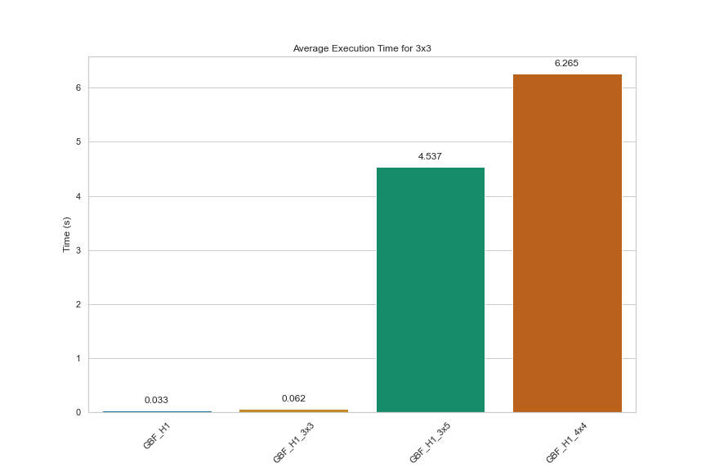
Scaled-up experiment - Execution Time
We can clearly see that the execution time follows an exponential curve with the number of tiles.
However all 200 puzzles have been solved under 60 secondes.

Slide 11
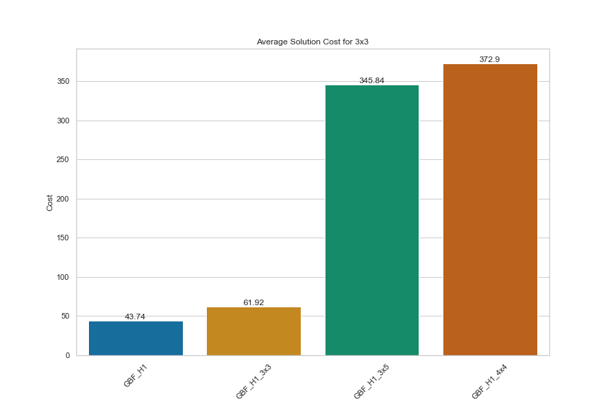
Scaled-up experiment - Average Cost
The cost unsurprisingly increases as the size of the puzzles increases. Since a bigger puzzle necessite more move to solve.
The hamming distance heuristic was already the costliest, with bigger puzzles this heuristic become exponentially more expensive.

