Slide 1
Haptics through magnetic implant stimulation
Research Interests:
Bionics (subdermal implants)
Haptic feedback rendering
Sensory substitution
Fougues Axel

Slide 2
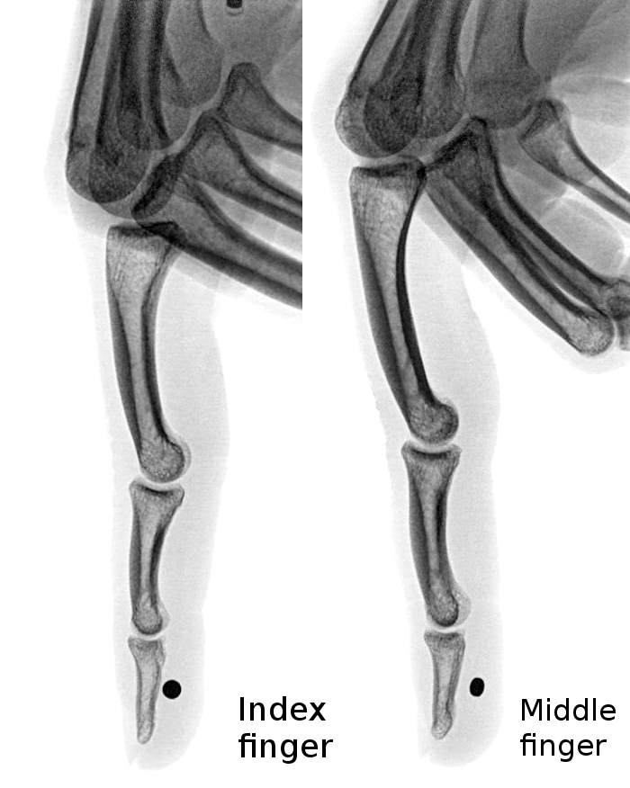
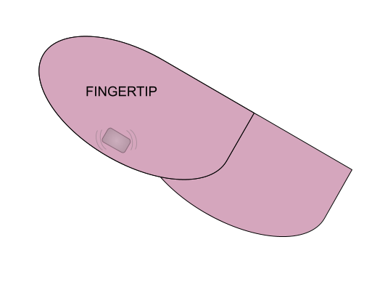
Fingertip magnetic implants move/vibrate in presence of a magnetic field. They stimulate nerve endings sending a distinct feedback.
In daily life: electric appliances, magnets, high currents, ferrous metals can be felt.
An idea:
Use electromagnets to purposefully stimulate them

Slide 3
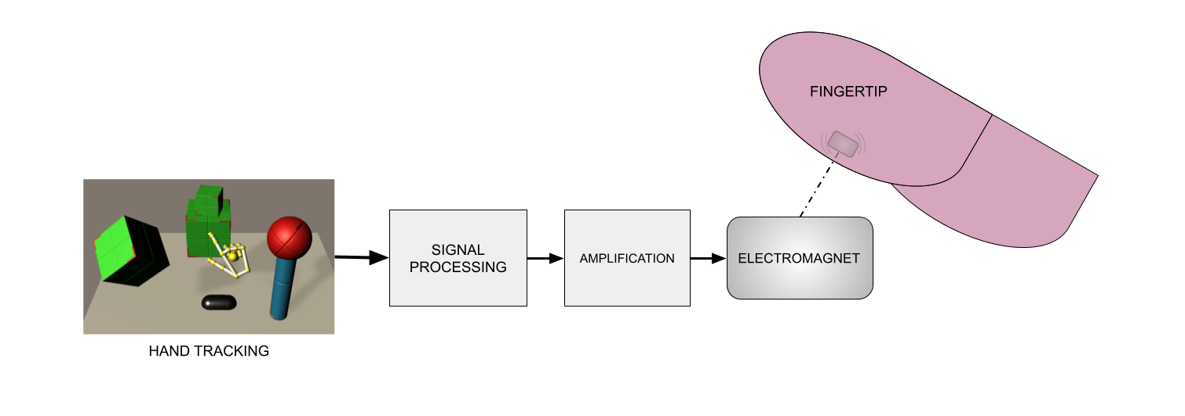
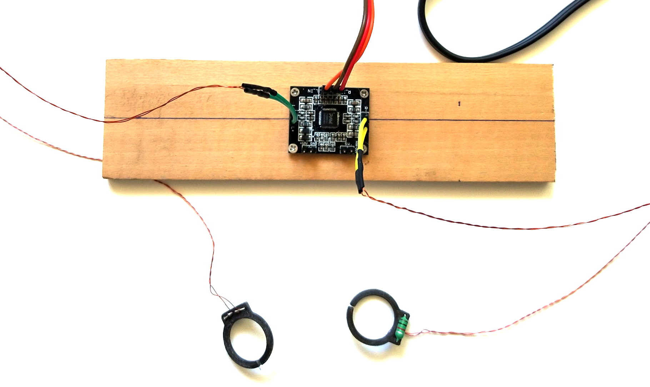
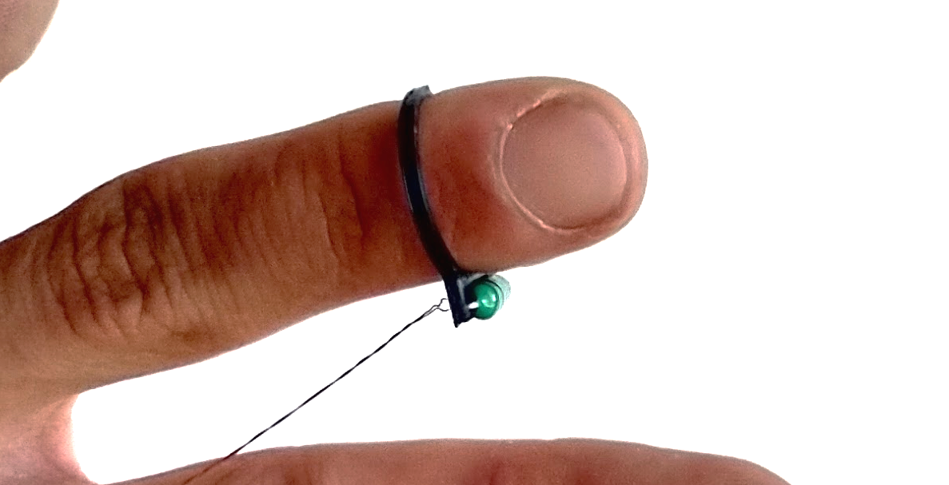


Haptic feedback for VR

Slide 4
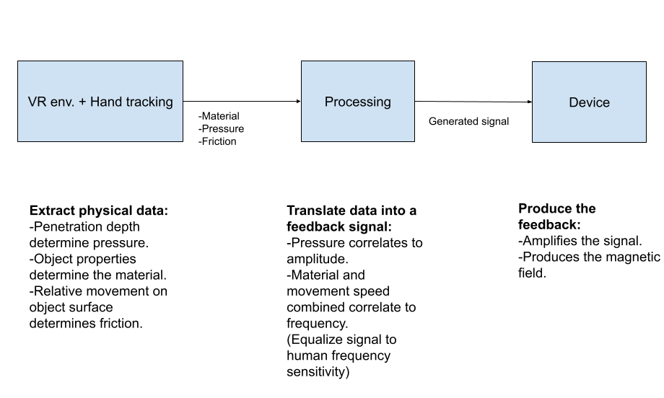

Slide 5
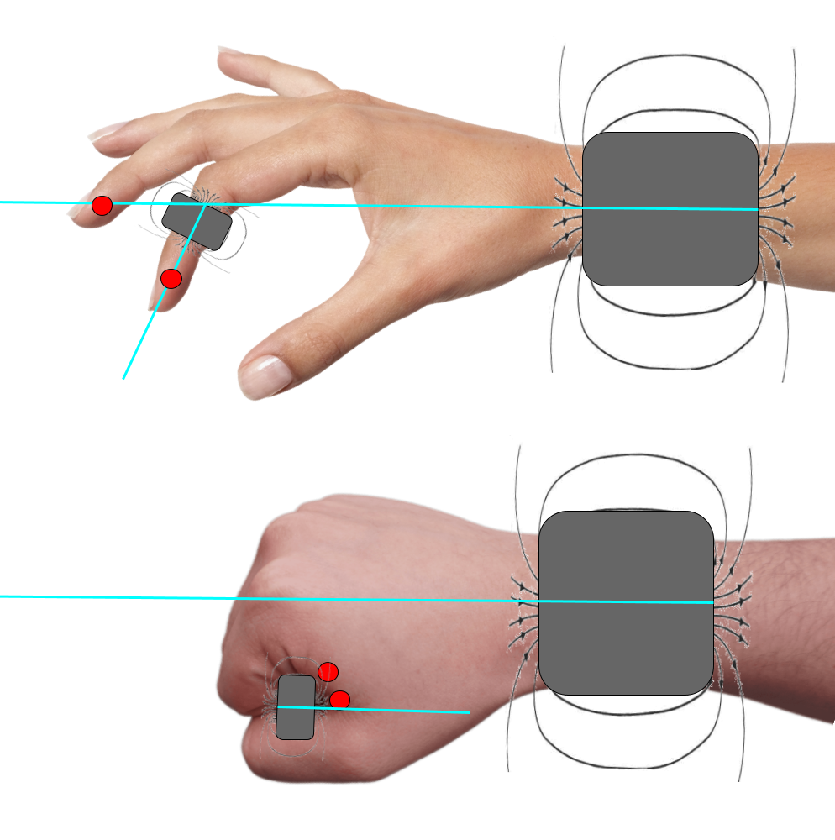
Challenges
Software:
Translating information into intelligible feedback
Hardware:
Improving the range and efficiency of stimulating electromagnets
Stimulator designs and alignments.

