Slide 1
SMIs* compared to existing mid-air haptic feedback
*subdermal magnetic implants

Slide 2
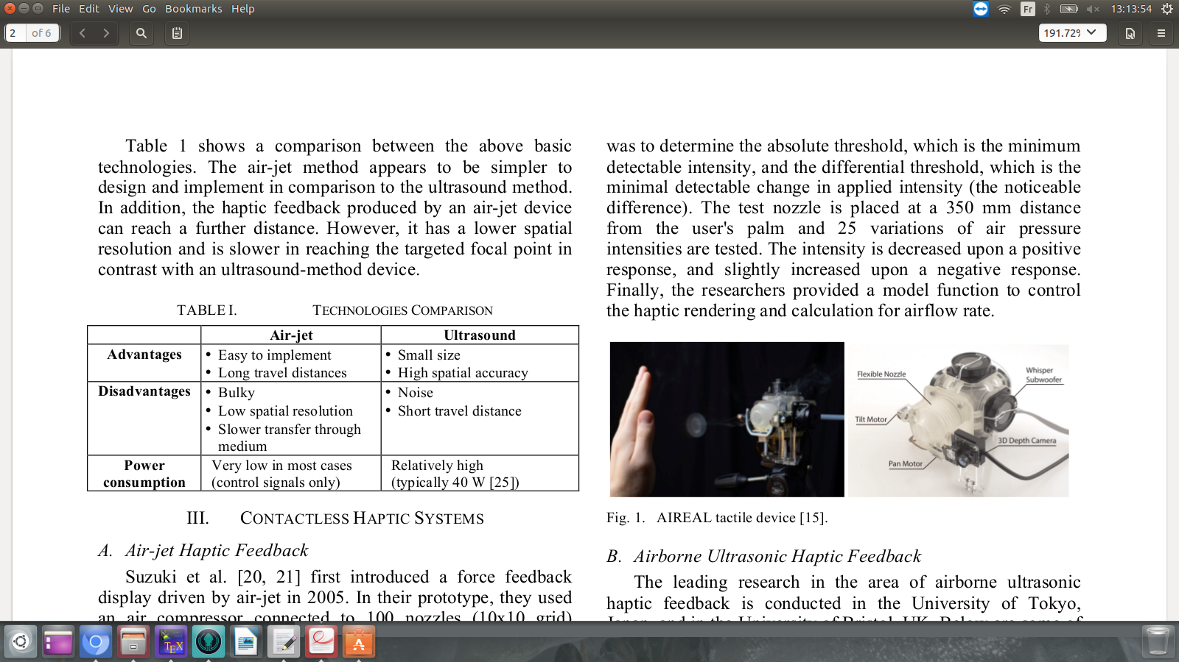
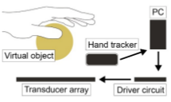
Mid-air Haptics

Slide 3
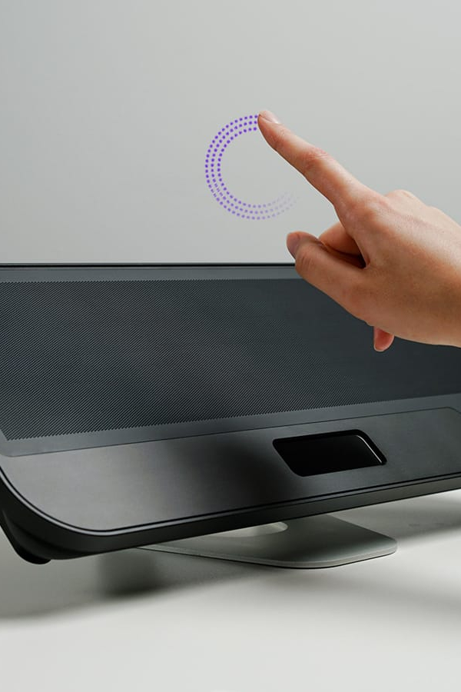
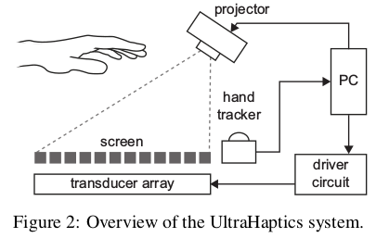
Ultrasound
Only works on hand (depending on frequency)
Doesn’t work with obstructions
Needs fast and reliable hand tracking.
Weak force.
Mostly used as haptic display.
Stratos by Ultraleap

Slide 4
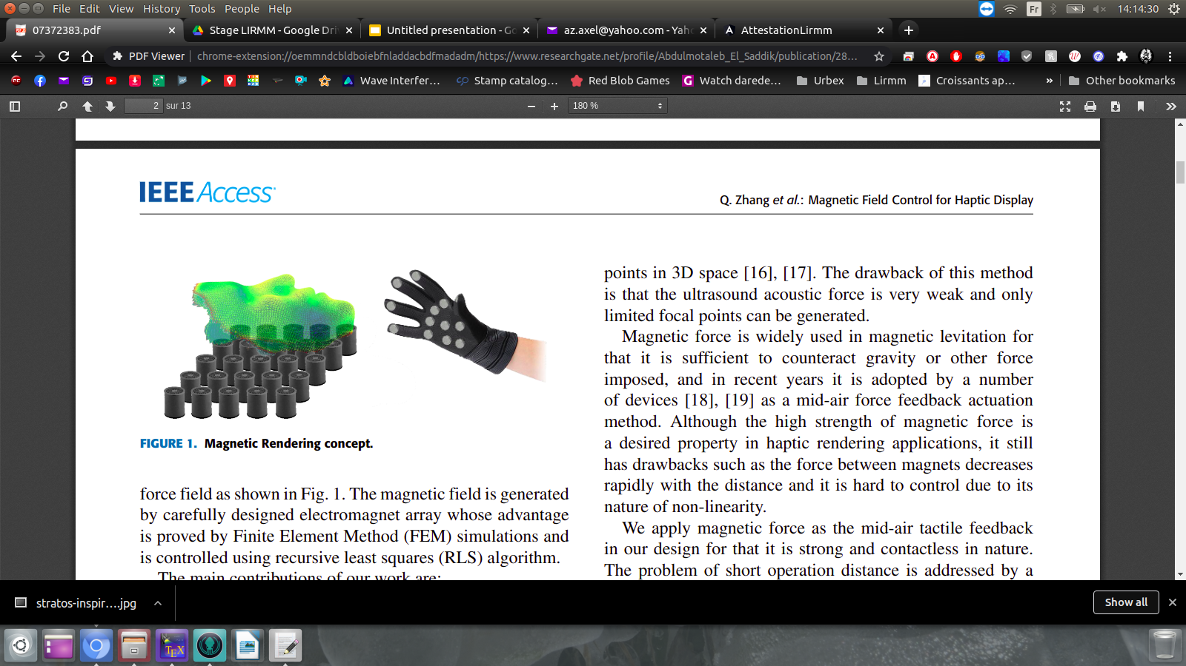
The magnetic equivalent in haptic displays
Has been thought of before:
Similar short range.
No sharp shapes.
Much stronger exerted force.
Necessary glove.
No need for hand tracking or constant updates.

Slide 5
SMI’s contribution
Contactless
More sensitive (than external magnets).
Strong feedback (and wide range).
Versatile system (wearable / haptic display / large scale).
Longer ranges possible (on large scale systems).
Magnetic fields do not affect / are not perceived by humans.
Single point stimulation (for now).
Implants necessary.

Slide 6

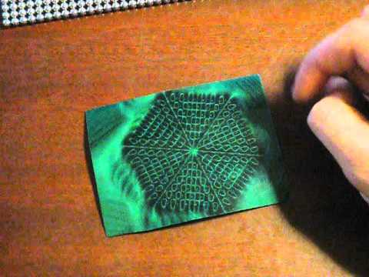
Interesting leads
Passive/active haptic displays.

Slide 7
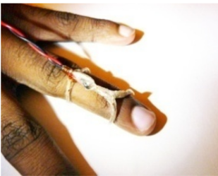
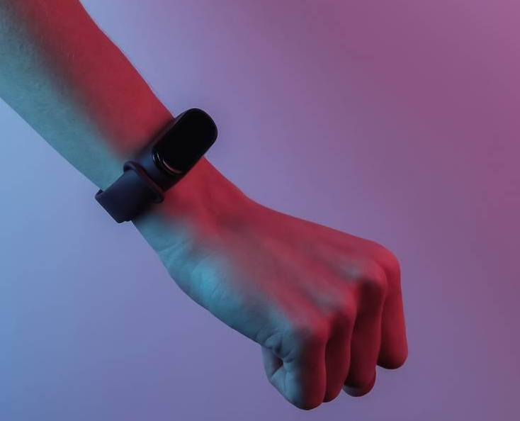
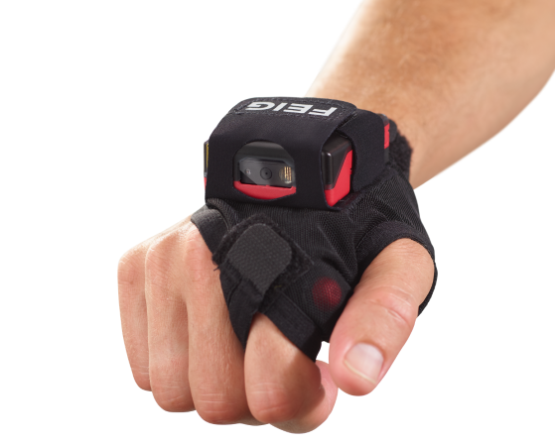
Interesting leads
Passive/active haptic displays.
Discreet wearable EDC device (haptic feedback, mobile phone periph., sensor feedback...).

Slide 8
Interesting leads
Passive/active haptic displays.
Discreet wearable EDC device (haptic feedback, mobile phone periph., sensor feedback...).
Optimal implant design (volume, mass, coating, implantation....):
“In both cases the magnets used are common 1mm by 3mm disk implants that are made this way due to coating and cost limitations. The apparent poor perception above 100Hz in harrison2018tf might very well be a mechanical limitation rather than a sensory one.”

