Slide 1
Sensitivity testing and coil design.
WEEK 7

Slide 2
Lowest perceived field strength
With a 100Hz sine my lowest consistently perceived field:
< 0.005 mT*
*Reached the gaussmeter’s resolution limit (0.002mT) so we can’t be more precise.
In Harrison 2018, median at 200Hz :
0.03 mT
*Values were estimated from coil and signal, not measured...

Slide 3
> 6 times more sensitive than expected, good but why?!
20% stronger implant
+
Measured values rather than estimated
(estimated ones seem to always be higher)
+
Parylene coating thinner than silicone (less useless mass)
+
Gaussmeter error? Waiting for the axial probe to arrive...

Slide 4
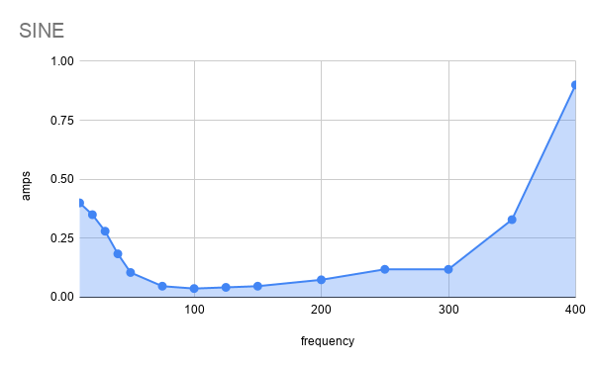
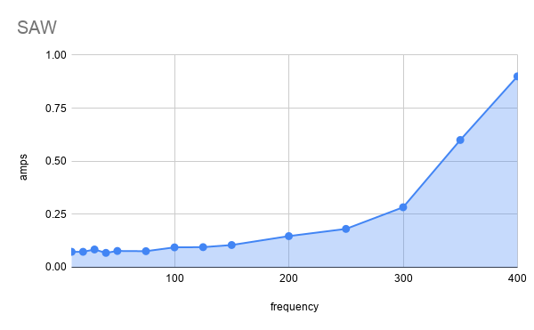
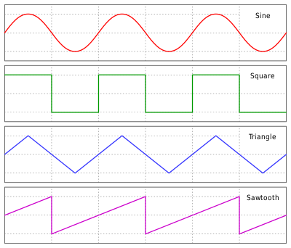
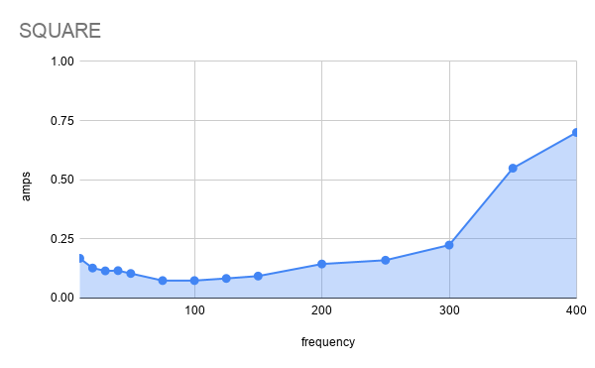
Sensitivity in relation to frequency and signal type

Slide 5
Each signal produces a different sensation. They can also be merged to extend the sensed frequency range.
100Hz was the most sensitive frequency despite being a blindspot for frequency discrimination (Harrison2018).
The most interesting range overall is 50-300 Hz with some interesting results on even lower frequencies.
Using lower frequencies I can produce a beating sensation (20-50 Hz) and a “deformation” sensation <20Hz (sine).

Slide 6
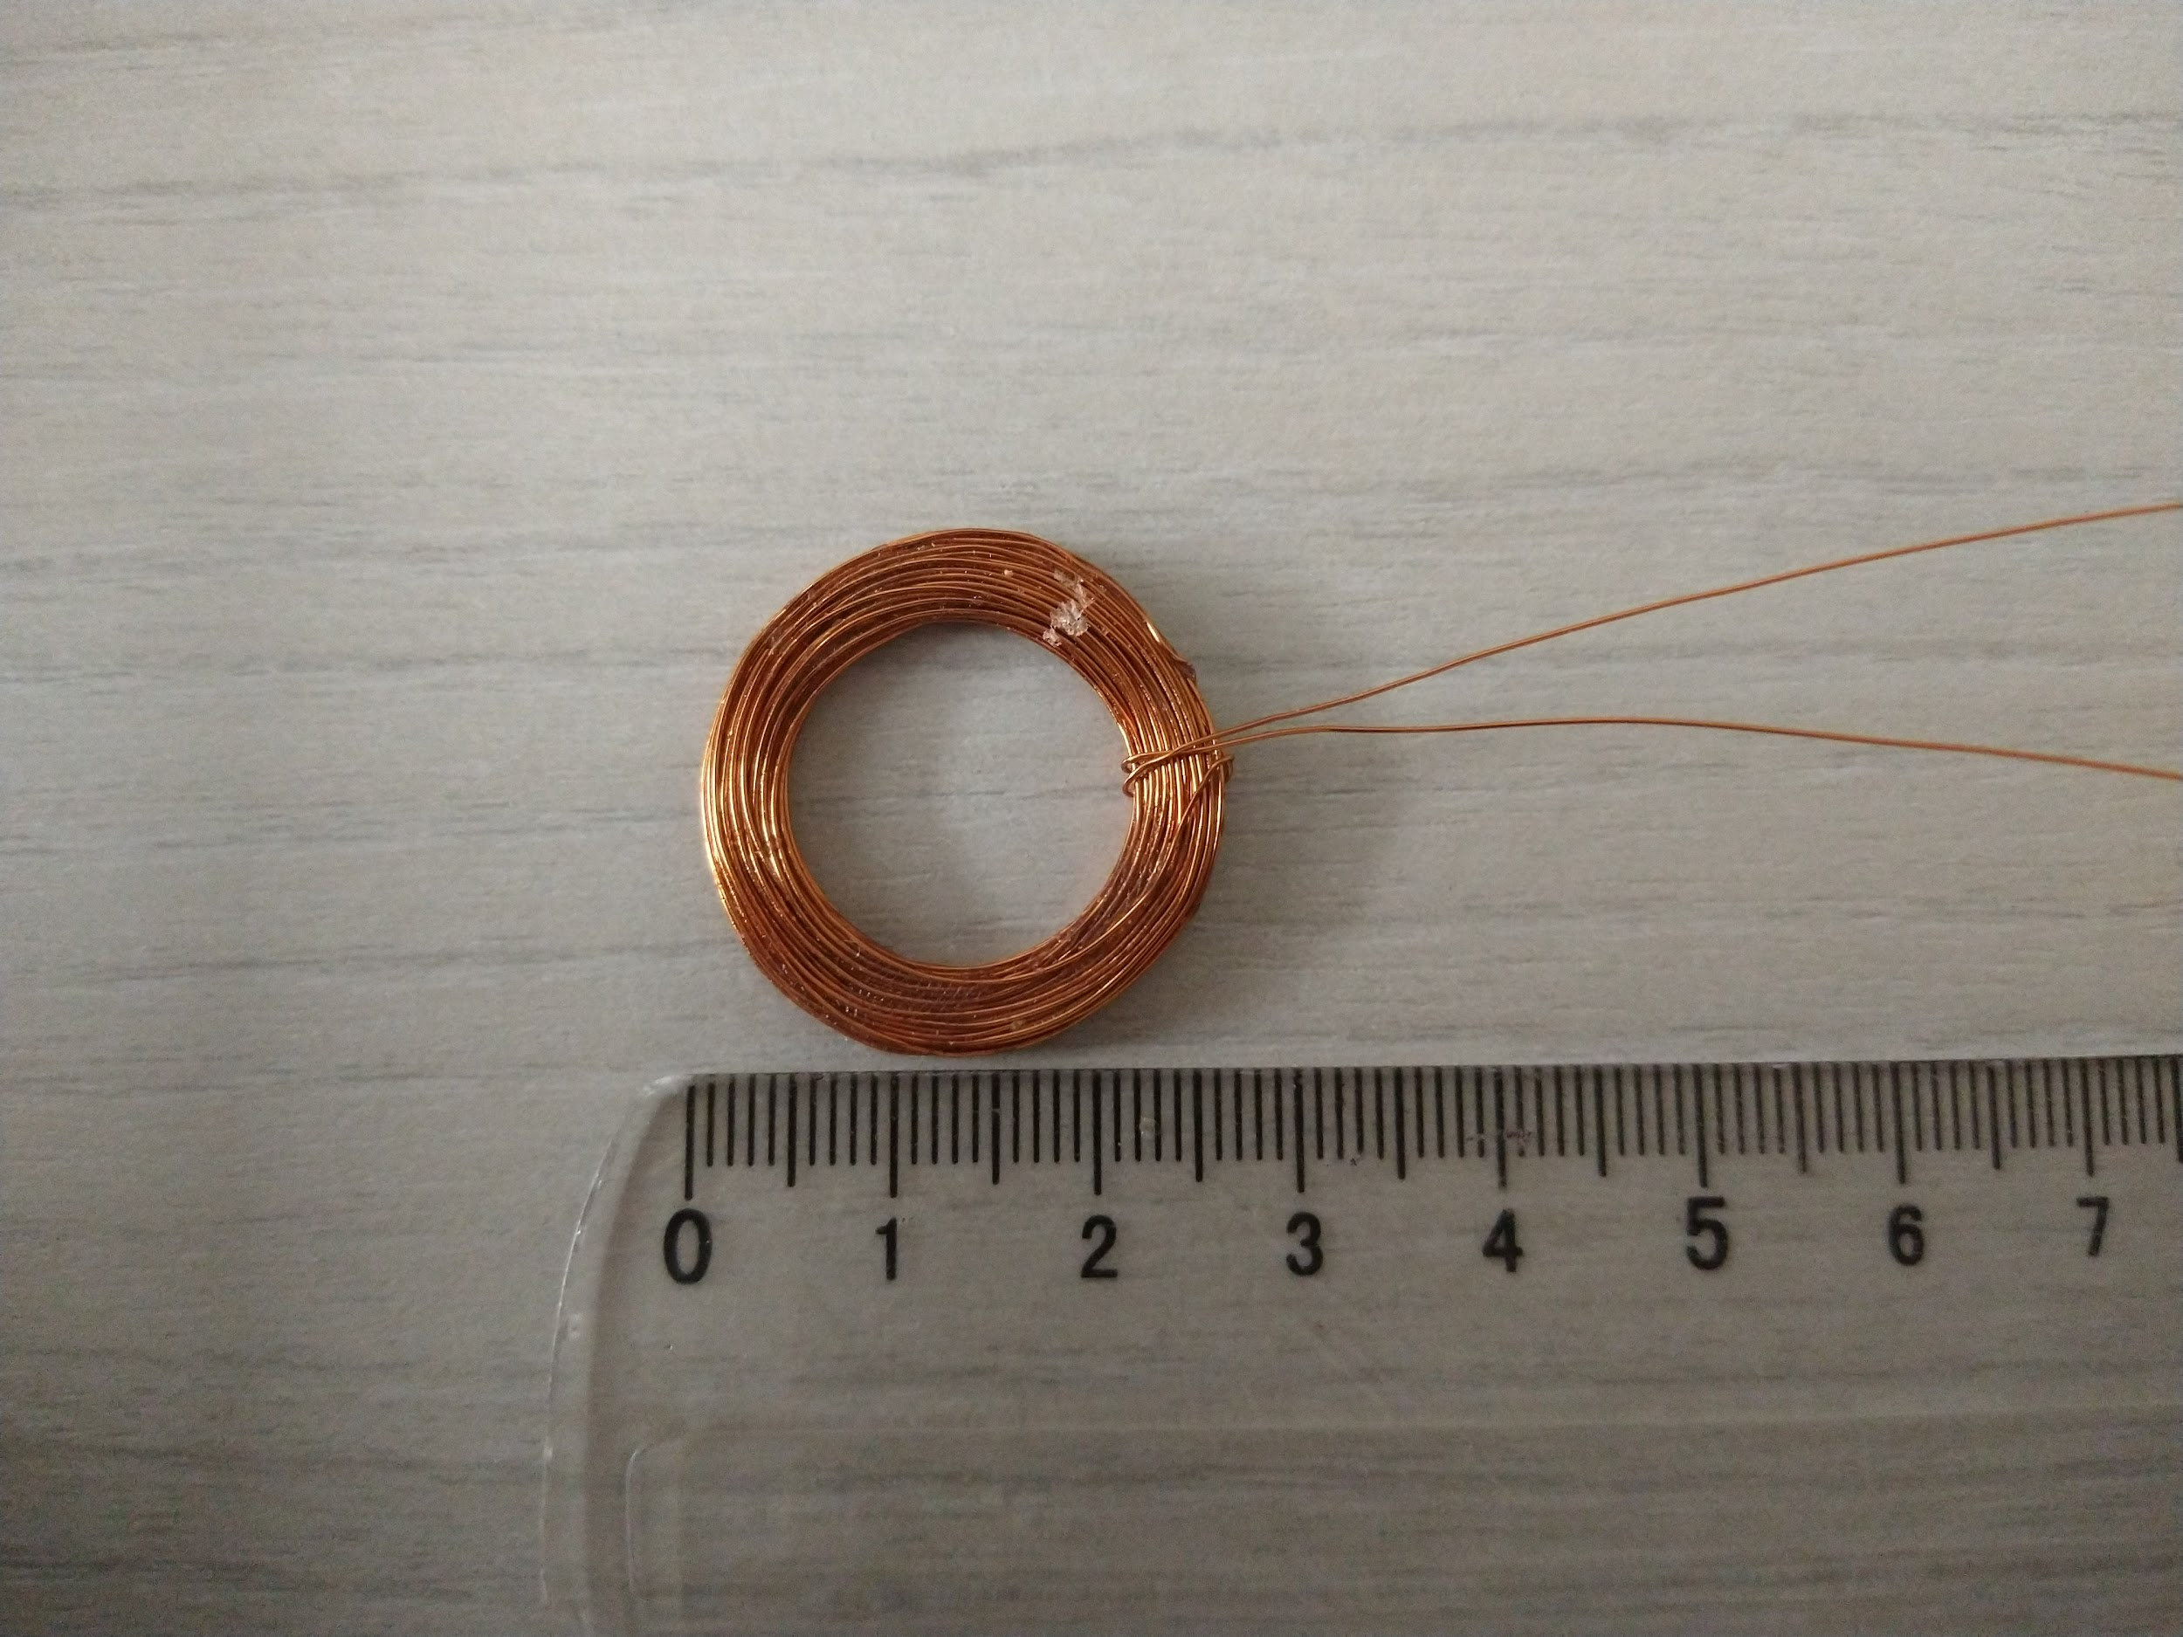
Coil design
Usable range of a hand made ring coil of reasonable size : 3 cm*
Ideal usable range for a ring : +- 6cm **
*using optimized signal types for low frequencies
** ring around the base of proximal phalanx rather than medial

Slide 7
Coil design
Increase width - impractical
Increase current - produces heat
Manage heat - impractical
Industrially made coils (+-30% more efficient, can fit more turns in less space)
Use a core

Slide 8
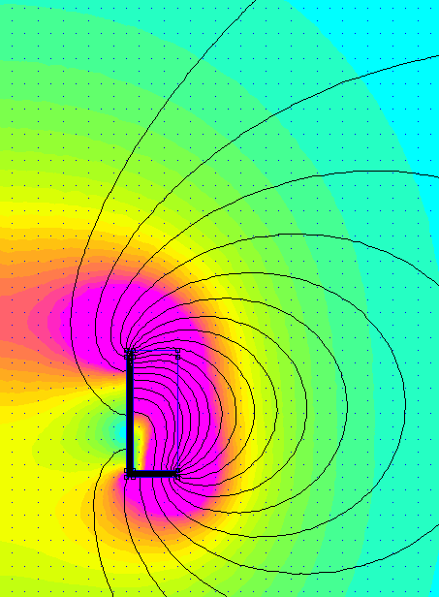
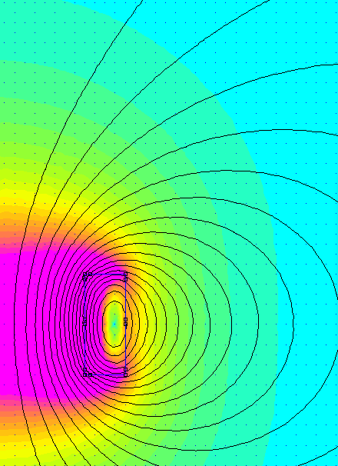
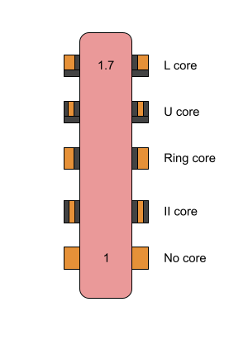
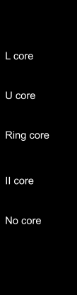
Core designs
L core - 1.7x stronger field at 15mm No core

Slide 9
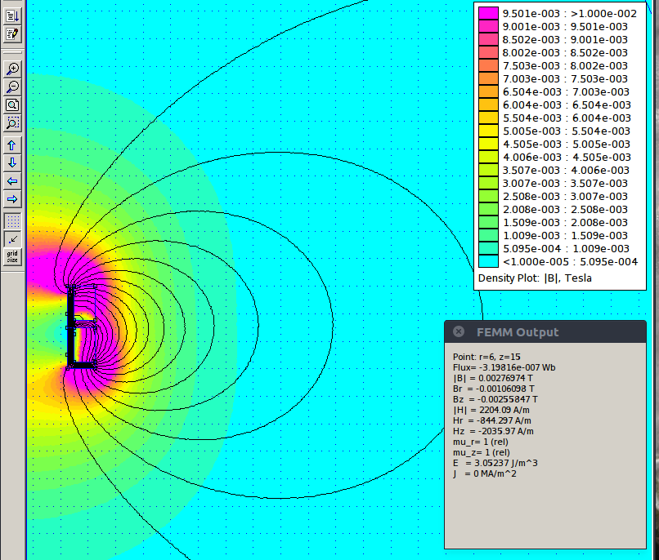
Further thoughts
Stacking L-Cores?

