Slide 1
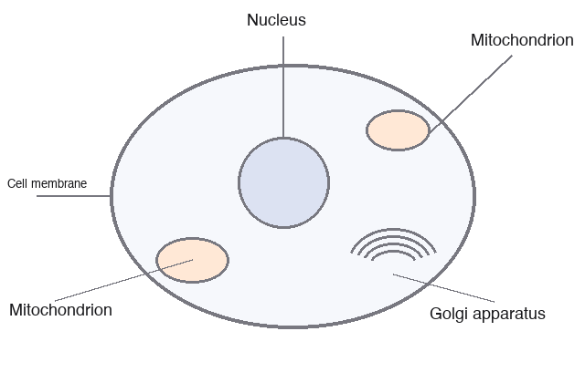
Cells
The animal cell has a nucleus that holds the DNA and mitochondria that make most of its energy.

Slide 2

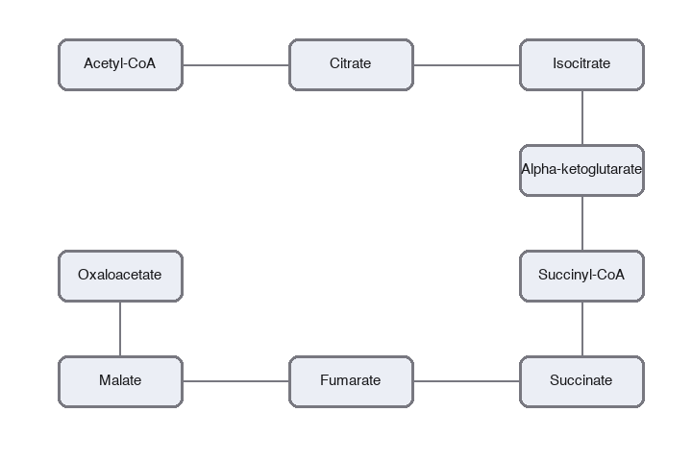
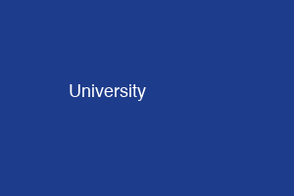
Energy
The Krebs cycle runs in the matrix of the mitochondrion and passes electrons to the transport chain.

Slide 3
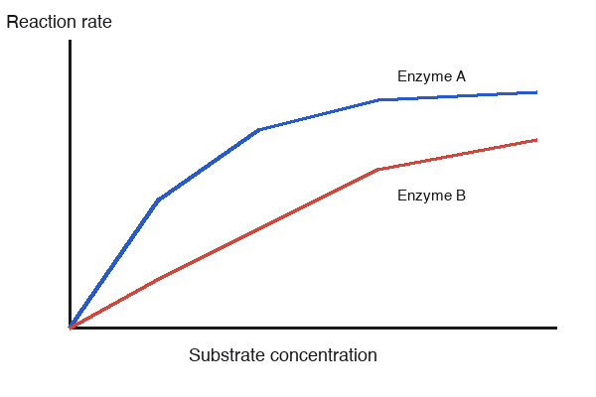
Rates
Enzymes speed up reactions, and the rate levels off when every enzyme is busy with substrate.

Slide 4
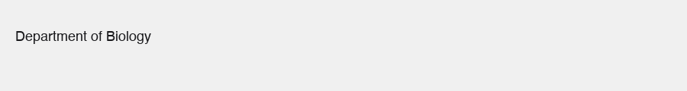

Banner and photo
A classroom where the students study the lecture slides together before the exam.

Slide 5
Just text
Glycolysis splits one glucose into two pyruvate in the cytoplasm and makes a little ATP.

