Slide 1





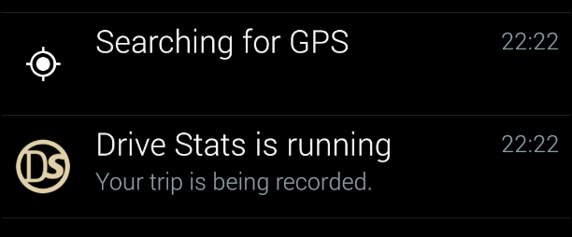

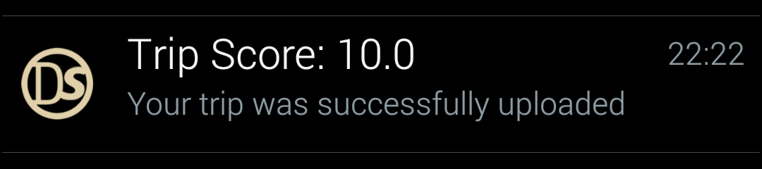
Simple and easy to use interface
Usable: Easy to use and navigate – even when you are not looking
Connect to Google+ API to get users information
Scalable: Can expanded to use other means of authentication like Facebook, or a simple username and password
Scalable: More Threads can be added to monitor more sensors
Monitor spikes in X, Y and Z axis and update trip state when there is a change
1) Three Threads are started
Monitor Location and speed and update the trip state when there are changes
Write trip state to offline file at regular intervals, 1 second in this application
2) User is notified that the trip is being recorded
Trip state
Offline file
1) All monitor threads are stopped
Scalable, Security: If there is no internet connection, none of the data is lost when the application is closed
2) Offline file is uploaded to the server for analysis on separate thread.
3) User is notified of their score, when the server returns a value

