Slide 1
Sequential Cognition Processes
A Framework for Reasoning with Non-monotonic Logics
Master of Computer Science Thesis: Axel Ind

Slide 2
Research Questions
Is there a way to systematically represent some (or all) non-monotonic logics in a framework that standardizes cognitive modelling under these logics without sacrificing their expressiveness?
Applications in human reasoning.
Searchability.
Can the reasoning of individuals be explained with small deviations from models for general reasoners?
How can cognitive modelling explain why humans do not follow classical logic rules?

Slide 3
My Achievements
A systematic, searchable, and extensible framework for modelling human reasoning.
General.
Individual.
Creation of a scoring algorithm for comparing these models
Within the same task.
Across tasks.
Novel techniques for modelling individual cases of the Suppression Task and the Wason Selection Task.

Slide 4
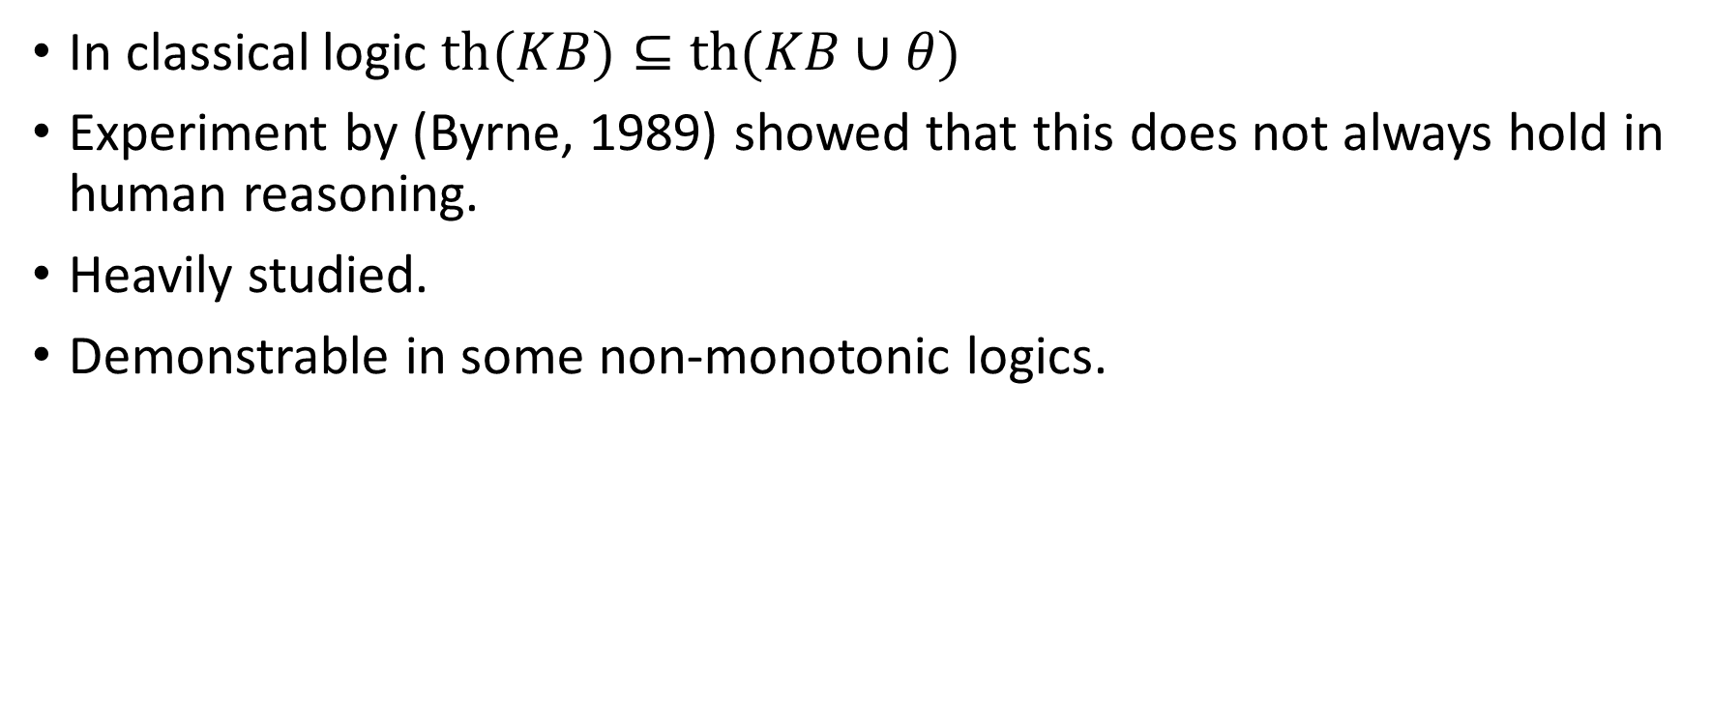
Experiments: The Suppression Task
In classical logic $th(KB)⊆th(KB∪θ)$
Experiment by (Byrne, 1989) showed that this does not always hold in human reasoning.
Heavily studied.
Demonstrable in some non-monotonic logics.

Slide 5
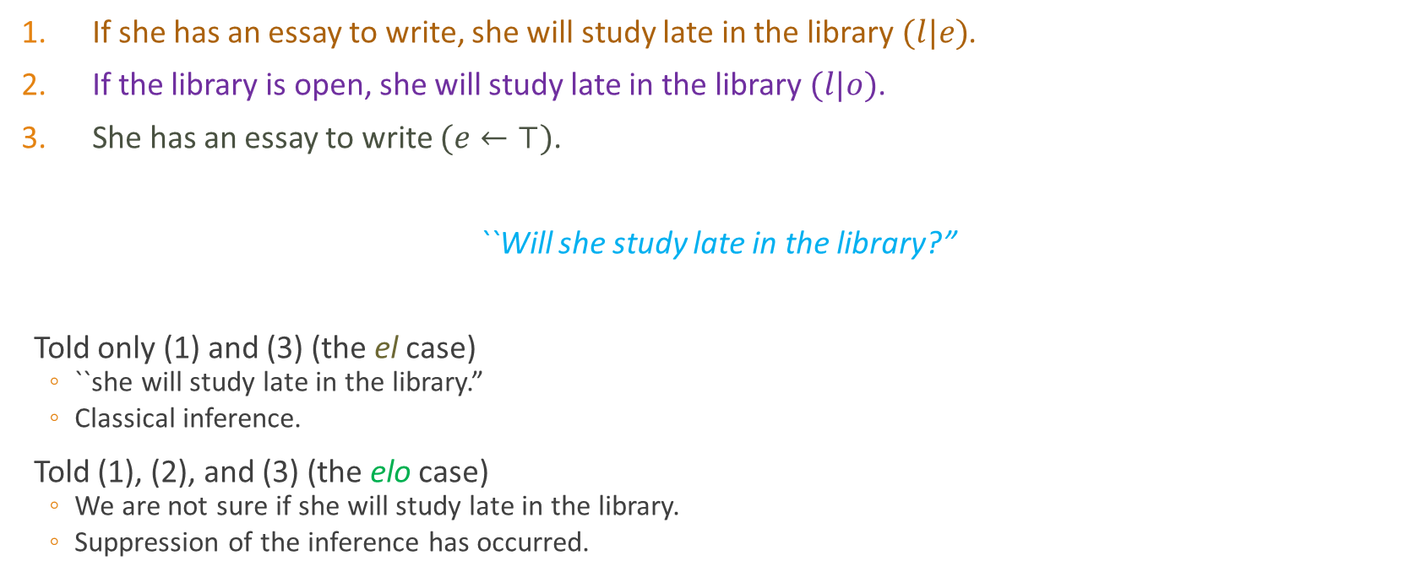
Suppression Task Formulation
If she has an essay to write, she will study late in the library $(l|e)$.
If the library is open, she will study late in the library $(l|o)$.
She has an essay to write $(e←⊤)$.
``Will she study late in the library?”
Told only (1) and (3) (the el case)
``she will study late in the library.”
Classical inference.
Told (1), (2), and (3) (the elo case)
We are not sure if she will study late in the library.
Suppression of the inference has occurred.

Slide 6
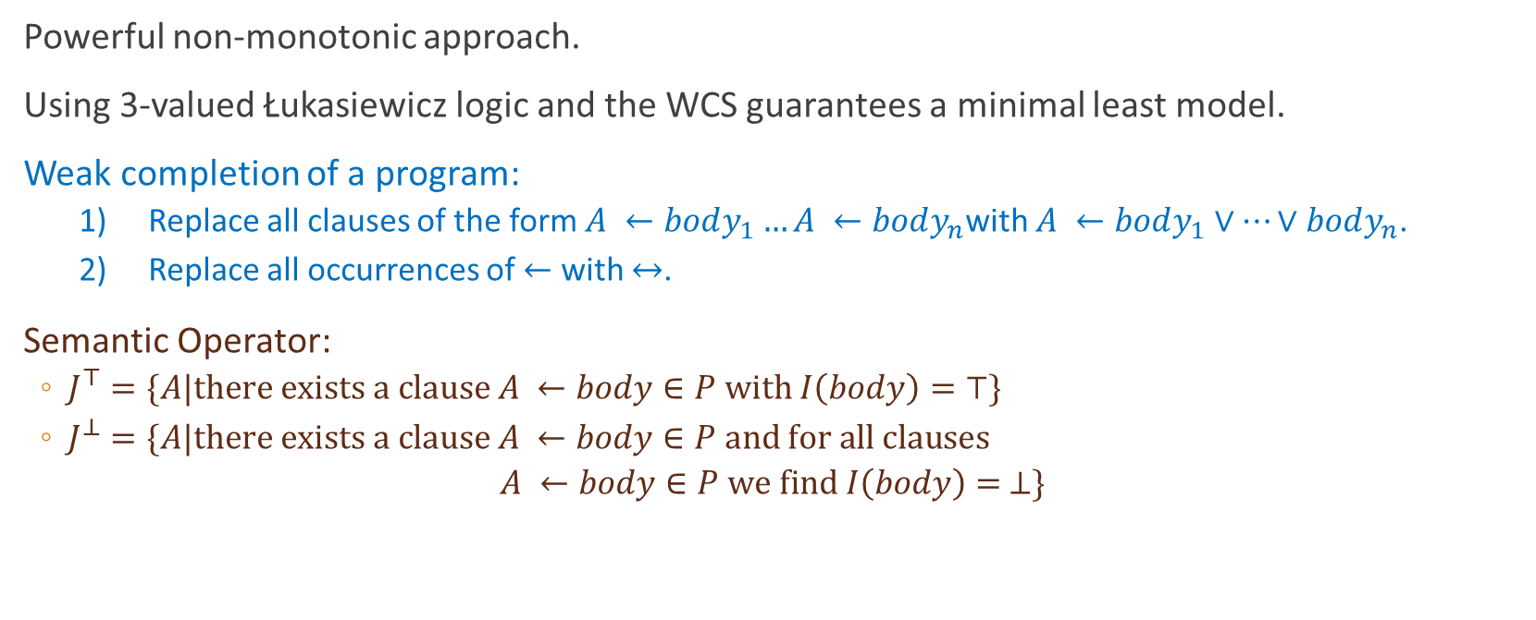
Weak Completion Semantics
Powerful non-monotonic approach.
Using 3-valued Łukasiewicz logic and the WCS guarantees a minimal least model.
Weak completion of a program:
1) Replace all clauses of the form $A ←body_{1}…A ←body_{n}$with $A ←body_{1}∨…∨body_{n}$.
2) Replace all occurrences of $←$ with $↔$.
Semantic Operator:
$J^{⊤}=\{A|there exists a clause A ←body∈P with I\left(body\right)=⊤\}$
$J^{⊥}=\{A|there exists a clause A ←body∈P and for all clauses$
$$A ←body∈P we find I\left(body\right)= ⊥\}$$

Slide 7

Applying the WCS to the Suppression Task
el case:
$KB_{noSup}=\{e←⊤, l←e ∧¬ab_{1}, ab_{1}←⊥\}$
$wc KB_{noSup}=\{e↔⊤, l↔e ∧¬ab_{1}, ab_{1}↔⊥\}$
least model $⊤=\left\{e,l\right\}, ⊥=\{ab_{1}\}$
elo case:
${KB}_{sup}{=\{e←⊤, l←e ∧¬ab_{1}, l←o ∧¬ab_{2}, ab_{1}←¬o, ab_{2}←¬e\}}$
${wc KB}_{sup}=\{e↔⊤, l↔\left(e ∧¬ab_{1}\right) ∨\left(o ∧¬ab_{2}\right), ab_{1}↔¬o, ab_{2}↔¬e\}$
least model $⊤=\left\{e\right\}, ⊥=\{ab_{2}\}$
$∴$Suppression observed.

Slide 8
Sequential Cognitive Processes
Model human reasoning as a sequence cognitive operations.
Can be used to encode:
Uncertainty in background knowledge
Non-monotonic final world states

Slide 9

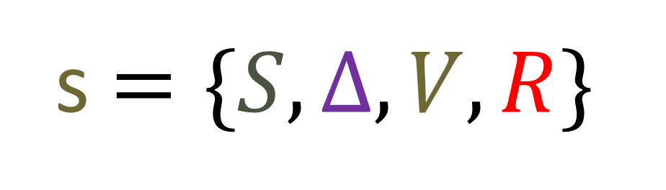
Epistemic States
Set of structural variables.
Structural variables encode the beliefs of the reasoner at a given moment.
No fixed set of structural variables, more can be added as required.
For the Weak Completion Semantics:
Propositional Knowledge Base
Epistemic state
Conditionals $(ψ|φ)$
s$=\{S,Δ,V,R\}$
(variable, value) pairs
(label:{instruction})

Slide 10

Cognitive Operation
Takes a state point as input, produces a state point as output.
State point: list of epistemic states.
Monotonic cognitive operations: #inputs = #outputs.
Non-monotonic cognitive operations: #inputs != #outputs.
Well founded:
In psychology, logic, physiology, etc.
Computational limitations of the human mind:
Time complexity.
Space complexity.
Pre-condition
$$(χ,e)$$
effect

Slide 11
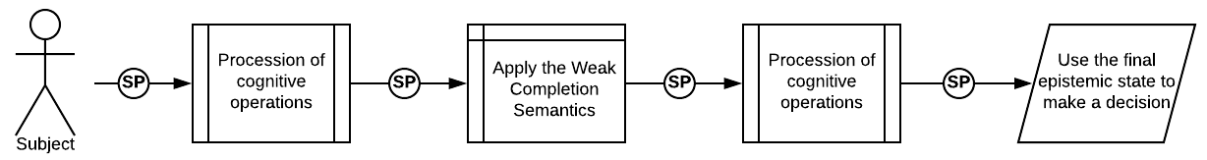
Sequential Cognitive Processes
A sequence of transformations on an initial state point.
Can be used to model existing non-monotonic logics.
Easily extended to model individual reasoners.
Allows classical search techniques.

Slide 12
The SCP Framework
Goal
SCP Task
SCP
SCP
Recipe
…
Realised SCP
Realised SCP
Realised SCP
…
Realised SCP
Result
…

Slide 13
SCP Framework: Cake Example
Goal
I want to have a cake
Mom’s Recipe
Grandma’s Recipe
Recipe
…
Too much flour
Too little sugar
Perfect cake
…
Thought salt was sugar
Result
…

Slide 14
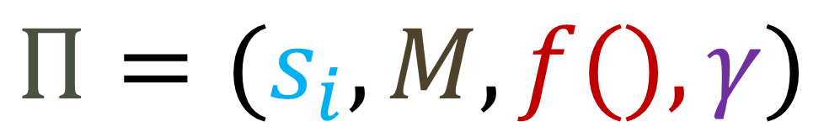
SCP Tasks
Models a final goal using a known initial state point and set of operations.
SCP Task
Initial State Point
External Evaluation function
$$Π=(s_{i}, M, f(), γ)$$
Set of Cognitive Operations
Goal

Slide 15
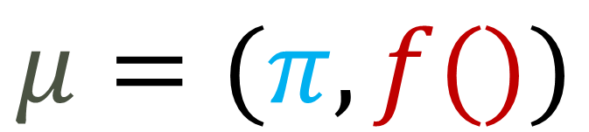
SCPs
Gives a sequence of instructions which could result in the desired goal.
SCP
Transition Model
$$μ=(π, f())$$
External Evaluation Function
$$π=(s_{i}⟼m_{1}⟼…⟼m_{n})$$
Initial State
Cognitive Operations

Slide 16
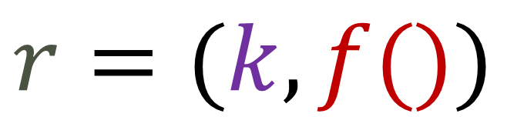
Realised SCPs
A single path through an SCP.
Results in a single epistemic state output from every cognitive operation.
Single Path
$$r=(k, f())$$
Realised SCP
External Evaluation Function

Slide 17


Modelling the Suppression Task
Model both cases:
With the extra conditional.
Without the extra conditional.
Two different plans:
$$Π_{el}=(s_{i}^{el}, M, f(), γ_{el})$$
$$Π_{elo}=(s_{i}^{elo}, M, f(), γ_{elo})$$

Slide 18




The el Case
Modelling the Suppression Task
$s_{i}^{el}=\{S, Δ_{noSup}, V\}$
$M=\{addAB, semantic, wc\}$
$f()=\left\{\begin{matrix}will study late & l∈p_{n}[V]⊨⊤ \\ will not study late & l∈p_{n}\left[V\right]⊨⊥ \\ we do not know & otherwise\end{matrix}\right\}$
$γ_{el}= will study late$
$$Π_{el}=(s_{i}^{el}, M, f(), γ_{el})$$
The elo Case
$s_{i}^{elo}=\{S, Δ_{sup}, V\}$
$γ_{elo}=we do not know$
$$Π_{elo}=(s_{i}^{elo}, M, f(), γ_{elo})$$

Slide 19
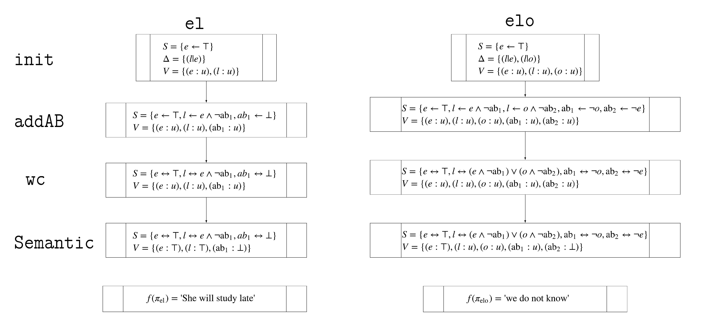
A possible SCP

Slide 20
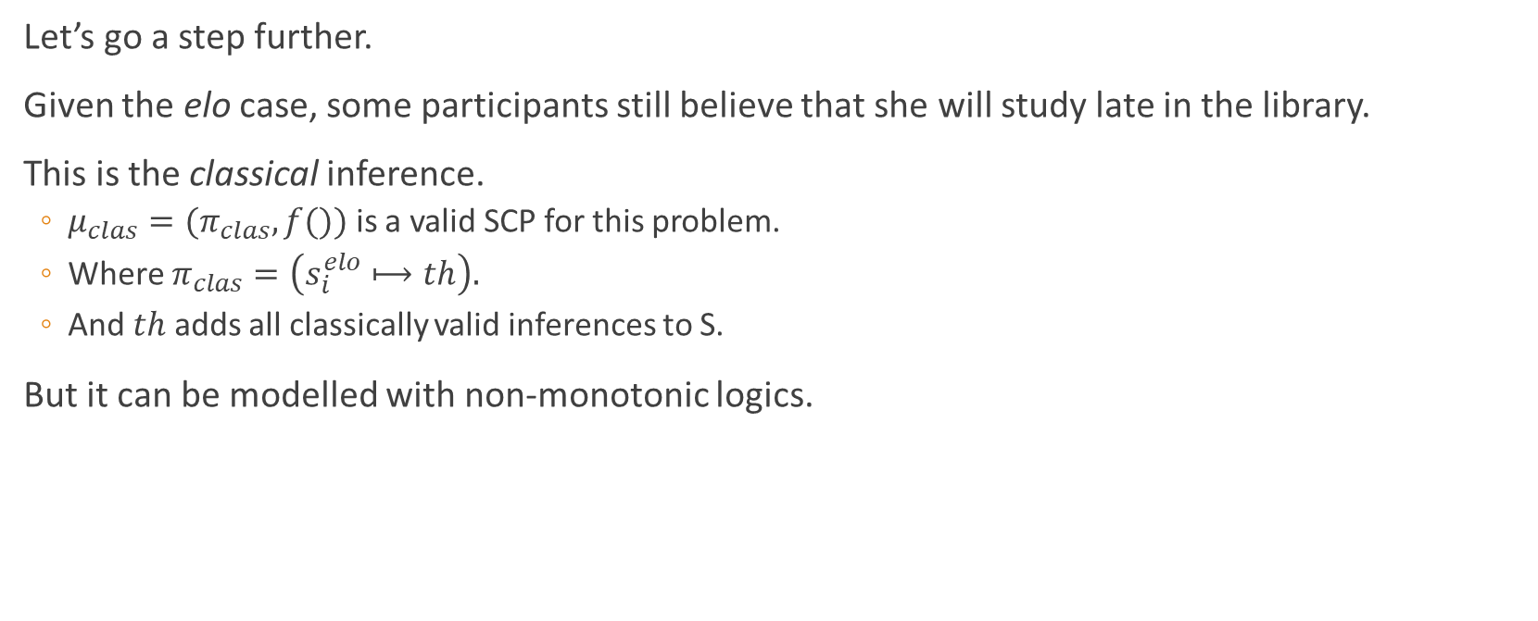
Modelling Individual Cases
Let’s go a step further.
Given the elo case, some participants still believe that she will study late in the library.
This is the classical inference.
$μ_{clas}=(π_{clas},f())$ is a valid SCP for this problem.
Where $π_{clas}=\left(s_{i}^{elo}⟼th\right).$
And $th$ adds all classically valid inferences to S.
But it can be modelled with non-monotonic logics.

Slide 21
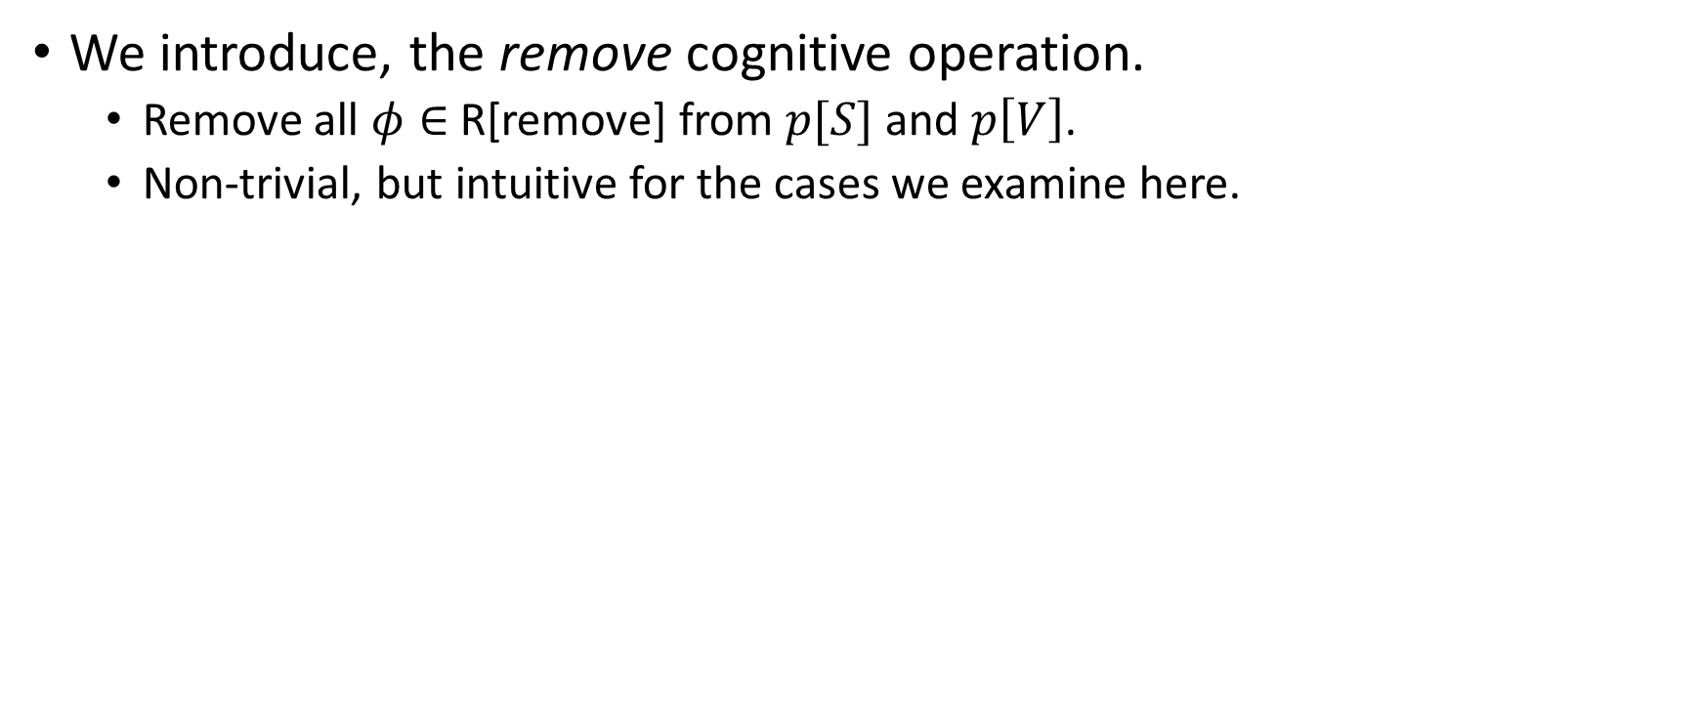
The Remove Operation
We introduce, the remove cognitive operation.
Remove all $φ∈$ R[remove] from $p[S]$ and $p\left[V\right]$.
Non-trivial, but intuitive for the cases we examine here.

Slide 22
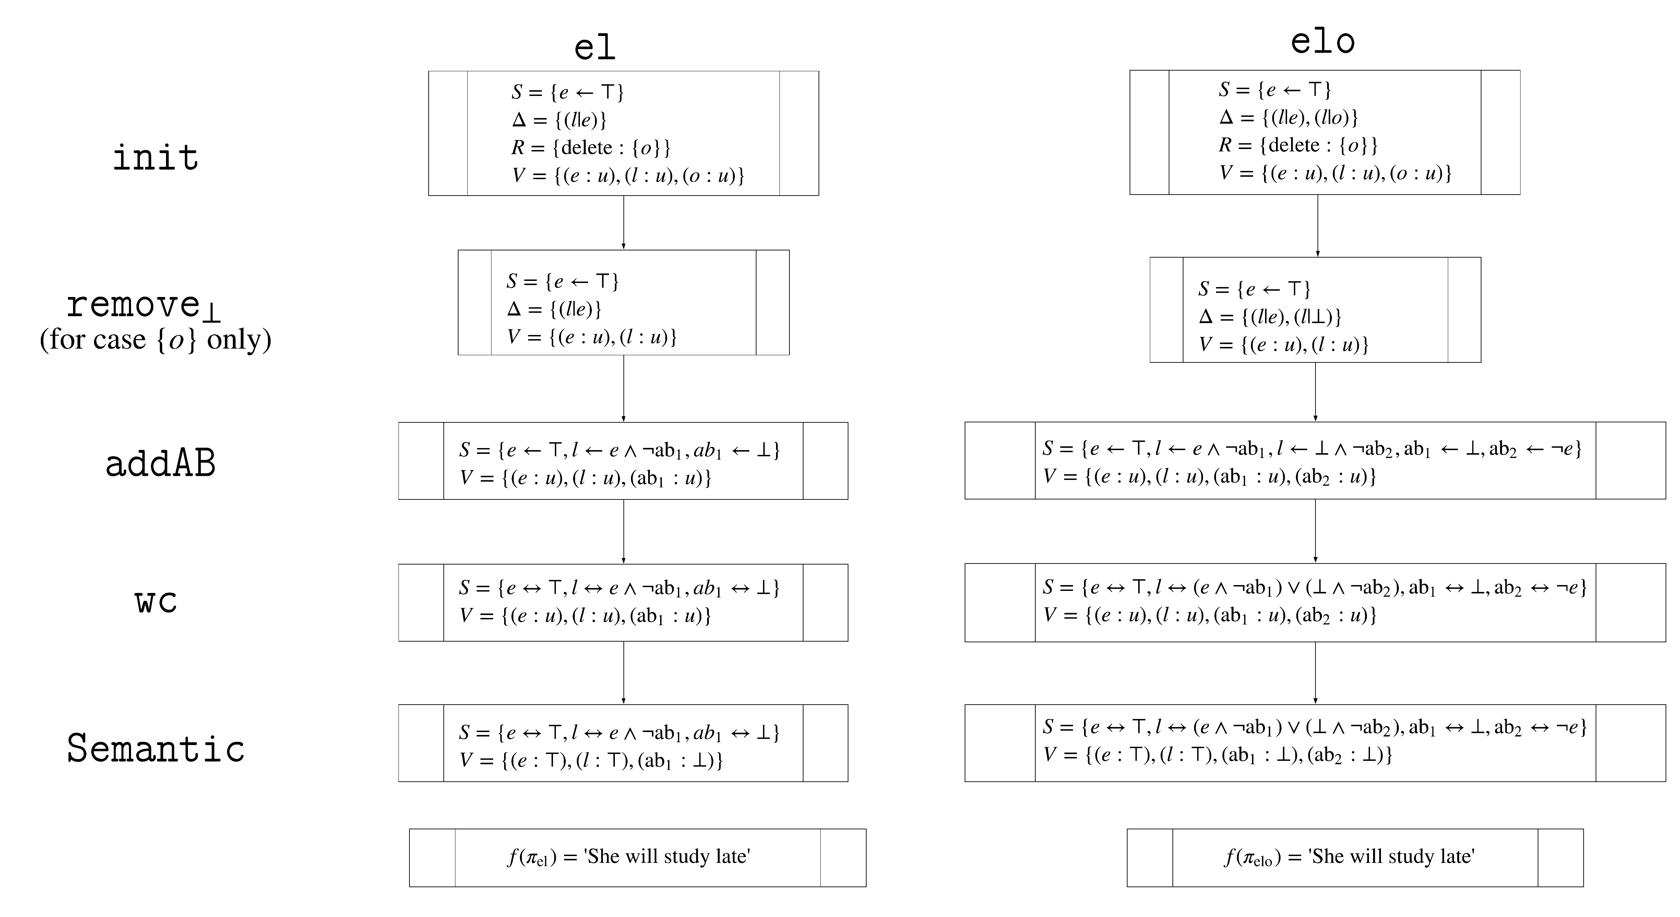

Slide 23
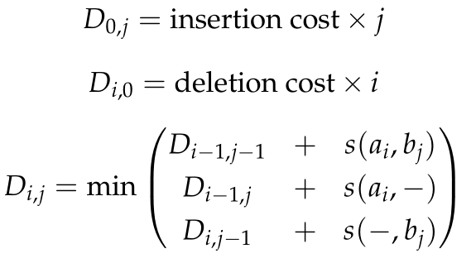
Comparing SCPs
It is possible to compare SCPs.
Assumption of common origin.
Needleman Wunsch Algorithm.
Simple string-matching.
Application in bioinformatics.

Slide 24
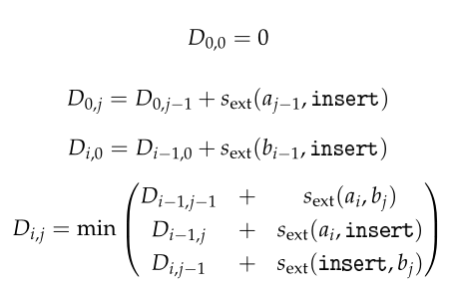
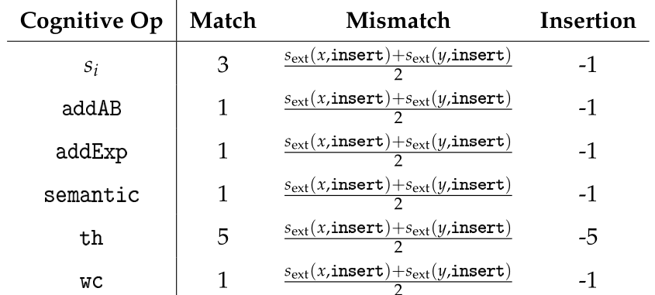

Extending Needleman Wunsch
We can apply the NW algorithm to SCPs.
Cognitive operations which occur across tasks are identical.
Match/Mismatch on a per operation basis.
$$delete$$

Slide 25
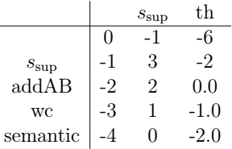
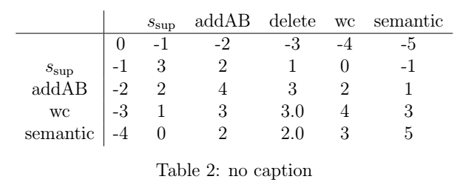
Alignment
Low similarity
Preferred

Slide 26
SCP Strengths and Weaknesses
Strengths | Weaknesses
Simplicity. | No infinite loops.
Adaptability. | Potentially high branching factor.
Can encode other logical frameworks. | Justifiability of chained cognitive operations.
Experimental evidence.
Searchability.
Extendability.
Can find preferred models.

Slide 27
Applications
Experimental
Model existing empirical data.
Predict new results.
Practical
Extensible set of tools for researchers.
Inter-model comparisons to find common motifs in human defeasible reasoning.
Existing implementation can be used and adapted to suit researchers.

Slide 28
Conclusion
SCPs are a powerful tool for modelling human reasoning.
Able to simulate and extend existing non-monotonic logics.
Allow plausibility comparisons.
Allow for problem-solving through search.
My thesis answered the question:
“Is there a way to systematically represent some (or all) non-monotonic logics in a framework that standardizes cognitive modelling under these logics without sacrificing their expressiveness?”
And the answer seems to be yes.

Slide 29
Thank You.

Slide 30
Appendix

Slide 31
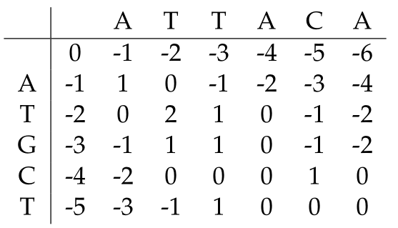
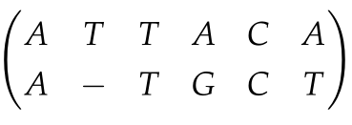
Optimum Alignment:

