Slide 1
fiskaltrust.Middleware
Technical introduction for POS Creators

Slide 2


Agenda
Operation, functionality & configuration
Interface, data flow & failure scenarios
More configuration examples
Phases of integration
Tools to support integration & rollout
Getting started, documentation & support
Q&A
Feedback

Slide 3
Introduction
Overview

Slide 4
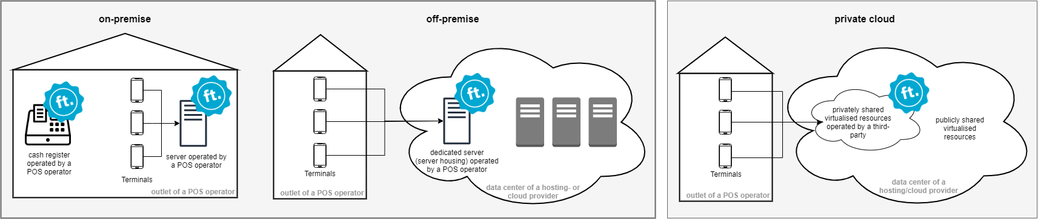
Operation of the fiskaltrust.Middleware
In Germany, the fiskaltrust.Middleware must always be operated as a local component of the electronic recording system:
Notes:
In Germany, the fiskaltrust.Middleware must always be operated as a local component of the electronic recording system. That means: in most cases, the fiskaltrust.Middleware is used at the checkout itself. The fiskaltrust.Middleware must be operated on a local server in a network if the electronic recording system is also operated on this and the data of the business transactions are recorded and transmitted with input stations' help. If the cash register runs in a data center, the fiskaltrust.Middleware must be operated in the same data center. The functionality is always the same regardless of the operating environment.

Slide 5
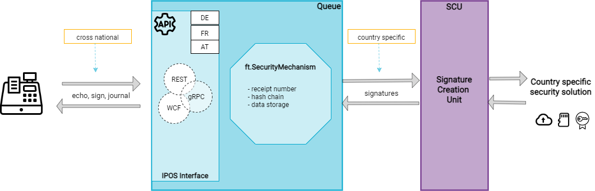
Components
Notes:
The cash register communicates with the Queue (component of the ft.Middleware) via the IPOS interface.
The IPOS interface is identical for all supported countries (cross national).
The iPOS Interface offers 3 interface methods: echo (check availability), sign (sign receipt data, send special receipts), journal (export data)
The iPOS Interface is accessible via REST, gRPC, WCF.
The requests are processed in the ft.SecurityMechanism. This mechanism takes care of the creation of the unique, consecutive receipt number, the chaining and the persistence of the data.
The Signature Creation Unit (SCU) handles the country-specific implementation of the security solution (Signature Devices, SCD, which are provided mostly by 3rd party vendors) and is responsible for the signatures (e.g. in Germany with the help of a certified TSE of your choice)

Slide 6
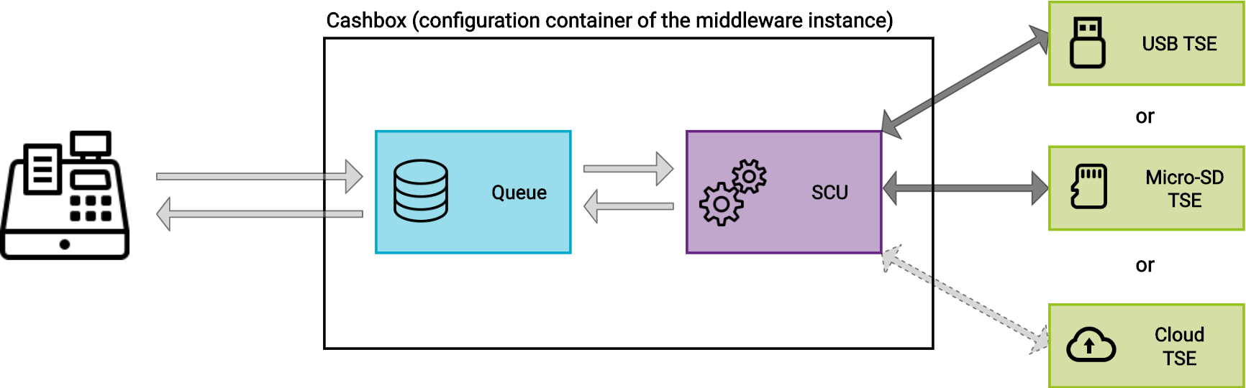
Configuration of a middleware instance (Cashbox)
Notes:
The configuration of a middleware instance is done via a so-called cashbox in the portal.
The cashbox is a configuration container that contains the configuration of the individual components of the ft.Middleware. These configurations can be connected to each other via the cashbox. The cashbox can contain the configuration of the queue, SCU and various helpers and connect them with each other.
The queue is a component of the ft.Middleware that collects the receipt requests and is responsible for creating and persisting the receipt request chain. The queue is the component of the ft.Middleware with which your POS System communicates. You send your receipt data via a request to it and receive signatures and other data back.
The SCU (Security Creation Unit) is a component of the ft.Middleware that is responsible for signatures. In Germany, it takes over the communication with the TSE, which finally carries out the signing. Depending on which TSE you want to use, the SCU needs a corresponding configuration to access it.
The cashbox contains the required configurations and connects them together. Each middleware instance needs a cashbox to be able to start operating.

Slide 7
Interface & data flow
The echo method

Slide 8
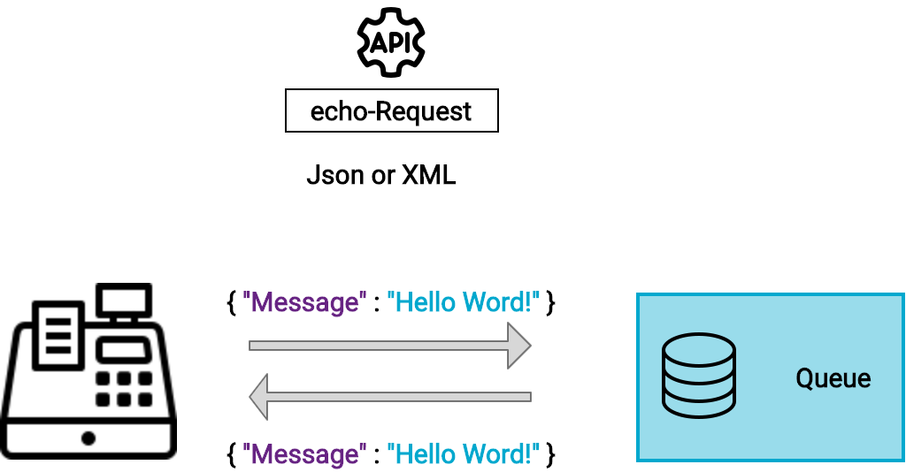
Echo
Notes:
Explanation of the echo method of the IPOS interface.
The POS system sends a message formatted with XML or JSON as a request to the Queue via the echo method of the IPOS Interface. If the Queue is reachable, it sends the same message back in the response.

Slide 9
Interface & data flow
The sign method including special receipts and failure scenarios

Slide 10
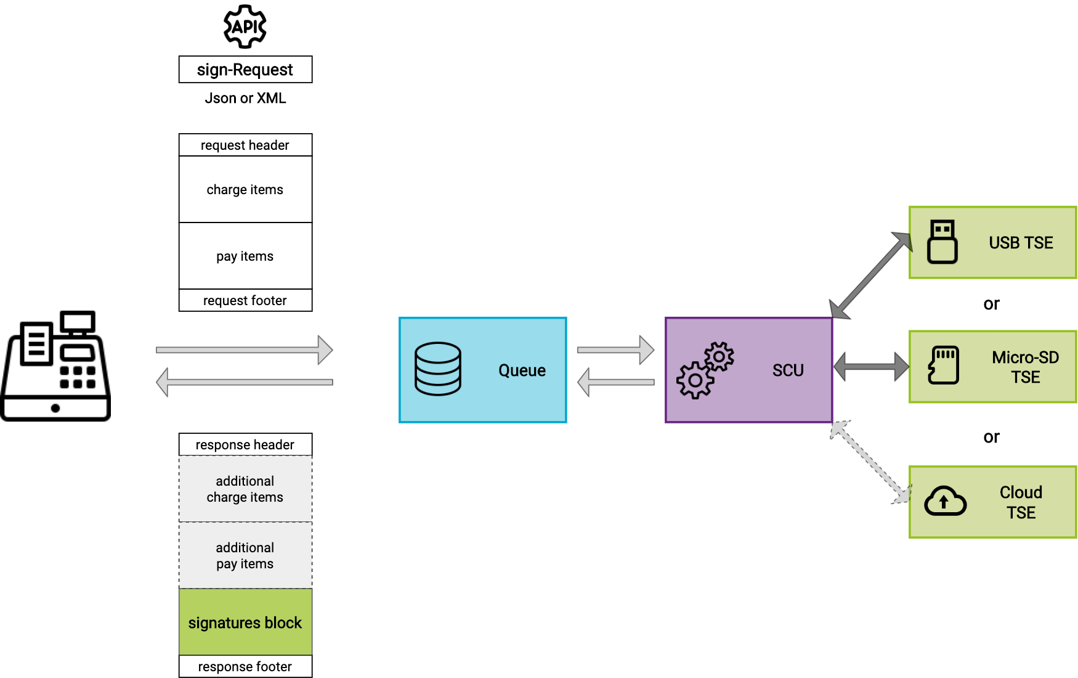
Sign
Notes:
Explanation of the sign method of the IPOS interface.
The POS system sends data formatted with XML or JSON to the Queue via the sign method of the IPOS interface.
The request data is divided into 4 blocks: request header data, catch items, pay items, and request footer data.
Example request header data: identification number of the POS System, identification number of the used terminal, reference number of the request, etc.
Example charge item: 1 beer, 19% VAT - quantity, amount, charge item case (delivery normal, 19%), moment of order, etc.
Example pay item: amount, pay item case (cash payment), moment of payment, etc.
Example request footer data: username, receipt case (e.g. "pos-receipt" or "zero-receipt"), reference to the previous - related receipt (e.g. in case of cancellation), additional individual data, etc.
The middleware processes the data and sends response data back to the POS System. The most important block in the response is the ”signatures" block. The data contained here must be printed on the receipt to ensure compliance.
The charge and pay item blocks initially sent to the Queue are not returned in the response! Optionally, only additional charge and pay item blocks may be returned (but this functionality is currently not used).
Example response header data: identification of the processing chain (queue), identification number of the used terminal, reference number of the request, moment of processing by the Queue, and so on
Example signatures: QR code, TSE process-type, TSE process-data, transaction number, signature counter, cash register serial number etc. (the QR code is optional, all other data must be printed on the receipt)
Example response footer data: status (status, e.g. ok or TSE not reachable, etc.), detailed data on the status (error message, info, etc.)

Slide 11
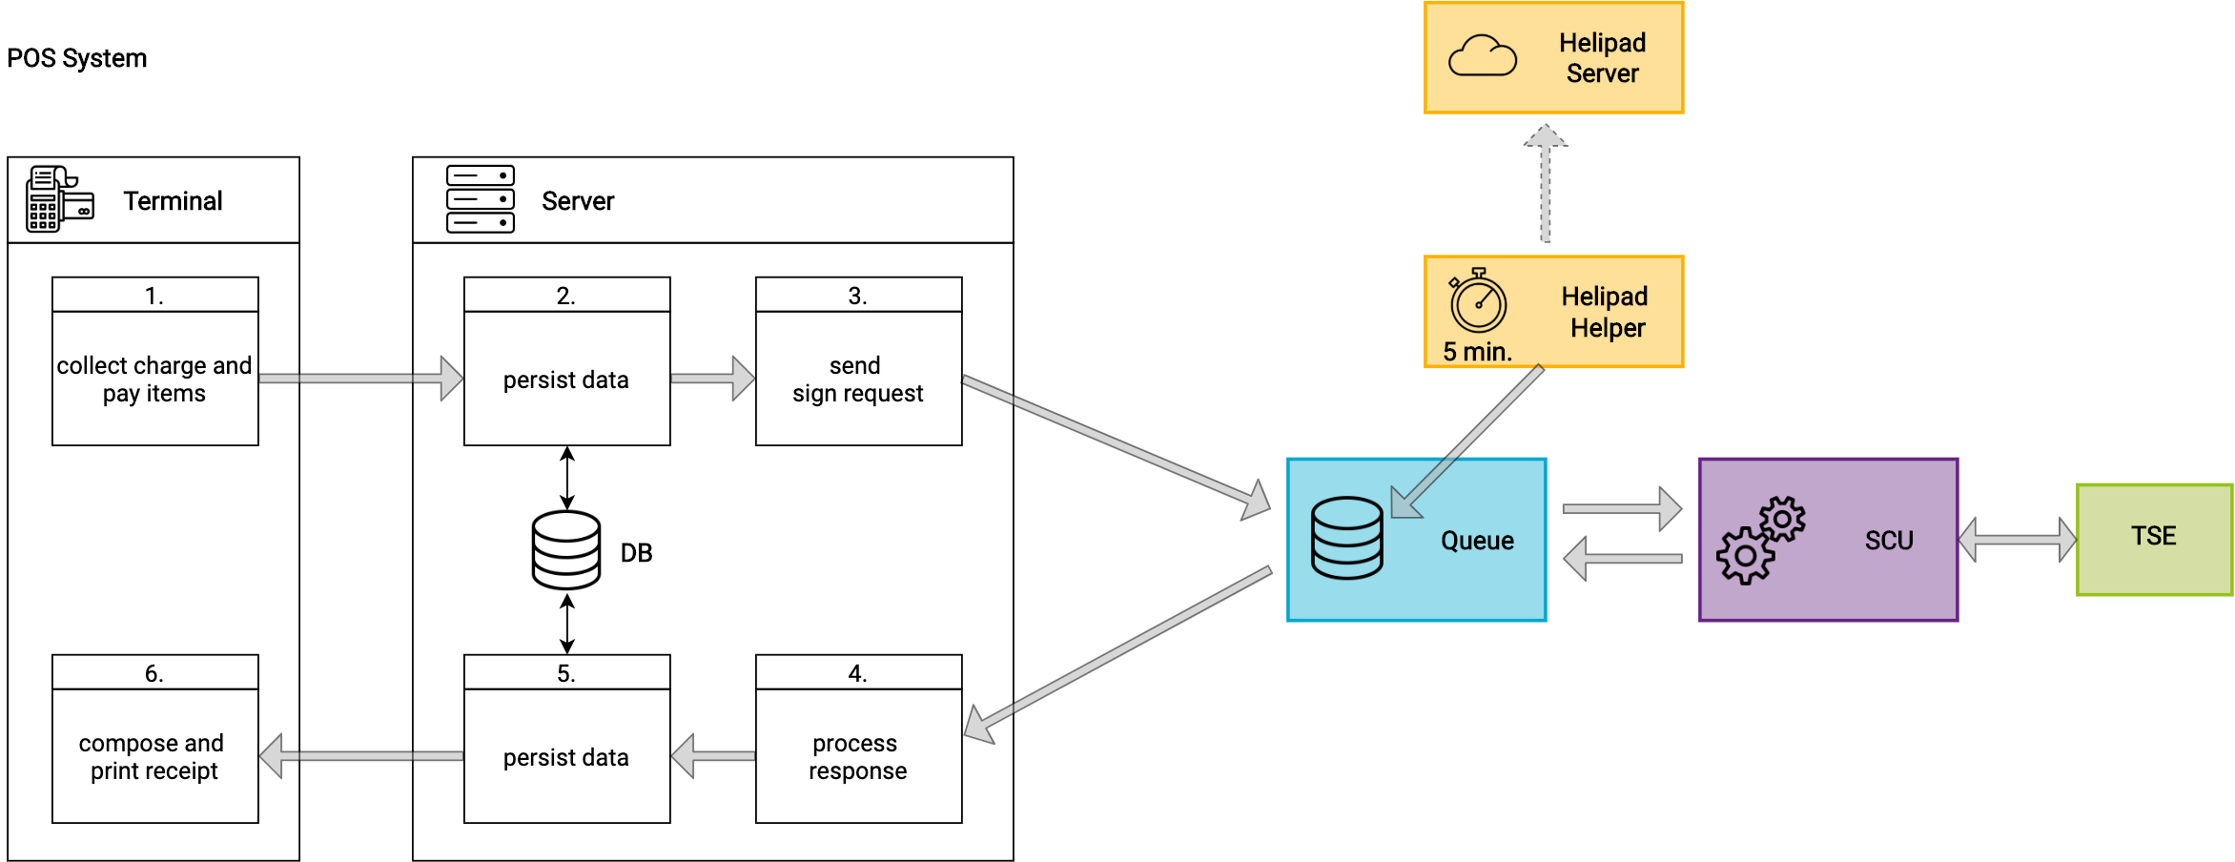
Sign data flow
Notes:
The Terminal of the POS System collects the charge and pay items for the request.
The Server of the POS System should persist the data locally. Data persistence is important because the request data is not returned by the Queue. Local archiving is also essential if fiskaltrust archiving is not available.
The Server of the POS System builds the request and sends the data to the sign method provided by the Queue. The ft.Middleware processes the received data and is taking care of chaining, persisting, signing and archiving the data.
The Server of the POS System receives the response and processes the data it contains.
The received data is persisted locally by the Server of the POS System (see also point 2)
The receipt is composed and printed by the Terminal (it contains the data from the signature block of the response)

Slide 12
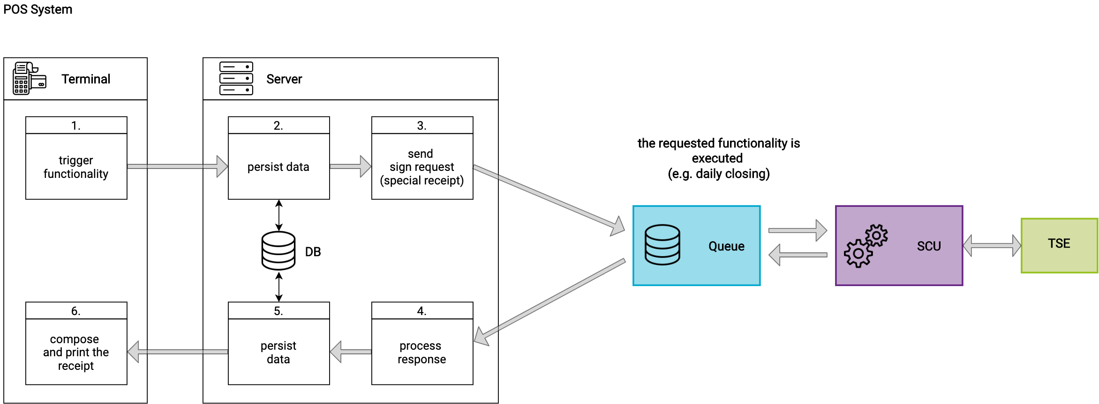
Sign data flow: special receipts (execution of functionality: zero receipt, initial operation receipt, daily closing…)
Notes:
Special receipt requests execute functionality. For example, the initialization of the TSE, daily closing closing, monthly closing, and so on.
The Terminal of the POS System triggers the functionality to be executed.
The Server of the POS System persists the data locally.
The Server of the POS system composes the request (setting the special receipt case - depending on the functionality to be executed) and sends the data to the sign method of the Queue. The ft.Middleware then executes the requested functionality
The Server of the POS system receives the response and processes the data it contains
The received data is persisted locally by the Server of the POS System
The receipt is composed and printed by the Terminal (it contains data from the signature block of the response)

Slide 13
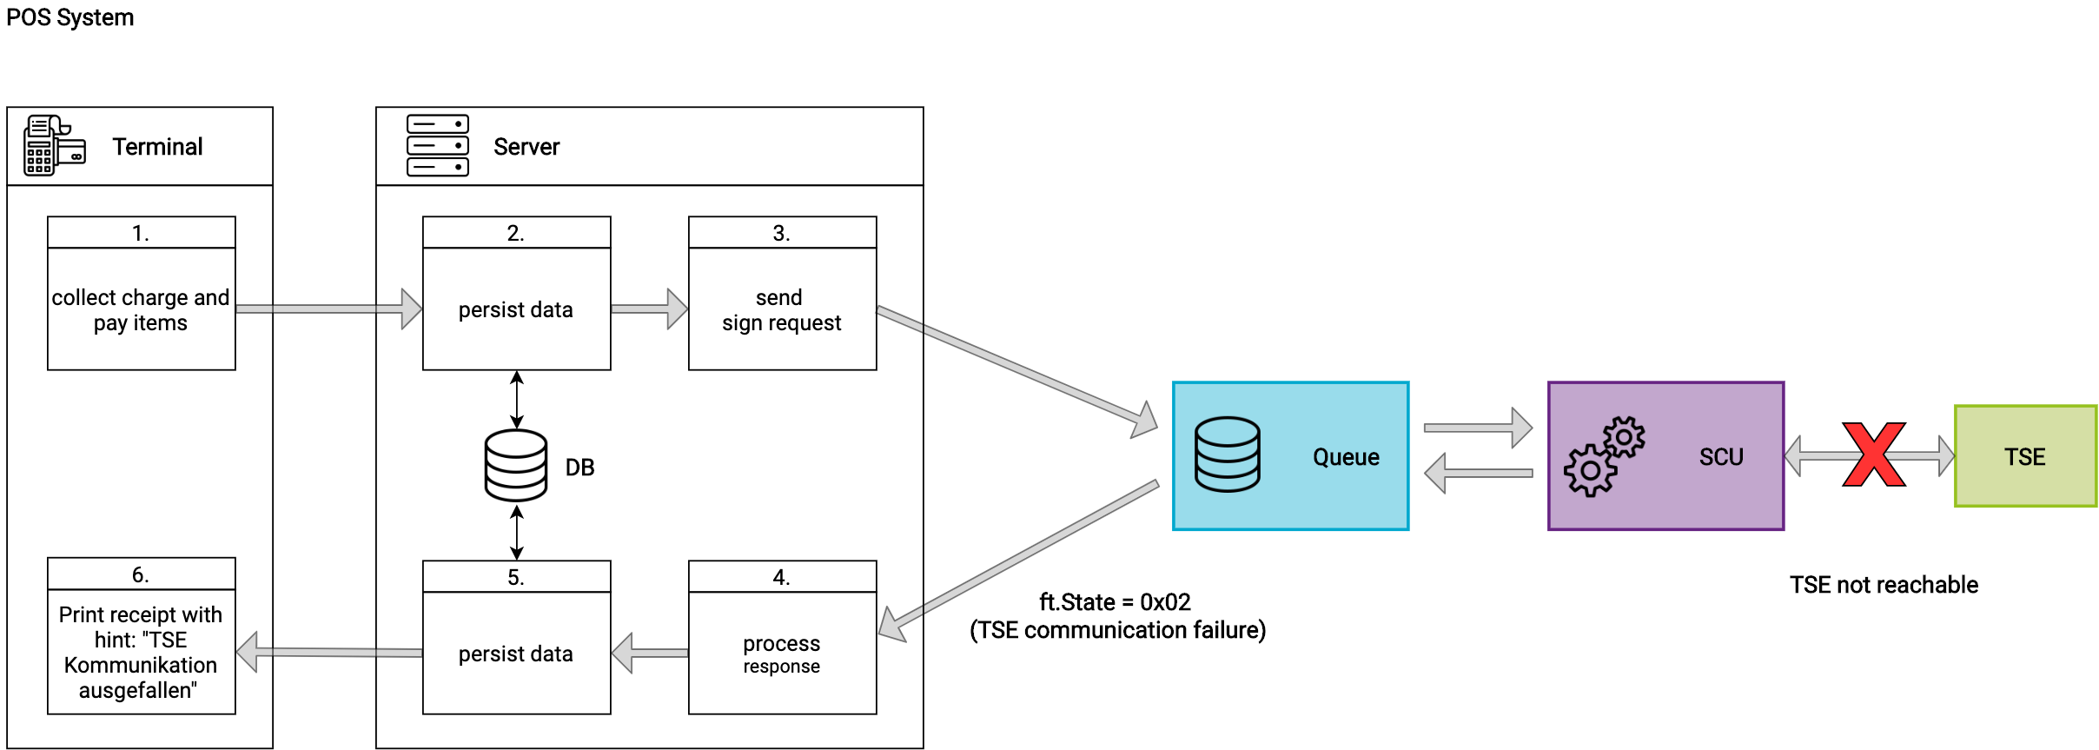
Sign data flow: failure scenario (TSE not reachable)
Notes:
If the communication with the TSE fails, the POS System can continue to operate until the TSE is accessible again. In this case, the POS System continues to send requests to the Queue as usual.
The Terminal of the POS System collects the charge and pay items for the request.
The Server of the POS System should persist the data locally. Data persistence is important because the request data is not returned by the ft.Middleware. Local archiving is also essential if fiskaltrust archiving is not available.
The Server of the POS System builds the request and sends the data to the sign method provided by the Queue. Because the TSE can not be reached, the Queue sends back the ft.Status = 0x02 (error: TSE communication failure).
The POS System receives the response and processes the data it contains.
The received data is persisted locally by the POS System
The receipt is created and printed by the Terminal (it contains the data from the signature block of the response including the note that the TSE communication has failed)
Important:
If communication with the TSE cannot be re-established, for example because the TSE is broken or has been stolen, the incident must be documented and a new setup with a new TSE must be set up. The ft.Middleware must be reconfigured and rolled out via the portal. A corresponding report to the tax authorities must be made.

Slide 14
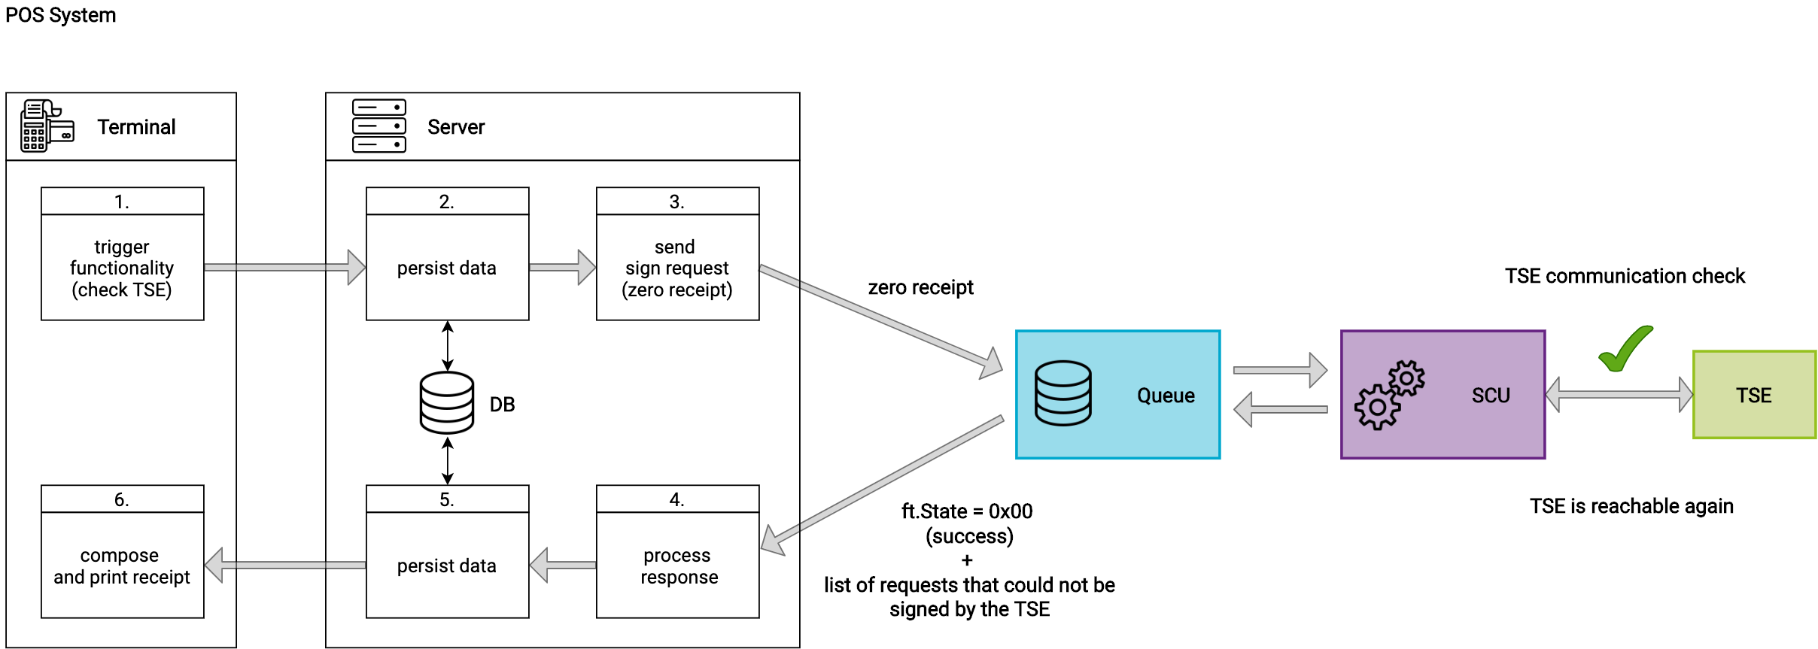
Sign data flow: failure scenario (TSE is reachable again)
Notes:
As soon as the TSE is reachable again, the POS System has to send a zero receipt to the Queue. This is important because the ft.Middleware does not itself try to find out whether the TSE is reachable again, so as not to disturb the operative business by timeouts. If a zero receipt is sent to the Queue, the SCU will try to restore the communication with the TSE. If the communication still fails, the ftState = 0x02 (TSE communication failed) is still returned in the response. If the communication works again, the ftState = 0x00 (ok) is returned to the POS system via the response and the ft.Middleware is ready for normal operation again. Furthermore, the response contains a listing of the requests that were not signed by the TSE. The requests affected by the failure of the communication with the TSE do not have to be sent to the Queue again after the problem has been resolved.

Slide 15
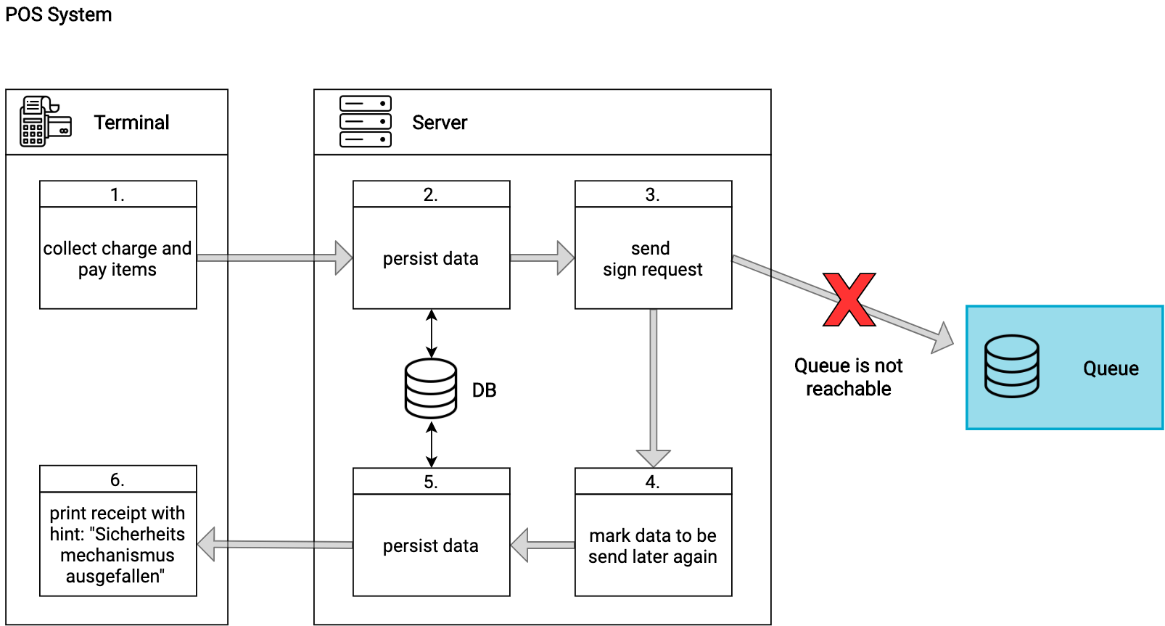
Sign data flow: failure case (ft.Middleware is not reachable)
Notes:
For the case that the Queue is not reachable:
4. The requests are marked by the Server of the POS System to be sent later again to the Queue
5. The printed receipt must contain the hint that the security mechanism is not reachable

Slide 16

Sign data flow: failure scenario (ft.Middleware is reachable again)
Notes:
At a later point in time, when the Queue is reachable again, the POS System sends the requests previously marked for repetition to the middleware in the so-called “late signing mode". Each request is marked with a flag (ftReceiptCase + "failed receipt" flag - 0x000000000000010000).
As soon as the middleware receives the first marked request, it switches to the “late signing mode". The POS System can now send further requests in this mode. The Queue answers with the ftState 0x08 which means that it is in “late signing mode". To leave the “late signing mode" the POS System must send a zero receipt to the Queue (see next slide)

Slide 17

Sign data flow: failure scenario (ft.Middleware – end late signing mode)
Notes:
To end the “late signing mode", the POS System must send a zero receipt to the Queue. The Queue responds with the ftState = 0x00, which means that it has left the “late signing mode" and is available for normal operation.

Slide 18
Interface & data flow
The journal method

Slide 19
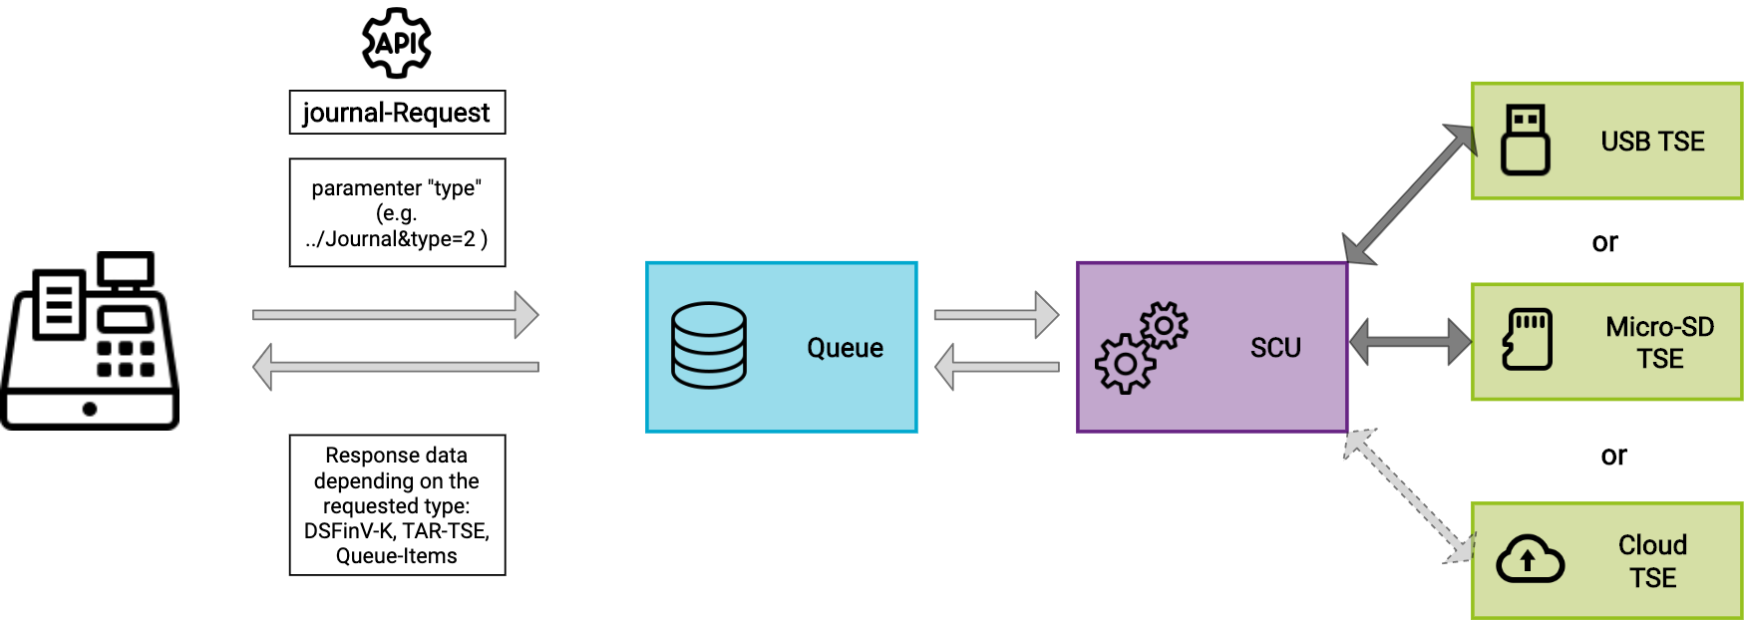
Journal
Notes:
Explanation of the journal method of the IPOS Interface.
The POS System calls the journal method with the parameter "type". Depending on the passed value, the requested data is returned. Via WCF the data is returned as stream.
Types are country specific. Examples for Germany:
1 = TAR file from TSE
2 = DSFinV-K-File

Slide 20
Operation, configuration & configuration examples

Slide 21
Configuration examples for Germany
Documentation on docs.fiskaltrust.cloud
Notes:
Rollout-Szenarien-Planung | fiskaltrust Documentation Platform

Slide 22
Phases of integration
Recommendation

Slide 23
Phases of integration (recommendation)
Connecting to the local fiskaltrust.Middleware
Sending of data and processing of responses (pos receipt, zero receipt, own business cases, cash balance, daily closing, etc.)
Invitation of the POS Dealers, prepare rollout/templating
Implementation of missing, complex business cases
Pilot installation in collaboration with selected POS Dealers
Handover for rollout to your POS Dealers

Slide 24
Tools to support integration & rollout

Slide 25
The portal as support for POS Creators
Registration of your POS system
Configuration and testing of your Middleware integration
Link your POS Dealers with your POS system
Preparation of the rollout with the help of templates for your POS Dealers

Slide 26
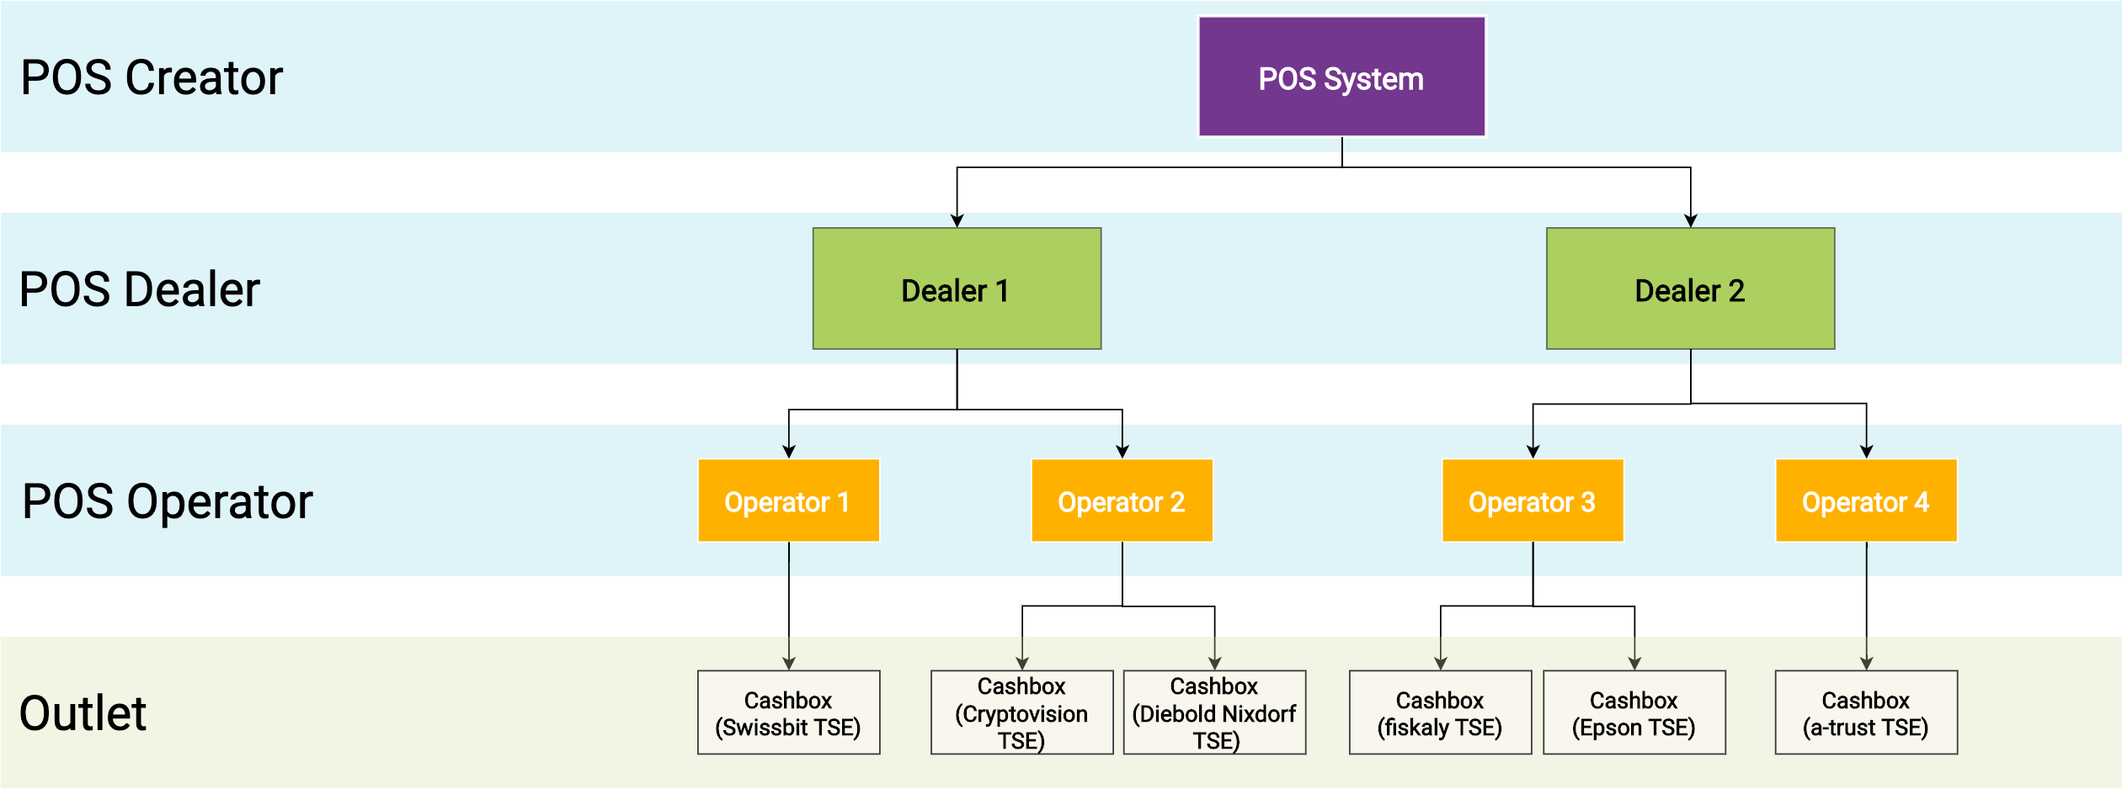
The portal as rollout management tool (role structure)

Slide 27
Das Portal als Rollout-Managementtool (Einladungsprozess)
Creator
Invites POS Dealers to the portal (via POS System)
Dealer
Receives an email with the signed operator-contract
Operator
Gives dealer authorisation for contract signing & access to operator account
Dealer
Creates portal-account
Signs POS Dealer contract
Signs POS Creator contract
Registers POS System
Links with POS system of POS Creator
Operator-accounts are created & contracts are signed automatically
Imports CSV file with master data of operators
Operator

Slide 28
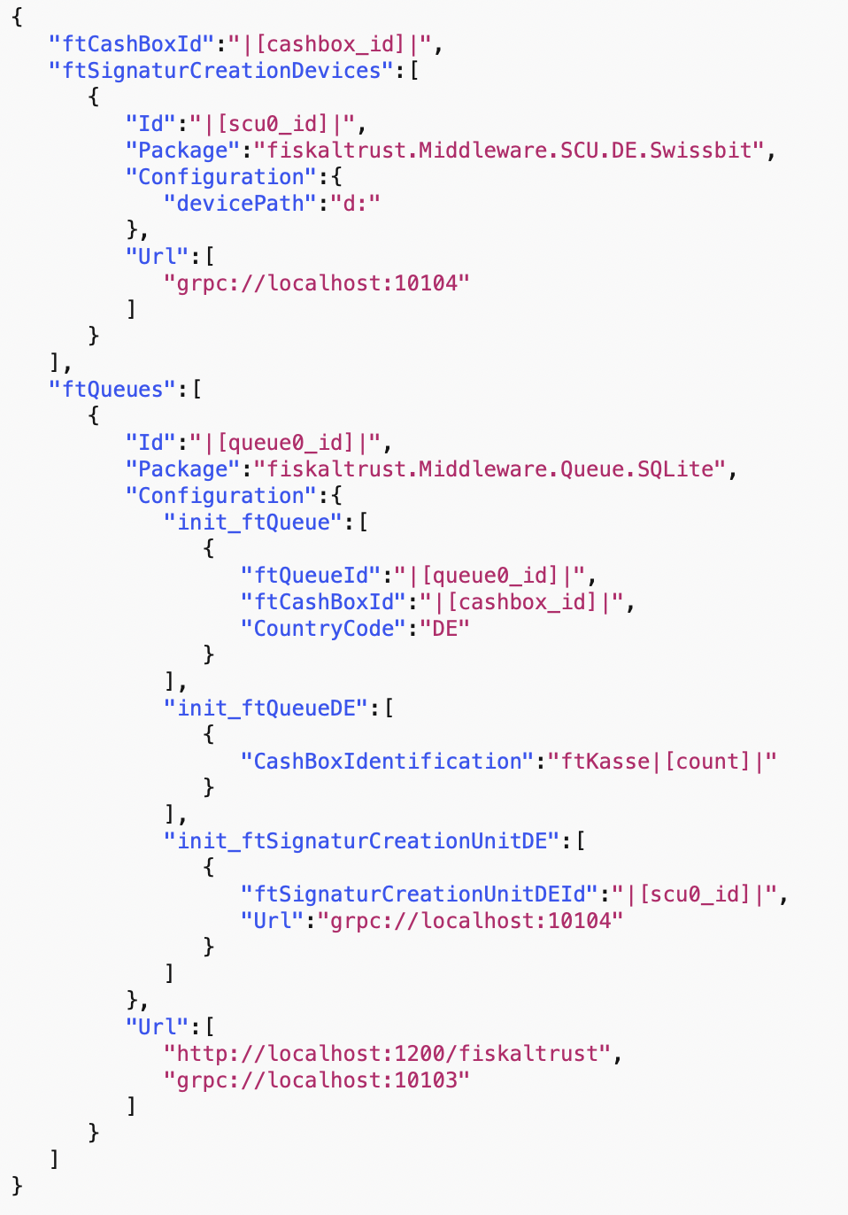

Example of a configuration template
Use of variables (e.g.| [cashbox_id]|)
TSE package
Path to the TSE
Endpoint of the SCU
Example: Configuration of the Queue
Persistence
Cash register serial number/TSE Client-Id
Link to SCU
Endpoint of the Queue
Notes:
The variables are automatically filled by the fiskaltrust.Portal when the template is checked out in the operator‘s fiskaltrust.Shop

Slide 29
The portal as a rollout management tool (rollout execution with template)
Manual with the fiskaltrust.Portal
Add in fiskaltrust.Portal
Checkout in fiskaltrust.Shop
Automated via API
Notes:
https://docs.fiskaltrust.cloud/doc/productdescription-de-doc/for-posdealers/02-pre-sales/automatisierter-rollout.html

Slide 30
Getting started, documentation & support

Slide 31
Getting started & documentation
https://docs.fiskaltrust.cloud
Notes:
Getting-started Guide Produktbeschreibung (Deutschland) Schnittstellenbeschreibung Release Notes Postman-Collection Middleware-Demos

Slide 32
Support-Flow
Register in production-portal: https://portal.fiskaltrust.de
Send an email to support@fiskaltrust.de. It will be answered by the support team.
For complex cases, the ticket will be created, assigned to and answered by the appropriate, specialized team.
Notes:
Wenn die Dokumentationsplattform das Problem nicht beantworten kann.

Slide 33
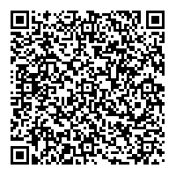
Webinar – Q&A Session
Get fast answers if they don’t need detailed analysis from our side
Every second Thursday from 12:00-12:30

Slide 34
Thank you very much for your attention!
Feedback

Slide 35
Q&A

Slide 36
















Return of time invested
Excellent. A really useful onboarding that worth more than the time spent on it. High value. | Above Average. I gained more than the time spent. Good value. | Average. I gained enough to justify the time spent on. I have not lost my time, no more. Value. | Useful, but it wasn’t worth 100% of the time spent on it. So I lost time. Little value. | Useless. I gained nothing. I really lost 2 hours! No value at all!

