Slide 1
If I WERE You app
DHBW Software Engineering Project 2014

Slide 2
Agenda
Vision
Software Requirements Specification
Use Cases
Project Management
RUP
Scrum
Architecture
Version Control
Functional Testing
Change Management
Live Demo

Slide 3

Vision

Slide 4
Software Requirement Specification
Functional Requirements
Use Cases
Non-functional requirements
Usability
Reliability
Definition of technology to be used
→ Provide developers with detailed information about project
→ Make it easy to check if every requirement has been implemented at the end of the project

Slide 5
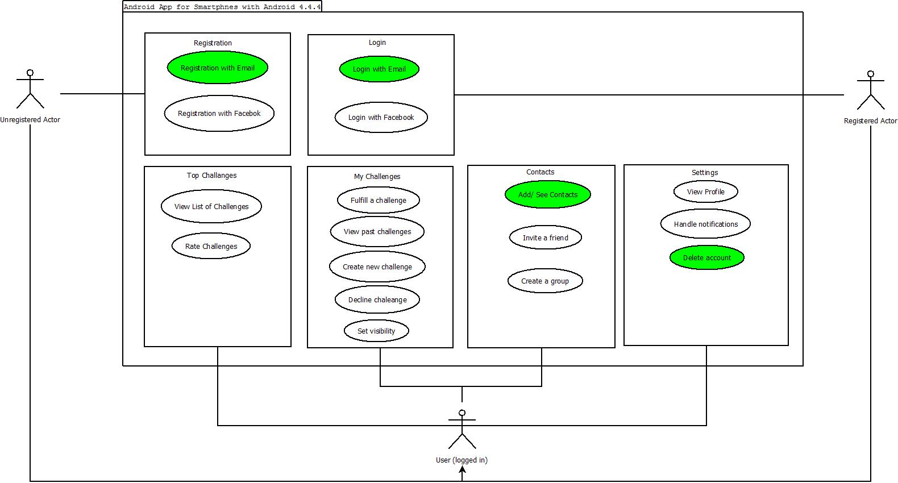
Overall Use Case Diagram

Slide 6
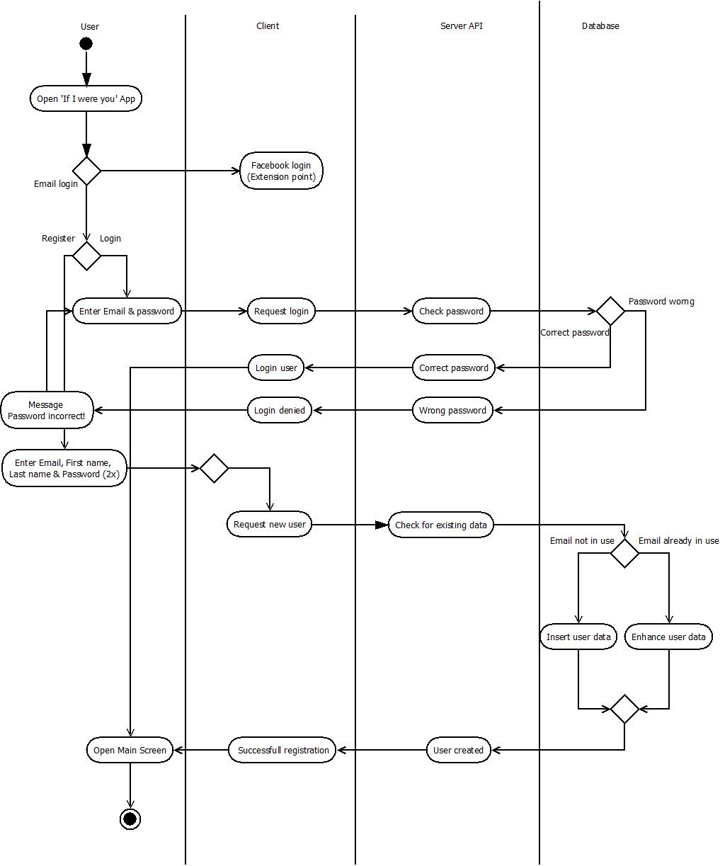
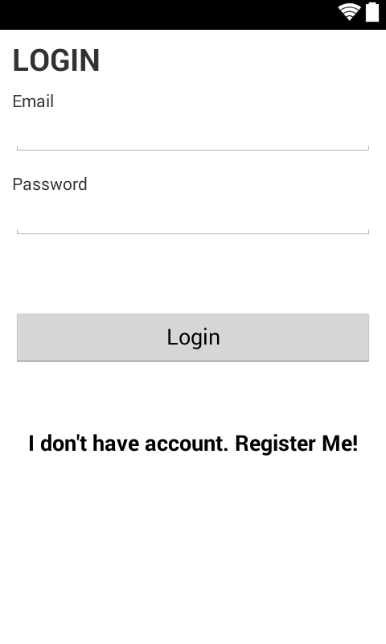
Example Use Case

Slide 7
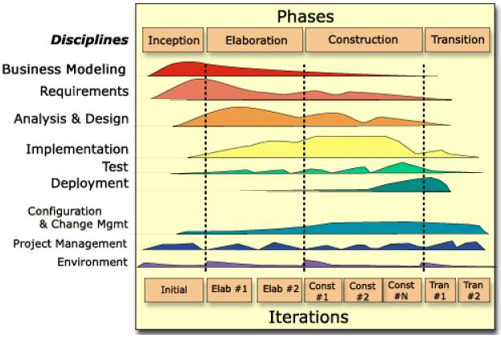
Project Management - RUP

Slide 8
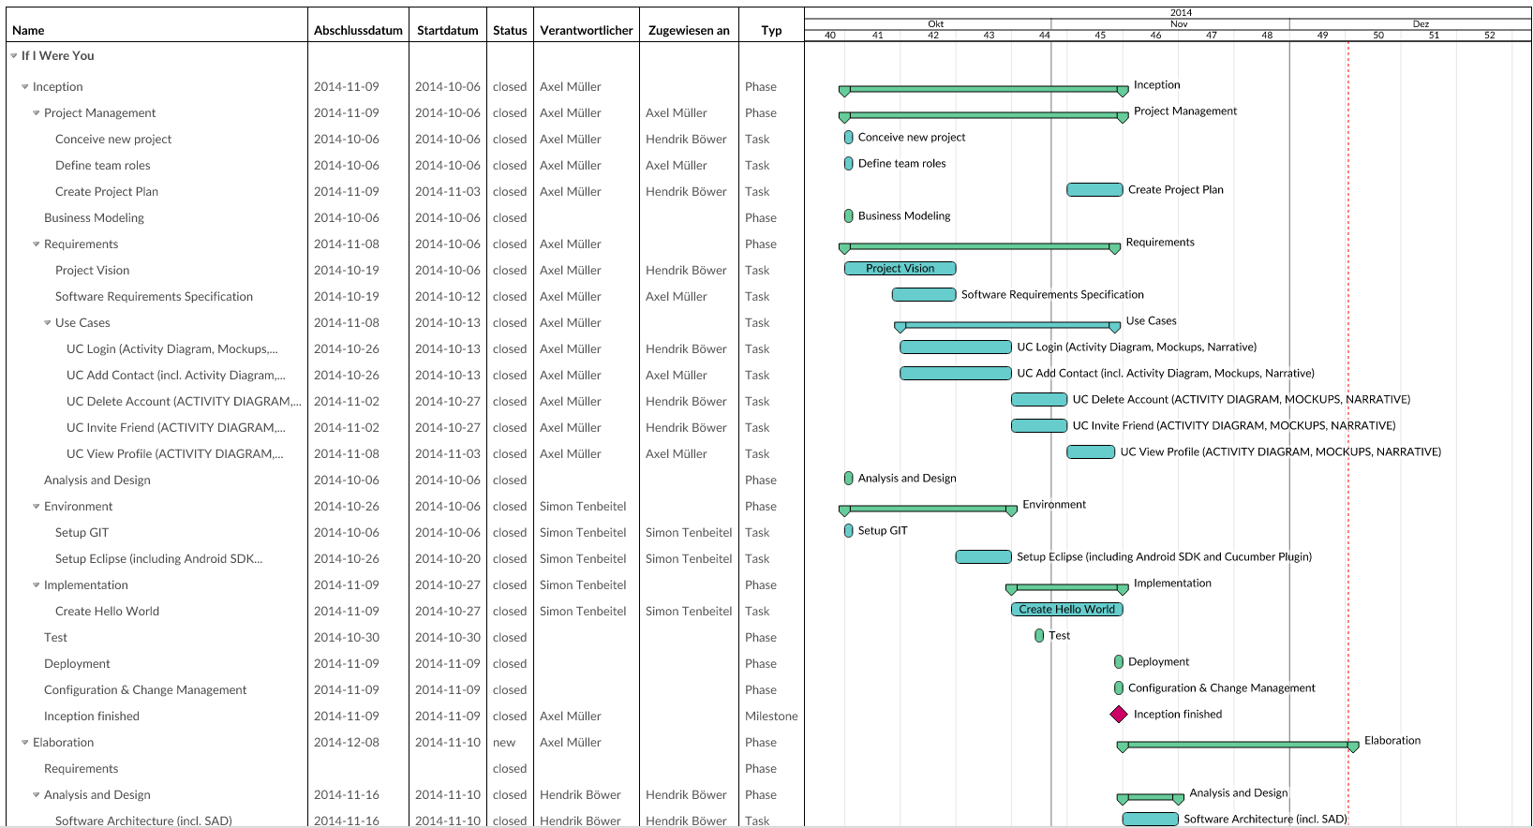
Project Management - GANTT

Slide 9
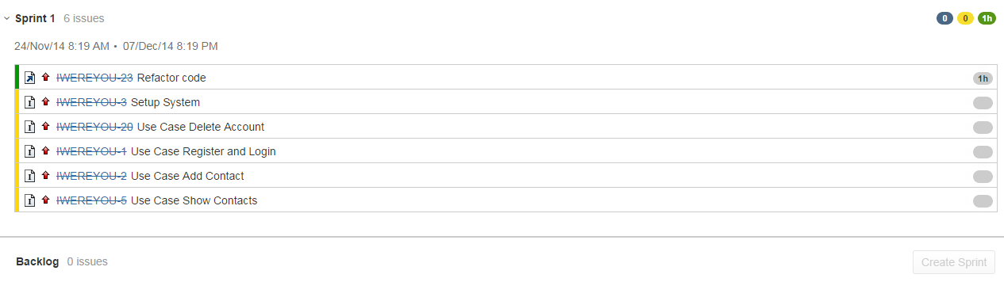
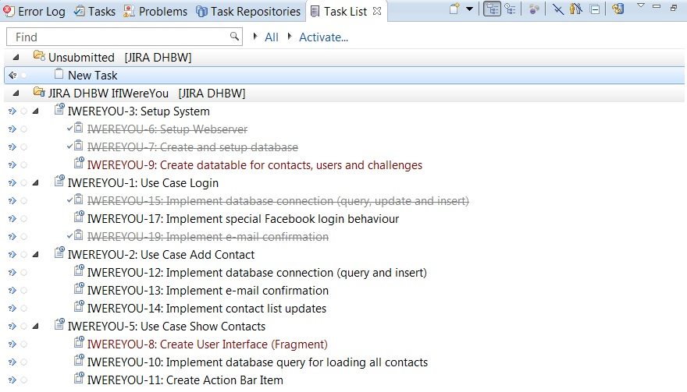
Project Management - SCRUM

Slide 10
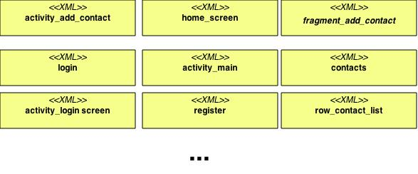
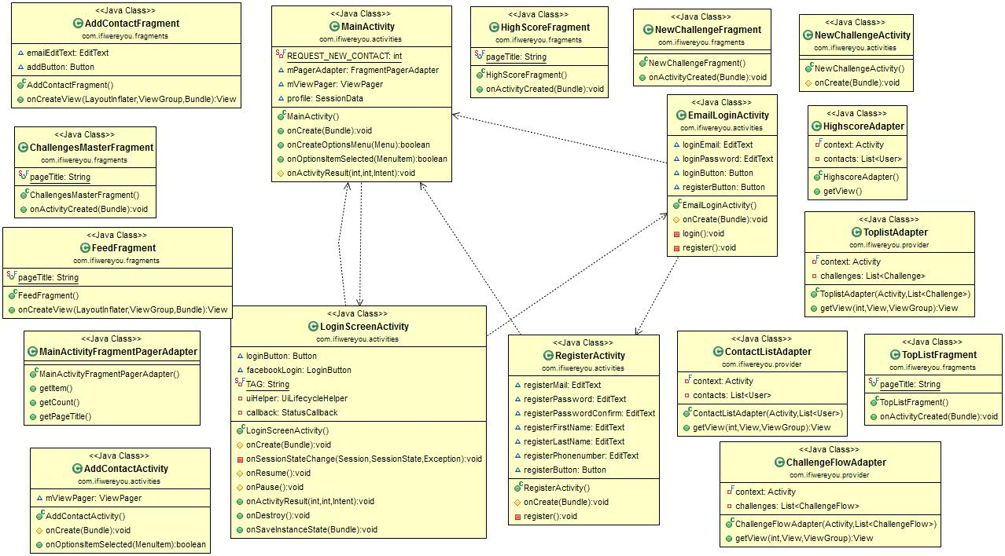
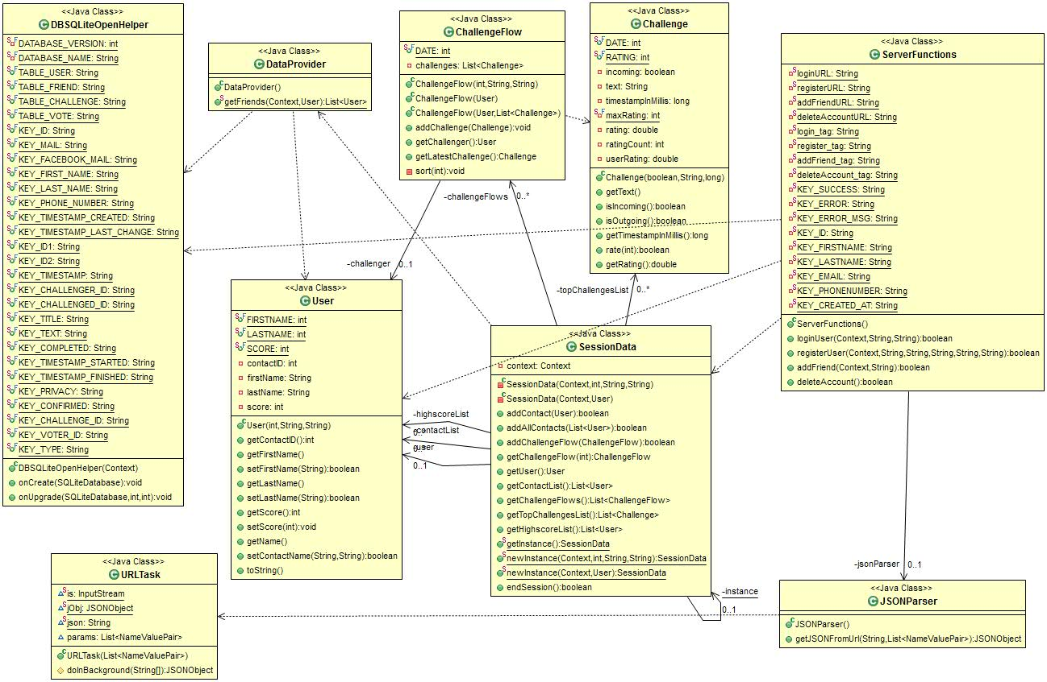
Architecture - MVC

Slide 11
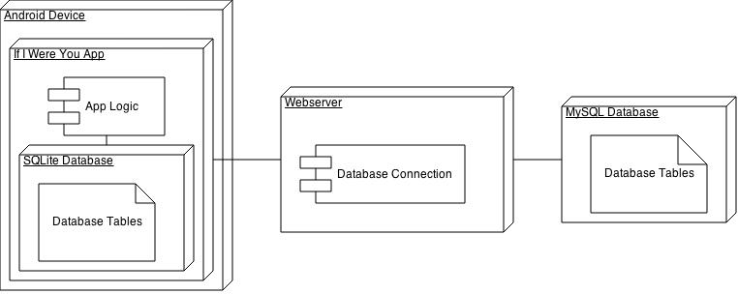
Architecture – Deployment Diagram

Slide 12
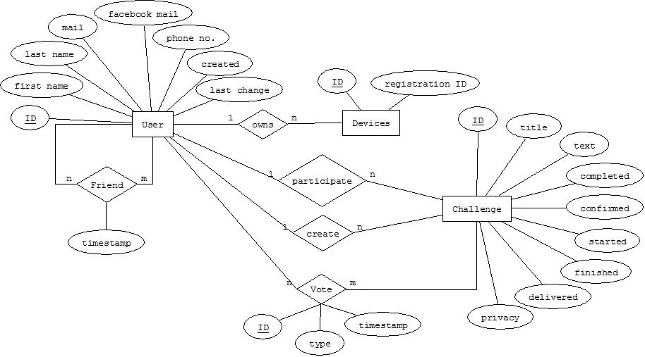
Architecture – Database

Slide 13
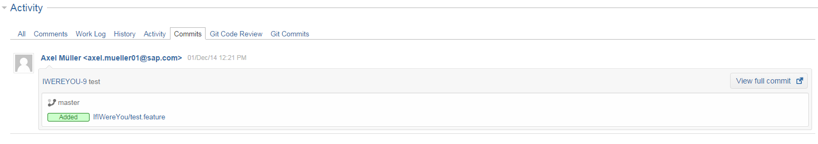

Version Control

Slide 14
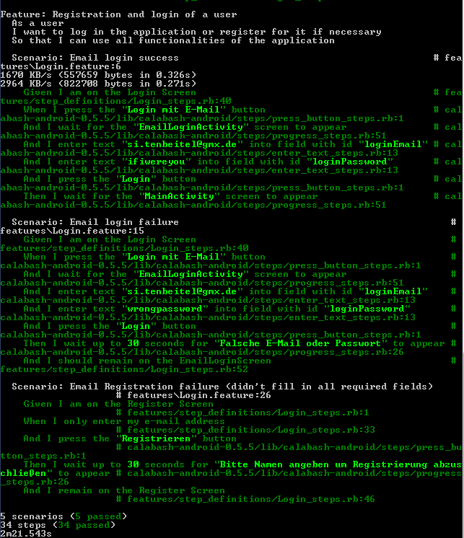
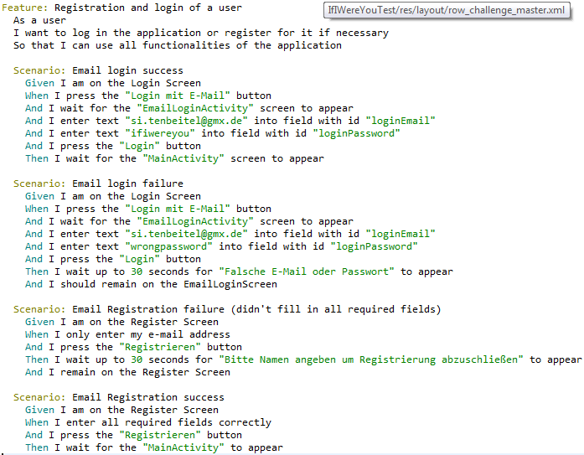
Functional Testing

Slide 15
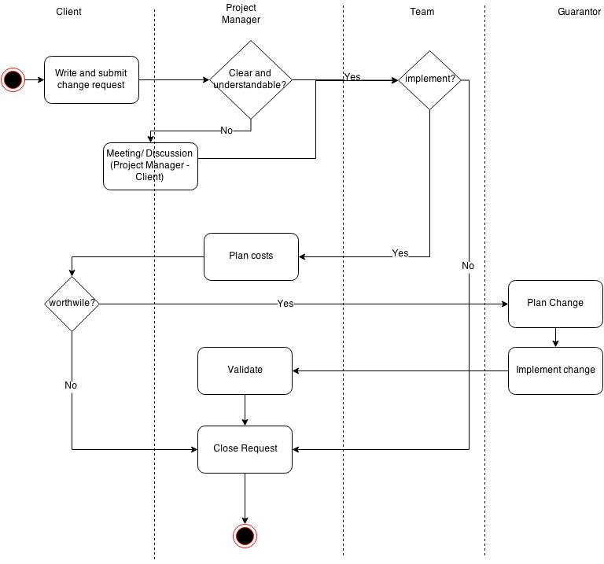
Change Managment - Workflow

Slide 16
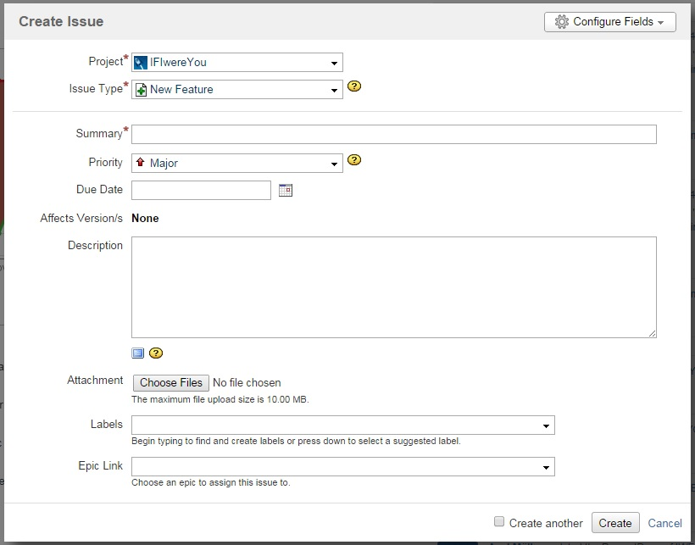
Change Managment - Form

Slide 17
Live Demo & Questions

