Slide 1








AWS Monitoring Tutorial for Dynatrace Instructions: https://github.com/Dynatrace/AWSMonitoringTutorials
Followed by live Q&A:
Part of: http://bit.ly/onlineperfclinic
Get Dynatrace SaaS Trial: http://bit.ly/dtsaastrial
Listen to PurePerformance: http://bit.ly/pureperf
Andreas Grabner, Dynatrace @grabnerandi

Slide 2
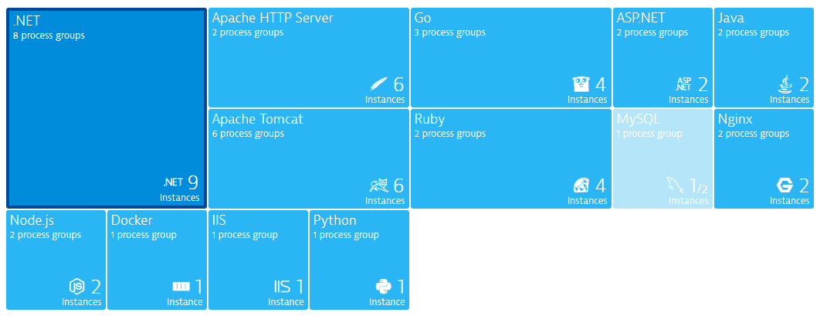
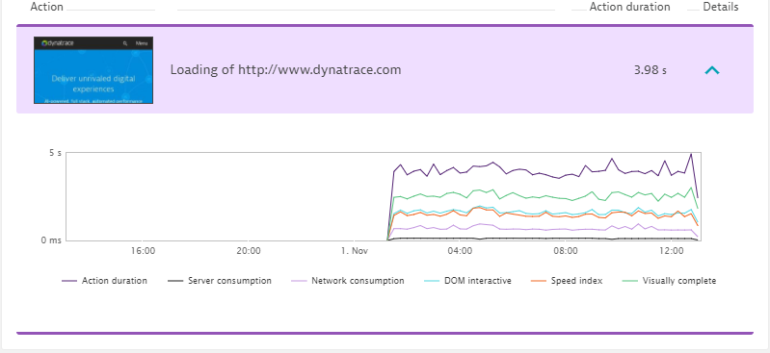
Agenda – AWS Monitoring Workshop
Pre-Requisites
Everyone needs an AWS Account: Sign-up http://aws.amazon.com
Everyone needs a Dynatrace Tenant: www.dynatrace.com/trial
“Win Alexa” Challenges. 2 Winners!
Most Technology Diverse Dynatrace Installation
Most valuable Web Check
Workshop
Based on https://github.com/Dynatrace/AWSMonitoringTutorials

Slide 3

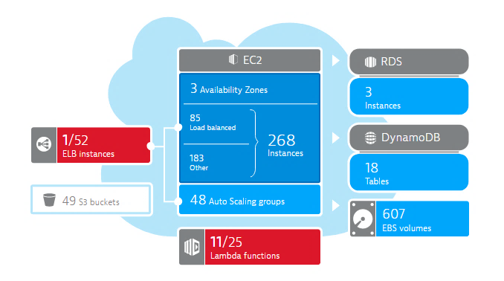
AWS Hands On 1
Goals: Setup Dynatrace AWS CloudWatch Monitoring Integration
API
Approach: Access Cloud Watch
via Key-based Authentication or
via Role-Based Authentication

Slide 4
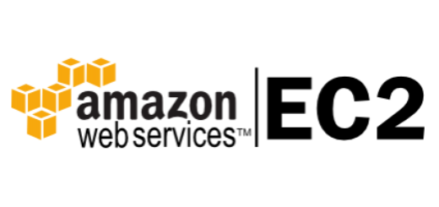
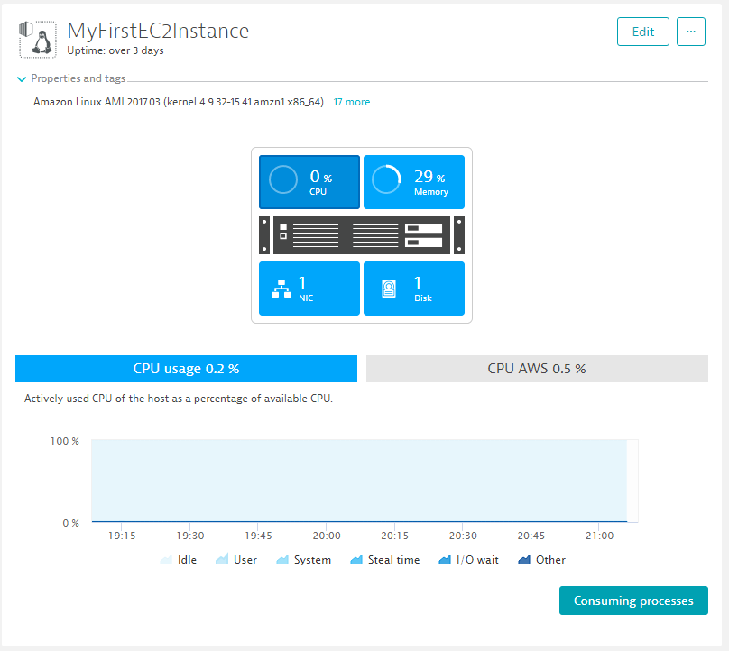

AWS Hands On 2
Goals: Deploying EC2 instance and monitor it with Dynatrace OneAgent
Dynatrace
OneAgent
Multiple Deployment Options
Via CodeDeploy, Puppet, Chef, Ansible
Via custom AMI
Via User Data launch script
…

Slide 5

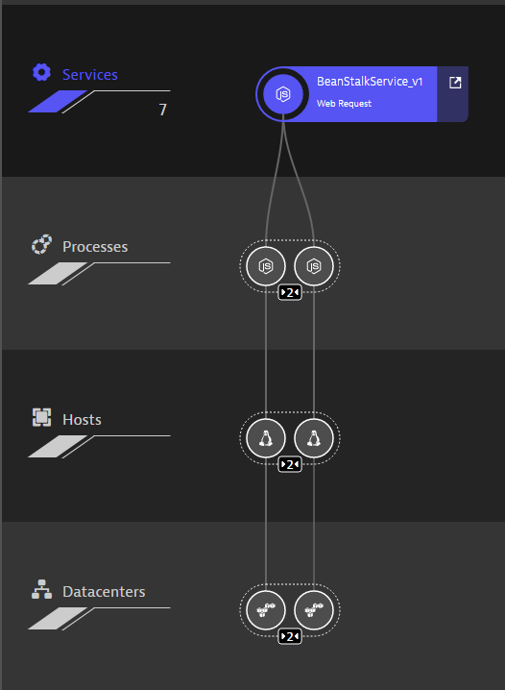
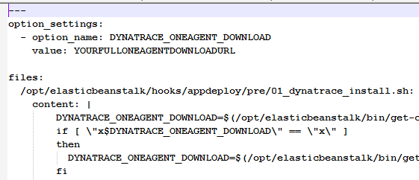
AWS Hands On 3
Goals: Deploy and Monitor NodeJS Beanstalk Application
AWS Elastic
Beanstalk
Dynatrace
OneAgent
Multiple Deployment Options
Via Custom Platform
Via .ebextension

Slide 6

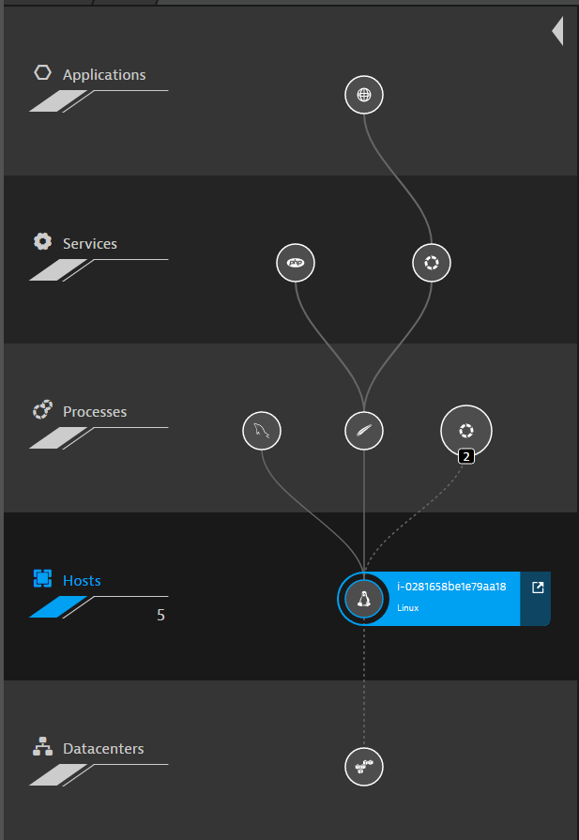
AWS Hands On 4
Goal: Deploy and Monitor a LAMP Stack through CloudFormation
AWS
CloudFormation
Dynatrace
OneAgent
Multiple Deployment Options
All of the previously mentioned

Slide 7
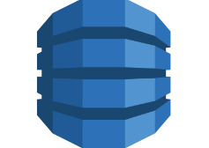
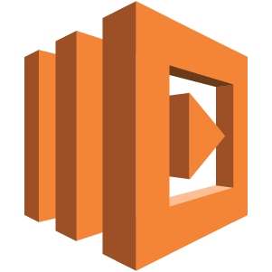
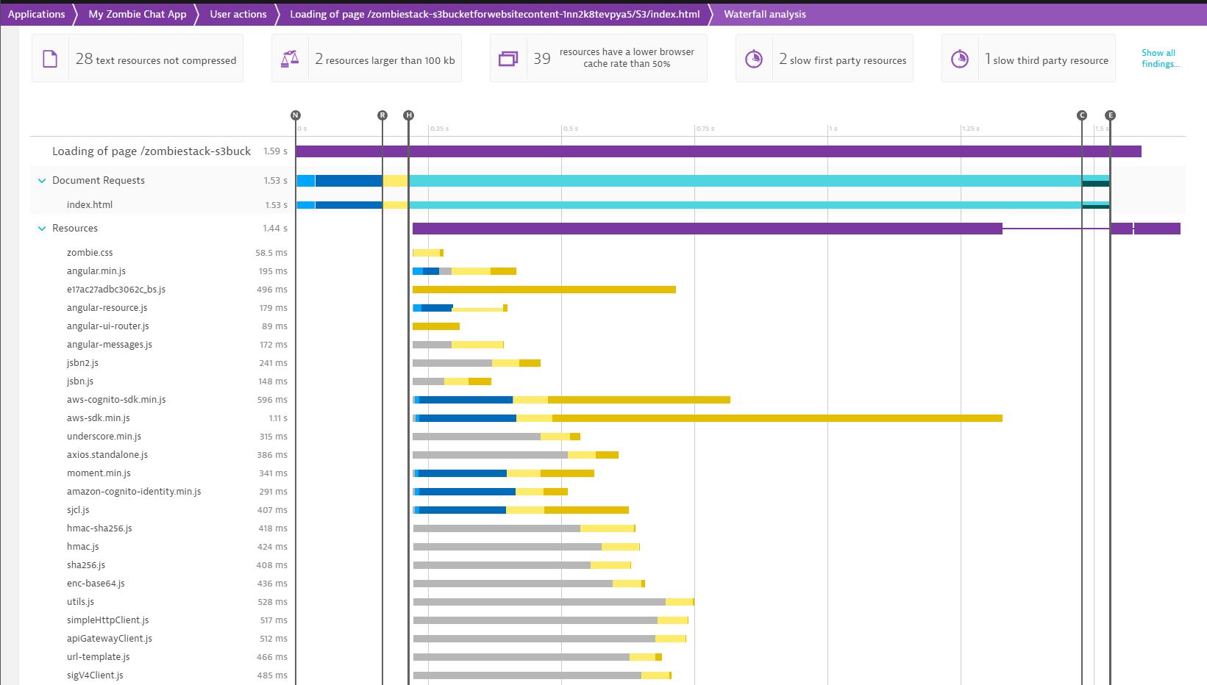


AWS Hands On 5
Goals: AWS Lambda Zombie Workshop with Dynatrace
Cloud Formation
DynamoDB
Lambda
RDS
API Gateway
Dynatrace
Agentless

Slide 8
LIVE Hands-On Time!

Slide 9
Pre-Requisits: https://github.com/Dynatrace/AWSMonitoringTutorials
Dynatrace SaaS or Managed Account
Get your Free Trial: http://bit.ly/dtsaastrial
AWS Account with administrative privileges
Get your Free Tier Account: http://aws.amazon.com
For Troubleshooting
Create a Key Pair for EC2
Download your key.pem
More instructions to Connect to EC2 via Linux (SSH), Windows (PuTTy): https://docs.aws.amazon.com/AWSEC2/latest/UserGuide/AccessingInstances.html

Slide 10
AWS Hands On 1
Goals: Setup Dynatrace AWS CloudWatch Monitoring Integration
API
Approach: Access Cloud Watch
via Key-based Authentication or
via Role-Based Authentication

Slide 11
AWS Hands On 2
Goals: Deploying EC2 instance and monitor it with Dynatrace OneAgent
Dynatrace
OneAgent
Multiple Deployment Options
Via CodeDeploy, Puppet, Chef, Ansible
Via custom AMI
Via User Data launch script
…

Slide 12
AWS Hands On 3
Goals: Deploy and Monitor NodeJS Beanstalk Application
AWS Elastic
Beanstalk
Dynatrace
OneAgent
Multiple Deployment Options
Via Custom Platform
Via .ebextension

Slide 13
AWS Hands On 4
Goal: Deploy and Monitor a LAMP Stack through CloudFormation
AWS
CloudFormation
Dynatrace
OneAgent
Multiple Deployment Options
All of the previously mentioned

Slide 14
AWS Hands On 5
Goals: AWS Lambda Zombie Workshop with Dynatrace
Cloud Formation
DynamoDB
Lambda
RDS
API Gateway
Dynatrace
Agentless

Slide 15
Open Q&A Use the Question Feature in GoTo Webinar or post it later to https://answers.dynatrace.com

Slide 17
