Slide 1
Agenda
What is SEM & BIO? Briefly BEM Deep dive into ITCSS Ravago code examples

Slide 2
SEM & BIO
A combination of methodologies
S
calable
E
xtensible
M
aintainable
B
EM: Block Element Modifier
I
TCSS: Inverted Triangle CSS
O
OCSS: Object Oriented CSS
Notes:
A comibination of methologies (BIO)

Slide 3
Focus
S
calable
E
xtensible
M
aintainable
B
EM: Block Element Modifier
I
TCSS: Inverted Triangle CSS
O
OCSS: Object Oriented CSS

Slide 4
SEM
S
calable
E
xtensible
M
aintainable
Notes:
A comibination of methologies (BIO)

Slide 5
S
calable
The same looking components should be used anywhere
without making any coding changes
Even if the markup is different,
the styles are identical by using the same classes.

Slide 6
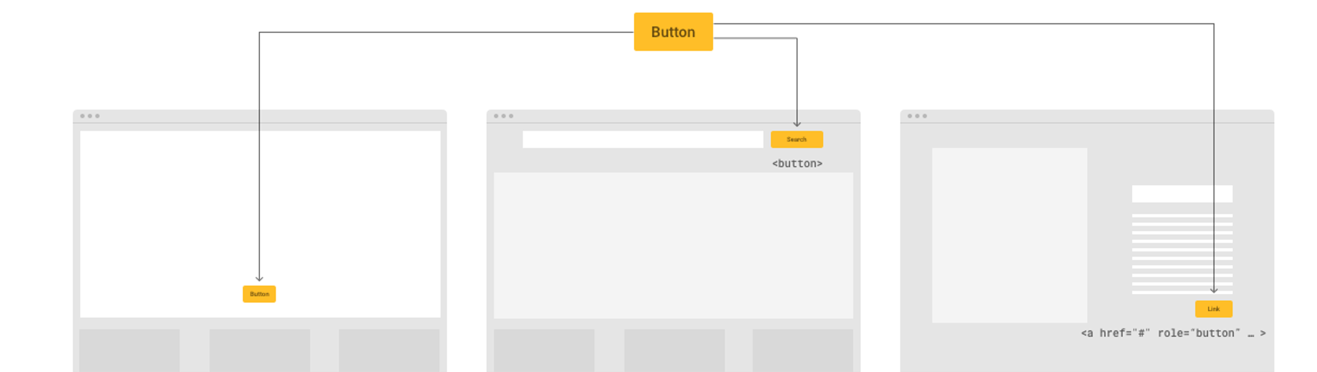
S
calable
The same looking components should be used anywhere without making any coding changes.
Even if the markup is different, the styles are identical by using the same classes. (c-btn and c-btn--yellow)

Slide 7
S
calable
The same looking components should be used anywhere without making any coding changes.
Even if the markup is different, the styles are identical by using the same classes. (.c-btn and .c-btn--yellow)
<button>
<a>

Slide 8
E
xtensible
Easily provide additional functionalities without breaking itself
or having to be written from scratch.

Slide 9
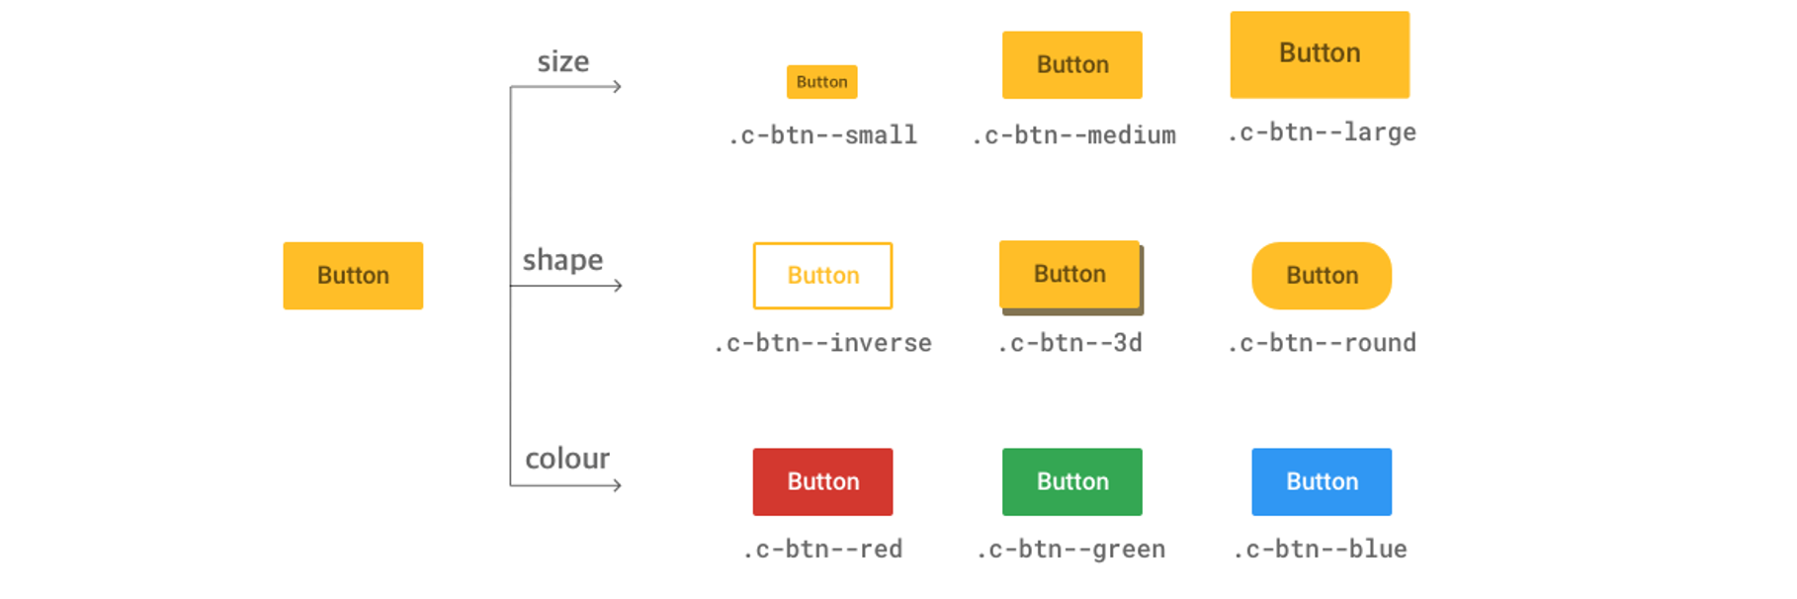
E
xtensible
Easily provide additional features/functionalities without breaking itself or having to be written from scratch.

Slide 10
M
aintainable
Keep it understandable for other developers
and for your future self

Slide 11
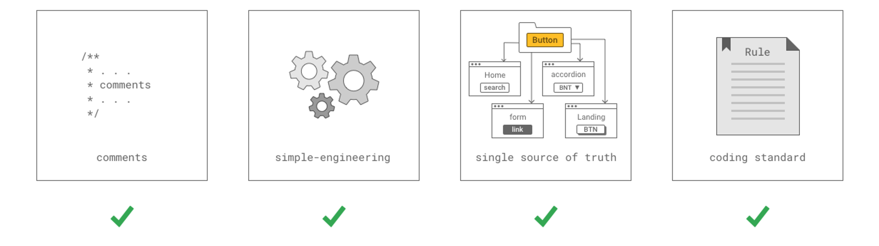
M
aintainable
Keep it understandable for other developers and for your future self

Slide 12
M
aintainable
Keep it understandable for other developers and for your future self

Slide 13
M
aintainable
Keep it understandable for other developers and for your future self

Slide 14
M
aintainable
Keep it understandable for other developers and for your future self

Slide 15
E
xample: Comments
.box { margin: 24px; }
Add comments when needed
.box { margin: 11px + 5px + 8px; // height label + margin label + padding input }

Slide 16
E
xample: Simple-engineering
.box { &__item { &--dark { &:hover { color: red; } } } }
Keep it simple
.box__item--dark:hover { color: red; }

Slide 17
E
xample: Simple-engineering
Expand when needed
.box { &__item { &:hover { color: blue; } &--dark:hover { color: white; } &--light:hover { color: black; } } }

Slide 18
BIO
B
EM: Block Element Modifier
I
TCSS: Inverted Triangle CSS
O
OCSS: Object Oriented CSS
Notes:
A comibination of methologies (BIO)

Slide 19
B
EM: Block Element Modifier
BEM is a very popular methodology to write CSS with
low CSS specificity and unique class names

Slide 20
B
EM: Block Element Modifier
.grid {
.grid__item {
.grid__item-form {
.grid__item-content {
// ...
}
}
}
}
.grid__item-content {
// ...
}
BEM
High CSS specificity
Nesting is hell
Low CSS specificity
Unique class names

Slide 21
B
EM: Explanation
<div class="block__element--modifier">
HTML
SCSS
<div class="card">
<div class="card__image"></div> <div class="card__image card__image--small"></div> </div>
.card {
// ...
&__image {
// ...
&--small { // ... } } }

Slide 22
B
EM: Block Element Modifier
Some rules

Slide 23
B
EM: Block
can contain other blocks
can contain elements
can have a modifiers
<div class="card"> // block
<div class="intro"> // block in block
<div class="intro__container"></div>
</div>
<div class="card__image"></div> // element </div>
<div class="card card--small"></div> // block modifier

Slide 24
B
EM: Element
can't contain blocks
can't contain elements
can have a modifiers
<div class="card">
<div class="card__intro"></div> // element
<div class="card__image"></div> // element <div class="card__image card__image--small"></div> // element modifier </div>

Slide 25
B
EM: Modifier
can't contain blocks, elements, modifiers
should always have a modified-selector + the modifier-itself
should always modify something (next slide)
<div class="card">
<div class="card__image"></div> <div class="card__image card__image--small"></div> // element modifier </div>
<div class="card card--small"></div> // block modifier

Slide 26
B
EM: Modifier
can't contain blocks, elements, modifiers
should always have a modified selector + the modifier itself
should always modify something
.card { &--small { color: gray; // modifies what? } &__image { &--small { padding: 5px; // modifies what? } } }
.card { color: black; // default &--small {
color: gray; // modifies default
} &__image { padding: 20px; // default &--small {
padding: 5px; // modifies default
} } }

Slide 27
P
ointers
A few pointers

Slide 28
P
ointer
Each CSS component is a Block itself
Because we use Angular… normally each file should have 1 parent selector
.hucs { &__list {} &__wrapper {} } .addresses { .k-label {} } :host ::ng-deep .k-grid { .k-text {} }
.hucs { &__list {} &__wrapper {} .addresses { .k-label {} } :host & ::ng-deep .k-grid { .k-text {} } }

Slide 29
P
ointer
Because we have unique class names we can target directly,
we should not unify modifiers with their element or block
.logs.logs--error {
}
.hucs__list.hucs__list--small {
}
.logs--error {
}
.hucs__list--small {
}

Slide 30
O
OCSS: Object Oriented CSS
Create individual parts separately and
construct them together to build components

Slide 31
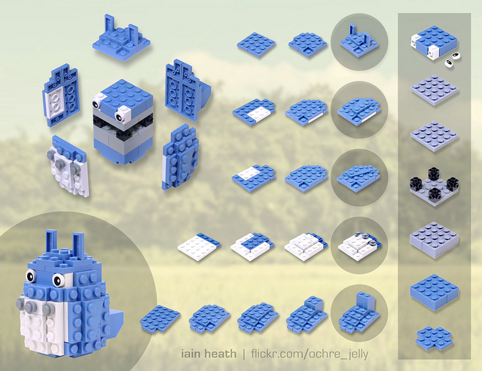
O
OCSS: Your LEGO childhood all over again

Slide 32
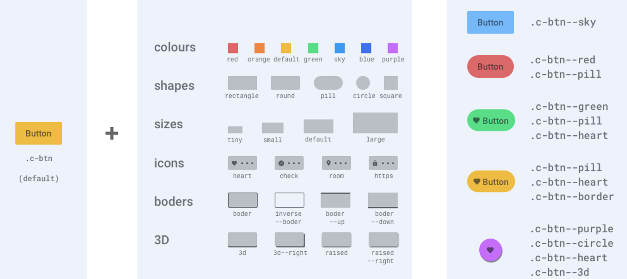
O
OCSS: Object Oriented CSS
+
=

Slide 33



E
xample
<button class="c-btn">
<button class="c-btn c-btn--sky">
<button class="c-btn c-btn--purple c-btn--circle c-btn--heart c-btn--3d">

Slide 34
I
TCSS: Iverted Triangle CSS
Organise CSS by applying a structure to determine
how specific to get with a specific component

Slide 35
I
TCSS: Inverted Triangle CSS
------- SETTINGS
------------- TOOLS
------------- VENDORS
-------------- ELEMENTS
----------------- OBJECTS
---------------- COMPONENTS
-------------------- PATTERNS
------------------------ SCOPES
----------------------- UTILITIES

Slide 36
TCSS: Settings
Settings are generally a collection of variables that do not generate CSS, bus are applied to classes
Examples: Base, Colour, Typography, Animation

Slide 37
TCSS: Tools
Tools also will not produce any CSS yet. They are typically preprocessor functions that help write or extend properties on classes
Examples: Functions, Placeholders, Mixins, Media Queries

Slide 38
TCSS: Vendors
Vendors are third-party styles that are being used in a project. They are high in the structure so we can override them. We also can add overrides at the end of this layer
Examples: reset.css, normalise.css, bootstrap, bootstrap-overrides

Slide 39
TCSS: Elements
Namespace e-
Elements are the HTML native elements which we would not style base on the class names. We should provide default styles to a <a> element rather the styling a .link class.
Examples: body, h1, span, body:not(.admin-page), section

Slide 40
TCSS: Objects
Namespace o-
Objects are used for design patterns, such as layouts, where items are being arranged rather than decorated.
Object classed are used across all pages, so if you make any change to an object class, you should be aware this affects all usages throughout the application
Examples: o-body, o-main, o-section, o-container, o-inner-container

Slide 41
TCSS: Components
Namespace c-
A component is a small feature that makes up a part of the app. Buttons, accordions, sliders, modal dialogs,…
Each component is fully functional by itself and does not rely on other components
Examples: c-btn, c-icon, c-masonry, c-link-underlined

Slide 42
TCSS: Components (continued)
Namespace c-
If you use a component based framework like Angular or React, this layer will be empty since the components are already isolated and encapsulated

Slide 43
TCSS: Patterns
Namespace p-
Patterns are components which are not scalable. Because they are too specific and not reusable, they can't be created as components.
Example component: c-accordion This can be used everywhere
Example pattern: p-header This can be used on all pages, but not in the content, sidebar, …

Slide 44
TCSS: Scopes
Namespace s-
The purpose of scope is to give us the highest specificity so we can override any styles for a specific purpose.
This layer should stay pretty empty. If you start to write a lot here, you probably have to refactor your CSS structure
Example:
.c-accordion.s-homepage & {
background-color: light-blue; // only for the homepage
}

Slide 45
TCSS: Utilities
Namespace u-
Sometimes you want to make changes only for a certain style in a specific place. In that case utility classes can help without changing the whole CSS structure
Because this is the last layer containing styles who should always win, you are allowed to use !important here
Like scope classes, if you are using too many utility classes, you should check with designer if the design can be more consistent across the app
Examples: u-clr-black, u-text-left, u-top-10, u-font-h2

Slide 46
D
emo
Time to see these layers in action!

Slide 47
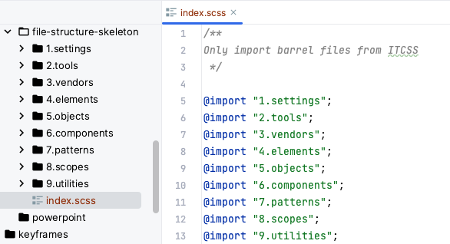
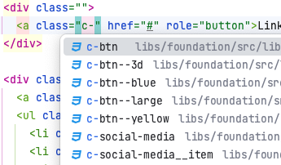
I
TCSS: BENEFITS
By using layers:
You have a better overview of overrides
You can decide more easily where styles should go
You have reusable styles (like utilities)
By using the namespaces:
You know better what you're doing
Your IDE gives you auto-suggestions

Slide 48

E
xample
Let's take this magic to WMS

Slide 49
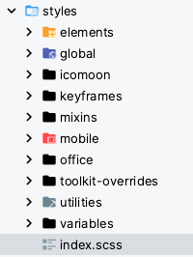
E
xample
03/03/2023
You see what I did here?
(Settings)
30/08/2023
16/10/2023
(Settings)
03/03/2023

Slide 50
E
xample
Let's be critical

Slide 51
E
xample 2
global?

Slide 52
E
xample 2
Everything is "global"

Slide 53
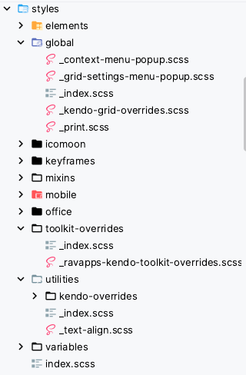
E
xample 3
overrides ?

Slide 54
E
xample 3
Everything is "overrides"

Slide 55
E
xample 4
I want to write CSS that will override all kendo-grid borders... And it's not in ravapps-kendo-toolkit yet…
Where do I put it?

Slide 56
E
xample 4
OK, fine. And it works like a charm…

Slide 57
E
xample 4
OK, fine. And it works like a charm…
Now I also override the color of the grid header, and I've put it here since it's also a part of kendo-grid…
But it doesn't work!

Slide 58
E
xample 4
OK, fine. And it works like a charm…
Now I also override the color of the grid header, and I've put it here since it's also a part of kendo-grid…
But it doesn't work!

Slide 59
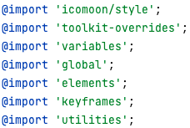
E
xample 4
It seems it's also overriden in ravaps_kendo_toolkit…
And looking at the main barrel file,
it makes sense:

Slide 60
E
xample 4
Conclusion: WTF?

Slide 61
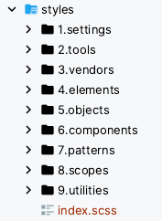
F
inal: Let's rearrange

Slide 62
F
inal result

Slide 63
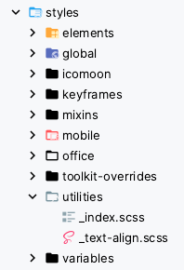
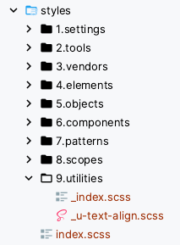
F
inal result

