Slide 1
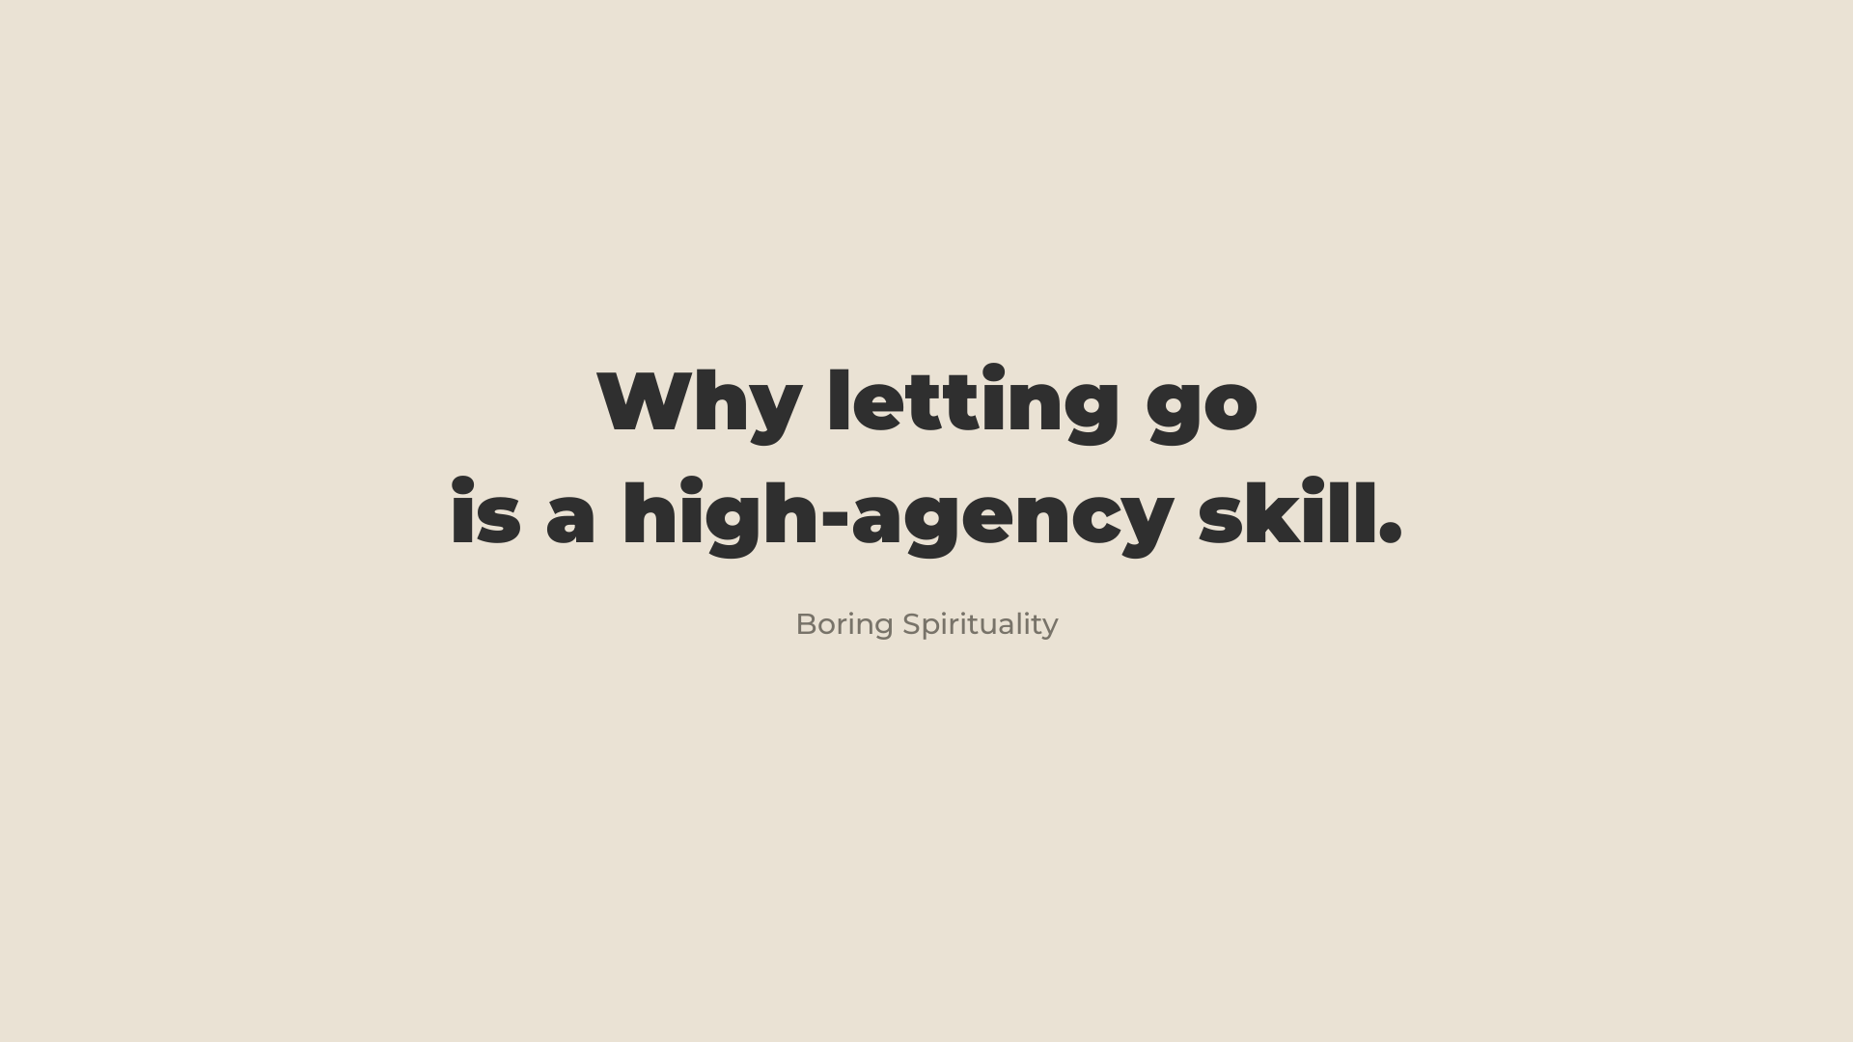
Notes:
0:00 · up as people sit down
- "This is a new way for me to explain what we do, so feedback welcome."
- Click to slide 01 as you start.

Slide 2

Notes:
PART 1 · 0:00–4:10 · LETTING GO · the axis is on screen while you explain it
- Two axes of development. Start with the one less spoken about.
- Letting go = being at ease with yourself. Able to show your inner world. Knowing how much you believe your own fears, how much the ideas in your head run you, how much other people's opinions move you. Your internal resilience. The caring, supportive part of you.
- The ideas in our head are a source of tension, and the tension lives in the body. Health. And effectiveness: TENSION IS A TAX ON YOUR ABILITY TO SEE SOLUTIONS. With enough fears you never even look at the unusual solution.
- So: the more we let go, the more of life we see, feel and express.
- Credit Jonny Miller, "How to Unclench", once. Then: "the entire talk is one big graph. Congratulations. The most rational approach to spirituality I've ever tried."
- Clear the confusion: this axis is not just meditation. It's admitting you were wrong and taking the first step. Sorry, for real. The hard conversation. Feel the "I don't want to" and step anyway.
- Optional: the fist demo, if the room is cold.
- "Any questions on this one?"

Slide 3
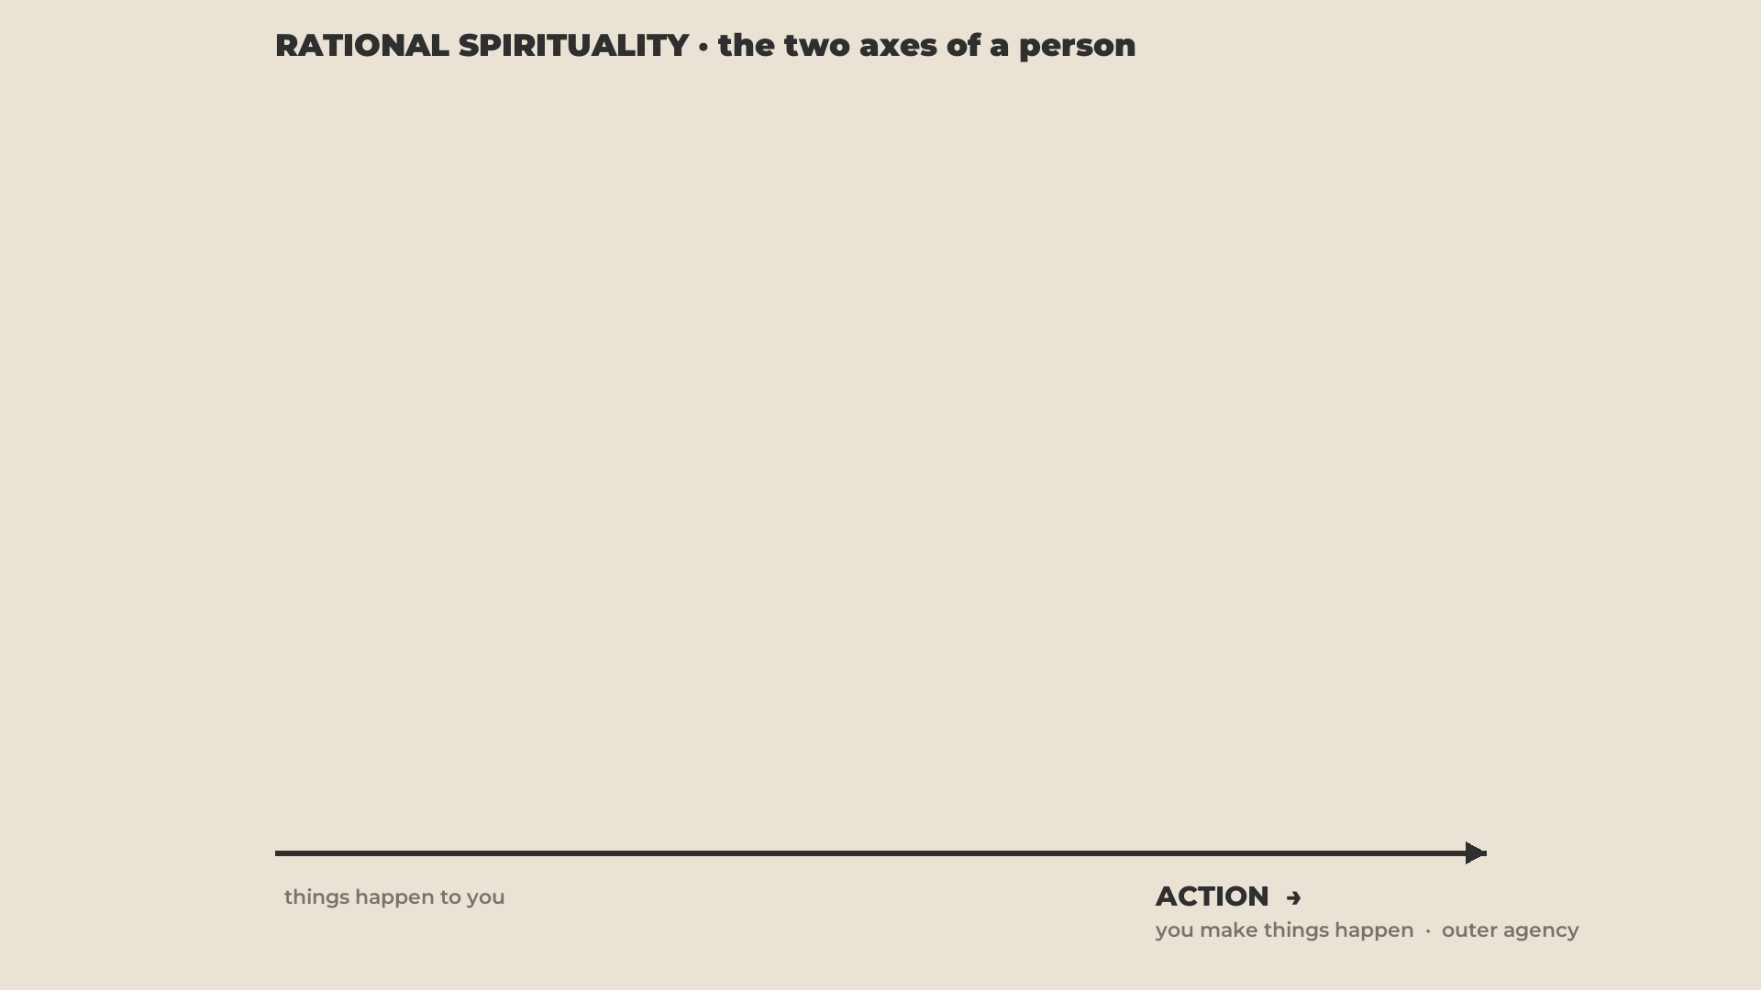
Notes:
PART 2 · 4:10–5:40 · ACTION · ninety seconds
- Action is simple: how much you hold the steering wheel of your life. Make things happen, or things happen to you. Initiator. Effort. Get stuff done.
- The easiest test: how well am I able to follow up on my words? Talk versus walk.
- Not a loud personality. A quiet person can do very hard things. Not a world-changing project. A direction you live in.

Slide 4
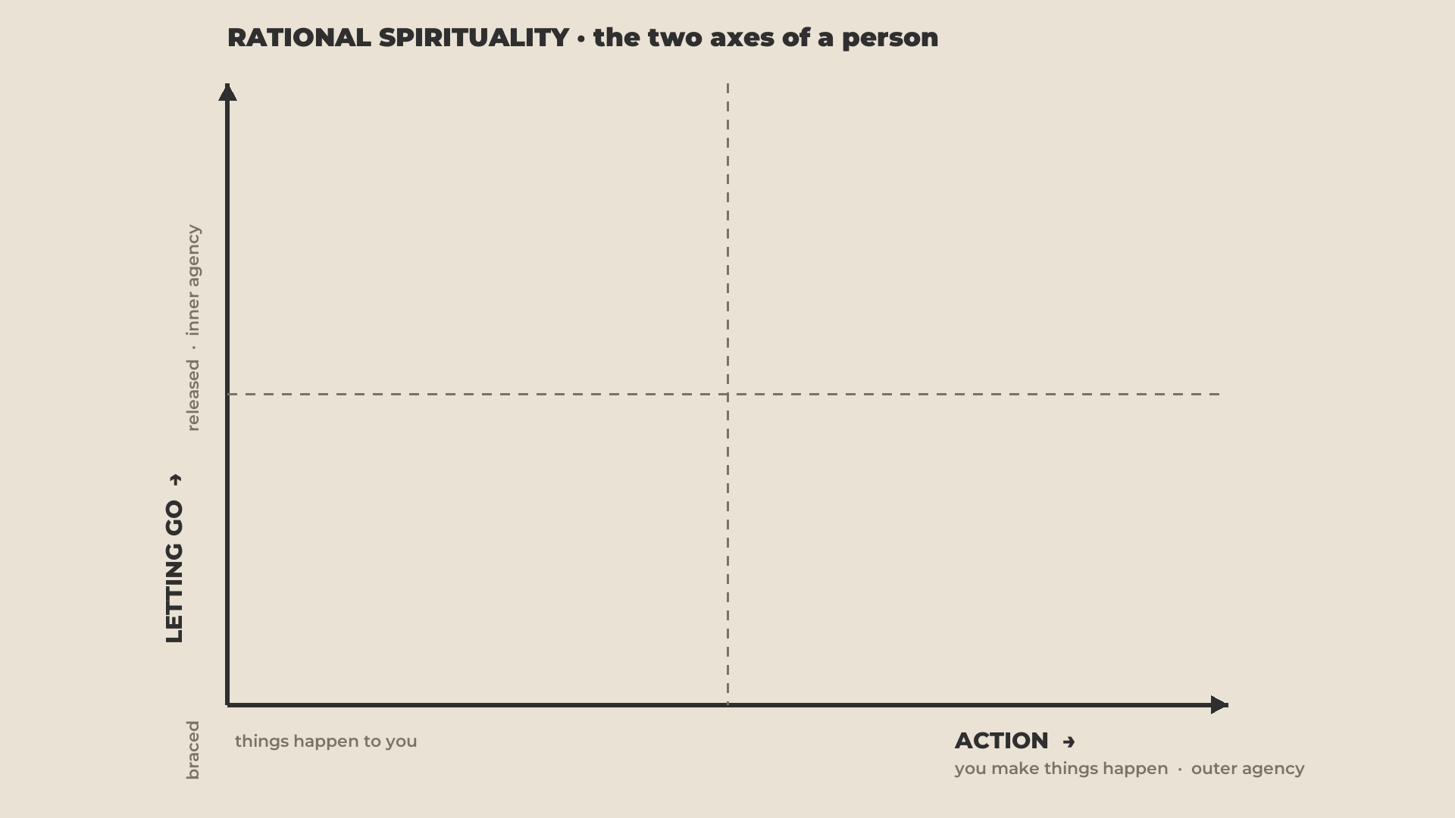
Notes:
5:40 · the quadrant appears, empty
- The two together make a quadrant. We live in it for the rest of the hour.

Slide 5
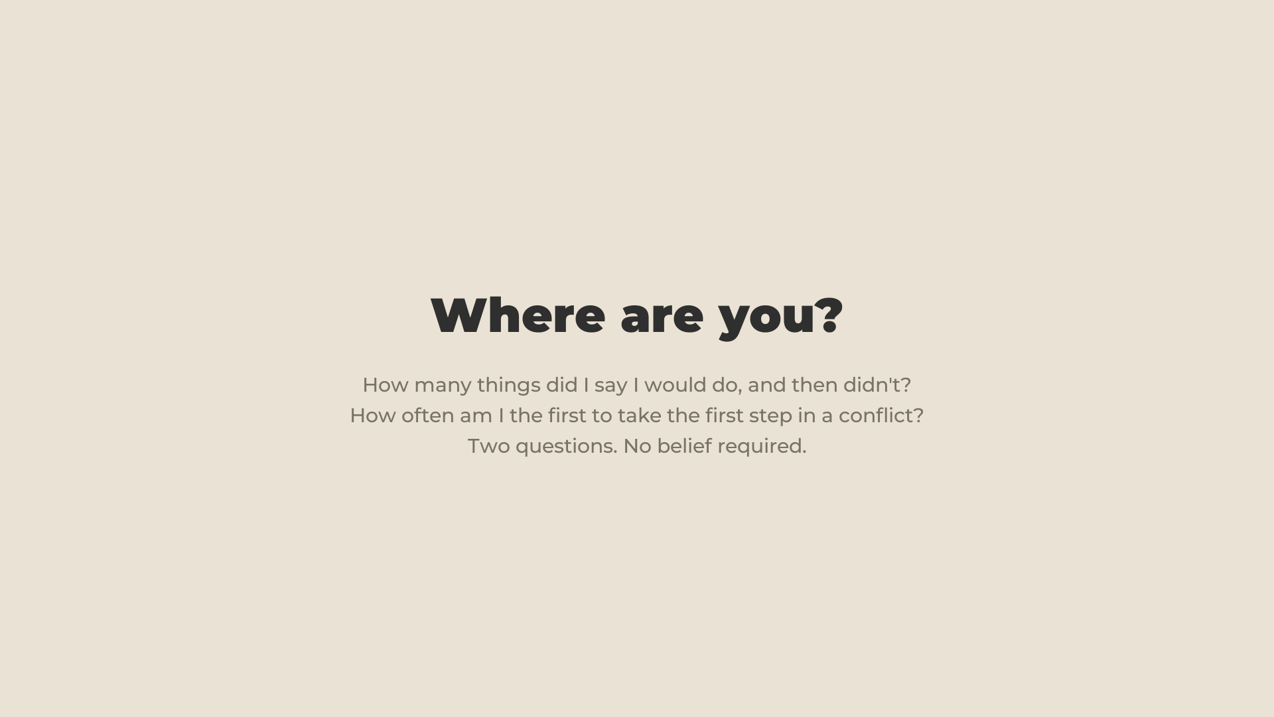
Notes:
- Two questions locate you. How many things did I say I'd do, and then didn't? How often am I the first to take the first step in a conflict?
- Let them answer silently. That's the whole test. No belief required.

Slide 6
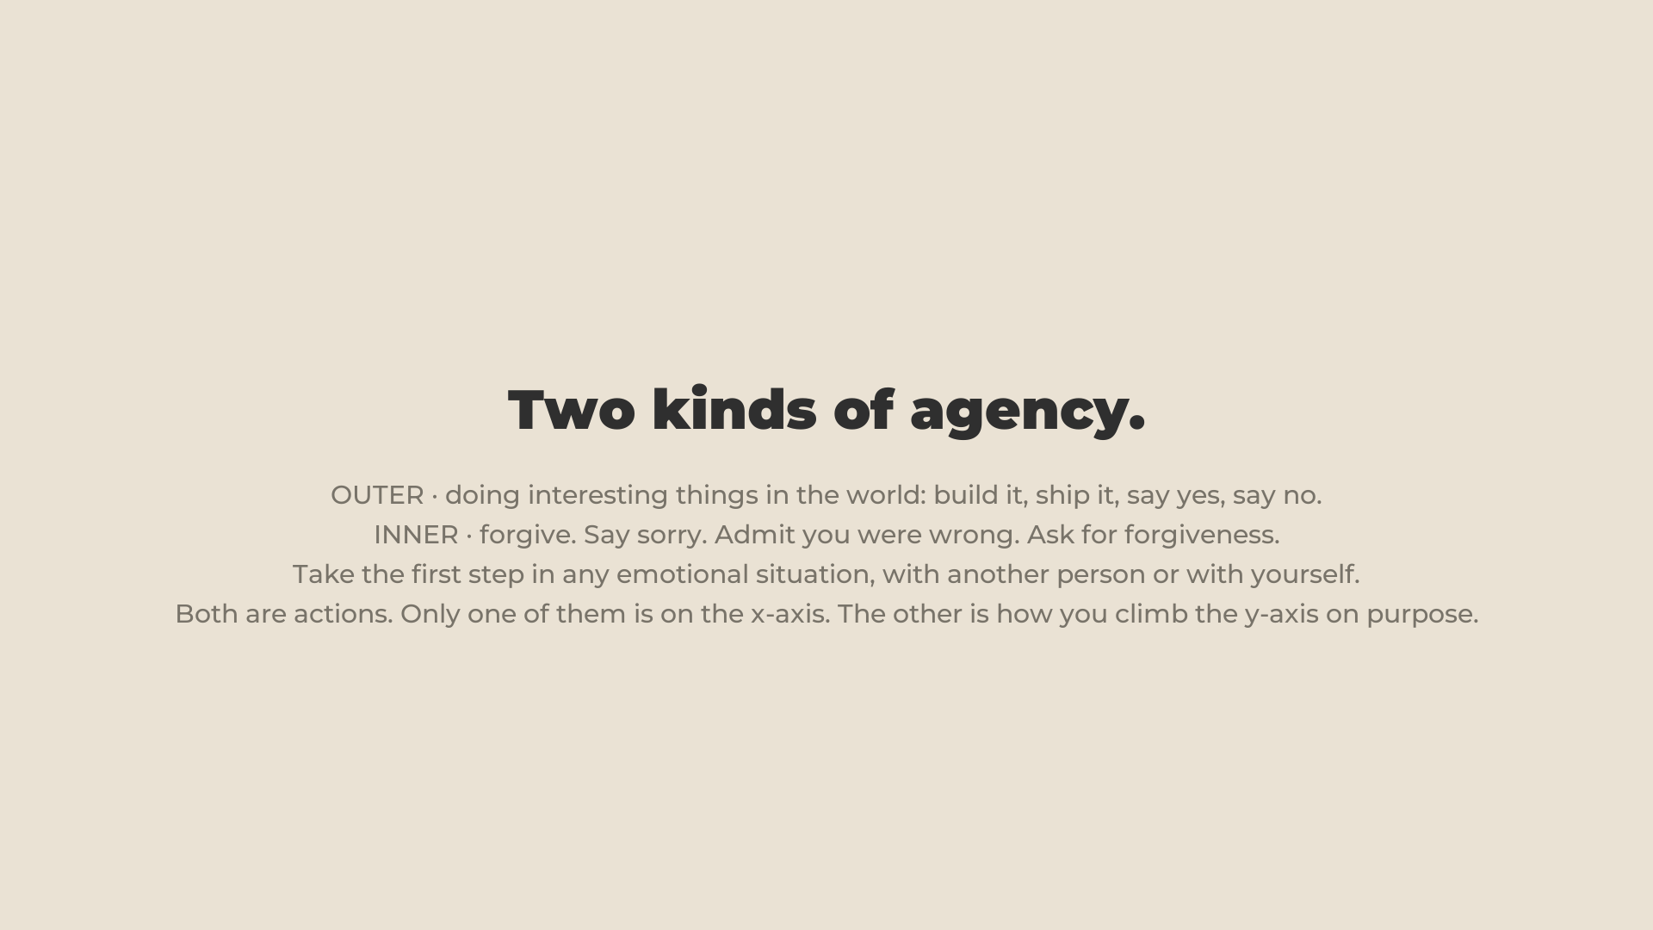
Notes:
6:40 · the word agency
- "Does everybody know the word agency?" In its purest form: the ability to express your being in this world. To live your potential.
- Two kinds. OUTER: I do things in the physical world. INNER: the one nobody talks about. The sorry, the first step, the admission.
- Both axes are a way of truly expressing yourself, and effectively. That's the word. The top-right room is named after it.

Slide 7
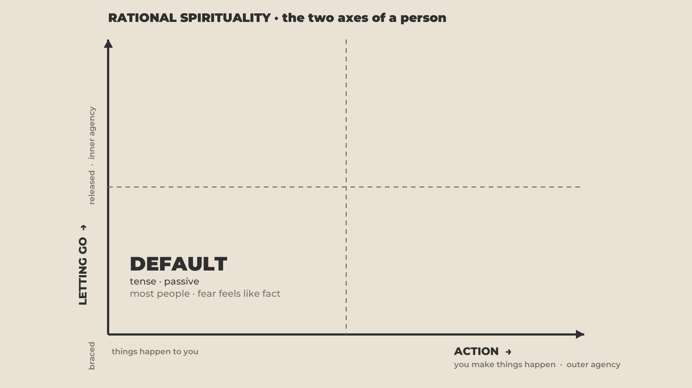
Notes:
DEFAULT · 7:40–12:40 · tense and passive
- A tense person who doesn't do much, or says a lot and doesn't follow through.
- Your number: about 95% of people. "Statistically, most of us here. I'm not making claims about anybody."
- [YOUR SLOT: join yourself in.]

Slide 8
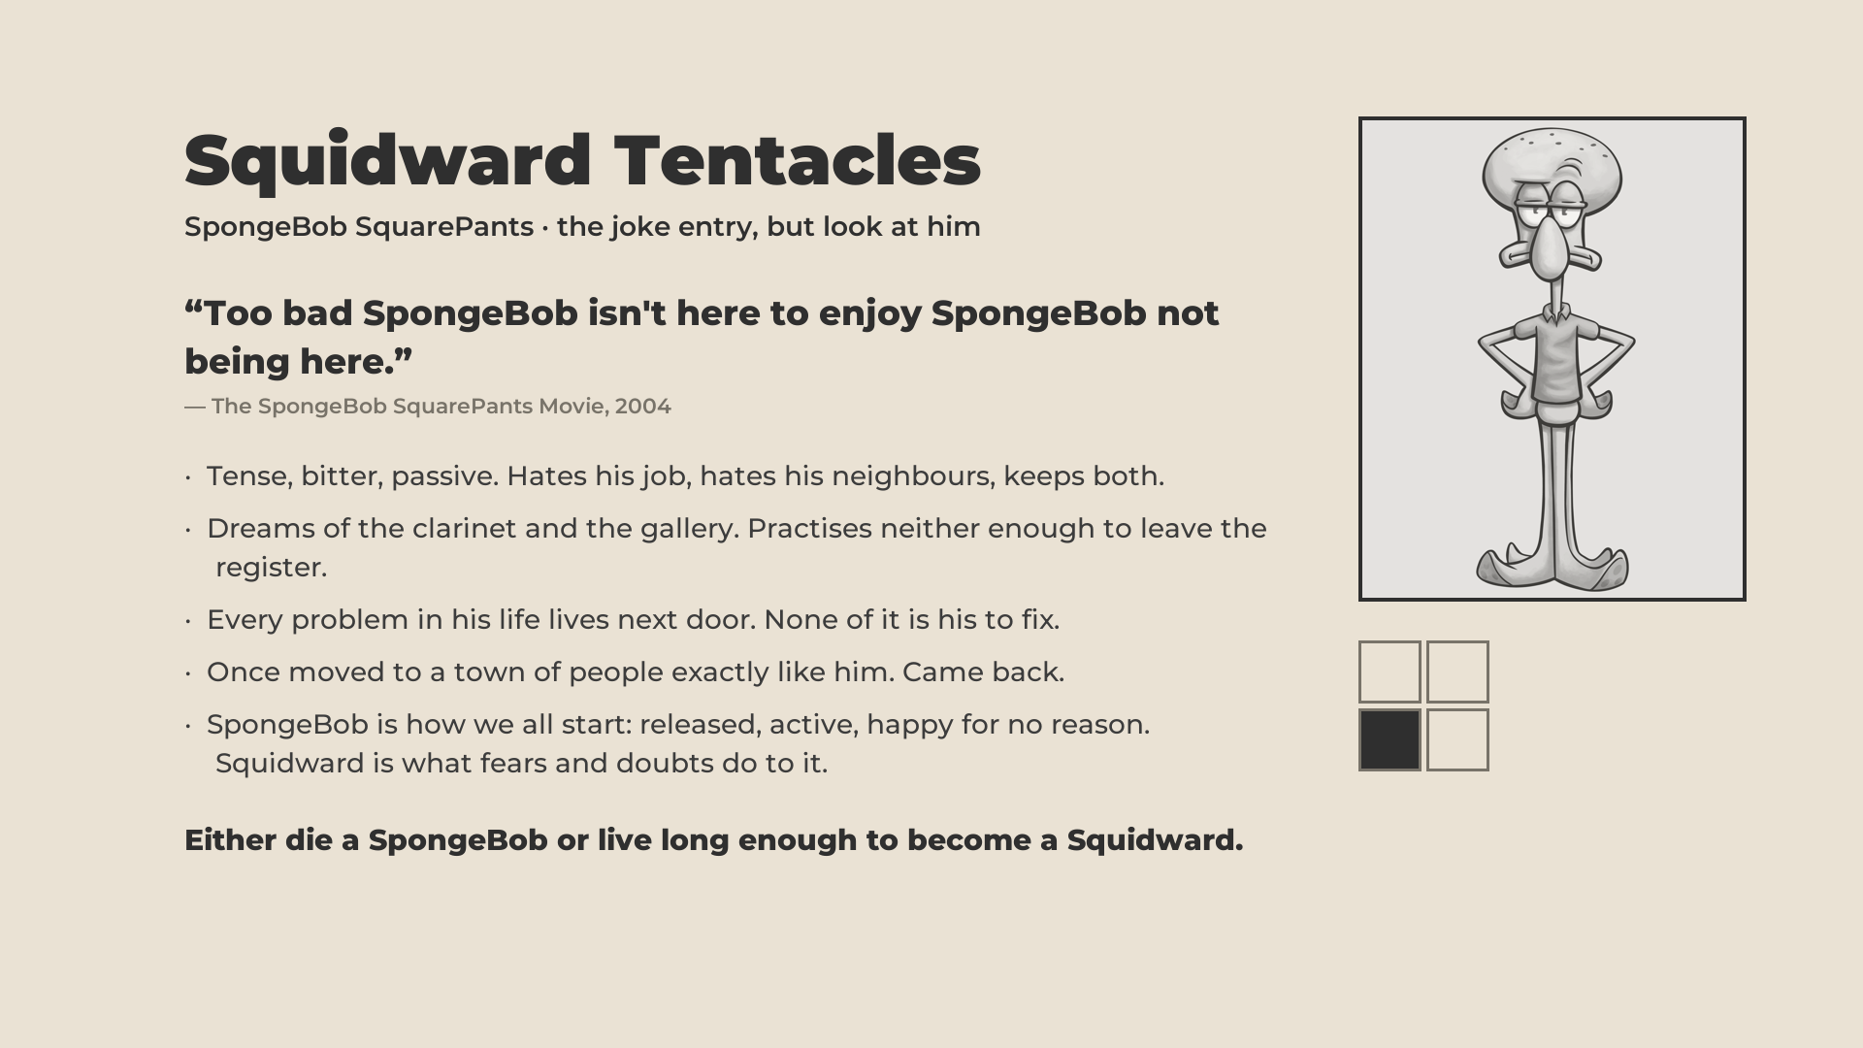
Notes:
- The most extreme case, for fun. Complains. All of his problems live as his neighbour. Takes no responsibility. Big dreams, never does anything. Moves to a town of Squidwards and leaves; they're annoying.
- The line: EITHER DIE A SPONGEBOB OR LIVE LONG ENOUGH TO BECOME A SQUIDWARD.
- Why it's true: kids are born relaxed, joyful, they try things, they don't know things are impossible. Life turns us into Squidward: ideas, doubts, fears, and we live in front of them.

Slide 9
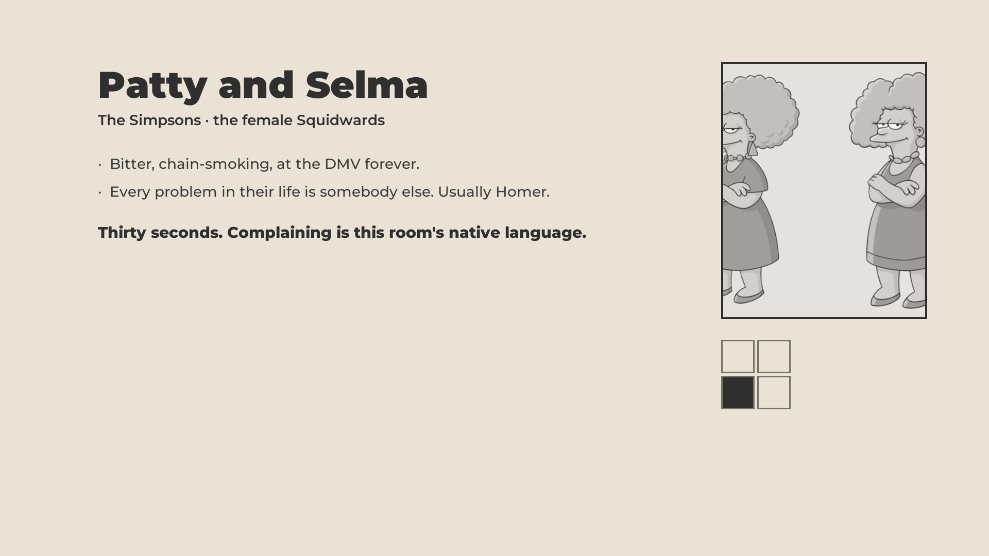
Notes:
- Thirty seconds. The female Squidwards. Bitter, chain-smoking, at the DMV forever.
- Every problem in their life is somebody else. Usually Homer. Complaining is this room's native language.

Slide 10
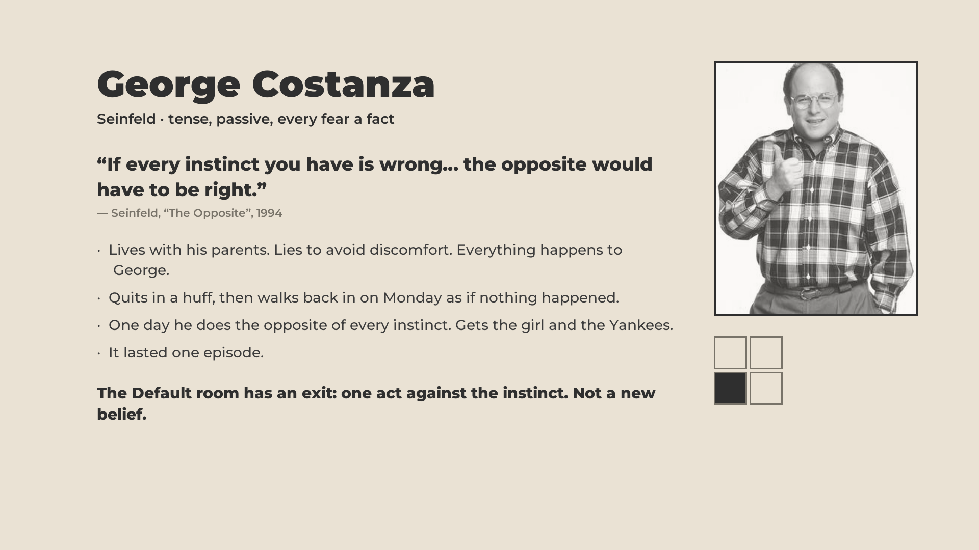
Notes:
- Lives with his parents. No job. Very insecure. Believes everything in his head.
- The episode: "if every instinct you have is wrong, do the opposite." He does. The whole episode: the girl, the job, the respect. "Not the perfect way out of this room. But maybe try it."
- The retreat observation, keep it: on a retreat all we ask is simple guidance. Attention here. No water at odd times. And people's brains make them do it anyway, and they don't notice until later. What they learn: "I don't make that many decisions in my day. My mind decides before me and I just do it." That is this room. Not fully living. Only a little.
- [YOUR SLOT: your own retreat example.]

Slide 11
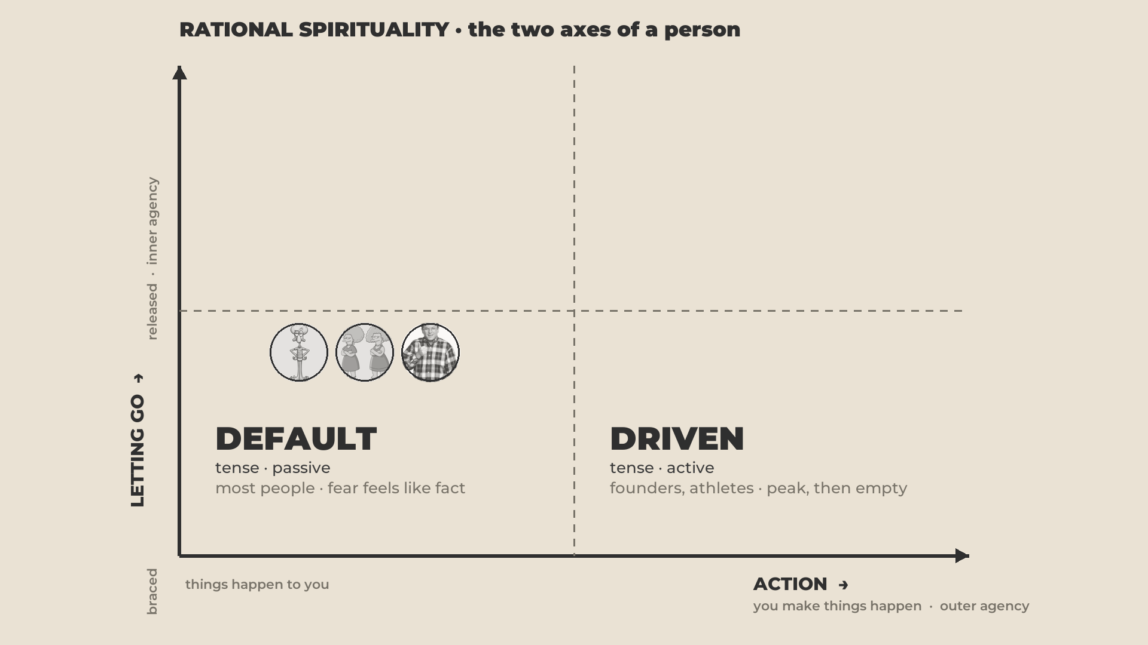
Notes:
DRIVEN · 12:40–17:00 · tense and active
- Still tense, they haven't let go. But they get stuff done. Everyone here has examples.
- The pattern: driven, but the motive is unconscious. "I'll prove them wrong." "I'll get it done and then they'll like me." A lack they can't let go of, so they go hardcore this way.
- Our whole culture pushes here. Every idea we have about success comes from this room. "We really don't have cases from the top-right."
- So: what happens when a driven person actually reaches the dream?

Slide 12
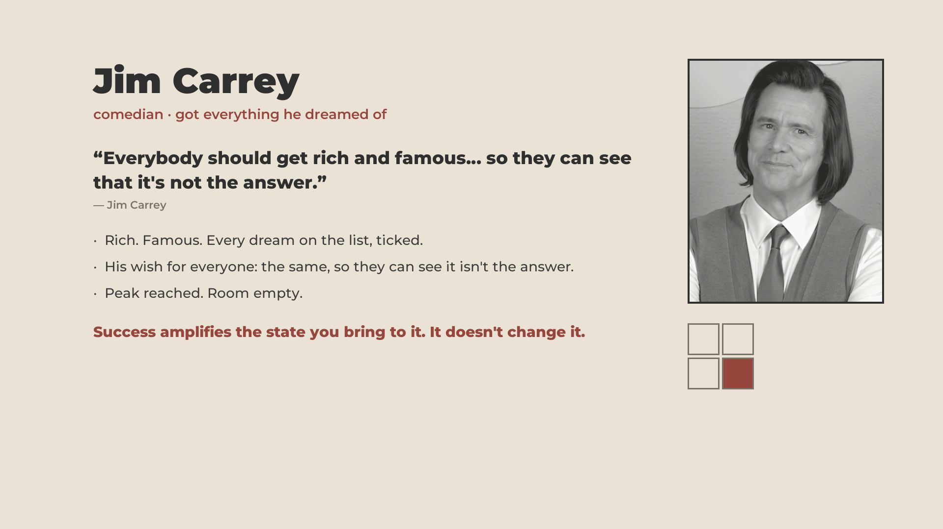
Notes:
- The phrase you love and wish would come true for everyone. Say it as printed or the full original.
- Reached everything. Immense depression, contemplated ending his life. The turn came through work with a teacher. He never even wanted to act; other people's ideas in his head. Now he talks inner growth more than films.

Slide 13
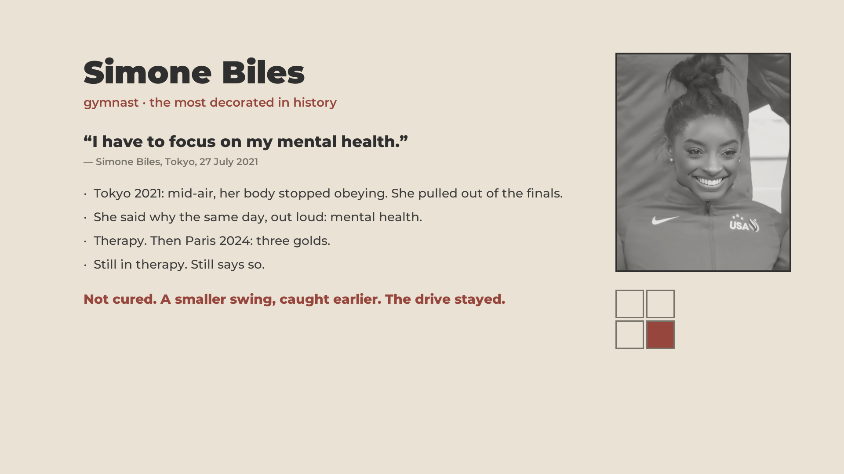
Notes:
- The most decorated gymnast in history. Tokyo 2021: mid-air, her body stopped obeying. She pulled out of the finals.
- She said why the same day, out loud: mental health.
- Therapy. Then Paris 2024: three golds. Still in therapy. Still says so.
- Keep: "she didn't quite exit this room yet." Not cured; a smaller swing, caught earlier. The drive stayed. The crash is one of the ways life pushes us out of our room. The swing comes later.
- Only what she has said herself. No diagnosis.

Slide 14
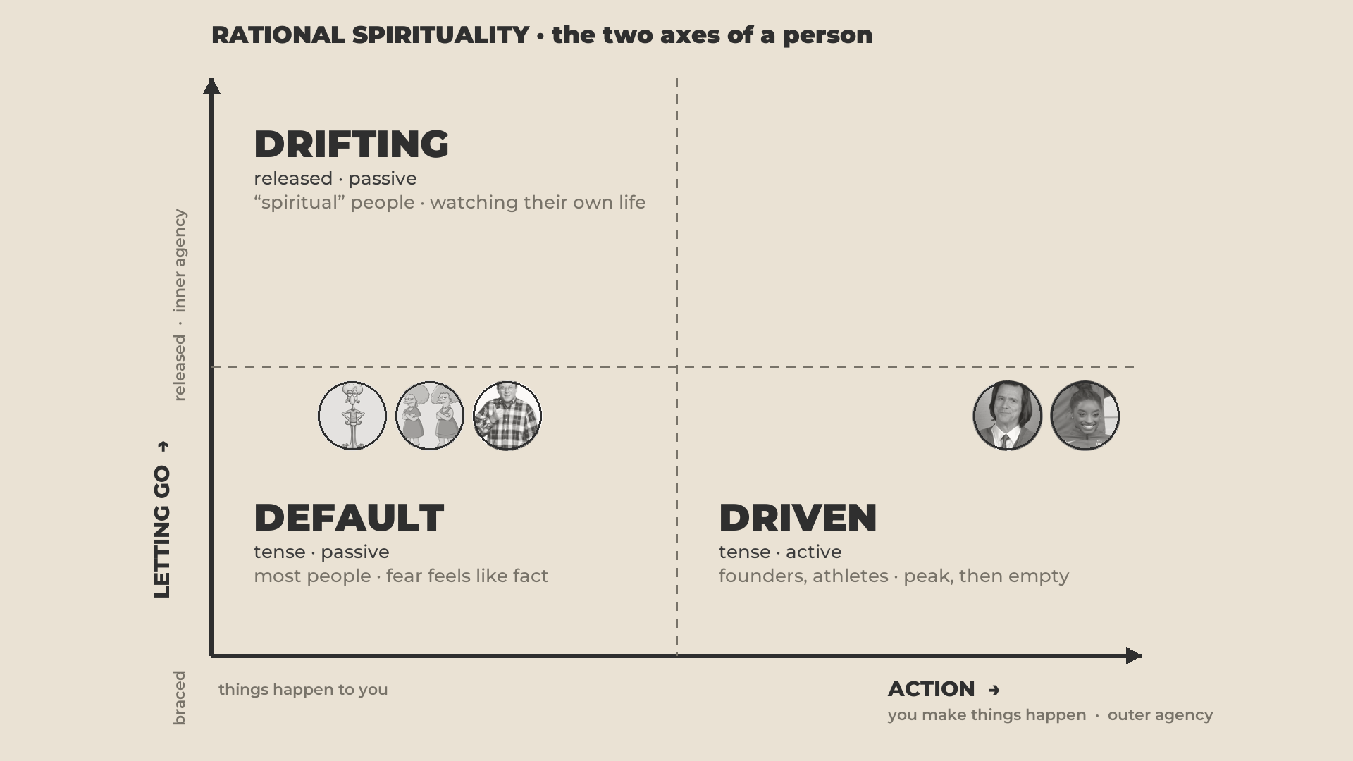
Notes:
DRIFTING · 17:00–23:20 · released and passive
- Join in first: "I call them drifting because I was a good drifter myself."
- The "spiritual" people. Hippies. Relaxed, calm, nice to be around. They do very little.
- [YOUR SLOT: the warm-climate aside and the Anna joke. Short.]
- The trap: you feel calm and nice, and usually because you're blocking life out. Not engaging the people who trigger you. An ashram of people who also do nothing.
- This put you off mainstream spirituality at first. Many students of our teacher started here. Mainstream spirituality TEACHES this room: be present, relax, let go. You need those. Not at the cost of being active. Together.

Slide 15
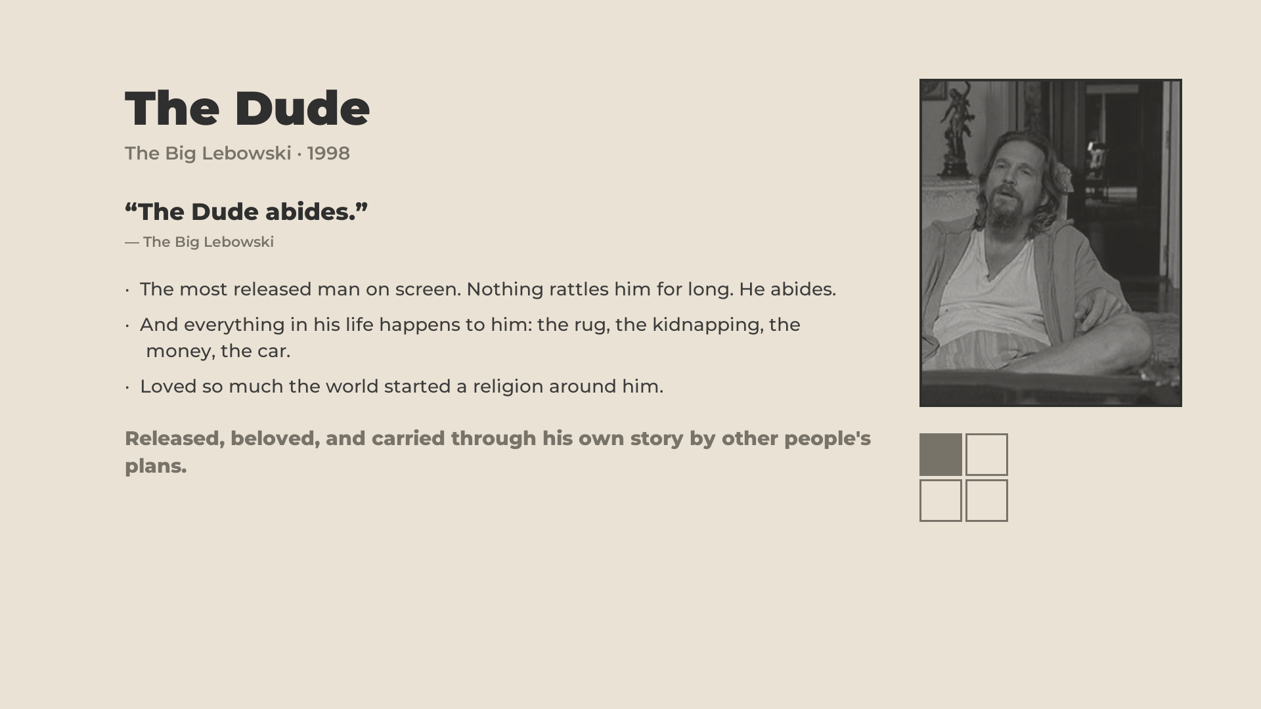
Notes:
- "The only popular example I could find. My favourite film. You can see why I fell into this room."
- The chillest person on screen, until he snaps. He never does anything; everything happens to him. The plot wouldn't change if he didn't exist.
- Loved, for good reason. We need more of that calm. Fun fact: Jeff Bridges is an advanced practitioner himself.

Slide 16
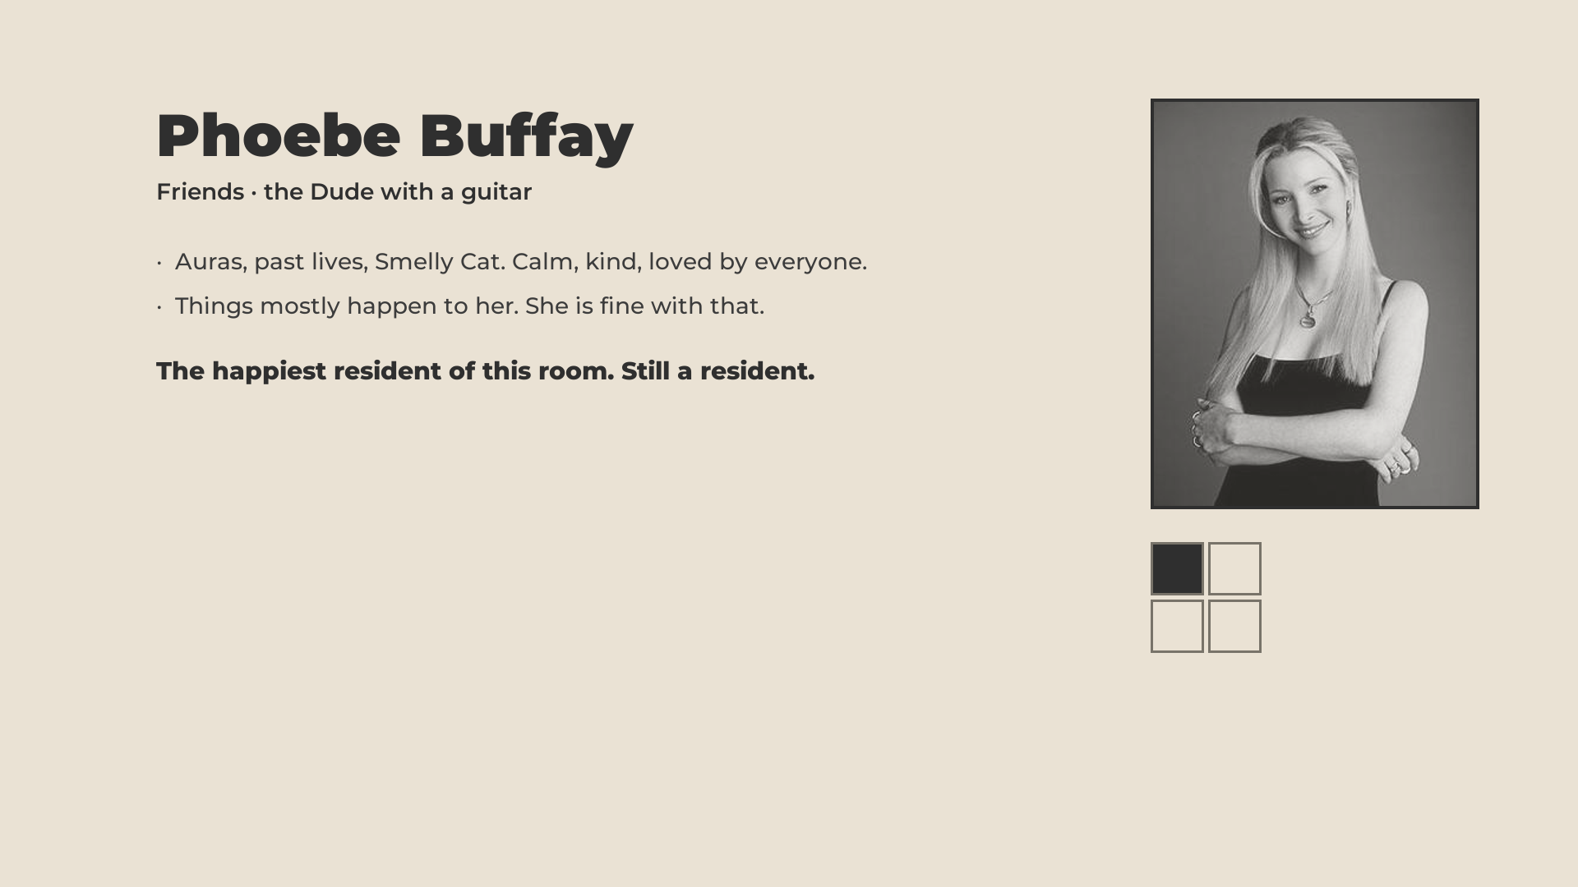
Notes:
- Thirty seconds. The Dude with a guitar: auras, past lives, Smelly Cat.
- Calm, kind, loved by everyone. Things mostly happen to her. The happiest resident of this room. Still a resident.

Slide 17
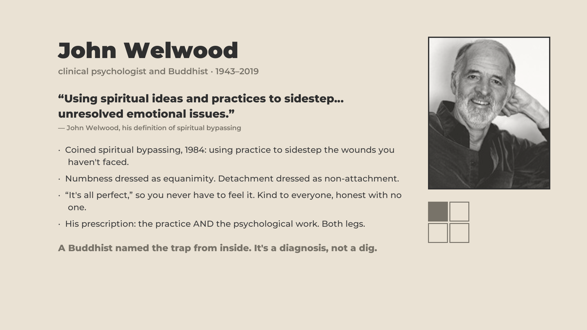
Notes:
- Not an example, a diagnosis. Psychologist and Buddhist. Coined SPIRITUAL BYPASSING: using spirituality to avoid your problems. The island, the meditation, so I don't deal with the relationship.
- The extreme case, keep it: the cold observer. Observational practice until you watch your own life from the side. "I have no problems," because nothing happens inside any more. Boring calm.
- "I was going that way myself, I'll admit. I got lucky; people fixed my silly ideas."
- The line: OPEN YOUR HEART, NOT JUST YOUR ATTENTION.

Slide 18
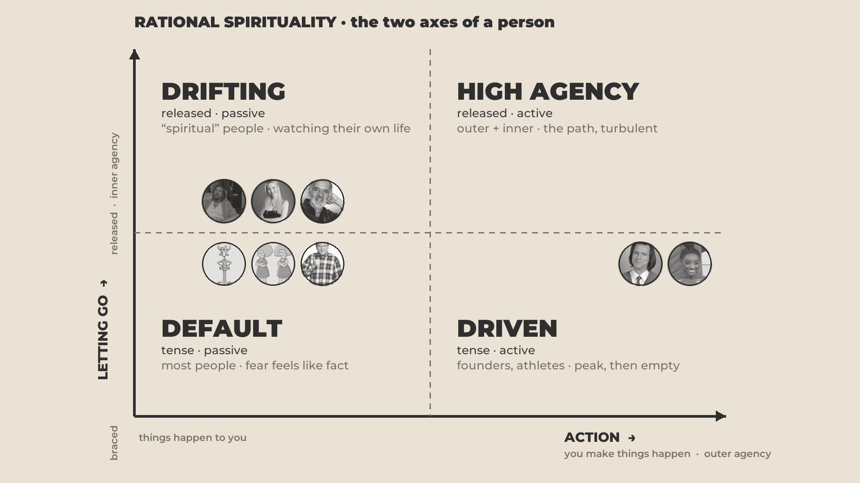
Notes:
HIGH AGENCY · 23:20–30:30 · released and active
- Both high, finally. Let go of some limitations AND doing things. The conscious version of a person's evolution. Turbulent.
- The jail-cell test (Mack, credit him once): third-world country, a cell, you don't speak the language. Who do you call? Capable, and cares enough to act. Your highest-agency person.
- Walking on two legs. Driven hops on the action leg. Drifting hops on the letting-go leg. Here every step swivels until you find the centre. NOT RELAXED. RELEASED. Free from your internal limitations.
- "Who can think of a high-agency person?" One or two from the room.

Slide 19

Notes:
- Kept going to school under the Taliban and said so, on a blog and on TV, at eleven.
- Shot in the head on the school bus at fifteen. Survived. Global movement for girls' education. Nobel at seventeen. Oxford degree.
- The inner leg, her words at the UN: she does not even hate the man who shot her.
- Outer and inner agency in one person. Disagrees with the status quo, and free of the hatred that would have been the easy fuel.

Slide 20
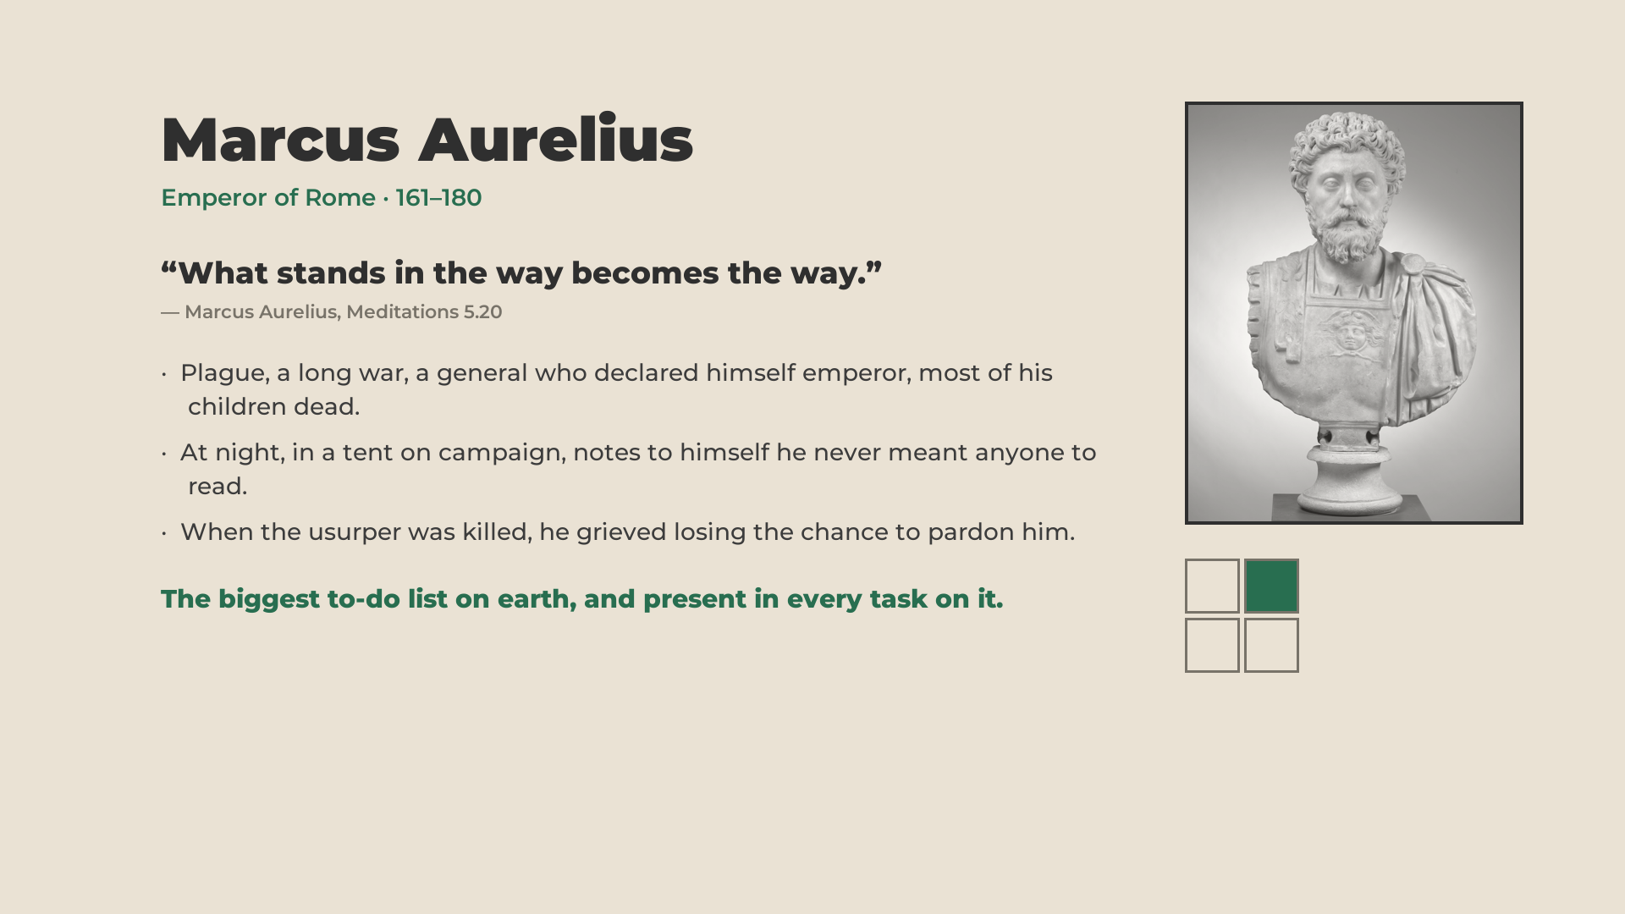
Notes:
- Stoicism, many here enjoy it. The Meditations: his inner work written down while running an empire with a plague and a war.
- The usurper rose and died; Marcus sorry he lost the chance to forgive a misguided man. Peak power on the planet, and the inner work at the same time.
- "We have a cool statue of him, and that's nice."

Slide 21
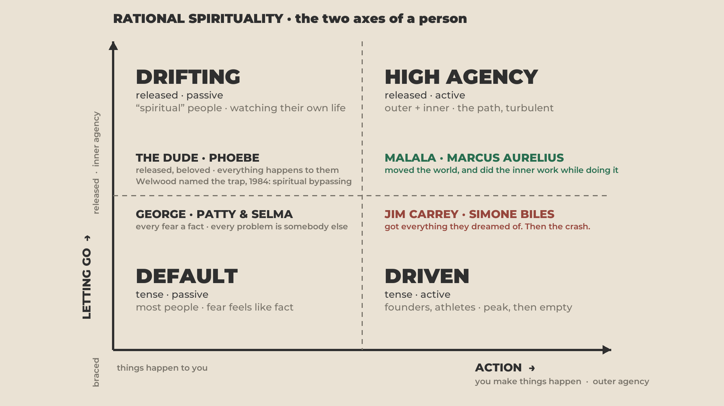
Notes:
30:30 · "let's use the pictures"
- Default: most people, not in a bad way. You can do interesting things and still live here.
- Driven and Drifting: too far one way without giving room to the other.
- High Agency: a whole person, expressing yourself in all of life.

Slide 22
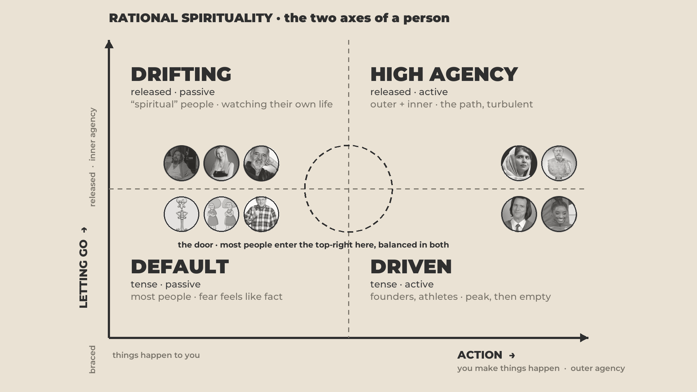
Notes:
31:15 · THE DOOR
- "You might hear us accidentally say the word awakening. We're used to it. Today I'll call it the door."
- Why it sits in the middle: from an extreme you can't turn straight toward the corner. Too much inertia. You're forced to temporarily give up the driven approach, come back toward balance, then climb.
- Jim Carrey: stopped his career for years, did the inner journey, then made films again. It didn't end his career.
- "Does this make sense?"

Slide 23
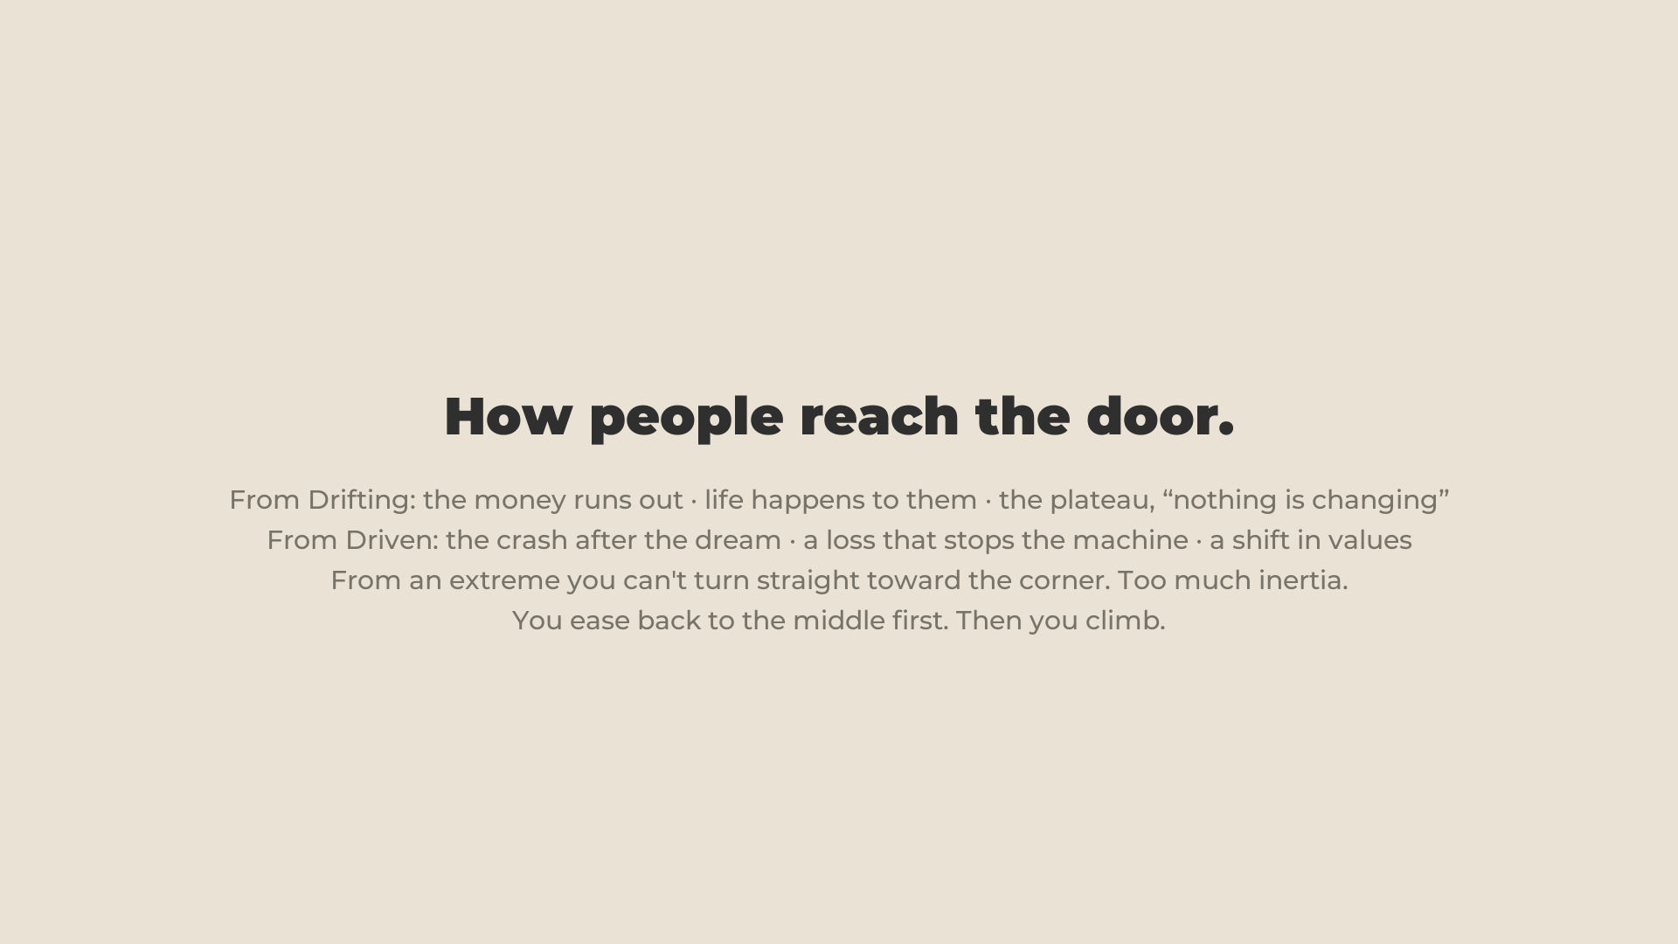
Notes:
33:40 · how people get to the door
- From Drifting, three pushes. One: the money runs out. "Sounds stupid. I really mean it." That's why manifestation courses sell: do nothing and be paid. The magic pill. MONEY MOVES A HUMAN THROUGH THE DOOR FROM BOTH SIDES.
- Two: life happens to them. Family. Something they can't stay passive through.
- Three: the plateau. "Nothing is changing. Waste of time." Then: "screw this, I'm getting a job, I'll never meditate again." Straight to the other corner. Friend b, later.
- From Driven: the crash, as with Biles. Or a shift in values when something happens. Hospital. Betrayal. "You don't stop in your tracks when you're having fun."
- If someone asks about love: love changes the exterior, not the core. But it points at the real thing: a reason bigger than yourself. Next slide.

Slide 24
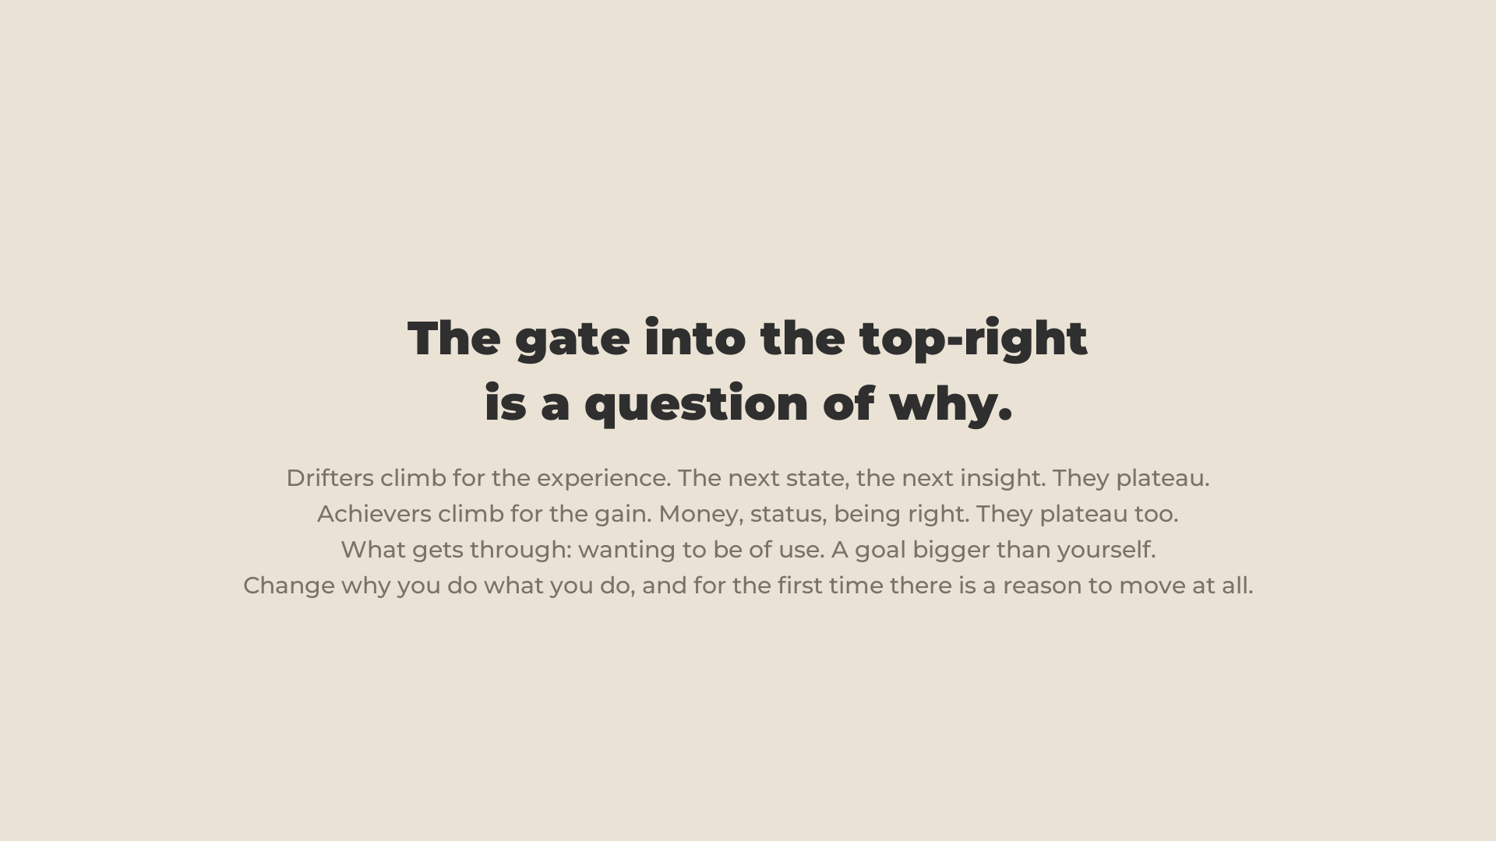
Notes:
37:30 · THE GATE
- The only way a person really crosses the ring, not just gets a bit less driven: a reason bigger than themselves.
- "I'll prove them wrong" → "I want to help people." "I have kids. I want to be a better person for them."
- Everything else is a driven person using meditation to be slightly more effective. Not the switch.
- The homework you promised: female examples. Patty & Selma, Bridget Jones · Simone Biles, Lady Gaga · Phoebe, Dharma · Malala, Rosa Parks. Full lines in TALK.md, Appendix B.

Slide 25
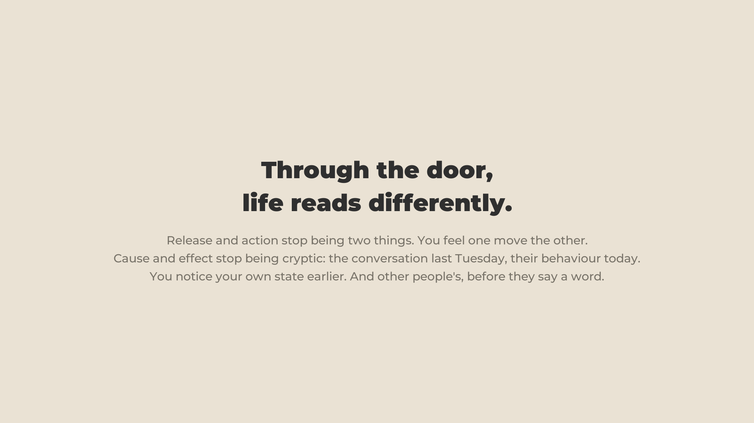
Notes:
40:40 · through the door
- Release and action stop being two things. It becomes a dance you have with life. Life gets spent in a more joyful way.
- Then the two sides.

Slide 26
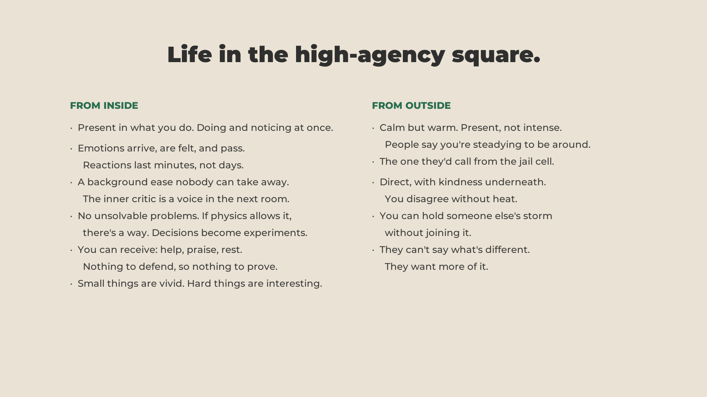
Notes:
- From inside: present in what you do, and it's extremely pleasant. Everyone has felt it: extreme sports, big love. People in this room say: in love with life.
- Emotions arrive, you feel them, you let them go without much suffering. A calm nobody can take from you. No unsolvable problems: if it's physically feasible it's solvable, just an interesting problem. Big challenges interesting, small things joyful. You can receive help, praise, rest. Nothing to defend. You express freely.
- Your line, keep: "From a young age I felt weird expressing how positively I feel about people. Unexpressed gratitude and love stays as tension inside. Any unexpressed emotion."
- From outside: calm but warm, present but not intense. Steady to be around. The one they call from the jail cell, "so don't be surprised to get a call." Direct but kind. When someone is in a hard moment you help them through instead of joining the mess.

Slide 27
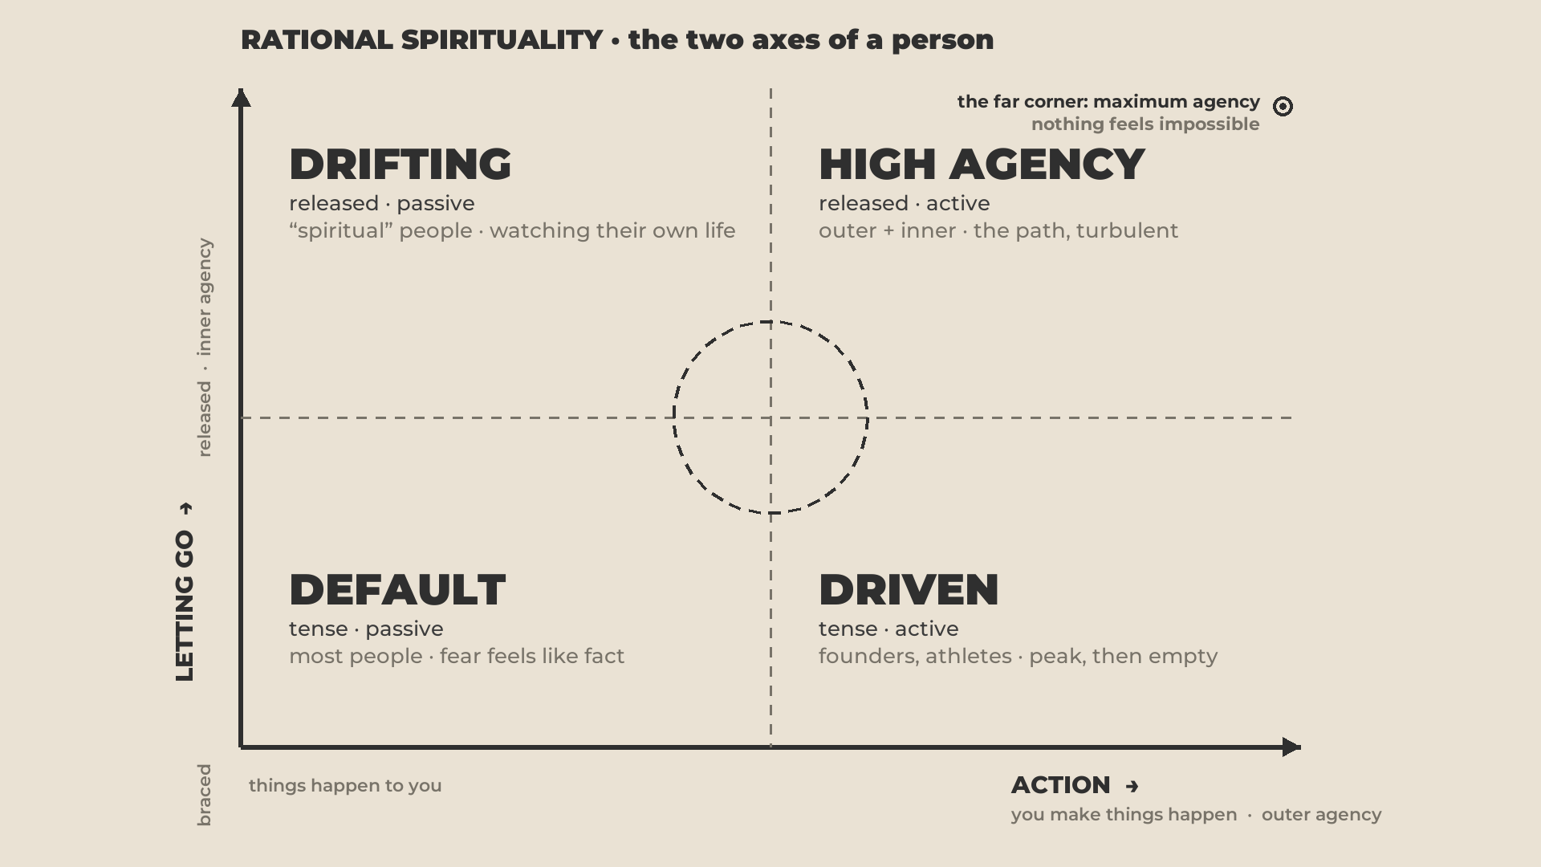
Notes:
44:45 · the peak
- 100 and 100. Nothing truly feels impossible. Nothing makes you doubt you can reach what you actually want.

Slide 28
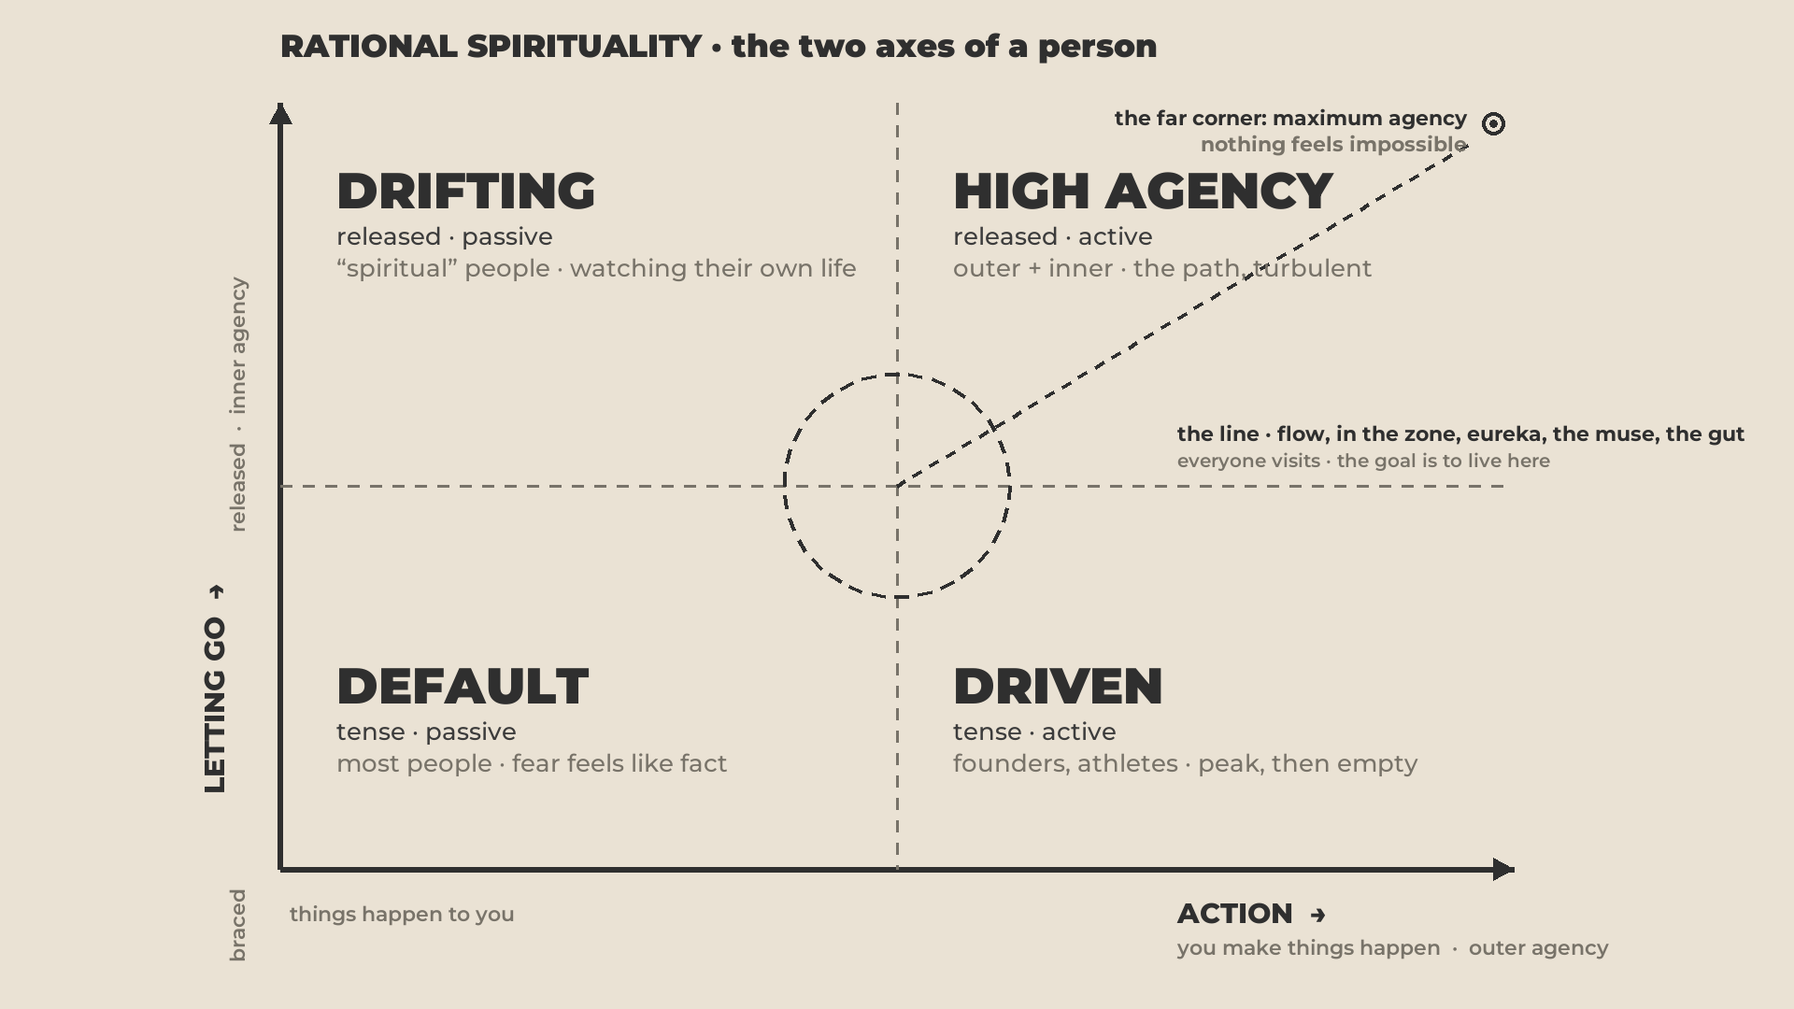
Notes:
- The balance between the two forces. You're at your peak when you're close to this line. Flow. The zone. The muse. The gut feeling of being in tune with life.
- Being in love, keep: the way anyone from any room lands on the line for a while without doing anything. Suddenly everything is good. Temporary. "Life giving you a hint: this exists. Now do the conscious work to live this way."
- Programmers in flow. Athletes in the zone, no choice: the zone or the bench. Musicians on stage at 100%. Off stage: depression and substances. They can't carry it into life.

Slide 29
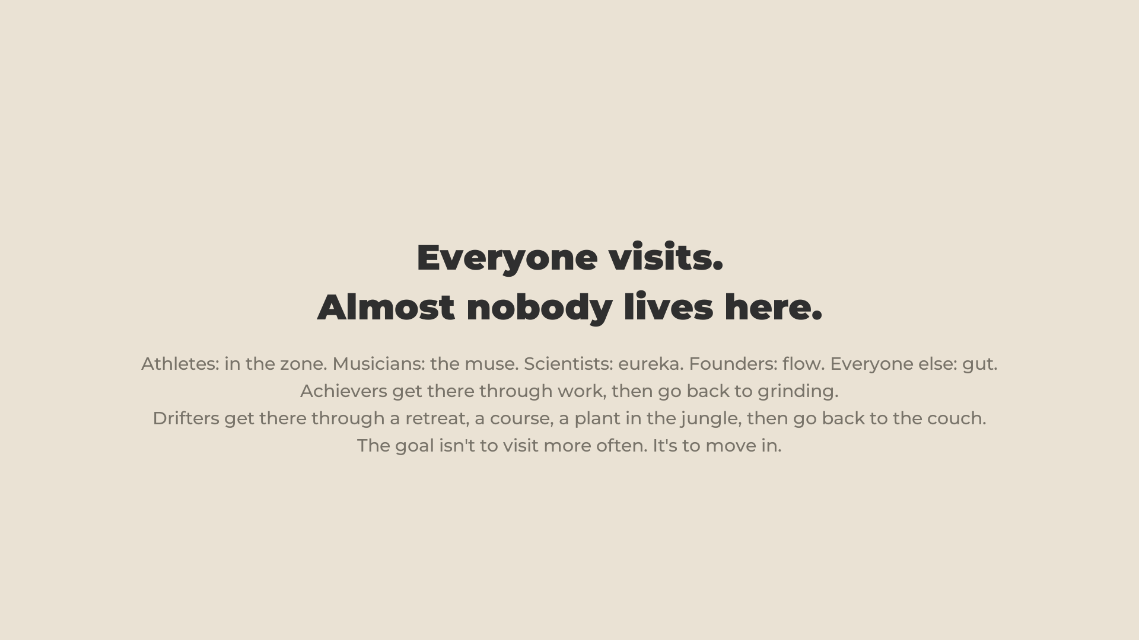
Notes:
48:20 · everybody visits
- Everybody visits. Nobody stays.
- "The whole thing Anna and I do is give people the opportunity to learn to live this way. To make it a conscious decision."
- Still turbulence. Definitely possible. Definitely worth it.

Slide 30
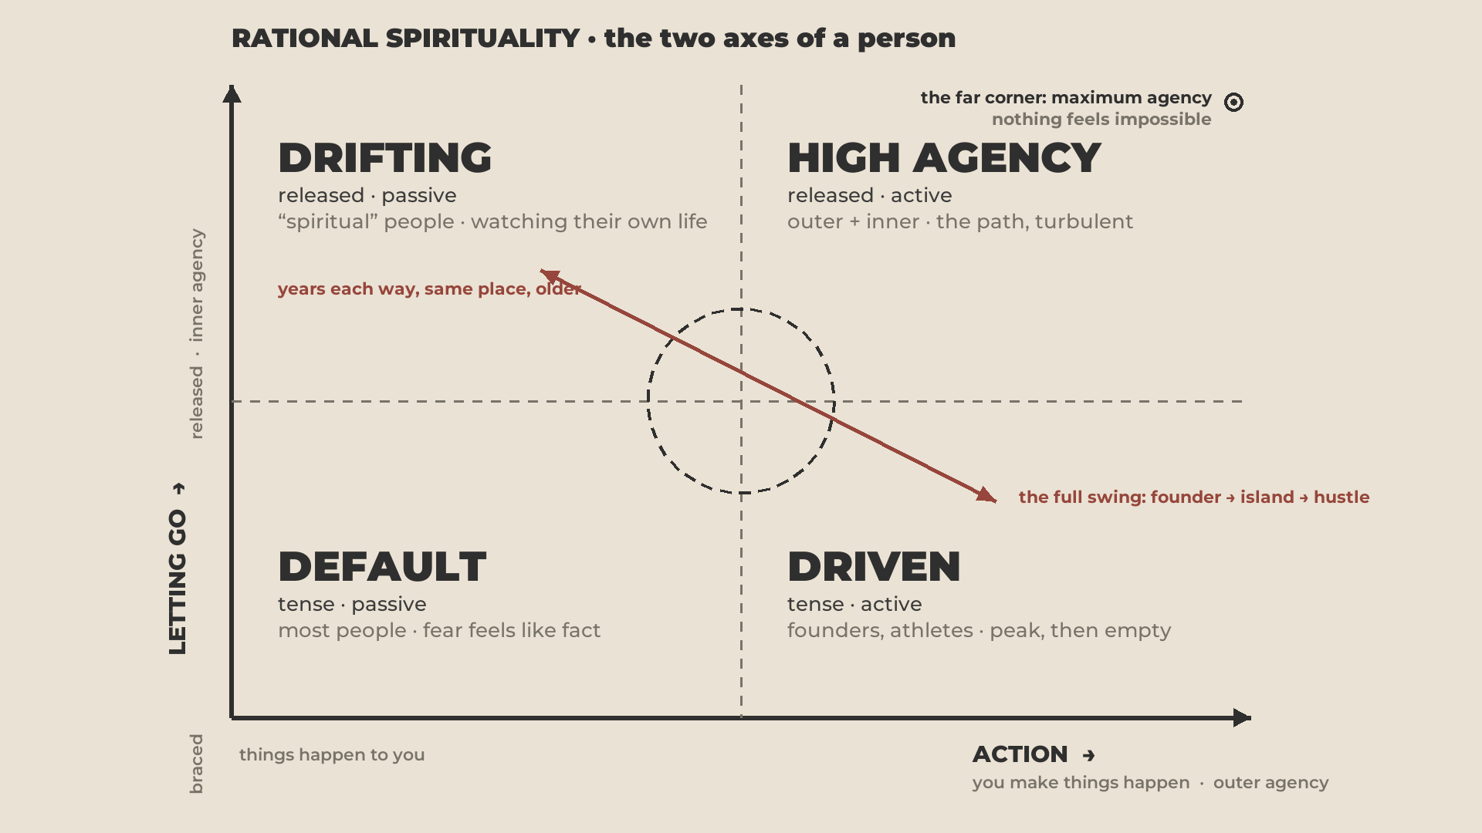
Notes:
48:55 · HOW YOU MOVE
- Close the loop on the swing. Driven → Drifting: burnout, "screw this", Bali. Drifting → Driven: "this is all crap, full business, I'll never meditate again."
- "I know people from both angles."

Slide 31
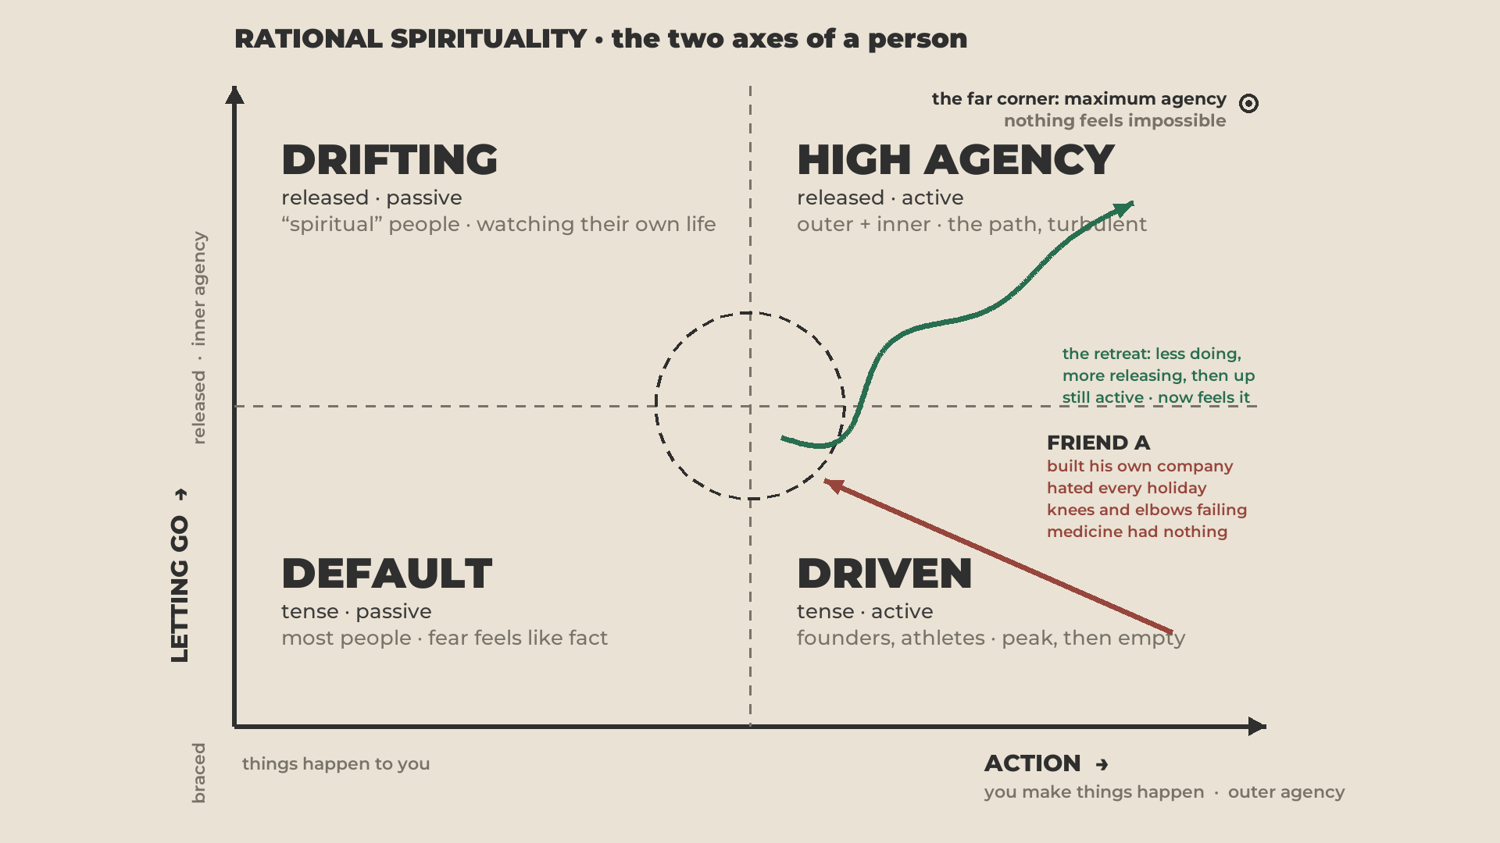
Notes:
⚠ His name only if he said yes. Otherwise "a friend, Israeli, a founder".
- Israeli medicine is top level. They could do nothing for his joints. He'd call it psychosomatic himself.
- The thing nobody expects: moved from Israel to Minsk for a retreat. For a while he stopped being as active as he was. He was forced to. He came back toward the ring.
- Only once he started this work did the joint problems go.
- "I've lived with him for a while. He joyfully expresses how he feels now. Significantly happier." Step by step, the green line.

Slide 32
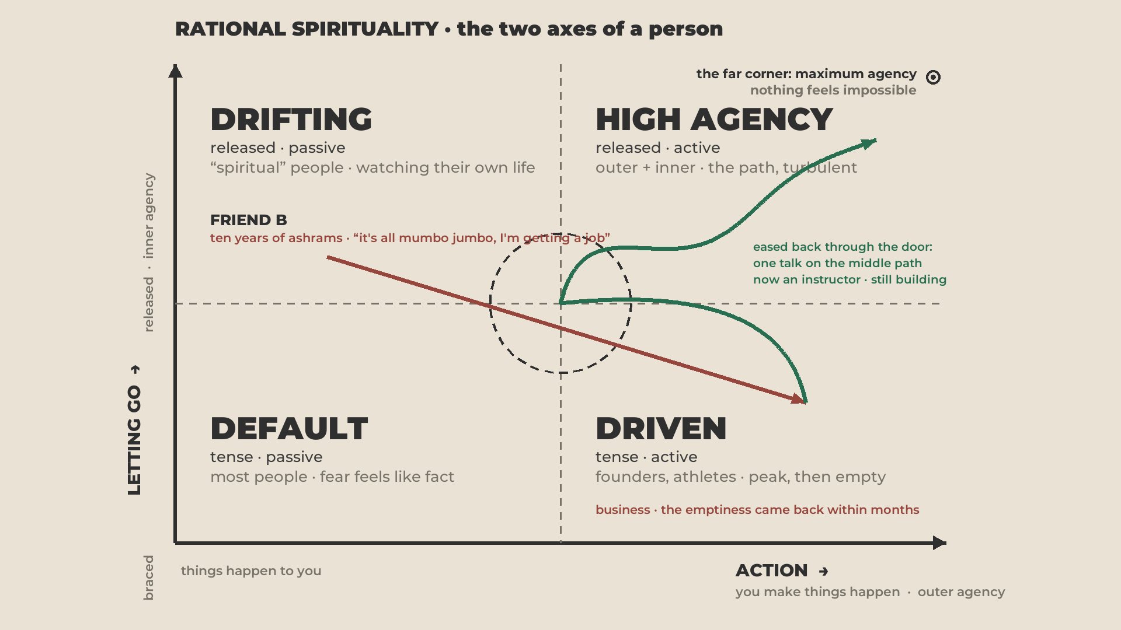
Notes:
⚠ Her name only if she said yes.
- Also an instructor. India twice a year, everything you can think of. Then "this is bullshit, I'll never make it." Straight into business in Moscow.
- Her inner maturity was already too high for that. Within months, the same emptiness Carrey had.
- One talk by our teacher, and she sensed it: "I went too far. The point is the middle. Both together." Now an instructor. [Your joke: "and a very poor person."]

Slide 33
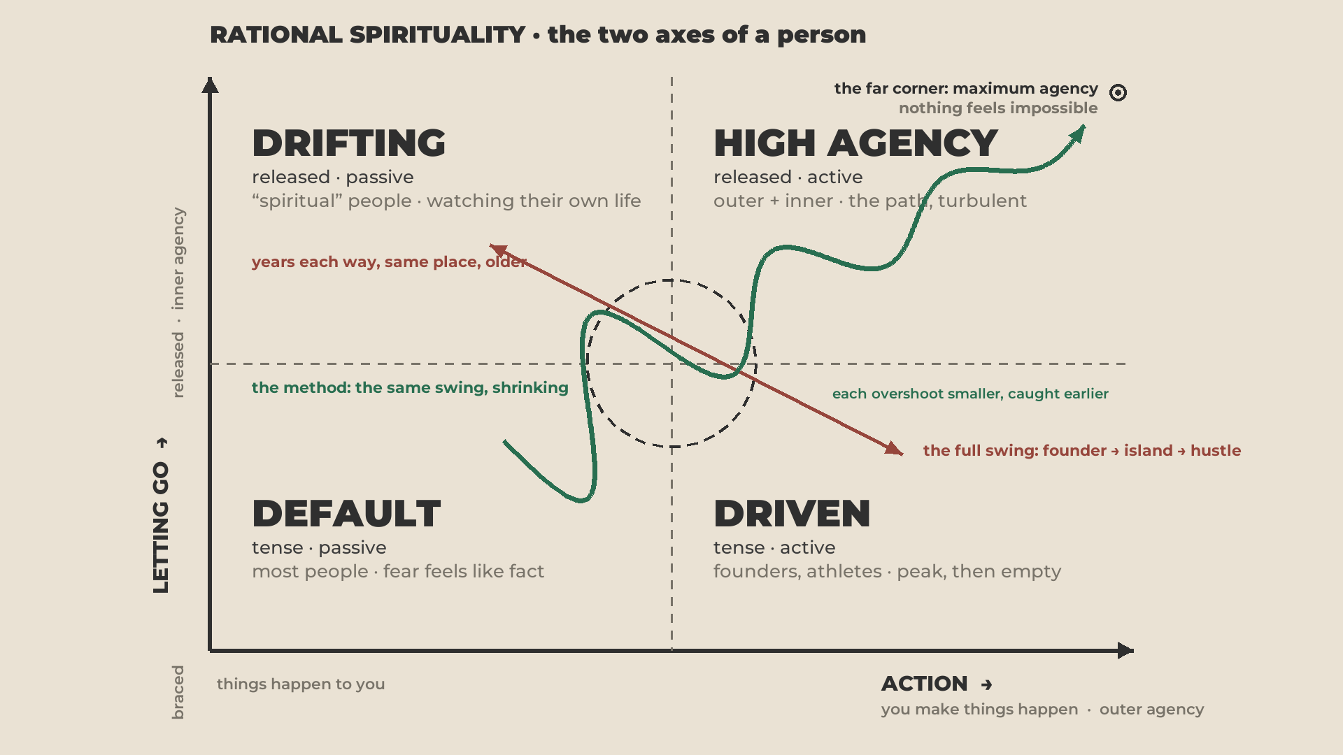
Notes:
52:55 · the shrinking swing
- Never linear. A child learning to walk on two legs looks wonky for a reason.
- At the start you overshoot all the time, and that's fine. It's how you learn.
- It shrinks and shrinks until you find the centre. The dot where life finally starts working.

Slide 34
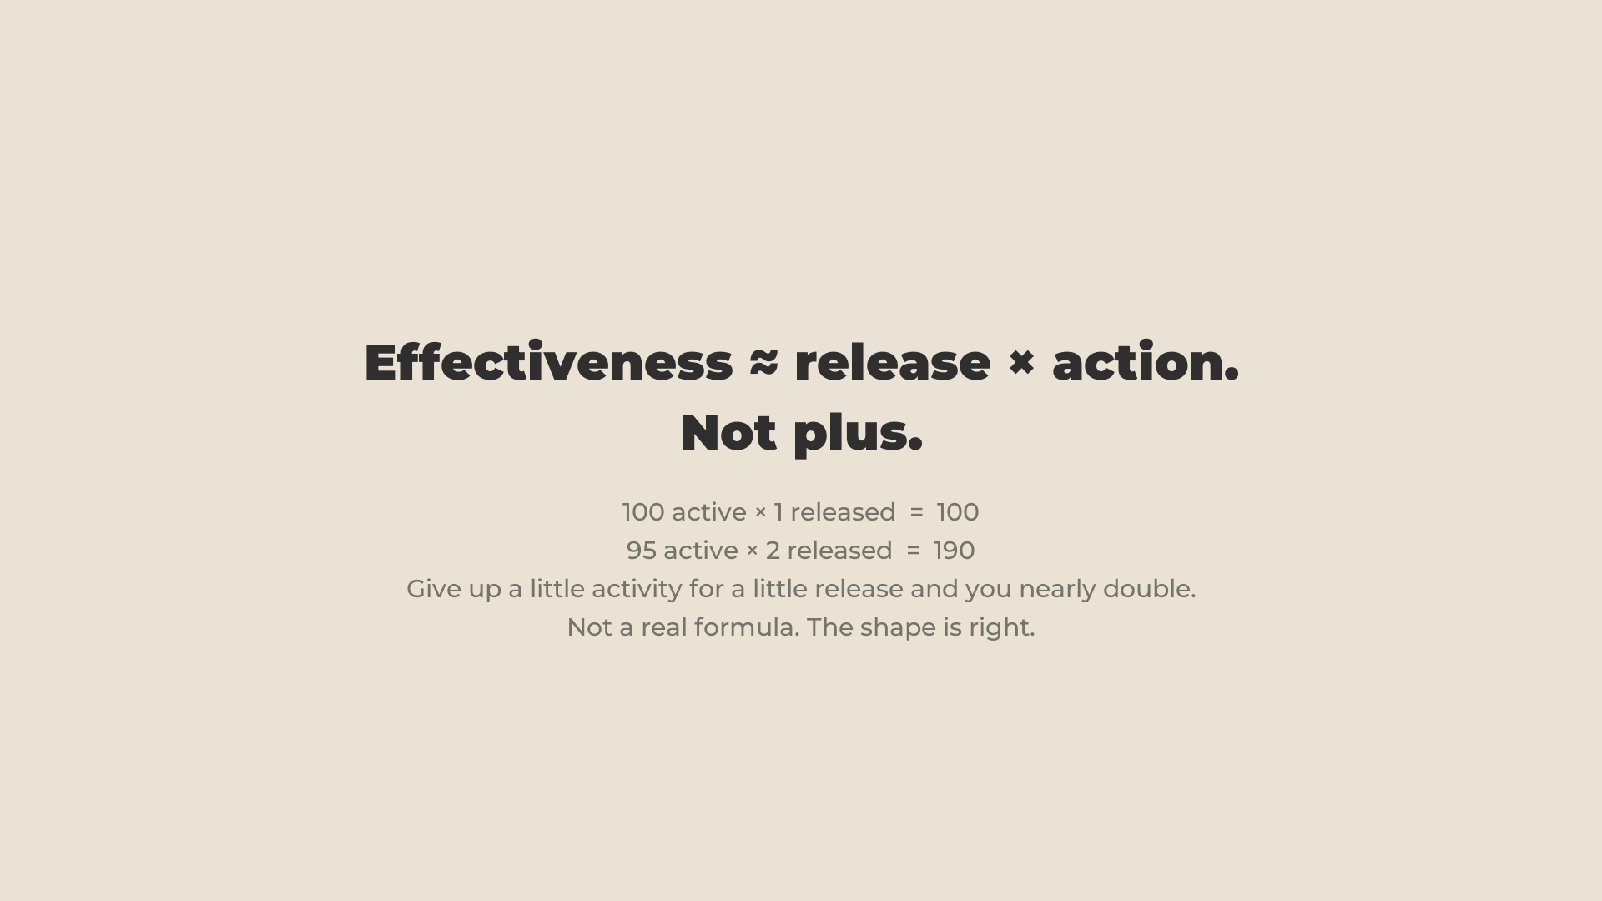
Notes:
53:55 · the math · "don't quote me on this"
- 100 active × 1 released = 100 effective.
- Lose five points of activity for a little release, and all of your activity gets far more effective.

Slide 35
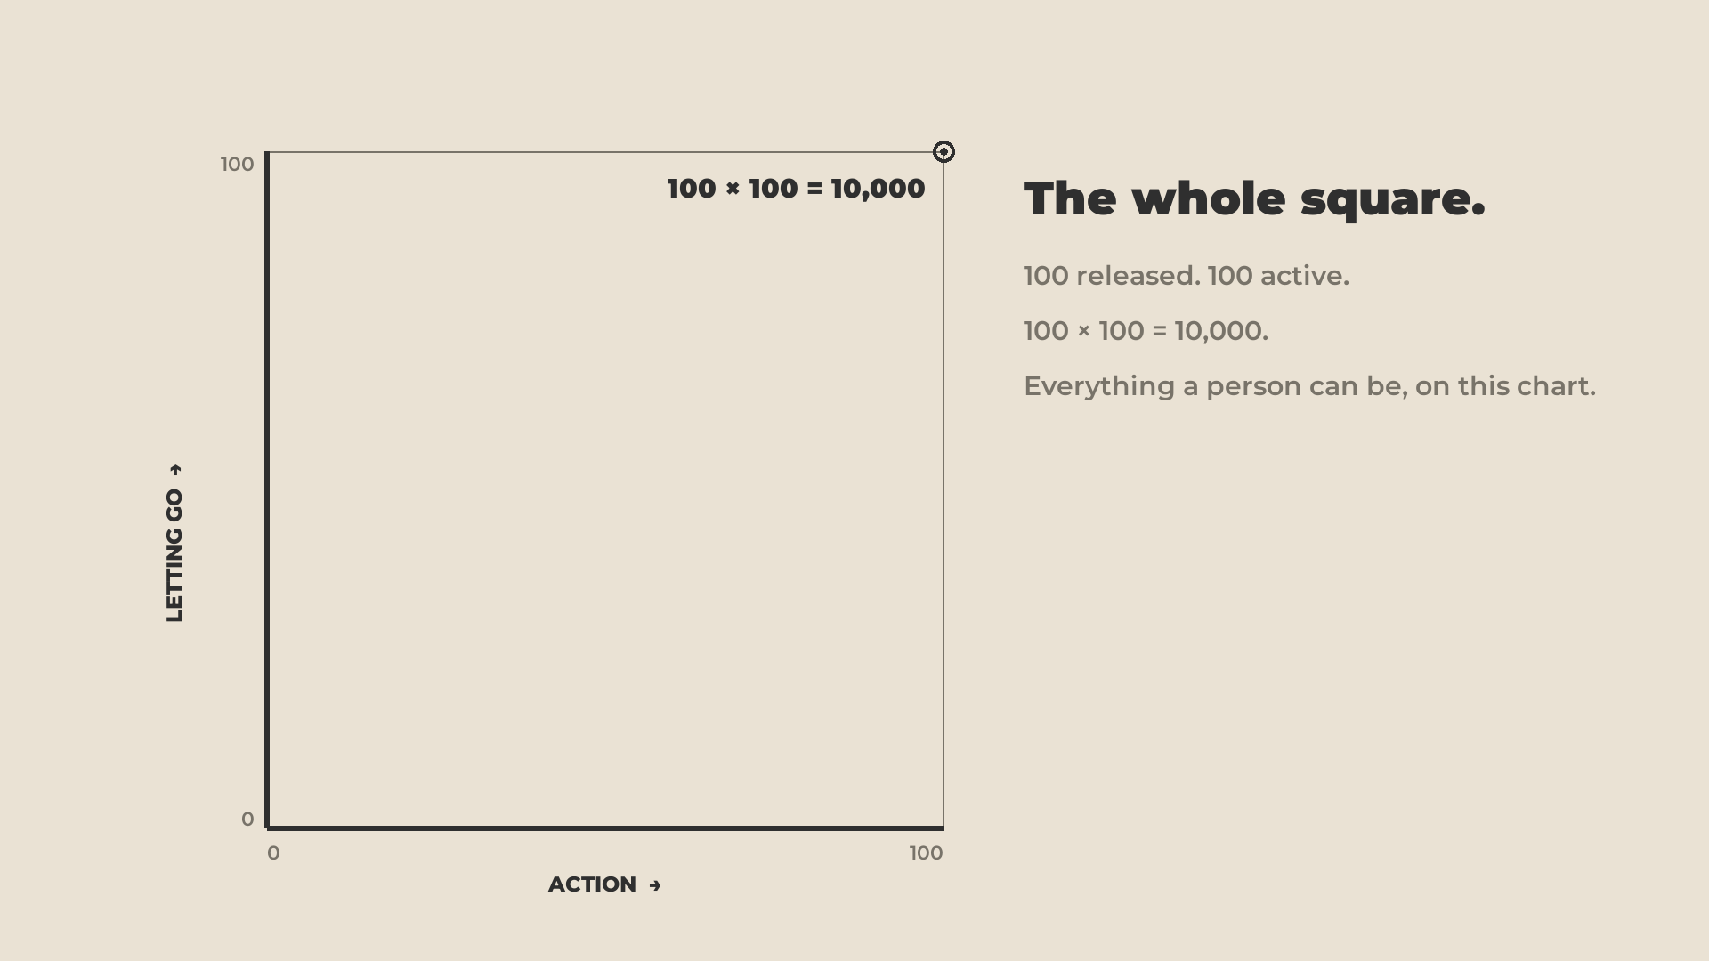
Notes:
- The whole square: 100 × 100 = 10,000. "We need 10,000 people, right? Let's go."

Slide 36
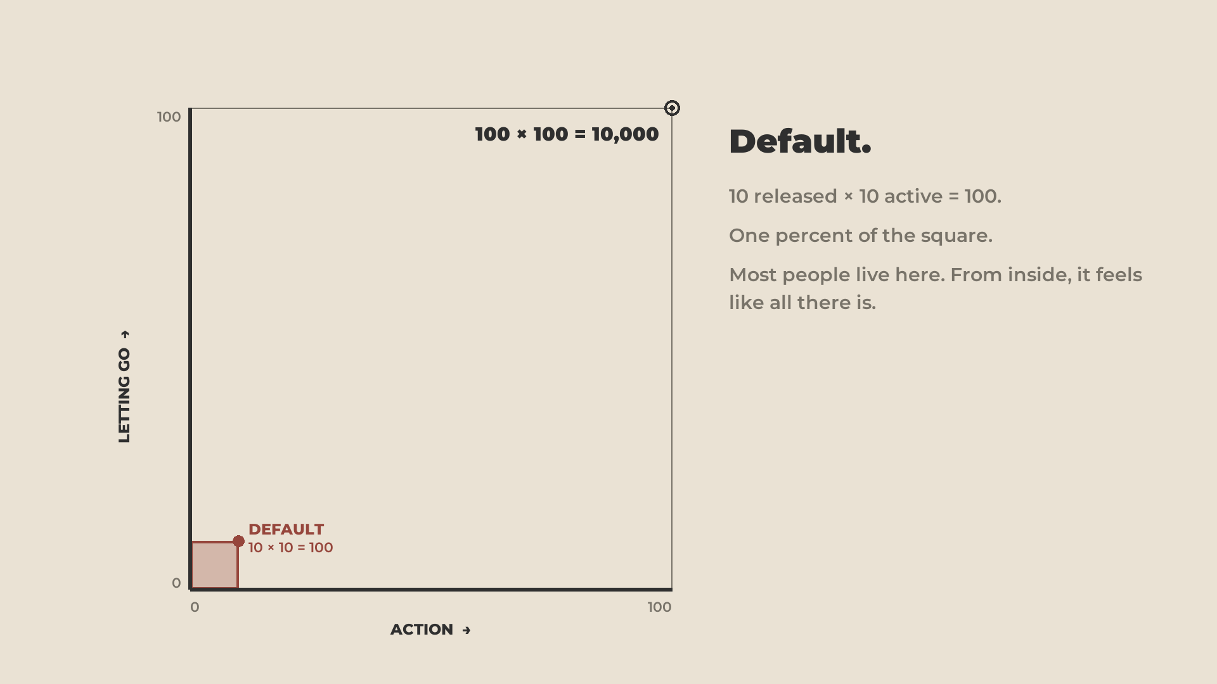
Notes:
- Default: a tiny square. Very low potential.

Slide 37
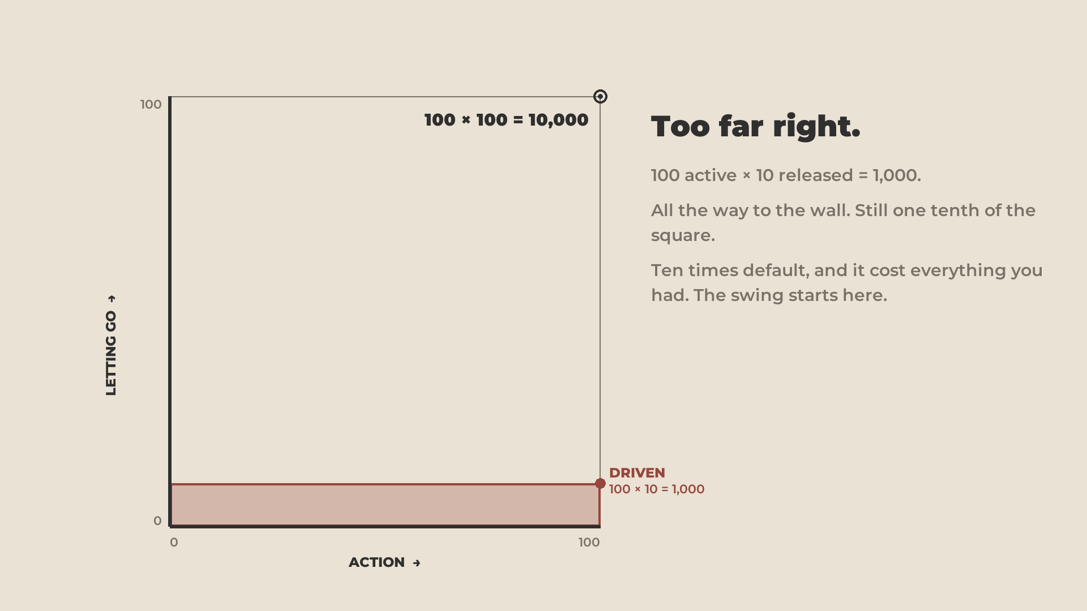
Notes:
- Driven, all the way to the wall: a strip. A fraction of the potential, and it cost everything.

Slide 38
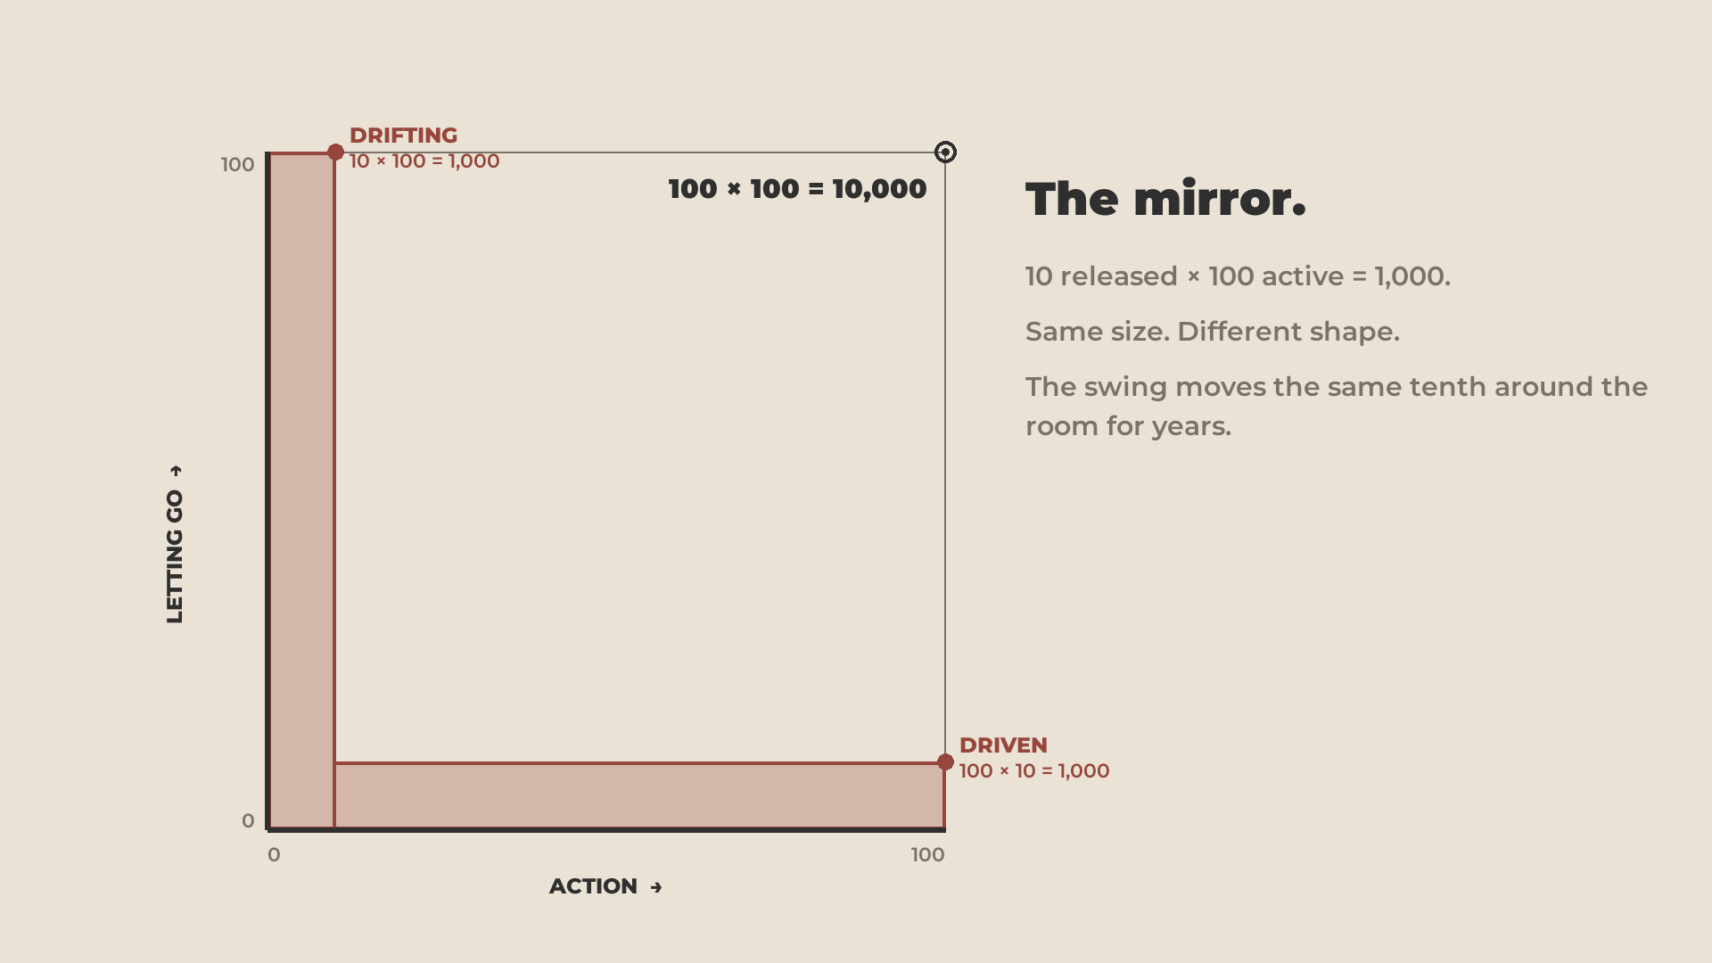
Notes:
- Drifting: the same strip the other way. Same size.

Slide 39
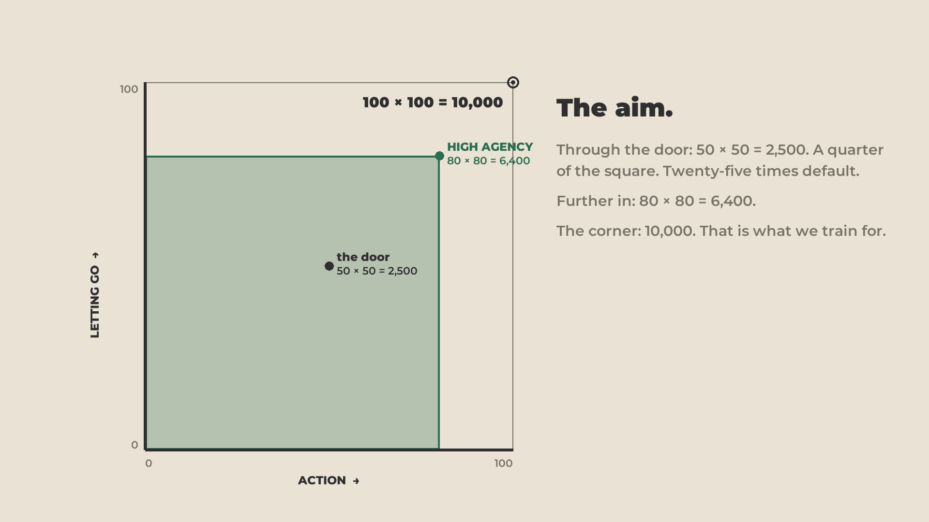
Notes:
- High Agency: you unlock the rest. "With this clever math it's apparent how much of your potential you close off by evolving in one direction only."

Slide 40
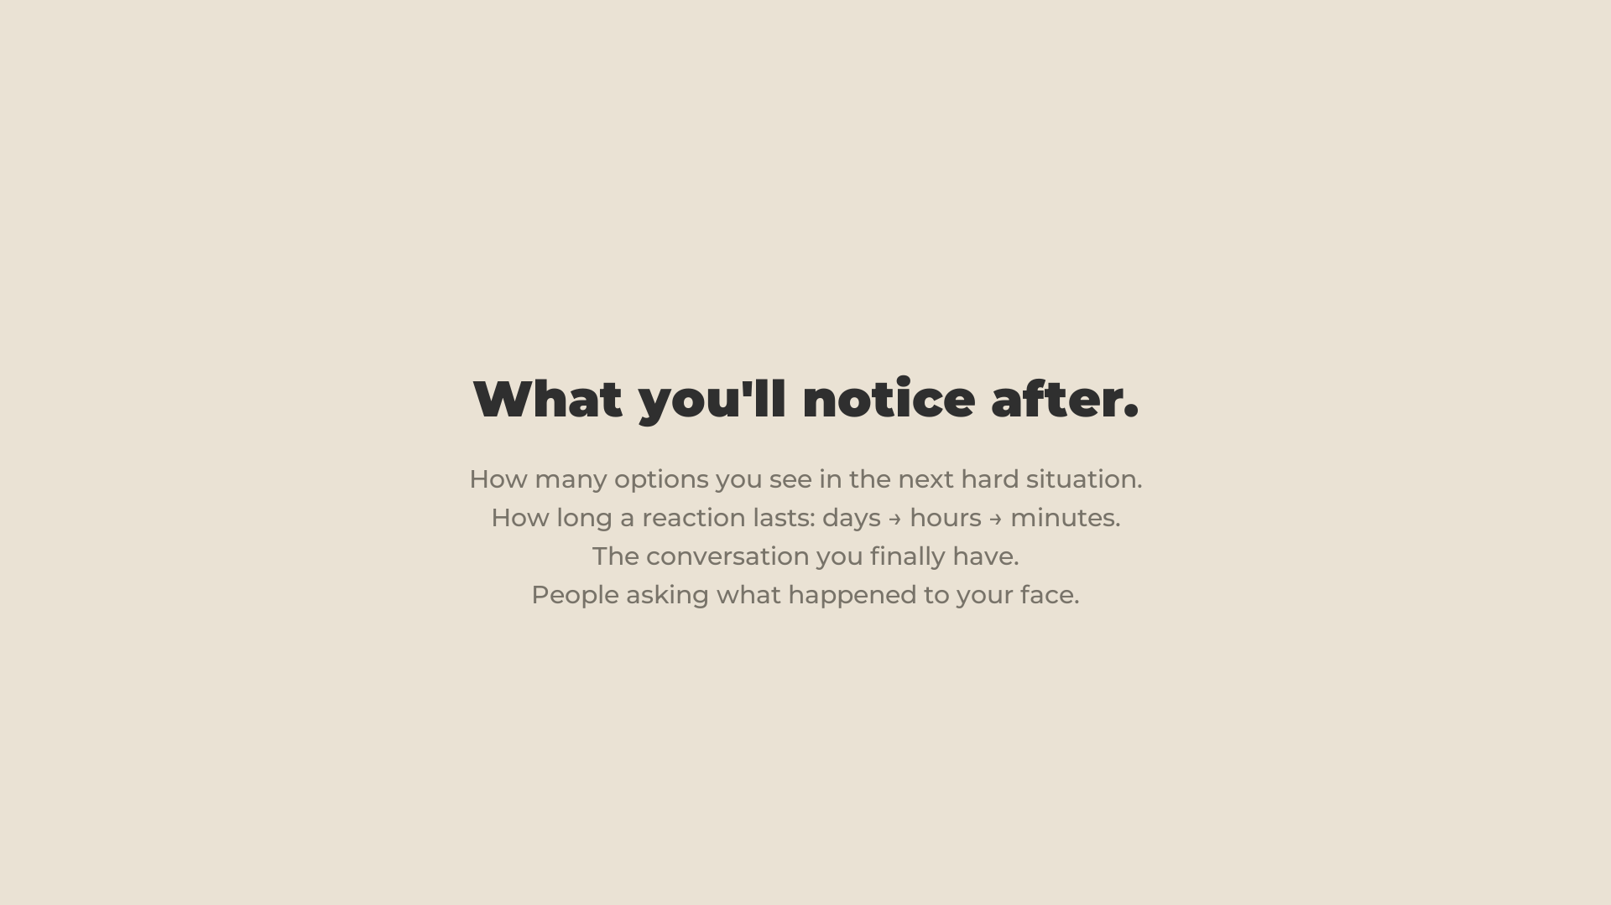
Notes:
55:00 · what you'll notice
- Going in depends on the reason bigger than yourself.
- At once: you see more options. How long your reactions last; how long you stay angry. How quickly you say sorry.
- "My fault. Who cares why. I care more about the relationship than about being right."

Slide 41
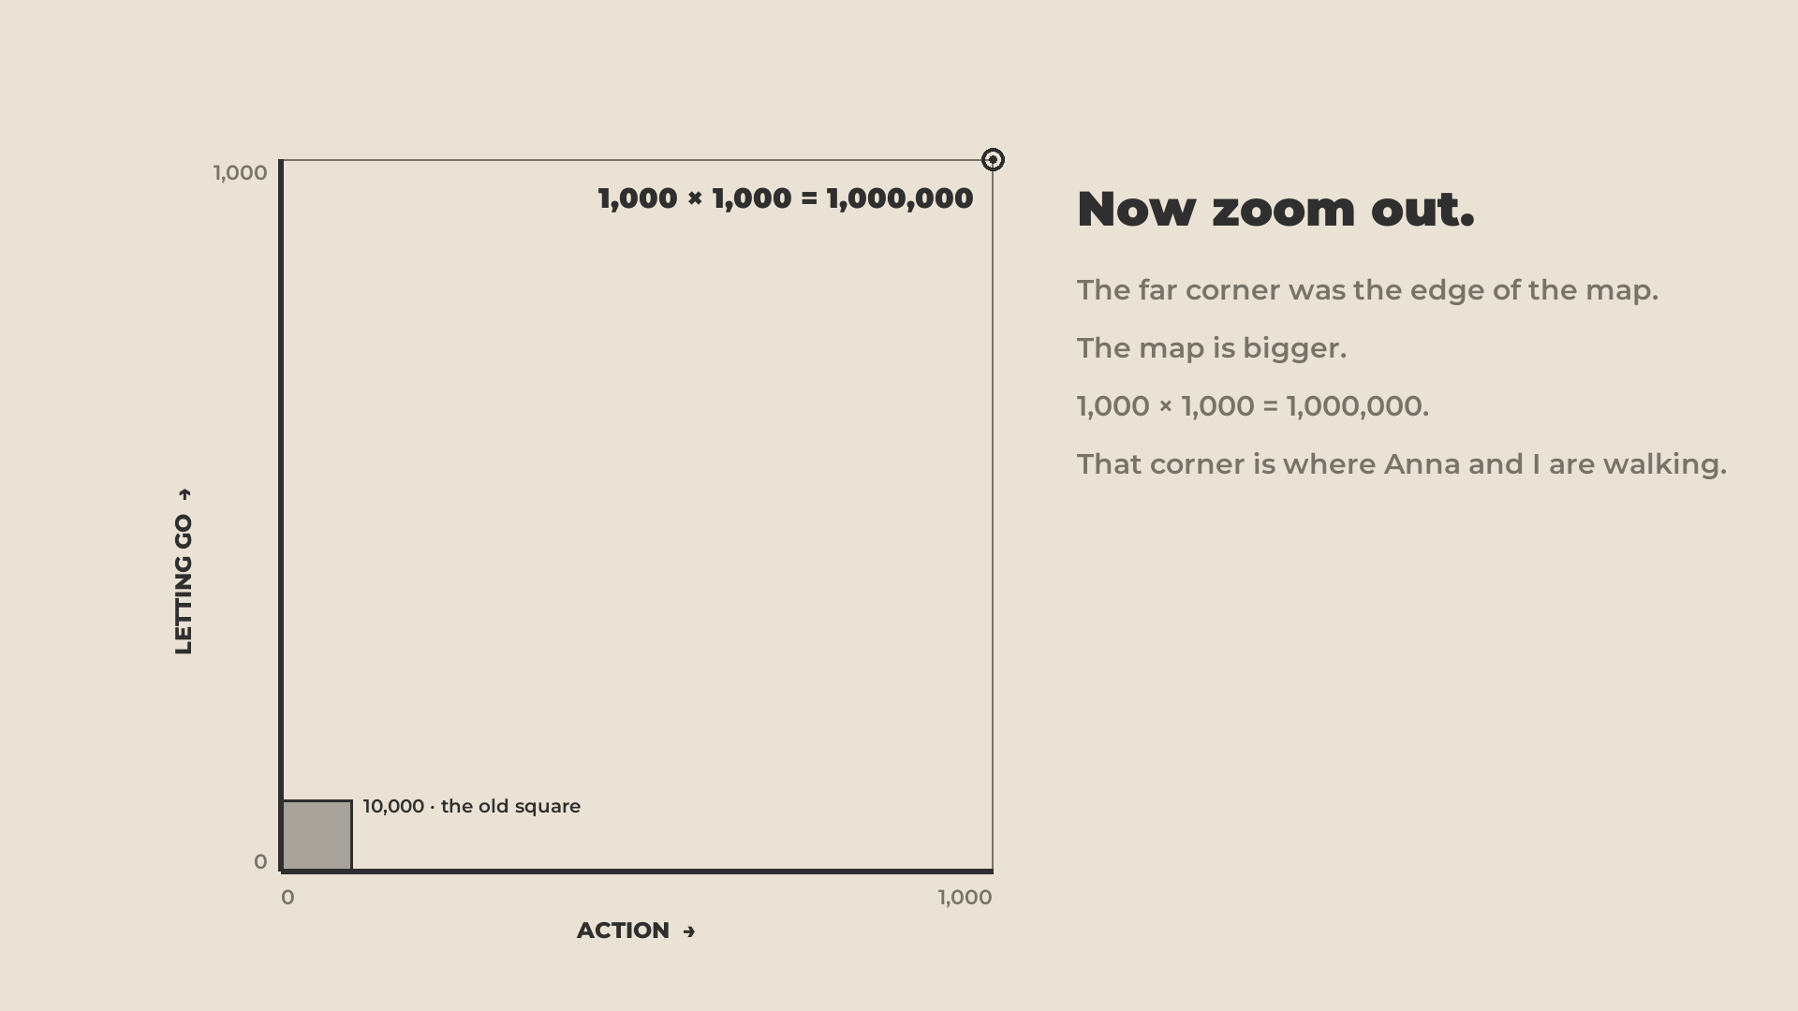
Notes:
55:55 · MY GOAL
- "I spent the whole talk on this cube. Take a bigger zoom out."
- The original square, small. "This is the goal Anna and I have, personally, for our lifetime."

Slide 42
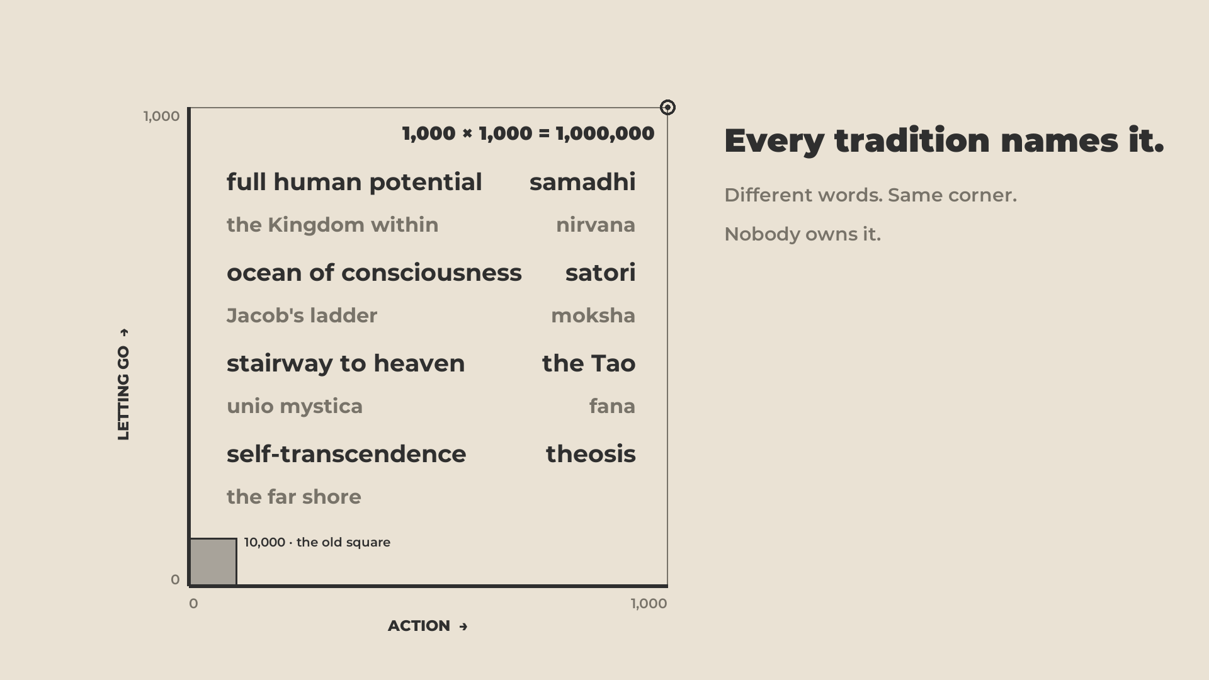
Notes:
- Different religions, different words: enlightenment, stairway to heaven, sea of consciousness. Read two or three.
- "I really like the term FULL HUMAN POTENTIAL. That's what it's supposed to mean."
- Until you've used up this little cube it's hard to talk about what's after. Mystical. Not today's talk. Everything inside the cube becomes possible for you. Then a whole new world opens.

Slide 43
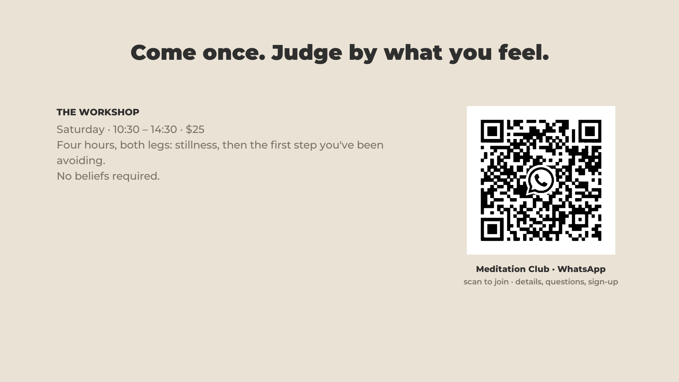
Notes:
57:10 · the workshop
- "We'll talk a little about what's beyond this realm of perception at the workshop."
- Saturday · 10:30–14:30 · $25. Say the PLACE out loud. The QR joins the Meditation Club group.

Slide 44
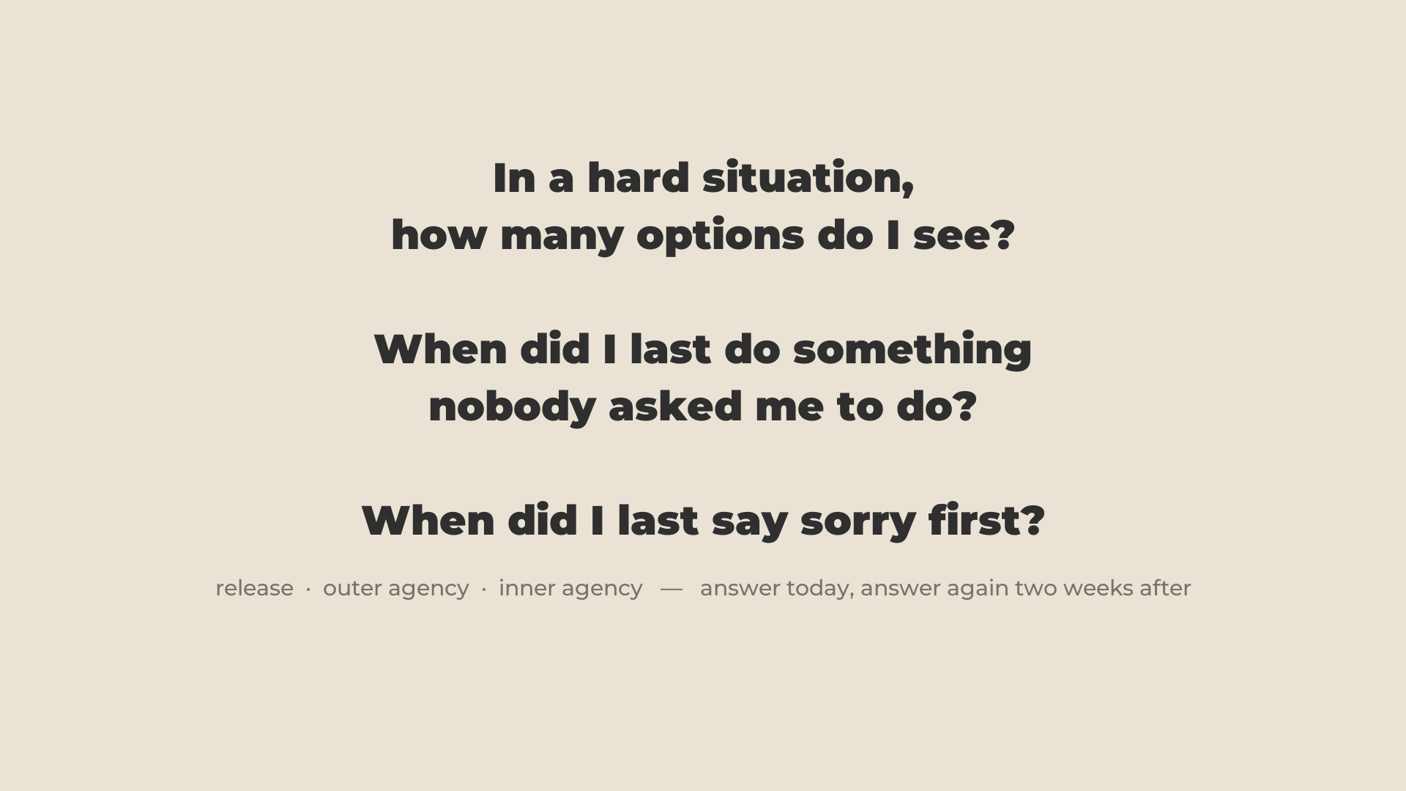
Notes:
58:00 · CLOSE · stays up through Q&A
- To gauge your movement on both axes: how many options do you see? When did I last do something nobody asked for, for the good of other people?
- "Say sorry. Be nice."
- Where you'll be on Saturday. Then questions.

